Slide 1
Pet Tech 유니콘 기업

Slide 2
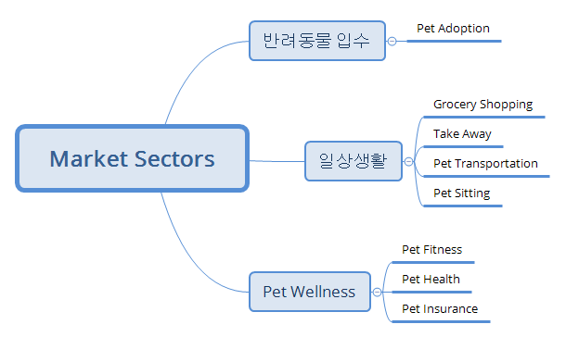
7 Incredible Tech Solutions to Inspire Innovative Pet Startups, medium

Slide 3
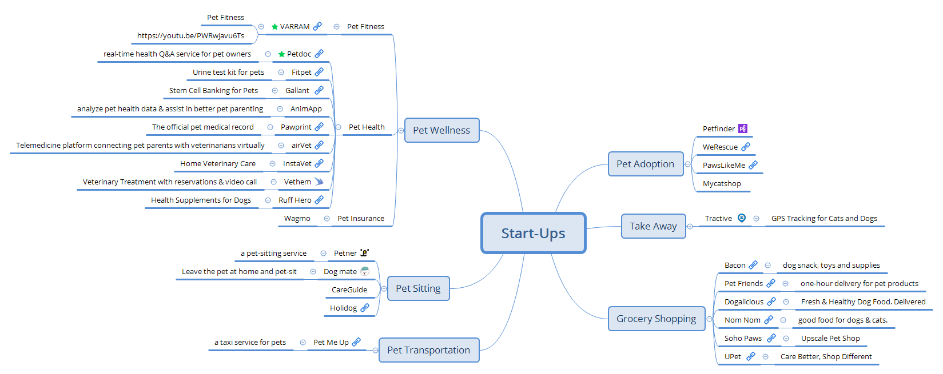

Slide 4
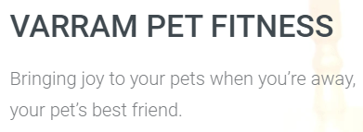
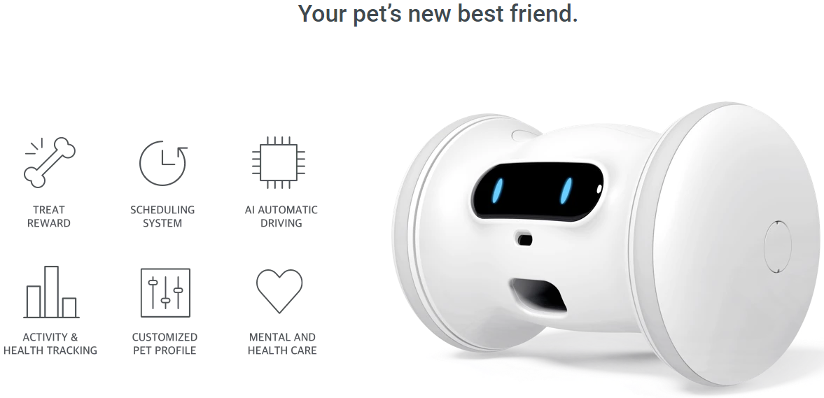
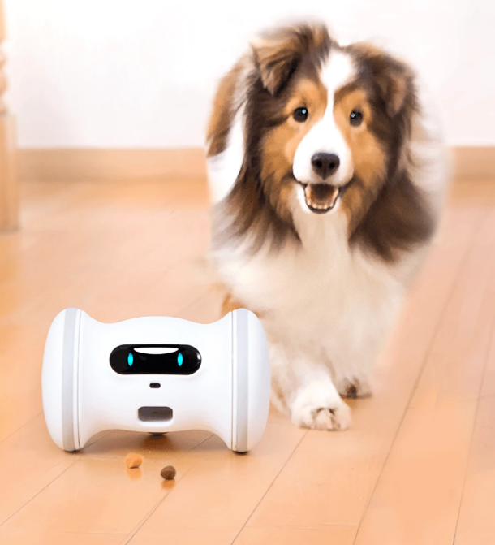
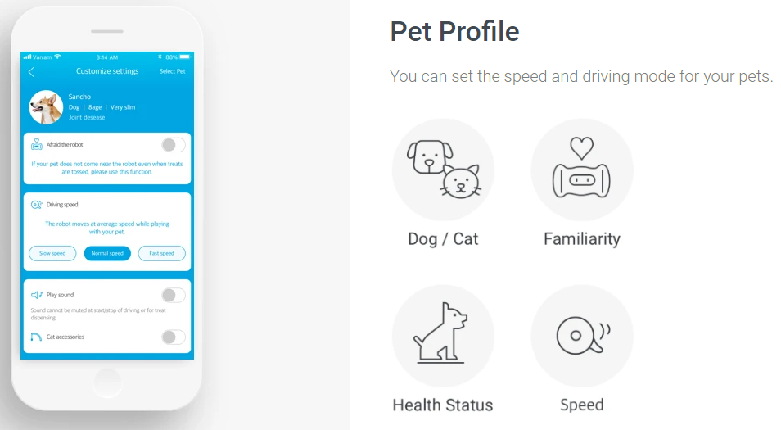

Varram
https://varram.com/

Slide 5
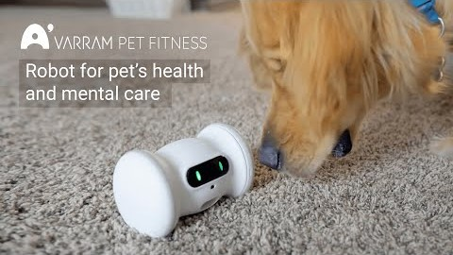
VARRAM Pet Robot: A Smart Fitness Robot For Your Pet https://youtu.be/PWRwjavu6Ts

