Slide 1
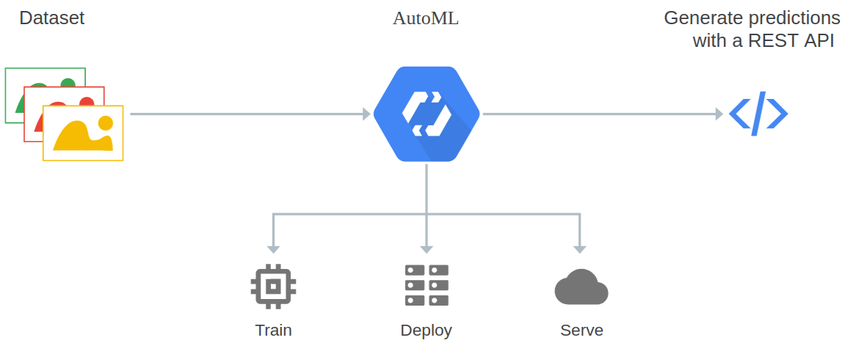
How AutoML works, Google Cloud AutoML

Slide 2
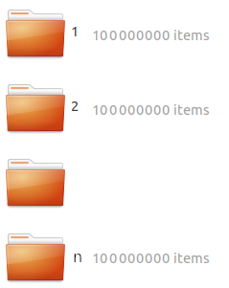
User
GUI (Dashboard)
AutoDL
(formatted)
dataset
Web / WAS
id, credentials
monitor_access_request
grant_access
show_initial_gui
fetch_selected_options
set_uri2dataset
(uncompress)
check_image_validity
convert_image_format
store_files
AutoDL Engine
success
id,
engine_options,
uri2dataset
initial_gui
DB
fetch_database
selected_ options,
dataset_files
prep_cluster
(Pull CNN Models)
Mount uri2dataset
(Launch more nodes)
Supported
image
files
.jpg
.gif
...
uri2dataset
files
S
t
o
r
a
g
e
run_training_cluster
trigger
Training Cluster
mount
Docker Image
(CNN Models)
Registries
(Docker, TF Models)
trigger
results
dashboard(?)
metrics etc.
fetch_training_results
show_results_on_gui
engine_options
re-run_training_cluster
select_a_model_or
decision
(fetch_selected_options)
deploy_a_model
trigger
request_to_generate_prediction(s)
Deployed Server / Instance
prediction_result(s)
Docker Image
(selected model)

