Slide 1


Introduction to Kubeflow and TensorFlow Extended
KT AI Service Lab 2020-05-14 (Thu)
Tae-Hyung Kim, Ph.D.
the.kim@kt.com

Slide 2
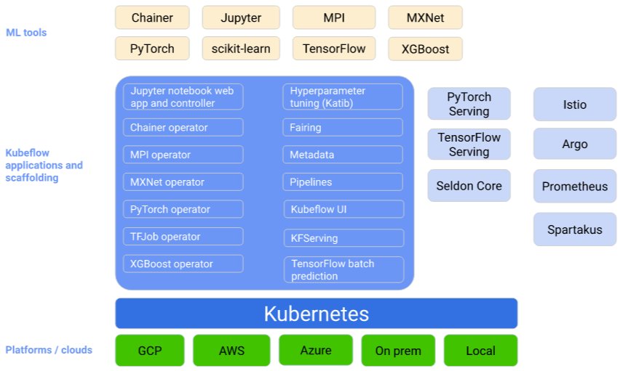
Kubeflow Overview
Kubeflow = Kubernetes + Machine Learning Flow
The Goal is to provide a straightforward way to deploy best-of-breed open-source systems for ML to diverse infrastructures not to recreate other services.
Conceptual overview
Kubeflow
Kubernetes
https://www.kubeflow.org/docs/started/kubeflow-overview/

Slide 3
Components of Kubeflow
Kubernetes Kubernetes Istio Connect, secure, control, and observe services Argo Open source Kubernetes native workflows, events, CI and CD Prometheus Monitoring system and time series database Spartakus Collecting usage information about Kubernetes clusters
Central Dashboard (Kubeflow UI) The central user interface (UI) in Kubeflow Multi-Tenancy in Kubeflow Multi-user isolation (Admin, User, Profile) & Identity Access Management Frameworks for Training (ML tools) Training of ML models in Kubeflow Miscellaneous Nuclio - High performance serverless for data processing and ML Jupyter Notebooks Using Jupyter notebooks in Kubeflow Pipelines ML Pipelines in Kubeflow Fairing Streamlines to build, train & deploy in a hybrid cloud environment Hyperparameter Tuning (Katib) Hyperparameter tuning of ML models in Kubeflow Metadata Tracking and managing metadata of machine learning workflows Tools for Serving Serving of ML models in Kubeflow
Kubernetes
Tools for Serving
https://www.kubeflow.org/docs/components/
https://www.kubeflow.org/docs/started/kubeflow-overview/

Slide 4
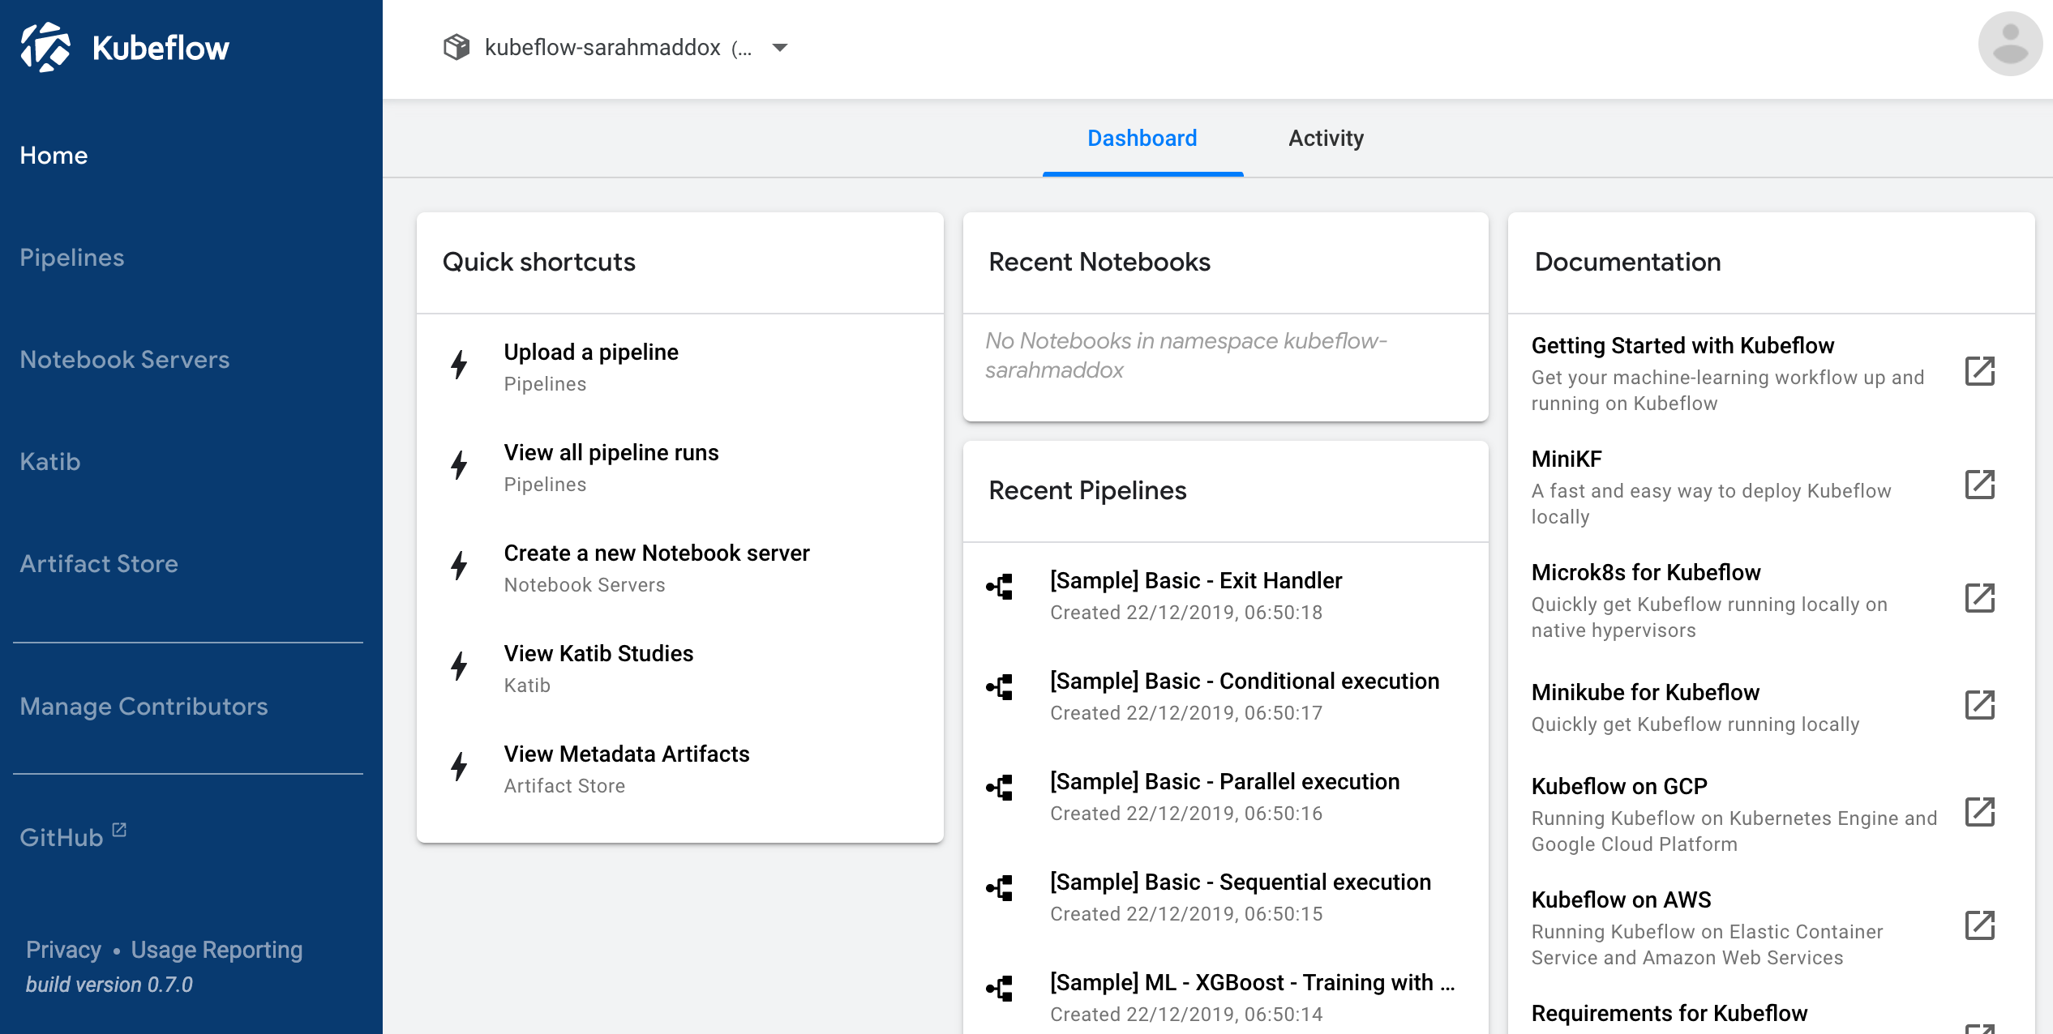
Kubeflow Central Dashboard or Kubeflow User Interface (KFUI)
Namespace configuration can host different team, group, user types, etc.
https://www.kubeflow.org/docs/started/kubeflow-overview/#kubeflow-user-interface-ui

Slide 5
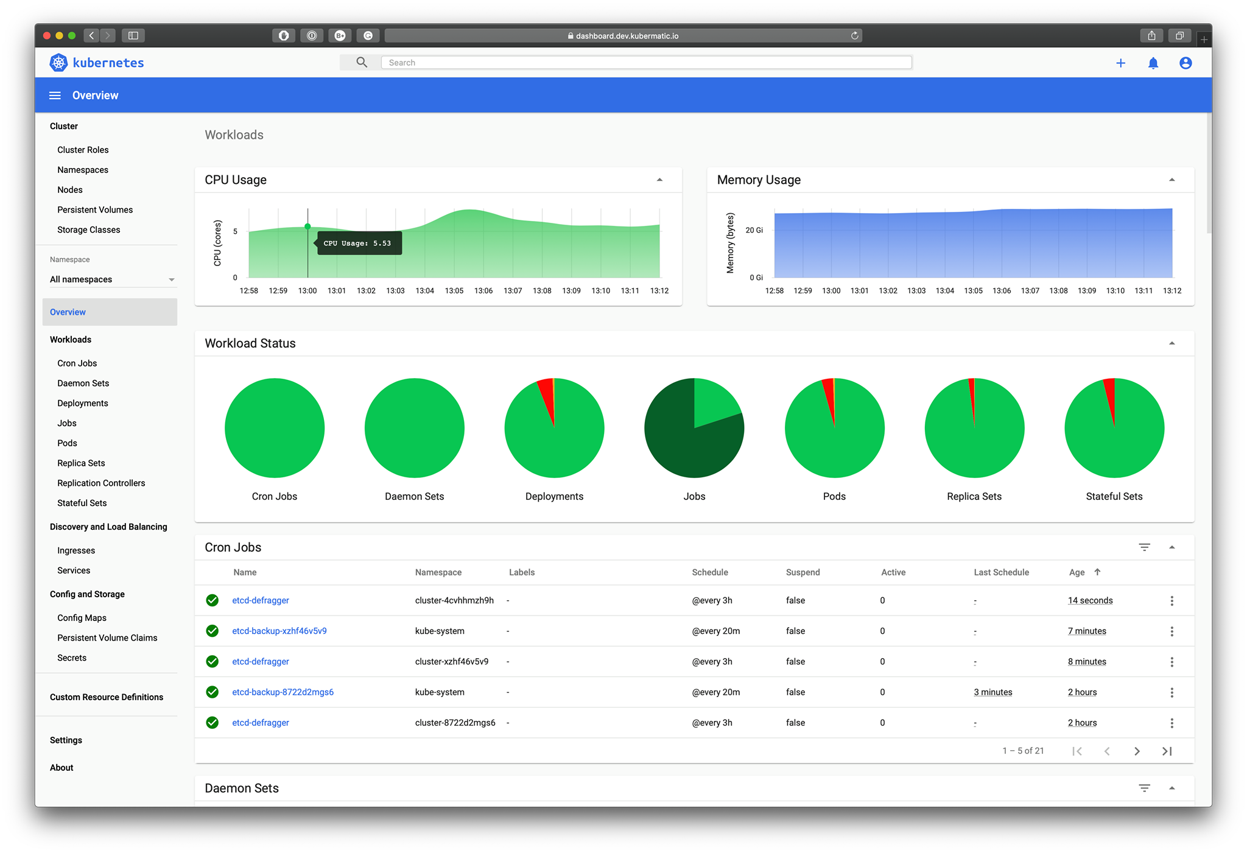
Kubernetes Dashboard
https://github.com/kubernetes/dashboard

Slide 6
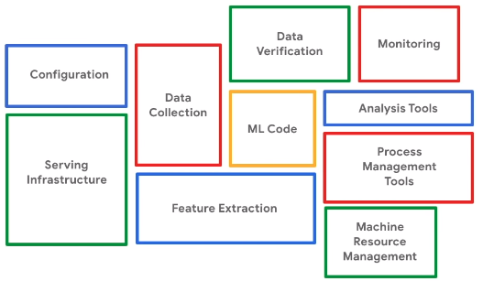
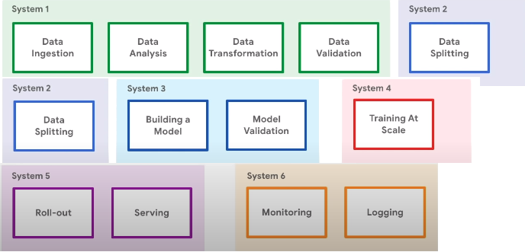
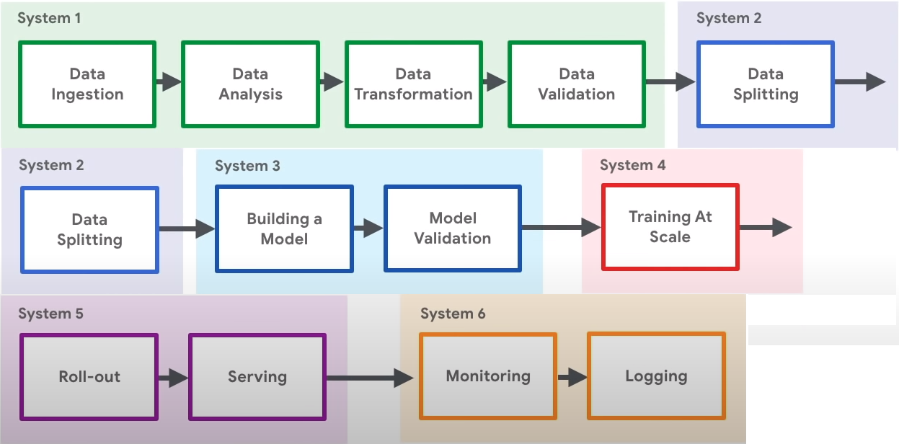
Introduction to Kubeflow - Kubeflow 101 (1/3)
https://youtu.be/cTZArDgbIWw [3:46]

Slide 7
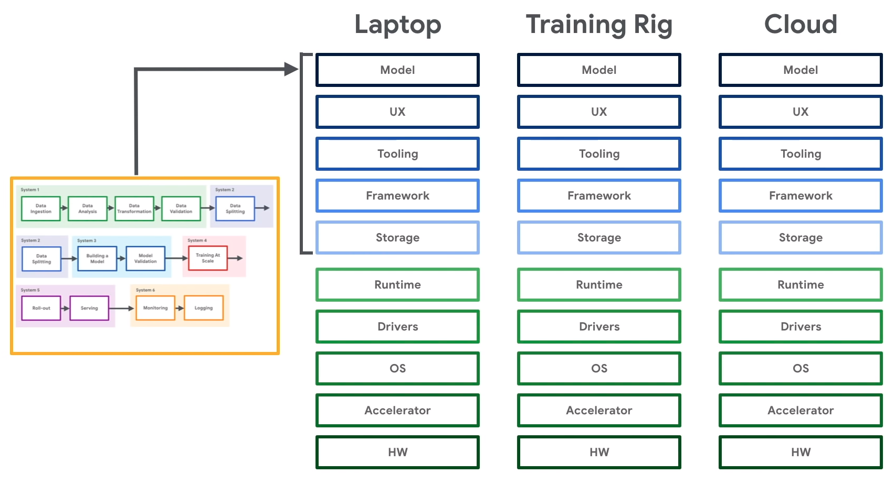
Introduction to Kubeflow - Kubeflow 101 (2/3)
https://youtu.be/cTZArDgbIWw [3:46]

Slide 8
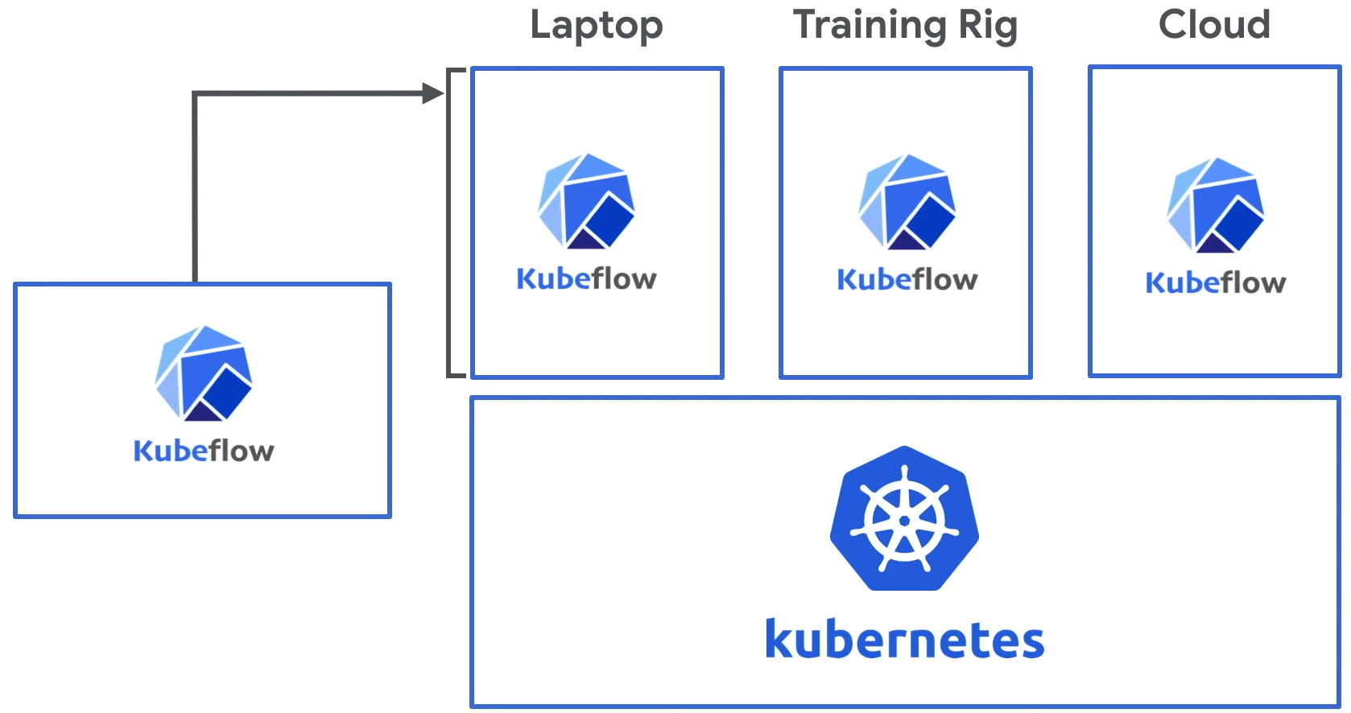
Introduction to Kubeflow - Kubeflow 101 (3/3)
https://youtu.be/cTZArDgbIWw [3:46]

Slide 9
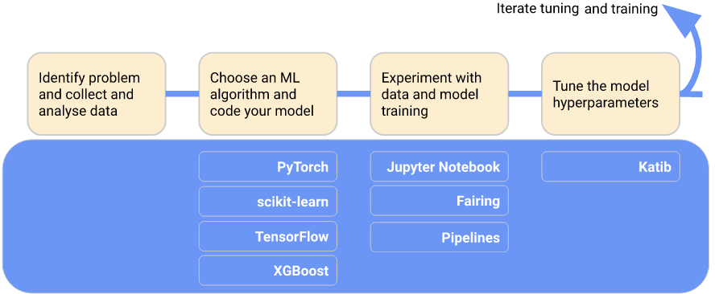
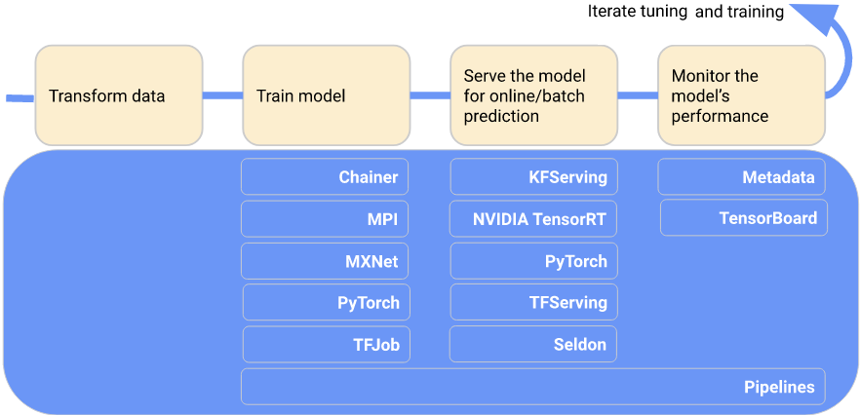
Kubeflow Components in the Machine Learning Workflow
Experimental Phase
Spawn & manage Jupyter notebooks
Kubeflow Pipelines build, deploy, & manage multi-step ML workflows based on Docker containers.
Production Phase
Kubeflow offers several components that you can use to build your ML training, hyperparameter tuning, and serving workloads across multiple platforms.

Slide 10
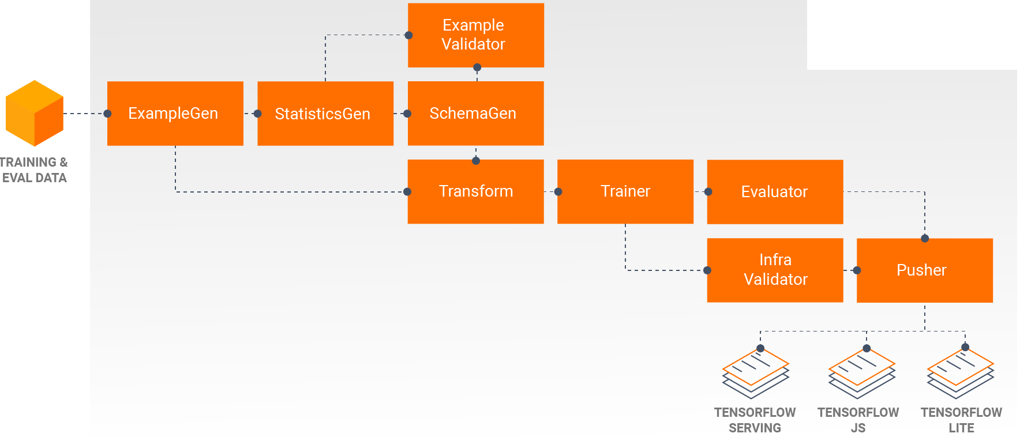
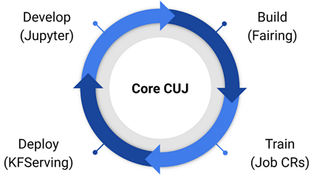
Big Picture: End-to-End Platform for Deploying Production Machine Learning Pipelines
Kubeflow
TensorFlow Extended (TFX)
The Machine Learning Toolkit for Kubernetes
an end-to-end platform for deploying production ML pipelines
https://www.kubeflow.org/
https://www.tensorflow.org/tfx

Slide 11
Overview of TensorFlow Extended (TFX)
･TensorFlow Extended (TFX) is a Google-production-scale machine learning platform based on TensorFlow. ･It provides a configuration framework and shared libraries to integrate common components needed to define, launch, and monitor your machine learning system.
･TensorFlow 2.x was released at TensorFlow Dev Summit 2019; TFX as an extension package.
- [15:06] TensorFlow Extended (TFX) Post-training Workflow (TF Dev Summit '19) https://youtu.be/0O201IQlkxc - [31:34] TensorFlow Extended (TFX) Overview and Pre-training Workflow (TF Dev Summit '19) https://youtu.be/A5wiwT1qFjc
･TFX is compatible with TensorFlow 2.x and the high-level APIs that existed in TensorFlow 1.x .
Installation
pip install tfx
Homepage/Git Repository
https://www.tensorflow.org/tfx
https://github.com/tensorflow/tfx

Slide 12
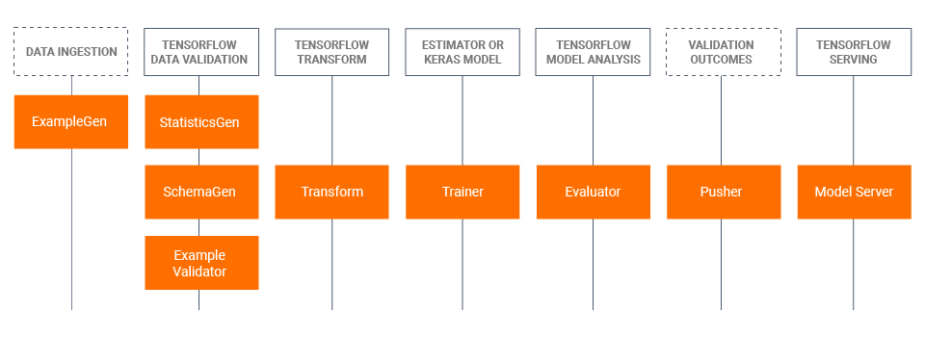
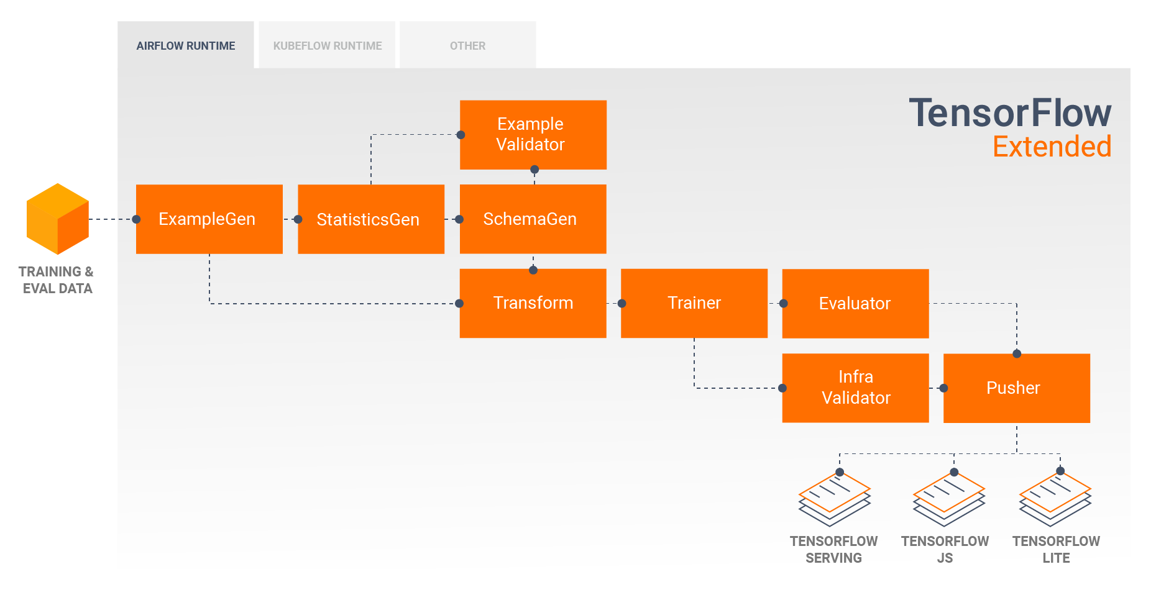
TensorFlow Extended (TFX) Libraries & Pipeline Components
TFX Libraries
TFX Pipeline Components
the flow of data between the components
Source: The TFX User Guide, https://www.tensorflow.org/tfx/guide

Slide 13
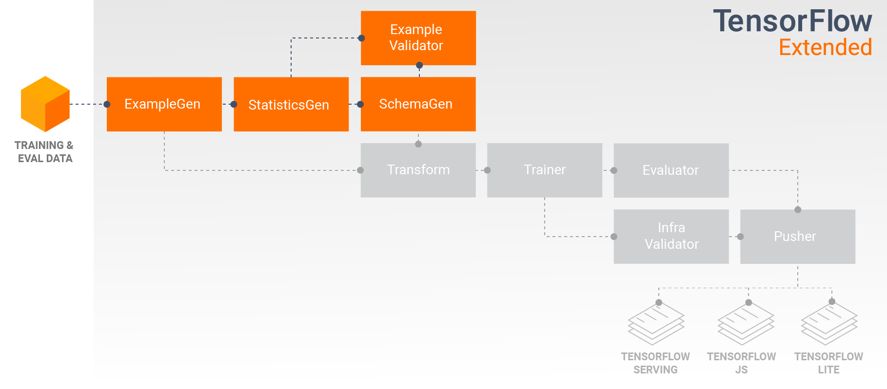
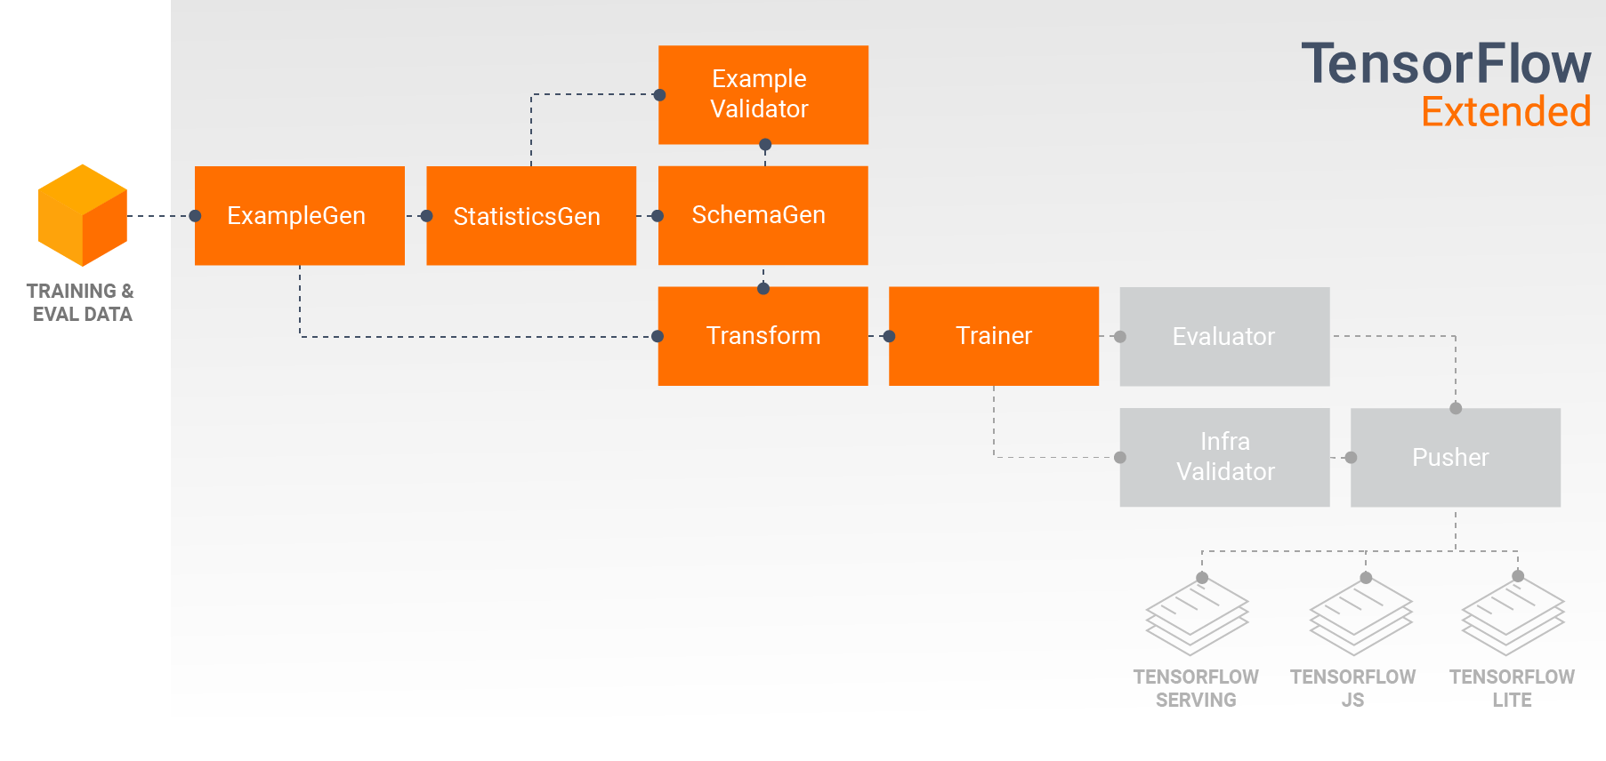
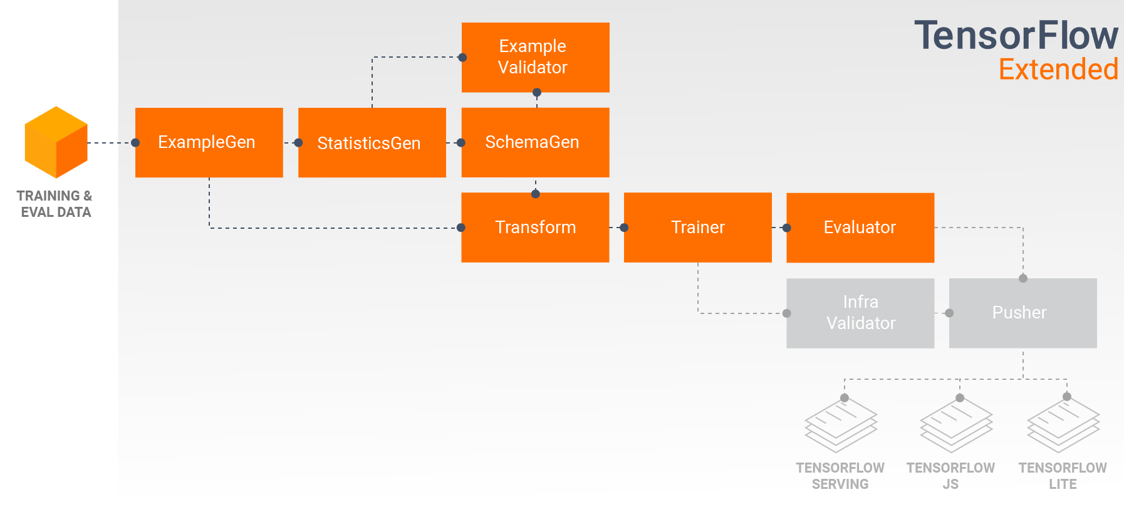
TensorFlow Extended (TFX) Pipleline Components in Action
Data Exploration, Visualization, and Cleaning
Developing and Training Models
Analyzing and Understanding Model Performance
Deployment Targets
Source: The TFX User Guide, https://www.tensorflow.org/tfx/guide

Slide 14
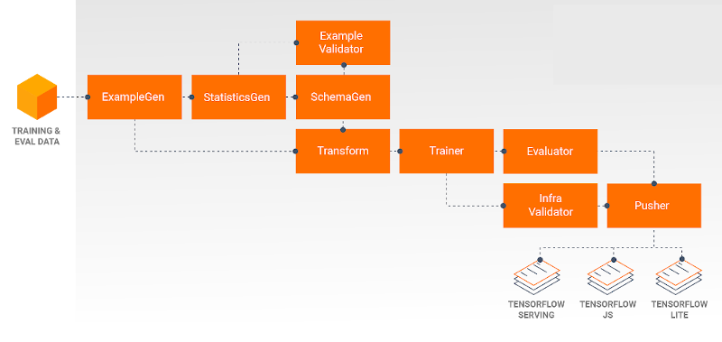
TensorFlow Serving for Inference
Inference: TensorFlow Serving
･TensorFlow Serving (TFS) is a flexible, high-performance serving system for machine learning models, designed for production environments. ･It runs as a set of processes on one or more network servers, using one of several advanced architectures to handle synchronization and distributed computation. ･It consumes a SavedModel and will accept inference requests over either REST or gRPC interfaces.
･In a typical pipeline, a SavedModel which has been trained in a Trainer component would first be infra-validated in an InfraValidator component. ･InfraValidator launches a canary TFS model server to actually serve the SavedModel. ･If validation has passed, a Pusher component will finally deploy the SavedModel to your TFS infrastructure. ･This includes handling multiple versions and model updates.
･ For details, refer to, - Serving Models, https://www.tensorflow.org/tfx/guide/serving - From Research to Production with TFX Pipelines and ML Metadata, https://blog.tensorflow.org/2019/05/research-to-production-with-tfx-ml.html

Slide 15
TensorFlow Extended (TFX) with respect to Kubeflow
Portability and Interoperability TFX is designed to be portable to multiple environments and orchestration frameworks, including ･ Apache Beam (required) ･Apache Airflow (optional), and ･Kubeflow (optional).
Creating a TFX Pipeline With Kubeflow Setup Kubeflow requires a Kubernetes cluster to run the pipelines at scale. See the Kubeflow deployment guideline that guide through the options for deploying the Kubeflow cluster. Configure and run TFX pipeline Please follow the TFX on Cloud AI Platform Pipeline tutorial to run the TFX example pipeline on Kubeflow. TFX components have been containerized to compose the Kubeflow pipeline and the sample illustrates the ability to configure the pipeline to read large public dataset and execute training and data processing steps at scale in the cloud.
Kubeflow is dedicated to making deployments of machine learning (ML) workflows on Kubernetes simple, portable and scalable. Kubeflow's goal is not to recreate other services, but to provide a straightforward way to deploy best-of-breed open-source systems for ML to diverse infrastructures.
Kubeflow Pipelines enable composition and execution of reproducible workflows on Kubeflow, integrated with experimentation and notebook based experiences. Kubeflow Pipelines services on Kubernetes include the hosted Metadata store, container based orchestration engine, notebook server, and UI to help users develop, run, and manage complex ML pipelines at scale. The Kubeflow Pipelines SDK allows for creation and sharing of components and composition of pipelines programmatically.
Source: The TFX User Guide, https://www.tensorflow.org/tfx/guide

Slide 16
Kubeflow Overview
Conceptual overview
https://www.kubeflow.org/docs/started/kubeflow-overview/

Slide 17
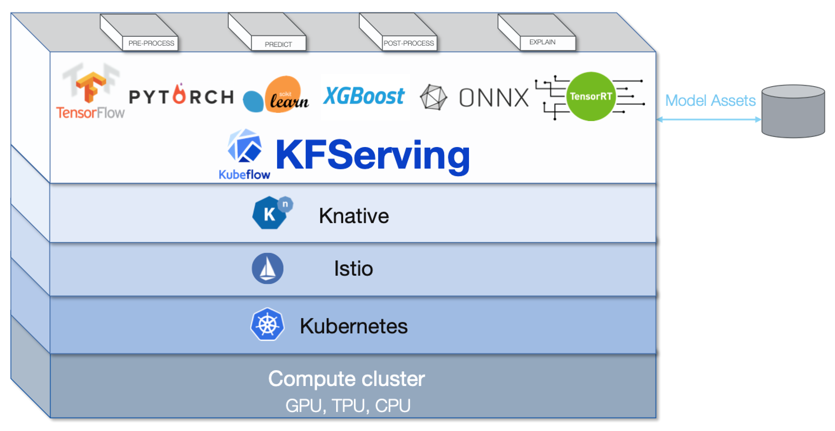
KFServing
KFServing provides a Kubernetes Custom Resource Definition for serving machine learning (ML) models on arbitrary frameworks. It aims to solve production model serving use cases by providing performant, high abstraction interfaces for common ML frameworks like Tensorflow, XGBoost, ScikitLearn, PyTorch, and ONNX.
It encapsulates the complexity of autoscaling, networking, health checking, and server configuration to bring cutting edge serving features like GPU Autoscaling, Scale to Zero, and Canary Rollouts to your ML deployments. It enables a simple, pluggable, and complete story for Production ML Serving including prediction, pre-processing, post-processing and explainability.
https://github.com/aimldl/computing_environments/blob/master/kubeflow/temp.md

Slide 18
Thanks

