Slide 1


Welcome

Slide 2
Python Installation
Go to : https://www.python.org/downloads/
Download latest Python executable
Run the executable
Follow the instructions

Slide 3
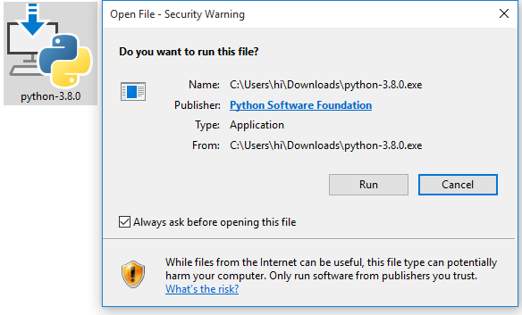
Python Installation
Run the executable

Slide 4
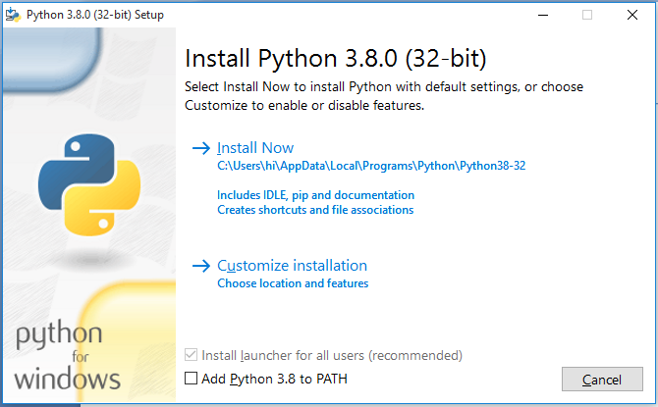
Python Installation
Click install now

Slide 5
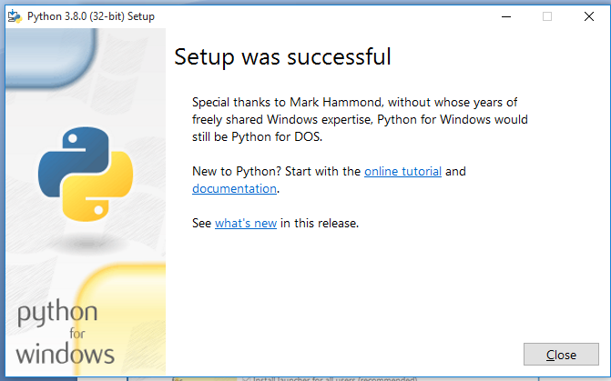
Python Installation
Click Close once setup was successful

Slide 6
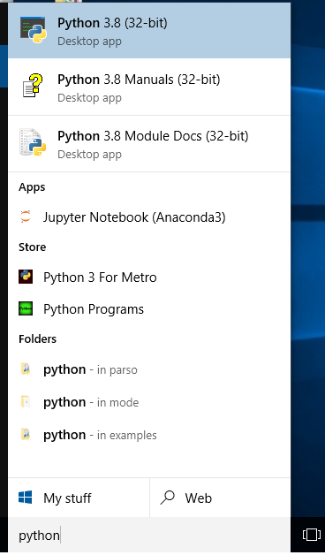
Python Verification
From start menu type Python

Slide 7
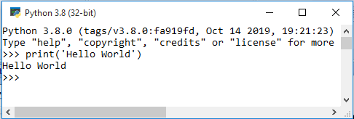
Python Verification
Print ‘Hello World’

Slide 8
Python Un-Installation
Run the executable

Slide 9
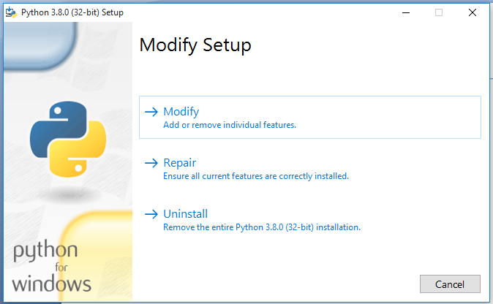
Python Un-Installation
Click on Uninstall

Slide 10
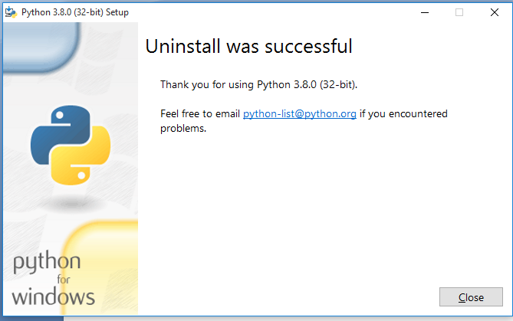
Python Un-Installation
Finish Uninstall

Slide 11
Anaconda Installation
Go to : https://www.anaconda.com/distribution/#download-section
Download latest anaconda+python executable
Run the executable
Follow the instructions

Slide 12
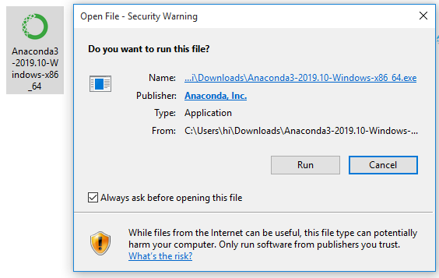
Anaconda Installation
Run the executable

Slide 13
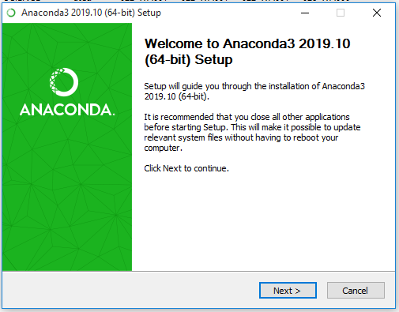
Anaconda Installation
Click Next

Slide 14
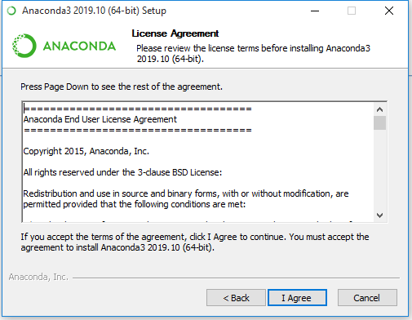
Anaconda Installation
Click on ‘I Agree’

Slide 15
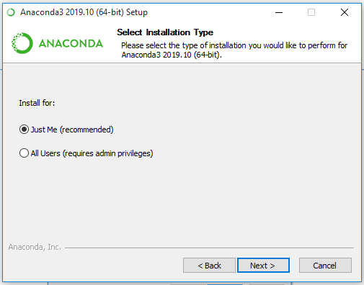
Anaconda Installation
Click ‘Next’

Slide 16
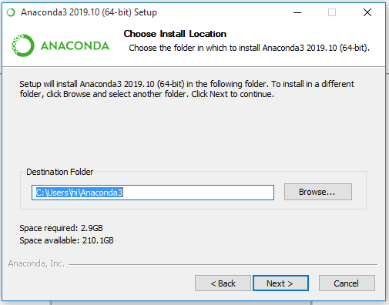
Anaconda Installation
Choose the Installation directory and click Next

Slide 17
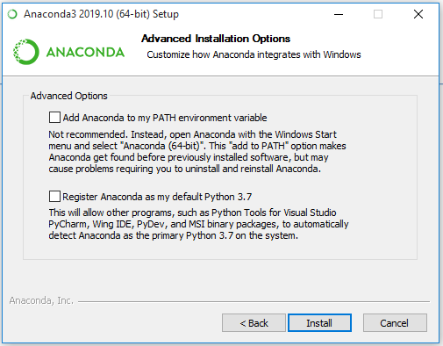
Anaconda Installation
Better don’t check any box and click on Install

Slide 18
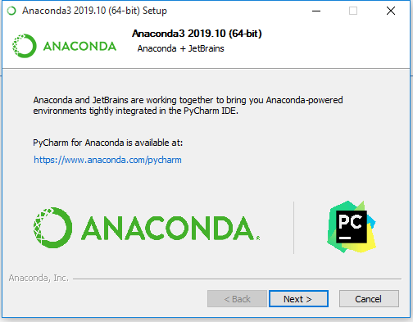
Anaconda Installation
Click Next ( Install PyCharm IDE) and complete Installation

Slide 19
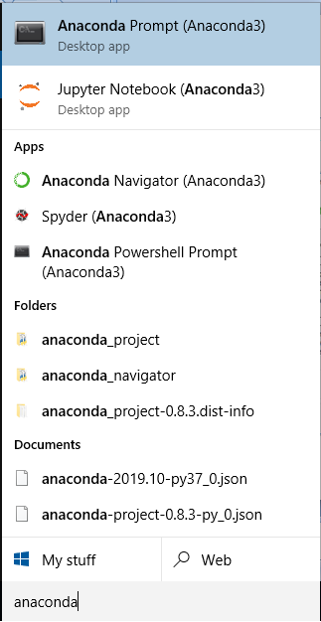
Anaconda Installation
From start menu type Anaconda
You should see
Anaconda Prompt
Jupyter Notebook
Spyder IDE
Anaconda Powershell Prompt

Slide 20
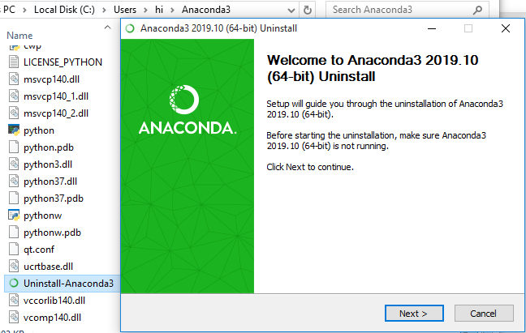
Anaconda Un-Installation
Navigate to Anaconda Installation directory
Locate Uninstall-Anaconda3 .exe
Run the executable

Slide 21
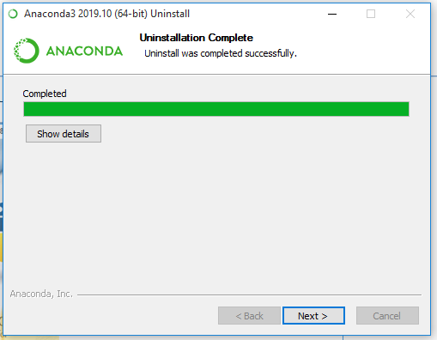
Anaconda Un-Installation
Finish Uninstall

Slide 22
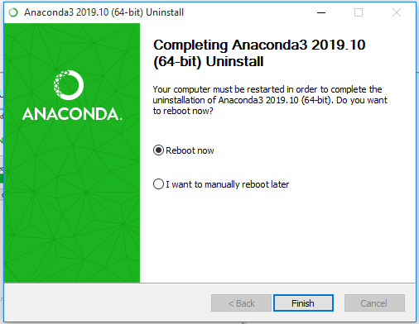
Anaconda Un-Installation
Reboot the system

