Slide 1



WELCOME

Slide 2
Vision
Vision
To become a trustworthy partner to the global business leaders / education institutions to upgrade the technical skillset of their human resources
www.yourwebsite.com

Slide 3
Goal
Our mission is to empower every computer graduate / working professional in this rapid changing competitive world, with the ability to solve the business problems using the advanced AI and ML technologies.

Slide 4
Strategy
To up skill your technical knowledge :
Interactive training over traditional teaching.
Real time data scientists, who are industry experts in multiple domains.
Collaborative development with In-house / open source AI/ML project teams, for better real-time experience.
Concurrent upgrade of trending technologies with the industry.
Periodic knowledge checkup programs. (Daily / Weekly / Bi-weekly / Monthly hackathons while training)

Slide 5
AI Statistics
The AI market will grow to a $190 billion industry by 2025, according to research firm Markets and Markets (source).
Global spending on cognitive and AI systems will reach $57.6 billion in 2021, according to market research firm IDC (source)
IDC forecasts 75% of commercial enterprise apps will use AI by 2021 (source)
AI Could Increase Productivity by 40%
The Use of AI Chatbots Will Increase 136% by 2021
65.8% of Smartphone Owners Have Used an AI-Voice Assistant
27% of Executives Plan to Incorporate AI Into Their Cyber security Strategy
Google analysts believe that next year, 2020, robots will be smart enough to mimic complex human behavior like jokes and flirting
AI startups grew 14 times over the last two decades

Slide 6
Introduction
ARTIFICIAL INTELLIGENCE
MACHINE LEARNING
DATA SCIENCE
DEEP LEARNING
DATA VISUALIZATION
EXPLORATORY DATA ANALYSIS (EDA)
PYTHON
PANDAS
SCIPY, SCIKIT-LEARN
NUMPY
MATPLOTLIB
SEABORN
STATISTICS
NLP AND NLTK
ARTIFICIAL INTELLIGENCEARTIFICIAL INTELLIGENCE

Slide 7
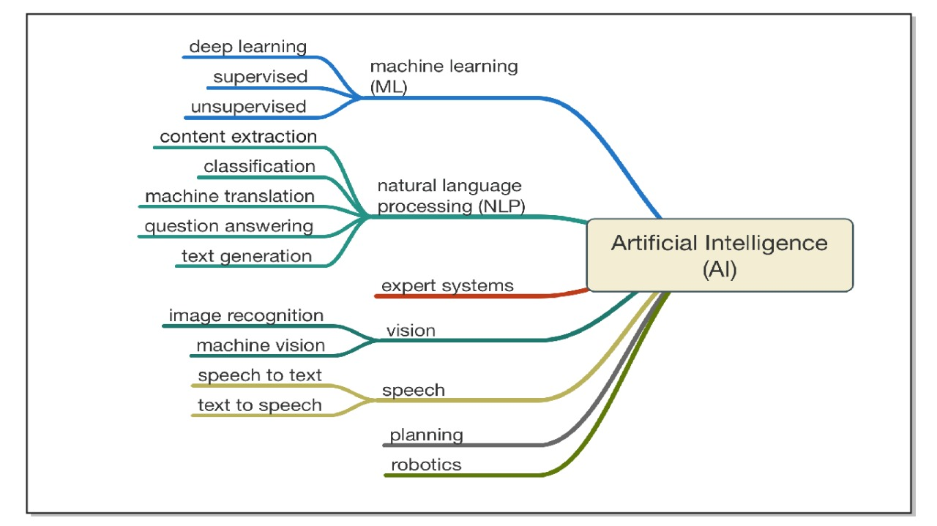
Introduction

Slide 8
Learning Flow
FINISH
DATA
VISUALIZATION
MATPLOTLIB/SEABORN
Deep Learning
Introduction to AI/ML/DS
Statistics
1
3
5
7
2
4
6
8
Python
EDA
PANDAS
NUMPY
Machine Learning
NLP/NLTK
START

Slide 9
Thank You

