Slide 1



Welcome

Slide 2


Myself
1
Over 15 years of experience as Enterprise Architect and Data Scientist
2
Post graduation in Computer science.
YOUR IMAGE
3
Worked with diversified domains like Healthcare, Life sciences, Banking, Digital, Retail, Gaming
Experience in Desktop, Distributed, Cloud, Gaming, Data analytics
4
Worked with MNCs like Apple, Infosys, Electronic Arts, JPMorgan & Chase etc..
5

Slide 3

AI Statistics
The AI market will grow to a $190 billion industry by 2025, according to research firm Markets and Markets (source).
Global spending on cognitive and AI systems will reach $57.6 billion in 2021, according to market research firm IDC (source)
IDC forecasts 75% of commercial enterprise apps will use AI by 2021 (source)
AI Could Increase Productivity by 40%
The Use of AI Chatbots Will Increase 136% by 2021
65.8% of Smartphone Owners Have Used an AI-Voice Assistant
27% of Executives Plan to Incorporate AI Into Their Cyber security Strategy
Google analysts believe that next year, 2020, robots will be smart enough to mimic complex human behavior like jokes and flirting
AI startups grew 14 times over the last two decades

Slide 4
Introduction
ARTIFICIAL INTELLIGENCE
MACHINE LEARNING
DATA SCIENCE
DEEP LEARNING
DATA VISUALIZATION
EXPLORATORY DATA ANALYSIS (EDA)
PYTHON
PANDAS
SCIPY, SCIKIT-LEARN
NUMPY
MATPLOTLIB
SEABORN
STATISTICS
NLP AND NLTK

Slide 5
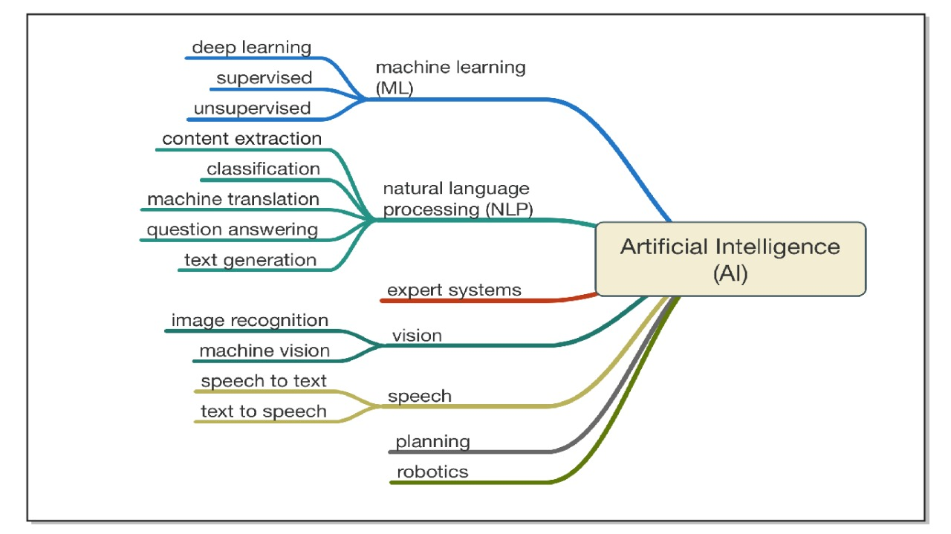
Introduction

Slide 6
Learning Flow
FINISH
DATA
VISUALIZATION
MATPLOTLIB/SEABORN
Deep Learning
Introduction to AI/ML/DS
Statistics
1
3
5
7
2
4
6
8
Python
EDA
PANDAS
NUMPY
Machine Learning
NLP/NLTK
START

Slide 7
Thank You

