Slide 1

Final Project Bank Customer Churn Prediction Using Supervised Learning
CSCA 5622 Introduction to Machine Learning: Supervised Learning
29 Apr 2025
Molly B
Notes:
Hi, I’m [Your Name], and today I’m presenting my final project for CSCA 5622: Bank Customer Churn Prediction using supervised learning. Let’s dive into the problem, approach, and results.

Slide 2

Project Overview
What
Predict whether a bank customer will churn (close their account)—a binary classification problem
Why
Churn costs banks millions annually Retaining high-value clients can save $10M–$500M by 2025 (estimated)
Dataset
Kaggle Bank Customer Churn Prediction dataset
10,002 samples
10 features (8 numeric, 2 categorical)
Challenge
Class imbalance (~20% churn), missing values (e.g., Geography: 1).
Notes:
Customer churn is a major issue for banks, costing millions annually. My project predicts churn using a Kaggle dataset with 10002 samples. The dataset has a class imbalance—only 20% of customers churn—and minor missing values, which we’ll address.

Slide 3
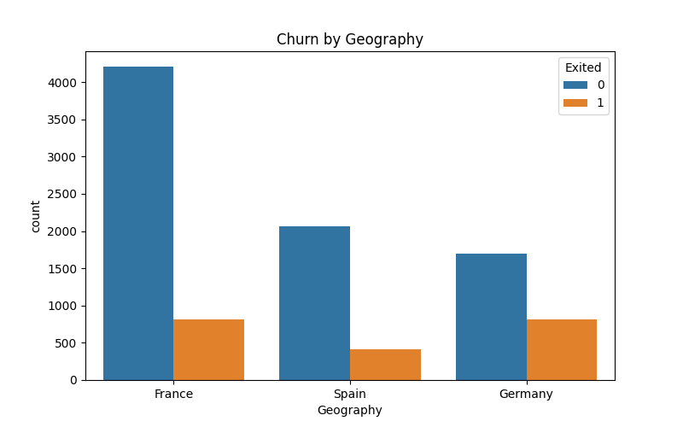
Approach: Data Preprocessing
Steps
Handle missing values: Impute Geography with ‘missing’, numeric features with median
Address imbalance: Apply SMOTE to balance training data (50/50)
Encode categorical features (Geography, Gender) with one-hot encoding
Scale numeric features using StandardScaler for model compatibility
Outcome
Prepared data for modeling with balanced classes and normalized features
Notes:
First, I preprocessed the data. I handled missing values by imputing Geography with ‘missing’ and numeric features with medians. To address the class imbalance, I used SMOTE to balance the training data. I also applied one-hot encoding for categorical features and scaled numeric features. This plot shows how Geography impacts churn, with Germany having a higher rate.

Slide 4
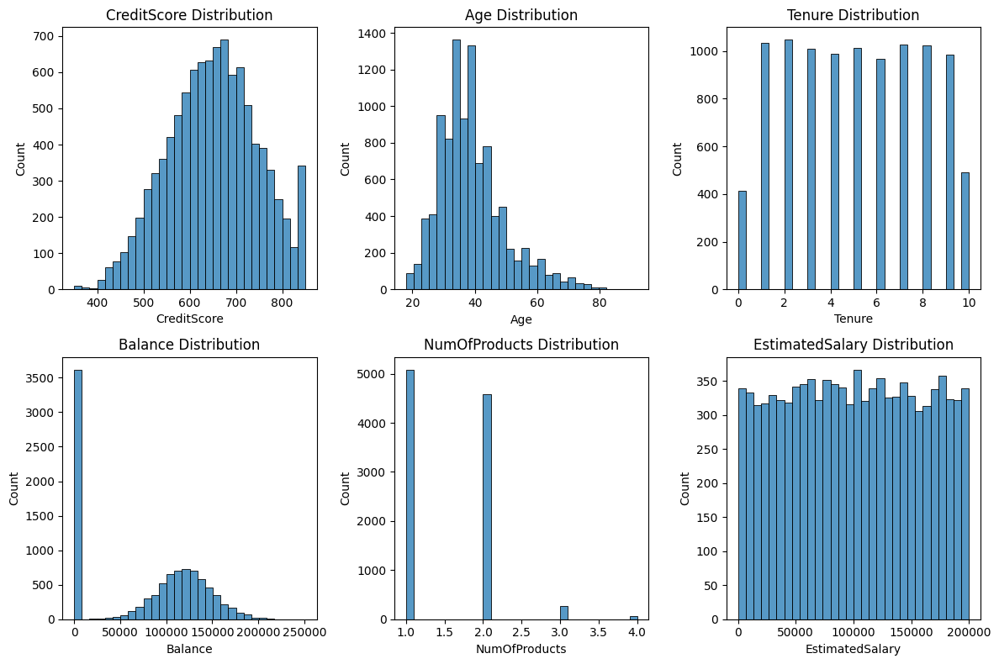
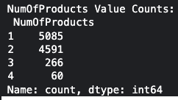
Data Numeric Distributions
Age is skewed right
suggesting a potential log-transformation to normalize it for modeling
Balance is bimodal
large peak at 0

Slide 5
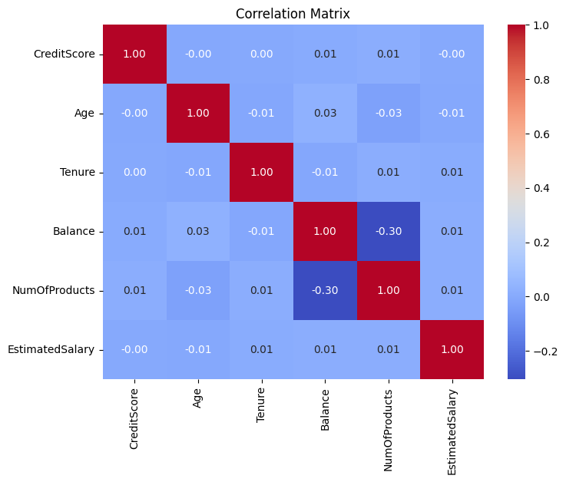
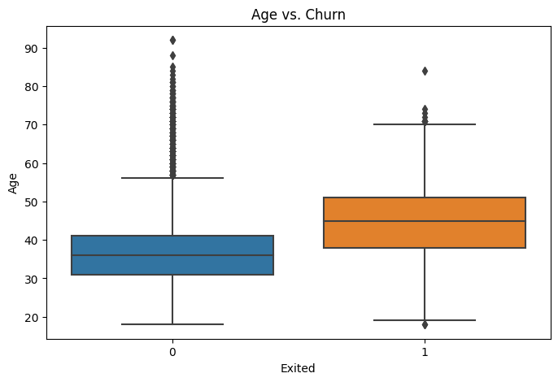
Correlations
Weak positive correlation between Age and Exited (0.03)
Age’s predictive power evident from the box plot
No strong multicollinearity is observed among numeric features
All can be retained for modeling

Slide 6
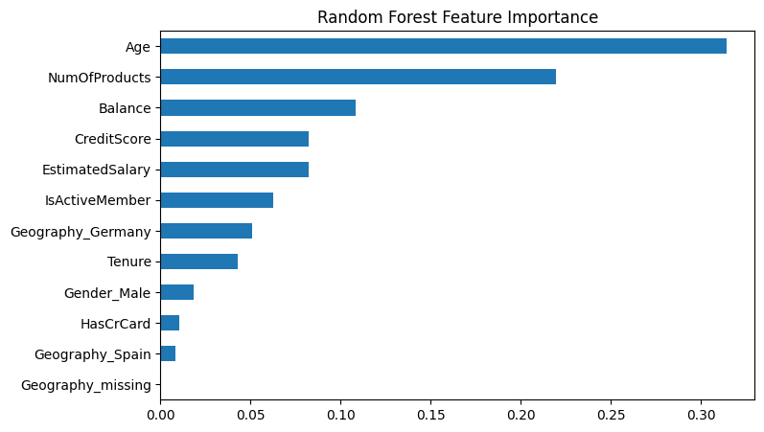
Approach: Model Development
Models:
Logistic Regression: Baseline linear model
Random Forest: Non-linear ensemble with hyperparameter tuning (GridSearchCV)
Neural Network: Deep learning with GPU (64/32/1 layers, dropout)
CatBoost: Gradient boosting with GPU, optimized for categorical data, SHAP for interpretability
Techniques:
SMOTE for imbalance
GPU acceleration for Neural Network and CatBoost
Dropout to reduce overfitting in Neural Network
Notes:
I trained four models: Logistic Regression as a baseline, Random Forest with hyperparameter tuning, a Neural Network using GPU, and CatBoost, also with GPU, for its strength with categorical data. I used SMOTE for imbalance, GPU acceleration for efficiency, and dropout to reduce overfitting in the Neural Network. This Random Forest feature importance plot shows Age and NumOfProducts as key predictors.

Slide 7
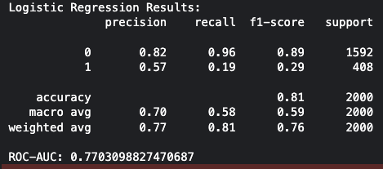
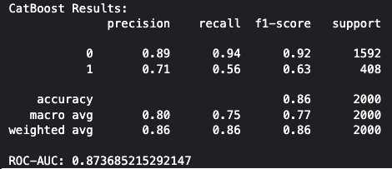
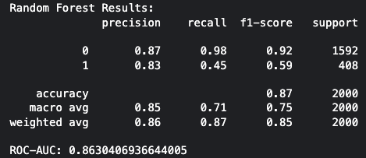
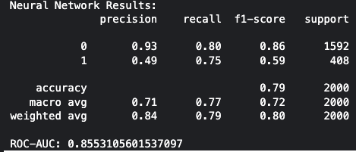
Comparison: Model
Logistic Regression
CatBoost
Random Forest
Neural Network

Slide 8
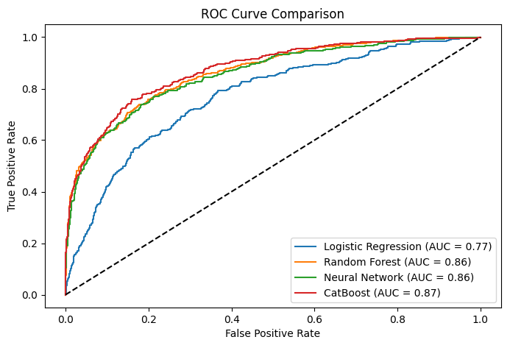
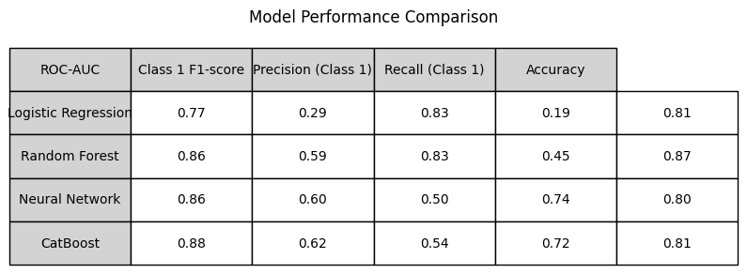
Results: Model Performance
Performance:
CatBoost (best model): ROC-AUC 0.87, Class 1 F1-score 0.62
Random Forest: ROC-AUC 0.86, F1-score 0.59
Neural Network: ROC-AUC 0.86, F1-score 0.60
Logistic Regression: ROC-AUC 0.77, F1-score 0.29
Key Insight:
CatBoost outperforms others
balancing accuracy and interpretability
Notes:
Here are the results: CatBoost achieved the highest ROC-AUC of 0.87 and an F1-score of 0.62, followed closely by Random Forest and Neural Network at 0.86. Logistic Regression lagged at 0.77. This ROC curve comparison shows CatBoost’s superior performance, making it the best model for this task.

Slide 9
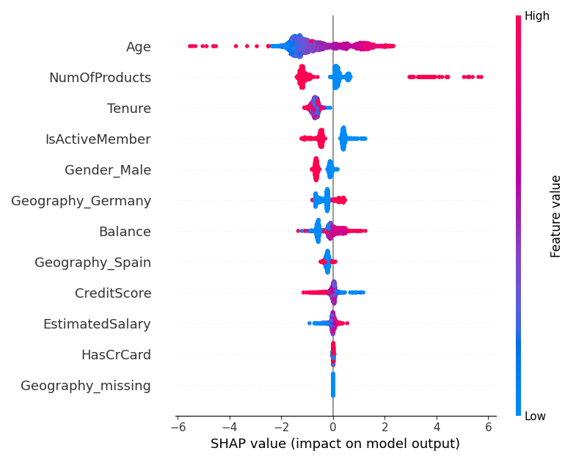
Insights: Understanding Churn Drivers
Key Predictors:
Age
NumOfProducts
Tenure
Geography (especially Germany) are top drivers of churn (via SHAP)
Business Insight:
Older customers in Germany with fewer products are at higher risk
Notes:
Using SHAP with CatBoost, I identified key churn drivers: Age, NumOfProducts, Tenure, and Geography, particularly Germany. This plot shows older customers in Germany with fewer products are at higher risk, providing actionable insights for banks to target retention efforts.

Slide 10
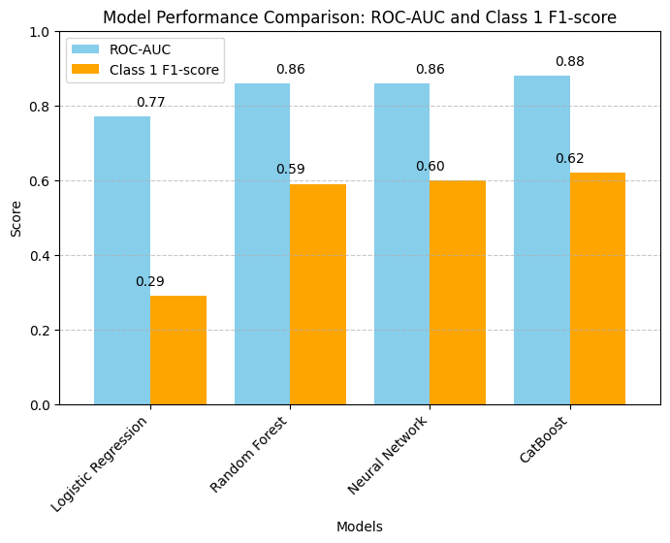
Conclusion and Future Work
Summary:
CatBoost (ROC-AUC 0.87) excels in predicting churn, with actionable insights via SHAP
Business Impact:
Enables banks to save $10M–$500M annually through targeted retention
Future Work:
Incorporate transaction data with LSTM models
Deploy CatBoost via Flask API for real-time prediction

Slide 11

GitHub Repository
Link to GitHub

