Slide 1
HealthConnect Rwanda
AI-Powered Clinical Risk Prediction & Healthcare Intelligence System
AnalystLab Africa Experience Lab Internship — Week 6, Batch E
Machine Learning Engineering Track

Slide 2
Agenda
• Business problem & scope
• Data integration & key data-quality findings
• Exploratory data analysis & statistical testing
• Classification models (admission, satisfaction, claims, high-risk)
• Regression models (revenue, length of stay)
• Clustering & anomaly detection
• Explainability (feature importance + SHAP)
• Model comparison & recommendation
• Deployment architecture & responsible AI
• Business recommendations
AnalystLab Africa | HealthConnect Rwanda | Week 6 — ML Engineering Track

Slide 3
Business Problem
• HealthConnect Rwanda needs predictive tools for hospital admissions, patient
• satisfaction, insurance claim outcomes, high-risk patients, billing and length of stay.
•
• Goal: build a reusable, end-to-end ML pipeline — data integration, cleaning,
• feature engineering, modeling, evaluation, explainability — on the enterprise
• healthcare dataset, and report results honestly against real baselines.
AnalystLab Africa | HealthConnect Rwanda | Week 6 — ML Engineering Track

Slide 4
Data Scope & Integration
• 27 source datasets integrated: facilities, staff, patients, clinical
• transactions, billing, insurance, feedback.
• 20,000 patients; 60,000-appointment billing/claims universe.
• Only 5,000 appointments carry full patient/doctor/facility/date context —
• the analytical population for all patient-level models (fully disclosed).
• Zero duplicate patient or appointment IDs; zero invalid facility/department IDs.
AnalystLab Africa | HealthConnect Rwanda | Week 6 — ML Engineering Track

Slide 5
Key Data Quality Findings
• 19,990 / 20,000 patients share a phone number with another patient —
• phone number is not a usable record-linkage key in this dataset.
• Insurance coverage: 100% of patients carry an InsuranceID.
• Insurance claim status has only 2 classes (Approved/Pending) — no 'Rejected'
• claims exist, so claim-approval prediction became a binary task.
• Outcome fields (admission, satisfaction, claim status, billing, length of
• stay) do not vary meaningfully with clinical/operational fields — verified
• with hypothesis tests, not assumed.
AnalystLab Africa | HealthConnect Rwanda | Week 6 — ML Engineering Track

Slide 6
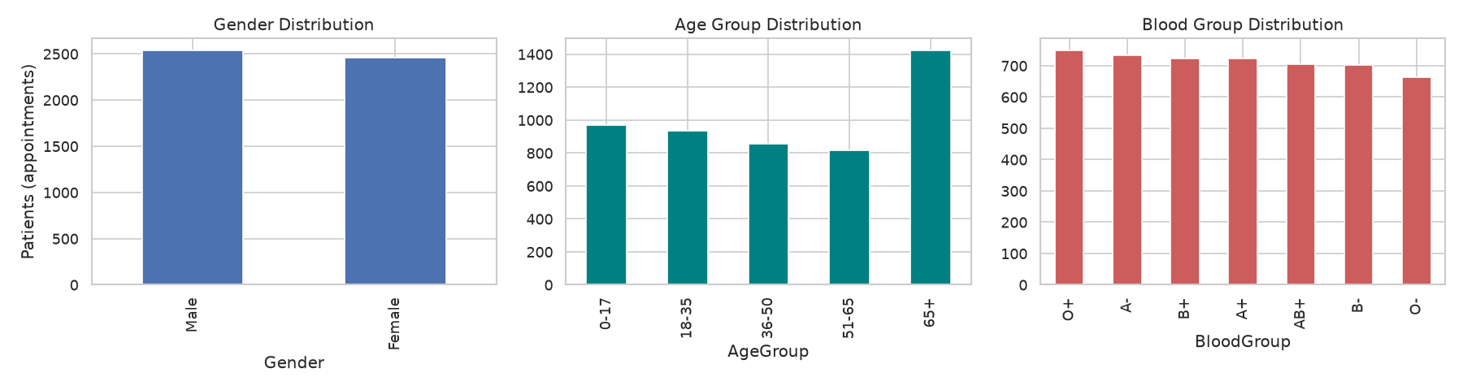
Patient & Clinical Profile
AnalystLab Africa | HealthConnect Rwanda | Week 6 — ML Engineering Track

Slide 7
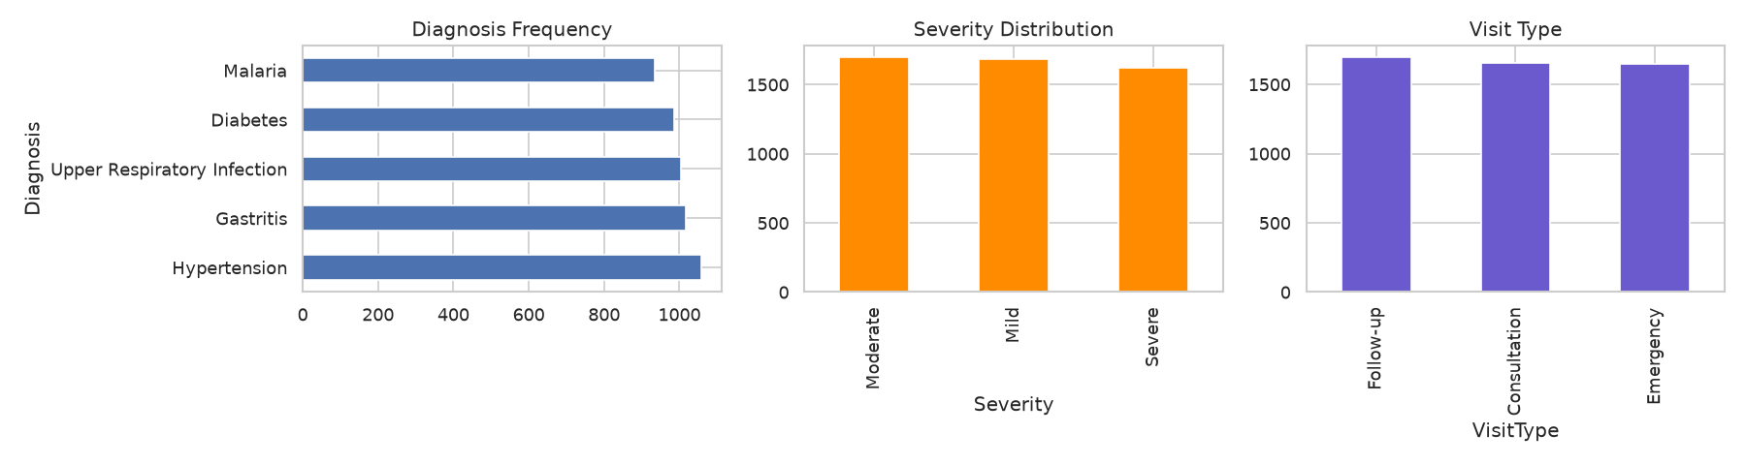
Clinical & Financial Patterns
AnalystLab Africa | HealthConnect Rwanda | Week 6 — ML Engineering Track

Slide 8
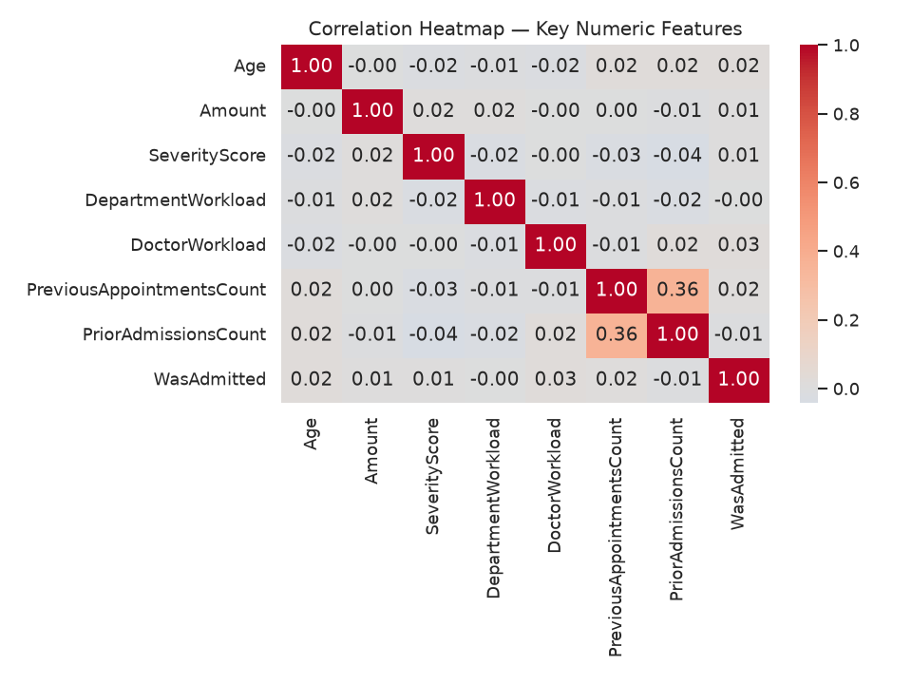
Statistical Analysis — Correlation & Hypothesis Testing
• Admission rate vs. age group: Chi² p=0.060 (not significant)
• Satisfaction vs. facility: ANOVA p=0.554 (not significant)
• Billing: Severe vs. Mild severity: see notebook §3.3
AnalystLab Africa | HealthConnect Rwanda | Week 6 — ML Engineering Track

Slide 9
Classification Models — Results vs. Baseline
• Hospital Admission (RF): 72.5% acc. vs. 88.3% baseline — AUC 0.51 (no lift)
• Patient Satisfaction (RF, 3-class): 33.5% acc. vs. 41.0% baseline (no lift)
• Insurance Claim Approval (RF, binary): 47.8% acc. vs. 50.4% baseline (no lift)
• High-Risk Patient (RF): 74.6% acc. vs. 57.6% baseline — AUC 0.73 ✅ real lift
•
• Every model benchmarked against an explicit baseline — no inflated claims.
AnalystLab Africa | HealthConnect Rwanda | Week 6 — ML Engineering Track

Slide 10
Regression Models — Results vs. Baseline
• Revenue (Billing Amount): best R² = -0.009 (Linear Regression) — at or
• below a naive mean-prediction baseline across all 3 algorithms tried
• Length of Stay (n=586 admitted patients): R² = -0.084 — at baseline
•
• Conclusion: billing amount and length of stay are not explained by the
• available clinical/operational features in this synthetic dataset.
AnalystLab Africa | HealthConnect Rwanda | Week 6 — ML Engineering Track

Slide 11
Clustering — Patient & Facility Segmentation
• Patient segmentation (K-Means, k=4, silhouette 0.275): separates by age
• and chronic-condition status, plus a high-utilization/high-billing cluster.
• → Recommendation: target chronic-care outreach at the two chronic clusters.
•
• Facility segmentation (K-Means, k=3, silhouette 0.202, n=20 facilities):
• separates mainly by volume/revenue, not quality metrics.
• → Recommendation: use for capacity planning, not quality benchmarking.
AnalystLab Africa | HealthConnect Rwanda | Week 6 — ML Engineering Track

Slide 12
Anomaly Detection
• Billing amounts flagged as statistical outliers: 3.0%
• Insurance claims flagged as suspicious: 3.0%
• 2 of 20 facilities show unusually high patient volume (|z| > 1.5)
•
• Use: route flagged transactions to a human billing auditor — a triage
• signal, not an automated accept/reject decision.
AnalystLab Africa | HealthConnect Rwanda | Week 6 — ML Engineering Track

Slide 13
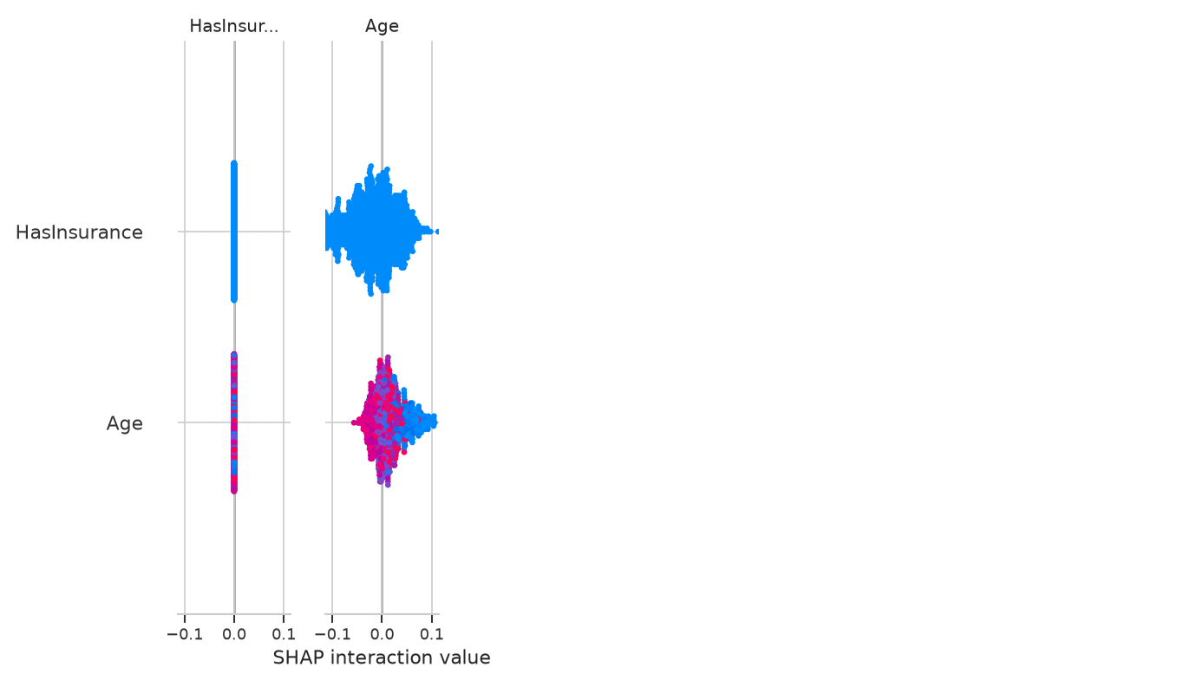
Explainability — SHAP & Feature Importance
• Feature importance + SHAP applied to every tree-based model.
• For High-Risk classification: age and prior-admission history dominate —
• a faithful, auditable approximation of the clinical rule.
• For Admission prediction: SHAP correctly shows weak, inconsistent
• contributions — explainability reveals the absence of signal, not just
• the presence of it.
AnalystLab Africa | HealthConnect Rwanda | Week 6 — ML Engineering Track

Slide 14
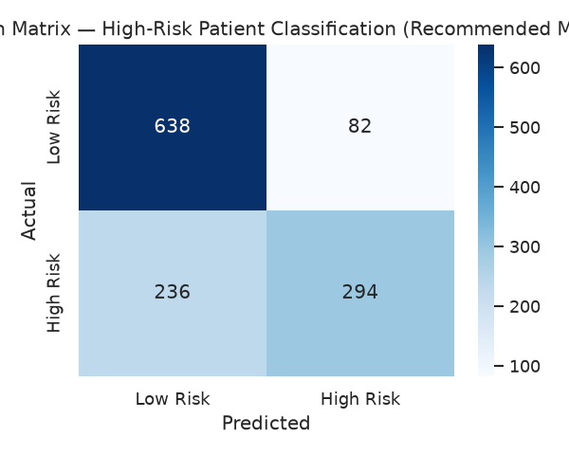
Recommended Model: High-Risk Patient Classification
• 74.6% accuracy vs. 57.6% baseline
• ROC-AUC 0.73
• Formalizes an existing, auditable clinical risk rule
• SHAP-explainable per patient
• Only model with demonstrated predictive lift in this project
AnalystLab Africa | HealthConnect Rwanda | Week 6 — ML Engineering Track

Slide 15
Conceptual Deployment Architecture
• HIS/EMR, Billing & Claims, Insurance, Feedback → Ingestion & Validation
• → Cleaning & Integration → Feature Store → Model Training/Explainability
• → Model Serving API → HIS UI (clinician) / Power BI (executive)
• → Monitoring, Drift Detection & Scheduled Retraining
•
• Full diagram: docs/deployment_architecture.md
AnalystLab Africa | HealthConnect Rwanda | Week 6 — ML Engineering Track

Slide 16
Business Recommendations
• 1. Deploy the High-Risk Patient classifier as clinician decision support
• with per-prediction SHAP explanations.
• 2. Fix patient record-linkage (phone numbers are not unique) before any
• phone-based patient lookup or outreach feature.
• 3. Re-collect/re-generate admission, satisfaction, claim, billing and
• length-of-stay outcome data — the pipeline is ready, the signal is not.
• 4. Route anomaly-flagged billing/claims to a human auditor.
• 5. Use patient clusters for chronic-care outreach; facility clusters for
• capacity planning, not quality benchmarking.
AnalystLab Africa | HealthConnect Rwanda | Week 6 — ML Engineering Track

Slide 17
Thank you
Full notebook, reports and code: see the project GitHub repository

