Slide 1
SwiftLog Logistics
Can machine learning predict delivery delays, returns, demand and customer value?
Week 5 Executive Presentation | Machine Learning Track (ML05)
Gyimah Ramsey Opoku, Junior Machine Learning Engineer, AnalystLab Africa Consulting
Notes:
SwiftLog is a fictional client with synthetic data. The headline: the honest answer is not with today's data, and here is the evidence.

Slide 2
The business problem
SwiftLog wants to move from reporting what happened to acting before it happens.
1
Late deliveries
2
Product returns
64% of shipments arrive 3+ days late
9.5% of orders come back
3
Inventory
4
Customer value
1.0M units in stock, far above demand
Which customers will matter next?
SwiftLog ML05 | Gyimah Ramsey Opoku | 2

Slide 3
Machine learning approach
1
2
3
4
5
Prepare
Engineer
Model
Tune and test
Explain and deploy
11 tables audited, cleaned and joined
Basket, calendar, history, warehouse load
4 problems, 5 algorithms each
Cross-validation, searches, baselines
Permutation, SHAP, Streamlit app
Delay and return are classification; demand and customer value are regression. Supplier reliability could not be built: no table links suppliers to anything.
SwiftLog ML05 | Gyimah Ramsey Opoku | 3

Slide 4
Two data problems caught early
1
A hidden copy of the target
2
No supplier link
Delivery_Performance repeats the shipment delay days in every row, and its Status is just "3 or more days". A model given it would score about 100% for no real reason, so it only defines the target.
No table other than Suppliers holds a SupplierID. Supplier reliability would need an invented link, so it was excluded and the data fix is recommended instead.
SwiftLog ML05 | Gyimah Ramsey Opoku | 4

Slide 5
Model performance on unseen data
R² -0.06
Demand forecast (0 = predicting the average)
R² -0.003
Customer value (0 = predicting the average)
SwiftLog ML05 | Gyimah Ramsey Opoku | 5
Notes:
Delay AUC 0.520 (95% CI 0.48 to 0.56); return AUC 0.491 (0.42 to 0.56). Both intervals include 0.5.

Slide 6
Why: the data carries no usable signal
1 of 22
3.7%
0.50
tests significant at 5% (about 1 expected by chance)
strongest correlation of any feature with a target
AUC with shuffled labels, same as the real model
Three independent checks agree. Tuning confirmed it: the optimiser pushed models toward heavy regularisation, which is what happens when there is nothing to learn. Demand in one month does not predict the next (correlation 0.02).
SwiftLog ML05 | Gyimah Ramsey Opoku | 6

Slide 7
Five algorithms, one result
All five algorithms land between 0.50 and 0.52.
Final choice by the one-standard-error rule: the simplest model statistically tied with the best.
SwiftLog ML05 | Gyimah Ramsey Opoku | 7

Slide 8
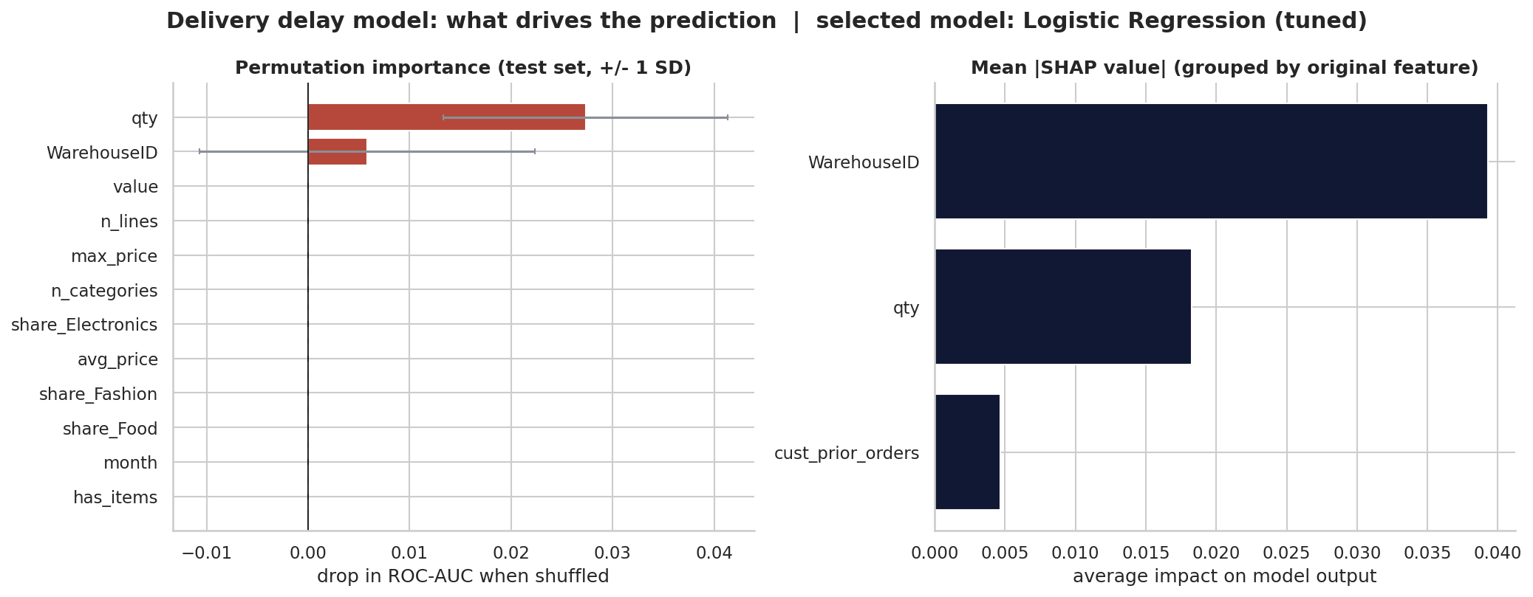
What drives the predictions?
Permutation importance on unseen data is near zero. SHAP describes what the model fitted, not what causes delays.
SwiftLog ML05 | Gyimah Ramsey Opoku | 8

Slide 9
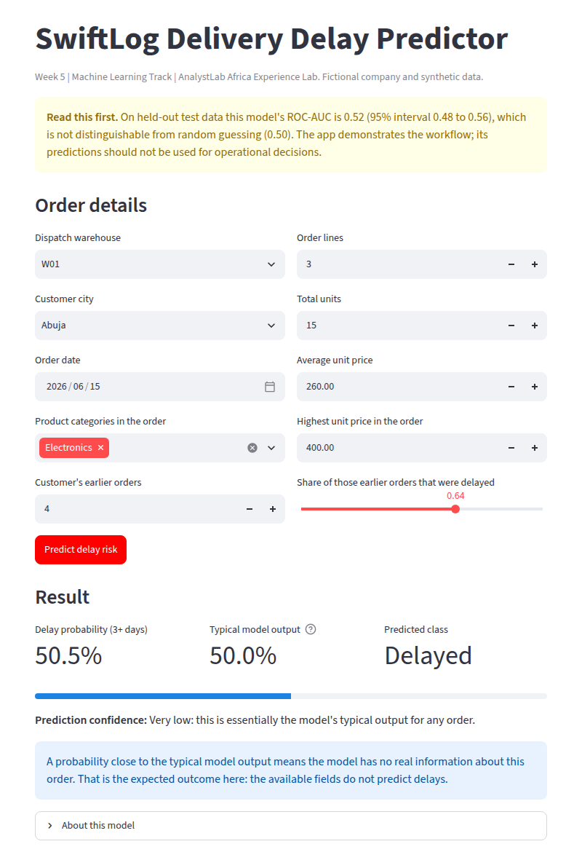
Live demo: delay predictor app
Streamlit app on the saved model
Takes order details, builds the exact training features, returns a delay probability and a confidence rating.
It shows its own test AUC and warns that scores are for demonstration only.
Run: streamlit run app.py

Slide 10
Key business findings
64%
150 mo
63%
shipments 3+ days late, no warehouse stands out
median months of demand covered by stock
of returns are wrong item or damaged goods
20 to 38
24%
236
shipments per employee across warehouses
of revenue from the top 10% of customers
orders with no line items
SwiftLog ML05 | Gyimah Ramsey Opoku | 10

Slide 11
Business recommendations
1
Hold off on operational use
2
Review the delay process
3
Capture better data
Neither model beats chance. Set a release bar first.
A uniform 64% failure rate points to a systemic cause.
Timestamps, carrier, route, stock movements.
4
Link suppliers
5
Cut returns at the source
6
Right-size inventory
Add SupplierID to unlock reliability modelling.
Fix picking and packing quality.
Verify the data, then release excess stock.
Twelve recommendations in the full technical report.
Notes:
Full list of twelve is in Reports/Technical_Report.pdf section 9.

Slide 12
Future AI roadmap
Now
Root-cause review of delays and returns; start capturing missing fields
Months 2 to 4
Pilot an alternative dispatch rule on a random share of orders
Months 6 to 12
Re-run the notebook on richer data; deploy only a model that beats baseline
Later
Route optimisation, return-reason text classification, a retrieval assistant for managers
SwiftLog ML05 | Gyimah Ramsey Opoku | 12

Slide 13
Conclusion
The engineering is complete and re-runnable.
The honest finding is that today's data cannot predict delays, returns, demand or customer value.
The value is knowing that now, and knowing exactly what to collect next.
Gyimah Ramsey Opoku | AnalystLab Africa Experience Lab | #AnalystLabAfrica

