Slide 1
CSC 301 – Design and Analysis of Algorithms
Instructor: Dr. M. Hasan Jamal
Lecture# 02: Asymptotic Notations and Analysis

Slide 2
Asymptotic Notations Properties
Categorize algorithms based on asymptotic growth rate
e.g. linear, quadratic, exponential
Ignore small constant and small inputs
Estimate upper bound and lower bound on growth rate of time complexity function
Describe running time of algorithm as n grows to ∞.
Limitations
not always useful for analysis on fixed-size inputs.
All results are for sufficiently large inputs.

Slide 3
Asymptotic Notations
Asymptotic Notations Θ, O, Ω, o, ω
We use Θ to mean “order exactly”, (Tight Bound)
O to mean “order at most”, (Tight Upper Bound)
Ω to mean “order at least”, (Tight Lower Bound)
o to mean “upper bound”,
ω to mean “lower bound”,
Define a set of functions which is in practice used to compare two function sizes.

Slide 4
Big-Oh Notation (O)
If f, g: N → R⁺, then we can define Big-Oh as
We may write f(n) = O(g(n)) OR f(n) ∈ O(g(n))
Intuitively:
Set of all functions whose rate of growth is the same as or lower than that of g(n). f(n) is bounded above by g(n) for all sufficiently large n

Slide 5
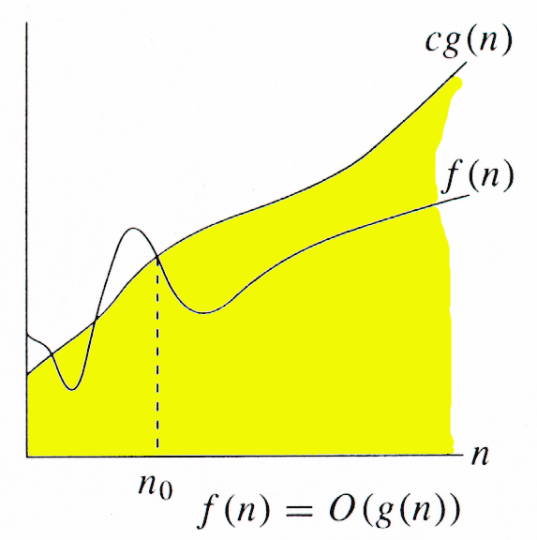
Big-Oh Notation (O)
f(n) ∈ O(g(n))
∃ c > 0, ∃ n₀ > 0 and ∀n ≥ n₀, 0 ≤ f(n) ≤ c.g(n)
g(n) is an asymptotic upper bound for f(n).

Slide 6
Big-Oh Notation (O)
The idea behind the big-O notation is to establish an upper boundary for the growth of a function f(n) for large n.
This boundary is specified by a function g(n) that is usually much simpler than f(n).
We accept the constant C in the requirement
f(n) ≤ C⋅g(n) whenever n > n₀,
We are only interested in large n, so it is OK if
f(n) > C⋅g(n) for n ≤ n₀.
The relationship between f and g can be expressed by stating either that g(n) is an upper bound on the value of f(n) or that in the long run , f grows at most as fast as g.

Slide 7
Example
As a simple illustrative example, we show that the function 2n² + 5n + 6 is O(n²).
For all n ≥ 1, it is the case that
2n² + 5n + 6 ≤ 2n² + 5n² + 6n² = 13n²
Hence, we can take с = 13 and n_{o} =1, and the definition is satisfied.

Slide 8
Example
Prove that 2n² = O(n³)
Proof:
Assume that f(n) = 2n², and g(n) = n³
f(n) = O(g(n)) ?
Now we have to find the existence of c and n₀
f(n) ≤ c.g(n) ➔ 2n² ≤ c.n³ ➔ 2 ≤ c.n
if we take, c = 1 and n₀= 2 OR
c = 2 and n₀= 1 then
2n² ≤ c.n³
Hence f(n) = O(g(n)), c = 1 and n₀= 2

Slide 9
Example
Prove that n² = O(n²)
Proof:
Assume that f(n) = n², and g(n) = n²
f(n) = O(g(n)) ?
Now we have to find the existence of c and n₀
f(n) ≤ c.g(n) ➔ n² ≤ c.n² ➔ 1 ≤ c
if we take, c = 1, n₀= 1
Then
n² ≤ c.n² for c = 1 and n ≥ 1
Hence, n² = O(n²), where c = 1 and n₀= 1

Slide 10
Example
Prove that 1000.n² + 1000.n = O(n²)
Proof:
Assume that f(n) = 1000.n² + 1000.n, and g(n) = n²
We have to find existence of c and n₀ such that
0 ≤ f(n) ≤ c.g(n) for all n ≥ n₀
1000.n² + 1000.n ≤ c.n²
for c = 1001, 1000.n² + 1000.n ≤ 1001.n²
1000.n ≤ n² ➔ n² - 1000.n ≥ 0
n (n-1000) ≥ 0,
this true for n ≥ 1000
Hence f(n) = O(g(n)) for c = 1001 and n₀ = 1000

Slide 11
Example
Disprove that n³ ≠ O(n²)
Proof:
On contrary we assume that there exist some positive constants c and n₀ such that
0 ≤ n³ ≤ c.n² for all n ≥ n₀
n ≤ c
Since c is any fixed number and n is any arbitrary constant, therefore n ≤ c is not possible in general.
Hence our supposition is wrong and n³ ≤ c.n², for n ≥ n₀ is not true for any combination of c and n₀.
Hence, n³ ≠ O(n²)

Slide 12
Example
Prove that 2n + 10 = O(n)
Proof:
Assume that f(n) = 2n + 10, and g(n) = n
f(n) = O(g(n)) ?
Now we have to find the existence of c and n₀
f(n) ≤ c.g(n) ➔ 2n + 10 ≤ c.n ➔ (c − 2) n ≥ 10 ➔ n ≥ 10/(c − 2)
c > 2 for n >0, we pick, c = 3, then n₀= 10
Then
2n + 10 ≤ c.n for c = 3 and n ≥ 10
Hence, 2n + 10 = O(n), where c = 3 and n₀= 10

Slide 13
Example
Prove which of the following function is larger by order of growth? (1/3)^{n} or 17?
Let’s check if
(1/3)^{n} = O( 17)
(1/3)^{n} ≤ c.17, which is true for c=1,n₀ = 1
Let’s check if
17 = O((1/3)^{n} )
17 ≤ c. (1/3)^{n} , which is true for c > 17. 3^{n}
And hence can’t be bounded for large n.
That’s why (1/3)^{n} is less in growth rate then 17.

Slide 14
Example
Prove or disprove 2^{2n} = O(2^{n} )?
To prove above argument we have to show
2^{2n} ≤ C . 2^{n}
2^{n} 2^{n} ≤ C .2^{n}
This inequality holds only when
2^{n} ≤ C
which makes C to be non-constant.
Hence we can’t bound 2^{2n} by O(2^{n})

Slide 15
Example
Prove that : 8n² + 2n - 3 = O(n²)
Proof:
Need c > 0 and n₀ ≥ 1 such that
8n² + 2n - 3 ≤ c.n² for n ≥ n₀
Consider the reasoning:
f(n) = 8n² + 2n - 3 ≤ 8n² + 2n ≤ 8n² + 2n² = 10n²
Hence, 8n² + 2n - 3 = O(n²), where c = 10 and n₀= 1

Slide 16
Example
Can you bound 3^{n} = O(2^{n} ) ?
To prove above argument we have to show
3^{n} ≤ C. 2^{n}
3^{n} ≤ C. 2^{n}
3^{n} ≤ (3/2)^{n} 2^{n}
This inequality holds only when C ≥ (3/2)^{n}, which makes C to be non-constant.
Hence we can’t bound 3^{n} by O(2^{n})

Slide 17
Example
Which of the following function is larger by order of growth? N log N or N^{1.5}?
Note that g(N) = N ^{1.5} = N•N ^{0.5}
Hence, between f(N) and g(N), we only need to compare growth rate of log(N) and N ^{0.5}
Equivalently, we can compare growth rate of log²N with N
Now, we can refer to the previously state result to figure out whether f(N) or g(N) grows faster!

Slide 18
Big-Omega Notation (Ω)
If f, g: N → R⁺, then we can define Big-Omega as
We may write f(n) = Ω(g(n)) OR f(n) ∈ Ω(g(n))
Intuitively:
Set of all functions whose rate of growth is the same as or higher than that of g(n).

Slide 19
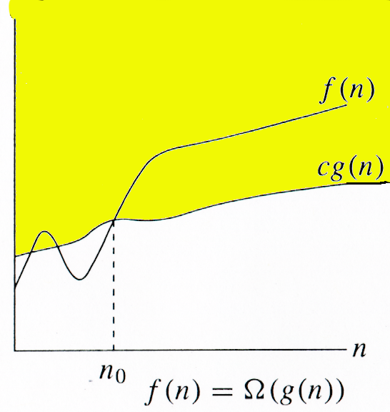
Big-Omega Notation (Ω)
f(n) ∈ Ω(g(n))
∃ c > 0, ∃ n₀ > 0 , ∀n ≥ n₀, f(n) ≥ c.g(n)
g(n) is an asymptotically lower bound for f(n).
Note the duality rule: t(n)∈Ω(f(n)) ≡ f(n)∈O(t(n))

Slide 20
Example
Prove that 3n + 2 = Ω(n)
Proof:
Assume that f(n) = 3n + 2 , and g(n) = n
f(n) = Ω(g(n)) ?
We have to find the existence of c and n₀ such that
c.g(n) ≤ f(n) for all n ≥ n₀
c.n ≤ 3n + 2
At R.H.S a positive term is being added to 3n, which will make L.H.S ≤ R.H.S for all values of n, when c = 3.
Hence f(n) = Ω(g(n)), for c = 3 and n₀= 1

Slide 21
Example
Prove that 5.n² = Ω(n)
Proof:
Assume that f(n) = 5.n² , and g(n) = n
f(n) = Ω(g(n)) ?
We have to find the existence of c and n₀ such that
c.g(n) ≤ f(n) for all n ≥ n₀
c.n ≤ 5.n² ➔ c ≤ 5.n
if we take, c = 5 and n₀= 1 then
c.n ≤ 5.n² for all n ≥ n₀
Hence f(n) = Ω(g(n)), for c = 5 and n₀= 1

Slide 22
Example
Prove that 5n² + 2n - 3 = Ω(n²)
Proof:
Assume that f(n) = 5n² + 2n - 3, and g(n) = n²
f(n) = Ω(g(n)) ?
We have to find the existence of c and n₀ such that
c.g(n) ≤ f(n) for all n ≥ n₀
c.n² ≤ 5.n² + 2n - 3
We can take c = 5, given that 2n-3 is always positive.
2n-3 is always positive for n ≥ 2. Therefore n₀ = 2.
And hence f(n) = Ω(g(n)), for c = 5 and n₀= 2

Slide 23
Example
Prove that 100.n + 5 = Ω(n²)
Proof:
Let f(n) = 100.n + 5, and g(n) = n²
Assume that f(n) = Ω(g(n)) ?
Now if f(n) = Ω(g(n)) then there exist c and n₀ such that
c.g(n) ≤ f(n) for all n ≥ n₀
c.n² ≤ 100.n + 5
For the above inequality to hold meaning f(n) grows faster than g(n).
But which means g(n) is growing faster than f(n)
And hence f(n) ≠ Ω(g(n))

Slide 24
Theta Notation (Θ)
If f, g: N → R⁺, then we can define Big-Theta as
We may write f(n) = Θ(g(n)) OR f(n) ∈ Θ(g(n))
Intuitively: Set of all functions that have same rate of growth as g(n).
When a problem is Θ(n), this represents both an upper and lower bound i.e. it is O(n) and Ω(n) (no algorithmic gap)

Slide 25
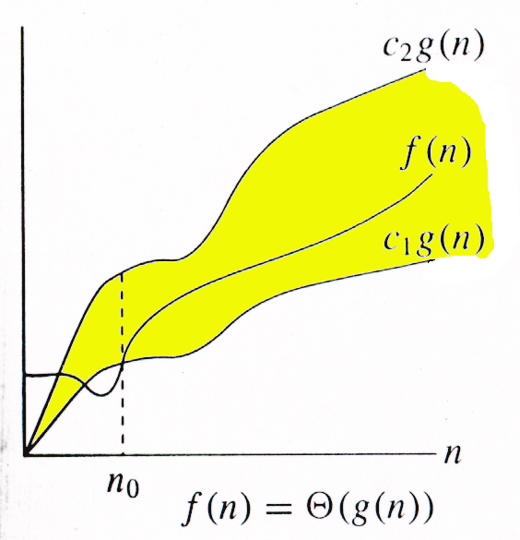
Theta Notation (Θ)
f(n) ∈ Θ(g(n))
∃ c₁> 0, c₂> 0, ∃ n₀ > 0, ∀ n ≥ n₀, c_{2.}g(n) ≤ f(n) ≤ c_{1.}g(n)
We say that g(n) is an asymptotically tight bound for f(n).

Slide 26
Example
Prove that ½.n² – ½.n = Θ(n²)
Proof:
Assume that f(n) = ½.n² – ½.n, and g(n) = n²
f(n) = Θ(g(n))?
We have to find the existence of c₁, c₂ and n₀ such that
c₁.g(n) ≤ f(n) ≤ c₂.g(n) for all n ≥ n₀
Since, ½ n² - ½ n ≤ ½ n² then c₂= ½ ,∀n ≥ 0 and
Since ½ n is subtracted from ½ n² , c₁ must be less than ½,
Assuming c₁= ¼ ➔ ¼ n² ≤ ½ n² - ½ n ➔ ∀n ≥ 2
c₁.g(n) ≤ f(n) ≤ c₂.g(n) ∀n ≥ 2, c₁= ¼, c₂ = ½
Hence f(n) = Θ(g(n)) ⇒ ½.n² – ½.n = Θ(n²)

Slide 27
Example
Prove that 2.n² + 3.n + 6 ≠ Θ(n³)
Proof: Let f(n) = 2.n² + 3.n + 6, and g(n) = n³
we have to show that f(n) ≠ Θ(g(n))
On contrary assume that f(n) ∈ Θ(g(n)) i.e. there exist some positive constants c₁, c₂ and n₀ such that:
c₁.g(n) ≤ f(n) ≤ c₂.g(n)
Solve for c₂:
f(n) ≤ c₂.g(n) ➔ 2n² + 3n + 6 ≤ 2n² + 3n² + 6n² ≤ c₂n³ ➔ c = 11 and n₀= 1
Solve for c₁:
c₁.g(n) ≤ f(n) ➔ c₁n³ ≤ 2n² + 3n + 6 ➔ c₁n³ ≤ 2n² ≤ 2n² + 3n + 6
c₁.n ≤ 2, for large n this is not possible
Hence f(n) ≠ Θ(g(n)) ⇒ 2.n² + 3.n + 6 ≠ Θ(n³)

Slide 28
Example from the book
Prove that ½.n² – 3.n = Θ(n²)
Proof
Let f(n) = ½.n² – 3.n, and g(n) = n² f(n) = Θ(g(n))?
We have to find the existence of c₁, c₂ and n₀ such that
c₁.g(n) ≤ f(n) ≤ c₂.g(n) ∀ n ≥ n₀
c₁. n² ≤ ½.n² – 3.n ≤ c₂. n²
Since, ½ n² - 3 n ≤ ½ n² ∀n ≥ 1 if c₂= ½ and
½ n² - 3 n ≥ 1/4 n² ( ∀n ≥ 6 ), c₁= ¼
c₁.g(n) ≤ f(n) ≤ c₂.g(n) ∀n ≥ 6, c₁= ¼, c₂ = ½
Hence f(n) = Θ(g(n)) ⇒ ½.n² – 3.n = Θ(n²)

Slide 29
Little-Oh Notation
o-notation is used to denote a upper bound that is not asymptotically tight.
f(n) becomes insignificant relative to g(n) as n approaches infinity. g(n) is an upper bound for f(n), not asymptotically tight

Slide 30
Example
Prove that 2n² = o(n³)
Proof:
Assume that f(n) = 2n² , and g(n) = n³
f(n) = o(g(n)) ?
Now we have to find the existence n₀ for any c
f(n) < c.g(n) this is true
2n² < c.n³ ➔ 2 < c.n
This is true for any c, because for any arbitrary c we can choose n₀ such that the above inequality holds.
Hence f(n) = o(g(n))

Slide 31
Example
Prove that n² ≠ o(n²)
Proof:
Assume that f(n) = n² , and g(n) = n²
Now we have to show that f(n) ≠ o(g(n))
Since
f(n) < c.g(n) ➔ n² < c.n² ➔ 1 ≤ c,
In our definition of small o, it was required to prove for any c but here there is a constraint over c .
Hence, n² ≠ o(n²), where c = 1 and n₀= 1

Slide 32
Little-Omega Notation
Little-ω notation is used to denote a lower bound that is not asymptotically tight.
f(n) becomes arbitrarily large relative to g(n) as n
approaches infinity

Slide 33
Example
Prove that 5.n² = ω(n)
Proof:
Assume that f(n) = 5.n² , and g(n) = n
f(n) = Ω(g(n)) ?
We have to prove that for any c there exists n₀ such that
c.g(n) < f(n) for all n ≥ n₀
c.n < 5.n² ➔ c < 5.n
This is true for any c, because for any arbitrary c e.g. c = 1000000, we can choose n₀ = 1000000/5 = 200000 and the above inequality does hold.
And hence f(n) = ω(g(n))

Slide 34
Example
Prove that 5.n + 10 ≠ ω(n)
Proof:
Assume that f(n) = 5.n + 10, and g(n) = n
f(n) ≠ Ω(g(n)) ?
We have to find the existence n₀ for any c, such that
c.g(n) < f(n) for all n ≥ n₀
c.n < 5.n + 10, if we take c = 16 then
16.n < 5.n + 10 ➔ 11.n < 10 is not true for any positive integer.
Hence f(n) ≠ ω(g(n))

Slide 35
Example
Prove that 100.n ≠ ω(n²)
Proof:
Let f(n) = 100.n, and g(n) = n²
Assume that f(n) = ω(g(n))
Now if f(n) = ω(g(n)) then there n₀ for any c such that
c.g(n) < f(n) for all n ≥ n₀
c.n² < 100.n ➔ c.n < 100
If we take c = 100, n < 1, not possible
Hence f(n) ≠ ω(g(n)) i.e. 100.n ≠ ω(n²)

Slide 36
Asymptotic Functions Summary
If f(n) = Θ(g(n)) we say that f(n) and g(n) grow at the same rate, asymptotically
If f(n) = O(g(n)) and f(n) ≠ Ω(g(n)), then we say that f(n) is asymptotically slower growing than g(n).
If f(n) = Ω(g(n)) and f(n) ≠ O(g(n)), then we say that f(n) is asymptotically faster growing than g(n).

Slide 37
Usefulness of Notations
It is not always possible to determine behaviour of an algorithm using Θ -notation.
For example, given a problem with n inputs, we may have an algorithm to solve it in a.n² time when n is even and c.n time when n is odd. OR
We may prove that an algorithm never uses more than e.n² time and never less than f.n time.
In either case we can neither claim Θ(n) nor Θ(n²) to be the order of the time usage of the algorithm.
Big O and Ω notation will allow us to give at least partial information

Slide 38
Usefulness of Notations
To express the efficiency of our algorithms which of the three notations should we use?
As computer scientist we generally like to express our algorithms as big O since we would like to know the upper bounds of our algorithms.
Why?
If we know the worse case then we can aim to improve it and/or avoid it.

Slide 39
Usefulness of Notations
Even though it is correct to say “7n - 3 is O(n³)”, a better statement is “7n - 3 is O(n)”, that is, one should make the approximation as tight as possible
Simple Rule:
Drop lower order terms and constant factors
7n-3 is O(n)
8n²log n + 5n² + n is O(n²log n)
Strictly speaking this use of the equals sign is incorrect
the relationship is a set inclusion, not an equality
f(n) ∈ O(g(n)) is better

Slide 40
Big Oh Does Not Tell the Whole Story
Question?
If two algorithms A and B have the same asymptotic complexity, say O(n²), will the execution time of the two algorithms always be same?
How to select between the two algorithms having the same asymptotic performance?
Answer:
They may not be the same. There is this small matter of the constant of proportionality.
Suppose that A does ten operations for each data item, but algorithm B only does three.
It is reasonable to expect B to be faster than A even though both have the same asymptotic performance. The reason is that asymptotic analysis ignores constants of proportionality.
Notes:
Suppose you have a choice of two approaches to writing a program. Both approaches have the same asymptotic performance (for example, both are O(n lg(n)).
Why select one over the other, they're both the same, right?
They may not be the same. There is this small matter of the constant of proportionality. Suppose algorithms A and B have the same asymptotic performance,
TA(n) = TB(n) = O(g(n)).
Now suppose that A does ten operations for each data item, but algorithm B only does three. It is reasonable to expect B to be faster than A even though both have the same asymptotic performance. The reason is that asymptotic analysis ignores constants of proportionality.

Slide 41
Big Oh Does Not Tell the Whole Story
Algorithm_A {
set up the algorithm; /*taking 50 time units*/
read in n elements into array A; /* 3 units per element */
for (i = 0; i < n; i++) {
do operation1 on A[i]; /* takes 10 units */
do operation2 on A[i]; /* takes 5 units */
do operation3 on A[i]; /* takes 15 units */
}
}
TA(n) = 50 + 3n + (10 + 5 + 15)*n
= 50 + 33*n
Algorithm_B {
set up the algorithm; /*taking 200 time units*/
read in n elements into array A; /* 3 units per element */
for (i = 0; i < n; i++) {
do operation1 on A[i]; /* takes 10 units */
do operation2 on A[i]; /* takes 5 units */
}
}
TB(n) = 200 + 3n + (10 + 5)*n
= 200 + 18*n

Slide 42
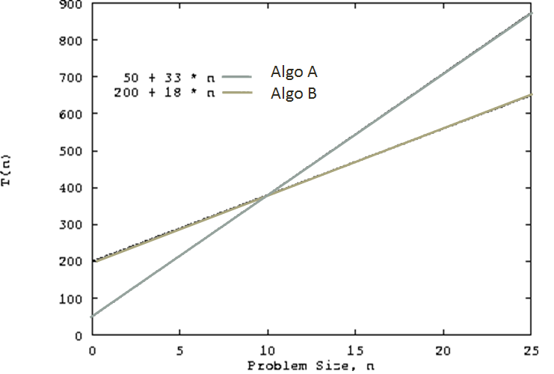
Big Oh Does Not Tell the Whole Story
Both algorithms have time complexity O(n).
Algorithm A sets up faster than B, but does more operations on the data
Algorithm A is the better choice for small values of n.
For values of n > 10, algorithm B is the better choice

Slide 43
A Misconception
A common misconception is that worst case running time is somehow defined by big-Oh, and that best case is defined by big-Omega.
There is no formal relationship like this.
However, worst case and big-Oh are commonly used together, because they are both techniques for finding an upper bound on running time.

Slide 44
Relations over Asymptotic Notations
Maximum rule: O(f(n)+g(n)) = O( max(f(n),g(n)) )
Additive and Multiplicative Property:
If e(n) = O(g(n)) & f(n) = O(h(n)) then e(n) + f(n) = O(g(n) + h(n))
If e(n) = O(g(n)) & f(n) = O(h(n)) then e(n) • f(n) = O(g(n) • h(n))
Dichotomy Property: If f(n) = O(g(n)) & g(n) = O(f(n)) then f(n) = Θ(g(n))
If f(n) = Ω(g(n)) and g(n) = Ω(f(n)) then f(n) = Θ(g(n))
Reflexive Property: If f(n) = O(f(n)) and f(n) = Ω(f(n)) and f(n) = Θ(f(n))
f(n) ≠ o(f(n)) and f(n) ≠ ω(f(n))
Symmetry over Θ: f(n) = Θ(g(n)) ⇔ g(n) = Θ(f(n))
Transitivity Property:
f(n) = Θ(g(n)) & g(n) = Θ(h(n)) ⇒ f(n) = Θ(h(n))
f(n) = O(g(n)) & g(n) = O(h(n)) ⇒ f(n) = O(h(n))
f(n) = Ω(g(n)) & g(n) = Ω(h(n)) ⇒ f(n) = Ω(h(n))
f(n) = o (g(n)) & g(n) = o (h(n)) ⇒ f(n) = o (h(n))
f(n) = ω(g(n)) & g(n) = ω(h(n)) ⇒ f(n) = ω(h(n))

