Slide 1
CSC 301 – Design and Analysis of Algorithms
Instructor: Dr. M. Hasan Jamal
Lecture# 01(c): Growth Rate and Complexity Classes

Slide 2
Comments on RAM Model
It makes poor assumption that each basic operation takes constant time.
Adding, Multiplying, Comparing etc.
However, regardless of its weaknesses, RAM model is not so bad because
We require comparison, not absolute analysis of any algorithm.
We require dealing with large inputs, not small size inputs
RAM model seems to work well describing computational power of modern nonparallel machines

Slide 3
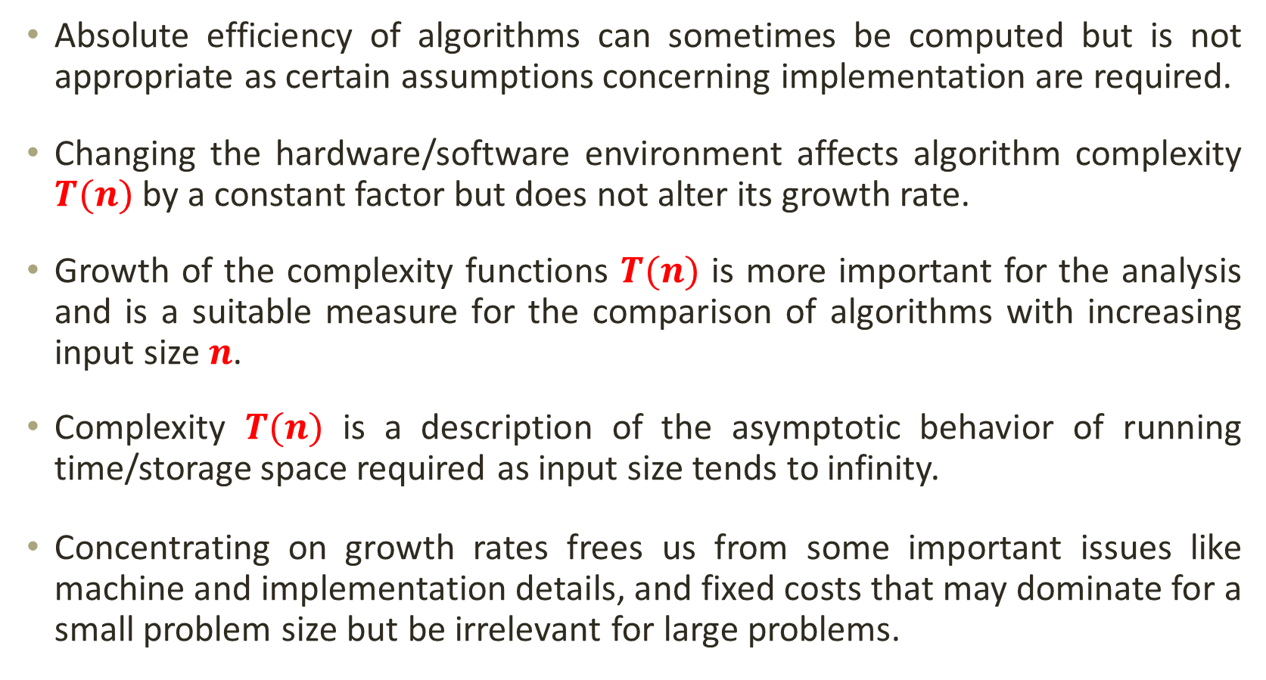
Growth Rate of Algorithms
Absolute efficiency of algorithms can sometimes be computed but is not appropriate as certain assumptions concerning implementation are required.
Changing the hardware/software environment affects algorithm complexity $T(n)$ by a constant factor but does not alter its growth rate.
Growth of the complexity functions $T(n)$ is more important for the analysis and is a suitable measure for the comparison of algorithms with increasing input size $n$.
Complexity $T(n)$ is a description of the asymptotic behavior of running time/storage space required as input size tends to infinity.
Concentrating on growth rates frees us from some important issues like machine and implementation details, and fixed costs that may dominate for a small problem size but be irrelevant for large problems.

Slide 4
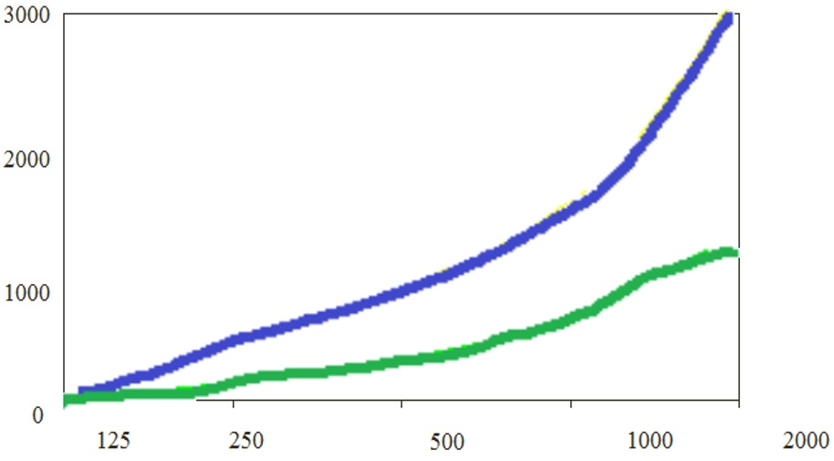


Growth Rate of Algorithms
Example: Running time to sort array of 2000 integers.
Computer Type | Desktop | Server | Mainframe | Supercomputer
Time (sec) | 51.95 | 11.58 | 0.43 | 0.09
$$f_{1}\left(n\right)=0.0007772n^{2}+0.00305n+0.001$$
$$f_{2}\left(n\right)=0.0001724n^{2}+0.00040n+0. 100$$
Array Size | Desktop | Server
125 | 12.5 | 2.8
250 | 49.3 | 11.0
500 | 195.8 | 43.4
1000 | 780.3 | 172.9
2000 | 3114.9 | 690.5
$$f_{1}\left(n\right)$$
$$f_{2}\left(n\right)$$

Slide 5
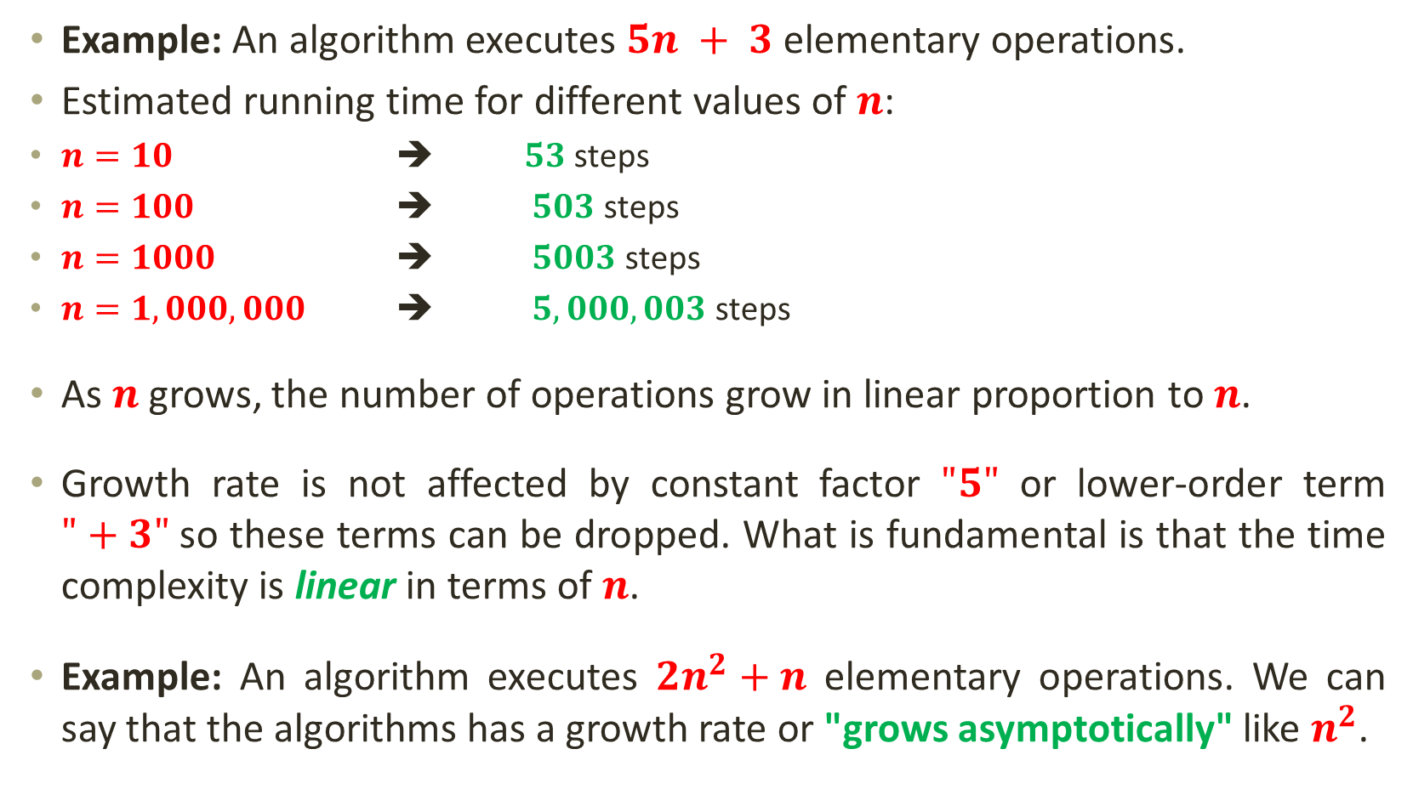
Growth Rate of Algorithms
Example: An algorithm executes $5n + 3$ elementary operations.
Estimated running time for different values of $n$:
$n=10$ ➔ $53$ steps
$n=100$ ➔ $503$ steps
$n=1000$ ➔ $5003$ steps
$n=1,000,000$ ➔ $5,000,003$ steps
As $n$ grows, the number of operations grow in linear proportion to $n$.
Growth rate is not affected by constant factor $"5"$ or lower-order term $"+3"$so these terms can be dropped. What is fundamental is that the time complexity is linear in terms of $n$.
Example: An algorithm executes $2n^{2}+n$ elementary operations. We can say that the algorithms has a growth rate or "grows asymptotically" like $n^{2}$.
Notes:
$"+3“$ becomes insignificant as $n$gets large
As per RAM Model, $"5“$ is inaccurate as different operations require varying amount of time and does not have any significant importance.

Slide 6
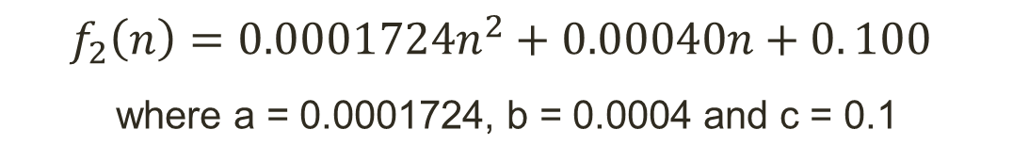
Growth Rate of Algorithms
$$f_{2}\left(n\right)=0.0001724n^{2}+0.00040n+0. 100$$
where a = 0.0001724, b = 0.0004 and c = 0.1
n | f(n) | a n² | % of n²
125 | 2.84 | 2.69 | 94.7
250 | 10.98 | 10.78 | 98.2
500 | 43.4 | 43.1 | 99.3
1000 | 172.9 | 172.4 | 99.7
2000 | 690.5 | 689.6 | 99.9

Slide 7
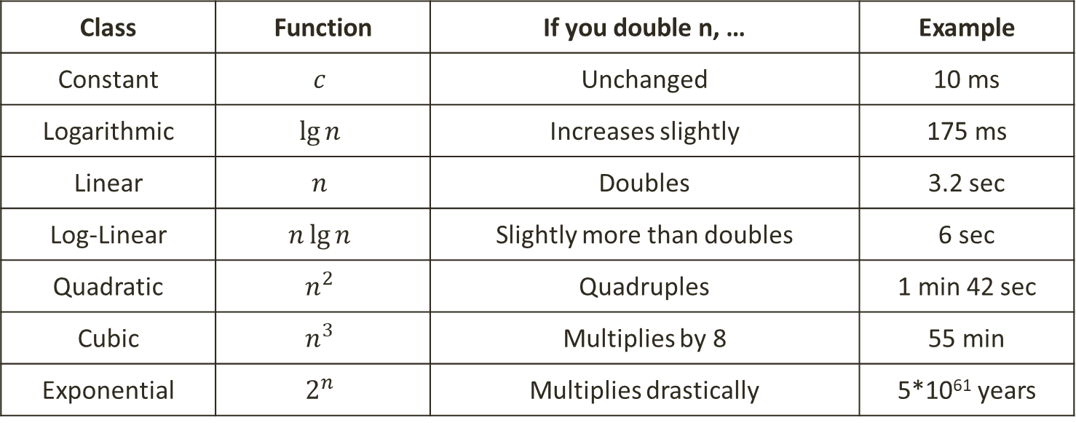
Growth Rate of Algorithms
Complexity Class: A category of algorithm efficiency based on the algorithm’s relationship to the input size $n$.
Class | Function | If you double n, … | Example
Constant | $$c$$ | Unchanged | 10 ms
Logarithmic | $$\lg{n}$$ | Increases slightly | 175 ms
Linear | $$n$$ | Doubles | 3.2 sec
Log-Linear | $$n\lg{n}$$ | Slightly more than doubles | 6 sec
Quadratic | $$n^{2}$$ | Quadruples | 1 min 42 sec
Cubic | $$n^{3}$$ | Multiplies by 8 | 55 min
Exponential | $$2^{n}$$ | Multiplies drastically | 5*10⁶¹ years

Slide 8
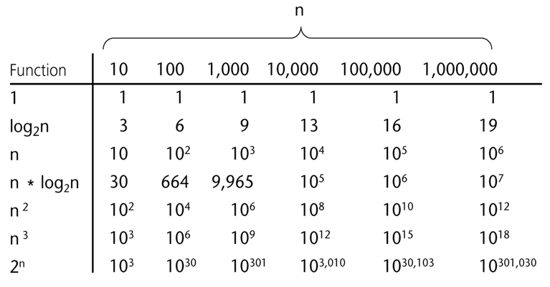

Growth Rate of Algorithms
Why analyze algorithms for large value of $n$?
What happens if we increase the input size $n$?

Slide 9
Growth Rate of Algorithms

Slide 10
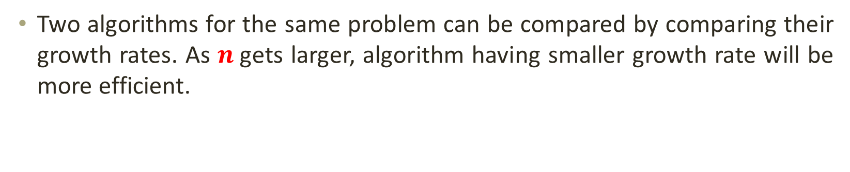
Growth Rate of Algorithms
Two algorithms for the same problem can be compared by comparing their growth rates. As $n$gets larger, algorithm having smaller growth rate will be more efficient.
0.05 N²
3N
Time (steps)
Input (size)
N = 60

