Slide 1
CSC 301 – Design and Analysis of Algorithms
Instructor: Dr. M. Hasan Jamal
Lecture# 04: Recurrences

Slide 2
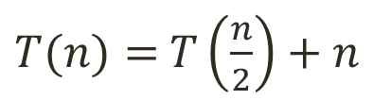
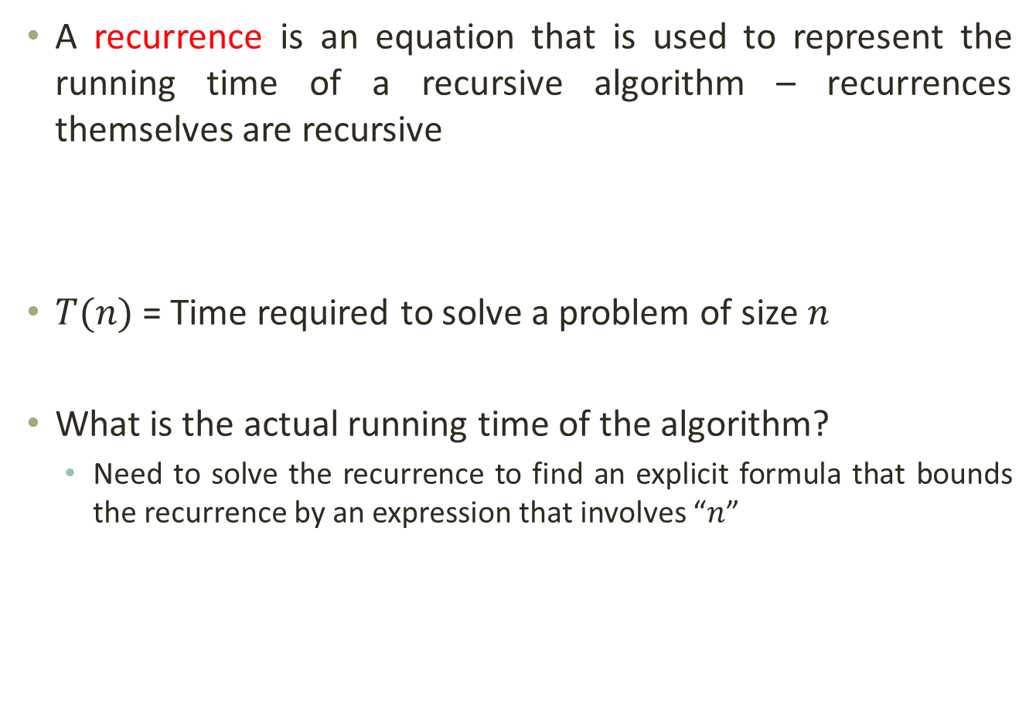
Recurrences and Running Time
A recurrence is an equation that is used to represent the running time of a recursive algorithm – recurrences themselves are recursive
$T(n)$ = Time required to solve a problem of size $n$
What is the actual running time of the algorithm?
Need to solve the recurrence to find an explicit formula that bounds the recurrence by an expression that involves “$n$”
$T(n)=$ $T\left(\frac{n}{2}\right)+n$

Slide 3

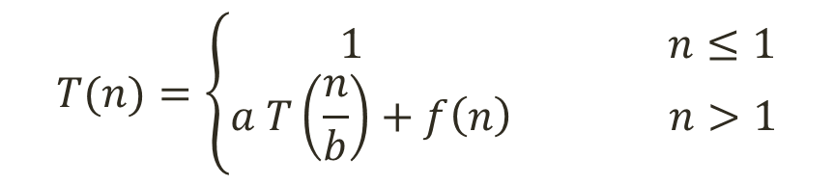
Recurrences and Running Time
A recursive method that calls itself recursively has two cases:
Recursive Case
Base Case
a is the number of times a function calls itself
b is the factor by which the input size is reduced
f(n) is the runtime of each function usually expressed in terms of Θ.
The base case is usually dropped from the definition. i.e.
$$T(n)=\left\{\begin{aligned} 1 n≤1 \\ a T\left(\frac{n}{b}\right)+f\left(n\right) n>1\end{aligned}\right.$$
$T(n)=$ $a T\left(\frac{n}{b}\right)+f\left(n\right)$

Slide 4

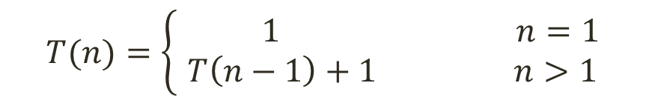
Recurrences Example: Factorial
n!, for any positive integer n, is defined to be the product of all integers between 1 and n inclusive.
factorial(n){
if (n == 0)
return 1;
else
return (n * factorial (n-1));
}
The recurrence for this problem is:
or simply:
$$T(n)=\left\{\begin{aligned} 1 n=1 \\ T\left(n−1\right)+1 n>1\end{aligned}\right.$$
$T(n)=$ $T\left(n−1\right)+1$

Slide 5
Recurrences Example: Exponentiation
Exponentiation is an operation involving two numbers, the base x and the exponent or power n, written as x^{n}, assuming n ≥ 0
Exp(x, n){
if (n == 0)
return 1;
else
return (x * Exp(x, n-1));
}
The recurrence for this problem is:
or simply:
$$T(n)=\left\{\begin{aligned} 1 n=1 \\ T\left(n−1\right)+1 n>1\end{aligned}\right.$$
$T(n)=$ $T\left(n−1\right)+1$

Slide 6
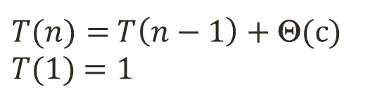
Running Time of a Recurrence
Recursive algorithm to find the minimum number in the array:
FindMinRec(A[], n){
1. if (n == 1)
2. return A[0];
3. else
4. return min(A[n-1], FindMinRec(A[], n-1));
}
Now, let’s count the number of comparisons.
Steps 1 and 2 will run in constant time Θ(c).
In Step 4, the recursive call will run on an input of size n-1 with runtime of T(n-1). The min operation will run in constant time Θ(c)
The recurrence for this problem will be:
$T(n)=$ $T\left(n−1\right)+\text{Θ}$(c)
$T(1)$ $=1$

Slide 7
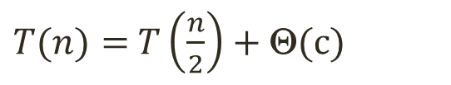
Recurrences Example: Binary Search
Given a sorted array A, determine if x is in the array.
BinarySearch(A, lo, hi, x){
if (lo >hi)
return -1
mid ← ⎣(lo + hi)/2⎦
if (x == A[mid])
return mid
if ( x < A[mid])
BinarySearch(A, lo, mid-1, x)
if ( x > A[mid])
BinarySearch(A, mid+1, hi, x)
}
The recurrence for this problem is:
1
2
3
4
5
6
7
8
2
3
5
7
9
10
11
12
lo
mid
hi
same problem of size n/2
same problem of size n/2
$T(n)=$ $T\left(\frac{n}{2}\right)+\text{Θ}$(c)

Slide 8
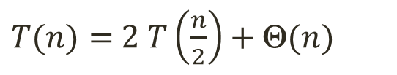
Recurrences Example: Merge Sort
Sorting an array A using Merge Sort
MergeSort(A, p, r){
if (p < r){
q = floor((p + r) / 2);
MergeSort(A, p, q);
MergeSort(A, q + 1, r);
Merge(A, p, q, r);
}
}
The recurrence for this problem will be:
Similarly, we have same recurrence equation for Quick Sort.
same problem of size n/2
same problem of size n/2
n operations per iteration
$T(n)=$ $2 T\left(\frac{n}{2}\right)+\text{Θ}$($n$)

Slide 9
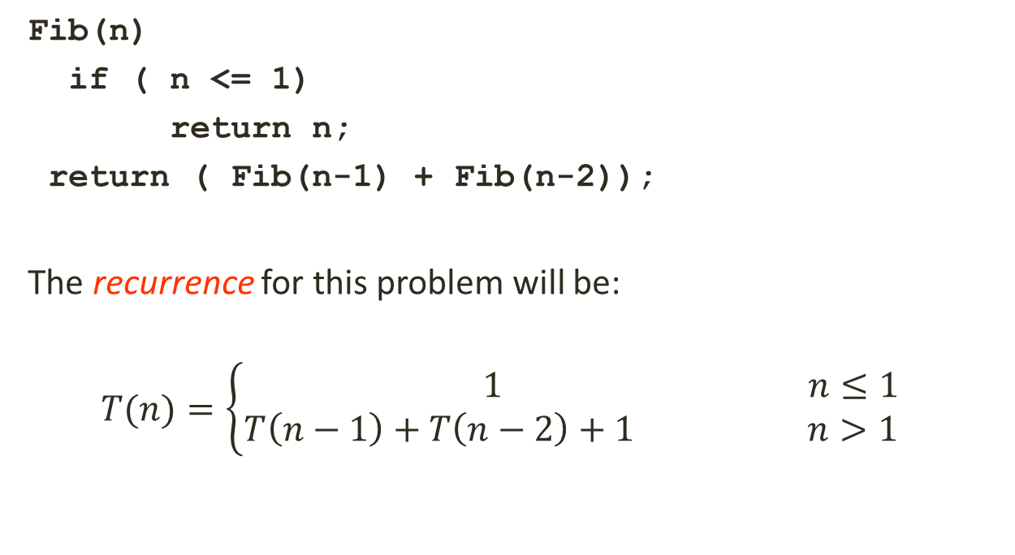
Recurrences Example: Fibonacci Sequence
Each number equals the sum of the two numbers before it, starting from 0 and 1
Fib(n)
if ( n <= 1)
return n;
return ( Fib(n-1) + Fib(n-2));
The recurrence for this problem will be:
$$T(n)=\left\{\begin{aligned} 1 n≤1 \\ T\left(n−1\right)+T\left(n−2\right)+1 n>1\end{aligned}\right.$$
9

Slide 10
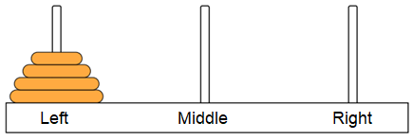
Towers of Hanoi Puzzle
Given: Three posts labeled “Left”, “Middle”, “Right” and N disks placed in order on the “Left” post.
Goal: Move all the disks on the “Left” post to the “Right” post, while preserving the original ordering.
Rules:
Only move one disk at a time.
A move is taking one disk from the post and putting it on another post (on top of any other disk).
Cannot put a larger disk on top of a smaller disk.
10

Slide 11
Towers of Hanoi Puzzle: A three disk Solution
For n = 3, the fastest solution is:
Move from Left Post to Right Post
Move from Left Post to Middle Post
Move from Right Post to Middle Post
Move from Left Post to Right Post
Move from Middle Post to Left Post
Move from Middle Post to Right Post
Move From Left Post to Right Post
The minimum required number of moves is 7.
11

Slide 12
Towers of Hanoi Puzzle: A four disk Solution???
12

Slide 13
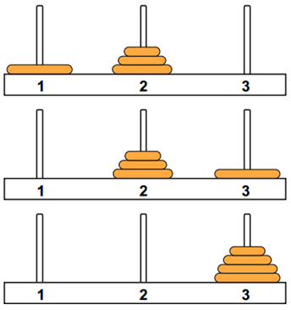
Recursive Algorithm Idea
Final step is to move the largest disk at the bottom from post 1 to post 3.
To do this, the other n-1 disks must be on post 2.
So we need a way to move n-1 disks from post 1 to post 2.
Base Case: moving the smallest disk is easy (you can always move it to any post in one step).
Step 1: Move top n-1 disks to post 2
Step 2: Move the largest disk to post 3
Step 3: Move n-1 disks from post 2 to post 3
13

Slide 14
Recursive Algorithm Idea
Step 1 is really the same problem, with fewer disks and a different target post.
“Move n-1 disks from post 1 to post 2”
And Step 3 is also the same problem, with fewer disks and different starting and target post.
“Move n-1 disks from post 2 to post 3”
So this is a recursive algorithm.
The terminal case is moving the smallest disk – can move directly without using third post.
Number disks from 1 (smallest) to n (largest).
14

Slide 15
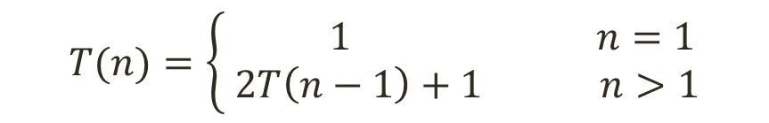
Towers of Hanoi Puzzle: Pseudocode
MoveDisk(count, startPost, endPost, midPost){
if (count == 1){
move directly;
}
else {
// Move top n-1 disks to mid post
MoveDisk(count-1, startPost, midPost, endPost);
// Move the largest disk to end post
MoveDisk(1, startPost, endPost, midPost);
// Move top n-1 disks from mid post to end post
MoveDisk(count-1, midPost, endPost, startPost);
}
}
Recurrence equation:
15
$$T(n)=\left\{\begin{aligned} 1 n=1 \\ 2T\left(n−1\right)+1 n>1\end{aligned}\right.$$

Slide 16
Towers of Hanoi Puzzle: Analysis
Disks Required Moves
1 1
2 3
3 7
4
5
:
n
15
Time Complexity: O(2^{n})
31
:
2^{n} – 1
Some problems are computationally too difficult to solve in reasonable amount of time.
While an effective algorithm exists, we still don’t have the time to wait for its completion.
16

Slide 17
Methods for Solving Recurrences
Substitution Method
Recursion Tree Method
Master Method

