Slide 1
CSC 301 – Design and Analysis of Algorithms
Instructor: Dr. M. Hasan Jamal
Lecture# 04(b): Substitution Method
Slides adapted from D. Diochnos and J. Verschelde
http://homepages.math.uic.edu/~jan/mcs360f10

Slide 2
Substitution Method
Substitution method for solving recurrences consists of two steps:
Guess the form of the solution, i.e. T(n) = O(g(n)), then
Use mathematical induction to find constants (c and n₀) in the form and show that the solution works
Step 1 (Base step) − Prove that the guess is true for the initial value.
Step 2 (Inductive step) − Prove that if the guess is true for T(k) ≤ c g(k), for all k < n, then this implies that T(n) ≤ c g(n), for some c > 0 and n ≥ n₀
The inductive hypothesis is applied to smaller values, similar like recursive calls bring us closer to the base case.
The substitution method is a powerful way to establish lower or upper bounds on a recurrence.
It is applied in cases when it is easy to guess the form of the solution.

Slide 3



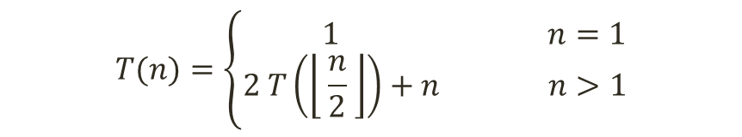








Substitution Method: Merge Sort
$$T(n)=\left\{\begin{aligned} 1 n=1 \\ 2 T\left(\left\lfloor \frac{n}{2} \right\rfloor \right)+n n>1\end{aligned}\right.$$
Guess:
$T(n)=$ $O(n$ lg $n$)
or
$T(n)≤$ c $∙n$ lg $n$, for some constant c and $n_{0}$ $≤$ $n$
Hypothesis:
$T(k)≤$ c $∙k$ lg $k$, for all $k$ $<$ $n$
We will use $k$ $=\frac{n}{2}$
Inductive Step:
$T(n)=$ $2 T\left(\left\lfloor \frac{n}{2} \right\rfloor \right)+$ $n$
$≤$ 2 $∙$c $∙\left(\left\lfloor \frac{n}{2} \right\rfloor \right)$ lg$\left(\left\lfloor \frac{n}{2} \right\rfloor \right)$ + $n$
$≤$ c $∙n$ lg$\left(\left\lfloor \frac{n}{2} \right\rfloor \right)$ + $n$
$=$ c $∙n$ lg$n$ $−$ c $∙n$ lg$2$ + $n$
$=$ c $∙n$ lg$n$ $−$ c $∙n$+$n$
$≤$ c $∙ n$ lg $n$
$if:− \text{c} ∙n \text{+} n≤$ 0 ➔ $\text{c}$ $≥$ 1

Slide 4
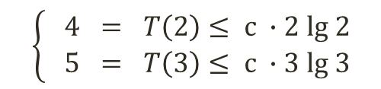
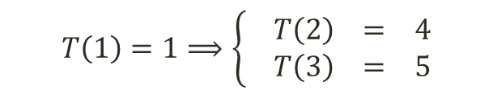
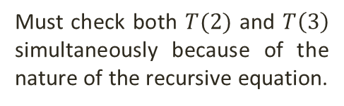
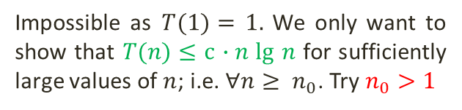



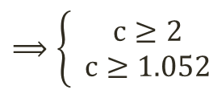
Substitution Method: Merge Sort
$$T(n)=\left\{\begin{aligned} 1 n=1 \\ 2 T\left(\left\lfloor \frac{n}{2} \right\rfloor \right)+n n>1\end{aligned}\right.$$
Guess:
$T(n)=$ $O(n$ lg $n$)
or
$T(n)≤$ c $∙n$ lg $n$, for some constant c and $n_{0}$ $≤$ $n$
Hypothesis:
$T(k)≤$ c $∙k$ lg $k$, for all $k$ $<$ $n$
From Inductive Step:
$T(n)≤$ c $∙n$ lg $n$ when $1$ $≤$ $c$
Impossible as $T(1)=$ $1.$ We only want to show that $T(n)≤$ c $∙n$ lg $n$ for sufficiently large values of $n$; i.e. $∀n≥ n_{0}$. Try $n_{0}>1$
Base Step:
$T(1)≤$ c $∙1∙$lg 1 → $T\left(1\right)=0$
We have:
$$T\left(1\right)=1⟹\left\{ \begin{aligned}T\left(2\right) = 4 \\ T\left(3\right) = 5\end{aligned}\right.$$
We want to satisfy simultaneously
$$\left\{ \begin{aligned}4 = T\left(2\right)≤ \text{c} ∙\text{2} \text{lg} 2 \\ 5 = T\left(3\right)≤ \text{c} ∙\text{3} \text{lg} 3\end{aligned}\right.$$
$$⟹\left\{ \begin{aligned}c≥2 \\ c≥1.052\end{aligned}\right.$$
Must check both $T(2)$ and $T\left(3\right)$ simultaneously because of the nature of the recursive equation.
$$⟹c≥ 2$$
$\text{We} \text{prove} \text{that}$ $T(n)≤$ $c∙n$ lg $n$, with $c\text{ =} 2$and $n_{0}=$ 2, $\text{so} T(n)= O(n \text{lg} n\text{)}$

Slide 5








Substitution Method: Merge Sort
$$T(n)=\left\{\begin{aligned} 1 n=1 \\ 2 T\left(\left\lfloor \frac{n}{2} \right\rfloor \right)+n n>1\end{aligned}\right.$$
Guess:
$T(n)=$ $O(n$)
or
$T(n)≤$ c $∙n$, for some constant c and $n_{0}$ $≤$ $n$
Hypothesis:
$T(k)≤$ c $∙k$, for all $k$ $<$ $n$
We will use $k$ $=\frac{n}{2}$
Inductive Step:
$T(n)=$ $2 T\left(\left\lfloor \frac{n}{2} \right\rfloor \right)+$ $n$
$≤$ 2 $∙$c $∙\left(\left\lfloor \frac{n}{2} \right\rfloor \right)$ + $n$
$=$ c $∙n$ + $n$
$=$ (c $+$ 1) $∙n$
$≰$ c $∙ n$
The above inequality does not hold because $c+1$ cannot be less than $c$.
Hence $T(n)≠$ $O(n$)

Slide 6









Substitution Method: Merge Sort (Lower Bound)
$$T(n)=\left\{\begin{aligned} 1 n=1 \\ 2 T\left(\left\lfloor \frac{n}{2} \right\rfloor \right)+n n>1\end{aligned}\right.$$
We want to show
$T(n)≥$ c $∙n$ lg $n.$
Assume that $n$ is a power of 2. We have:
$T(n)≥$ 2 $∙$c $∙\left(\left\lfloor \frac{n}{2} \right\rfloor \right)$ lg$\left(\left\lfloor \frac{n}{2} \right\rfloor \right)$ + $n$
$=$ c $∙n$ lg$\left(\frac{n}{2}\right)$ + $n$
$=$ c $∙n$ lg$n$ $−$ c $∙n$ lg$2$ + $n$
$=$ c $∙n$ lg$n$ $−$ (c $−1) n$
$≥$ c $∙ n$ lg $n$
$as long as \text{c}$ $≤$ 1
We also want to satisfy the boundary condition ($T\left(2\right)=4$)
$T\left(2\right)≥\text{c} ∙\text{2} \text{lg} \text{2 = 2}∙$c
In other words, it is enough if $\text{c}$ $≤$ 2. By the requirement $\text{c}$ $≤$ 1 for the induction step we choose $\text{c}$ $=$ 1

Slide 7






Substitution Method: Merge Sort (Lower Bound)
$$T(n)=\left\{\begin{aligned} 1 n=1 \\ 2 T\left(\left\lfloor \frac{n}{2} \right\rfloor \right)+n n>1\end{aligned}\right.$$
We will prove that $T(n)$ is strictly increasing.
Assuming for all $k$ $≤$ $n$ it holds $T\left(k\right)>$ $T\left(k−1\right),$we want to show that $T\left(n+1\right)>$ $T\left(n\right)$
For the base case note that
$T\left(1\right)=$ 1 $<$ 4 = $T\left(2\right)$
$T\left(n+1\right)=$ 2 $∙T\left(\left\lfloor \frac{n+1}{2} \right\rfloor \right)$ + $n+1$
$=$ 2 $∙T$ $\left(\frac{n}{2}\right)$ + $n+1$
$=$ T$\left(n\right)$ + $1$
$>$ T(n)
$\text{We} \text{prove} \text{that}$ $T(n)≥$ $c∙n$ lg $n$, with $c\text{ =} 1$and $n_{0}=$ 2, $\text{so} T(n)= Ω(n \text{lg} n\text{)}$

Slide 8












Substitution Method: Quick Sort (Worse Case)
$$T(n)=\left\{\begin{aligned} 1 n=1 \\ T\left(n−1\right)+n n>1\end{aligned}\right.$$
or
Guess:
$T(n)=$ $O(n^{2}$)
$T(n)≤$ c $∙n^{2}$, for some constant c and $n_{0}$ $≤$ $n$
Hypothesis:
$T(k)≤$ c $∙k^{2}$, for all $k$ $<$ $n$
We will use $k$ $=n−1$
Inductive Step:
$T(n)=$ $T\left(n−1\right)+$ $n$
$≤$ c $∙{(n−1)}^{2}$ + $n$
= c $∙(n^{2}−2n+1)$ + $n$
$=$ $\text{c}n^{2}−2\text{c}n+\text{c}$ + $n$
$≤$ c $∙n^{2}$
$if:−2\text{c}n+\text{c}\text{ + }n≤$ 0 ➔ $\text{c}$ $≥$ 1
Base Step:
$T(1)≤$ c $∙{(1)}^{2}$ $⟹ T\left(1\right)≤c$
$\text{We} \text{prove} \text{that}$ $T(n)≤$ $c∙n^{2}$, with $c\text{ =} 1$and $n_{0}=$ 1, $\text{so} T(n)= O(n^{2}\text{)}$

Slide 9
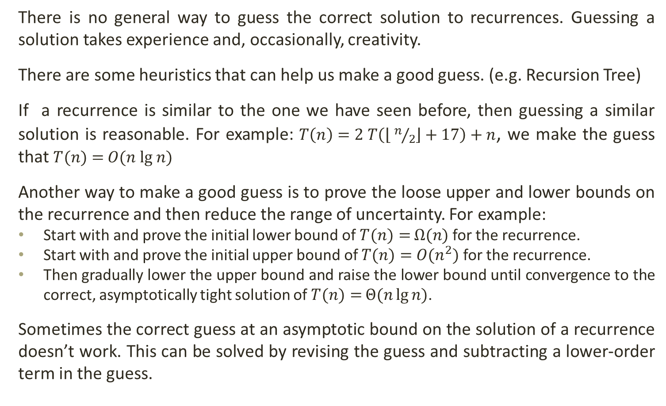
Substitution Method: Making a Good Guess
There is no general way to guess the correct solution to recurrences. Guessing a solution takes experience and, occasionally, creativity.
There are some heuristics that can help us make a good guess. (e.g. Recursion Tree)
If a recurrence is similar to the one we have seen before, then guessing a similar solution is reasonable. For example: $T\left(n\right)=2 T\left(\left\lfloor n/2\right\rfloor +17\right)+n$, we make the guess that $T(n)=$ $O(n$ lg $n$)
Another way to make a good guess is to prove the loose upper and lower bounds on the recurrence and then reduce the range of uncertainty. For example:
Start with and prove the initial lower bound of $T(n)=$ $Ω(n$) for the recurrence.
Start with and prove the initial upper bound of $T(n)=$ $O(n^{2}$) for the recurrence.
Then gradually lower the upper bound and raise the lower bound until convergence to the correct, asymptotically tight solution of $T(n)=$ $Θ(n\lg{n}$).
Sometimes the correct guess at an asymptotic bound on the solution of a recurrence doesn’t work. This can be solved by revising the guess and subtracting a lower-order term in the guess.

Slide 10





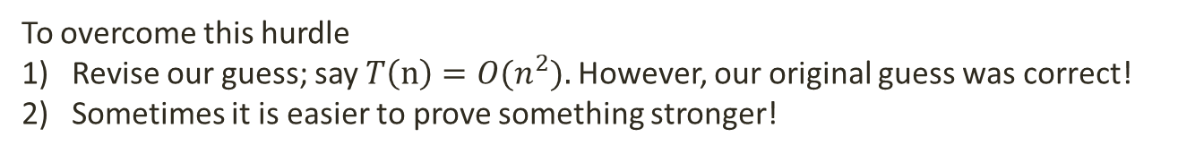
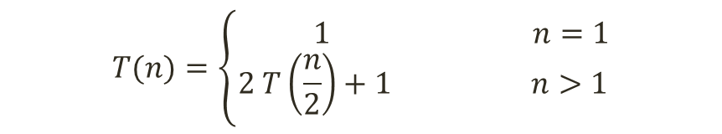

Substitution Method (loose bound)
$$T(n)=\left\{\begin{aligned} 1 n=1 \\ 2 T\left(\frac{n}{2}\right)+1 n>1\end{aligned}\right.$$
or
Guess:
$T(n)=$ $O(n$)
$T(n)≤$ c $∙n$, for some constant c and $n_{0}$ $≤$ $n$
Hypothesis:
$T(k)≤$ c $∙k$, for all $k$ $<$ $n$
We will use $k$ $=\frac{n}{2}$
Inductive Step:
$T(n)=$ $2 T\left(\frac{n}{2}\right)+$ $1$
$≤$ 2 $∙$c $∙\left(\frac{n}{2}\right)$ + $1$
$=$ c $∙n$ + $1$
$≰$ c $∙n$
Which does not imply that $T(n)≤$ c $∙n$, for any c. We need to show the exact form.
To overcome this hurdle
Revise our guess; say $T\left(n\right)=O(n^{2}\text{)}\text{. }$However, our original guess was correct!
Sometimes it is easier to prove something stronger!

Slide 11







Substitution Method (trying a tighter bound)
$$T(n)=\left\{\begin{aligned} 1 n=1 \\ 2 T\left(\frac{n}{2}\right)+1 n>1\end{aligned}\right.$$
Let’s try
Guess:
$T(n)=$ $O(n$).
$T(n)≤$ c $∙n−$ b, where b is another constant.
Hypothesis:
$T(k)≤$ c $∙k−b$, for all $k$ $<$ $n$
We will use $k$ $=\frac{n}{2}$
Inductive Step:
$T(n)=$ $2 T\left(\frac{n}{2}\right)+$ $1$
$≤$ 2 $\left[\text{c}∙\left(\frac{n}{2}\right)−b\right]∙$+ $1$
$=$ c $n$ $−$2b + $1$
$≤$ c $n−b$
$if:−b+1≤$ 0 ➔ $\text{b}$ $≥$ 1
Base Step:
$T(1)≤$ c $∙1−b$ $⟹ 1≤c−b⟹ b≤c$
$\text{We} \text{prove} \text{that}$ $T(n)≤$ $cn−b$, with $c\text{ =} 2, b=1$and $n_{0}=$ 1, $\text{so} T(n)= O(n\text{)}$

Slide 12

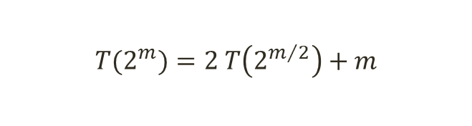





Substitution Method (changing variables)
Consider the recurrence
$$T(n)=2 T\left(\left\lfloor \sqrt{n}\right\rfloor \right)+\lg{n}$$
We can simplify this recurrence with a change of variables.
Rename
$m=$ $\lg{n}$.
We have:
$$T(2^{m})=2 T\left(2^{m/2}\right)+m$$
Define
$$S\left(m\right)=T\left(2^{m}\right).$$
We get:
$$S(m)=2 S\left(\frac{m}{2}\right)+m$$
Hence, the solution is
$$O(m\lg{m}\text{)}\text{,}$$
or with substitution
$$O(\lg{n}∙\lg\left(\lg{n}\right)\text{)}$$

Slide 13








Practice Questions
Apply the substitution method to the given recurrences and show that the given guesses are the solution to these recurrences. Assume $T(1)=1$ as the base case.
$T(n)=$ $T\left(n−1\right)+T\left(n−2\right)+1$
$($Guess: $O(2^{n}\text{)}$)
$T(n)=$ $2T\left(n−1\right)+1$
$($Guess: $O(2^{n}\text{)}$)
$T(n)=$ $3T\left(\frac{n}{4}\right)+n^{2}$
$($Guess: $O(n^{2}\text{)}$)
$T(n)=$ $3T\left(\frac{n}{4}\right)+n$
$($Guess: $O(n\text{)}$)

