Slide 1
CSC 301 – Design and Analysis of Algorithms
Instructor: Dr. M. Hasan Jamal
Lecture# 04(d): Master Method

Slide 2
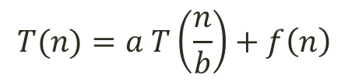
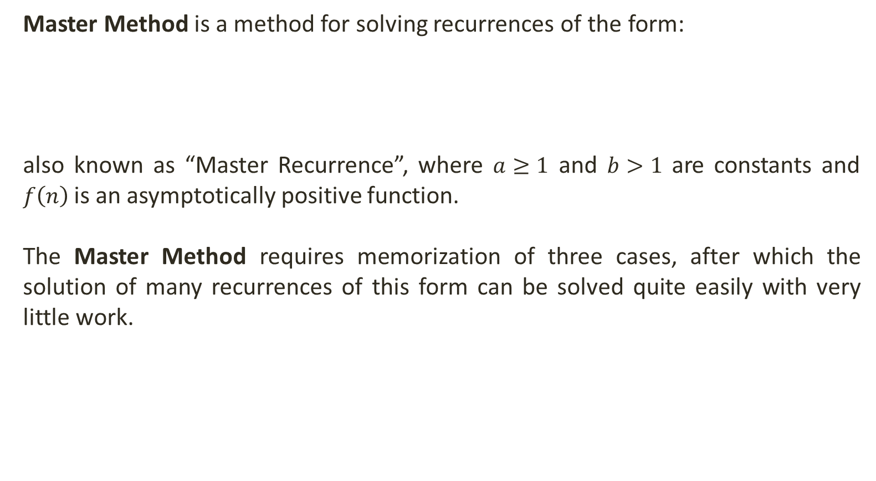
Master Method
Master Method is a method for solving recurrences of the form:
also known as “Master Recurrence”, where $a≥1$ and $b>1$ are constants and $f\left(n\right)$ is an asymptotically positive function.
The Master Method requires memorization of three cases, after which the solution of many recurrences of this form can be solved quite easily with very little work.
$$T(n)=a T\left(\frac{n}{b}\right)+f\left(n\right)$$

Slide 3
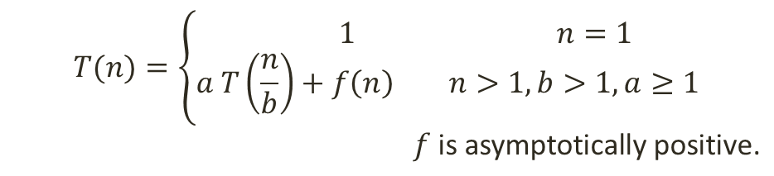

Master Method
Let’s solve the Master Recurrence using the Recurrence Tree Method to see what is going on.
Assumption: $n$ is exact power of b.
$$T(n)=\left\{\begin{aligned} 1 n=1 \\ a T\left(\frac{n}{b}\right)+f\left(n\right) n>1,b>1, a≥1\end{aligned}\right.$$
$f \text{is} \text{asymptotically} \text{positive}\text{.}$

Slide 4



Master Method
f(n)
$$T(n)=a T\left(\frac{n}{b}\right)+f(n)$$
$$\text{. . .}$$
$$T(\frac{n}{b})=a.T(\frac{n}{b^{2}})+f(\frac{n}{b})$$
T(n/b)
T(n/b)
T(n/b)
a

Slide 5







Master Method
f(n)
$$T(n)=a T\left(\frac{n}{b}\right)+f(n)$$
$$\text{. . .}$$
$$T(\frac{n}{b})=a.T(\frac{n}{b^{2}})+f(\frac{n}{b})$$
f(n/b)
f(n/b)
f(n/b)
$$\text{. . .}$$
$$\text{. . .}$$
$$\text{. . .}$$
$$T(\frac{n}{b^{2}})=a.T(\frac{n}{b^{3}})+f(\frac{n}{b^{2}})$$
$T(\frac{n}{b^{2}})$ $T(\frac{n}{b^{2}})$ $T\left(\frac{n}{b^{2}}\right)$
$T(\frac{n}{b^{2}})$ $T(\frac{n}{b^{2}})$ $T\left(\frac{n}{b^{2}}\right)$
$T(\frac{n}{b^{2}})$ $T(\frac{n}{b^{2}})$ $T\left(\frac{n}{b^{2}}\right)$

Slide 6





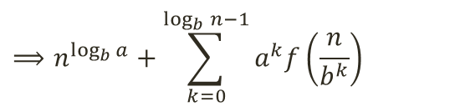








Master Method
f(n)
$$f(n)$$
$$T(n)=a T\left(\frac{n}{b}\right)+f(n)$$
$$\text{. . .}$$
$$af\left(\frac{n}{b}\right)$$
$$T(\frac{n}{b})=a.T(\frac{n}{b^{2}})+f(\frac{n}{b})$$
f(n/b)
f(n/b)
f(n/b)
$$\text{. . .}$$
$$\text{. . .}$$
$$\text{. . .}$$
$$T(\frac{n}{b^{2}})=a.T(\frac{n}{b^{3}})+f(\frac{n}{b^{2}})$$
$$a^{2}f\left(\frac{n}{b^{2}}\right)$$
$$\text{f}\text{(}\text{n}\text{/}\text{b}\text{2}\text{)} \text{f}\text{(}\text{n}\text{/}\text{b}\text{2}\text{)} \text{f}\text{(}\text{n}\text{/}\text{b}\text{2}\text{)}$$
$$\text{f}\text{(}\text{n}\text{/}\text{b}\text{2}\text{)} \text{f}\text{(}\text{n}\text{/}\text{b}\text{2}\text{)} \text{f}\text{(}\text{n}\text{/}\text{b}\text{2}\text{)}$$
$$\text{f}\text{(}\text{n}\text{/}\text{b}\text{2}\text{)} \text{f}\text{(}\text{n}\text{/}\text{b}\text{2}\text{)} \text{f}\text{(}\text{n}\text{/}\text{b}\text{2}\text{)}$$
$$T(\frac{n}{b^{k}})=T(1)$$
…
…
…
…
…
…
…
…
…
…
…
…
…
…
…
…
…
…
…
…
…
…
…
…
…
…
…
…
$$n=b^{k}$$
$$a^{k−1}f\left(\frac{n}{b^{k−1}}\right)$$
$$k=\log_{b}{n}$$
T(1)
T(1)
T(1)
T(1)
T(1)
T(1)
T(1)
T(1)
T(1)
$$L_{c}=a^{k}$$
$$⟹a^{\log_{b}{n}}$$
$$⟹n^{\log_{b}{a}}$$
$$⟹n^{\log_{b}{a}}+\sum_{k=0}^{\log_{b}{n}−1}{a^{k}f\left(\frac{n}{b^{k}}\right)}$$
Total Cost = L_{c} + I_{c}

Slide 7
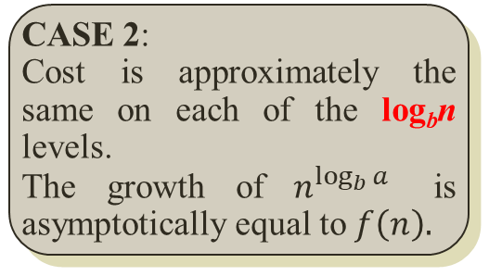

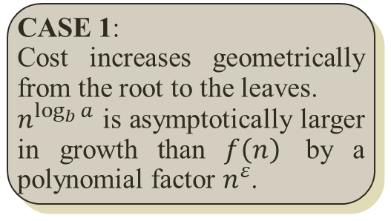
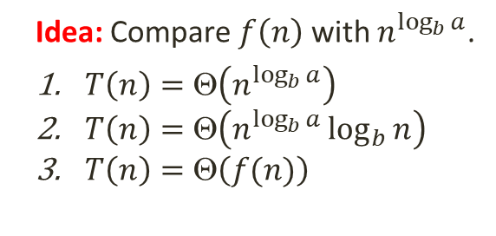
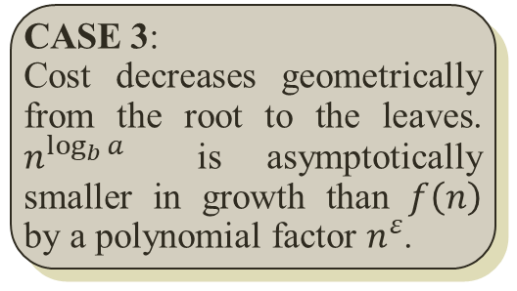
Master Method
f(n)
$$f(n)$$
Idea: Compare $f\left(n\right)$ with $n^{\log_{b}{a}}$.
$T\left(n\right)=\text{Θ}\left(n^{\log_{b}{a}}\right)$
$T\left(n\right)=\text{Θ}\left(n^{\log_{b}{a}}\log_{b}{n}\right)$
$T\left(n\right)=\text{Θ}\left(f(n)\right)$
$$\text{. . .}$$
$$k=\log_{b}{n}$$
f(n/b)
f(n/b)
f(n/b)
$$af\left(\frac{n}{b}\right)$$
$$\text{. . .}$$
$$\text{. . .}$$
$$\text{. . .}$$
$$\text{f}\text{(}\text{n}\text{/}\text{b}\text{2}\text{)} \text{f}\text{(}\text{n}\text{/}\text{b}\text{2}\text{)} \text{f}\text{(}\text{n}\text{/}\text{b}\text{2}\text{)}$$
$$\text{f}\text{(}\text{n}\text{/}\text{b}\text{2}\text{)} \text{f}\text{(}\text{n}\text{/}\text{b}\text{2}\text{)} \text{f}\text{(}\text{n}\text{/}\text{b}\text{2}\text{)}$$
$$\text{f}\text{(}\text{n}\text{/}\text{b}\text{2}\text{)} \text{f}\text{(}\text{n}\text{/}\text{b}\text{2}\text{)} \text{f}\text{(}\text{n}\text{/}\text{b}\text{2}\text{)}$$
$$a^{2}f\left(\frac{n}{b^{2}}\right)$$
…
…
…
…
…
…
…
…
…
…
…
…
…
…
…
…
…
…
…
…
…
…
…
…
…
…
…
…
$$a^{k−1}f\left(\frac{n}{b^{k−1}}\right)$$
T(1)
T(1)
T(1)
T(1)
T(1)
T(1)
T(1)
T(1)
T(1)
CASE 1:
Cost increases geometrically from the root to the leaves.
$n^{\log_{b}{a}}$ is asymptotically larger in growth than $f\left(n\right)$ by a polynomial factor $n^{ε}$.
CASE 2:
Cost is approximately the same on each of the log_{b}n levels.
The growth of $n^{\log_{b}{a}}$ is asymptotically equal to $f\left(n\right).$
CASE 3:
Cost decreases geometrically from the root to the leaves. $n^{\log_{b}{a}}$ is asymptotically smaller in growth than $f\left(n\right)$ by a polynomial factor $n^{ε}$.

Slide 8
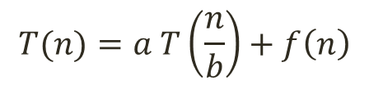
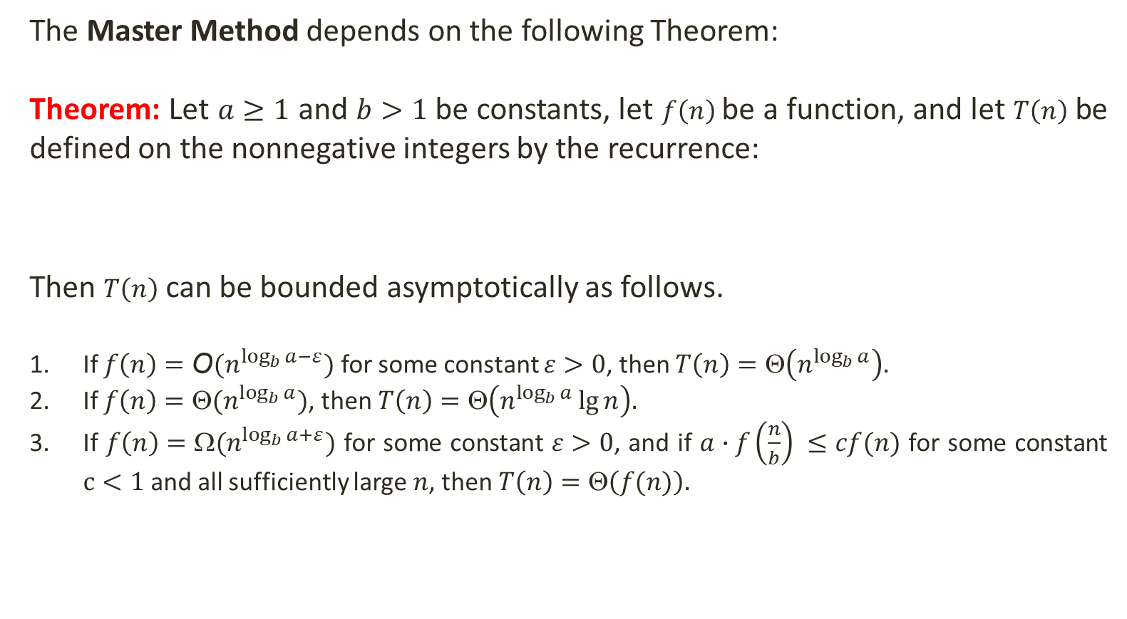
The Master Theorem
The Master Method depends on the following Theorem:
Theorem: Let $a≥1$ and $b>1$ be constants, let $f\left(n\right)$ be a function, and let $T\left(n\right)$ be defined on the nonnegative integers by the recurrence:
Then $T\left(n\right)$ can be bounded asymptotically as follows.
If $f\left(n\right)=\text{O}(n^{\log_{b}{a}−ε})$ for some constant $ε>0$, then $T\left(n\right)=\text{Θ}\left(n^{\log_{b}{a}}\right).$
If $f\left(n\right)=\text{Θ}(n^{\log_{b}{a}})$, then $T\left(n\right)=\text{Θ}\left(n^{\log_{b}{a}}\lg{n}\right).$
If $f\left(n\right)=\text{Ω}(n^{\log_{b}{a}+ε})$ for some constant $ε>0$, and if $a∙f\left(\frac{n}{b}\right) ≤cf(n)$ for some constant $c<1$ and all sufficiently large $n$, then $T\left(n\right)=\text{Θ}\left(f(n)\right).$
$$T(n)=a T\left(\frac{n}{b}\right)+f\left(n\right)$$
regularity condition

Slide 9


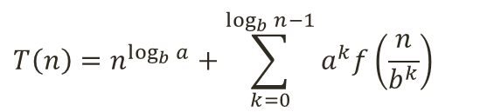
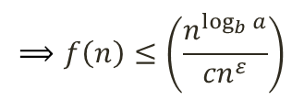
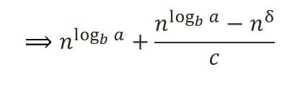
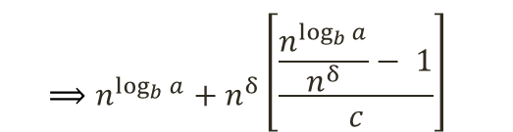

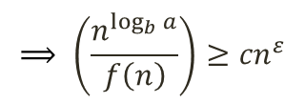
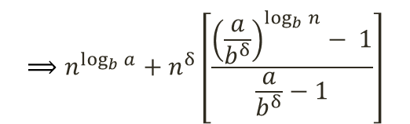
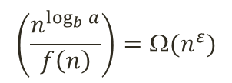
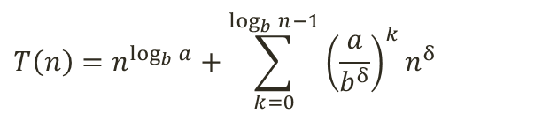

Master Method: Case 1→ $n^{\log_{b}{a}}$ > $f\left(n\right)$
$$\left(\frac{n^{\log_{b}{a}}}{f\left(n\right)}\right)={\text{Ω}(n}^{ε})$$
$$⟹ \left(\frac{n^{\log_{b}{a}}}{f\left(n\right)}\right)≥{cn}^{ε}$$
$$⟹f\left(n\right)≤\left(\frac{n^{\log_{b}{a}}}{{cn}^{ε}}\right)$$
$$⟹f\left(n\right)≤cn^{\log_{b}{a−ε}}$$
$$⟹f\left(n\right)=\text{O}(n^{\log_{b}{a}−ε})$$
$$T\left(n\right)=n^{\log_{b}{a}}+\sum_{k=0}^{\log_{b}{n}−1}{a^{k}f\left(\frac{n}{b^{k}}\right)}$$
Suppose $f\left(n\right)=n^{δ},$ where $δ<\log_{b}{a}$ or $b^{δ}<a.$Then:
$$⟹n^{\log_{b}{a}}+n^{δ}\left[\frac{{\left(\frac{a}{b^{δ}}\right)}^{\log_{b}{n}}− 1}{\frac{a}{b^{δ}}−1}\right]$$
$$⟹n^{\log_{b}{a}}+n^{δ}\left[\frac{\frac{n^{\log_{b}{a}}}{n^{δ}}− 1}{c}\right]$$
$$T\left(n\right)=n^{\log_{b}{a}}+\sum_{k=0}^{\log_{b}{n}−1}{{\left(\frac{a}{b^{δ}}\right)}^{k}n^{δ}}$$
$$⟹n^{\log_{b}{a}}+\frac{n^{\log_{b}{a}}−n^{δ}}{c}$$
$$⟹\text{Θ}\left(n^{\log_{b}{a}}\right)$$
Case 1: If $f\left(n\right)=\text{O}(n^{\log_{b}{a}−ε})$ for some constant $ε>0$, then $T\left(n\right)=\text{Θ}\left(n^{\log_{b}{a}}\right).$

Slide 10

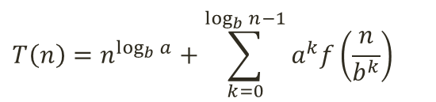



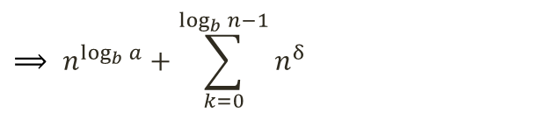


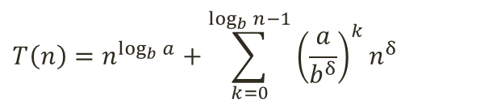

Master Method: Case 2→ $n^{\log_{b}{a}}$ = $f\left(n\right)$
$f\left(n\right)={\text{Θ}(n}^{\log_{b}{a}}$)
$$T\left(n\right)=n^{\log_{b}{a}}+\sum_{k=0}^{\log_{b}{n}−1}{a^{k}f\left(\frac{n}{b^{k}}\right)}$$
Suppose $f\left(n\right)=n^{δ},$ where $δ=\log_{b}{a}$ or $b^{δ}=a.$Then:
$$T\left(n\right)=n^{\log_{b}{a}}+\sum_{k=0}^{\log_{b}{n}−1}{{\left(\frac{a}{b^{δ}}\right)}^{k}n^{δ}}$$
$$⟹ n^{\log_{b}{a}}+\sum_{k=0}^{\log_{b}{n}−1}{n^{δ}}$$
$$⟹n^{\log_{b}{a}}+n^{δ}\log_{b}{n}$$
$$⟹n^{\log_{b}{a}}+n^{\log_{b}{a}}\log_{b}{n}$$
$$⟹n^{\log_{b}{a}}+c∙n^{\log_{b}{a}}\lg{n}$$
$\log_{b}{n}= \frac{\log_{2}{n}}{\log_{2}{b}}$
$$⟹\text{Θ}\left(n^{\log_{b}{a}}\lg{n}\right)$$
Case 2: If $f\left(n\right)=\text{Θ}(n^{\log_{b}{a}})$, then $T\left(n\right)=\text{Θ}\left(n^{\log_{b}{a}}\lg{n}\right).$

Slide 11





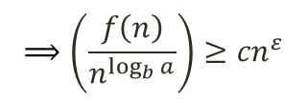
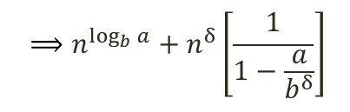
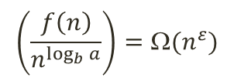
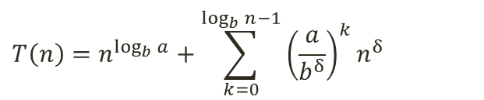

Master Method: Case 3→ $n^{\log_{b}{a}}$ < $f\left(n\right)$
$$\left(\frac{f\left(n\right)}{n^{\log_{b}{a}}}\right)={\text{Ω}(n}^{ε})$$
$$⟹\left(\frac{f\left(n\right)}{n^{\log_{b}{a}}}\right)≥{cn}^{ε}$$
$$⟹f\left(n\right)≥{{cn}^{ε}∙n}^{\log_{b}{a}}$$
$$⟹f\left(n\right)≥cn^{\log_{b}{a+ε}}$$
$$⟹f\left(n\right)=\text{Ω}(n^{\log_{b}{a}+ε})$$
$$T\left(n\right)=n^{\log_{b}{a}}+\sum_{k=0}^{\log_{b}{n}−1}{a^{k}f\left(\frac{n}{b^{k}}\right)}$$
Suppose $f\left(n\right)=n^{δ},$ where $δ>\log_{b}{a}$ or $b^{δ}>a.$Then:
$$T\left(n\right)=n^{\log_{b}{a}}+\sum_{k=0}^{\log_{b}{n}−1}{{\left(\frac{a}{b^{δ}}\right)}^{k}n^{δ}}$$
$$⟹n^{\log_{b}{a}}+n^{δ}\left[\frac{1}{1−\frac{a}{b^{δ}}}\right]$$
$$⟹n^{\log_{b}{a}}+c∙n^{δ}$$
$$⟹\text{Θ}\left(f\left(n\right)\right)$$
Case 3: If $f\left(n\right)=\text{Ω}(n^{\log_{b}{a}+ε})$ for some constant $ε>0$, and if $a∙f\left(\frac{n}{b}\right) ≤cf(n)$ for some constant $c<1$ and all sufficiently large $n$, then $T\left(n\right)=\text{Θ}\left(f(n)\right).$

Slide 12

Master Method
Important to note that the three cases do not cover all the possibilities.
Gap between cases 1 and 2 when $f\left(n\right)$ is smaller than $n^{\log_{b}{a}}$ but not polynomially smaller.
Gap between cases 2 and 3 when $f\left(n\right)$ is larger than $n^{\log_{b}{a}}$ but not polynomially larger.
If $f\left(n\right)$ falls into one of these gaps, or if the regularity condition in case 3 fails to hold, the master method cannot be used to solve the recurrence.

Slide 13







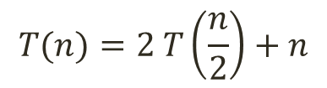




Master Method: Example 1
$$T(n)=2 T\left(\frac{n}{2}\right)+n$$
$$a=2$$
$$b=2$$
$$f(n)=n$$
$$n^{\log_{b}{a}}⟹n^{\log_{2}{2}}⟹n$$
Compare $f(n)$ and $n^{\log_{b}{a}}:$
$⟹f\left(n\right)=n^{\log_{b}{a}}$ so case 2 is applied.
$$\left[f\left(n\right)=\text{Θ}(n^{\log_{b}{a}})\right]$$
$$⟹T(n)=\text{Θ}\left(n^{\log_{b}{a}}\lg{n}\right)$$
$$=\text{Θ}\left(n^{\log_{2}{2}}\lg{n}\right)$$
$$=\text{Θ}\left(n\lg{n}\right)$$
$$Hence:T(n)=\text{Θ}\left(n\lg{n}\right)$$

Slide 14


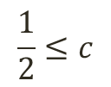

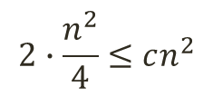


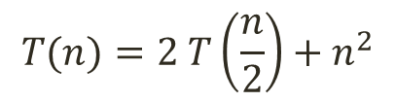



Master Method: Example 2
$$T(n)=2 T\left(\frac{n}{2}\right)+n^{2}$$
$$a=2$$
$$b=2$$
$$f(n)=n^{2}$$
$$n^{\log_{b}{a}}⟹n^{\log_{2}{2}}⟹n$$
Compare $f(n)$ and $n^{\log_{b}{a}}:$
Verify Regularity Condition:
$⟹f\left(n\right)>n^{\log_{b}{a}}$ so case 3 is applied.
$$\left[f\left(n\right)=\text{Ω}(n^{\log_{b}{a}+ε})\right]$$
$$a∙f\left(\frac{n}{b}\right) ≤cf(n)$$
$$⟹T(n)=\text{Θ}\left(f(n)\right)$$
$$2∙f\left(\frac{n}{2}\right) ≤cn^{2}$$
$$=\text{Θ}\left(n^{2}\right)$$
$$2∙\frac{n^{2}}{4}≤cn^{2}$$
$$Hence:T(n)=\text{Θ}\left(n^{2}\right)$$
$$\frac{1}{2}≤c$$

Slide 15





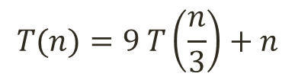



Master Method: Example 3
$$T(n)=9 T\left(\frac{n}{3}\right)+n$$
$$a=9$$
$$b=3$$
$$f(n)=n$$
$$n^{\log_{b}{a}}⟹n^{\log_{3}{9}}⟹n^{2}$$
Compare $f(n)$ and $n^{\log_{b}{a}}:$
$⟹f\left(n\right)<n^{\log_{b}{a}}$ so case 1 is applied.
$$\left[f\left(n\right)=\text{O}(n^{\log_{b}{a}−ε})\right]$$
$$⟹T(n)=\text{Θ}\left(n^{\log_{b}{a}}\right)$$
$$=\text{Θ}\left(n^{\log_{3}{9}}\right)$$
$$=\text{Θ}\left(n^{2}\right)$$
$$Hence:T(n)=\text{Θ}\left(n^{2}\right)$$

Slide 16



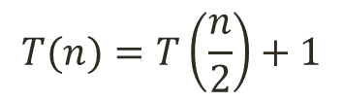



Master Method: Example 4
$$T(n)=T\left(\frac{n}{2}\right)+1$$
$$a=1$$
$$b=2$$
$$f(n)=n^{0}$$
$$n^{\log_{b}{a}}⟹n^{\log_{2}{1}}⟹n^{0}$$
Compare $f(n)$ and $n^{\log_{b}{a}}:$
$⟹f\left(n\right)=n^{\log_{b}{a}}$ so case 2 is applied.
$$\left[f\left(n\right)=\text{Θ}(n^{\log_{b}{a}})\right]$$
$$⟹T(n)=\text{Θ}\left(n^{\log_{b}{a}}\lg{n}\right)$$
$$=\text{Θ}\left(n^{\log_{2}{1}}\lg{n}\right)$$
$$=\text{Θ}\left(n^{0}\lg{n}\right)$$
$$Hence:T(n)=\text{Θ}\left(\lg{n}\right)$$

Slide 17


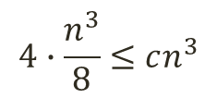


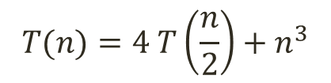


Master Method: Example 5
$$T(n)=4 T\left(\frac{n}{2}\right)+n^{3}$$
$$a=4$$
$$b=2$$
$$f(n)=n^{3}$$
$$n^{\log_{b}{a}}⟹n^{\log_{2}{4}}⟹n^{2}$$
Compare $f(n)$ and $n^{\log_{b}{a}}:$
Verify Regularity Condition:
$⟹f\left(n\right)>n^{\log_{b}{a}}$ so case 3 is applied.
$$\left[f\left(n\right)=\text{Ω}(n^{\log_{b}{a}+ε})\right]$$
$$a∙f\left(\frac{n}{b}\right) ≤cf(n)$$
$$⟹T(n)=\text{Θ}\left(f(n)\right)$$
$$4∙f\left(\frac{n}{2}\right) ≤cn^{3}$$
$$=\text{Θ}\left(n^{3}\right)$$
$$4∙\frac{n^{3}}{8}≤cn^{3}$$
$$Hence:T(n)=\text{Θ}\left(n^{3}\right)$$
$$\frac{1}{2}≤c$$

Slide 18
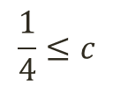
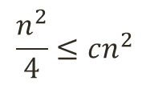

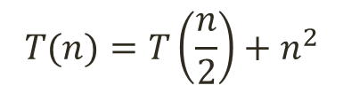

Master Method: Example 6
$$T(n)=T\left(\frac{n}{2}\right)+n^{2}$$
$$a=1$$
$$b=2$$
$$f(n)=n^{2}$$
$$n^{\log_{b}{a}}⟹n^{\log_{2}{1}}⟹n^{0}$$
Compare $f(n)$ and $n^{\log_{b}{a}}:$
Verify Regularity Condition:
$⟹f\left(n\right)>n^{\log_{b}{a}}$ so case 3 is applied.
$$\left[f\left(n\right)=\text{Ω}(n^{\log_{b}{a}+ε})\right]$$
$$a∙f\left(\frac{n}{b}\right) ≤cf(n)$$
$$⟹T(n)=\text{Θ}\left(f(n)\right)$$
$$1∙f\left(\frac{n}{2}\right) ≤cn^{2}$$
$$=\text{Θ}\left(n^{2}\right)$$
$$\frac{n^{2}}{4}≤cn^{2}$$
$$\frac{1}{4}≤c$$
$$Hence:T(n)=\text{Θ}\left(n^{2}\right)$$

Slide 19

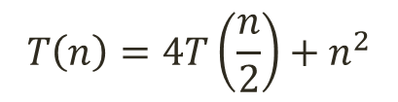



Master Method: Example 7
$$T\left(n\right)=4T\left(\frac{n}{2}\right)+n^{2}$$
$$a=4$$
$$b=2$$
$$f(n)=n^{2}$$
$$n^{\log_{b}{a}}⟹n^{\log_{2}{4}}⟹n^{2}$$
Compare $f(n)$ and $n^{\log_{b}{a}}:$
$⟹f\left(n\right)=n^{\log_{b}{a}}$ so case 2 is applied.
$$\left[f\left(n\right)=\text{Θ}(n^{\log_{b}{a}})\right]$$
$$⟹T(n)=\text{Θ}\left(n^{\log_{b}{a}}\lg{n}\right)$$
$$=\text{Θ}\left(n^{\log_{2}{4}}\lg{n}\right)$$
$$=\text{Θ}\left(n^{2}\lg{n}\right)$$
$$Hence:T(n)=\text{Θ}\left(n^{2}\lg{n}\right)$$

Slide 20
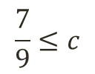

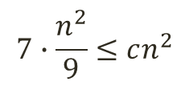


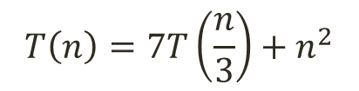

Master Method: Example 8
$$T\left(n\right)=7T\left(\frac{n}{3}\right)+n^{2}$$
$$a=7$$
$$b=3$$
$$f(n)=n^{2}$$
$$n^{\log_{b}{a}}⟹n^{\log_{3}{7}}⟹n^{1.77}$$
Compare $f(n)$ and $n^{\log_{b}{a}}:$
Verify Regularity Condition:
$⟹f\left(n\right)>n^{\log_{b}{a}}$ so case 3 is applied.
$$\left[f\left(n\right)=\text{Ω}(n^{\log_{b}{a}+ε})\right]$$
$$a∙f\left(\frac{n}{b}\right) ≤cf(n)$$
$$⟹T(n)=\text{Θ}\left(f(n)\right)$$
$$7∙f\left(\frac{n}{3}\right) ≤cn^{2}$$
$$=\text{Θ}\left(n^{2}\right)$$
$$7∙\frac{n^{2}}{9}≤cn^{2}$$
$$\frac{7}{9}≤c$$
$$Hence:T(n)=\text{Θ}\left(n^{2}\right)$$

Slide 21


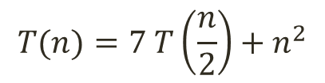


Master Method: Example 9
$$T(n)=7 T\left(\frac{n}{2}\right)+n^{2}$$
$$a=7$$
$$b=2$$
$$f(n)=n^{2}$$
$$n^{\log_{b}{a}}⟹n^{\log_{2}{7}}⟹n^{2.81}$$
Compare $f(n)$ and $n^{\log_{b}{a}}:$
$⟹f\left(n\right)<n^{\log_{b}{a}}$ so case 1 is applied.
$$\left[f\left(n\right)=\text{O}(n^{\log_{b}{a}−ε})\right]$$
$$⟹T(n)=\text{Θ}\left(n^{\log_{b}{a}}\right)$$
$$=\text{Θ}\left(n^{\log_{2}{7}}\right)$$
$$Hence:T(n)=\text{Θ}\left(n^{\log_{2}{7}}\right)$$

Slide 22


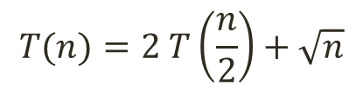

Master Method: Example 10
$$T(n)=2 T\left(\frac{n}{2}\right)+\sqrt{n}$$
$$a=2$$
$$b=2$$
$$f(n)=n^{1/2}$$
$$n^{\log_{b}{a}}⟹n^{\log_{2}{2}}⟹n$$
Compare $f(n)$ and $n^{\log_{b}{a}}:$
$⟹f\left(n\right)<n^{\log_{b}{a}}$ so case 1 is applied.
$$\left[f\left(n\right)=\text{O}(n^{\log_{b}{a}−ε})\right]$$
$$⟹T(n)=\text{Θ}\left(n^{\log_{b}{a}}\right)$$
$$=\text{Θ}\left(n^{\log_{2}{2}}\right)$$
$$Hence:T(n)=\text{Θ}\left(n\right)$$

Slide 23

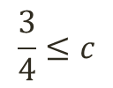



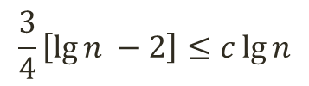

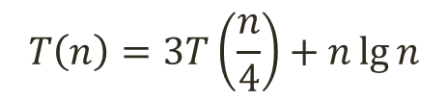


Master Method: Example 11
$$T\left(n\right)=3T\left(\frac{n}{4}\right)+n\lg{n}$$
$$a=3$$
$$b=4$$
$$f\left(n\right)=n\lg{n}$$
$$n^{\log_{b}{a}}⟹n^{\log_{4}{3}}⟹n^{0.79}$$
Compare $f(n)$ and $n^{\log_{b}{a}}:$
Verify Regularity Condition:
$⟹f\left(n\right)>n^{\log_{b}{a}}$ so case 3 is applied.
$$\left[f\left(n\right)=\text{Ω}(n^{\log_{b}{a}+ε})\right]$$
$$a∙f\left(\frac{n}{b}\right) ≤cf(n)$$
$$⟹T(n)=\text{Θ}\left(f(n)\right)$$
$$3∙f\left(\frac{n}{4}\right) ≤cn\lg{n}$$
$$=\text{Θ}\left(n\lg{n}\right)$$
$$3∙\frac{n}{4}\lg{\frac{n}{4}}≤cn\lg{n}$$
$$\frac{3}{4}\left[\lg{n −2}\right]≤c\lg{n}$$
$$Hence:T(n)=\text{Θ}\left(n\lg{n}\right)$$
$$\frac{3}{4}≤c$$

Slide 24


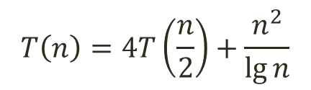
Master Method: Example 12
$$T\left(n\right)=4T\left(\frac{n}{2}\right)+\frac{n^{2}}{\lg{n}}$$
$$a=4$$
$$b=2$$
$$f\left(n\right)=n^{2}/\lg{n}$$
$$n^{\log_{b}{a}}⟹n^{\log_{2}{4}}⟹n^{2}$$
Compare $f(n)$ and $n^{\log_{b}{a}}:$
$$⟹$$
Non-polynomial difference between $f\left(n\right)$ and $n^{\log_{b}{a}}$. Master method does not apply.
The difference must be polynomially larger by a factor of $n^{ε}$ where $ε>0$.
In this case the difference is only larger by a factor of 1/$\lg{n.}$

Slide 25
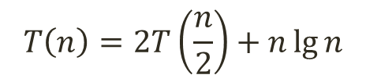
Master Method: Example 13
$$T\left(n\right)=2T\left(\frac{n}{2}\right)+n\lg{n}$$
$$a=2$$
$$b=2$$
$$f\left(n\right)=n\lg{n}$$
$$n^{\log_{b}{a}}⟹n^{\log_{2}{2}}⟹n$$
Compare $f(n)$ and $n^{\log_{b}{a}}:$
Seems like case 3 should apply.
$$⟹$$
Master method does not apply. Non-polynomial difference between $f\left(n\right)$ and $n^{\log_{b}{a}}$.
The difference must be polynomially larger by a factor of $n^{ε}$ where $ε>0$.
In this case the difference is only larger by a factor of $\lg{n.}$

Slide 26


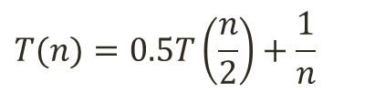















Practice Questions
Solve the following recurrences using the Master Method.
$$T(n)=3T\left(\frac{n}{2}\right)+n^{2}$$
$$T(n)=T\left(\frac{n}{2}\right)+n$$
$$T(n)=4T\left(\frac{n}{2}\right)+\lg{n}$$
$$T(n)=16T\left(\frac{n}{4}\right)+n^{2}$$
$$T(n)=2T\left(\frac{n}{4}\right)+n^{0.51}$$
$$T(n)=4T\left(\frac{n}{2}\right)+\frac{n}{\lg{n}}$$
$$T(n)=T\left(\frac{2n}{5}\right)+n$$
$$T(n)=4T\left(\frac{n}{2}\right)+n$$
$$T(n)=0.5T\left(\frac{n}{2}\right)+\frac{1}{n}$$
$$T(n)=3T\left(\frac{n}{2}\right)+n$$
$$T(n)=3T\left(\frac{n}{3}\right)+n$$
$$T\left(n\right)=4T\left(\frac{n}{2}\right)+n\lg{n}$$
$$T(n)=3T\left(\frac{n}{3}\right)+1$$
$$T(n)=nT\left(\frac{n}{2}\right)+n$$
$$T\left(n\right)=6T\left(\frac{n}{3}\right)+n^{2}\lg{n}$$
$$T(n)=16T\left(\frac{n}{4}\right)+n$$
$$T(n)=2T\left(\frac{n}{2}\right)+2^{n}$$
$$T\left(n\right)=64T\left(\frac{n}{8}\right)+n^{2}\lg{n}$$

Slide 27
THANK YOU

