Slide 1
CSC 301 – Design and Analysis of Algorithms
Instructor: Dr. M. Hasan Jamal
Lecture# 07: Greedy Algorithms

Slide 2
Greedy Algorithms: Introduction
An optimization problem is one that has multiple feasible solutions, each having a specific cost. Our objective is to find the best of all possible solutions.
Greedy algorithms are typically used to solve optimization problems.
A greedy algorithm works in phases. At each phase:
Make the choice that looks best at the moment without regard for future consequences
Hope that by choosing a local optimum at each phase, global optimum can be achieved
Once a choice is made it cannot be un-done on subsequent steps of the algorithm
Greedy algorithms are simple and appealing but don’t always give the best solution. However, greedy algorithms can often come close to the globally optimal solutions.
Simple examples:
Playing cards by making best move without lookahead
Giving fewest number of coins as change
Notes:
i.e. to minimize (or maximize) the cost.
Is “sorting a sequence of numbers” an optimization problem?

Slide 3
Greedy Algorithms: Counting Money Example
Suppose you want to count out a certain amount of money, using the fewest possible bills and coins How would a greedy algorithm solve this problem?
At each step, take the largest possible bill or coin that does not overshoot
Example: To make Rs. 6,658, you can choose:
a Rs. 5,000 bill
a Rs. 1,000 bill, to make Rs. 6,000
a Rs. 500 bill, to make Rs. 6,500
a Rs. 100 bill, to make Rs. 6,600
a Rs. 50 bill, to make Rs. 6,550
A Rs. 5 coin, to make Rs. 6,555
A Rs. 2 coin, to make Rs. 6,557
A Rs. 1 coin, to make Rs. 6,558
Does this algorithm always find an optimal solution?
For Pakistani and US currency, greedy algorithm always gives optimum solution.

Slide 4
Greedy Algorithms: Counting Money Example
Failure of the greedy algorithm:
In some (fictional) monetary system, “krons” come in 1 kron, 7 kron, and 10 kron coins.
Using a greedy algorithm to count out 15 krons, we would get:
a 10 kron coin
five 1 kron coins
For a total of 15 krons, six krons are required.
A better solution: Use two 7 kron coins and one 1 kron coin, requiring only three coins
The greedy algorithm results in a solution, but not in an optimum solution.

Slide 5
Greedy Algorithms: Properties
A greedy algorithm works if a problem exhibits the following two properties:
Optimal sub-structure: An optimal solution to the problem contains within it, optimal solutions to sub-problems
Greedy Choice Property: A globally optimal solution can be achieved by making a locally optimal (greedy) choice (locally best ➔ globally best)

Slide 6
Greedy Graph Algorithms

Slide 7
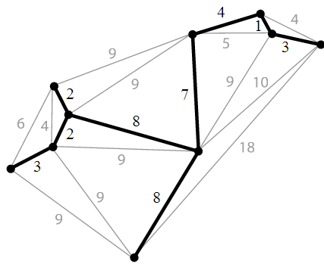

Greedy Algorithms: Minimum Spanning Tree
A spanning tree of a graph $G$is a tree (acyclic) that connects all the vertices of $G$.
i.e. the tree “spans” every vertex in $G$
A minimum spanning tree (MST) is a spanning tree on a weighted graph that has the minimum total weight.

Slide 8
Greedy Algorithms: Minimum Spanning Tree
Problem: Given a connected, undirected, weighted graph $G$, find the minimum spanning tree using edges that minimize the total weight.
Which edges should be picked to find the MST of this graph?
6
4
5
9
14
Two common greedy algorithms used to find the MST.
Kruskal
Prim
10
2
15
3
8

Slide 9
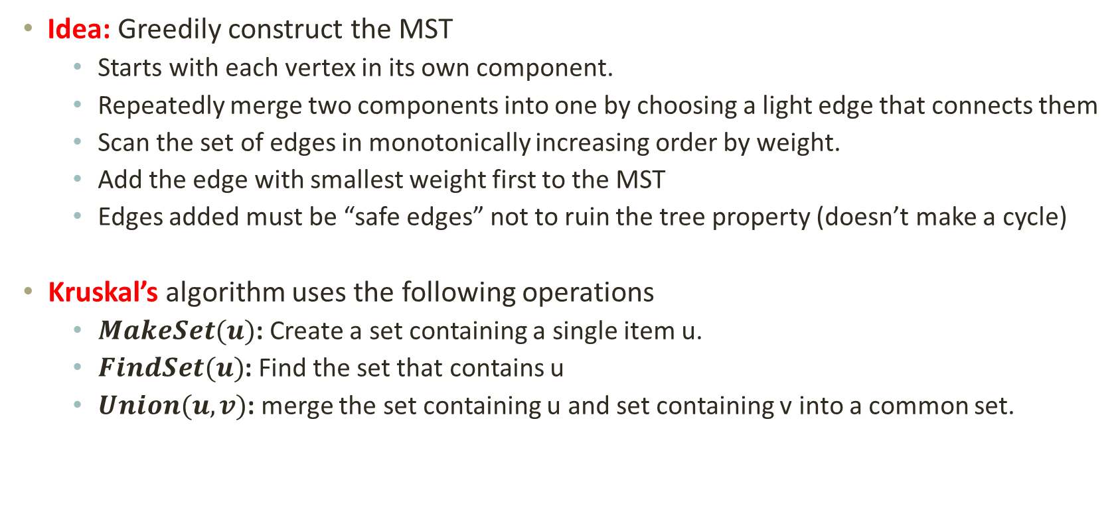
Greedy Algorithms: Kruskal’s MST Algorithm
Idea: Greedily construct the MST
Starts with each vertex in its own component.
Repeatedly merge two components into one by choosing a light edge that connects them
Scan the set of edges in monotonically increasing order by weight.
Add the edge with smallest weight first to the MST
Edges added must be “safe edges” not to ruin the tree property (doesn’t make a cycle)
Kruskal’s algorithm uses the following operations
$MakeSet(u)$: Create a set containing a single item u.
$FindSet(u)$: Find the set that contains u
$Union(u,v)$: merge the set containing u and set containing v into a common set.

Slide 10
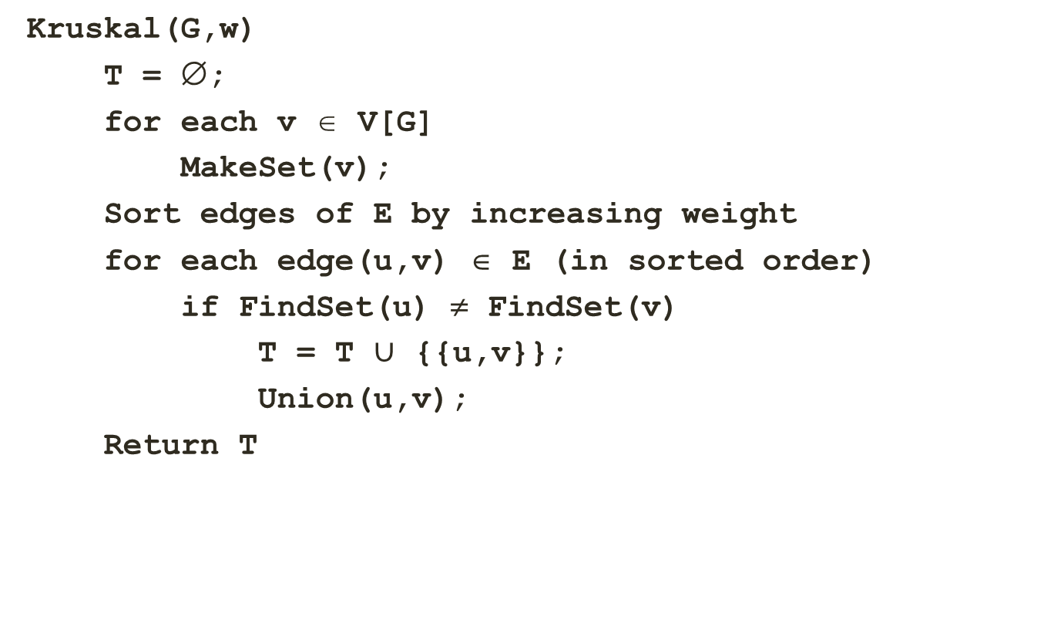
Greedy Algorithms: Kruskal’s MST Algorithm
Kruskal(G,w)
T = ∅;
for each v ∈ V[G]
MakeSet(v);
Sort edges of E by increasing weight
for each edge(u,v) ∈ E (in sorted order)
if FindSet(u) ≠ FindSet(v)
T = T $∪$ {{u,v}};
Union(u,v);
Return T
The MST starts out as empty
Make each vertex a set
Check whether u and v belong to the same set
Add the edge to the MST and merge the sets.

Slide 11
Greedy Algorithms: Kruskal’s MST Algorithm
Kruskal(G,w)
T = ∅;
for each v ∈ V[G]
MakeSet(v);
Sort edges of E by increasing weight
for each edge(u,v) ∈ E (in sorted order)
if FindSet(u) ≠ FindSet(v)
T = T $∪$ {{u,v}};
Union(u,v);
Return T
2
19
9
14
17
8
25
5
21
13
1

Slide 12
Greedy Algorithms: Kruskal’s MST Algorithm
Kruskal(G,w)
T = ∅;
for each v ∈ V[G]
MakeSet(v);
Sort edges of E by increasing weight
for each edge(u,v) ∈ E (in sorted order)
if FindSet(u) ≠ FindSet(v)
T = T $∪$ {{u,v}};
Union(u,v);
Return T
2
19
9
14
17
8
25
5
21
13
1?
1

Slide 13
Greedy Algorithms: Kruskal’s MST Algorithm
Kruskal(G,w)
T = ∅;
for each v ∈ V[G]
MakeSet(v);
Sort edges of E by increasing weight
for each edge(u,v) ∈ E (in sorted order)
if FindSet(u) ≠ FindSet(v)
T = T $∪$ {{u,v}};
Union(u,v);
Return T
2?
2
19
9
14
17
8
25
5
21
13
1

Slide 14
Greedy Algorithms: Kruskal’s MST Algorithm
Kruskal(G,w)
T = ∅;
for each v ∈ V[G]
MakeSet(v);
Sort edges of E by increasing weight
for each edge(u,v) ∈ E (in sorted order)
if FindSet(u) ≠ FindSet(v)
T = T $∪$ {{u,v}};
Union(u,v);
Return T
2
19
9
14
17
8
25
5?
5
21
13
1

Slide 15
Greedy Algorithms: Kruskal’s MST Algorithm
Kruskal(G,w)
T = ∅;
for each v ∈ V[G]
MakeSet(v);
Sort edges of E by increasing weight
for each edge(u,v) ∈ E (in sorted order)
if FindSet(u) ≠ FindSet(v)
T = T $∪$ {{u,v}};
Union(u,v);
Return T
2
19
9
14
17
8
25
8?
5
21
13
1

Slide 16
Greedy Algorithms: Kruskal’s MST Algorithm
Kruskal(G,w)
T = ∅;
for each v ∈ V[G]
MakeSet(v);
Sort edges of E by increasing weight
for each edge(u,v) ∈ E (in sorted order)
if FindSet(u) ≠ FindSet(v)
T = T $∪$ {{u,v}};
Union(u,v);
Return T
2
19
9
9?
14
17
8
25
5
21
13
1

Slide 17
Greedy Algorithms: Kruskal’s MST Algorithm
Kruskal(G,w)
T = ∅;
for each v ∈ V[G]
MakeSet(v);
Sort edges of E by increasing weight
for each edge(u,v) ∈ E (in sorted order)
if FindSet(u) ≠ FindSet(v)
T = T $∪$ {{u,v}};
Union(u,v);
Return T
2
19
9
14
17
8
25
5
21
13?
13
1

Slide 18
Greedy Algorithms: Kruskal’s MST Algorithm
Kruskal(G,w)
T = ∅;
for each v ∈ V[G]
MakeSet(v);
Sort edges of E by increasing weight
for each edge(u,v) ∈ E (in sorted order)
if FindSet(u) ≠ FindSet(v)
T = T $∪$ {{u,v}};
Union(u,v);
Return T
2
19
9
14
14?
17
8
25
5
21
13
1

Slide 19
Greedy Algorithms: Kruskal’s MST Algorithm
Kruskal(G,w)
T = ∅;
for each v ∈ V[G]
MakeSet(v);
Sort edges of E by increasing weight
for each edge(u,v) ∈ E (in sorted order)
if FindSet(u) ≠ FindSet(v)
T = T $∪$ {{u,v}};
Union(u,v);
Return T
2
19?
19
9
14
17
25
17?
8
25?
5
21?
21
13
1

Slide 20
Greedy Algorithms: Kruskal’s MST Algorithm
Kruskal(G,w)
T = ∅;
for each v ∈ V[G]
MakeSet(v);
Sort edges of E by increasing weight
for each edge(u,v) ∈ E (in sorted order)
if FindSet(u) ≠ FindSet(v)
T = T $∪$ {{u,v}};
Union(u,v);
Return T
2
19
9
14
17
8
25
5
21
13
1

Slide 21
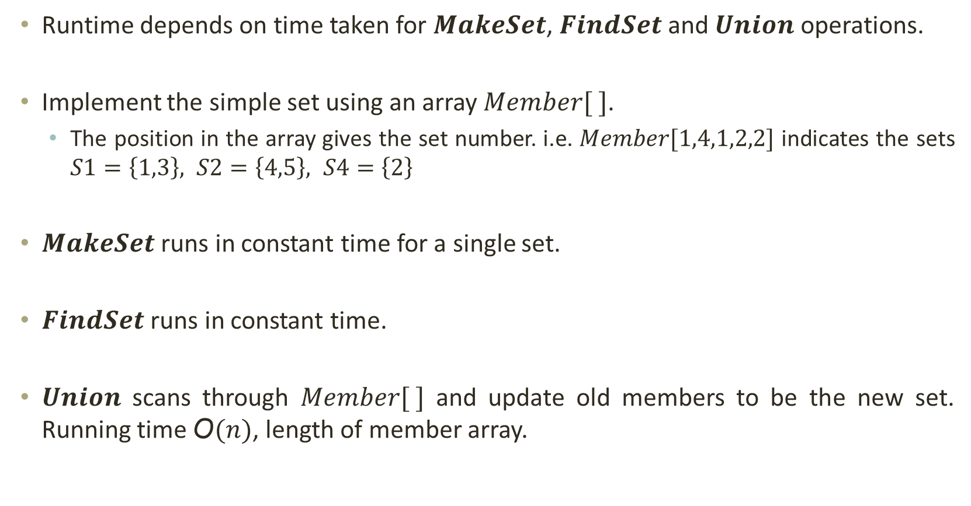
Greedy Algorithms: Kruskal’s Algorithm Runtime
Runtime depends on time taken for $MakeSet$, $FindSet$ and $Union$ operations.
Implement the simple set using an array $Member[ ]$.
The position in the array gives the set number. i.e. $Member[1,4,1,2,2]$ indicates the sets $S1=\left\{1,3\right\}, S2=\left\{4,5\right\}, S4=\left\{2\right\}$
$MakeSet$ runs in constant time for a single set.
$FindSet$ runs in constant time.
$Union$ scans through $Member[ ]$ and update old members to be the new set. Running time $\text{O}(n)$, length of member array.
Notes:
So lets see how these operation can be implemented.

Slide 22
Greedy Algorithms: Kruskal’s Algorithm Runtime
Kruskal(G,w)
T = ∅;
for each v ∈ V[G]
MakeSet(v);
Sort edges of E by increasing weight
for each edge(u,v) ∈ E (in sorted order)
if FindSet(u) ≠ FindSet(v)
T = T $∪$ {{u,v}};
Union(u,v);
Return T
O(V)
O(ElgE) using heap sort
O(1)
O(E.V)
O(V)
What will be the running time?
Total running time: O(E.V)
CLRS book describes a version using disjoint sets that runs in O(E*lgE) time.

Slide 23
Greedy Algorithms: Kruskal’s Algo. Correctness
Assume algorithm is wrong: result is not an MST.
Then algorithm adds a wrong edge at some point
If it adds a wrong edge, there must be a lower weight edge
But algorithm chooses lowest weight edge at each step.
CONTRADICTION!!!

Slide 24
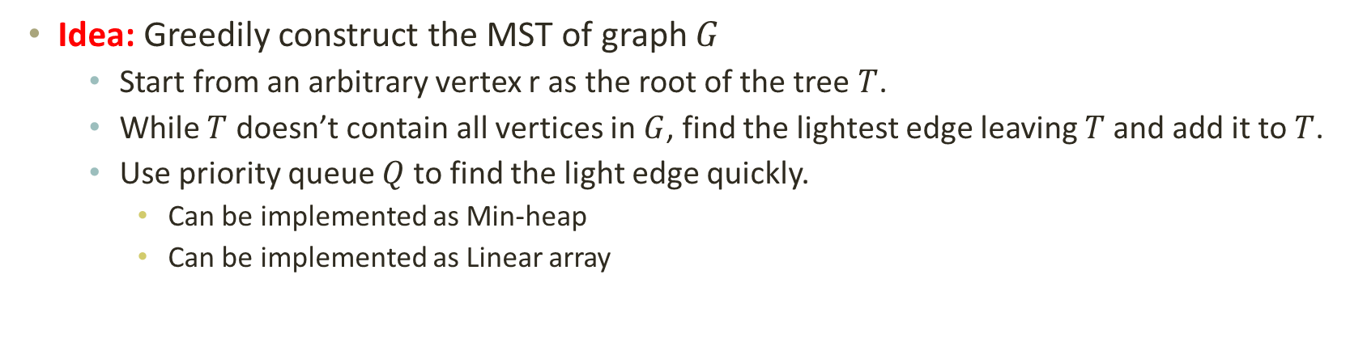
Greedy Algorithms: Prim’s MST Algorithm
Idea: Greedily construct the MST of graph $G$
Start from an arbitrary vertex r as the root of the tree $T$.
While $T$ doesn’t contain all vertices in $G$, find the lightest edge leaving $T$and add it to $T$.
Use priority queue $Q$ to find the light edge quickly.
Can be implemented as Min-heap
Can be implemented as Linear array

Slide 25
Greedy Algorithms: Prim’s MST Algorithm
Prim(G,w,r)
Q = V[G];
for each u ∈ Q
key[u] = ∞;
p[u] = NIL;
key[r] = 0;
while (Q ≠ Ø)
u = ExtractMin(Q);
for each v ∈ Adj[u]
if (v∈Q && w(u,v) < key[v])
p[v] = u;
key[v] = w(u,v);
Return T
Insert all the vertices in the minimum priority queue
Initialize key to infinite distance
Set parent of each vertex to NIL
Remove closest vertex based on key
Update children of “u” so they have parents and a minimum key value.
Key is the weight between vertex and parent.

Slide 26
Greedy Algorithms: Prim’s MST Algorithm
Prim(G,w,r)
Q = V[G];
for each u ∈ Q
key[u] = ∞;
p[u] = NIL;
key[r] = 0;
while (Q ≠ Ø)
u = ExtractMin(Q);
for each v ∈ Adj[u]
if (v∈Q && w(u,v) < key[v])
p[v] = u;
key[v] = w(u,v);
Return T
A
6
4
9
B
C
D
5
14
10
2
15
E
G
H
3
F
8

Slide 27
Greedy Algorithms: Prim’s MST Algorithm
r
Prim(G,w,r)
Q = V[G];
for each u ∈ Q
key[u] = ∞;
p[u] = NIL;
key[r] = 0;
while (Q ≠ Ø)
u = ExtractMin(Q);
for each v ∈ Adj[u]
if (v∈Q && w(u,v) < key[v])
p[v] = u;
key[v] = w(u,v);
Return T
A/0
6
4
9
B/∞
C/∞
D/∞
5
14
10
2
15
E/∞
G/∞
H/∞
3
F/∞
8
Not in Tree
Q = A B C D E F G H
0 ∞ ∞

Slide 28
Greedy Algorithms: Prim’s MST Algorithm
u
Prim(G,w,r)
Q = V[G];
for each u ∈ Q
key[u] = ∞;
p[u] = NIL;
key[r] = 0;
while (Q ≠ Ø)
u = ExtractMin(Q);
for each v ∈ Adj[u]
if (v∈Q && w(u,v) < key[v])
p[v] = u;
key[v] = w(u,v);
Return T
A/0
6
4
9
B/6
C/4
D/∞
5
14
10
2
15
E/∞
G/∞
H/∞
3
F/∞
8
Q = C B D E F G H
4 6 ∞ ∞

Slide 29
Greedy Algorithms: Prim’s MST Algorithm
u
Prim(G,w,r)
Q = V[G];
for each u ∈ Q
key[u] = ∞;
p[u] = NIL;
key[r] = 0;
while (Q ≠ Ø)
u = ExtractMin(Q);
for each v ∈ Adj[u]
if (v∈Q && w(u,v) < key[v])
p[v] = u;
key[v] = w(u,v);
Return T
A/0
6
4
9
B/5
C/4
D/9
5
14
10
2
15
E/∞
G/2
H/∞
3
F/∞
8
Q = G B D E F H
2 5 9 ∞ ∞ ∞

Slide 30
Greedy Algorithms: Prim’s MST Algorithm
Prim(G,w,r)
Q = V[G];
for each u ∈ Q
key[u] = ∞;
p[u] = NIL;
key[r] = 0;
while (Q ≠ Ø)
u = ExtractMin(Q);
for each v ∈ Adj[u]
if (v∈Q && w(u,v) < key[v])
p[v] = u;
key[v] = w(u,v);
Return T
A/0
6
4
9
B/5
C/4
D/9
5
14
10
2
15
E/∞
G/2
H/15
3
F/8
8
u
Q = B F D H E
5 8 9 15 ∞

Slide 31
Greedy Algorithms: Prim’s MST Algorithm
Prim(G,w,r)
Q = V[G];
for each u ∈ Q
key[u] = ∞;
p[u] = NIL;
key[r] = 0;
while (Q ≠ Ø)
u = ExtractMin(Q);
for each v ∈ Adj[u]
if (v∈Q && w(u,v) < key[v])
p[v] = u;
key[v] = w(u,v);
Return T
u
A/0
6
4
9
B/5
C/4
D/9
5
14
10
2
15
E/14
G/2
H/15
3
F/8
8
Q = F D E H
8 9 14 15

Slide 32
Greedy Algorithms: Prim’s MST Algorithm
Prim(G,w,r)
Q = V[G];
for each u ∈ Q
key[u] = ∞;
p[u] = NIL;
key[r] = 0;
while (Q ≠ Ø)
u = ExtractMin(Q);
for each v ∈ Adj[u]
if (v∈Q && w(u,v) < key[v])
p[v] = u;
key[v] = w(u,v);
Return T
A/0
6
4
9
B/5
C/4
D/9
5
14
10
2
15
E/3
G/2
H/15
3
F/8
8
u
Q = E D H
3 9 15

Slide 33
Greedy Algorithms: Prim’s MST Algorithm
Prim(G,w,r)
Q = V[G];
for each u ∈ Q
key[u] = ∞;
p[u] = NIL;
key[r] = 0;
while (Q ≠ Ø)
u = ExtractMin(Q);
for each v ∈ Adj[u]
if (v∈Q && w(u,v) < key[v])
p[v] = u;
key[v] = w(u,v);
Return T
A/0
6
4
9
B/5
C/4
D/9
5
14
10
2
15
E/3
G/2
H/15
3
F/8
8
u
Q = D H
9 15

Slide 34
Greedy Algorithms: Prim’s MST Algorithm
u
Prim(G,w,r)
Q = V[G];
for each u ∈ Q
key[u] = ∞;
p[u] = NIL;
key[r] = 0;
while (Q ≠ Ø)
u = ExtractMin(Q);
for each v ∈ Adj[u]
if (v∈Q && w(u,v) < key[v])
p[v] = u;
key[v] = w(u,v);
Return T
A/0
6
4
9
B/5
C/4
D/9
5
14
10
2
15
E/3
G/2
H/15
3
F/8
8
Q = H
15

Slide 35
Greedy Algorithms: Prim’s MST Algorithm
Prim(G,w,r)
Q = V[G];
for each u ∈ Q
key[u] = ∞;
p[u] = NIL;
key[r] = 0;
while (Q ≠ Ø)
u = ExtractMin(Q);
for each v ∈ Adj[u]
if (v∈Q && w(u,v) < key[v])
p[v] = u;
key[v] = w(u,v);
Return T
A/0
6
4
9
B/5
C/4
D/9
5
14
10
2
15
E/3
G/2
H/15
3
F/8
8
u
Q = ∅

Slide 36
Greedy Algorithms: Prim’s MST Algorithm
Prim(G,w,r)
Q = V[G];
for each u ∈ Q
key[u] = ∞;
p[u] = NIL;
key[r] = 0;
while (Q ≠ Ø)
u = ExtractMin(Q);
for each v ∈ Adj[u]
if (v∈Q && w(u,v) < key[v])
p[v] = u;
key[v] = w(u,v);
Return T
A
6
4
9
B
C
D
5
14
10
2
15
E
G
H
3
F
8
Notes:
No matter where you start from, the key values and the parents of vertices can vary, but the resulting MST will be the same.

Slide 37
Greedy Algorithms: Prim’s Algorithm Runtime
Using Min-Heap for Queue
Prim(G,w,r)
Q = V[G];
for each u ∈ Q
key[u] = ∞;
p[u] = NIL;
key[r] = 0;
while (Q ≠ Ø)
u = ExtractMin(Q);
for each v ∈ Adj[u]
if (v∈Q && w(u,v) < key[v])
p[v] = u;
key[v] = w(u,v);
Return T
O(V)
What will be the running time?
O(V lg V) + O(E lg V) ➔ O(E lg V)
O(V)
O(V lg V) for the all vertices
O(E) over entire while loop
O(lg V) to update in the heap, O(E lg V) for the entire for loop.
Inner loop takes O(E lg V) for the heap update inside the O(E) loop. This is over all executions, so it is not multiplied by O(V) for the while loop (this is included in the O(E) runtime through all edges.

Slide 38
Greedy Algorithms: Prim’s Algorithm Runtime
Using Linear Array for Queue
Prim(G,w,r)
Q = V[G];
for each u ∈ Q
key[u] = ∞;
p[u] = NIL;
key[r] = 0;
while (Q ≠ Ø)
u = ExtractMin(Q);
for each v ∈ Adj[u]
if (v∈Q && w(u,v) < key[v])
p[v] = u;
key[v] = w(u,v);
Return T
What will be the running time?
O(V)
O(V²) + O(E) ➔ O(V²)
Using Min-Heap the runtime was O(E lg V).
Which is worse?
Which is worse for a fully connected graph?
O(V)
O(V²) for the all vertices
O(E) over entire while loop
O(1) to update in the array.
O(E) for the entire for loop.
Inner loop takes O(E) over all iterations of the outer loop. It is not multiplied by O(V) for the while loop.

Slide 39
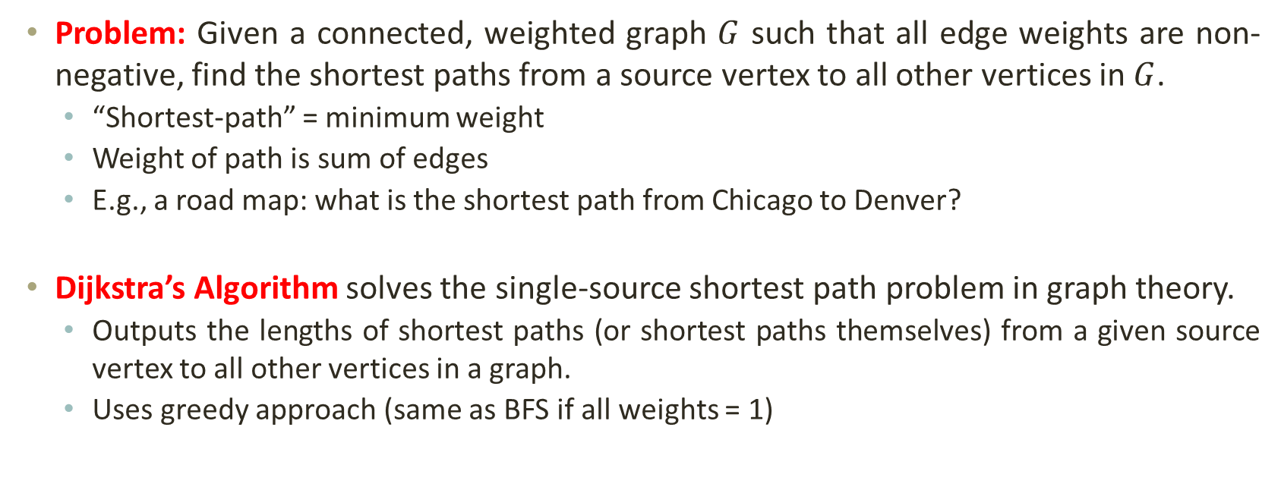
Greedy Algorithms: Single-Source Shortest Path Problem
Problem: Given a connected, weighted graph $G$ such that all edge weights are non-negative, find the shortest paths from a source vertex to all other vertices in $G$.
“Shortest-path” = minimum weight
Weight of path is sum of edges
E.g., a road map: what is the shortest path from Chicago to Denver?
Dijkstra’s Algorithm solves the single-source shortest path problem in graph theory.
Outputs the lengths of shortest paths (or shortest paths themselves) from a given source vertex to all other vertices in a graph.
Uses greedy approach (same as BFS if all weights = 1)

Slide 40
Greedy Algorithms: Dijkstra’s Algorithm Idea
Initially
Mark the source vertex as known (path length is zero)
For each out-edge, set the distance of each neighboring vertex equal to the cost (length) of the out-edge, and set its predecessor to the initially given source vertex.
Repeatedly (until all vertices are known),
Find an unknown vertex containing the smallest distance
Mark the new vertex as known
For each vertex adjacent to the new vertex, examine its neighbors to see whether their estimated distance can be reduced (distance to known vertex plus cost of out-edge)
If so, also reset the predecessor of the new vertex

Slide 41
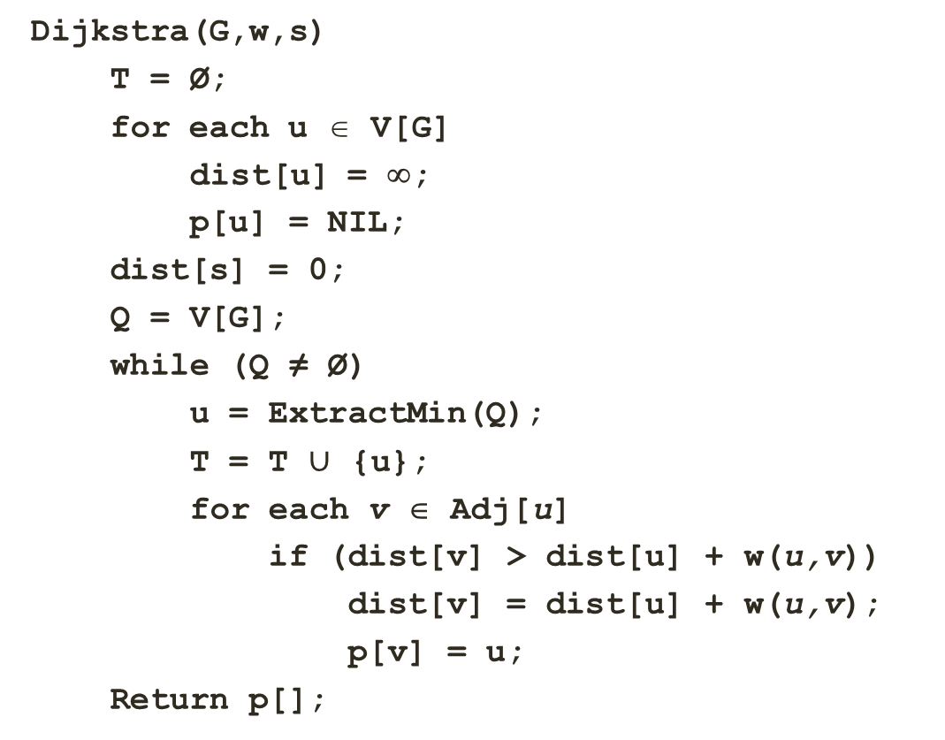
Greedy Algorithms: Dijkstra’s Algorithm
Dijkstra(G,w,s)
T = Ø;
for each u ∈ V[G]
dist[u] = ∞;
p[u] = NIL;
dist[s] = 0;
Q = V[G];
while (Q ≠ Ø)
u = ExtractMin(Q);
T = T $∪$ {u};
for each v ∈ Adj[u]
if (dist[v] > dist[u] + w(u,v))
dist[v] = dist[u] + w(u,v);
p[v] = u;
Return p[];
Set of known vertices, initially empty
Set distances of all vertices to infinity and distance of source vertex is zero
Insert all the vertices in the minimum priority queue
Select the vertex with minimum distance
Add vertex “u” to known vertices
If new shortest path found.
Set new value of shortest path.

Slide 42
Greedy Algorithms: Dijkstra’s Algorithm
Dijkstra(G,w,s)
T = Ø;
for each u ∈ V[G]
dist[u] = ∞;
p[u] = NIL;
dist[s] = 0;
Q = V[G];
while (Q ≠ Ø)
u = ExtractMin(Q);
T = T $∪$ {u};
for each v ∈ Adj[u]
if (dist[v] > dist[u] + w(u,v))
dist[v] = dist[u] + w(u,v);
p[v] = u;
Return p[];
24
9
18
14
2
6
30
19
15
5
11
20
16
6
44
Vertex | Distance | Path
S
2
3
4
5
6
7
8

Slide 43
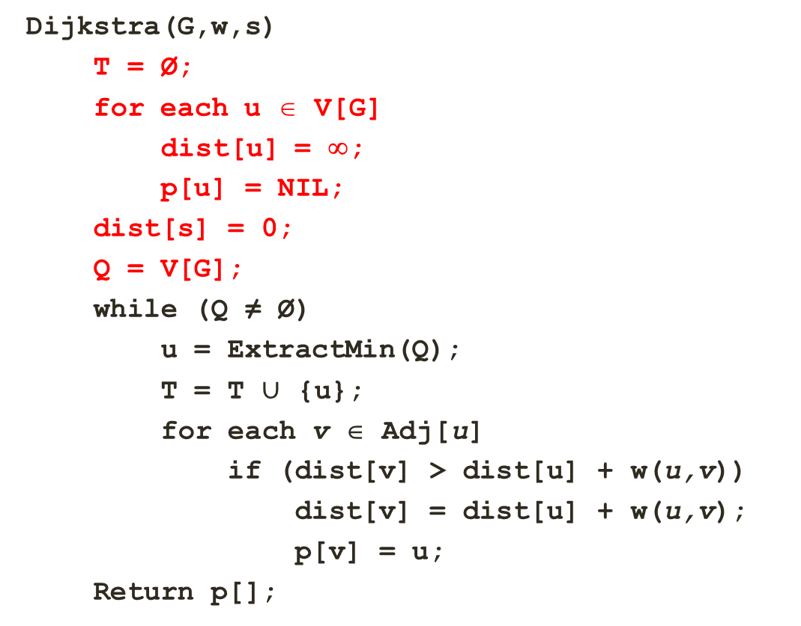
Greedy Algorithms: Dijkstra’s Algorithm
Dijkstra(G,w,s)
T = Ø;
for each u ∈ V[G]
dist[u] = ∞;
p[u] = NIL;
dist[s] = 0;
Q = V[G];
while (Q ≠ Ø)
u = ExtractMin(Q);
T = T $∪$ {u};
for each v ∈ Adj[u]
if (dist[v] > dist[u] + w(u,v))
dist[v] = dist[u] + w(u,v);
p[v] = u;
Return p[];
24
9
18
14
2
6
30
19
15
5
11
20
16
6
44
Vertex | Distance | Path
S | 0
2 | ∞
3 | ∞
4 | ∞
5 | ∞
6 | ∞
7 | ∞
8 | ∞
T = { Ø }
Q = { s, 2, 3, 4, 5, 6, 7, 8 }

Slide 44
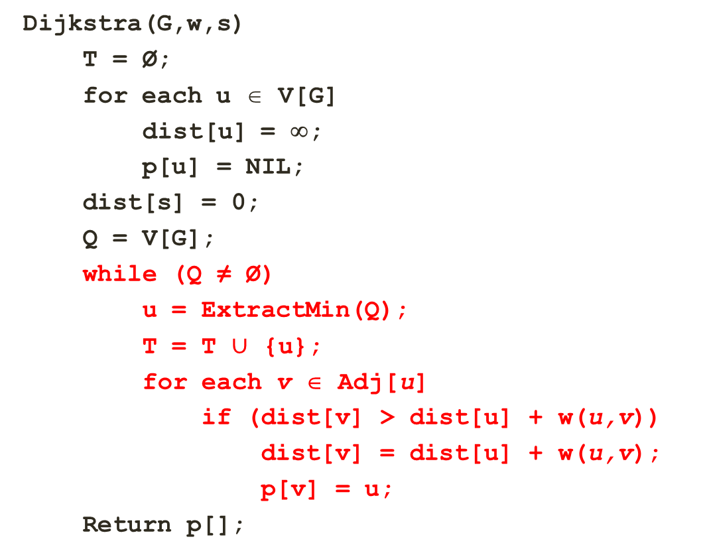
Greedy Algorithms: Dijkstra’s Algorithm
Dijkstra(G,w,s)
T = Ø;
for each u ∈ V[G]
dist[u] = ∞;
p[u] = NIL;
dist[s] = 0;
Q = V[G];
while (Q ≠ Ø)
u = ExtractMin(Q);
T = T $∪$ {u};
for each v ∈ Adj[u]
if (dist[v] > dist[u] + w(u,v))
dist[v] = dist[u] + w(u,v);
p[v] = u;
Return p[];
24
9
18
14
2
6
30
19
15
5
11
20
16
6
44
Vertex | Distance | Path
S | 0
2 | ∞, 9 | s
3 | ∞
4 | ∞
5 | ∞
6 | ∞, 14 | s
7 | ∞, 15 | s
8 | ∞
T = { s }
Q = { 2, 3, 4, 5, 6, 7, 8 }

Slide 45
Greedy Algorithms: Dijkstra’s Algorithm
Dijkstra(G,w,s)
T = Ø;
for each u ∈ V[G]
dist[u] = ∞;
p[u] = NIL;
dist[s] = 0;
Q = V[G];
while (Q ≠ Ø)
u = ExtractMin(Q);
T = T $∪$ {u};
for each v ∈ Adj[u]
if (dist[v] > dist[u] + w(u,v))
dist[v] = dist[u] + w(u,v);
p[v] = u;
Return p[];
24
9
18
14
2
6
30
19
15
5
11
20
16
6
44
Vertex | Distance | Path
S | 0
2 | ∞, 9 | s
3 | ∞, 33 | 2
4 | ∞
5 | ∞
6 | ∞, 14 | s
7 | ∞, 15 | s
8 | ∞
T = { s, 2 }
Q = { 3, 4, 5, 6, 7, 8 }

Slide 46
Greedy Algorithms: Dijkstra’s Algorithm
Dijkstra(G,w,s)
T = Ø;
for each u ∈ V[G]
dist[u] = ∞;
p[u] = NIL;
dist[s] = 0;
Q = V[G];
while (Q ≠ Ø)
u = ExtractMin(Q);
T = T $∪$ {u};
for each v ∈ Adj[u]
if (dist[v] > dist[u] + w(u,v))
dist[v] = dist[u] + w(u,v);
p[v] = u;
Return p[];
24
9
18
14
2
6
30
19
15
5
11
20
16
6
44
Vertex | Distance | Path
S | 0
2 | ∞, 9 | s
3 | ∞, 33, 32 | 2, 6
4 | ∞
5 | ∞,44 | 6
6 | ∞, 14 | s
7 | ∞, 15 | s
8 | ∞
T = { s, 2, 6 }
Q = { 3, 4, 5, 7, 8 }

Slide 47
Greedy Algorithms: Dijkstra’s Algorithm
Dijkstra(G,w,s)
T = Ø;
for each u ∈ V[G]
dist[u] = ∞;
p[u] = NIL;
dist[s] = 0;
Q = V[G];
while (Q ≠ Ø)
u = ExtractMin(Q);
T = T $∪$ {u};
for each v ∈ Adj[u]
if (dist[v] > dist[u] + w(u,v))
dist[v] = dist[u] + w(u,v);
p[v] = u;
Return p[];
24
9
18
14
2
6
30
19
15
5
11
20
16
6
44
Vertex | Distance | Path
S | 0
2 | ∞, 9 | s
3 | ∞, 33, 32 | 2, 6
4 | ∞
5 | ∞, 44, 35 | 6, 7
6 | ∞, 14 | s
7 | ∞, 15 | s
8 | ∞, 59 | 7
T = { s, 2, 6, 7 }
Q = { 3, 4, 5, 8 }

Slide 48
Greedy Algorithms: Dijkstra’s Algorithm
Dijkstra(G,w,s)
T = Ø;
for each u ∈ V[G]
dist[u] = ∞;
p[u] = NIL;
dist[s] = 0;
Q = V[G];
while (Q ≠ Ø)
u = ExtractMin(Q);
T = T $∪$ {u};
for each v ∈ Adj[u]
if (dist[v] > dist[u] + w(u,v))
dist[v] = dist[u] + w(u,v);
p[v] = u;
Return p[];
24
9
18
14
2
6
30
19
15
5
11
20
16
6
44
Vertex | Distance | Path
S | 0
2 | ∞, 9 | s
3 | ∞, 33, 32 | 2, 6
4 | ∞
5 | ∞, 44, 35, 34 | 6, 7, 3
6 | ∞, 14 | s
7 | ∞, 15 | s
8 | ∞, 59, 51 | 7, 3
T = { s, 2, 6, 7, 3 }
Q = {4, 5, 8 }

Slide 49
Greedy Algorithms: Dijkstra’s Algorithm
Dijkstra(G,w,s)
T = Ø;
for each u ∈ V[G]
dist[u] = ∞;
p[u] = NIL;
dist[s] = 0;
Q = V[G];
while (Q ≠ Ø)
u = ExtractMin(Q);
T = T $∪$ {u};
for each v ∈ Adj[u]
if (dist[v] > dist[u] + w(u,v))
dist[v] = dist[u] + w(u,v);
p[v] = u;
Return p[];
24
9
18
14
2
6
30
19
15
5
11
20
16
6
44
Vertex | Distance | Path
S | 0
2 | ∞, 9 | s
3 | ∞, 33, 32 | 2, 6
4 | ∞, 45 | 5
5 | ∞, 44, 35, 34 | 6, 7, 3
6 | ∞, 14 | s
7 | ∞, 15 | s
8 | ∞, 59, 51, 50 | 7, 3, 5
T = { s, 2, 6, 7, 3, 5 }
Q = {4, 8 }

Slide 50
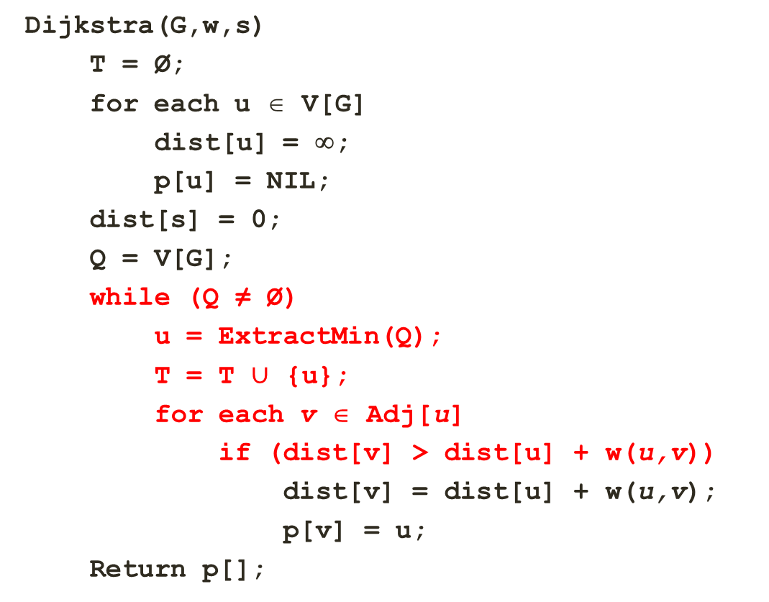
Greedy Algorithms: Dijkstra’s Algorithm
Dijkstra(G,w,s)
T = Ø;
for each u ∈ V[G]
dist[u] = ∞;
p[u] = NIL;
dist[s] = 0;
Q = V[G];
while (Q ≠ Ø)
u = ExtractMin(Q);
T = T $∪$ {u};
for each v ∈ Adj[u]
if (dist[v] > dist[u] + w(u,v))
dist[v] = dist[u] + w(u,v);
p[v] = u;
Return p[];
24
9
18
14
2
6
30
19
15
5
11
20
16
6
44
Vertex | Distance | Path
S | 0
2 | ∞, 9 | s
3 | ∞, 33, 32 | 2, 6
4 | ∞, 45 | 5
5 | ∞, 44, 35, 34 | 6, 7, 3
6 | ∞, 14 | s
7 | ∞, 15 | s
8 | ∞, 59, 51, 50 | 7, 3, 5
T = { s, 2, 6, 7, 3, 5, 4 }
Q = { 8 }

Slide 51
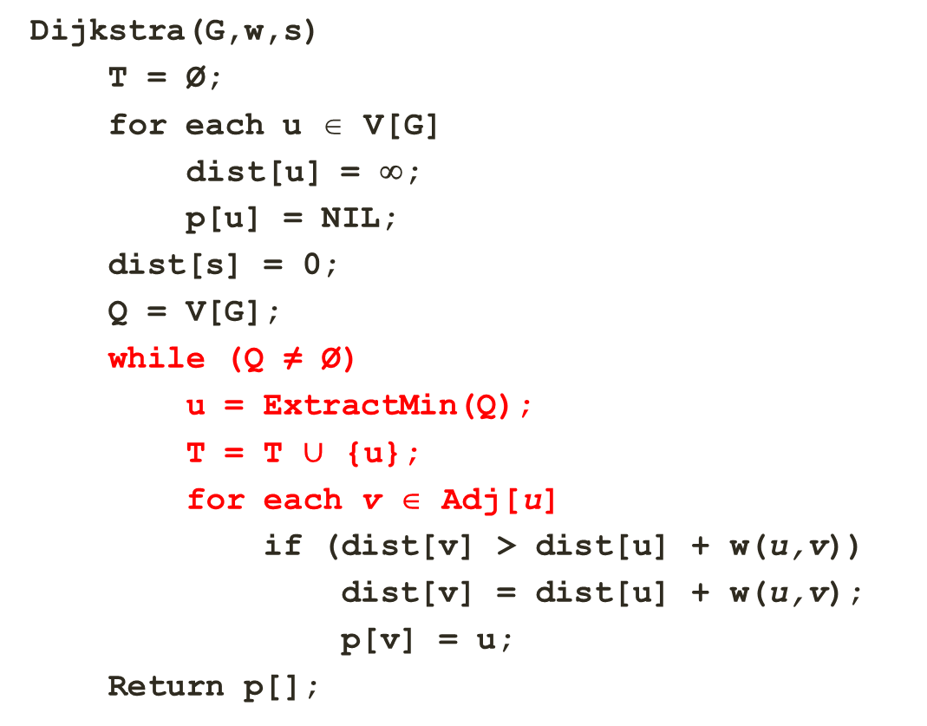
Greedy Algorithms: Dijkstra’s Algorithm
Dijkstra(G,w,s)
T = Ø;
for each u ∈ V[G]
dist[u] = ∞;
p[u] = NIL;
dist[s] = 0;
Q = V[G];
while (Q ≠ Ø)
u = ExtractMin(Q);
T = T $∪$ {u};
for each v ∈ Adj[u]
if (dist[v] > dist[u] + w(u,v))
dist[v] = dist[u] + w(u,v);
p[v] = u;
Return p[];
24
9
18
14
2
6
30
19
15
5
11
20
16
6
44
Vertex | Distance | Path
S | 0
2 | ∞, 9 | s
3 | ∞, 33, 32 | 2, 6
4 | ∞, 45 | 5
5 | ∞, 44, 35, 34 | 6, 7, 3
6 | ∞, 14 | s
7 | ∞, 15 | s
8 | ∞, 59, 51, 50 | 7, 3, 5
T = { s, 2, 6, 7, 3, 5, 4, 8 }
Q = { Ø }

Slide 52
Greedy Algorithms: Dijkstra’s Algorithm
Dijkstra(G,w,s)
T = Ø;
for each u ∈ V[G]
dist[u] = ∞;
p[u] = NIL;
dist[s] = 0;
Q = V[G];
while (Q ≠ Ø)
u = ExtractMin(Q);
T = T $∪$ {u};
for each v ∈ Adj[u]
if (dist[v] > dist[u] + w(u,v))
dist[v] = dist[u] + w(u,v);
p[v] = u;
Return p[];
24
9
18
14
2
6
30
19
15
5
11
20
16
6
44
Vertex | Distance | Path
S | 0
2 | ∞, 9 | s
3 | ∞, 33, 32 | 2, 6
4 | ∞, 45 | 5
5 | ∞, 44, 35, 34 | 6, 7, 3
6 | ∞, 14 | s
7 | ∞, 15 | s
8 | ∞, 59, 51, 50 | 7, 3, 5
T = { s, 2, 6, 7, 3, 5, 4, 8 }
Q = { Ø }
Notes:
So using Dijkstras algorithm, we have determined the shortest distance from source vertex S to all other vertices in the graph.

Slide 53
Greedy Algorithms: Dijkstra’s Algorithm Runtime
Using Min-Heap for Queue
Dijkstra(G,w,s)
T = Ø;
for each u ∈ V[G]
dist[u] = ∞;
p[u] = NIL;
dist[s] = 0;
Q = V[G];
while (Q ≠ Ø)
u = ExtractMin(Q);
T = T $∪$ {u};
for each v ∈ Adj[u]
if (dist[v] > dist[u] + w(u,v))
dist[v] = dist[u] + w(u,v);
p[v] = u;
Return p[];
O(V)
What will be the running time?
O(V lg V) + O(E lg V) ➔ O(E lg V)
O(V)
O(V)
O(V lg V) for the all vertices
O(E) over entire while loop
O(lg V) to update in the heap, O(E lg V) for the entire for loop.
Inner loop takes O(E lg V) for the heap update inside the O(E) loop. This is over all executions, so it is not multiplied by O(V) for the while loop.

Slide 54
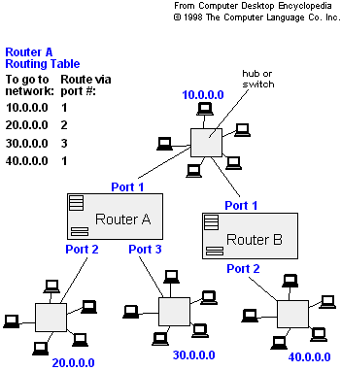
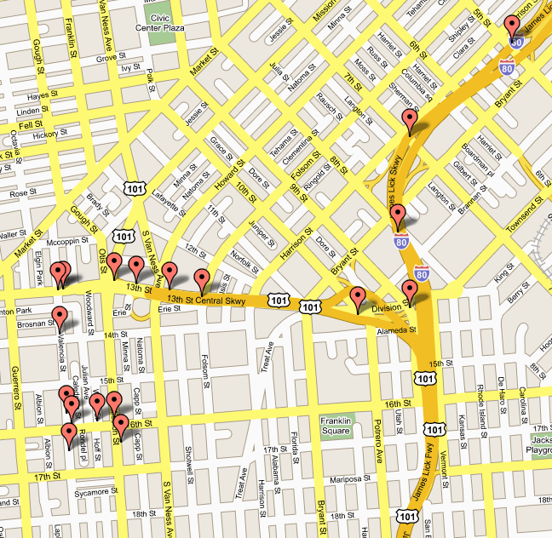
Greedy Algorithms: Dijkstra’s Algorithm
Applications
Traffic Information Systems
Mapping (Map Quest, Google Maps)
Routing Systems

Slide 55
THANK YOU

