Slide 1
CSC 301 – Design and Analysis of Algorithms
Instructor: Dr. M. Hasan Jamal
Lecture# 07(b): Topological Sorting

Slide 2
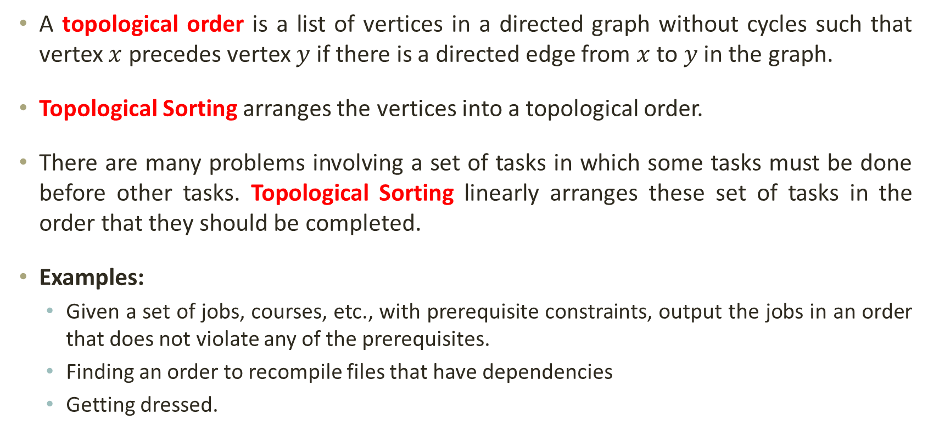
Applications of Graphs: Topological Sorting
A topological order is a list of vertices in a directed graph without cycles such that vertex $x$ precedes vertex $y$ if there is a directed edge from $x$ to $y$ in the graph.
Topological Sorting arranges the vertices into a topological order.
There are many problems involving a set of tasks in which some tasks must be done before other tasks. Topological Sorting linearly arranges these set of tasks in the order that they should be completed.
Examples:
Given a set of jobs, courses, etc., with prerequisite constraints, output the jobs in an order that does not violate any of the prerequisites.
Finding an order to recompile files that have dependencies
Getting dressed.

Slide 3
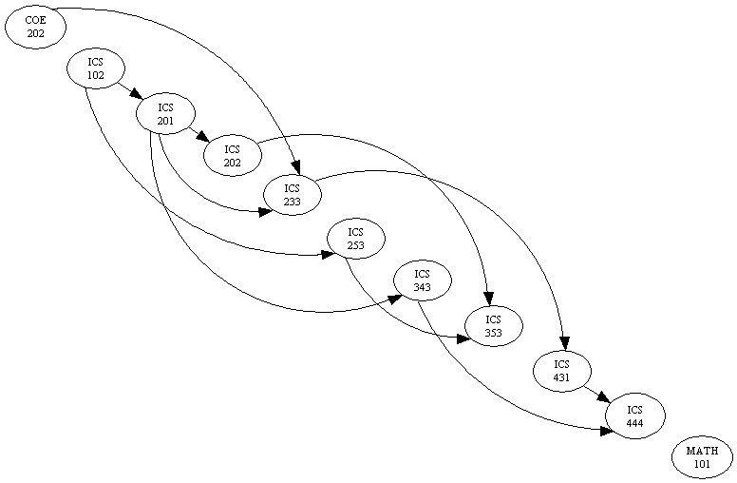
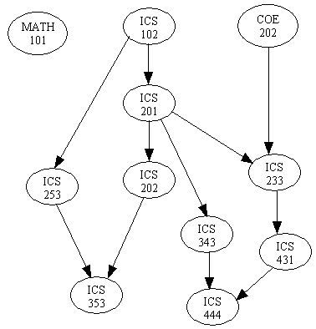
Topological Sorting

Slide 4

Topological Sorting
Given a directed graph $G$.
Rule: If there is an edge $u$ → $v$, then $u$ must come before $v$.
Example:
A
B
A
B
G
G
F
C
F
C
I
H
I
H
E
D
E
D

Slide 5
Topological Sorting: Intuition
Select any node from the list of nodes with no in-edges (in-degree = 0).
print it
delete it
and delete all the edges leaving it, and update in-degree of the destinations of those edges
If any drops to zero, add to the list
Repeat

Slide 6
Topological Sorting
There may be several topological orders for a given graph.
What if there were a new vertex G unconnected to the others?
C
[A, B, C, D, E, F], [A, B, C, D, F, E],
[A, B, D, C, E, F], [A, B, D, C, F, E],
[B, A, C, D, E, F], [B, A, C, D, F, E],
[B, A, D, C, E, F], [B, A, D, C, F, E],
[B, C, A, D, E, F], [B, C, A, D, F, E],
...
F
B
E
D
A

Slide 7
Topological Sort Algorithm
TopologicalSort( )
map := {each vertex → its in-degree}.
queue := {all vertices with in-degree = 0}.
ordering := { }.
Repeat until queue is empty:
Dequeue the first vertex v from the queue.
ordering += v.
Decrease the in-degree of all v's neighbors by 1 in the map.
queue += {any neighbors now having in-degree of 0}.
map := { A=0, B=0, C=1, D=2, E=2, F=2 }
queue := { B, A }
ordering := { }
C
F
B
E
D
A

Slide 8
Topological Sort Algorithm
TopologicalSort( )
map := {each vertex → its in-degree}.
queue := {all vertices with in-degree = 0}.
ordering := { }.
Repeat until queue is empty:
Dequeue the first vertex v from the queue. // B
ordering += v.
Decrease the in-degree of all v's // C, D neighbors by 1 in the map.
queue += {any neighbors now having in-degree of 0}.
map := { A=0, B=0, C=0, D=1, E=2, F=2 }
queue := { A, C }
ordering := { B }
C
F
B
E
D
A

Slide 9
Topological Sort Algorithm
TopologicalSort( )
map := {each vertex → its in-degree}.
queue := {all vertices with in-degree = 0}.
ordering := { }.
Repeat until queue is empty:
Dequeue the first vertex v from the queue. // A
ordering += v.
Decrease the in-degree of all v's // D neighbors by 1 in the map.
queue += {any neighbors now having in-degree of 0}.
map := { A=0, B=0, C=0, D=0, E=2, F=2 }
queue := { C, D }
ordering := { B, A }
C
F
B
E
D
A

Slide 10
Topological Sort Algorithm
TopologicalSort( )
map := {each vertex → its in-degree}.
queue := {all vertices with in-degree = 0}.
ordering := { }.
Repeat until queue is empty:
Dequeue the first vertex v from the queue. // C
ordering += v.
Decrease the in-degree of all v's // E, F neighbors by 1 in the map.
queue += {any neighbors now having in-degree of 0}.
map := { A=0, B=0, C=0, D=0, E=1, F=1 }
queue := { D }
ordering := { B, A, C }
C
F
B
E
D
A

Slide 11
Topological Sort Algorithm
TopologicalSort( )
map := {each vertex → its in-degree}.
queue := {all vertices with in-degree = 0}.
ordering := { }.
Repeat until queue is empty:
Dequeue the first vertex v from the queue. // D
ordering += v.
Decrease the in-degree of all v's // F, E neighbors by 1 in the map.
queue += {any neighbors now having in-degree of 0}.
map := { A=0, B=0, C=0, D=0, E=0, F=0 }
queue := { F, E }
ordering := { B, A, C, D }
C
F
B
E
D
A

Slide 12
Topological Sort Algorithm
TopologicalSort( )
map := {each vertex → its in-degree}.
queue := {all vertices with in-degree = 0}.
ordering := { }.
Repeat until queue is empty:
Dequeue the first vertex v from the queue. // F
ordering += v.
Decrease the in-degree of all v's // none neighbors by 1 in the map.
queue += {any neighbors now having in-degree of 0}.
map := { A=0, B=0, C=0, D=0, E=0, F=0 }
queue := { E }
ordering := { B, A, C, D, F }
C
F
B
E
D
A

Slide 13
Topological Sort Algorithm
TopologicalSort( )
map := {each vertex → its in-degree}.
queue := {all vertices with in-degree = 0}.
ordering := { }.
Repeat until queue is empty:
Dequeue the first vertex v from the queue. // F
ordering += v.
Decrease the in-degree of all v's // none neighbors by 1 in the map.
queue += {any neighbors now having in-degree of 0}.
map := { A=0, B=0, C=0, D=0, E=0, F=0 }
queue := { }
ordering := { B, A, C, D, F, E }
C
F
B
E
D
A

Slide 14
Topological Sort Algorithm
TopologicalSort( )
map := {each vertex → its in-degree}.
queue := {all vertices with in-degree = 0}.
ordering := { }.
Repeat until queue is empty:
Dequeue the first vertex v from the queue. // F
ordering += v.
Decrease the in-degree of all v's // none neighbors by 1 in the map.
queue += {any neighbors now having in-degree of 0}.
O(V)
O(V)
O(1)
O(1)
O(E) for all passes
What will be the running time?
Total running time: O(V + E)
Essentially O(V) time for sparse graph (Fast!).

Slide 15
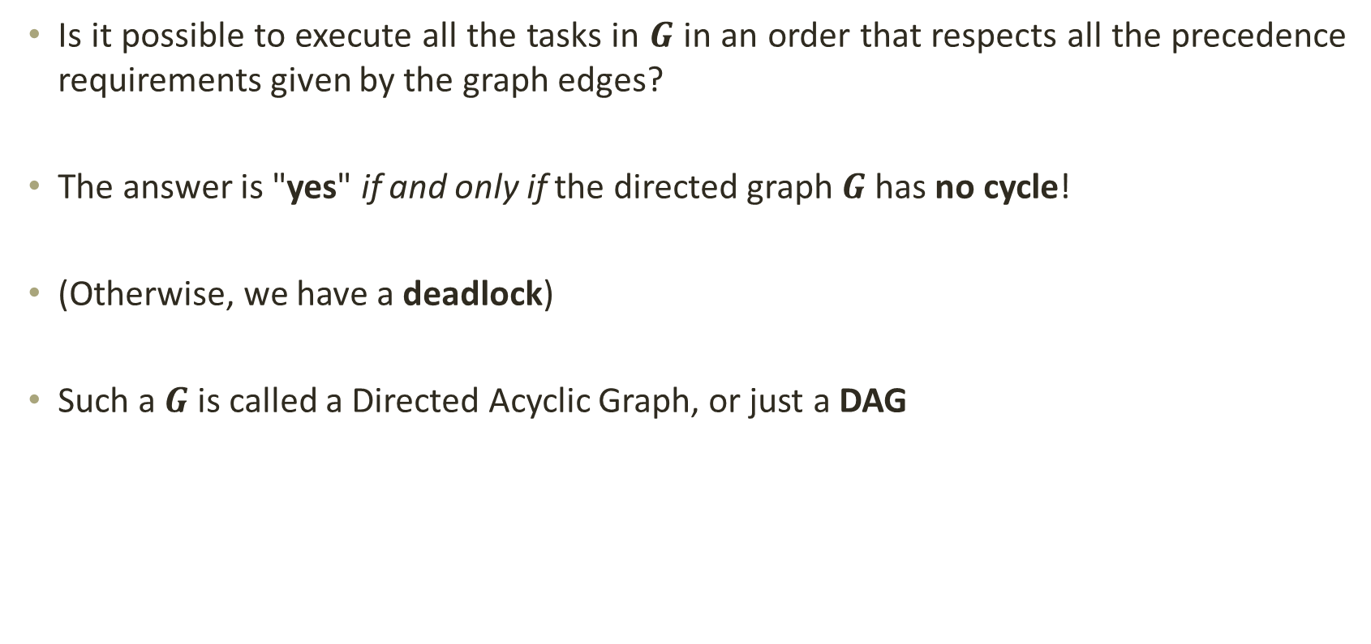
Topological Sorting
Is it possible to execute all the tasks in $G$ in an order that respects all the precedence requirements given by the graph edges?
The answer is "yes" if and only if the directed graph $G$ has no cycle!
(Otherwise, we have a deadlock)
Such a $G$ is called a Directed Acyclic Graph, or just a DAG

Slide 16
Topological Sorting
Applications
Finding cycle in a graph
Operation System deadlock detection
Dependency resolution
Sentence Ordering
Critical Path Analysis
Course Schedule problem
Other applications like manufacturing workflows, data serialization and context-free grammar.

Slide 17
Backup

Slide 18
Algorithm for TS
TOPOLOGICAL-SORT(G):
call DFS(G) to compute finishing times f[v] for each vertex v
as each vertex is finished, insert it onto the front of a linked list
return the linked list of vertices
Note that the result is just a list of vertices in order of decreasing finish times f[ ]
Topic Adopted from slideplayer.com

Slide 19
Edge classification by DFS
Edge (u,v) of G is classified as a:
(1) Tree edge iff u discovers v during the DFS: P[v] = u
If (u,v) is NOT a tree edge then it is a:
(2) Forward edge iff u is an ancestor of v in the DFS tree
(3) Back edge iff u is a descendant of v in the DFS tree
(4) Cross edge iff u is neither an ancestor nor a descendant of v
Topic Adopted from slideplayer.com

Slide 20
Edge classification by DFS
Tree edges
Forward edges
Back edges
Cross edges
a
b
d
c
The edge classification depends on the particular DFS tree!
Topic Adopted from slideplayer.com

Slide 21
Edge classification by DFS
Tree edges
Forward edges
Back edges
Cross edges
Both are valid
a
a
b
b
c
c
The edge classification depends on the particular DFS tree!
Topic Adopted from slideplayer.com

Slide 22
DAGs and back edges
Can there be a back edge in a DFS on a DAG?
NO! Back edges close a cycle!
A graph G is a DAG <=> there is no back edge classified by DFS(G)
Topic Adopted from slideplayer.com

Slide 23
Back to topological sort
TOPOLOGICAL-SORT(G):
call DFS(G) to compute finishing times f[v] for each vertex v
as each vertex is finished, insert it onto the front of a linked list
return the linked list of vertices
Topic Adopted from slideplayer.com

Slide 24
Topological sort
Call DFS(G) to compute the finishing times f[v]
Time = 1
Time = 2
d = ∞
f = ∞
Let’s say we start the DFS from the vertex c
a
d = ∞
f = ∞
Next we discover the vertex d
d = ∞
f = ∞
d = 1
f = ∞
b
c
c
d = ∞
f = ∞
d = ∞
f = ∞
d
e
d = ∞
f = ∞
f
Topic Adopted from slideplayer.com

Slide 25
Topological sort
Call DFS(G) to compute the finishing times f[v]
Time = 2
Time = 3
d = ∞
f = ∞
Let’s say we start the DFS from the vertex c
a
d = 1
f = ∞
Next we discover the vertex d
d = ∞
f = ∞
b
c
c
d = ∞
f = ∞
d = ∞
f = ∞
d = 2
f = ∞
d
d
e
d = ∞
f = ∞
f
Topic Adopted from slideplayer.com

Slide 26
Topological sort
Call DFS(G) to compute the finishing times f[v]
Time = 3
Time = 4
as each vertex is finished, insert it onto the front of a linked list
d = ∞
f = ∞
Let’s say we start the DFS from the vertex c
a
d = 1
f = ∞
Next we discover the vertex d
d = ∞
f = ∞
b
c
c
Next we discover the vertex f
d = 2
f = ∞
d = ∞
f = ∞
f is done, move back to d
d
d
e
d = 3
f = ∞
d = 3
f = 4
f
f
f
Topic Adopted from slideplayer.com

Slide 27
Topological sort
Call DFS(G) to compute the finishing times f[v]
Time = 4
Time = 5
d = ∞
f = ∞
Let’s say we start the DFS from the vertex c
a
d = 1
f = ∞
Next we discover the vertex d
d = ∞
f = ∞
b
c
c
Next we discover the vertex f
d = 2
f = 5
d = ∞
f = ∞
f is done, move back to d
d
d
e
d is done, move back to c
d = 3
f = 4
f
f
d
f
Topic Adopted from slideplayer.com

Slide 28
Topological sort
Call DFS(G) to compute the finishing times f[v]
Time = 5
Time = 6
d = ∞
f = ∞
Let’s say we start the DFS from the vertex c
a
d = 1
f = ∞
Next we discover the vertex d
d = ∞
f = ∞
b
c
c
Next we discover the vertex f
d = 2
f = 5
d = ∞
f = ∞
f is done, move back to d
d
d
e
d is done, move back to c
d = 3
f = 4
f
Next we discover the vertex e
f
d
f
Topic Adopted from slideplayer.com

Slide 29
Topological sort
Call DFS(G) to compute the finishing times f[v]
Time = 6
Time = 7
d = ∞
f = ∞
Let’s say we start the DFS from the vertex c
a
d = 1
f = ∞
Next we discover the vertex d
d = ∞
f = ∞
b
c
Next we discover the vertex f
Both edges from e are cross edges
d = 2
f = 5
d = 6
f = ∞
f is done, move back to d
d
d
e
e
d is done, move back to c
d = 3
f = 4
f
Next we discover the vertex e
f
e is done, move back to c
e
d
f
Topic Adopted from slideplayer.com

Slide 30
Topological sort
Call DFS(G) to compute the finishing times f[v]
Time = 7
Time = 8
d = ∞
f = ∞
Let’s say we start the DFS from the vertex c
a
Just a note: If there was (c,f) edge in the graph, it would be classified as a forward edge
(in this particular DFS run)
d = 1
f = ∞
Next we discover the vertex d
d = ∞
f = ∞
b
c
Next we discover the vertex f
d = 2
f = 5
d = 6
f = 7
f is done, move back to d
d
d
e
e
d is done, move back to c
d = 3
f = 4
f
Next we discover the vertex e
f
e is done, move back to c
c
e
d
f
c is done as well
Topic Adopted from slideplayer.com

Slide 31
Topological sort
Call DFS(G) to compute the finishing times f[v]
Time = 9
Time = 10
d = ∞
f = ∞
Let’s now call DFS visit from the vertex a
d = 9
f = ∞
a
a
d = 1
f = 8
Next we discover the vertex c,
but c was already processed => (a,c) is a cross edge
d = ∞
f = ∞
b
c
d = 2
f = 5
d = 6
f = 7
Next we discover the vertex b
d
d
e
e
d = 3
f = 4
f
f
c
e
d
f
Topic Adopted from slideplayer.com

Slide 32
Topological sort
Call DFS(G) to compute the finishing times f[v]
Time = 10
Time = 11
d = 9
f = ∞
Let’s now call DFS visit from the vertex a
a
a
d = 1
f = 8
Next we discover the vertex c,
but c was already processed => (a,c) is a cross edge
d = 10
f = ∞
d = 10
f = 11
b
b
c
d = 2
f = 5
d = 6
f = 7
Next we discover the vertex b
d
d
e
e
b is done as (b,d) is a cross edge => now move back to a
d = 3
f = 4
f
f
b
c
e
d
f
Topic Adopted from slideplayer.com

Slide 33
Topological sort
Call DFS(G) to compute the finishing times f[v]
Time = 11
Time = 12
d = 9
f = ∞
Let’s now call DFS visit from the vertex a
a
a
d = 1
f = 8
Next we discover the vertex c,
but c was already processed => (a,c) is a cross edge
d = 10
f = 11
b
b
c
d = 2
f = 5
d = 6
f = 7
Next we discover the vertex b
d
d
e
e
b is done as (b,d) is a cross edge => now move back to a
d = 3
f = 4
f
f
a is done as well
b
c
e
d
f
Topic Adopted from slideplayer.com

Slide 34
Topological sort
Call DFS(G) to compute the finishing times f[v]
Time = 11
Time = 13
d = 9
f = 12
Let’s now call DFS visit from the vertex a
WE HAVE THE RESULT!
return the linked list of vertices
a
a
d = 1
f = 8
Next we discover the vertex c,
but c was already processed => (a,c) is a cross edge
d = 10
f = 11
b
b
c
d = 2
f = 5
d = 6
f = 7
Next we discover the vertex b
d
d
e
e
b is done as (b,d) is a cross edge => now move back to c
d = 3
f = 4
f
f
a is done as well
a
b
c
e
d
f
Topic Adopted from slideplayer.com

Slide 35
Topological sort
Time = 11
Time = 13
The linked list is sorted in decreasing order of finishing times f[ ]
d = 9
f = 12
a
a
d = 10
f = 11
d = 1
f = 8
b
Try yourself with different vertex order for DFS visit
b
c
d = 2
f = 5
d = 6
f = 7
d
d
e
e
Note: If you redraw the graph so that all vertices are in a line ordered by a valid topological sort, then all edges point „from left to right“
d = 3
f = 4
f
f
a
b
c
e
d
f
Topic Adopted from slideplayer.com

Slide 36
Time complexity of TS(G)
Running time of topological sort:
Θ(n + m) where n=|V| and m=|E|
Why? Depth first search takes Θ(n + m) time in the worst case, and inserting into the front of a linked list takes Θ(1) time
Topic Adopted from slideplayer.com

Slide 37
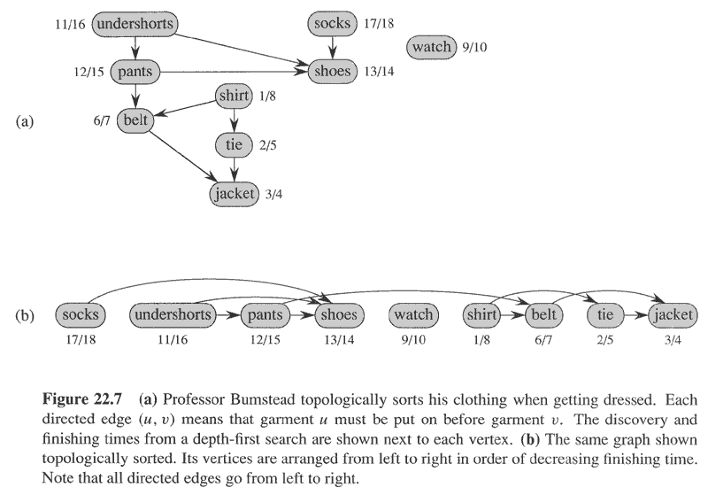
Getting Dressed

Slide 38
THANK YOU

