Slide 1
CSC 301 – Design and Analysis of Algorithms
Instructor: Dr. M. Hasan Jamal
Lecture# 09(b): Dynamic Programming – Knapsack Problem
Slides adapted from Sarah Buchanan
http://www.cs.ucf.edu/~sarahb/COP3503/Lectures/

Slide 2
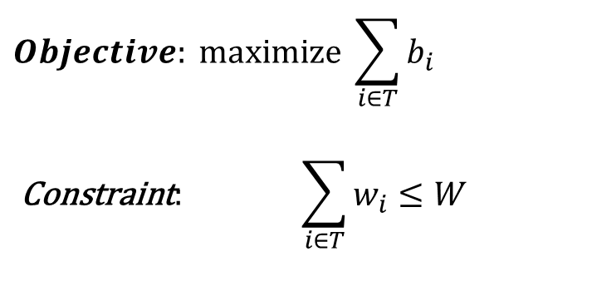
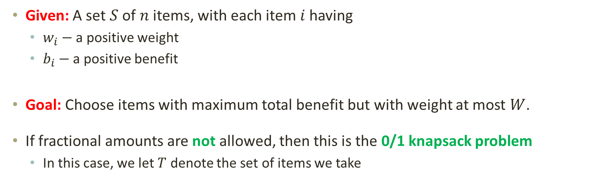
Dynamic Programming: 0/1 Knapsack Problem
Given: A set $S$ of $n$ items, with each item $i$ having
$w_{i}−$ a positive weight
$b_{i}−$ a positive benefit
Goal: Choose items with maximum total benefit but with weight at most $W$.
If fractional amounts are not allowed, then this is the 0/1 knapsack problem
In this case, we let $T$ denote the set of items we take
$$Objective: \operatorname{maximize}{\sum_{i∈T}{b_{i}}}$$
$$\text{Constraint}\text{: } \sum_{i∈T}{w_{i}≤W}$$

Slide 3
Dynamic Programming: 0/1 Knapsack Problem
Example: Brute Force Approach
Subset Total weight Total value
∅ 0 0 # W B
{1} 2 20 1 2 20
{2} 5 30 2 5 30
{3} 10 50 3 10 50
{4} 5 10 4 5 10
{1,2} 7 50
{1,3} 12 70 knapsack capacity W = 16
{1,4} 7 30
{2,3} 15 80
{2,4} 10 40
{3,4} 15 60
{1,2,3} 17 not feasible
{1,2,4} 12 60
{1,3,4} 17 not feasible
{2,3,4} 20 not feasible
{1,2,3,4} 22 not feasible
Go through all combinations and find the one with maximum value and with total weight ≤ W
Running time = O(2^{n})

Slide 4
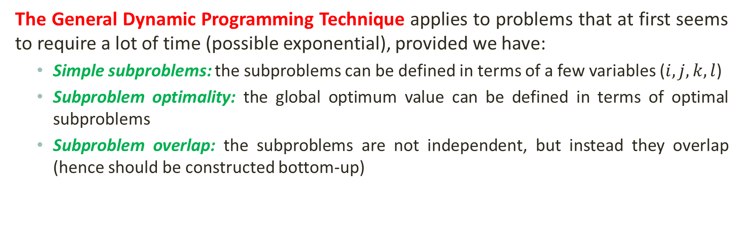
Dynamic Programming: 0/1 Knapsack Problem
The General Dynamic Programming Technique applies to problems that at first seems to require a lot of time (possible exponential), provided we have:
Simple subproblems: the subproblems can be defined in terms of a few variables ($i, j, k, l$)
Subproblem optimality: the global optimum value can be defined in terms of optimal subproblems
Subproblem overlap: the subproblems are not independent, but instead they overlap (hence should be constructed bottom-up)

Slide 5






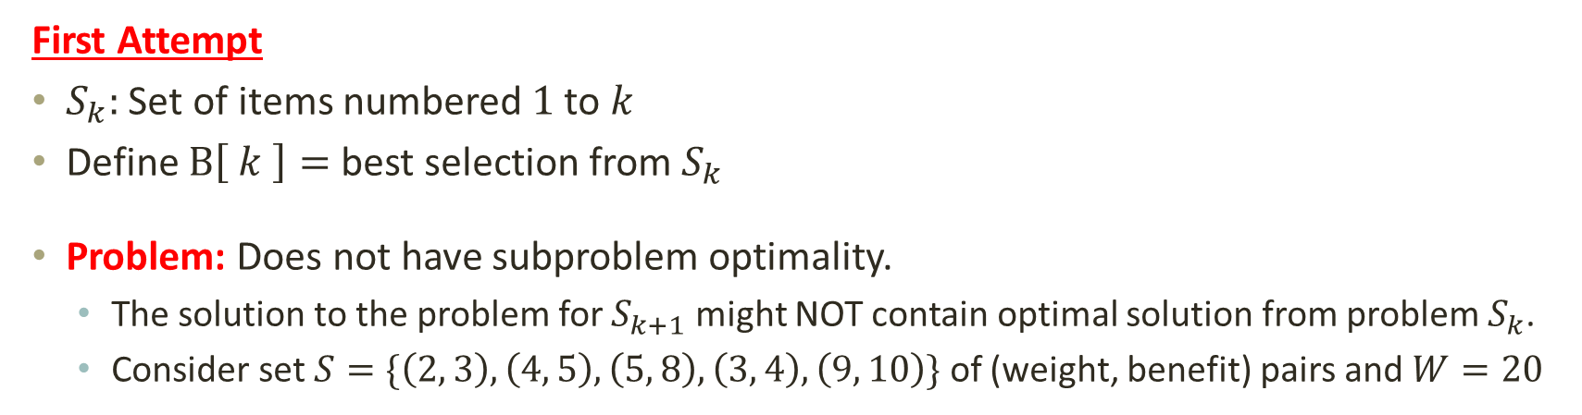





Dynamic Programming: 0/1 Knapsack Problem
First Attempt
$S_{k}:$ Set of items numbered $1$ to $k$
Define $B\left[ k \right]=$ best selection from $S_{k}$
Problem: Does not have subproblem optimality.
The solution to the problem for $S_{k+1}$ might NOT contain optimal solution from problem $S_{k}$.
Consider set $S=\{\left(2, 3\right), \left(4, 5\right), \left(5, 8\right), \left(3, 4\right), \left(9, 10\right)\}$ of (weight, benefit) pairs and $W=20$
Solution for S₄ is not part of the solution for S₅!!!
$$20$$
$$\left(2, 3\right)$$
$$\left(4, 5\right)$$
$$\left(5, 8\right)$$
$$\left(3, 4\right)$$
Best for $S_{4}$
$$\left(2, 3\right)$$
$$\left(4, 5\right)$$
$$\left(5, 8\right)$$
$$\left(9, 10\right)$$
Best for $S_{5}$
Notes:
We are given a set of items numbered 1 to k. We define bk to be the best selection from the set which gives the us the maximum benefit for the subproblem of size k. B[1] will be the smallest subproblem containing only the first item. But this definition of subproblems only using item numbers does not have subproblem optimality.
We cannot define the global optimum value in terms of optimal subproblem
Maximum benefit of 26 is achieved with S4.
the solution for S₄ is not part of the solution for S₅ so our definition of a sub-problem is flawed, and we need another one! Considering only item number in the subproblem is not sufficient.

Slide 6
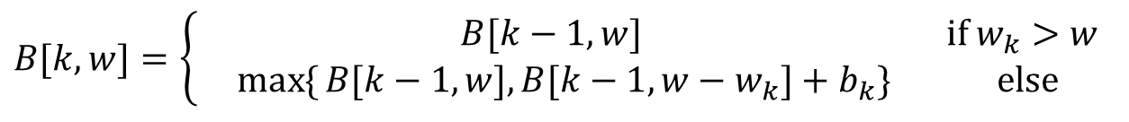
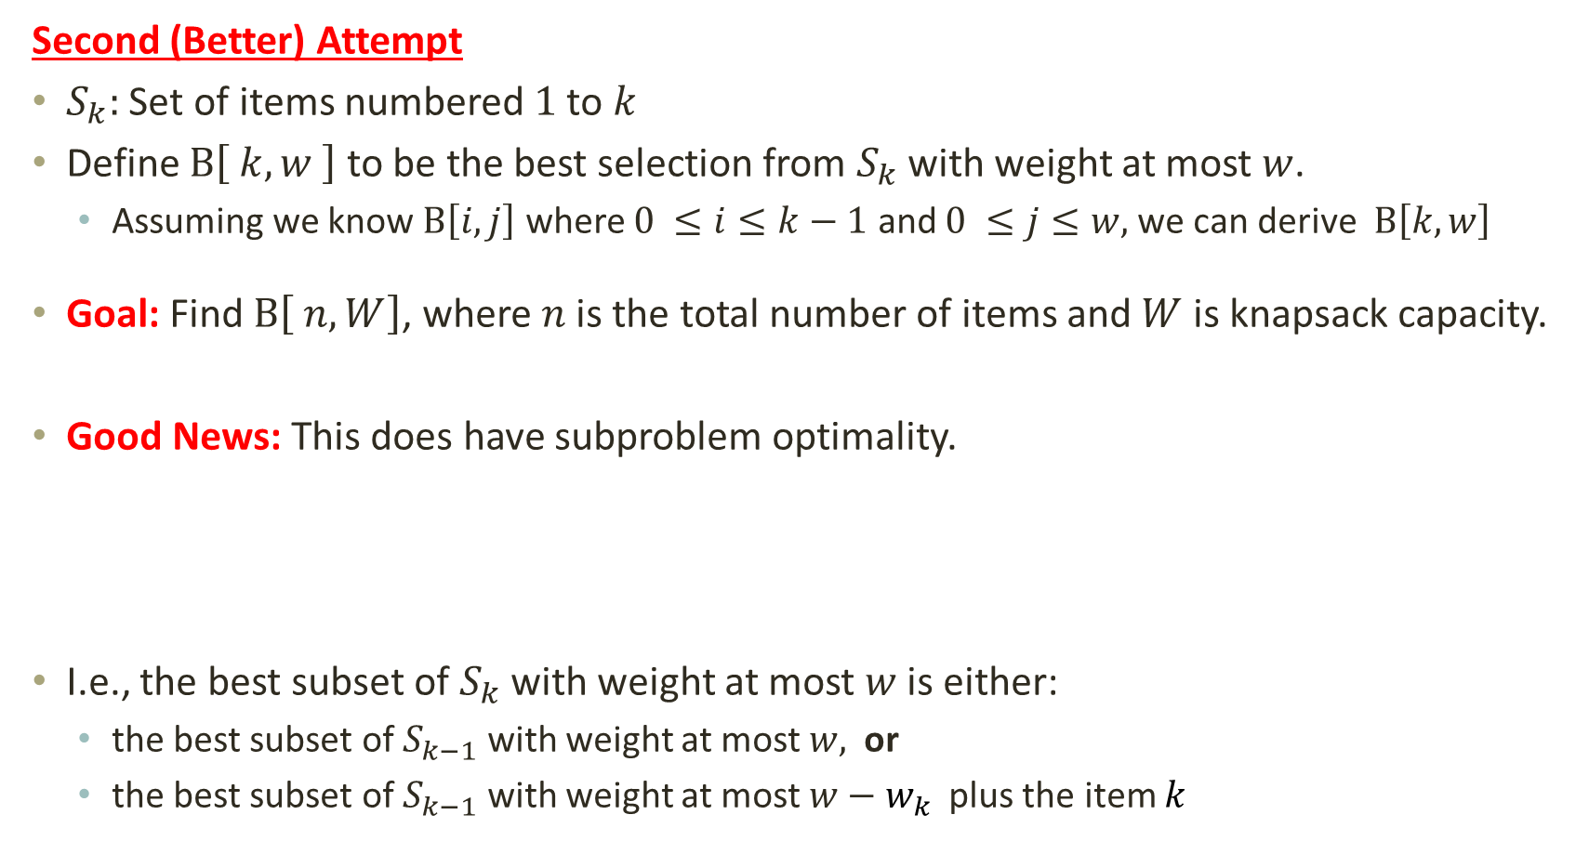
Dynamic Programming: 0/1 Knapsack Problem
Second (Better) Attempt
$S_{k}:$ Set of items numbered $1$ to $k$
Define $B\left[ k,w \right]$ to be the best selection from $S_{k}$ with weight at most $w$.
Assuming we know $B\left[i,j\right]$ where $0 ≤i≤k−1$ and $0 ≤j≤w,$we can derive $B\left[k,w\right]$
Goal: Find $B\left[ n,W\right]$, where $n$ is the total number of items and $W$ is knapsack capacity.
Good News: This does have subproblem optimality.
I.e., the best subset of $S_{k}$ with weight at most $w$is either:
the best subset of $S_{k−1}$ with weight at most $w,$or
the best subset of $S_{k−1}$ with weight at most $w−w_{k}$ plus the item $k$
$$B[k,w]=\left\{\begin{matrix} B[k−1,w] \text{if} w_{k}>w \\ \max{\{}B[k−1,w],B[k−1,w−w_{k}]+b_{k}\} \text{else}\end{matrix}\right.$$
Notes:
Let’s add another parameter: w, which will represent the maximum weight for each subset of items.
The sub-problem then will be to compute B[k,w], i.e., to find best selection from S_{k} in a knapsack of size w
W have two cases here. The first case, is when the item weight is larger than the subproblem weight capacity. In this case, item k cannot be part of the solution, since it is overweight.
For the second case, the item weight is smaller than the subproblem weight capacity. This case can have two scenarios. The best subset of S_{k} either contains item k or it does not. Here choose the case with greater value.

Slide 7
Dynamic Programming: 0/1 Knapsack Problem
Second (Better) Attempt
i / w | 0 | 1 | 2 |  |  | W
0
1
2
n
$$B[k,w]=\left\{\begin{matrix} B[k−1,w] \text{if} w_{k}>w \\ \max{\{}B[k−1,w],B[k−1,w−w_{k}]+b_{k}\} \text{else}\end{matrix}\right.$$
To compute the Optimal Solution, using bottom-up approach, first find optimal solutions to subproblems, and then use them to find an optimal solution to the problem.

Slide 8
Dynamic Programming: 0/1 Knapsack Problem
Knapsack_01(S, W)
for w = 0 to W
B[0,w] = 0
for i = 1 to n
B[i,0] = 0
for i = 1 to n
for w = 0 to W
if w_{i} <= w
if b_{i} + B[i-1,w-w_{i}] > B[i-1,w]
B[i,w] = b_{i} + B[i-1,w- w_{i}]
else
B[i,w] = B[i-1,w]
else B[i,w] = B[i-1,w]
return B;
// Initialize 1st row to 0’s
// Initialize 1st column to 0’s
// item "i" can be part of the solution
// item "i" IS part of the solution
// item "i" IS NOT part of the solution
// The weight of item "i" exceeds capacity w

Slide 9
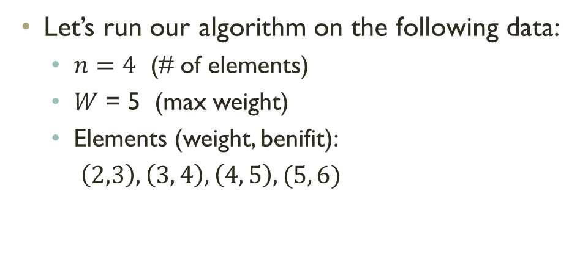
Dynamic Programming: 0/1 Knapsack Problem
Knapsack_01(S, W)
for w = 0 to W
B[0,w] = 0
for i = 1 to n
B[i,0] = 0
for i = 1 to n
for w = 0 to W
if w_{i} <= w
if b_{i} + B[i-1,w-w_{i}] > B[i-1,w]
B[i,w] = b_{i} + B[i-1,w- w_{i}]
else
B[i,w] = B[i-1,w]
else B[i,w] = B[i-1,w]
return B;
Let’s run our algorithm on the following data:
$n=4$ (# of elements)
$W$ = 5 (max weight)
Elements (weight, benifit):
$\left(2,3\right), \left(3, 4\right), \left(4, 5\right), (5, 6)$

Slide 10
Dynamic Programming: 0/1 Knapsack Problem
Items:
1: (2,3)
2: (3,4)
3: (4,5)
4: (5,6)
Knapsack_01(S, W)
for w = 0 to W
B[0,w] = 0
for i = 1 to n
B[i,0] = 0
for i = 1 to n
for w = 0 to W
if w_{i} <= w
if b_{i} + B[i-1,w-w_{i}] > B[i-1,w]
B[i,w] = b_{i} + B[i-1,w- w_{i}]
else
B[i,w] = B[i-1,w]
else B[i,w] = B[i-1,w]
return B;
i / w | 0 | 1 | 2 | 3 | 4 | 5
0
1
2
3
4

Slide 11
Dynamic Programming: 0/1 Knapsack Problem
Items:
1: (2,3)
2: (3,4)
3: (4,5)
4: (5,6)
Knapsack_01(S, W)
for w = 0 to W
B[0,w] = 0
for i = 1 to n
B[i,0] = 0
for i = 1 to n
for w = 0 to W
if w_{i} <= w
if b_{i} + B[i-1,w-w_{i}] > B[i-1,w]
B[i,w] = b_{i} + B[i-1,w- w_{i}]
else
B[i,w] = B[i-1,w]
else B[i,w] = B[i-1,w]
return B;
i / w | 0 | 1 | 2 | 3 | 4 | 5
0 | 0 | 0 | 0 | 0 | 0 | 0
1 | 0
2 | 0
3 | 0
4 | 0

Slide 12
Dynamic Programming: 0/1 Knapsack Problem
Items:
1: (2,3)
2: (3,4)
3: (4,5)
4: (5,6)
Knapsack_01(S, W)
for w = 0 to W
B[0,w] = 0
for i = 1 to n
B[i,0] = 0
for i = 1 to n
for w = 0 to W
if w_{i} <= w
if b_{i} + B[i-1,w-w_{i}] > B[i-1,w]
B[i,w] = b_{i} + B[i-1,w- w_{i}]
else
B[i,w] = B[i-1,w]
else B[i,w] = B[i-1,w]
return B;
i / w | 0 | 1 | 2 | 3 | 4 | 5
0 | 0 | 0 | 0 | 0 | 0 | 0
1 | 0
2 | 0
3 | 0
4 | 0
 |  | 0
i = 1
b_{i} = 3
w_{i} = 2
w = 1
w-w_{i} = -1

Slide 13
Dynamic Programming: 0/1 Knapsack Problem
Items:
1: (2,3)
2: (3,4)
3: (4,5)
4: (5,6)
Knapsack_01(S, W)
for w = 0 to W
B[0,w] = 0
for i = 1 to n
B[i,0] = 0
for i = 1 to n
for w = 0 to W
if w_{i} <= w
if b_{i} + B[i-1,w-w_{i}] > B[i-1,w]
B[i,w] = b_{i} + B[i-1,w- w_{i}]
else
B[i,w] = B[i-1,w]
else B[i,w] = B[i-1,w]
return B;
i / w | 0 | 1 | 2 | 3 | 4 | 5
0 | 0 | 0 | 0 | 0 | 0 | 0
1 | 0 | 0
2 | 0
3 | 0
4 | 0
 |  |  | 3
i = 1
b_{i} = 3
w_{i} = 2
w = 2
w-w_{i} = 0

Slide 14
Dynamic Programming: 0/1 Knapsack Problem
Items:
1: (2,3)
2: (3,4)
3: (4,5)
4: (5,6)
Knapsack_01(S, W)
for w = 0 to W
B[0,w] = 0
for i = 1 to n
B[i,0] = 0
for i = 1 to n
for w = 0 to W
if w_{i} <= w
if b_{i} + B[i-1,w-w_{i}] > B[i-1,w]
B[i,w] = b_{i} + B[i-1,w- w_{i}]
else
B[i,w] = B[i-1,w]
else B[i,w] = B[i-1,w]
return B;
i / w | 0 | 1 | 2 | 3 | 4 | 5
0 | 0 | 0 | 0 | 0 | 0 | 0
1 | 0 | 0 | 3
2 | 0
3 | 0
4 | 0
 |  |  |  | 3
i = 1
b_{i} = 3
w_{i} = 2
w = 3
w-w_{i} = 1

Slide 15
Dynamic Programming: 0/1 Knapsack Problem
Items:
1: (2,3)
2: (3,4)
3: (4,5)
4: (5,6)
Knapsack_01(S, W)
for w = 0 to W
B[0,w] = 0
for i = 1 to n
B[i,0] = 0
for i = 1 to n
for w = 0 to W
if w_{i} <= w
if b_{i} + B[i-1,w-w_{i}] > B[i-1,w]
B[i,w] = b_{i} + B[i-1,w- w_{i}]
else
B[i,w] = B[i-1,w]
else B[i,w] = B[i-1,w]
return B;
i / w | 0 | 1 | 2 | 3 | 4 | 5
0 | 0 | 0 | 0 | 0 | 0 | 0
1 | 0 | 0 | 3 | 3
2 | 0
3 | 0
4 | 0
 |  |  |  |  | 3
i = 1
b_{i} = 3
w_{i} = 2
w = 4
w-w_{i} = 2

Slide 16
Dynamic Programming: 0/1 Knapsack Problem
Items:
1: (2,3)
2: (3,4)
3: (4,5)
4: (5,6)
Knapsack_01(S, W)
for w = 0 to W
B[0,w] = 0
for i = 1 to n
B[i,0] = 0
for i = 1 to n
for w = 0 to W
if w_{i} <= w
if b_{i} + B[i-1,w-w_{i}] > B[i-1,w]
B[i,w] = b_{i} + B[i-1,w- w_{i}]
else
B[i,w] = B[i-1,w]
else B[i,w] = B[i-1,w]
return B;
i / w | 0 | 1 | 2 | 3 | 4 | 5
0 | 0 | 0 | 0 | 0 | 0 | 0
1 | 0 | 0 | 3 | 3 | 3
2 | 0
3 | 0
4 | 0
 |  |  |  |  |  | 3
i = 1
b_{i} = 3
w_{i} = 2
w = 5
w-w_{i} = 3

Slide 17
Dynamic Programming: 0/1 Knapsack Problem
Items:
1: (2,3)
2: (3,4)
3: (4,5)
4: (5,6)
Knapsack_01(S, W)
for w = 0 to W
B[0,w] = 0
for i = 1 to n
B[i,0] = 0
for i = 1 to n
for w = 0 to W
if w_{i} <= w
if b_{i} + B[i-1,w-w_{i}] > B[i-1,w]
B[i,w] = b_{i} + B[i-1,w- w_{i}]
else
B[i,w] = B[i-1,w]
else B[i,w] = B[i-1,w]
return B;
i / w | 0 | 1 | 2 | 3 | 4 | 5
0 | 0 | 0 | 0 | 0 | 0 | 0
1 | 0 | 0 | 3 | 3 | 3 | 3
2 | 0
3 | 0
4 | 0
 |  | 0
i = 2
b_{i} = 4
w_{i} = 3
w = 1
w-w_{i} = -2

Slide 18
Dynamic Programming: 0/1 Knapsack Problem
Items:
1: (2,3)
2: (3,4)
3: (4,5)
4: (5,6)
Knapsack_01(S, W)
for w = 0 to W
B[0,w] = 0
for i = 1 to n
B[i,0] = 0
for i = 1 to n
for w = 0 to W
if w_{i} <= w
if b_{i} + B[i-1,w-w_{i}] > B[i-1,w]
B[i,w] = b_{i} + B[i-1,w- w_{i}]
else
B[i,w] = B[i-1,w]
else B[i,w] = B[i-1,w]
return B;
i / w | 0 | 1 | 2 | 3 | 4 | 5
0 | 0 | 0 | 0 | 0 | 0 | 0
1 | 0 | 0 | 3 | 3 | 3 | 3
2 | 0 | 0
3 | 0
4 | 0
 |  |  | 3
i = 2
b_{i} = 4
w_{i} = 3
w = 2
w-w_{i} = -1

Slide 19
Dynamic Programming: 0/1 Knapsack Problem
Items:
1: (2,3)
2: (3,4)
3: (4,5)
4: (5,6)
Knapsack_01(S, W)
for w = 0 to W
B[0,w] = 0
for i = 1 to n
B[i,0] = 0
for i = 1 to n
for w = 0 to W
if w_{i} <= w
if b_{i} + B[i-1,w-w_{i}] > B[i-1,w]
B[i,w] = b_{i} + B[i-1,w- w_{i}]
else
B[i,w] = B[i-1,w]
else B[i,w] = B[i-1,w]
return B;
i / w | 0 | 1 | 2 | 3 | 4 | 5
0 | 0 | 0 | 0 | 0 | 0 | 0
1 | 0 | 0 | 3 | 3 | 3 | 3
2 | 0 | 0 | 3
3 | 0
4 | 0
 |  |  |  | 4
i = 2
b_{i} = 4
w_{i} = 3
w = 3
w-w_{i} = 0

Slide 20
Dynamic Programming: 0/1 Knapsack Problem
Items:
1: (2,3)
2: (3,4)
3: (4,5)
4: (5,6)
Knapsack_01(S, W)
for w = 0 to W
B[0,w] = 0
for i = 1 to n
B[i,0] = 0
for i = 1 to n
for w = 0 to W
if w_{i} <= w
if b_{i} + B[i-1,w-w_{i}] > B[i-1,w]
B[i,w] = b_{i} + B[i-1,w- w_{i}]
else
B[i,w] = B[i-1,w]
else B[i,w] = B[i-1,w]
return B;
i / w | 0 | 1 | 2 | 3 | 4 | 5
0 | 0 | 0 | 0 | 0 | 0 | 0
1 | 0 | 0 | 3 | 3 | 3 | 3
2 | 0 | 0 | 3 | 4
3 | 0
4 | 0
 |  |  |  |  | 4
i = 2
b_{i} = 4
w_{i} = 3
w = 4
w-w_{i} = 1

Slide 21
Dynamic Programming: 0/1 Knapsack Problem
Items:
1: (2,3)
2: (3,4)
3: (4,5)
4: (5,6)
Knapsack_01(S, W)
for w = 0 to W
B[0,w] = 0
for i = 1 to n
B[i,0] = 0
for i = 1 to n
for w = 0 to W
if w_{i} <= w
if b_{i} + B[i-1,w-w_{i}] > B[i-1,w]
B[i,w] = b_{i} + B[i-1,w- w_{i}]
else
B[i,w] = B[i-1,w]
else B[i,w] = B[i-1,w]
return B;
i / w | 0 | 1 | 2 | 3 | 4 | 5
0 | 0 | 0 | 0 | 0 | 0 | 0
1 | 0 | 0 | 3 | 3 | 3 | 3
2 | 0 | 0 | 3 | 4 | 4
3 | 0
4 | 0
 |  |  |  |  |  | 7
i = 2
b_{i} = 4
w_{i} = 3
w = 5
w-w_{i} = 2

Slide 22
Dynamic Programming: 0/1 Knapsack Problem
Items:
1: (2,3)
2: (3,4)
3: (4,5)
4: (5,6)
Knapsack_01(S, W)
for w = 0 to W
B[0,w] = 0
for i = 1 to n
B[i,0] = 0
for i = 1 to n
for w = 0 to W
if w_{i} <= w
if b_{i} + B[i-1,w-w_{i}] > B[i-1,w]
B[i,w] = b_{i} + B[i-1,w- w_{i}]
else
B[i,w] = B[i-1,w]
else B[i,w] = B[i-1,w]
return B;
i / w | 0 | 1 | 2 | 3 | 4 | 5
0 | 0 | 0 | 0 | 0 | 0 | 0
1 | 0 | 0 | 3 | 3 | 3 | 3
2 | 0 | 0 | 3 | 4 | 4 | 7
3 | 0
4 | 0
 |  | 0 | 3 | 4
i = 3
b_{i} = 5
w_{i} = 4
w = 1, …, 3
w-w_{i} = -3, …, -1

Slide 23
Dynamic Programming: 0/1 Knapsack Problem
Items:
1: (2,3)
2: (3,4)
3: (4,5)
4: (5,6)
Knapsack_01(S, W)
for w = 0 to W
B[0,w] = 0
for i = 1 to n
B[i,0] = 0
for i = 1 to n
for w = 0 to W
if w_{i} <= w
if b_{i} + B[i-1,w-w_{i}] > B[i-1,w]
B[i,w] = b_{i} + B[i-1,w- w_{i}]
else
B[i,w] = B[i-1,w]
else B[i,w] = B[i-1,w]
return B;
i / w | 0 | 1 | 2 | 3 | 4 | 5
0 | 0 | 0 | 0 | 0 | 0 | 0
1 | 0 | 0 | 3 | 3 | 3 | 3
2 | 0 | 0 | 3 | 4 | 4 | 7
3 | 0 | 0 | 3 | 4
4 | 0
 |  |  |  |  | 5
i = 3
b_{i} = 5
w_{i} = 4
w = 4
w-w_{i} = 0

Slide 24
Dynamic Programming: 0/1 Knapsack Problem
Items:
1: (2,3)
2: (3,4)
3: (4,5)
4: (5,6)
Knapsack_01(S, W)
for w = 0 to W
B[0,w] = 0
for i = 1 to n
B[i,0] = 0
for i = 1 to n
for w = 0 to W
if w_{i} <= w
if b_{i} + B[i-1,w-w_{i}] > B[i-1,w]
B[i,w] = b_{i} + B[i-1,w- w_{i}]
else
B[i,w] = B[i-1,w]
else B[i,w] = B[i-1,w]
return B;
i / w | 0 | 1 | 2 | 3 | 4 | 5
0 | 0 | 0 | 0 | 0 | 0 | 0
1 | 0 | 0 | 3 | 3 | 3 | 3
2 | 0 | 0 | 3 | 4 | 4 | 7
3 | 0 | 0 | 3 | 4 | 5
4 | 0
 |  |  |  |  |  | 7
i = 3
b_{i} = 5
w_{i} = 4
w = 5
w-w_{i} = 1

Slide 25
Dynamic Programming: 0/1 Knapsack Problem
Items:
1: (2,3)
2: (3,4)
3: (4,5)
4: (5,6)
Knapsack_01(S, W)
for w = 0 to W
B[0,w] = 0
for i = 1 to n
B[i,0] = 0
for i = 1 to n
for w = 0 to W
if w_{i} <= w
if b_{i} + B[i-1,w-w_{i}] > B[i-1,w]
B[i,w] = b_{i} + B[i-1,w- w_{i}]
else
B[i,w] = B[i-1,w]
else B[i,w] = B[i-1,w]
return B;
i / w | 0 | 1 | 2 | 3 | 4 | 5
0 | 0 | 0 | 0 | 0 | 0 | 0
1 | 0 | 0 | 3 | 3 | 3 | 3
2 | 0 | 0 | 3 | 4 | 4 | 7
3 | 0 | 0 | 3 | 4 | 5 | 7
4 | 0
 |  | 0 | 3 | 4 | 5
i = 4
b_{i} = 6
w_{i} = 5
w = 1, …, 4
w-w_{i} = -4,…, -1

Slide 26
Dynamic Programming: 0/1 Knapsack Problem
Items:
1: (2,3)
2: (3,4)
3: (4,5)
4: (5,6)
Knapsack_01(S, W)
for w = 0 to W
B[0,w] = 0
for i = 1 to n
B[i,0] = 0
for i = 1 to n
for w = 0 to W
if w_{i} <= w
if b_{i} + B[i-1,w-w_{i}] > B[i-1,w]
B[i,w] = b_{i} + B[i-1,w- w_{i}]
else
B[i,w] = B[i-1,w]
else B[i,w] = B[i-1,w]
return B;
i / w | 0 | 1 | 2 | 3 | 4 | 5
0 | 0 | 0 | 0 | 0 | 0 | 0
1 | 0 | 0 | 3 | 3 | 3 | 3
2 | 0 | 0 | 3 | 4 | 4 | 7
3 | 0 | 0 | 3 | 4 | 5 | 7
4 | 0 | 0 | 3 | 4 | 5
 |  |  |  |  |  | 7
i = 4
b_{i} = 6
w_{i} = 5
w = 5
w-w_{i} = 0

Slide 27
Dynamic Programming: 0/1 Knapsack Problem
Items:
1: (2,3)
2: (3,4)
3: (4,5)
4: (5,6)
Knapsack_01(S, W)
for w = 0 to W
B[0,w] = 0
for i = 1 to n
B[i,0] = 0
for i = 1 to n
for w = 0 to W
if w_{i} <= w
if b_{i} + B[i-1,w-w_{i}] > B[i-1,w]
B[i,w] = b_{i} + B[i-1,w- w_{i}]
else
B[i,w] = B[i-1,w]
else B[i,w] = B[i-1,w]
return B;
i / w | 0 | 1 | 2 | 3 | 4 | 5
0 | 0 | 0 | 0 | 0 | 0 | 0
1 | 0 | 0 | 3 | 3 | 3 | 3
2 | 0 | 0 | 3 | 4 | 4 | 7
3 | 0 | 0 | 3 | 4 | 5 | 7
4 | 0 | 0 | 3 | 4 | 5 | 7
We’re DONE!
The max possible value that can be carried in this knapsack is $7.

Slide 28
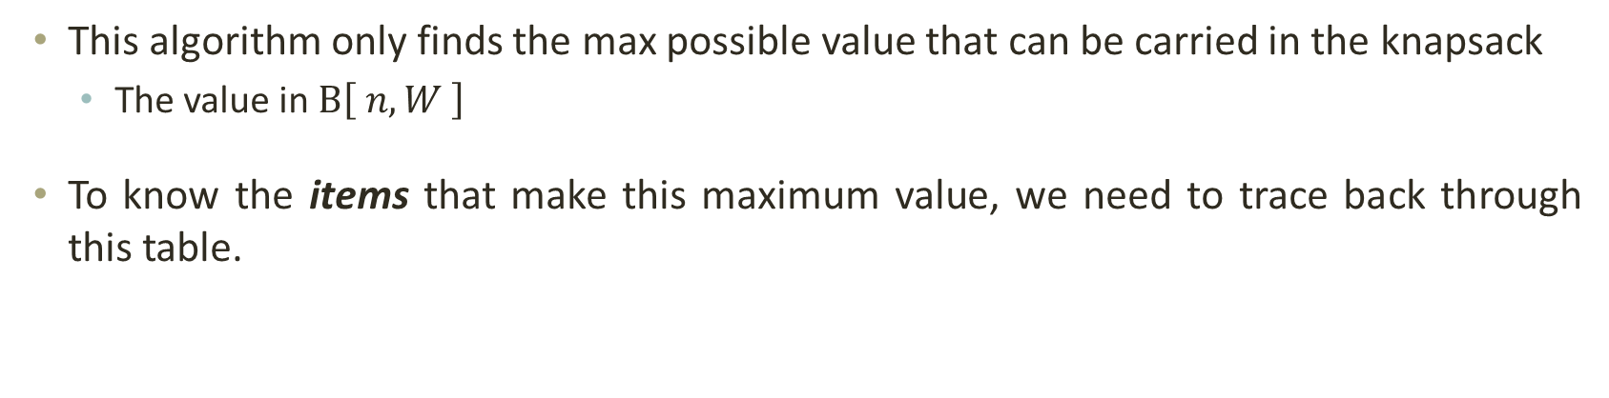
Dynamic Programming: 0/1 Knapsack Problem
This algorithm only finds the max possible value that can be carried in the knapsack
The value in $B\left[ n,W \right]$
To know the items that make this maximum value, we need to trace back through this table.
i = n, k = W
while i, k > 0
if B[i, k] ≠ B[i-1, k]
mark the i^{th} item as in the knapsack
i = i-1, k = k-w_{i}
else
i = i-1 // The i^{th} item is not in the optimally packed knapsack

Slide 29
Dynamic Programming: 0/1 Knapsack Problem
Items:
1: (2,3)
2: (3,4)
3: (4,5)
4: (5,6)
Knapsack:
i / w | 0 | 1 | 2 | 3 | 4 | 5
0 | 0 | 0 | 0 | 0 | 0 | 0
1 | 0 | 0 | 3 | 3 | 3 | 3
2 | 0 | 0 | 3 | 4 | 4 | 7
3 | 0 | 0 | 3 | 4 | 5 | 7
4 | 0 | 0 | 3 | 4 | 5 | 7
i = 4
k = 5
b_{i} = 6
w_{i} = 5
B[i,k] = 7
B[i-1,k] = 7
i = n, k = W
while i, k > 0
if B[i, k] ≠ B[i-1, k]
mark the i^{th} item as in the knapsack
i = i-1, k = k-w_{i}
else
i = i-1 // The i^{th} item is not in the optimally packed knapsack

Slide 30
Dynamic Programming: 0/1 Knapsack Problem
Items:
1: (2,3)
2: (3,4)
3: (4,5)
4: (5,6)
Knapsack:
i / w | 0 | 1 | 2 | 3 | 4 | 5
0 | 0 | 0 | 0 | 0 | 0 | 0
1 | 0 | 0 | 3 | 3 | 3 | 3
2 | 0 | 0 | 3 | 4 | 4 | 7
3 | 0 | 0 | 3 | 4 | 5 | 7
4 | 0 | 0 | 3 | 4 | 5 | 7
i = 3
k = 5
b_{i} = 5
w_{i} = 4
B[i,k] = 7
B[i-1,k] = 7
i = n, k = W
while i, k > 0
if B[i, k] ≠ B[i-1, k]
mark the i^{th} item as in the knapsack
i = i-1, k = k-w_{i}
else
i = i-1 // The i^{th} item is not in the optimally packed knapsack

Slide 31
Dynamic Programming: 0/1 Knapsack Problem
Items:
1: (2,3)
2: (3,4)
3: (4,5)
4: (5,6)
Knapsack:
i / w | 0 | 1 | 2 | 3 | 4 | 5
0 | 0 | 0 | 0 | 0 | 0 | 0
1 | 0 | 0 | 3 | 3 | 3 | 3
2 | 0 | 0 | 3 | 4 | 4 | 7
3 | 0 | 0 | 3 | 4 | 5 | 7
4 | 0 | 0 | 3 | 4 | 5 | 7
Item 2
i = 2
k = 5
b_{i} =4
w_{i} = 3
B[i,k] = 7
B[i-1,k] = 3
k – w_{i} = 2
i = n, k = W
while i, k > 0
if B[i, k] ≠ B[i-1, k]
mark the i^{th} item as in the knapsack
i = i-1, k = k-w_{i}
else
i = i-1 // The i^{th} item is not in the optimally packed knapsack

Slide 32
Dynamic Programming: 0/1 Knapsack Problem
Items:
1: (2,3)
2: (3,4)
3: (4,5)
4: (5,6)
Knapsack:
i / w | 0 | 1 | 2 | 3 | 4 | 5
0 | 0 | 0 | 0 | 0 | 0 | 0
1 | 0 | 0 | 3 | 3 | 3 | 3
2 | 0 | 0 | 3 | 4 | 4 | 7
3 | 0 | 0 | 3 | 4 | 5 | 7
4 | 0 | 0 | 3 | 4 | 5 | 7
Item 2
i = 1
k = 2
b_{i} =3
w_{i} = 2
B[i,k] = 3
B[i-1,k] = 0
k – w_{i} = 0
Item 1
i = n, k = W
while i, k > 0
if B[i, k] ≠ B[i-1, k]
mark the i^{th} item as in the knapsack
i = i-1, k = k-w_{i}
else
i = i-1 // The i^{th} item is not in the optimally packed knapsack

Slide 33
Dynamic Programming: 0/1 Knapsack Problem
Items:
1: (2,3)
2: (3,4)
3: (4,5)
4: (5,6)
Knapsack:
i / w | 0 | 1 | 2 | 3 | 4 | 5
0 | 0 | 0 | 0 | 0 | 0 | 0
1 | 0 | 0 | 3 | 3 | 3 | 3
2 | 0 | 0 | 3 | 4 | 4 | 7
3 | 0 | 0 | 3 | 4 | 5 | 7
4 | 0 | 0 | 3 | 4 | 5 | 7
Item 2
i = 0
k = 0
Item 1
k = 0, so we’re DONE!
The optimal knapsack should contain: Item 1 and Item 2.
i = n, k = W
while i, k > 0
if B[i, k] ≠ B[i-1, k]
mark the i^{th} item as in the knapsack
i = i-1, k = k-w_{i}
else
i = i-1 // The i^{th} item is not in the optimally packed knapsack

Slide 34

Dynamic Programming: 0/1 Knapsack Problem
Knapsack_01(S, W)
for w = 0 to W
B[0,w] = 0
for i = 1 to n
B[i,0] = 0
for i = 1 to n
for w = 0 to W
if w_{i} <= w
if b_{i} + B[i-1,w-w_{i}] > B[i-1,w]
B[i,w] = b_{i} + B[i-1,w- w_{i}]
else
B[i,w] = B[i-1,w]
else B[i,w] = B[i-1,w]
return B;
// Initialize 1st row to 0’s
O(W)
// Initialize 1st column to 0’s
O(n)
Repeat n times
O(W)
// item “i" can be part of the solution
Time Complexity = $\text{O}$($nW$)
// w_{i} > w
Remember that the brute-force algorithm takes O(2^{n})

Slide 35
Dynamic Programming: 0/1 Knapsack Problem
For the practice questions given below:
Fill out the dynamic programming table for the knapsack problem to the right.
Trace back through the table to find the items in the knapsack.
Item | Weight | Value
1 | 3 | 25
2 | 2 | 20
3 | 1 | 15
4 | 4 | 40
5 | 5 | 50
Knapsack Capacity W = 6
Item | Weight | Value
1 | 2 | 20
2 | 5 | 30
3 | 10 | 50
4 | 5 | 10
Knapsack Capacity W = 16

Slide 36
Greedy Algorithms vs. Dynamic Programming
Greedy algorithms and dynamic programming are similar; both generally work under the same circumstances.
Both techniques rely on the presence of optimal substructure.
The optimal solution contains the optimal solutions to subproblems.
Dynamic programming solves subproblems first, then makes a decision.
Greedy algorithm makes decision first, then solve subproblems.
Greedy-choice property gains efficiency
Consider the 0-1 knapsack problem, greedy algorithm will pick as much of the most valuable items first which does not necessarily give optimal value!

Slide 37
THANK YOU

