Slide 1
CSC 301 – Design and Analysis of Algorithms
Instructor: Dr. M. Hasan Jamal
Lecture# 09(d): Dynamic Programming – Floyd-Warshall Algorithm

Slide 2
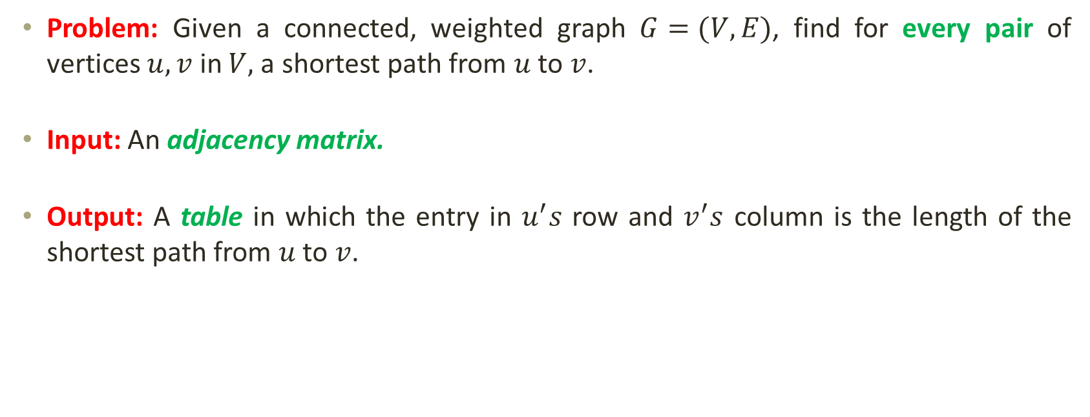
All-Pairs Shortest Paths Problem
Problem: Given a connected, weighted graph $G=(V,E)$, find for every pair of vertices $u, v$ in $V,$a shortest path from $u$ to $v$.
Input: An adjacency matrix.
Output: A table in which the entry in $u^{′}s$ row and $v^{′}s$ column is the length of the shortest path from $u$ to $v$.

Slide 3
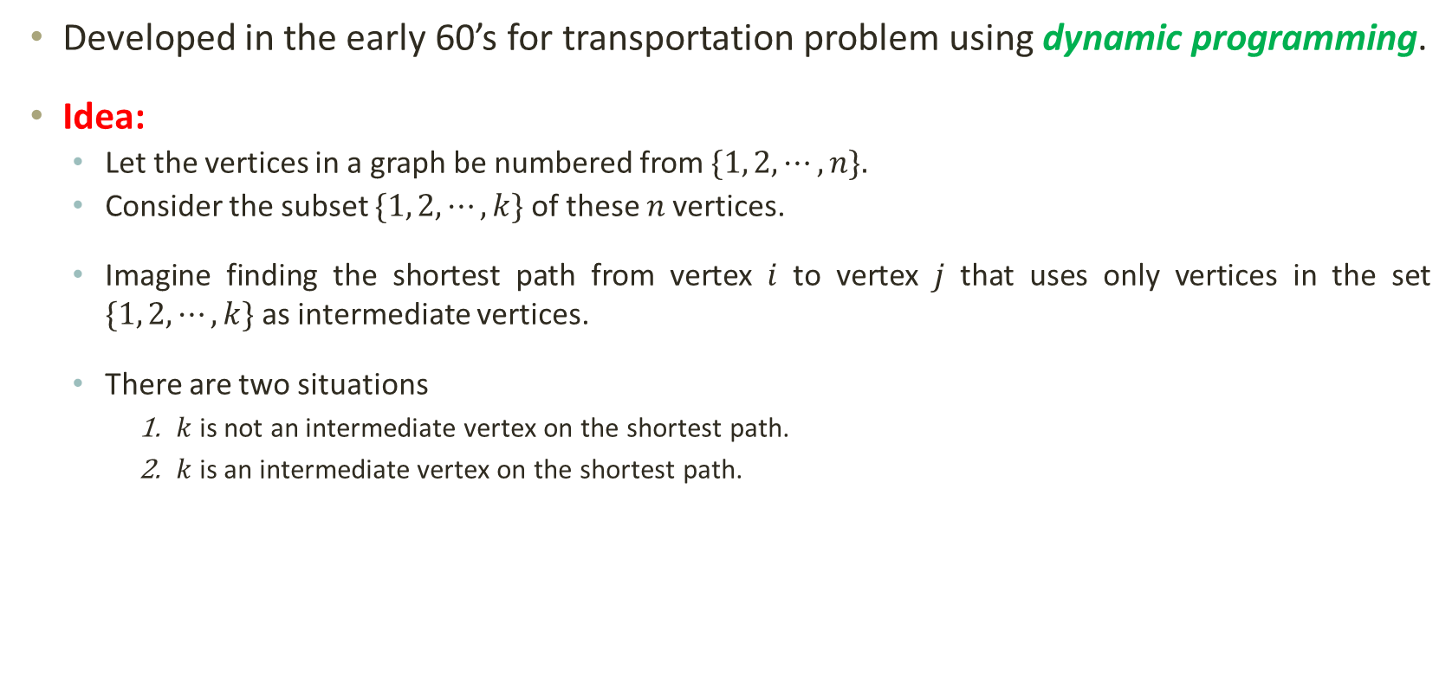
Floyd-Warshall Algorithm
Developed in the early 60’s for transportation problem using dynamic programming.
Idea:
Let the vertices in a graph be numbered from $\{1, 2, ⋯,n\}$.
Consider the subset $\{1, 2, ⋯,k\}$ of these $n$ vertices.
Imagine finding the shortest path from vertex $i$ to vertex $j$ that uses only vertices in the set $\{1, 2, ⋯,k\}$ as intermediate vertices.
There are two situations
$k$ is not an intermediate vertex on the shortest path.
$k$ is an intermediate vertex on the shortest path.
k
i
j

Slide 4
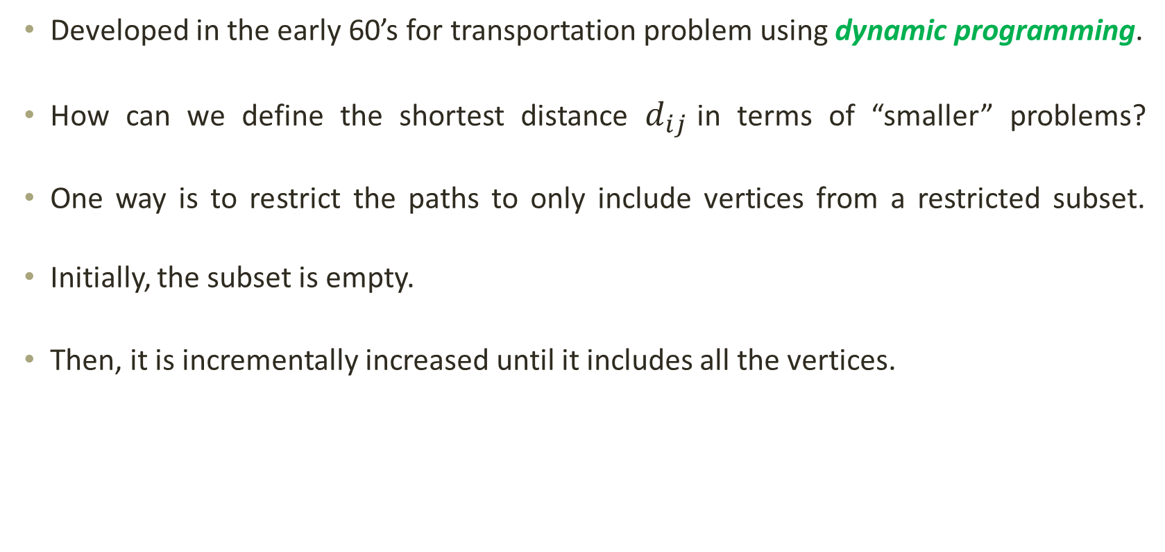
Floyd-Warshall Algorithm
Developed in the early 60’s for transportation problem using dynamic programming.
How can we define the shortest distance $d_{ij}$ in terms of “smaller” problems?
One way is to restrict the paths to only include vertices from a restricted subset.
Initially, the subset is empty.
Then, it is incrementally increased until it includes all the vertices.

Slide 5
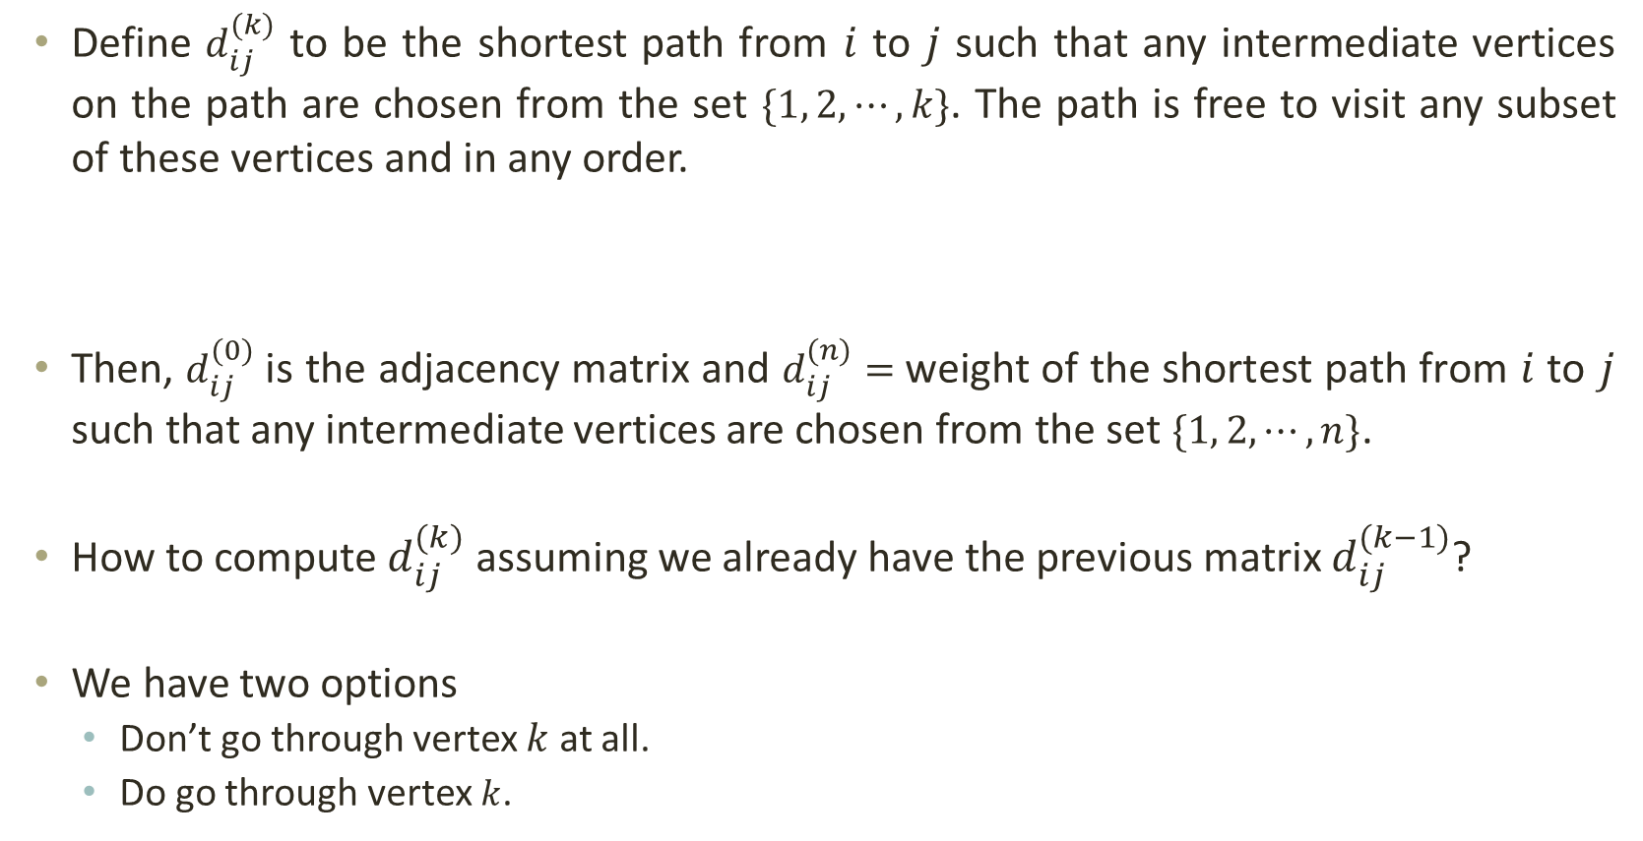
Floyd-Warshall Algorithm
Define $d_{ij}^{(k)}$ to be the shortest path from $i$ to $j$ such that any intermediate vertices on the path are chosen from the set $\{1, 2, ⋯,k\}$. The path is free to visit any subset of these vertices and in any order.
Then, $d_{ij}^{(0)}$ is the adjacency matrix and $d_{ij}^{(n)}=$ weight of the shortest path from $i$ to $j$ such that any intermediate vertices are chosen from the set $\{1, 2, ⋯,n\}$.
How to compute $d_{ij}^{(k)}$ assuming we already have the previous matrix $d_{ij}^{(k−1)}$?
We have two options
Don’t go through vertex $k$ at all.
Do go through vertex $k$.
i
≤k ≤k ≤k
...
j

Slide 6

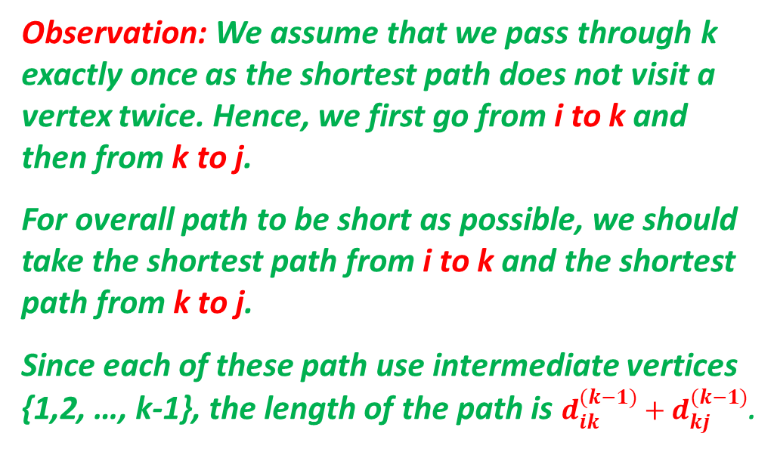



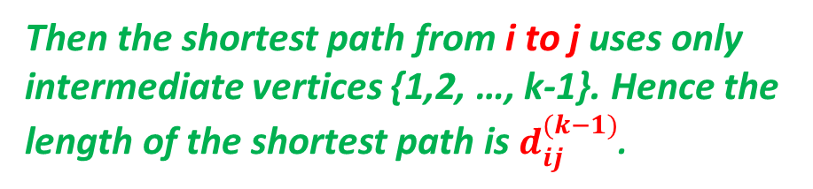



Floyd-Warshall Algorithm
We have two options
Don’t go through vertex $k$ at all.
Do go through vertex $k$.
Then the shortest path from i to j uses only intermediate vertices {1,2, …, k-1}. Hence the length of the shortest path is $d_{ij}^{(k−1)}$.
i
$$d_{ij}^{(k−1)}$$
j
Observation: We assume that we pass through k exactly once as the shortest path does not visit a vertex twice. Hence, we first go from i to k and then from k to j.
For overall path to be short as possible, we should take the shortest path from i to k and the shortest path from k to j.
Since each of these path use intermediate vertices {1,2, …, k-1}, the length of the path is $d_{ik}^{(k−1)}+d_{kj}^{(k−1)}$.
$$d_{ik}^{(k−1)}$$
$$d_{kj}^{(k−1)}$$
k
$$d_{ij}^{(k−1)}$$
i
j
$$d_{ij}^{(k)}=min(d_{ij}^{\left(k−1\right)},d_{ik}^{(k−1)}+d_{kj}^{(k−1)})$$
$$if k ≥1$$

Slide 7
Floyd-Warshall Algorithm
Initialize shortest distances between vertices as infinity
FloydWarshall(G)
for each u ∈ V[G]
for each v ∈ V[G]
d[u][v] = ∞;
π[u][v] = NULL;
for each v ∈ V[G]
d[v][v] = 0;
for each e ∈ E[G]
d[u][v] = w(u,v);
π[u][v] = u;
for each k ∈ V[G]
for each i ∈ V[G]
for each j ∈ V[G]
if (d[i][j] > d[i][k] + d[k][j])
d[i][j] = d[i][k] + d[k][j];
π[i][j] = π[k][j];
return d, π;
Initialize next vertex in shortest path to zero
Finally, ‘d’ will contain shortest distances between all pairs of vertices and ‘π’ can be used to reconstruct the shortest path if needed.
Initialize diagonal elements to zero
Update shortest distances with edge weights
Add neighboring vertex “u” as next vertex in the path
Update, if the shortest distance between i and j is found through k and update ‘π’ accordingly.

Slide 8
Floyd-Warshall Algorithm
FloydWarshall(G)
for each u ∈ V[G]
for each v ∈ V[G]
d[u][v] = ∞;
π[u][v] = NULL;
for each v ∈ V[G]
d[v][v] = 0;
for each e ∈ E[G]
d[u][v] = w(u,v);
π[u][v] = u;
for each k ∈ V[G]
for each i ∈ V[G]
for each j ∈ V[G]
if (d[i][j] > d[i][k] + d[k][j])
d[i][j] = d[i][k] + d[k][j];
π[i][j] = π[k][j];
return d, π;
2
3
4
7
1
8
3
2
1
-4
-5
5
4
6

Slide 9


Floyd-Warshall Algorithm
0 3 8 ∞ -4
∞ 0 ∞ 1 7
∞ 4 0 ∞ ∞
2 ∞ -5 0 ∞
∞ ∞ ∞ 6 0
FloydWarshall(G)
for each u ∈ V[G]
for each v ∈ V[G]
d[u][v] = ∞;
π[u][v] = NULL;
for each v ∈ V[G]
d[v][v] = 0;
for each e ∈ E[G]
d[u][v] = w(u,v);
π[u][v] = u;
for each k ∈ V[G]
for each i ∈ V[G]
for each j ∈ V[G]
if (d[i][j] > d[i][k] + d[k][j])
d[i][j] = d[i][k] + d[k][j];
π[i][j] = π[k][j];
return d, π;
$$d^{0}=$$
2
3
4
7
1
8
3
2
1
-4
-5
∅ 1 1 ∅ 1
∅ ∅ ∅ 2 2
∅ 3 ∅ ∅ ∅
4 ∅ 4 ∅ ∅
∅ ∅ ∅ 5 ∅
5
4
6
$${\text{}}^{0}=$$

Slide 10


Floyd-Warshall Algorithm
0 3 8 ∞ -4
∞ 0 ∞ 1 7
∞ 4 0 ∞ ∞
2 ∞ -5 0 ∞
∞ ∞ ∞ 6 0
FloydWarshall(G)
for each u ∈ V[G]
for each v ∈ V[G]
d[u][v] = ∞;
π[u][v] = NULL;
for each v ∈ V[G]
d[v][v] = 0;
for each e ∈ E[G]
d[u][v] = w(u,v);
π[u][v] = u;
for each k ∈ V[G]
for each i ∈ V[G]
for each j ∈ V[G]
if (d[i][j] > d[i][k] + d[k][j])
d[i][j] = d[i][k] + d[k][j];
π[i][j] = π[k][j];
return d, π;
$$d^{1}=$$
2
3
4
7
1
8
3
2
1
-4
-5
∅ 1 1 ∅ 1
∅ ∅ ∅ 2 2
∅ 3 ∅ ∅ ∅
4 ∅ 4 ∅ ∅
∅ ∅ ∅ 5 ∅
5
4
6
$${\text{}}^{1}=$$

Slide 11
Floyd-Warshall Algorithm
0 3 8 ∞ -4
∞ 0 ∞ 1 7
∞ 4 0 ∞ ∞
2 5 -5 0 -2
∞ ∞ ∞ 6 0
FloydWarshall(G)
for each u ∈ V[G]
for each v ∈ V[G]
d[u][v] = ∞;
π[u][v] = NULL;
for each v ∈ V[G]
d[v][v] = 0;
for each e ∈ E[G]
d[u][v] = w(u,v);
π[u][v] = u;
for each k ∈ V[G]
for each i ∈ V[G]
for each j ∈ V[G]
if (d[i][j] > d[i][k] + d[k][j])
d[i][j] = d[i][k] + d[k][j];
π[i][j] = π[k][j];
return d, π;
$$d^{1}=$$
2
3
4
7
1
8
3
2
1
-4
-5
∅ 1 1 ∅ 1
∅ ∅ ∅ 2 2
∅ 3 ∅ ∅ ∅
4 1 4 ∅ 1
∅ ∅ ∅ 5 ∅
5
4
6
$${\text{}}^{1}=$$

Slide 12


Floyd-Warshall Algorithm
0 3 8 ∞ -4
∞ 0 ∞ 1 7
∞ 4 0 ∞ ∞
2 5 -5 0 -2
∞ ∞ ∞ 6 0
FloydWarshall(G)
for each u ∈ V[G]
for each v ∈ V[G]
d[u][v] = ∞;
π[u][v] = NULL;
for each v ∈ V[G]
d[v][v] = 0;
for each e ∈ E[G]
d[u][v] = w(u,v);
π[u][v] = u;
for each k ∈ V[G]
for each i ∈ V[G]
for each j ∈ V[G]
if (d[i][j] > d[i][k] + d[k][j])
d[i][j] = d[i][k] + d[k][j];
π[i][j] = π[k][j];
return d, π;
$$d^{2}=$$
2
3
4
7
1
8
3
2
1
-4
-5
∅ 1 1 ∅ 1
∅ ∅ ∅ 2 2
∅ 3 ∅ ∅ ∅
4 1 4 ∅ 1
∅ ∅ ∅ 5 ∅
5
4
6
$${\text{}}^{2}=$$

Slide 13
Floyd-Warshall Algorithm
0 3 8 4 -4
∞ 0 ∞ 1 7
∞ 4 0 5 11
2 5 -5 0 -2
∞ ∞ ∞ 6 0
FloydWarshall(G)
for each u ∈ V[G]
for each v ∈ V[G]
d[u][v] = ∞;
π[u][v] = NULL;
for each v ∈ V[G]
d[v][v] = 0;
for each e ∈ E[G]
d[u][v] = w(u,v);
π[u][v] = u;
for each k ∈ V[G]
for each i ∈ V[G]
for each j ∈ V[G]
if (d[i][j] > d[i][k] + d[k][j])
d[i][j] = d[i][k] + d[k][j];
π[i][j] = π[k][j];
return d, π;
$$d^{2}=$$
2
3
4
7
1
8
3
2
1
-4
-5
∅ 1 1 2 1
∅ ∅ ∅ 2 2
∅ 3 ∅ 2 2
4 1 4 ∅ 1
∅ ∅ ∅ 5 ∅
5
4
6
$${\text{}}^{2}=$$

Slide 14


Floyd-Warshall Algorithm
0 3 8 4 -4
∞ 0 ∞ 1 7
∞ 4 0 5 11
2 5 -5 0 -2
∞ ∞ ∞ 6 0
FloydWarshall(G)
for each u ∈ V[G]
for each v ∈ V[G]
d[u][v] = ∞;
π[u][v] = NULL;
for each v ∈ V[G]
d[v][v] = 0;
for each e ∈ E[G]
d[u][v] = w(u,v);
π[u][v] = u;
for each k ∈ V[G]
for each i ∈ V[G]
for each j ∈ V[G]
if (d[i][j] > d[i][k] + d[k][j])
d[i][j] = d[i][k] + d[k][j];
π[i][j] = π[k][j];
return d, π;
$$d^{3}=$$
2
3
4
7
1
8
3
2
1
-4
-5
∅ 1 1 2 1
∅ ∅ ∅ 2 2
∅ 3 ∅ 2 2
4 1 4 ∅ 1
∅ ∅ ∅ 5 ∅
5
4
6
$${\text{}}^{3}=$$

Slide 15
Floyd-Warshall Algorithm
0 3 8 4 -4
∞ 0 ∞ 1 7
∞ 4 0 5 11
2 -1 -5 0 -2
∞ ∞ ∞ 6 0
FloydWarshall(G)
for each u ∈ V[G]
for each v ∈ V[G]
d[u][v] = ∞;
π[u][v] = NULL;
for each v ∈ V[G]
d[v][v] = 0;
for each e ∈ E[G]
d[u][v] = w(u,v);
π[u][v] = u;
for each k ∈ V[G]
for each i ∈ V[G]
for each j ∈ V[G]
if (d[i][j] > d[i][k] + d[k][j])
d[i][j] = d[i][k] + d[k][j];
π[i][j] = π[k][j];
return d, π;
$$d^{3}=$$
2
3
4
7
1
8
3
2
1
-4
-5
∅ 1 1 2 1
∅ ∅ ∅ 2 2
∅ 3 ∅ 2 2
4 3 4 ∅ 1
∅ ∅ ∅ 5 ∅
5
4
6
$${\text{}}^{3}=$$

Slide 16


Floyd-Warshall Algorithm
0 3 8 4 -4
∞ 0 ∞ 1 7
∞ 4 0 5 11
2 -1 -5 0 -2
∞ ∞ ∞ 6 0
FloydWarshall(G)
for each u ∈ V[G]
for each v ∈ V[G]
d[u][v] = ∞;
π[u][v] = NULL;
for each v ∈ V[G]
d[v][v] = 0;
for each e ∈ E[G]
d[u][v] = w(u,v);
π[u][v] = u;
for each k ∈ V[G]
for each i ∈ V[G]
for each j ∈ V[G]
if (d[i][j] > d[i][k] + d[k][j])
d[i][j] = d[i][k] + d[k][j];
π[i][j] = π[k][j];
return d, π;
$$d^{4}=$$
2
3
4
7
1
8
3
2
1
-4
-5
∅ 1 1 2 1
∅ ∅ ∅ 2 2
∅ 3 ∅ 2 2
4 3 4 ∅ 1
∅ ∅ ∅ 5 ∅
5
4
6
$${\text{}}^{4}=$$

Slide 17
Floyd-Warshall Algorithm
0 3 -1 4 -4
3 0 -4 1 -1
7 4 0 5 3
2 -1 -5 0 -2
8 5 1 6 0
FloydWarshall(G)
for each u ∈ V[G]
for each v ∈ V[G]
d[u][v] = ∞;
π[u][v] = NULL;
for each v ∈ V[G]
d[v][v] = 0;
for each e ∈ E[G]
d[u][v] = w(u,v);
π[u][v] = u;
for each k ∈ V[G]
for each i ∈ V[G]
for each j ∈ V[G]
if (d[i][j] > d[i][k] + d[k][j])
d[i][j] = d[i][k] + d[k][j];
π[i][j] = π[k][j];
return d, π;
$$d^{4}=$$
2
3
4
7
1
8
3
2
1
-4
-5
∅ 1 4 2 1
4 ∅ 4 2 1
4 3 ∅ 2 1
4 3 4 ∅ 1
4 3 4 5 ∅
5
4
6
$${\text{}}^{4}=$$

Slide 18


Floyd-Warshall Algorithm
0 3 -1 4 -4
3 0 -4 1 -1
7 4 0 5 3
2 -1 -5 0 -2
8 5 1 6 0
FloydWarshall(G)
for each u ∈ V[G]
for each v ∈ V[G]
d[u][v] = ∞;
π[u][v] = NULL;
for each v ∈ V[G]
d[v][v] = 0;
for each e ∈ E[G]
d[u][v] = w(u,v);
π[u][v] = u;
for each k ∈ V[G]
for each i ∈ V[G]
for each j ∈ V[G]
if (d[i][j] > d[i][k] + d[k][j])
d[i][j] = d[i][k] + d[k][j];
π[i][j] = π[k][j];
return d, π;
$$d^{5}=$$
2
3
4
7
1
8
3
2
1
-4
-5
∅ 1 4 2 1
4 ∅ 4 2 1
4 3 ∅ 2 1
4 3 4 ∅ 1
4 3 4 5 ∅
5
4
6
$${\text{}}^{5}=$$

Slide 19
Floyd-Warshall Algorithm
0 1 -3 2 -4
3 0 -4 1 -1
7 4 0 5 3
2 -1 -5 0 -2
8 5 1 6 0
FloydWarshall(G)
for each u ∈ V[G]
for each v ∈ V[G]
d[u][v] = ∞;
π[u][v] = NULL;
for each v ∈ V[G]
d[v][v] = 0;
for each e ∈ E[G]
d[u][v] = w(u,v);
π[u][v] = u;
for each k ∈ V[G]
for each i ∈ V[G]
for each j ∈ V[G]
if (d[i][j] > d[i][k] + d[k][j])
d[i][j] = d[i][k] + d[k][j];
π[i][j] = π[k][j];
return d, π;
$$d^{5}=$$
2
3
4
7
1
8
3
2
1
-4
-5
∅ 3 4 5 1
4 ∅ 4 2 1
4 3 ∅ 2 1
4 3 4 ∅ 1
4 3 4 5 ∅
5
4
6
$${\text{}}^{5}=$$

Slide 20
Floyd-Warshall Algorithm
0 1 -3 2 -4
3 0 -4 1 -1
7 4 0 5 3
2 -1 -5 0 -2
8 5 1 6 0
FloydWarshall(G)
for each u ∈ V[G]
for each v ∈ V[G]
d[u][v] = ∞;
π[u][v] = NULL;
for each v ∈ V[G]
d[v][v] = 0;
for each e ∈ E[G]
d[u][v] = w(u,v);
π[u][v] = u;
for each k ∈ V[G]
for each i ∈ V[G]
for each j ∈ V[G]
if (d[i][j] > d[i][k] + d[k][j])
d[i][j] = d[i][k] + d[k][j];
π[i][j] = π[k][j];
return d, π;
$$d^{5}=$$
2
3
4
7
1
8
3
2
1
-4
-5
∅ 3 4 5 1
4 ∅ 4 2 1
4 3 ∅ 2 1
4 3 4 ∅ 1
4 3 4 5 ∅
5
4
6
$${\text{}}^{5}=$$

Slide 21
Floyd-Warshall Algorithm
FloydWarshall(G)
for each u ∈ V[G]
for each v ∈ V[G]
d[u][v] = ∞;
π[u][v] = NULL;
for each v ∈ V[G]
d[v][v] = 0;
for each e ∈ E[G]
d[u][v] = w(u,v);
π[u][v] = u;
for each k ∈ V[G]
for each i ∈ V[G]
for each j ∈ V[G]
if (d[i][j] > d[i][k] + d[k][j])
d[i][j] = d[i][k] + d[k][j];
π[i][j] = π[k][j];
return d, π;
O(V²)
What will be the running time?
O(V)
O(V³)
O(E)
O(V³)

Slide 22


Floyd-Warshall Algorithm: Reconstructing Shortest Path
ReconstructPath(π, start, end)
path = [end];
while start != end
end = π[start][end];
path.append(end);
return path;
0 1 -3 2 -4
3 0 -4 1 -1
7 4 0 5 3
2 -1 -5 0 -2
8 5 1 6 0
$$d^{5}=$$
Path from 1 to 2:
2
∅ 3 4 5 1
4 ∅ 4 2 1
4 3 ∅ 2 1
4 3 4 ∅ 1
4 3 4 5 ∅
3
4
7
$${\text{}}^{5}=$$
1
8
3
2
1
-4
-5
5
4
Path Length ➔ -4 + 6 - 5 + 4 = 1
6

Slide 23
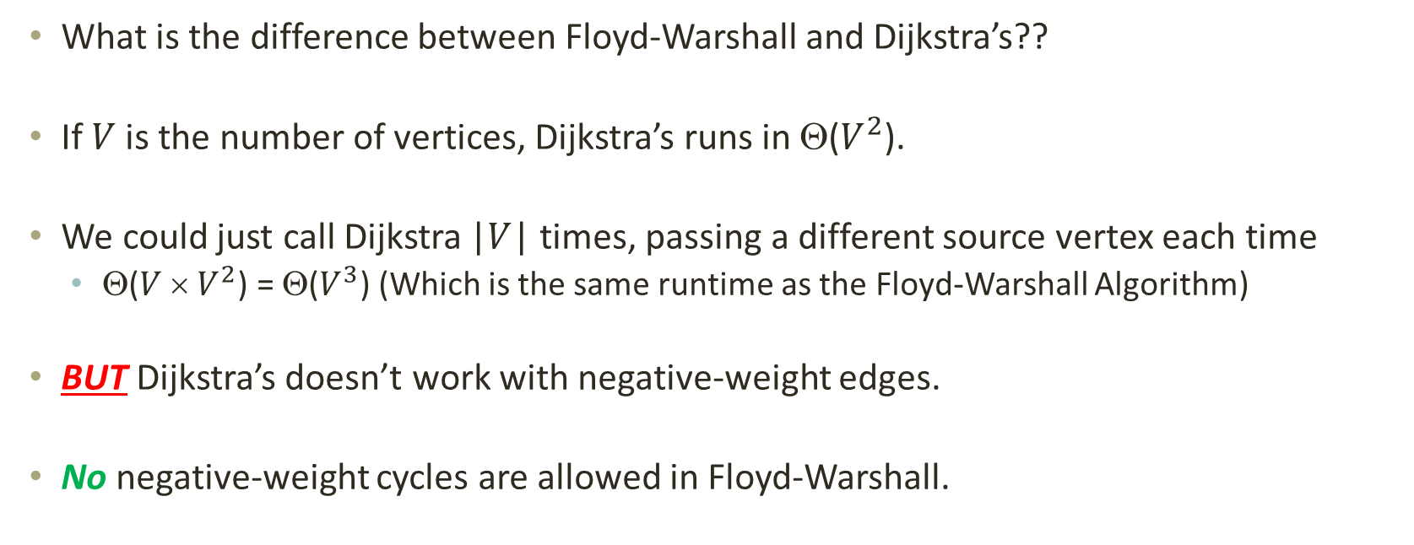
Floyd-Warshall vs. Dijkstra’s?
What is the difference between Floyd-Warshall and Dijkstra’s??
If $V$ is the number of vertices, Dijkstra’s runs in Θ($V^{2}$).
We could just call Dijkstra |$V$| times, passing a different source vertex each time
Θ($V$ × $V^{2}$) = Θ($V^{3}$) (Which is the same runtime as the Floyd-Warshall Algorithm)
BUT Dijkstra’s doesn’t work with negative-weight edges.
No negative-weight cycles are allowed in Floyd-Warshall.

Slide 24
THANK YOU

