Slide 1
CSC 301 – Design and Analysis of Algorithms
Instructor: Dr. M. Hasan Jamal
Lecture# 04(c): Recursion Tree Method

Slide 2
Recursion Tree Method
Making a good guess is sometimes difficult with the substitution method.
Recursion Tree Method can be used to devise a good guess.
Recursion Trees show successive expansions of recurrences using trees.
Recursion Trees model the costs (time) of a recursive execution of an algorithm that is composed of two part:
cost of non-recursive part.
cost of recursive call on smaller input size.
A Tree node represents the cost of a sub-problem (recursive function invocation).
To determine the total cost of the Recursion Tree, evaluate:
Cost of individual node at depth “i”
Sum up the cost of all nodes at depth “i”
Sum up all per-level costs of the Recursion Tree.

Slide 3
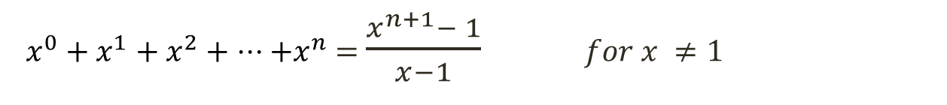


Recursion Tree Method: Example 1
$$T(n)=\left\{\begin{aligned} 1 n=1 \\ 2 T\left(\frac{n}{2}\right)+n n>1\end{aligned}\right.$$
Solve the following recurrence using the Recurrence Tree Method.
Assumption: We assume that n is exact power of 2.
$x^{\log_{y}{n}}$ $⟹n^{\log_{y}{x}}$
$x^{0}+x^{1}+x^{2}+ ⋅⋅⋅+x^{n}$ $=$ $\frac{x^{n+1}− 1}{x−1}$ $for x ≠1$
$x^{0}+x^{1}+x^{2}+ ⋅⋅⋅$ $=$ $\frac{1}{1−x}$ $for \left|x\right|<1$

Slide 4


Recursion Tree Method: Example 1
n
$$T(n)=2 T\left(\frac{n}{2}\right)+n$$
$$T(\frac{n}{2})=2.T(\frac{n}{2^{2}})+\frac{n}{2}$$
T(n/2)
T(n/2)

Slide 5

Recursion Tree Method: Example 1
n
$$T(n)=2 T\left(\frac{n}{2}\right)+n$$
$$T(\frac{n}{2})=2.T(\frac{n}{2^{2}})+\frac{n}{2}$$
n/2
n/2
$$T(\frac{n}{2^{2}})=2.T(\frac{n}{2^{3}})+\frac{n}{2^{2}}$$
T(n/4)
T(n/4)
T(n/4)
T(n/4)

Slide 6



Recursion Tree Method: Example 1
n
$$T(n)=2 T\left(\frac{n}{2}\right)+n$$
$$T(\frac{n}{2})=2.T(\frac{n}{2^{2}})+\frac{n}{2}$$
n/2
n/2
$$T(\frac{n}{2^{2}})=2.T(\frac{n}{2^{3}})+\frac{n}{2^{2}}$$
n/4
n/4
n/4
n/4
$$\text{. . .}$$
$$T(\frac{n}{2^{k−1}})=2.T(\frac{n}{2^{k}})+\frac{n}{2^{k−1}}$$
T(n/8)
T(n/8)
T(n/8)
T(n/8)
$$T(\frac{n}{2^{k}})=T(1)$$
…
…
Continue expanding until the problem size reduces to 1.
T(1)
Total Cost = Cost of Leaf Nodes + Cost of Internal Nodes
Total Cost = (cost of leaf node x total leaf nodes) + (sum of costs at each level of internal nodes)
Total Cost = L_{c} + I_{c}

Slide 7






Recursion Tree Method: Example 1
n
n
$$T(n)=2 T\left(\frac{n}{2}\right)+n$$
$$T(\frac{n}{2})=2.T(\frac{n}{2^{2}})+\frac{n}{2}$$
n/2
n/2
n
$$T(\frac{n}{2^{2}})=2.T(\frac{n}{2^{3}})+\frac{n}{2^{2}}$$
n/4
n/4
n/4
n/4
n
$$\text{. . .}$$
$$T(\frac{n}{2^{k−1}})=2.T(\frac{n}{2^{k}})+\frac{n}{2^{k−1}}$$
…
T(n/8)
T(n/8)
T(n/8)
T(n/8)
$$T(\frac{n}{2^{k}})=T(1)$$
…
…
$$n=2^{k} ⟹ k=\lg{n}$$
T(1)
$L_{c}=2^{k} ⟹2^{\lg{n}}$ $⟹n^{\lg{2}}$ $⟹n$
$$I_{c}=k∙n$$
$$I_{c}=n\lg{n}$$
Total Cost = L_{c} + I_{c}
$$⟹n+ n\lg{n}$$
$$Hence:T(n)∈Ο(n\lg{n})$$

Slide 8

Recursion Tree Method: Example 2
$$T(n)=\left\{\begin{aligned} 1 n=1 \\ 2 T\left(\frac{n}{2}\right)+n^{2} n>1\end{aligned}\right.$$
Solve the following recurrence using the Recurrence Tree Method.
Assumption: We assume that n is exact power of 2.

Slide 9


Recursion Tree Method: Example 2
n²
$$T(n)=2 T\left(\frac{n}{2}\right)+n^{2}$$
$$T(\frac{n}{2})=2.T(\frac{n}{2^{2}})+\frac{n^{2}}{2^{2}}$$
T(n/2)
T(n/2)

Slide 10



Recursion Tree Method: Example 2
n²
$$T(n)=2 T\left(\frac{n}{2}\right)+n^{2}$$
$$T(\frac{n}{2})=2.T(\frac{n}{2^{2}})+\frac{n^{2}}{2^{2}}$$
n²/4
n²/4
$$T(\frac{n}{2^{2}})=2.T(\frac{n}{2^{3}})+\frac{n^{2}}{4^{2}}$$
T(n/4)
T(n/4)
T(n/4)
T(n/4)

Slide 11
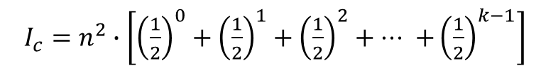






Recursion Tree Method: Example 2
n²
n²
$$T(n)=2 T\left(\frac{n}{2}\right)+n^{2}$$
$$T(\frac{n}{2})=2.T(\frac{n}{2^{2}})+\frac{n^{2}}{2^{2}}$$
n²/4
n²/4
n²/2
$$T(\frac{n}{2^{2}})=2.T(\frac{n}{2^{3}})+\frac{n^{2}}{4^{2}}$$
n²/16
n²/16
n²/16
n²/16
n²/4
$$\text{. . .}$$
$$T(\frac{n}{2^{k}})=T(1)$$
…
T(n/8)
T(n/8)
T(n/8)
T(n/8)
$$n=2^{k} ⟹ k=\lg{n}$$
…
…
n²/2^{k-1}
$L_{c}=2^{k} ⟹2^{\lg{n}}$ $⟹n^{\lg{2}}$ $⟹n$
T(1)
$I_{c}=n^{2}∙\left[{\left(\frac{1}{2}\right)}^{0}+{\left(\frac{1}{2}\right)}^{1}+{\left(\frac{1}{2}\right)}^{2}+ ⋅⋅⋅ +{\left(\frac{1}{2}\right)}^{k−1}\right]$
$$I_{c}=n^{2}∙\left[\frac{1}{1−1/2}\right] ⟹2n^{2}$$
Total Cost = L_{c} + I_{c}
$$⟹n+2n^{2}$$
$$Hence:T(n)∈Ο(n^{2})$$

Slide 12

Recursion Tree Method: Example 3
$$T(n)=\left\{\begin{aligned} 1 n=1 \\ 3 T\left(\frac{n}{4}\right)+n^{2} n>1\end{aligned}\right.$$
Solve the following recurrence using the Recurrence Tree Method.
Assumption: We assume that n is exact power of 4.

Slide 13


Recursion Tree Method: Example 3
n²
$$T(n)=3 T\left(\frac{n}{4}\right)+n^{2}$$
$$T(\frac{n}{4})=3.T(\frac{n}{4^{2}})+\frac{n^{2}}{4^{2}}$$
T(n/4)
T(n/4)
T(n/4)

Slide 14






Recursion Tree Method: Example 3
n²
$$T(n)=3 T\left(\frac{n}{4}\right)+n^{2}$$
$$T(\frac{n}{4})=3.T(\frac{n}{4^{2}})+\frac{n^{2}}{4^{2}}$$
n²/16
n²/16
n²/16
$$T(\frac{n}{4^{2}})=3.T(\frac{n}{4^{3}})+\frac{n^{2}}{{16}^{2}}$$
$T(\frac{n}{16})$ $T(\frac{n}{16})$ $T\left(\frac{n}{16}\right)$
$T(\frac{n}{16})$ $T(\frac{n}{16})$ $T\left(\frac{n}{16}\right)$
$T(\frac{n}{16})$ $T(\frac{n}{16})$ $T\left(\frac{n}{16}\right)$

Slide 15



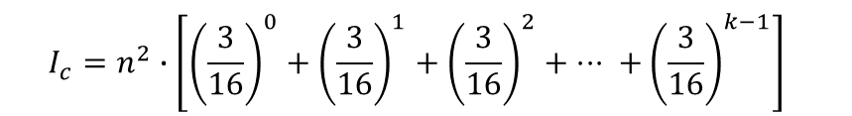












Recursion Tree Method: Example 3
n²
$$n^{2}$$
$$T(n)=3 T\left(\frac{n}{4}\right)+n^{2}$$
n²/16
n²/16
n²/16
$$\frac{3}{16}n^{2}$$
$$T(\frac{n}{4})=3.T(\frac{n}{4^{2}})+\frac{n^{2}}{4^{2}}$$
$$T(\frac{n}{4^{2}})=3.T(\frac{n}{4^{3}})+\frac{n^{2}}{{16}^{2}}$$
$$\frac{\text{n}\text{2}}{256} \frac{\text{n}\text{2}}{256} \frac{\text{n}\text{2}}{256}$$
$$\frac{\text{n}\text{2}}{256} \frac{\text{n}\text{2}}{256} \frac{\text{n}\text{2}}{256}$$
$$\frac{\text{n}\text{2}}{256} \frac{\text{n}\text{2}}{256} \frac{\text{n}\text{2}}{256}$$
$$\frac{9}{256}n^{2}$$
$$T(\frac{n}{4^{k}})=T(1)$$
…
…
…
…
…
$$\frac{3^{k−1}}{{16}^{k−1}}n^{2}$$
…
…
…
…
…
…
…
…
…
…
…
…
…
…
…
…
…
…
…
…
…
…
…
$$n=4^{k}$$
T(1)
T(1)
T(1)
T(1)
T(1)
T(1)
T(1)
T(1)
T(1)
$$k=\log_{4}{n}$$
$$L_{c}=3^{k}$$
$$⟹n^{\log_{4}{3}}$$
$$I_{c}=n^{2}∙\left[{\left(\frac{3}{16}\right)}^{0}+{\left(\frac{3}{16}\right)}^{1}+{\left(\frac{3}{16}\right)}^{2}+ ⋅⋅⋅ +{\left(\frac{3}{16}\right)}^{k−1}\right]$$
$$⟹3^{\log_{4}{n}}$$
$$I_{c}=n^{2}∙\left[\frac{1}{1−3/{16}}\right] ⟹\frac{16}{13}n^{2}$$
Total Cost = L_{c} + I_{c}
$$⟹n^{\log_{4}{3}}+\frac{16}{13}n^{2}$$
$$Hence:T(n)∈Ο(n^{2})$$

Slide 16
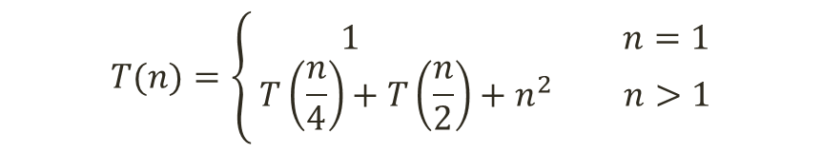
Recursion Tree Method: Example 4
$$T(n)=\left\{\begin{aligned} 1 n=1 \\ T\left(\frac{n}{4}\right)+T\left(\frac{n}{2}\right)+n^{2} n>1\end{aligned}\right.$$
Solve the following recurrence using the Recurrence Tree Method.

Slide 17



Recursion Tree Method: Example 4
$$T(n)=T\left(\frac{n}{4}\right)+T\left(\frac{n}{2}\right)+n^{2}$$
n²
$$T(\frac{n}{4})=T(\frac{n}{16})+T(\frac{n}{8})+\frac{n^{2}}{16}$$
T(n/4)
T(n/2)
$$T(\frac{n}{2})=T(\frac{n}{8})+T(\frac{n}{4})+\frac{n^{2}}{4}$$

Slide 18



Recursion Tree Method: Example 4
$$T(n)=T\left(\frac{n}{4}\right)+T\left(\frac{n}{2}\right)+n^{2}$$
n²
$$T(\frac{n}{4})=T(\frac{n}{16})+T(\frac{n}{8})+\frac{n^{2}}{16}$$
n²/16
n²/4
$$T(\frac{n}{2})=T(\frac{n}{8})+T(\frac{n}{4})+\frac{n^{2}}{4}$$
T(n/16)
T(n/8)
T(n/8)
T(n/4)
$$T(\frac{n}{16})=T(\frac{n}{64})+T(\frac{n}{32})+\frac{n^{2}}{256}$$
$$T(\frac{n}{8})=T(\frac{n}{32})+T(\frac{n}{16})+\frac{n^{2}}{64}$$
$$T(\frac{n}{4})=T(\frac{n}{16})+T(\frac{n}{8})+\frac{n^{2}}{16}$$

Slide 19

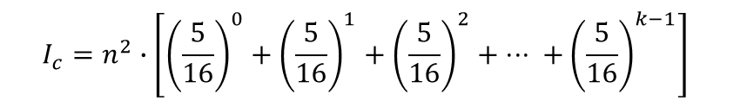









Recursion Tree Method: Example 4
$$T(n)=T\left(\frac{n}{4}\right)+T\left(\frac{n}{2}\right)+n^{2}$$
n²
$$n^{2}$$
$$T(\frac{n}{4})=T(\frac{n}{16})+T(\frac{n}{8})+\frac{n^{2}}{16}$$
n²/16
n²/4
$$\frac{5}{16}n^{2}$$
$$T(\frac{n}{2})=T(\frac{n}{8})+T(\frac{n}{4})+\frac{n^{2}}{4}$$
n²/256
n²/64
n²/64
n²/16
$$\frac{25}{256}n^{2}$$
$$T(\frac{n}{16})=T(\frac{n}{64})+T(\frac{n}{32})+\frac{n^{2}}{256}$$
…
…
…
…
…
…
…
…
…
$$\frac{5^{k−1}}{{16}^{k−1}}n^{2}$$
$$T(\frac{n}{8})=T(\frac{n}{32})+T(\frac{n}{16})+\frac{n^{2}}{64}$$
T(1)
T(1)
T(1)
T(1)
$$T(\frac{n}{4})=T(\frac{n}{16})+T(\frac{n}{8})+\frac{n^{2}}{16}$$
$$I_{c}=n^{2}∙\left[{\left(\frac{5}{16}\right)}^{0}+{\left(\frac{5}{16}\right)}^{1}+{\left(\frac{5}{16}\right)}^{2}+ ⋅⋅⋅ +{\left(\frac{5}{16}\right)}^{k−1}\right]$$
$$T(\frac{n}{2^{k}})=T(1)$$
$$I_{c}=n^{2}∙\left[\frac{1}{1−5/{16}}\right] ⟹\frac{16}{11}n^{2}$$
$$n=2^{k} ⟹ k=\lg{n}$$
$$⟹n+\frac{16}{11}n^{2}$$
$L_{c}=2^{k} ⟹2^{\lg{n}}$ $⟹n^{\lg{2}}$ $⟹n$
Total Cost = L_{c} + I_{c}
$$Hence:T(n)∈Ο(n^{2})$$

Slide 20
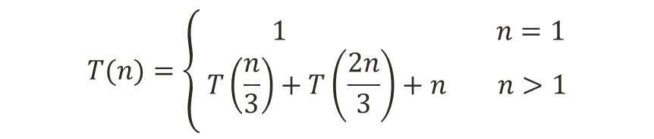
Recursion Tree Method: Example 5
$$T(n)=\left\{\begin{aligned} 1 n=1 \\ T\left(\frac{n}{3}\right)+T\left(\frac{2n}{3}\right)+n n>1\end{aligned}\right.$$
Solve the following recurrence using the Recurrence Tree Method.

Slide 21


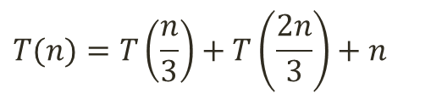
Recursion Tree Method: Example 5
$$T(n)=T\left(\frac{n}{3}\right)+T\left(\frac{2n}{3}\right)+n$$
n
$$T(\frac{n}{3})=T(\frac{n}{9})+T(\frac{2n}{9})+\frac{n}{3}$$
T(n/3)
T(2n/3)
$$T(\frac{2n}{3})=T(\frac{2n}{9})+T(\frac{4n}{9})+\frac{2n}{3}$$

Slide 22



Recursion Tree Method: Example 5
$$T(n)=T\left(\frac{n}{3}\right)+T\left(\frac{2n}{3}\right)+n$$
n
$$T(\frac{n}{3})=T(\frac{n}{9})+T(\frac{2n}{9})+\frac{n}{3}$$
n/3
2n/3
$$T(\frac{2n}{3})=T(\frac{2n}{9})+T(\frac{4n}{9})+\frac{2n}{3}$$
T(n/9)
T(2n/9)
T(2n/9)
T(4n/9)
$$T(\frac{n}{9})=T(\frac{n}{27})+T(\frac{2n}{27})+\frac{n}{9}$$
$$T(\frac{2n}{9})=T(\frac{2n}{27})+T(\frac{4n}{27})+\frac{2n}{9}$$
$$T(\frac{4n}{9})=T(\frac{4n}{27})+T(\frac{8n}{27})+\frac{4n}{9}$$

Slide 23








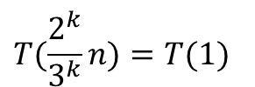





Recursion Tree Method: Example 5
$$T(n)=T\left(\frac{n}{3}\right)+T\left(\frac{2n}{3}\right)+n$$
n
$$n$$
$$T(\frac{n}{3})=T(\frac{n}{9})+T(\frac{2n}{9})+\frac{n}{3}$$
n/3
2n/3
$$n$$
$$T(\frac{2n}{3})=T(\frac{2n}{9})+T(\frac{4n}{9})+\frac{2n}{3}$$
n/9
2n/9
2n/9
4n/9
$$n$$
$$T(\frac{n}{9})=T(\frac{n}{27})+T(\frac{2n}{27})+\frac{n}{9}$$
…
…
…
…
…
…
…
…
…
$$T(\frac{2n}{9})=T(\frac{2n}{27})+T(\frac{4n}{27})+\frac{2n}{9}$$
$$n$$
T(1)
T(1)
T(1)
T(1)
$$T(\frac{4n}{9})=T(\frac{4n}{27})+T(\frac{8n}{27})+\frac{4n}{9}$$
$$I_{c}=n∙k$$
$$I_{c}=n\log_{3/2}{n}$$
$$T(\frac{2^{k}}{3^{k}}n)=T(1)$$
$$⟹ n=\frac{3^{k}}{2^{k}}$$
$$⟹k=\log_{3/2}{n}$$
$$L_{c}=2^{k}$$
$$⟹2^{\log_{3/2}{n}}$$
$$⟹n^{\log_{3/2}{2}}$$
Total Cost = L_{c} + I_{c}
$$⟹n^{\log_{3/2}{2}}+n\log_{3/2}{n}$$
$$T\left(n\right)∈Ο\left(n\lg{n}\right)??$$

Slide 24
Recursion Tree Method: Caution Note
Recursion Trees are best used to generate good guesses.
Verify guesses using the substitution method.
A small amount of “sloppiness” can be tolerated.
Using an infinite decreasing geometric series as an upper bound.
Assuming “n” to be an exact power of 2, 3, or 4.
By carefully drawing out a recursion tree and summing the costs, recursion tree method can be used as a direct proof of a solution to any recurrence.

Slide 25





Practice Questions
Solve the following recurrences using the Recurrence Tree Method.
$$T(n)=4T\left(\frac{n}{2}\right)+n^{2}$$
$$T(n)=2T\left(\frac{n}{3}\right)+n$$
$T(n)=$ $2T\left(n−1\right)+1$
$T(n)=$ $3T\left(\frac{n}{4}\right)+n$
$T(n)=$ $T\left(\frac{n}{4}\right)+T\left(\frac{3n}{4}\right)+n$

Slide 26
THANK YOU

