Slide 1
CSC 301 – Design and Analysis of Algorithms
Instructor: Dr. M. Hasan Jamal
Lecture# 05: Hashing

Slide 2
Hashing: Introduction
Many applications deal with a lot of data, stored in some form of a table (with multiple fields), containing information.
For example: A telephone directory has fields name, address and phone number. To find somebody’s phone number, the book is searched on the name field.
To find the entry in the table, the contents of one of the fields is required. We don’t need to know the contents of all the fields.
The field used to search the contents of other fields is called the key.
Ideally, the key should uniquely identify the entry, i.e. no two names in the telephone directory should be the same.

Slide 3
Hashing: Introduction
The Table formulation can be treated as an abstract data type that is composed of a collection of (key, value) pairs, such that each key is distinct.
The storage size is dependent on the number of distinct keys
A set of operations can be defined for this ADT.
Insert
Search
Delete

Slide 4















Hashing: Introduction
Given an ADT, what would be the complexity to perform these operations.
 | Insert | Search | Delete
Unsorted Array
Sorted Array
Unsorted Linked List
Sorted Linked List
Ordered Binary Tree
$$\text{O}(1)$$
$$\text{O}(n)$$
$$\text{O}(n)$$
$$\text{O}(n)$$
$$\text{O}(\lg{n})$$
$$\text{O}(n)$$
$$\text{O}(1)$$
$$\text{O}(n)$$
$$\text{O}(n)$$
$$\text{O}(n)$$
$$\text{O}(n)$$
$$\text{O}(n)$$
$$\text{O}(\lg{n})$$
$$\text{O}(\lg{n})$$
$$\text{O}(\lg{n})$$

Slide 5
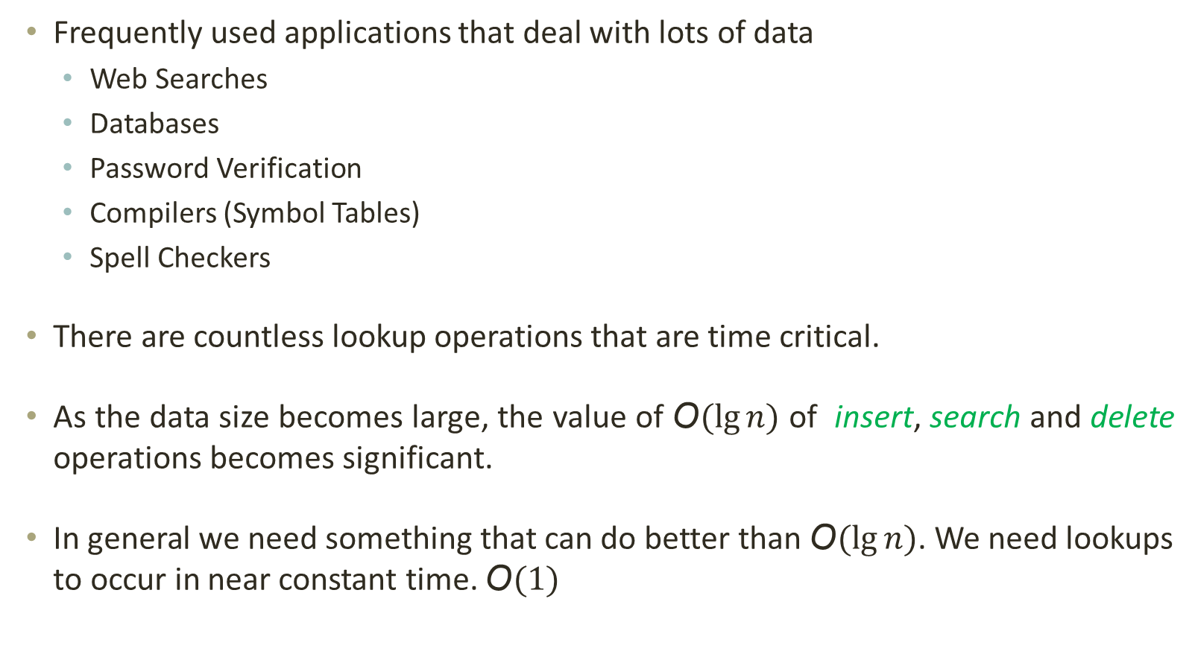
Hashing: Introduction
Frequently used applications that deal with lots of data
Web Searches
Databases
Password Verification
Compilers (Symbol Tables)
Spell Checkers
There are countless lookup operations that are time critical.
As the data size becomes large, the value of $\text{O}(\lg{n})$ of insert, search and delete operations becomes significant.
In general we need something that can do better than $\text{O}(\lg{n})$. We need lookups to occur in near constant time. $\text{O}(1)$

Slide 6
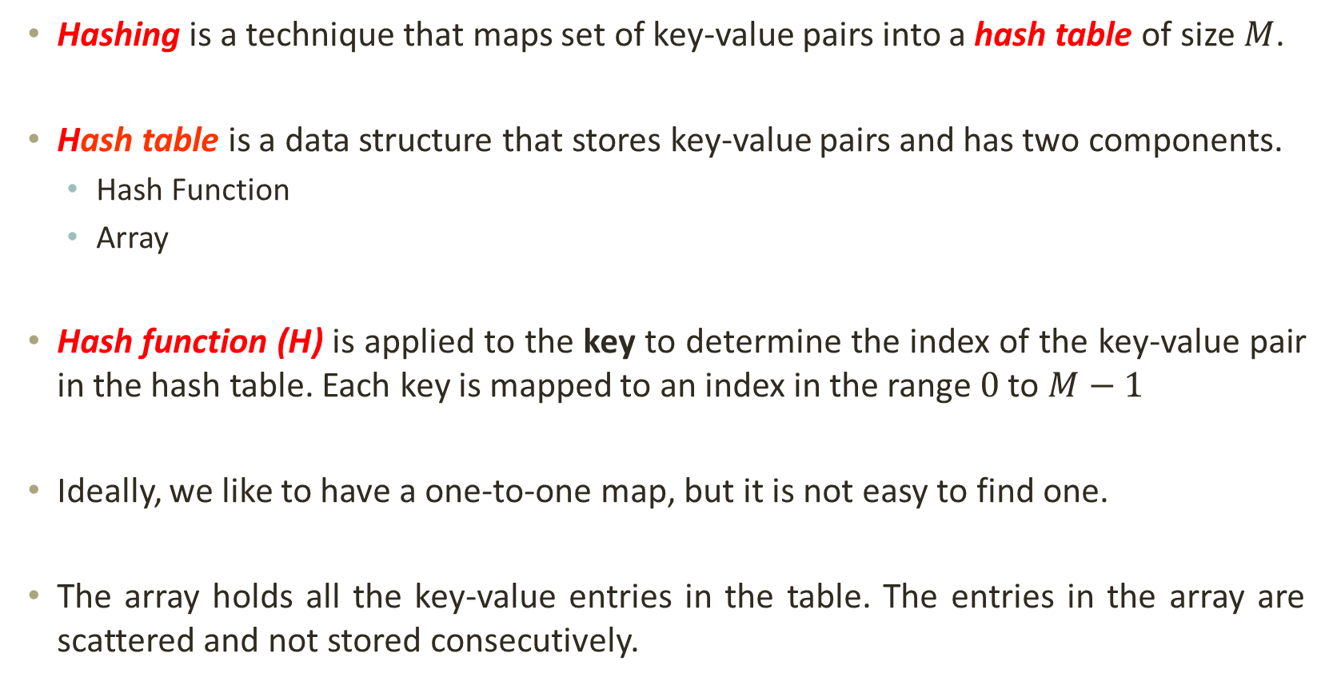
Hashing: Idea
Hashing is a technique that maps set of key-value pairs into a hash table of size $M$.
Hash table is a data structure that stores key-value pairs and has two components.
Hash Function
Array
Hash function (H) is applied to the key to determine the index of the key-value pair in the hash table. Each key is mapped to an index in the range $0$ to $M−1$
Ideally, we like to have a one-to-one map, but it is not easy to find one.
The array holds all the key-value entries in the table. The entries in the array are scattered and not stored consecutively.

Slide 7
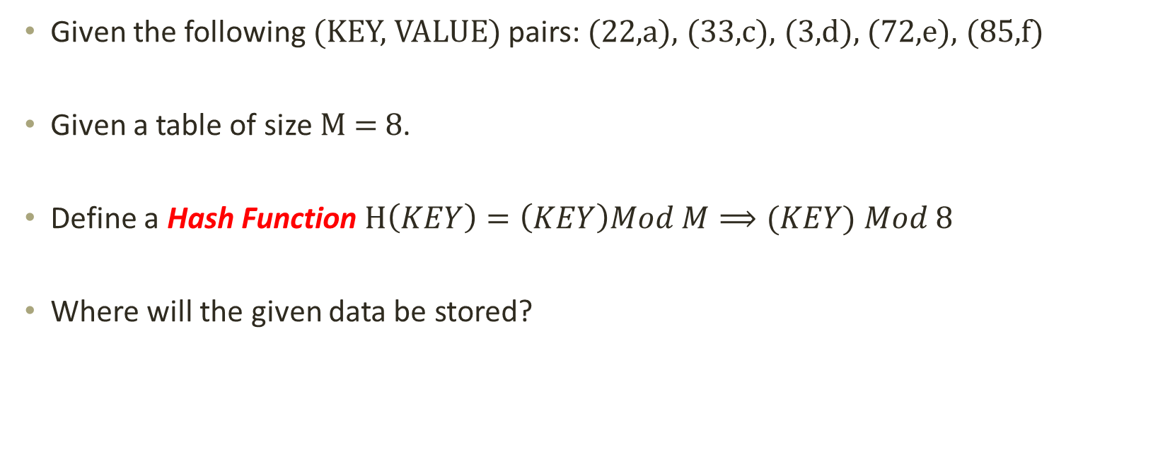
Hashing: Example
Given the following (KEY, VALUE) pairs: (22,a), (33,c), (3,d), (72,e), (85,f)
Given a table of size M = 8.
Define a Hash Function $H\left(KEY\right)=\left(KEY\right)Mod M⟹(KEY) Mod 8$
Where will the given data be stored?
(72,e)
(33,c)
(3,d)
(85,f)
(22,a)
[0] [1] [2] [3] [4] [5] [6] [7]

Slide 8
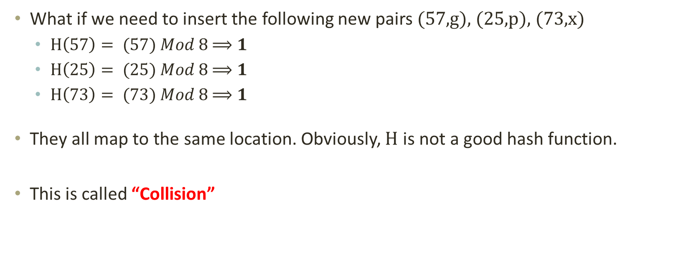
Hashing: Collisions
What if we need to insert the following new pairs (57,g), (25,p), (73,x)
$H\left(57\right)= (57) Mod 8$ $⟹1$
$H\left(25\right)= (25) Mod 8$ $⟹1$
$H\left(73\right)= (73) Mod 8$ $⟹1$
They all map to the same location. Obviously, $H$ is not a good hash function.
This is called “Collision”
(72,e)
(33,c)
(3,d)
(85,f)
(22,a)
[0] [1] [2] [3] [4] [5] [6] [7]

Slide 9
Hashing: Collisions
Two or more keys hashing to the same slot leads to “Collision”.
When collisions occur, we need to “handle” them.
Collisions can be reduced by:
Choosing a good hash function
Increasing the size of the hash table
Devising a mechanism to deal with collisions

Slide 10
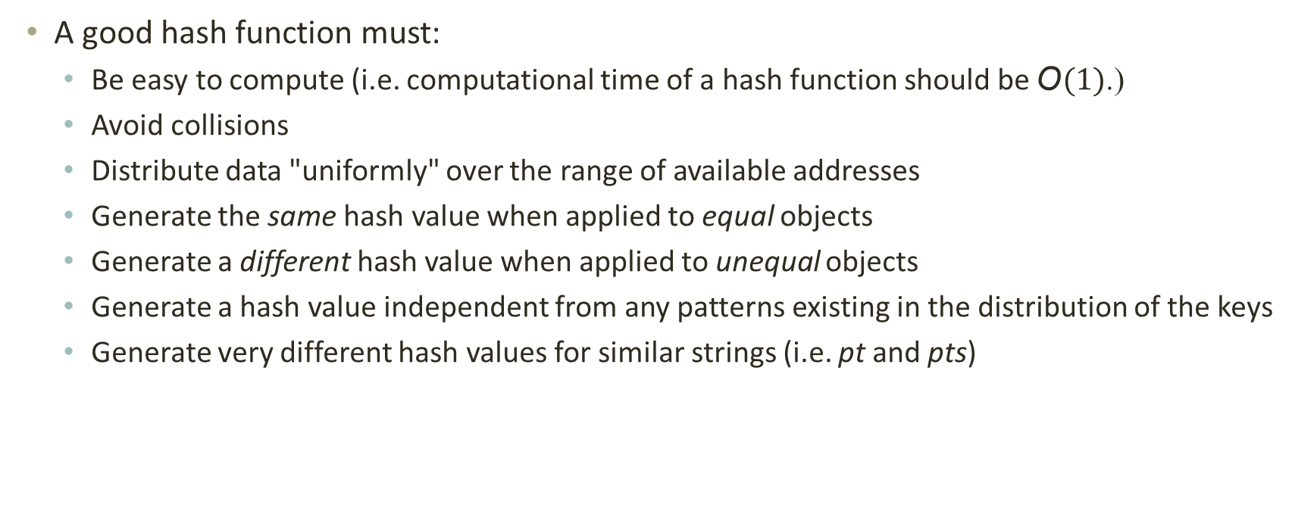
Hashing: Choosing a Hash Function
A good hash function must:
Be easy to compute (i.e. computational time of a hash function should be $\text{O}(1)$.)
Avoid collisions
Distribute data "uniformly" over the range of available addresses
Generate the same hash value when applied to equal objects
Generate a different hash value when applied to unequal objects
Generate a hash value independent from any patterns existing in the distribution of the keys
Generate very different hash values for similar strings (i.e. pt and pts)

Slide 11
Hashing: Choosing a Hash Function
How do we find a good hash function?
In general, we cannot -- there is no such magic function
In some specific cases, where all possible values are known in advance, it is possible to compute a perfect hash function
What is the next best thing?
A perfect hash function would tell us exactly where to look
In general, the best we can do is choose a function that tells us where to start looking!

Slide 12
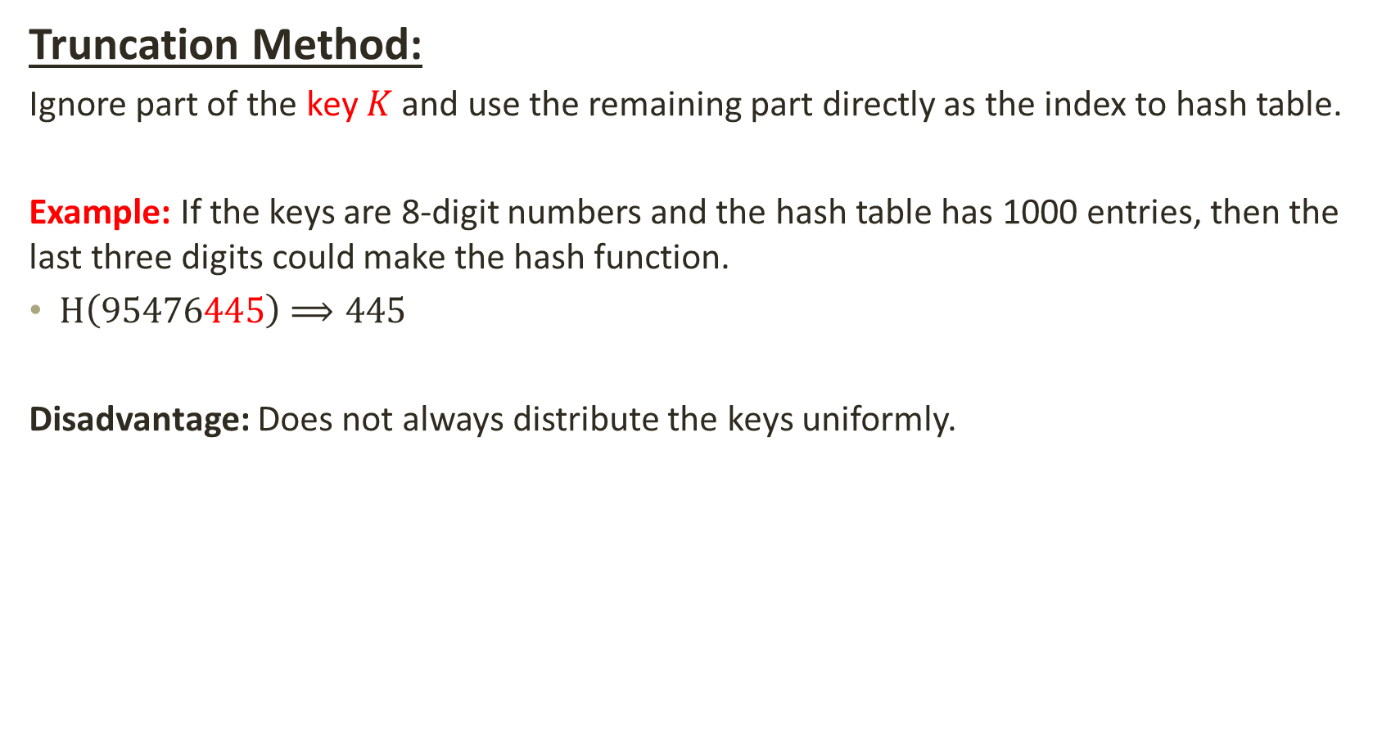
Hashing: Choosing a Hash Function
Truncation Method:
Ignore part of the key $K$ and use the remaining part directly as the index to hash table.
Example: If the keys are 8-digit numbers and the hash table has 1000 entries, then the last three digits could make the hash function.
$H\left(\text{9}\text{5}\text{47}\text{6}\text{445}\right)$ $⟹\text{445}$
Disadvantage: Does not always distribute the keys uniformly.

Slide 13
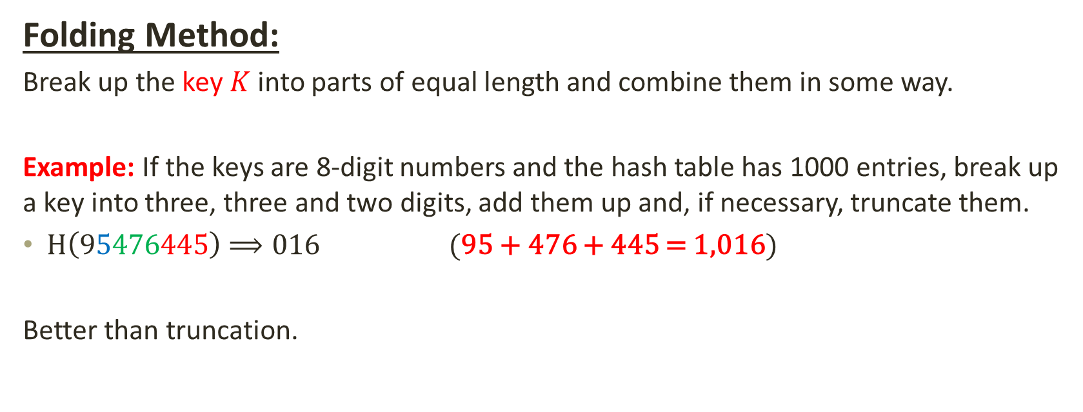
Hashing: Choosing a Hash Function
Folding Method:
Break up the key $K$ into parts of equal length and combine them in some way.
Example: If the keys are 8-digit numbers and the hash table has 1000 entries, break up a key into three, three and two digits, add them up and, if necessary, truncate them.
$H\left(\text{9}\text{5}\text{47}\text{6}\text{445}\right)$ $⟹\text{016}$ (95 + 476 + 445 = 1,016)
Better than truncation.

Slide 14
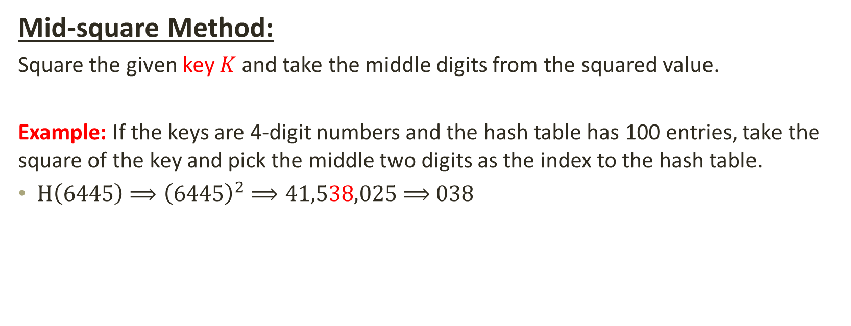
Hashing: Choosing a Hash Function
Mid-square Method:
Square the given key $K$ and take the middle digits from the squared value.
Example: If the keys are 4-digit numbers and the hash table has 100 entries, take the square of the key and pick the middle two digits as the index to the hash table.
$H\left(\text{6}\text{445}\right)$ $⟹{\left(\text{6445}\right)}^{2}$ $⟹41,538,025$ $⟹$ 038

Slide 15

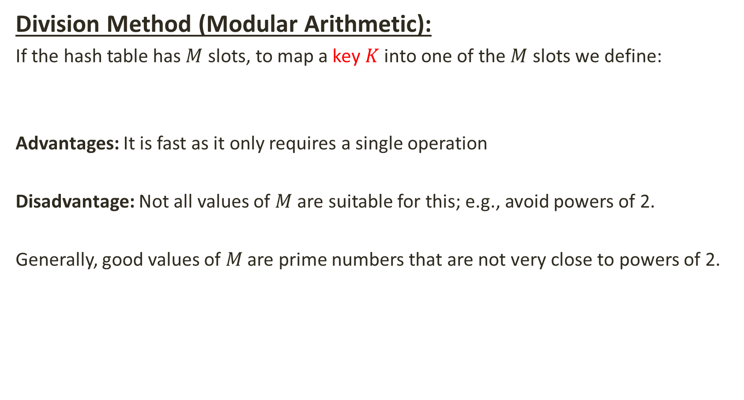
Hashing: Choosing a Hash Function
Division Method (Modular Arithmetic):
If the hash table has $M$ slots, to map a key $K$ into one of the $M$ slots we define:
Advantages: It is fast as it only requires a single operation
Disadvantage: Not all values of $M$ are suitable for this; e.g., avoid powers of 2.
Generally, good values of$M$are prime numbers that are not very close to powers of 2.
$H\left(K\right)= (K) Mod M$

Slide 16
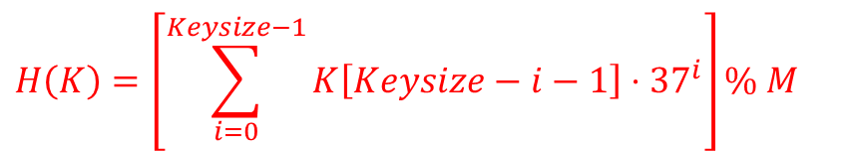
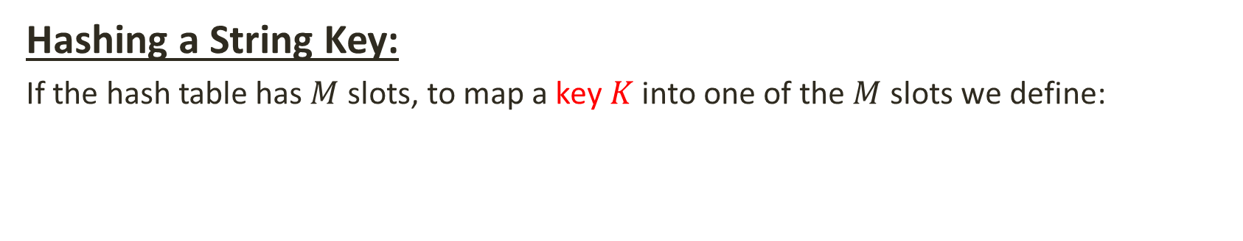
Hashing: Choosing a Hash Function
Hashing a String Key:
If the hash table has $M$ slots, to map a key $K$ into one of the $M$ slots we define:
$$H\left(K\right)=\left[\sum_{i=0}^{Keysize−1}{K\left[Keysize−i−1\right]⋅37^{i}}\right]\% M$$
97
108
105
K[ i ]
K
KeySize = 3;
a
l
i
0 1 2
i
0
1
$$H\left("ali"\right)=\left[\left(105×1\right)+\left(108×37\right)+\left(97×37^{2}\right)\right] \% 1,009 ⇒679$$
2
……
hash function
679
“ali”
ali
……
1,009

Slide 17
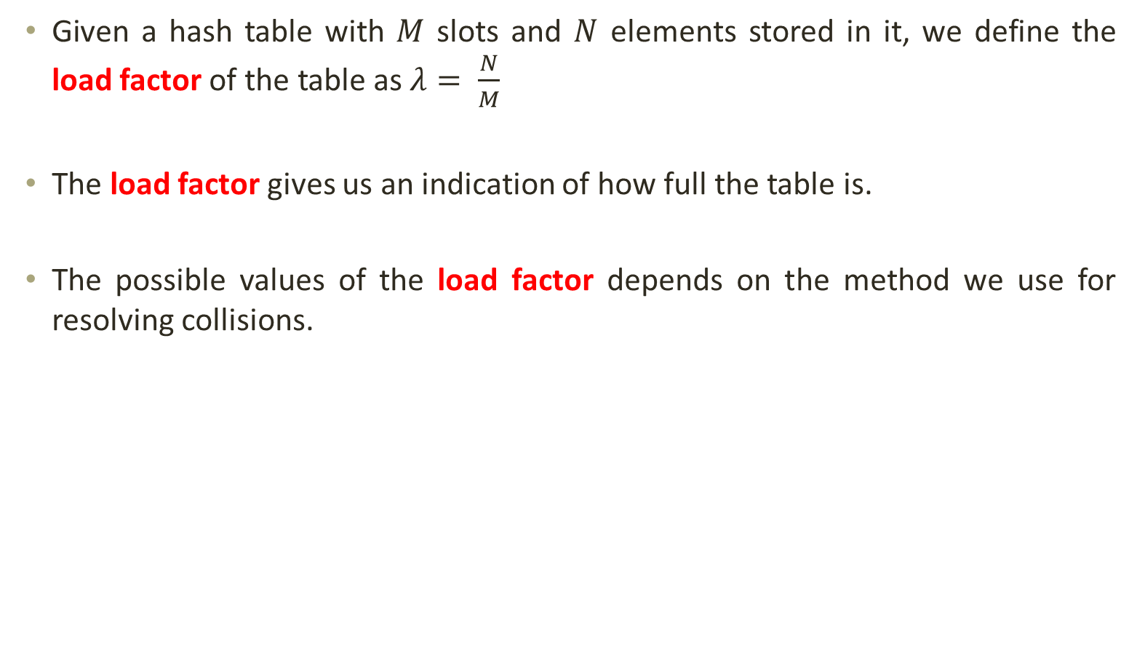
Hashing: Hash Table Size
Given a hash table with $M$ slots and $N$ elements stored in it, we define the load factor of the table as $λ= \frac{N}{M}$
The load factor gives us an indication of how full the table is.
The possible values of the load factor depends on the method we use for resolving collisions.

Slide 18
Hashing: Collision Resolving Strategies
Separate chaining
Open addressing
Linear Probing
Quadratic Probing
Double Probing

Slide 19
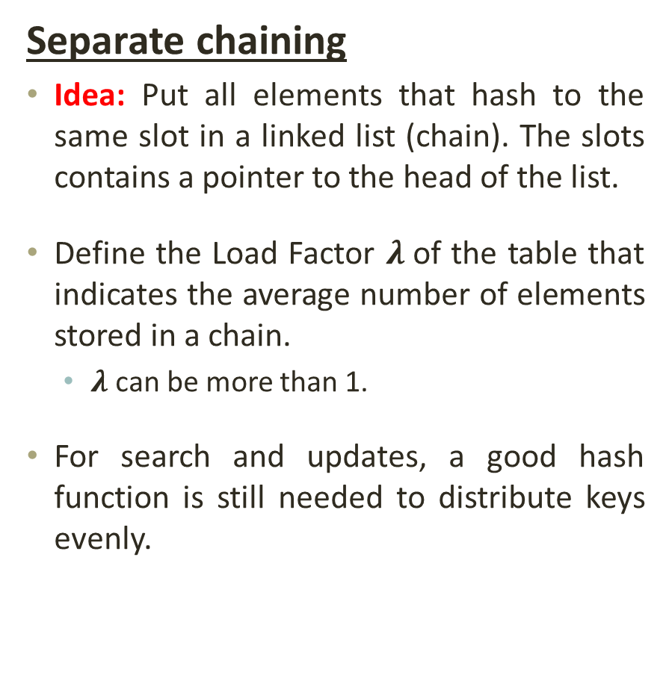
Hashing: Collision Resolving Strategies
Separate chaining
Idea: Put all elements that hash to the same slot in a linked list (chain). The slots contains a pointer to the head of the list.
Define the Load Factor $λ$of the table that indicates the average number of elements stored in a chain.
$λ$can be more than 1.
For search and updates, a good hash function is still needed to distribute keys evenly.
Keys: 0, 1, 4, 9, 16, 25, 36, 49, 64, 81
hash(key) = key % 10.
0
0
1
81
1
2
3
4
64
4
5
25
6
36
16
7
8
9
49
9

Slide 20
Hashing: Collision Resolving Strategies
Separate chaining
Insert: The slot in the table is located using the hash function and the key is inserted to the head of the linked list at that slot (search the list first to avoid duplicates).
Search: The slot in the table is located using the hash function and the key searched in the linked list, headed at that slot, using linear search.
Delete: The slot in the table is located using the hash function and the key is deleted in the linked list headed at that slot.
Advantages: average case performance stays good even when 𝝀>𝟏; better space utilization for large number of items; more items than the hash table size; delete is easier to implement than with open addressing.
Disadvantages: requires dynamic data, requires storage for pointers in addition to data, can have poor locality which causes poor caching performance

Slide 21
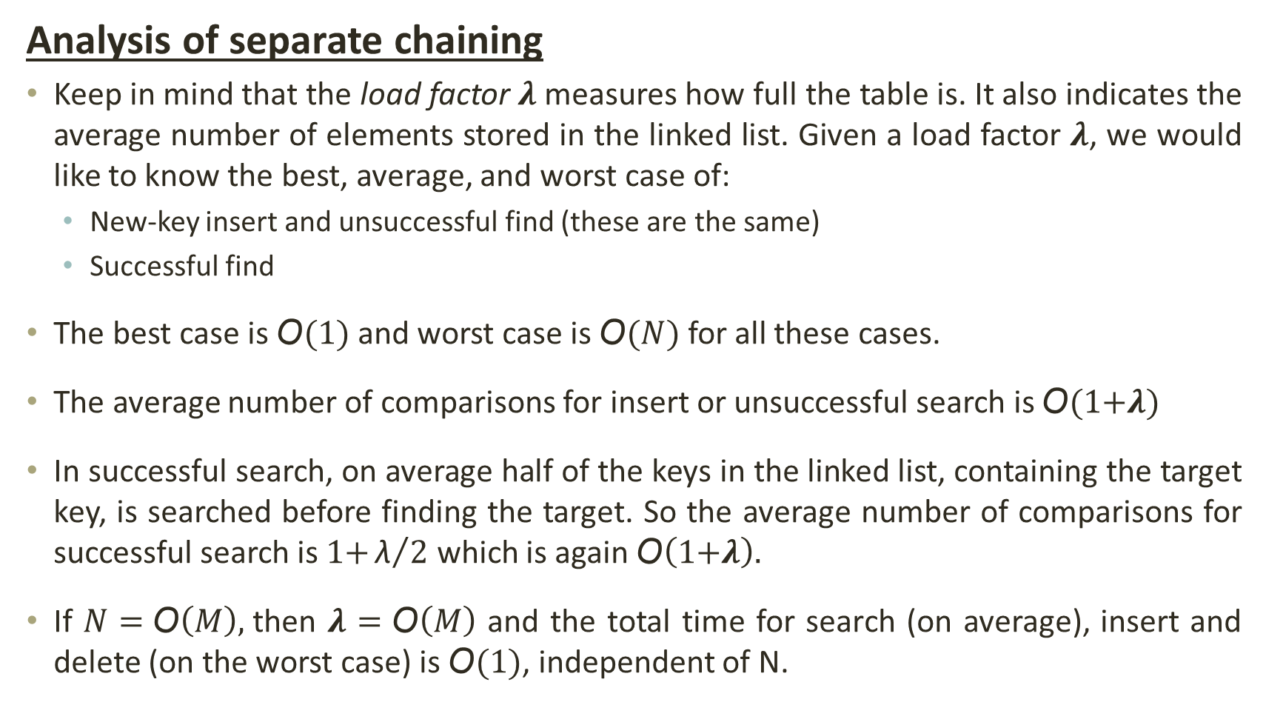
Hashing: Collision Resolving Strategies
Analysis of separate chaining
Keep in mind that the load factor 𝝀 measures how full the table is. It also indicates the average number of elements stored in the linked list. Given a load factor 𝝀, we would like to know the best, average, and worst case of:
New-key insert and unsuccessful find (these are the same)
Successful find
The best case is $\text{O}(1)$ and worst case is $\text{O}(N)$ for all these cases.
The average number of comparisons for insert or unsuccessful search is $\text{O}(\text{1+}\text{λ})$
In successful search, on average half of the keys in the linked list, containing the target key, is searched before finding the target. So the average number of comparisons for successful search is $\text{1+}{\text{λ}}/2$ which is again $\text{O}\left(\text{1+}\text{λ}\right).$
If $N=\text{O}\left(M\right),$then 𝝀 $=\text{O}\left(M\right)$ and the total time for search (on average), insert and delete (on the worst case) is $\text{O}(1)$, independent of N.

Slide 22
Hashing: Collision Resolving Strategies
Open Addressing
Idea: Store all elements in the hash table itself. If a collision occurs, find another slot. When searching for an element, examine slots until the element is found or the element is not in the table.
It is possible that the table is full, and a new element cannot be inserted.
Resize the hash table
The sequence of slots to be examined (probed) is computed in a systematic way.
There are three common ways to determine a probe sequence:
Linear probing
Quadratic probing
Double probing

Slide 23
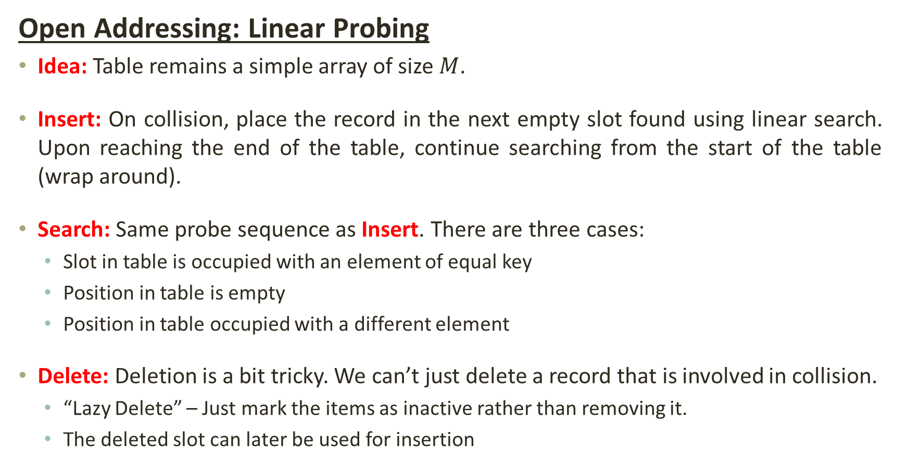
Hashing: Collision Resolving Strategies
Open Addressing: Linear Probing
Idea: Table remains a simple array of size $M$.
Insert: On collision, place the record in the next empty slot found using linear search. Upon reaching the end of the table, continue searching from the start of the table (wrap around).
Search: Same probe sequence as Insert. There are three cases:
Slot in table is occupied with an element of equal key
Position in table is empty
Position in table occupied with a different element
Delete: Deletion is a bit tricky. We can’t just delete a record that is involved in collision.
“Lazy Delete” – Just mark the items as inactive rather than removing it.
The deleted slot can later be used for insertion

Slide 24



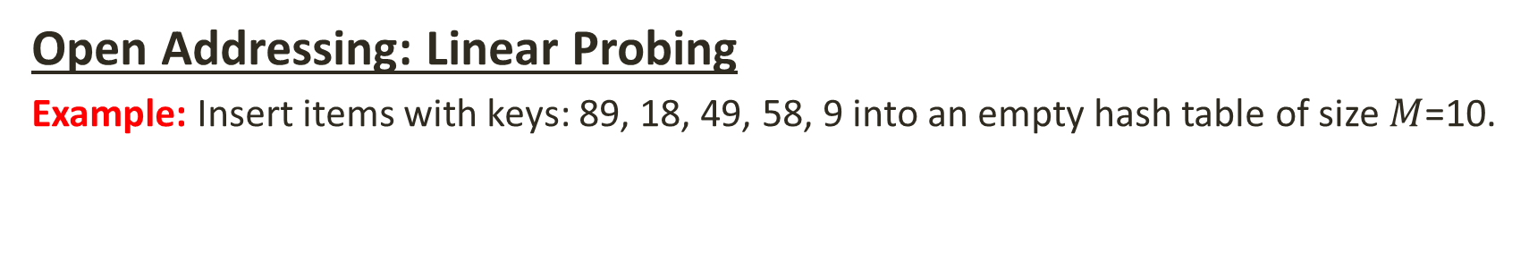



Hashing: Collision Resolving Strategies
Open Addressing: Linear Probing
Example: Insert items with keys: 89, 18, 49, 58, 9 into an empty hash table of size $M$=10.
$H\left(K\right)= (K) Mod 10$
49
58
9
18
89
[0] [1] [2] [3] [4] [5] [6] [7] [8] [9]
$H\left(89\right)= (89) Mod 10$ $⟹9$
$H\left(18\right)= (18) Mod 10$ $⟹8$
$H\left(49\right)= (49) Mod 10$ $⟹9$
$H\left(58\right)= (58) Mod 10$ $⟹8$
$H\left(09\right)= (09) Mod 10$ $⟹9$

Slide 25
Hashing: Collision Resolving Strategies
Open Addressing: Linear Probing
An issue with linear probing is that it has the tendency to form “clusters”.
A “cluster” is a group of elements stored consecutively in the hash table without containing any empty slots.
The bigger a cluster gets; it starts taking more time to find a free slot or to search an element. Additionally, it becomes more likely that the new values will hash into the cluster and make it ever bigger.
Even if the table is relatively empty, clustering is still possible.
This effect is known as primary clustering.

Slide 26
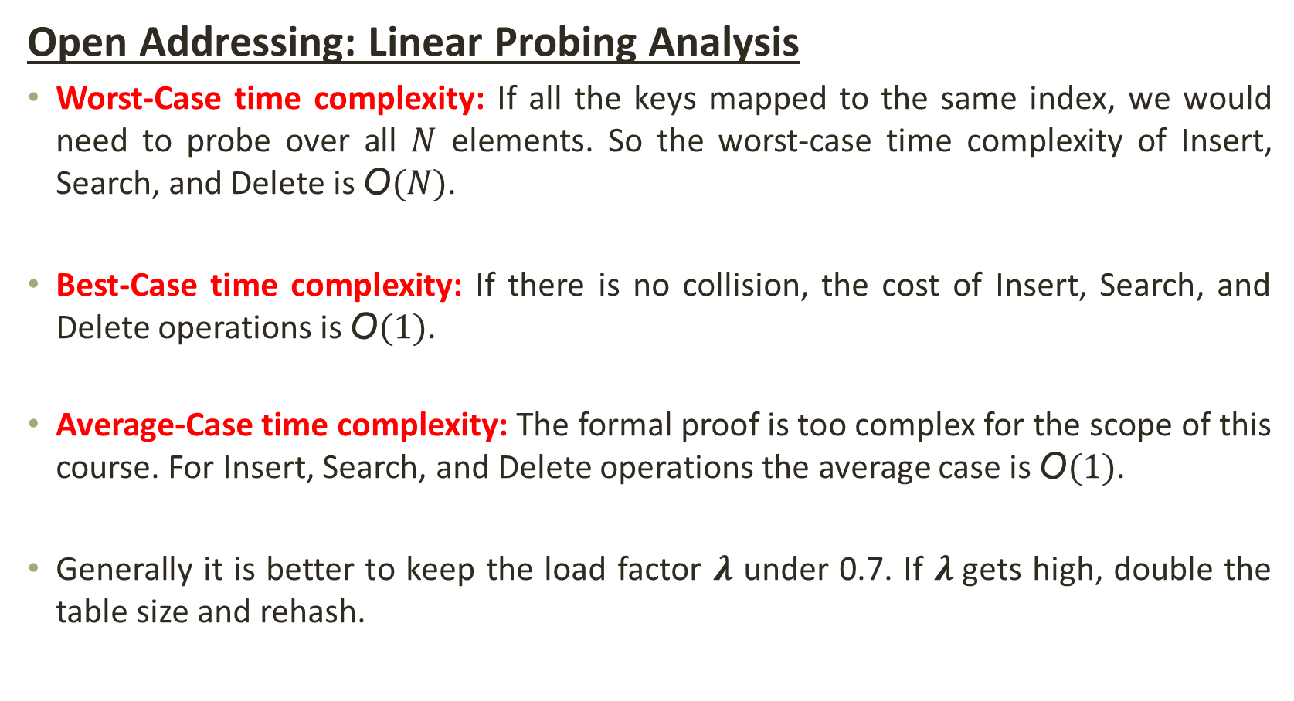
Hashing: Collision Resolving Strategies
Open Addressing: Linear Probing Analysis
Worst-Case time complexity: If all the keys mapped to the same index, we would need to probe over all $N$ elements. So the worst-case time complexity of Insert, Search, and Delete is $\text{O}(N)$.
Best-Case time complexity: If there is no collision, the cost of Insert, Search, and Delete operations is $\text{O}(1)$.
Average-Case time complexity: The formal proof is too complex for the scope of this course. For Insert, Search, and Delete operations the average case is $\text{O}(1)$.
Generally it is better to keep the load factor $\text{λ}$ under 0.7. If $\text{λ}$gets high, double the table size and rehash.

Slide 27
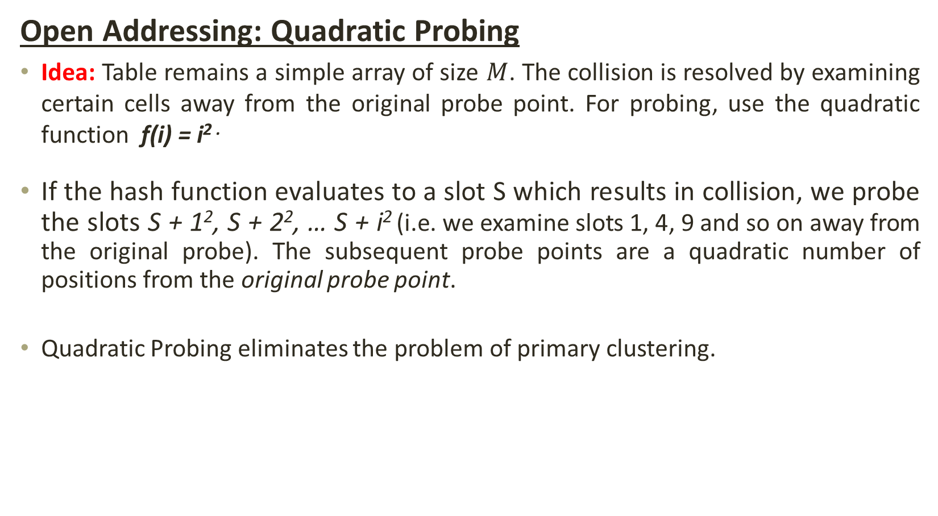
Hashing: Collision Resolving Strategies
Open Addressing: Quadratic Probing
Idea: Table remains a simple array of size $M$. The collision is resolved by examining certain cells away from the original probe point. For probing, use the quadratic function f(i) = i^{2 .}
If the hash function evaluates to a slot S which results in collision, we probe the slots S + 1², S + 2², … S + i² (i.e. we examine slots 1, 4, 9 and so on away from the original probe). The subsequent probe points are a quadratic number of positions from the original probe point.
Quadratic Probing eliminates the problem of primary clustering.

Slide 28
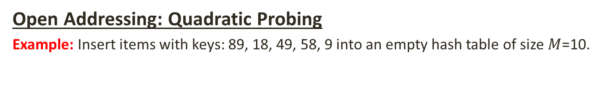
Hashing: Collision Resolving Strategies
Open Addressing: Quadratic Probing
Example: Insert items with keys: 89, 18, 49, 58, 9 into an empty hash table of size $M$=10.
$H\left(K\right)= (K) Mod 10$
49
58
9
18
89
[0] [1] [2] [3] [4] [5] [6] [7] [8] [9]
$H\left(89\right)= (89) Mod 10$ $⟹9$
$H\left(18\right)= (18) Mod 10$ $⟹8$
$H\left(49\right)= (49) Mod 10$ $⟹9$
$H\left(58\right)= (58) Mod 10$ $⟹8$
$H\left(09\right)= (09) Mod 10$ $⟹9$

Slide 29
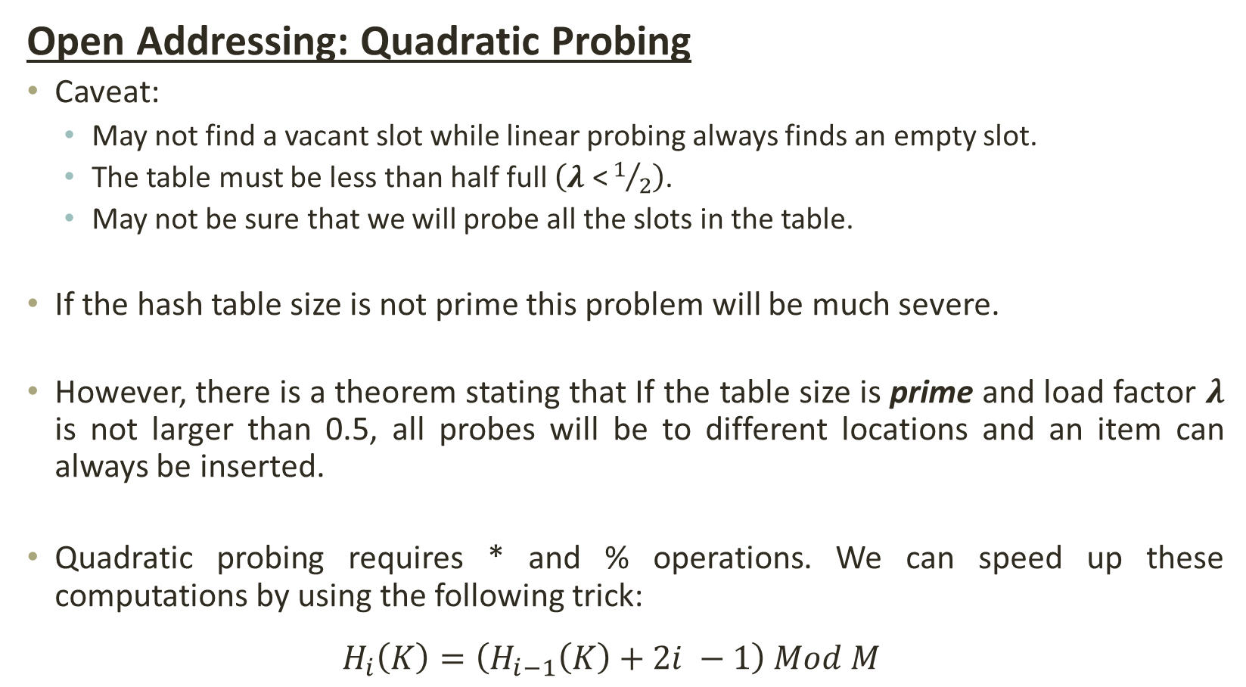
Hashing: Collision Resolving Strategies
Open Addressing: Quadratic Probing
Caveat:
May not find a vacant slot while linear probing always finds an empty slot.
The table must be less than half full $\left(\text{λ}\text{ <}1/2\right)$.
May not be sure that we will probe all the slots in the table.
If the hash table size is not prime this problem will be much severe.
However, there is a theorem stating that If the table size is prime and load factor $\text{λ}$ is not larger than 0.5, all probes will be to different locations and an item can always be inserted.
Quadratic probing requires * and % operations. We can speed up these computations by using the following trick:
$$H_{i}\left(K\right)=\left(H_{i−1}\left(K\right)+2i −1\right) Mod M$$

Slide 30
Hashing: Collision Resolving Strategies
Open Addressing: Quadratic Probing
If the load factor gets too high, dynamically expand and double the table size as soon as the load factor reaches 0.5; always double to a prime number; and refill the new table by using the new hash function.
Quadratic probing does not suffer from primary clustering:
No problem with keys initially hashing to the same neighborhood
But it doesn’t help if keys initially hash to the same index as they will probe the same alternative cells. This is called secondary clustering.
Using probe functions that depends on the key can avoid secondary clustering. This technique is called double probing (hashing).

Slide 31
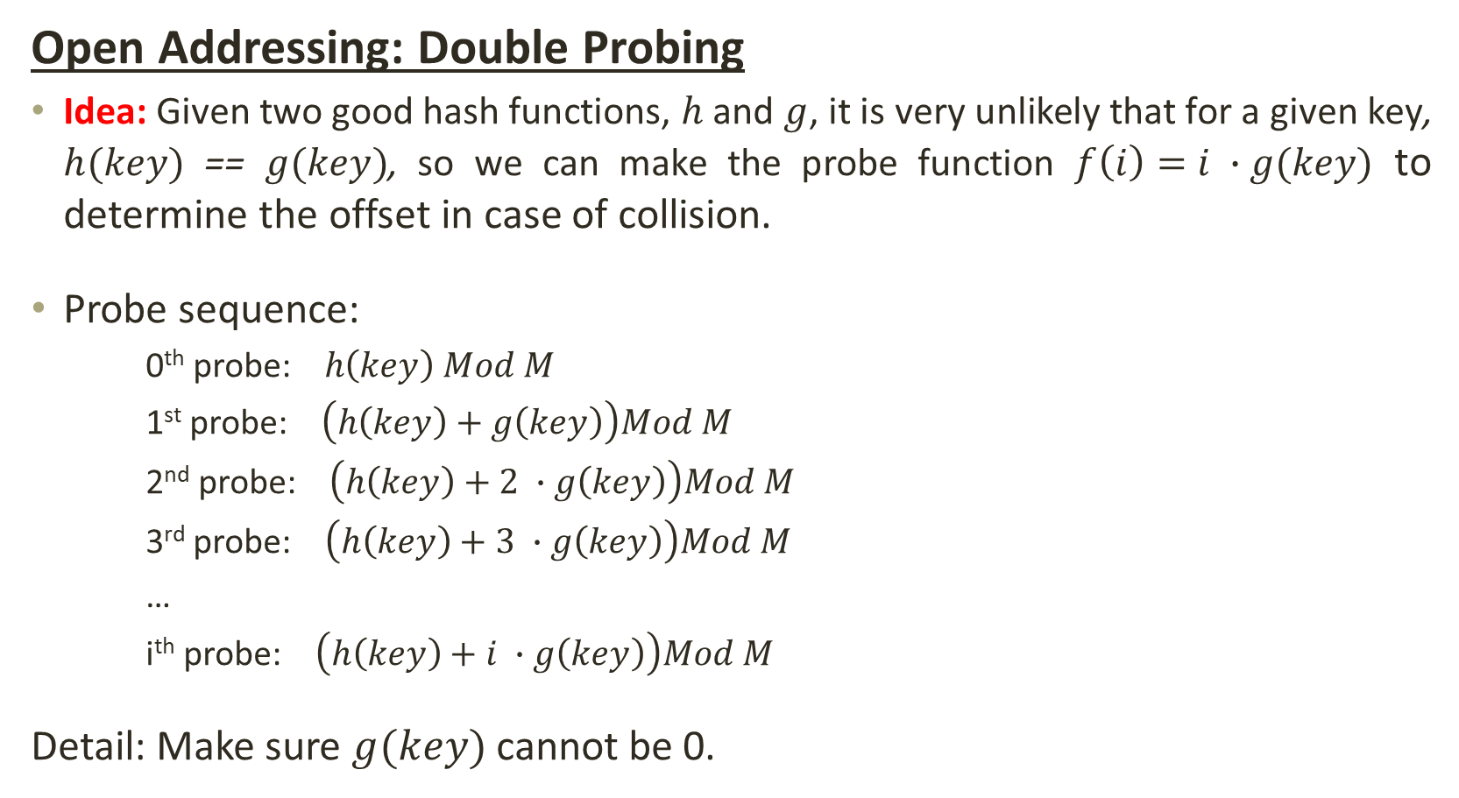
Hashing: Collision Resolving Strategies
Open Addressing: Double Probing
Idea: Given two good hash functions, $h$ and $g$, it is very unlikely that for a given key, $h(key)$ == $g(key)$, so we can make the probe function $f\left(i\right)=i ∙g(key)$ to determine the offset in case of collision.
Probe sequence:
0th probe: $h\left(key\right) Mod M$
1st probe: $\left(h\left(key\right)+g\left(key\right)\right)Mod M$
2nd probe: $\left(h\left(key\right)+2 ∙g\left(key\right)\right)Mod M$
3rd probe: $\left(h\left(key\right)+3 ∙g\left(key\right)\right)Mod M$
…
i^{th} probe: $\left(h\left(key\right)+i ∙g\left(key\right)\right)Mod M$
Detail: Make sure $g(key)$cannot be 0.

Slide 32
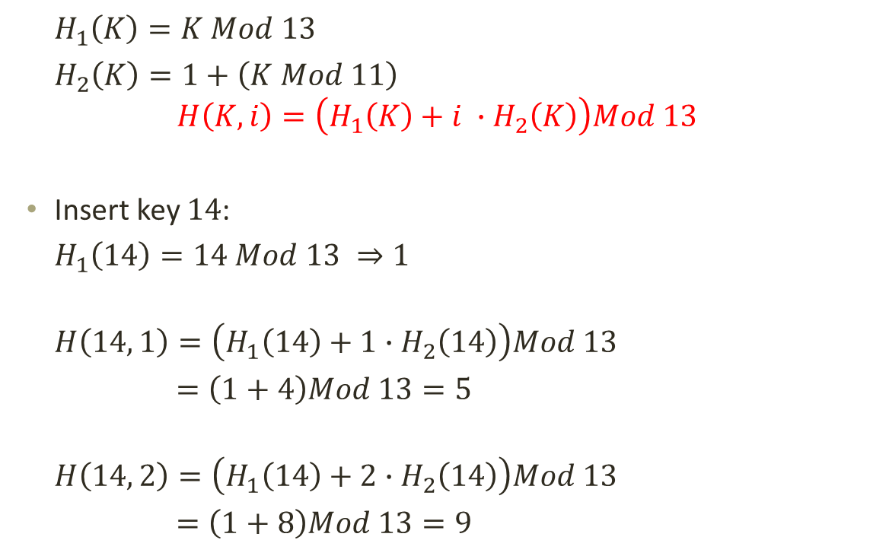
Hashing: Collision Resolving Strategies
Open Addressing: Double Probing
0
79
69
98
72
50
$H_{1}\left(K\right)=K Mod 13$
$H_{2}\left(K\right)=1+\left(K Mod 11\right)$
$$H\left(K,i\right)=\left(H_{1}\left(K\right)+i ∙H_{2}\left(K\right)\right)Mod 13$$
Insert key $14$:
$H_{1}\left(14\right)=14 Mod 13 ⇒1$
$$H\left(14, 1\right)=\left(H_{1}\left(14\right)+1∙H_{2}\left(14\right)\right)Mod 13$$
$=\left(1+4\right)Mod 13=5$
$$H\left(14, 2\right)=\left(H_{1}\left(14\right)+2∙H_{2}\left(14\right)\right)Mod 13$$
$=\left(1+8\right)Mod 13=9$
1
2
3
4
5
6
7
8
9
14
10
11
12

Slide 33
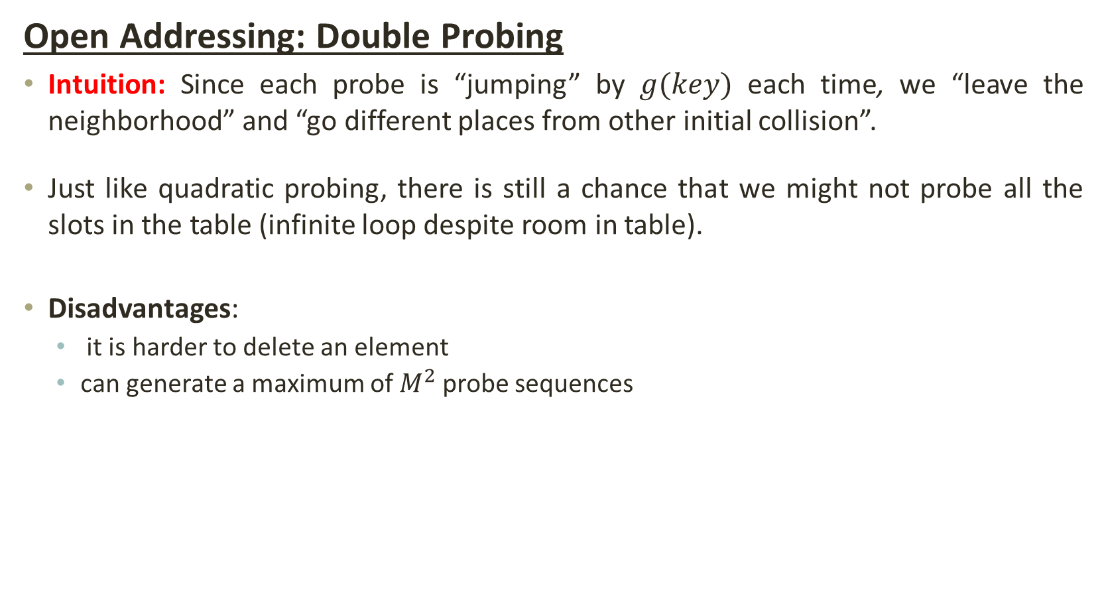
Hashing: Collision Resolving Strategies
Open Addressing: Double Probing
Intuition: Since each probe is “jumping” by $g(key)$ each time, we “leave the neighborhood” and “go different places from other initial collision”.
Just like quadratic probing, there is still a chance that we might not probe all the slots in the table (infinite loop despite room in table).
Disadvantages:
it is harder to delete an element
can generate a maximum of $M^{2}$probe sequences

Slide 34
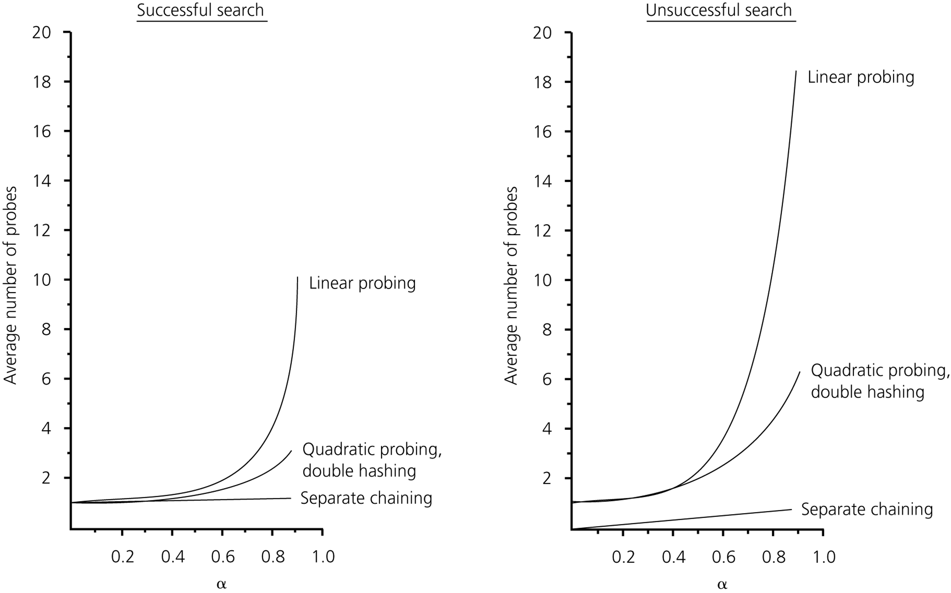


Hashing: Collision Resolving Strategies
Efficiency:
$$\text{λ}$$
$$\text{λ}$$

Slide 35
Hashing: Summary
The hash table is one of the most important data structures
Supports only find, insert and delete efficiently
Important to use a good hash function
Important to keep hash table at a good size
Side-Comment: Hash functions have uses beyond hash tables
Example: Cryptography, check-sums

Slide 36
THANK YOU

