Slide 1
CSC 301 – Design and Analysis of Algorithms
Instructor: Dr. M. Hasan Jamal
Lecture# 07(b): Greedy Algorithms - Huffman Coding

Slide 2
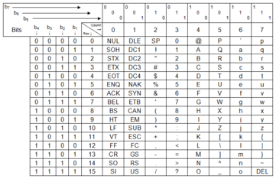
Greedy Algorithms: Huffman Coding
All data stored on a system or transmitted across systems is represented as binary digit
stream of 1s and 0s.
Since there are finite number of characters to represent, traditional solution assigned every character with a unique standardized binary pattern of a fixed length.
7-bit ASCII codes (American Standard Code for Information Exchange)
8-bit EBCDIC codes (Extended Binary Coded Decimal Interchange Code)

Slide 3
Greedy Algorithms: Huffman Coding
Encoding the following string using ASCII codes: CAN A CLAM CRAM IN A CLEAN CREAM CAN?
CAN “ ” A “ ” CLAM
100001110000011001110 0100000 1000001 0100000 1000011100110010000011001101
“ ” CRAM “ ” IN “ ” A “ ”
0100000 1000011101001010000011001101 0100000 10010011001110 0100000 1000001 0100000
CLEAN “ ” CREAM “ ”
10000111001100100010110000011001110 0100000 10000111010010100010110000011001101 0100000
CAN ?
100001110000011001110 0111111
No. of Characters (n) = 37
No. of bits per character (ℓ) = 7
Total space usage in bits: nℓ bits ➔ 259 bits
Character | A | C | E | I | L | M | N | R | “ ” | ?
ASCII Code (Decimal) | 65 | 67 | 69 | 73 | 76 | 77 | 78 | 82 | 32 | 63
ASCII Code (Binary) | 1000001 | 1000011 | 1000101 | 1001001 | 1001100 | 1001101 | 1001110 | 1010010 | 100000 | 111111

Slide 4
Greedy Algorithms: Huffman Coding
Problem: Assigning 7 bits to each character in a document takes up a lot of space. We need ways to efficiently store and transmit data.
Solution: Use fixed length codes
Encoding the following string using Fixed length codes:
CAN A CLAM CRAM IN A CLEAN CREAM CAN?
Character | Fixed Length Code
A | 0000
C | 0001
E | 0010
I | 0011
L | 0100
M | 0101
N | 0110
R | 0111
“ “ | 1000
? | 1001
CAN “ ” A “ ” CLAM “ ”
000100000110 1000 0000 1000 0001010000000101 1000
CRAM “ ” IN “ ” A “ ”
0001011100000101 0100000 00110110 1000 0000 1000
CLEAN “ ” CREAM “ ” CAN ?
00010100001000000110 1000 00010111001000000101 1000 000100000110 1001
No. of Characters (n) = 37
No. of bits per character (ℓ) = 4
Total space usage in bits: nℓ bits ➔ 148 bits
Notes:
Decoding fix length codes is easy as all characters have the same number of bits. Slice the input string in fixed size bit and determine what character does it represent.

Slide 5
Greedy Algorithms: Huffman Coding
Why should the character “X” and “Z” take up the same number of bits as “e” or “ “?
Huffman codes use variable-length codes to represent each character. More frequently used letters have shorter strings to represent them (probability based).
Huffman codes use prefix property. No character’s code is the prefix of any other character’s code.
This makes decoding a compressed string easy; simply include successive bits until a code is recognized, translate it for output, and remove it from the input string.
The technique for creating codes guarantees the prefix property of the codes.
Huffman coding is a simple example of data compression
representing data in fewer bits than it would otherwise need
Notes:
Not all characters occur with the same frequency!
Yet all characters are allocated the same amount of space

Slide 6
Greedy Algorithms: Huffman Coding
Binary tree can be used to represent any binary code scheme where all characters are stored at the leaves of the tree.
Leaf nodes also contain the probability of occurrence of each character.
An interior node contain the sum of the frequencies of the leaves in its subtree.
A Left-edge is numbered “0” and a right-edge is numbered “1”. The code of a character is obtained by following the root-to-leaf path.
The code generated is a prefix code since each of the leaves has a path ending in it, without continuation.
To ensure smaller (efficient) code, frequently occurring symbols should be closer to the root.
If the tree is full then we are not “wasting” bits.
0
1
0
1
0
1
A
B
C
D
{A : 00, B : 01, C : 10, D : 11}
Notes:
Encoding and decoding are similar and reverse process.

Slide 7
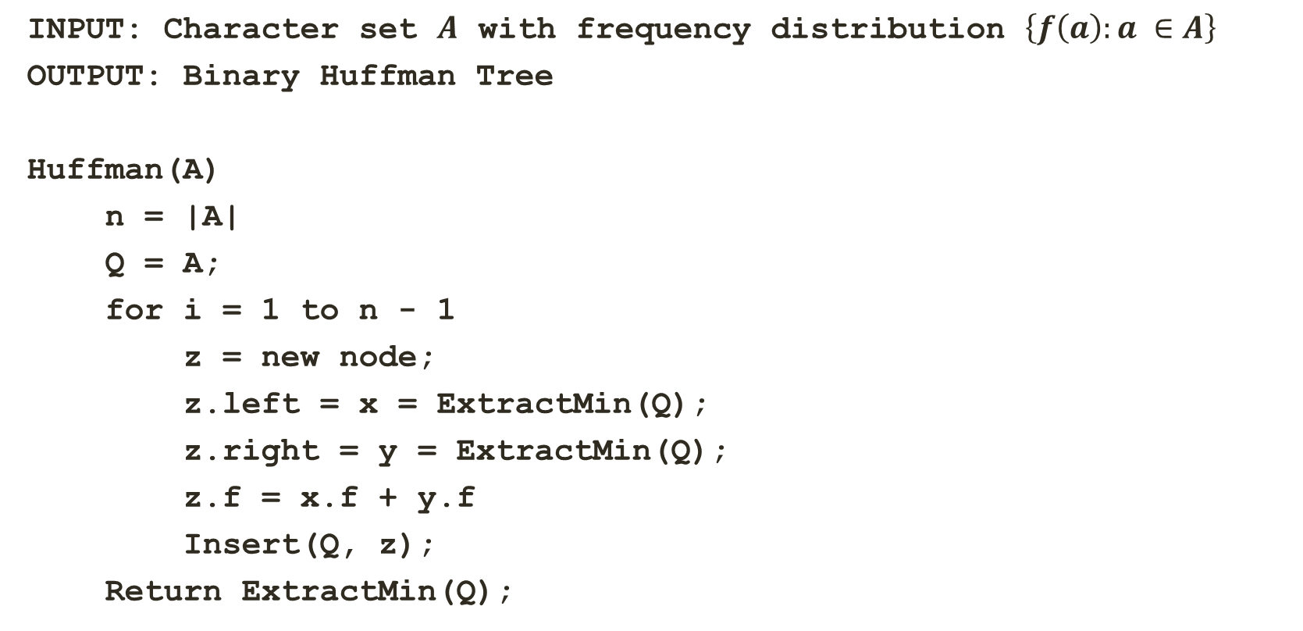
Greedy Algorithms: Huffman Coding
INPUT: Character set $A$ with frequency distribution $\left\{f\left(a\right):a ∈A\right\}$
OUTPUT: Binary Huffman Tree
Huffman(A)
n = |A|
Q = A;
for i = 1 to n - 1
z = new node;
z.left = x = ExtractMin(Q);
z.right = y = ExtractMin(Q);
z.f = x.f + y.f
Insert(Q, z);
Return ExtractMin(Q);
Insert character set in priority queue
Create a new tree node
Extract two characters with minimum frequency
Update frequency of the new node
Insert the new node in the priority queue
Return the root node of the tree

Slide 8
Greedy Algorithms: Huffman Coding
Using Huffman coding, encode the string: “CAN A CLAM CRAM IN A CLEAN CREAM CAN?”
I : 1
? : 1
E : 2
L : 2
R : 2
M : 3
N : 4
C : 6
A : 8
“ ” : 8

Slide 9
Greedy Algorithms: Huffman Coding
Using Huffman coding, encode the string: “CAN A CLAM CRAM IN A CLEAN CREAM CAN?”
E : 2
L : 2
R : 2
M : 3
N : 4
C : 6
A : 8
“ ” : 8
2
2
I : 1
I : 1
? : 1
? : 1

Slide 10
Greedy Algorithms: Huffman Coding
Using Huffman coding, encode the string: “CAN A CLAM CRAM IN A CLEAN CREAM CAN?”
L : 2
R : 2
M : 3
N : 4
C : 6
A : 8
“ ” : 8
4
2
E : 2
2
E : 2
I : 1
? : 1
I : 1
? : 1

Slide 11
Greedy Algorithms: Huffman Coding
Using Huffman coding, encode the string: “CAN A CLAM CRAM IN A CLEAN CREAM CAN?”
M : 3
4
N : 4
C : 6
A : 8
“ ” : 8
2
E : 2
4
I : 1
? : 1
L : 2
R : 2
L : 2
R : 2

Slide 12
Greedy Algorithms: Huffman Coding
Using Huffman coding, encode the string: “CAN A CLAM CRAM IN A CLEAN CREAM CAN?”
4
N : 4
C : 6
A : 8
“ ” : 8
L : 2
R : 2
7
4
M : 3
4
M : 3
2
E : 2
2
E : 2
I : 1
? : 1
I : 1
? : 1

Slide 13
Greedy Algorithms: Huffman Coding
Using Huffman coding, encode the string: “CAN A CLAM CRAM IN A CLEAN CREAM CAN?”
C : 6
7
A : 8
“ ” : 8
M : 3
4
8
2
E : 2
4
4
N : 4
N : 4
I : 1
? : 1
L : 2
R : 2
L : 2
R : 2

Slide 14
Greedy Algorithms: Huffman Coding
Using Huffman coding, encode the string: “CAN A CLAM CRAM IN A CLEAN CREAM CAN?”
13
8
A : 8
“ ” : 8
7
C : 6
7
4
C : 6
N : 4
4
M : 3
4
M : 3
L : 2
R : 2
2
2
E : 2
E : 2
I : 1
I : 1
? : 1
? : 1

Slide 15
Greedy Algorithms: Huffman Coding
Using Huffman coding, encode the string: “CAN A CLAM CRAM IN A CLEAN CREAM CAN?”
“ ” : 8
13
16
C : 6
7
A : 8
M : 3
4
8
A : 8
8
4
2
E : 2
4
N : 4
N : 4
L : 2
R : 2
L : 2
R : 2
I : 1
? : 1

Slide 16
Greedy Algorithms: Huffman Coding
Using Huffman coding, encode the string: “CAN A CLAM CRAM IN A CLEAN CREAM CAN?”
21
16
“ ” : 8
“ ” : 8
13
13
8
A : 8
C : 6
7
C : 6
7
4
N : 4
M : 3
4
M : 3
4
L : 2
R : 2
2
E : 2
2
E : 2
I : 1
? : 1
I : 1
? : 1

Slide 17
Greedy Algorithms: Huffman Coding
Using Huffman coding, encode the string: “CAN A CLAM CRAM IN A CLEAN CREAM CAN?”
37
16
21
8
A : 8
“ ” : 8
13
4
N : 4
C : 6
7
L : 2
R : 2
M : 3
4
2
E : 2
I : 1
? : 1

Slide 18
Greedy Algorithms: Huffman Coding
Using Huffman coding, encode the string: “CAN A CLAM CRAM IN A CLEAN CREAM CAN?”
0
37
1
Character | Frequency | Huffman Code | Total bits
A | 8 | 01 | 16
C | 6 | 110 | 18
E | 2 | 11111 | 10
I | 1 | 111100 | 6
L | 2 | 0000 | 8
M | 3 | 1110 | 12
N | 4 | 001 | 12
R | 2 | 0001 | 8
“ “ | 8 | 10 | 16
? | 1 | 111101 | 6
16
21
0
1
0
1
8
A : 8
“ ” : 8
13
0
1
0
1
4
N : 4
C : 6
7
0
1
0
1
L : 2
R : 2
M : 3
4
Note the savings:
ASCII codes → 259 bits
Fixed-Length code → 148 bits
Huffman Coding → 112 bits
0
1
Total space usage in bits:
2
E : 2
16 + 18 + 10 + 6 + 8 + 12 + 12 + 8 + 16 + 6 = 112 bits
0
1
I : 1
? : 1
Notes:
Left-edge is numbered “0” and a right-edge is numbered “1”. The code of a character is obtained by following the root-to-leaf path.
Not a prefix of another code. Frequency of root node should equal number of characters in text.

Slide 19
Greedy Algorithms: Huffman Coding
Using Huffman coding, encode the string: “CAN A CLAM CRAM IN A CLEAN CREAM CAN?”
0
37
1
Character | Frequency | Huffman Code | Total bits
A | 8 | 01 | 16
C | 6 | 110 | 18
E | 2 | 11111 | 10
I | 1 | 111100 | 6
L | 2 | 0000 | 8
M | 3 | 1110 | 12
N | 4 | 001 | 12
R | 2 | 0001 | 8
“ “ | 8 | 10 | 16
? | 1 | 111101 | 6
16
21
0
1
0
1
8
A : 8
“ ” : 8
13
0
1
0
1
4
N : 4
C : 6
7
0
1
0
1
L : 2
R : 2
M : 3
4
Note the savings:
ASCII codes → 259 bits
Fixed-Length code → 148 bits
Huffman Coding → 112 bits
0
1
Total space usage in bits:
2
E : 2
16 + 18 + 10 + 6 + 8 + 12 + 12 + 8 + 16 + 6 = 112 bits
0
1
I : 1
? : 1
Notes:
Left-edge is numbered “0” and a right-edge is numbered “1”. The code of a character is obtained by following the root-to-leaf path.
Not a prefix of another code. Frequency of root node should equal number of characters in text.

Slide 20
Greedy Algorithms: Huffman Coding
INPUT: Character set $A$ with frequency distribution $\left\{f\left(a\right):a ∈A\right\}$
OUTPUT: Binary Huffman Tree
Huffman(A)
n = |A|
Q = A;
for i = 1 to n - 1
z = new node;
z.left = x = ExtractMin(Q);
z.right = y = ExtractMin(Q);
z.f = x.f + y.f
Insert(Q, z);
Return ExtractMin(Q);
What will be the running time?
O(n lg n)
O(n) to build the min-heap
O(n)
O(n lg n) for the entire for loop
O(n lg n) for the entire for loop

Slide 21
Greedy Algorithms: Huffman Coding Practicality
Huffman coding is practical if:
The encoded string is large relative to the code table
Code table is agreed upon beforehand
Easy to find a table of letter frequencies for English (or other alphabet-based languages)
Huffman coding is not practical when using it for a single short string as code table is required for decoding and including the code table in the entire message makes the whole thing bigger than just the ASCII message.

Slide 22
Greedy Algorithms: Huffman Coding Example
Given the following characters with their frequency of occurrence in a file of length 100. Find the fixed-length and variable length (Huffman) code for these characters.
F | E | D | C | B | A
5 | 9 | 16 | 12 | 13 | 45

Slide 23
THANK YOU

