Slide 1

Operating Systems
Lecture 1

Slide 2
Agenda for Today
Introduction and purpose of the course
Organization of a computer system
Purpose of a computer system—setting the stage for OS concepts and principles
Outline of topics to be discussed in the course
What is an operating system?
Recap of the lecture

Slide 3
Computer System
Hardware
Operating system
Applications programs
Users

Slide 4

Layered View of a Computer System

Slide 5

Purpose of a Computer System
Computer systems consist of software and hardware that are combined to provide a tool to solve specific problems in an efficient manner
Execute programs

Slide 6
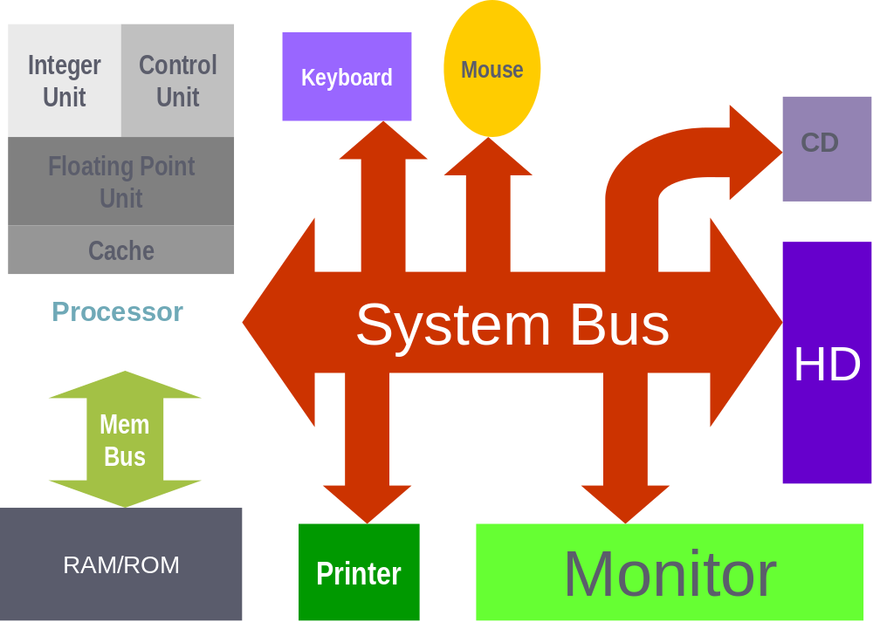
Computer System Hardware

Slide 7
Course Outline
Operating system concepts
Operating system structures
Introduction to UNIX/Linux user interface
Processes and threads—scheduling, concurrency, synchronization, etc.
Deadlocks
Memory management
Virtual memory
File system
Secondary storage management

Slide 8
Operating System Concepts
Single-user systems
Batch systems
Multiprogrammed systems
Time-sharing systems
Real-time systems
Interrupts, traps, and software interrupts (UNIX signals)
Hardware protection

Slide 9
Operating System Structures
Operating system services
System calls
Semantics of system call execution
Operating system structures (monolithic, microkernel-based, layered, virtual machines, DOS-Windows, UNIX)
System design and implementation

Slide 10
Introduction to UNIX/Linux
Directory structure
Browsing directory structure
Useful commands

Slide 11
Processes
Process concept (process, states, attributes, etc.)
Process scheduling (scheduler)
Context switching (dispatcher)
Operations on processes (creation, termination, signaling, suspend, foreground, background, etc.)
Process management in UNIX (fork, wait, exec, exit, etc.)

Slide 12
Processes (continued)
Sample code for UNIX/Linux process management
Cooperating processes
Interprocess communication (IPC)
IPC in UNIX/Linux (pipe, FIFO, socket, message queue, etc.)

Slide 13
Processes (continued)
Communication between UNIX/Linux processes (pipe, mkfifo, read, write, close, etc.)
Sample code
UNIX/Linux processes (process images, control structures, etc. explained with sample code)
Managing UNIX/Linux processes (ps, top, fg, bg, <Ctrl-Z>, <Ctrl-C>, etc.)

Slide 14
Threads
Thread concept (thread, states, attributes, etc.)
User- and kernel-level threads
POSIX threads (the pthread library)
Sample code

Slide 15
CPU Scheduling
Basic concepts
Scheduling criteria
Scheduling triggers
Scheduling algorithms
UNIX System V scheduling algorithm
Optimal scheduling
Algorithm evaluation

Slide 16
Process Synchronization
Basic concept
The Critical Section Problem
Solutions for the Critical Section Problem
Software-based solutions—the Bakery Algorithm
Hardware-based solutions
Semaphores
Binary and counting semaphores

Slide 17
Process Synchronization …
Classic problems of synchronization
Deadlocks and starvation
Critical regions
Monitors
Synchronization tools used in Solaris, Linux, and Windows
Deadlocks and starvation
Pthread library functions

Slide 18
Deadlocks
Basic concept
Deadlock characterization
Deadlock handling (prevention, avoidance, detection and recovery)
Banker’s algorithm

Slide 19
Memory Management
Basic concepts
Various techniques for memory management
Logical to physical address translation
Swapping
Contiguous memory allocation: MFT, MVT
External fragmentation
Paging
Hardware support for paging
Internal fragmentation

Slide 20
Memory Management …
Performance of paging
Protection and sharing
Page table issues: Multi-level paging, Hashed page tables, Inverted page tables
Segmentation
Protection and sharing
Segmentation with paging
Intel P4 example

Slide 21
Virtual Memory
Basic concept
Demand paging
Page fault
Performance of demand paging
Page replacement
Allocation of frames
Thrashing
Operating-system examples
Other considerations (I/O locking, page size, …)

Slide 22
File System Interface
Basic concepts (file attributes, operations, types, structure, etc.)
Access methods (sequential, random, etc.)
Directory structure
UNIX/Linux directory structure (links in UNIX)
File system mounting, sharing, and protection
UNIX/Linux examples for sharing and protection, and relevant commands (chmod, ln, ln –s, etc.)

Slide 23
File System Implementation
Basic concepts (overview of disk structure, file structure, boot control block, super block, inode, per process file descriptor table, system-wide open-file table, etc.)
Directory implementation
Free space management methods
Space Allocation Methods
Time and space performance of allocation methods
Brief introduction to Network File System (NFS)

Slide 24
Mass Storage Structure and Scheduling
Disk structure and scheduling
Disk management (formatting, boot block, bad blocks, etc.)
Course Recap

Slide 25
What is an Operating System?
A program that acts as an intermediary between a user of a computer and the computer hardware—provides the user a simpler (virtual) machine to work with
A program that allocates and deallocates computer system resources in an efficient, fair, and secure manner—a resource manager

Slide 26
Operating System Goals
Execute user programs and make solving user problems easier.
Make the computer system convenient to use.
Use the computer hardware in an efficient manner.

Slide 27
Operating Systems
Lecture 1

