Slide 1
Software Engineering
Lecture #15
Fakhar Lodhi

Slide 2
Evaluating the Object-Oriented Design Quality

Slide 3
Object-Oriented versus
Action-Oriented Design

Slide 4
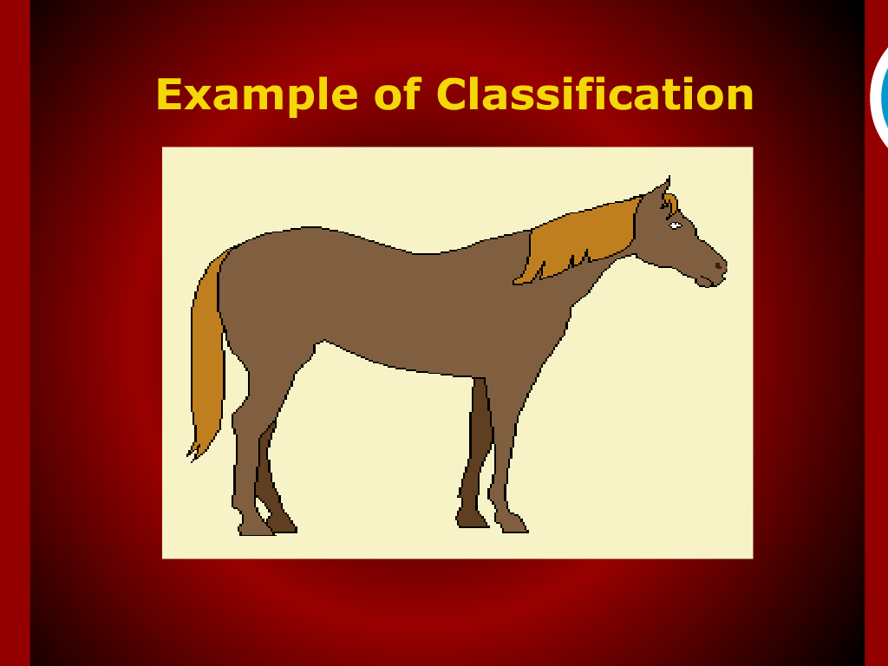

Slide 5
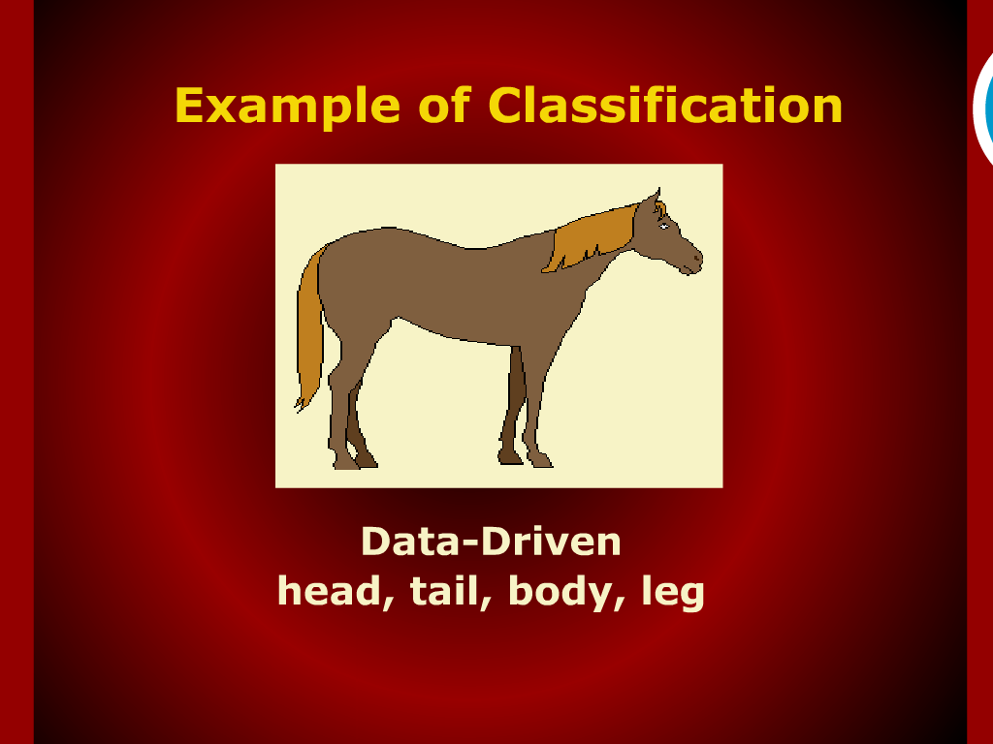

Slide 6
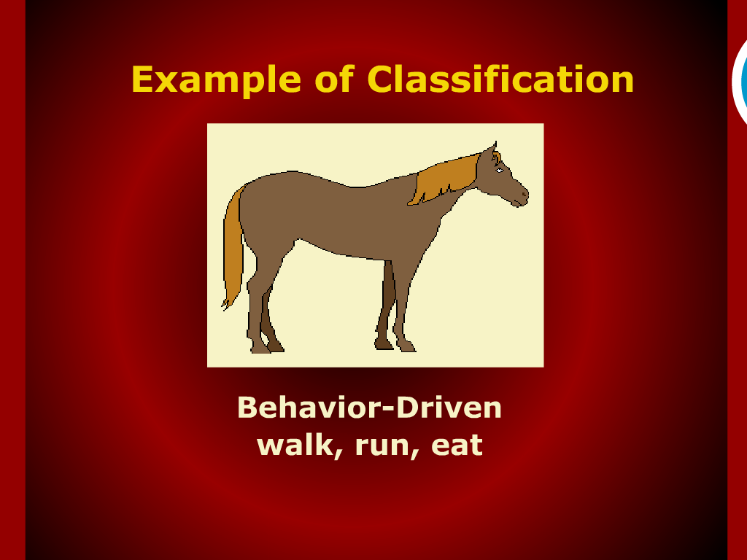

Slide 7
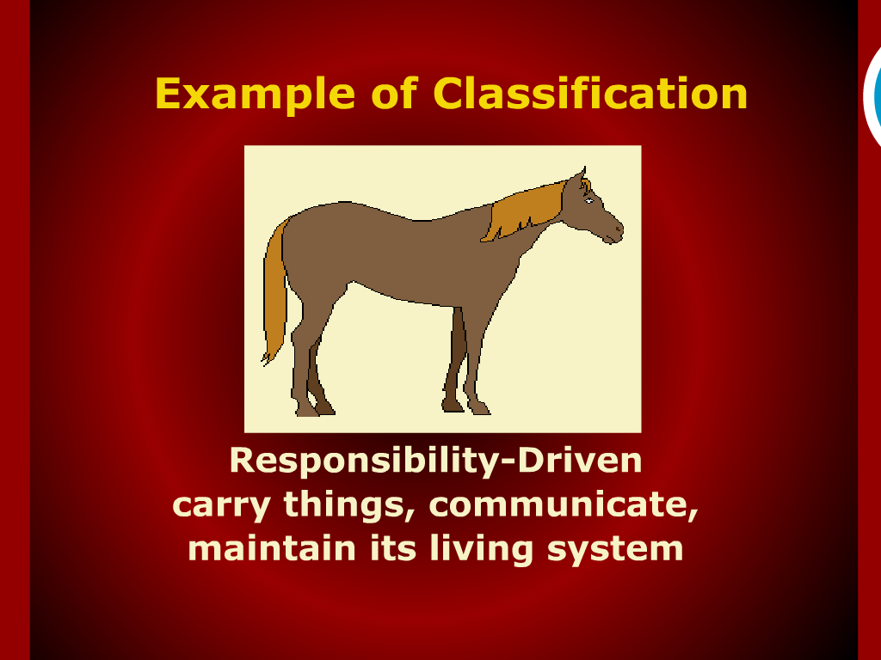

Slide 8
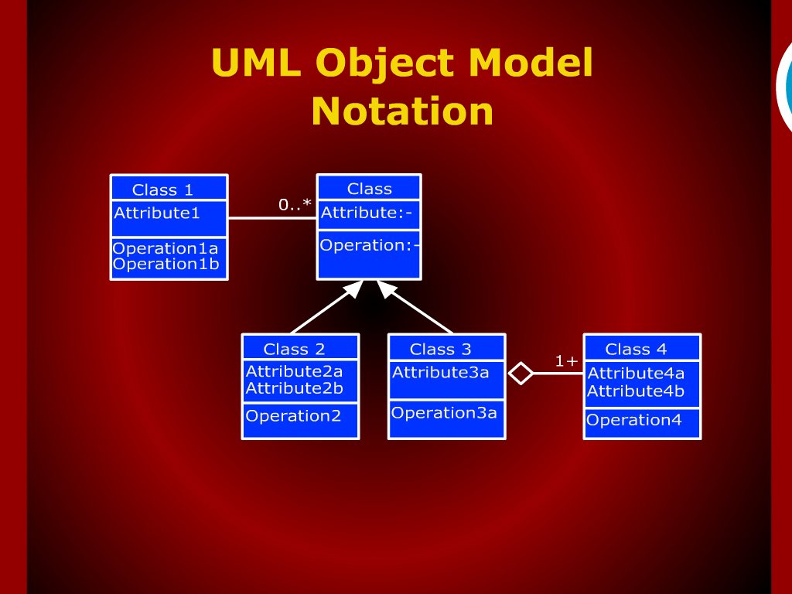
UML Object Model Notation

Slide 9


Slide 10
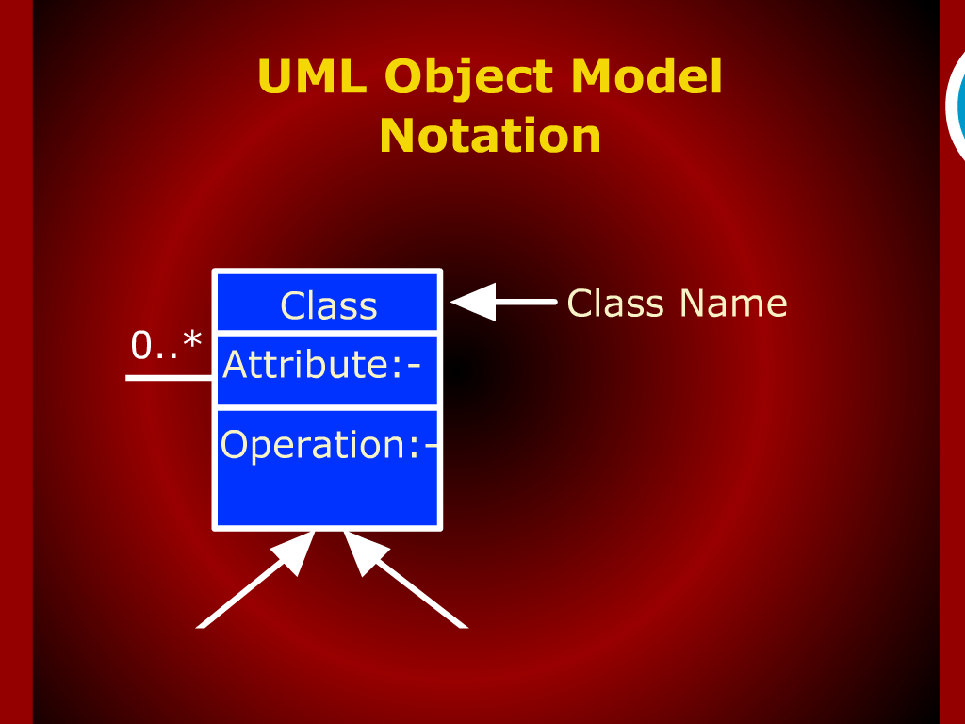

Slide 11
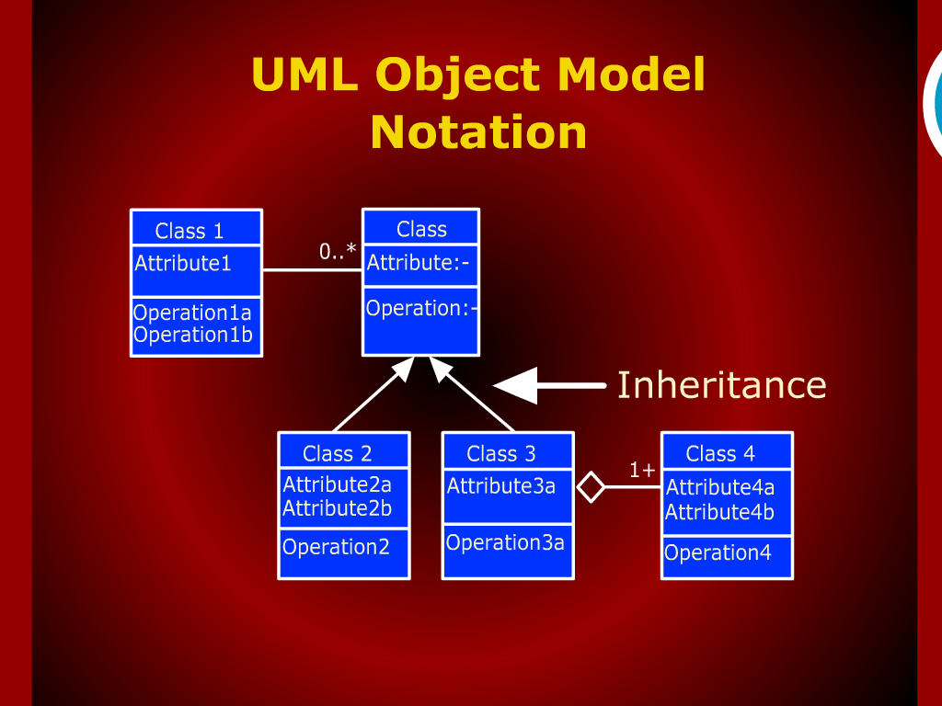

Slide 13
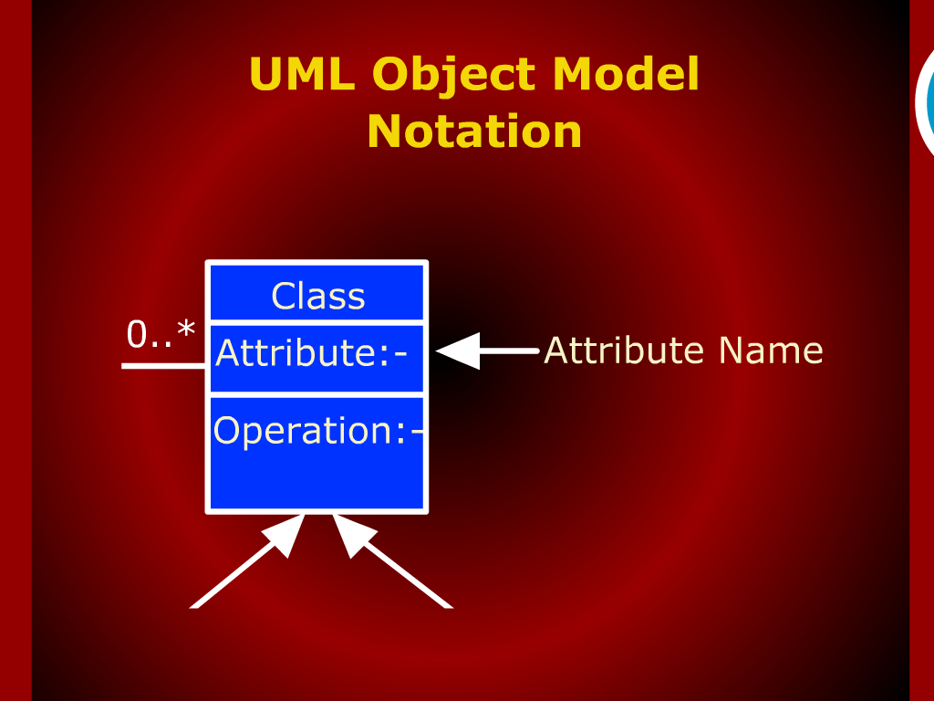

Slide 14
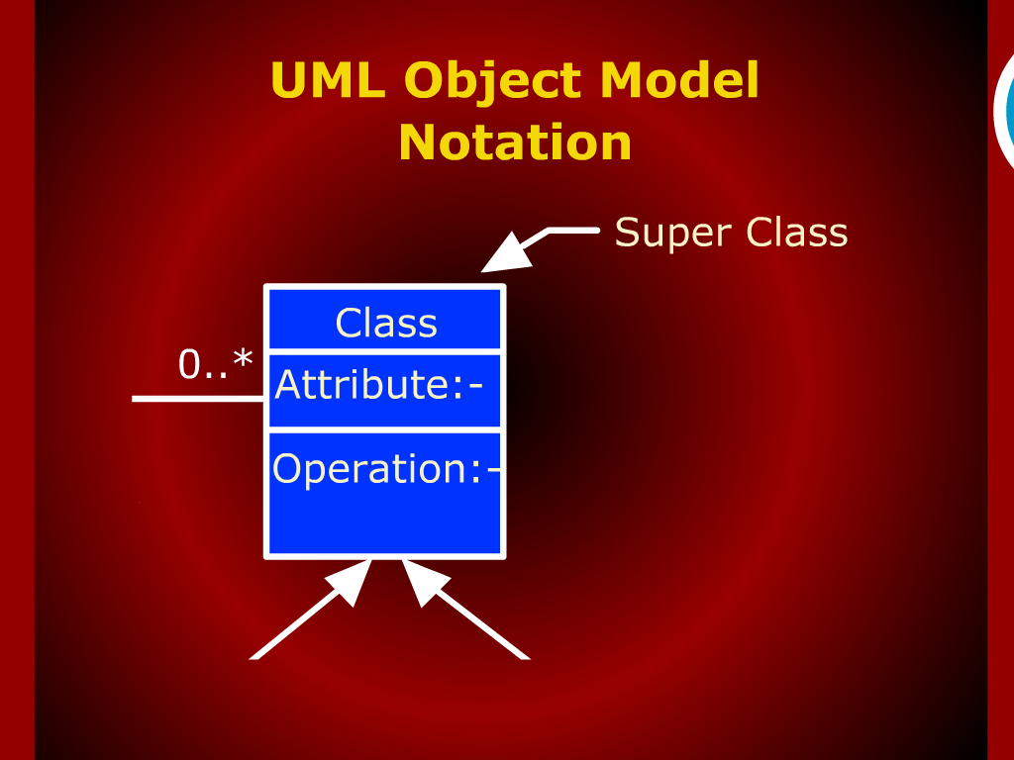

Slide 15
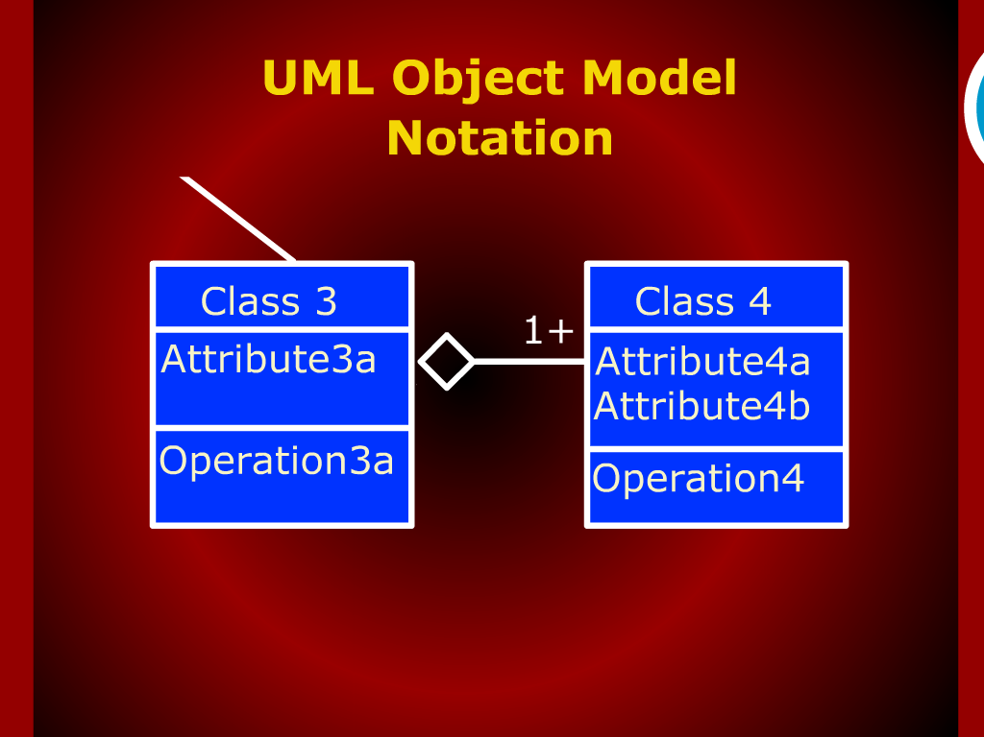

Slide 16
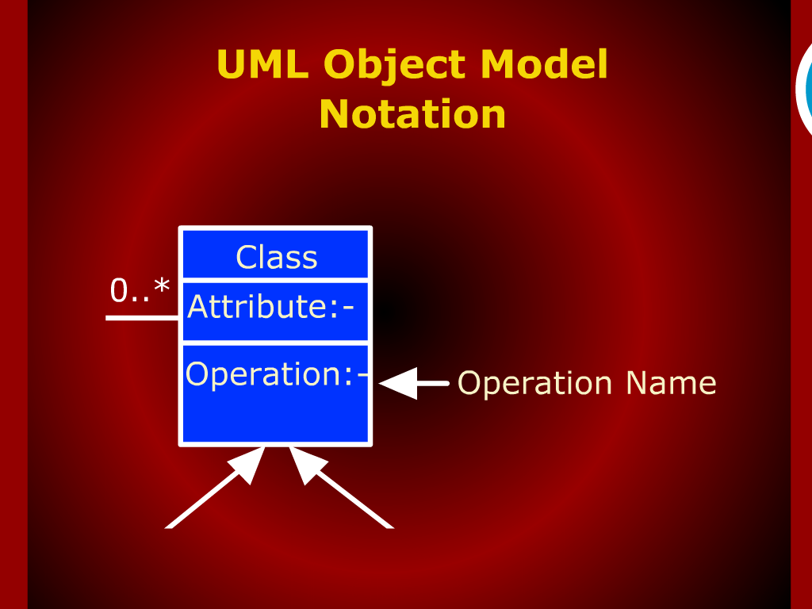

Slide 17
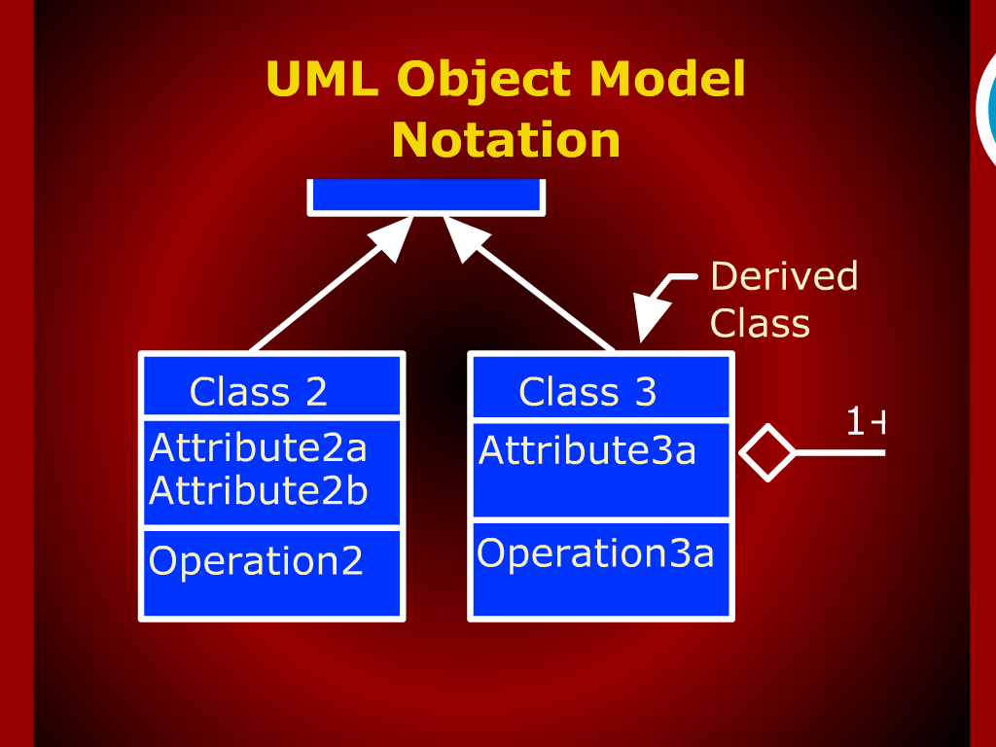

Slide 18
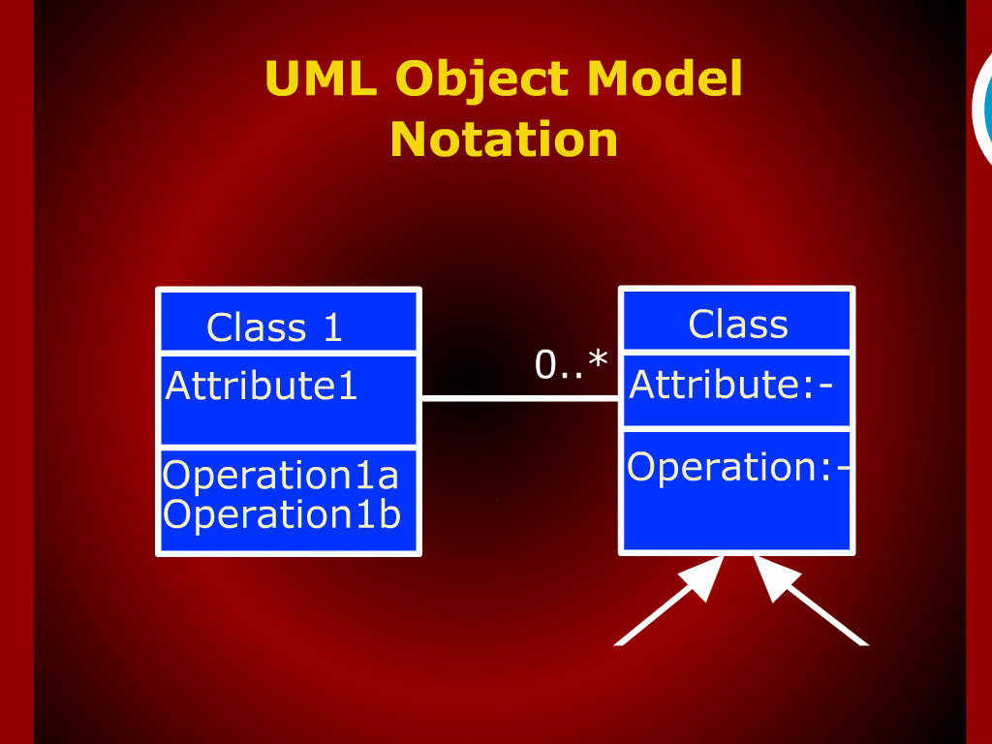

Slide 19
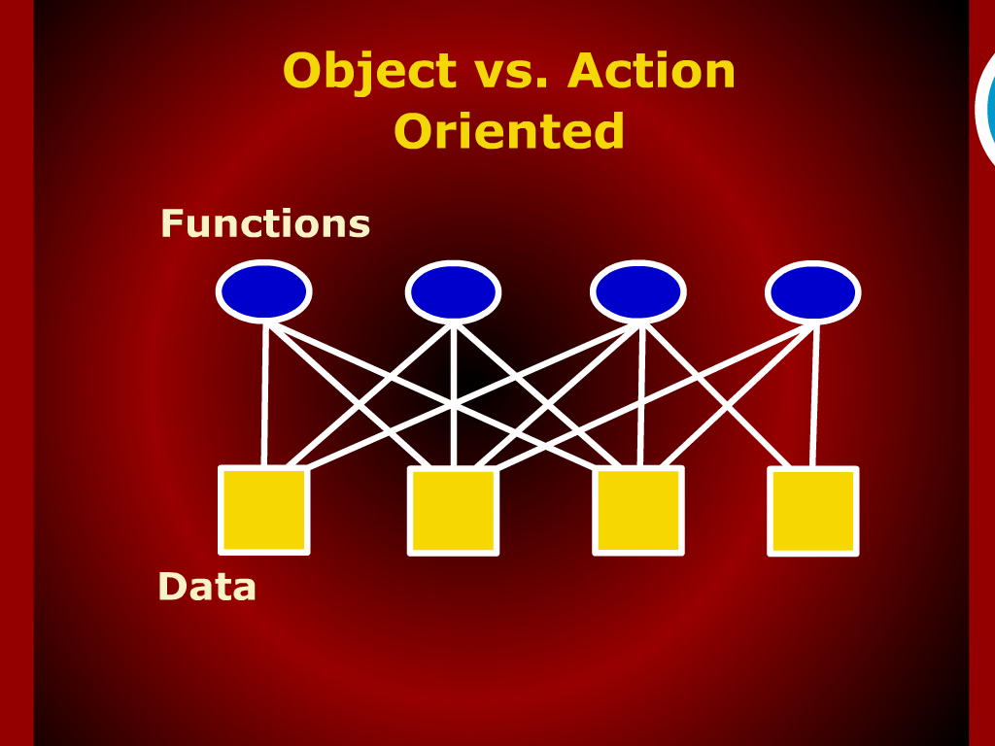

Slide 20
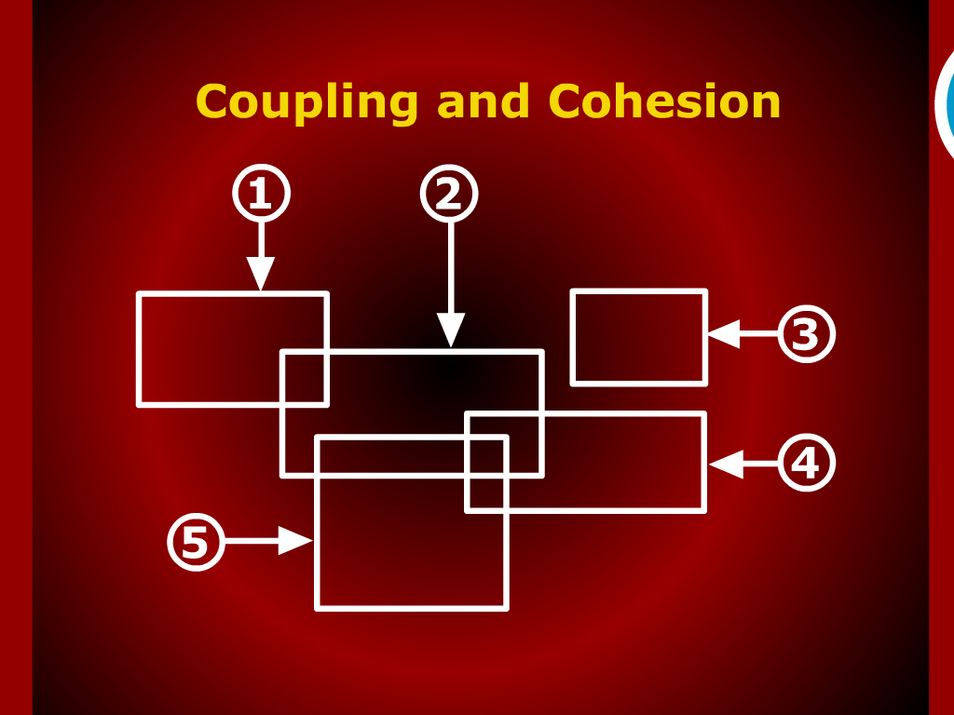

Slide 21
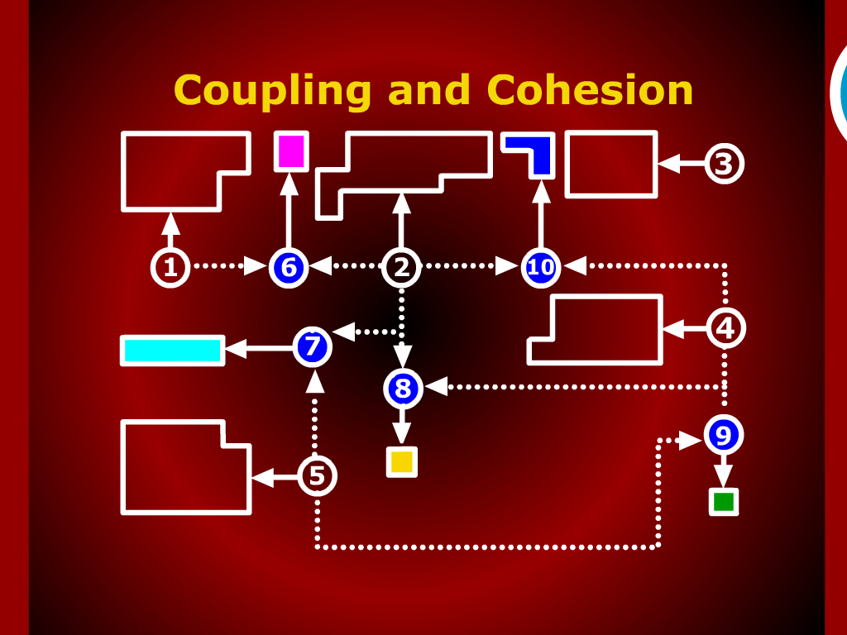

Slide 22
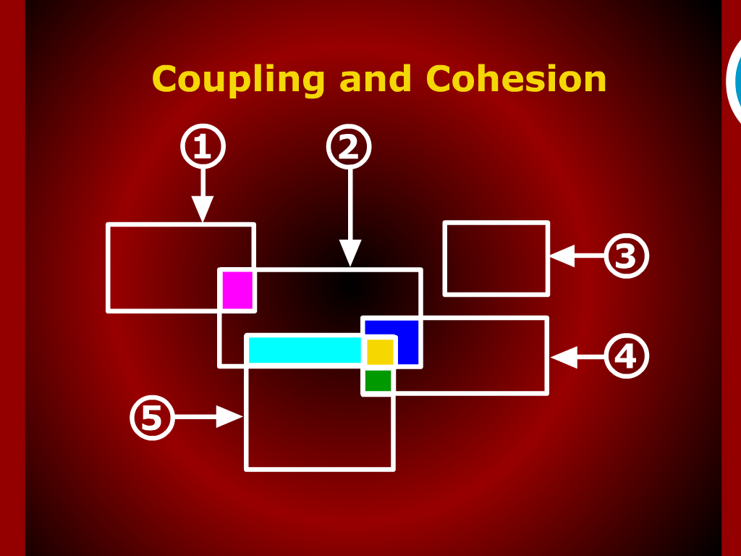

Slide 24
Coupling and Cohesion

Slide 25
Summary of Today’s Discussion

Slide 26
Recap

Slide 27
Classification

