Slide 1
Software Engineering
Lecture #23
Fakhar Lodhi

Slide 2
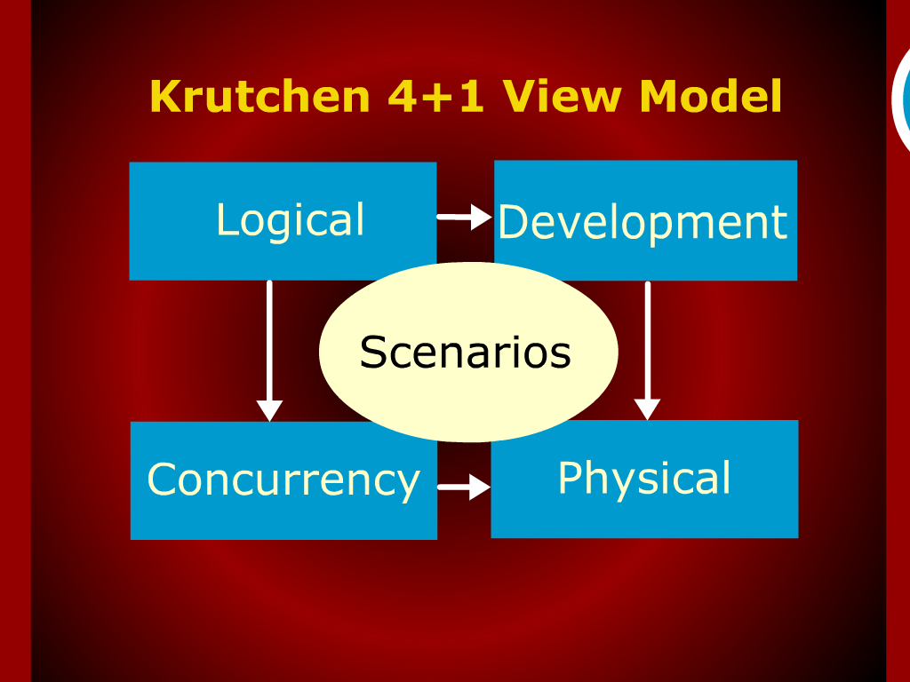
Krutchen 4 + 1 View Model

Slide 3
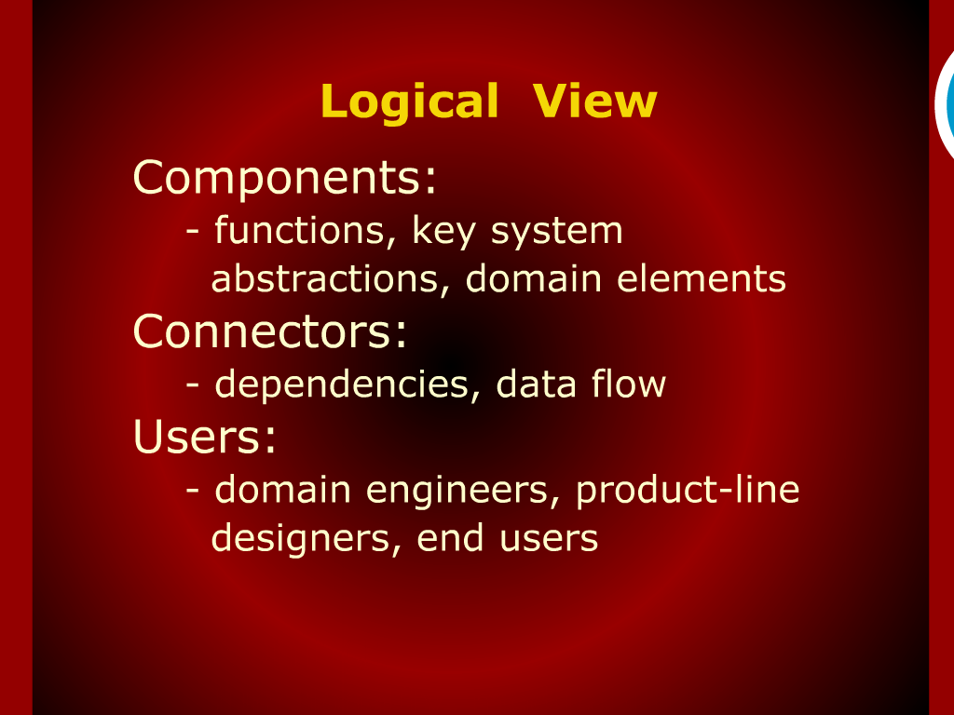
Logical View

Slide 4

Logical View

Slide 5
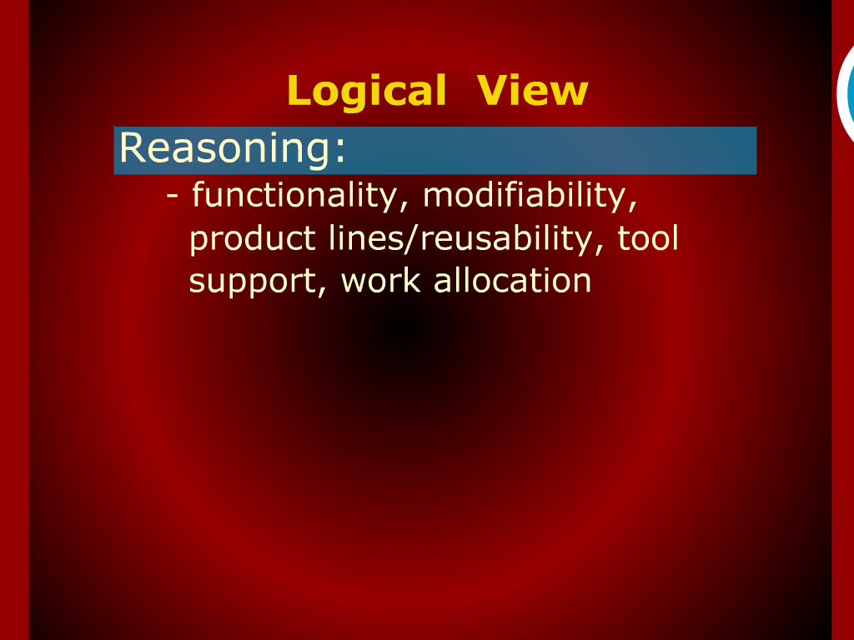
Logical View

Slide 6
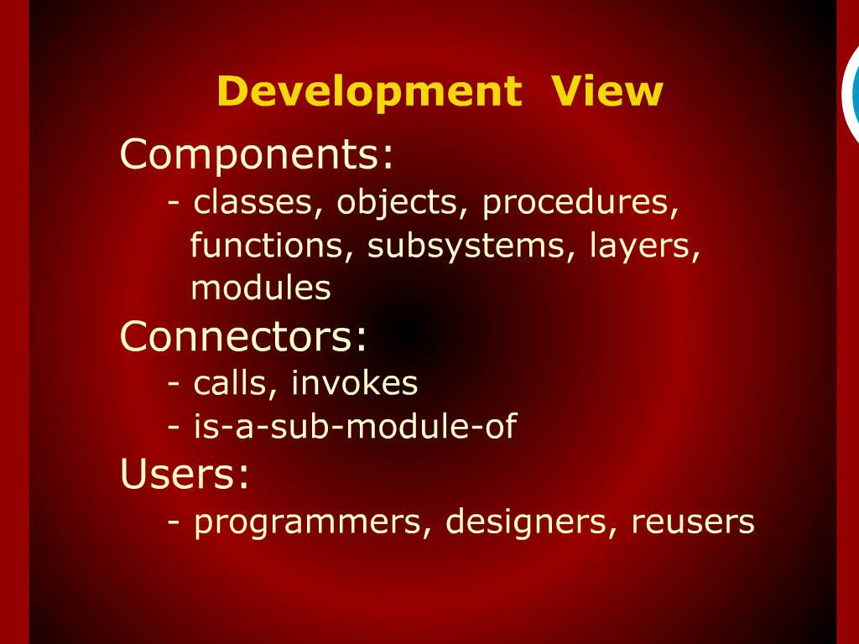
Development View

Slide 7
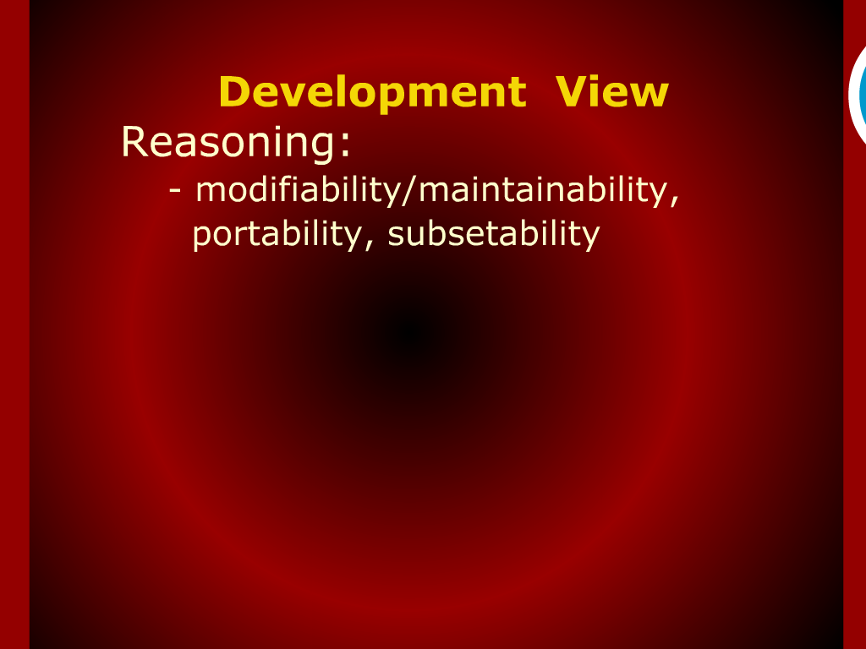
Development View

Slide 8
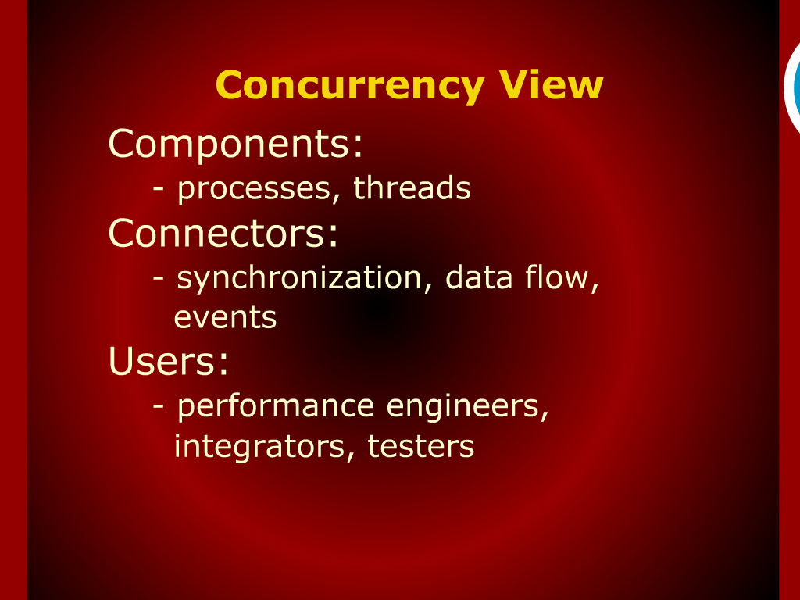
Concurrency View

Slide 9
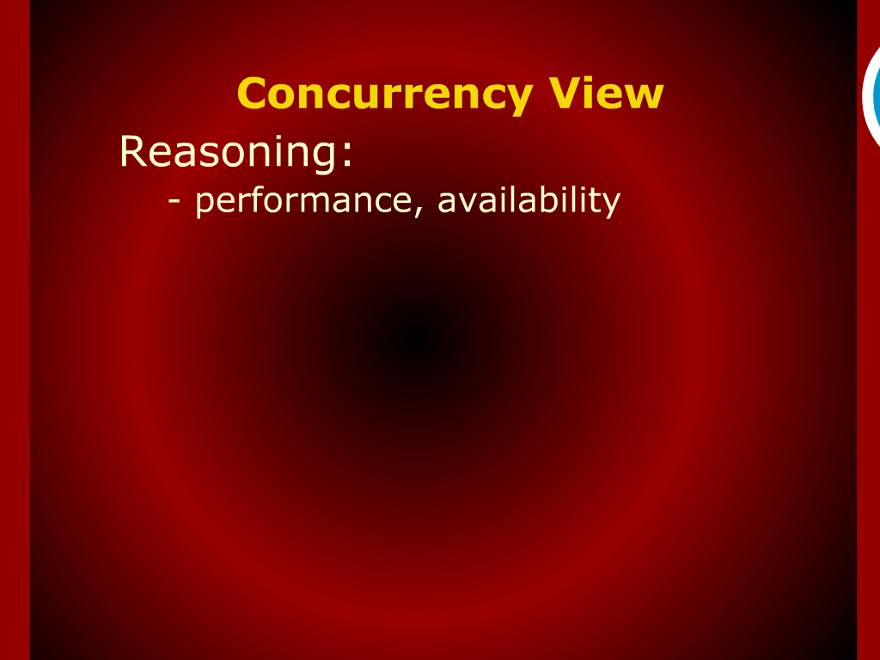
Concurrency View

Slide 10
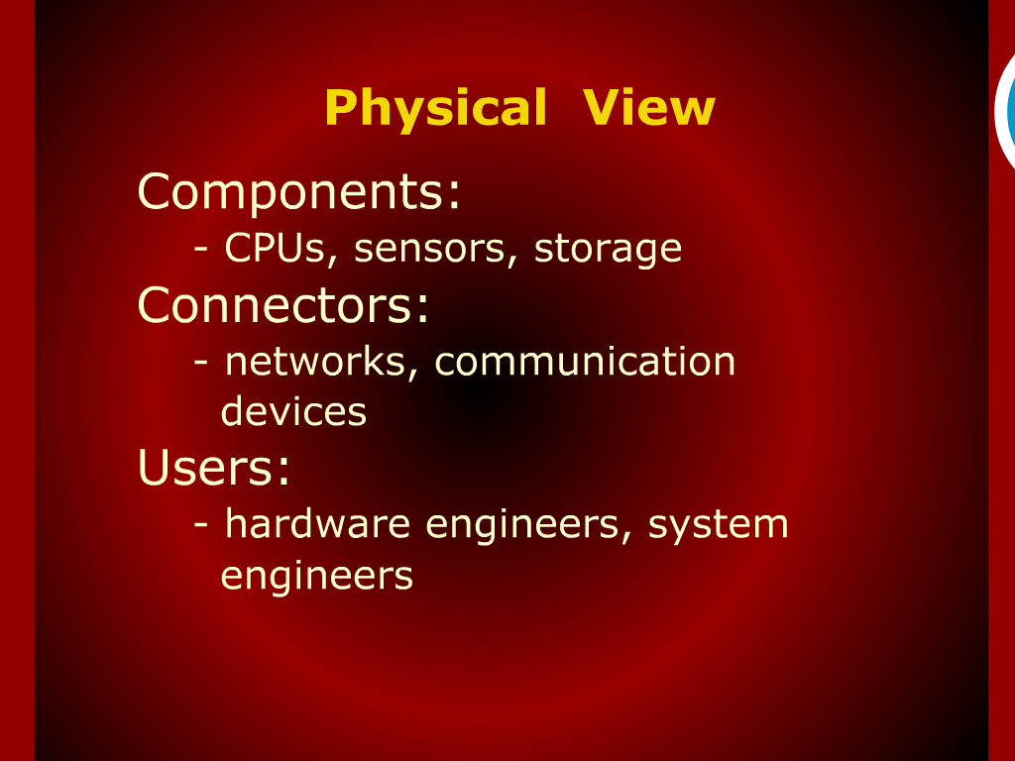
Physical View

Slide 11
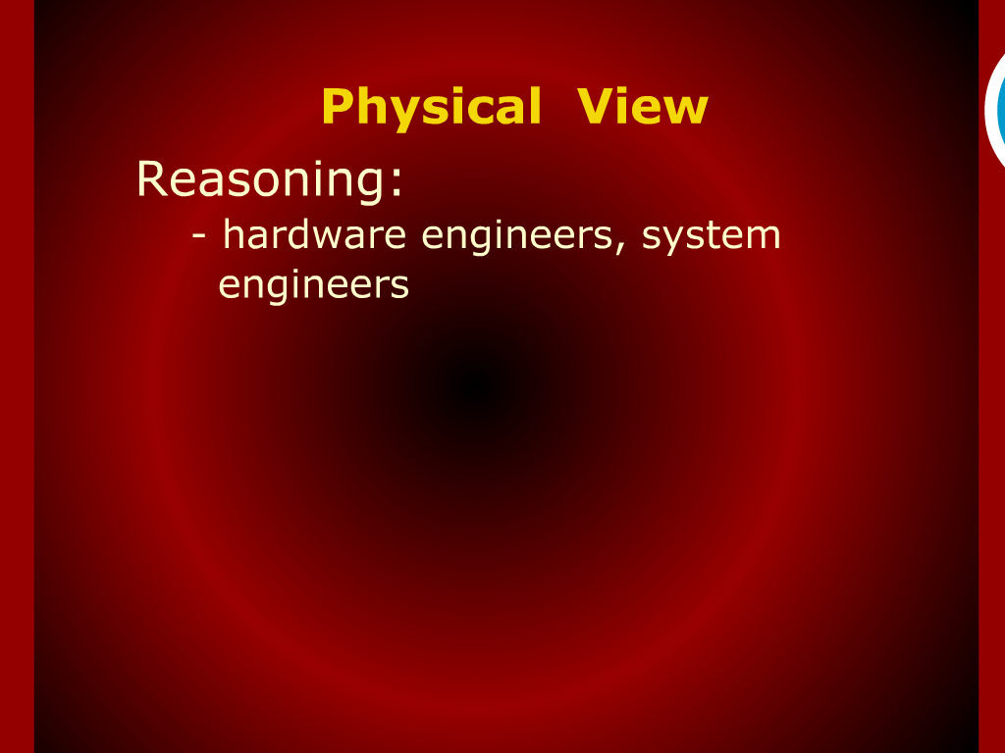
Physical View

Slide 12
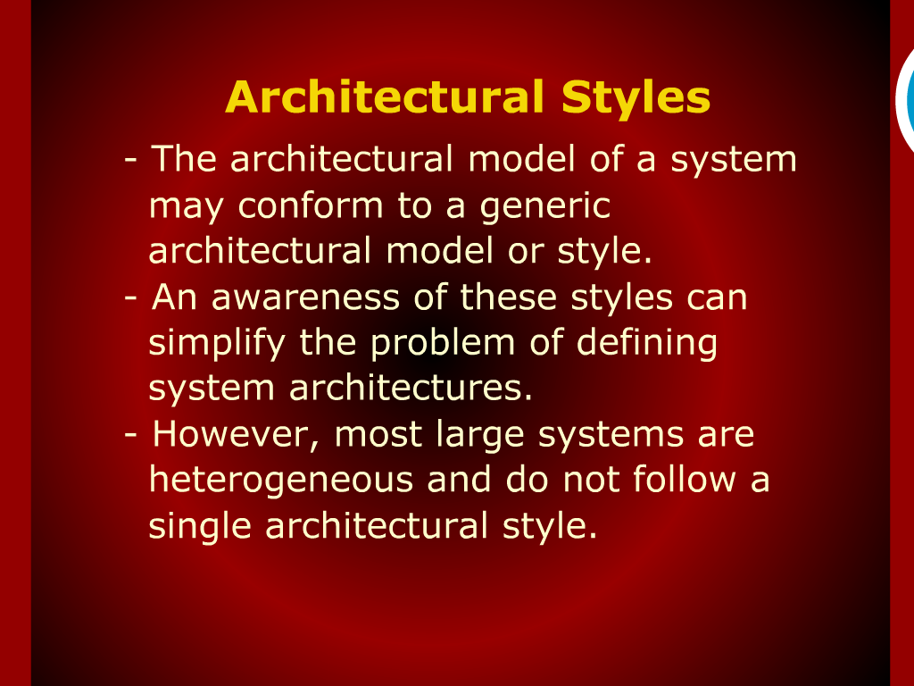
Architectural Styles

Slide 13
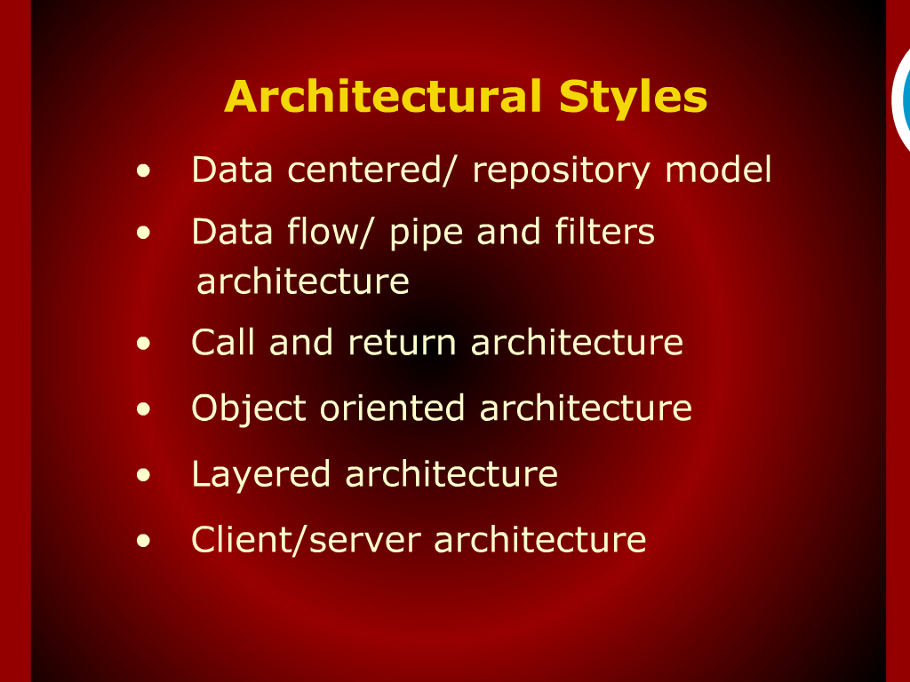
Architectural Styles

Slide 14
Recap

Slide 15
Summary of Today’s Lecture

Slide 16
Relationship among Views

Slide 17
Architectural Styles

Slide 18
Scenarios

Slide 20
Concurrency View Model

