Slide 1
Software Engineering
Lecture #3
Fakhar Lodhi

Slide 2
Requirement Engineering

Slide 3
Definitions

Slide 4
Importance of requirements

Slide 5
Levels of Requirements

Slide 6
Functional and Non-functional Requirements

Slide 7
Requirement Statement versus
Requirement
Specification

Slide 8
Some Risks from Inadequate Requirement Process

Slide 9
Summary of Today’s Discussion

Slide 10
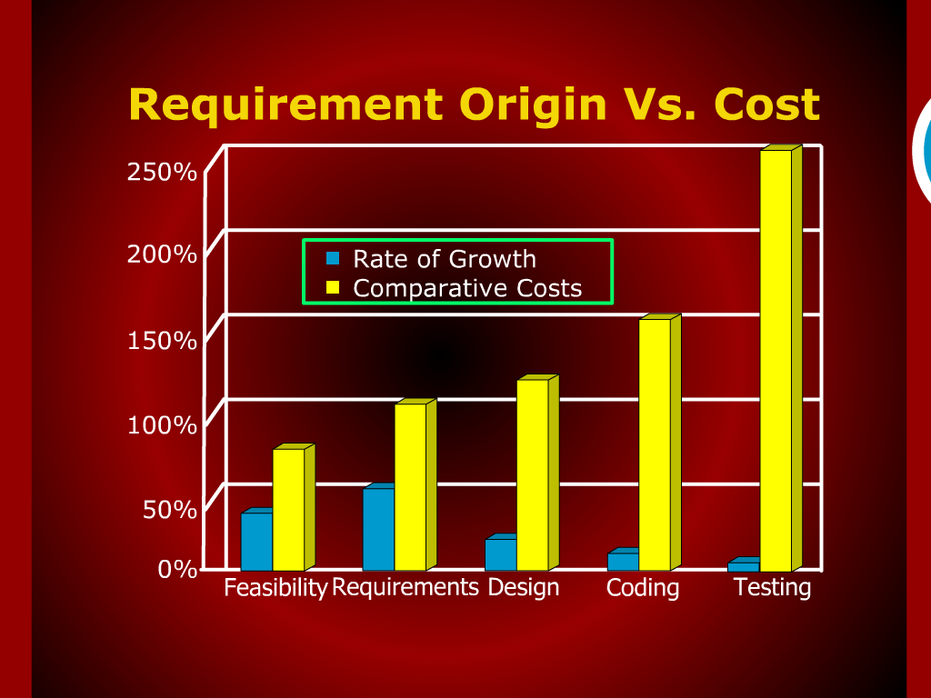

Slide 11
Recap

Slide 12
Software Engineering Phases
Vision – focus on why
Definition – focus on what
2. Development – focus on how
3. Maintenance – focus on change
Vision
Definition
Development
Maintenance

Slide 13
Software Requirements – Definition - IEEE
A condition or capability needed by user to solve a problem or achieve an objective.
A condition or capability that must be met or possessed by a system or system component to satisfy a contract, standard, specification, or other formally imposed document.
A documented representation of a condition or capability as in 1 or 2.
Notes:
Make the definitions appear one by one.

Slide 14
Software Requirements – Definition - Jones
The statement of needs by a user that triggers the development of a program or system - Jones 1994

Slide 15
Software Requirements – Definition – Davis
A user need or necessary feature, function, or attribute of a system that can be sensed from a position external to that system - Alan Davis 1993

Slide 16
Software Requirements - Definition
Requirements are ... A specification of what should be implemented. They are descriptions of how the system should behave, or of a system property or attribute. They may be a constraint on the development process of the system. - Sommerville 1997
Notes:
Highlight the text line by line i.e. this text will have line by line animation.

Slide 17
Levels of Requirements
Business Requirements
User Requirements
Functional Requirements
Non-Functional Requirements
Notes:
Make every bullet one by one

Slide 18
Relationship of Several components of Software Requirements
Business
Requirements
Vision and
Scope document
User
Requirements
Quality
Attributes
Other
Non-functional
Requirements
Use Case document
System
Requirements
Functional
Requirements
Constraints
Functional Specification
Documents

Slide 19
Importance of the Software Requirement Process
The hardest single part of building a software system is deciding precisely what to build. No other part of the conceptual work is as difficult as establishing the detailed technical requirements, including all the interfaces to people, to machines, and to other software systems. No other part of the work so cripples the system if done wrong. No other part is more difficult to rectify later.
    Fred Brooks - No Silver Bullet: Essence and Accidents of Software Engineering, 1987.

Slide 20
Role of Requirements
Project
Planning
Construction
Process
Project
Tracking
Software
Requirements
User
Documentation
Change
Control
System
Testing

Slide 21
Some Risks From Inadequate Requirement Process
Insufficient user involvement leads to unacceptable products.
Creeping user requirements contribute to overruns and degrade product quality.
Ambiguous requirements lead to ill-spent time and rework.
Gold-plating by developers and users adds unnecessary features.
Minimal specifications lead to missing key requirements.
Overlooking the needs of certain user classes (stake holders) leads to dissatisfied customers.
Incompletely defined requirements make accurate project planning and tracking impossible.

Slide 22
Stake Holders
Management
Marketing
provides business
requirements and
project parameters
Provides Business
Requirements and
Project Parameters
Software
Requirements
allocate system
requirements to software
Specifies hardware
interfaces the software
must respect
describe user
requirements and
quality attributes
System Eng.
Users
Hardware Eng.

Slide 23
Stake Holders
provides business
requirements and
project parameters
describe user requirements and
quality attributes
describe user requirements and
quality attributes
Marketing
Management
Software
Requirements
Provides Business
Requirements and
Project Parameters
System Eng.
Hardware Eng.
allocate system
requirements to software
Users
Specifies hardware
interfaces the software
must respect

Slide 24
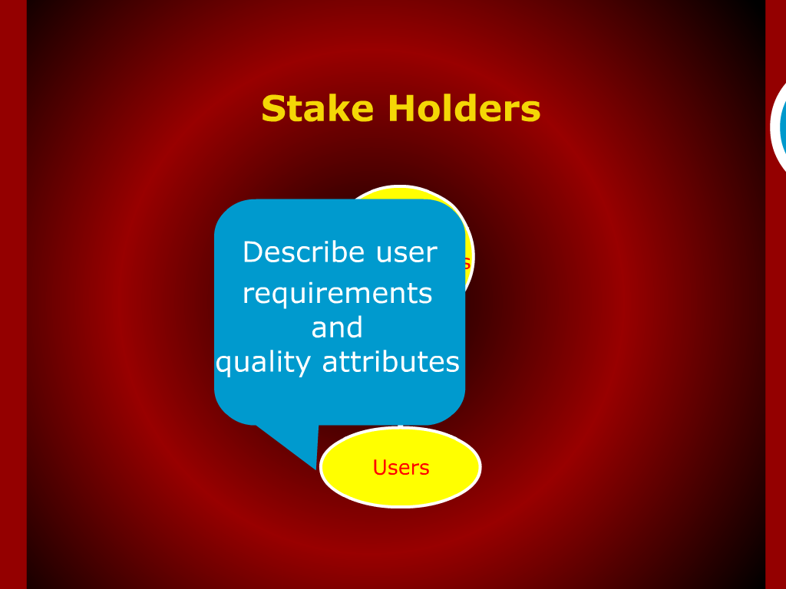

Slide 25
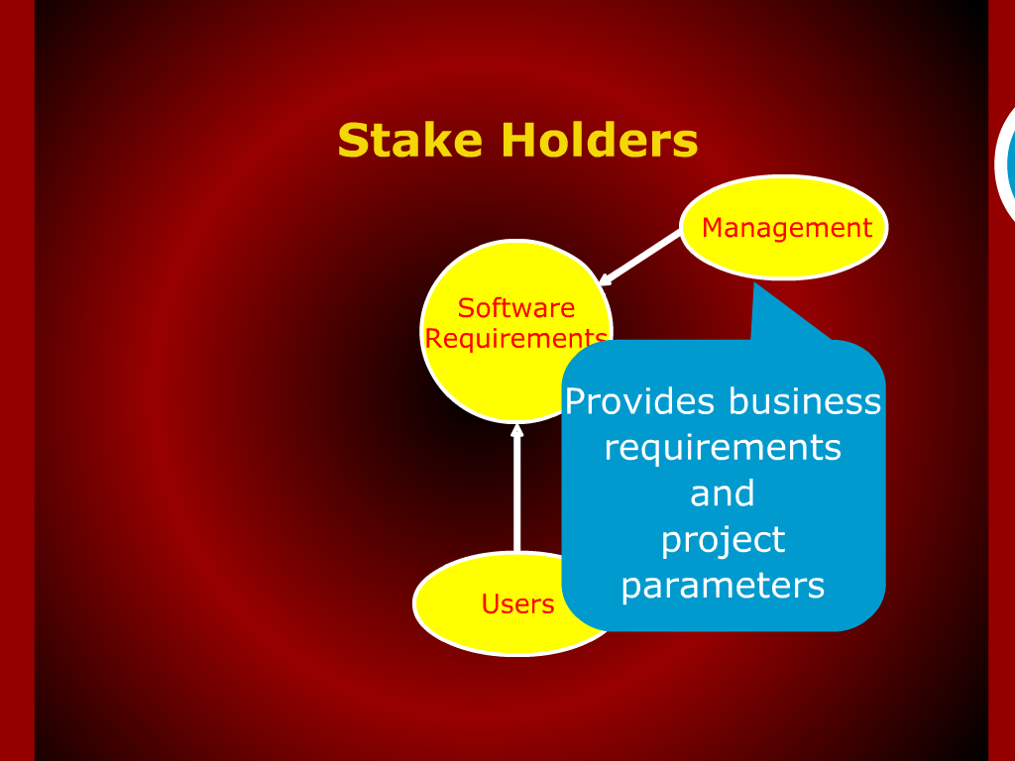

Slide 26
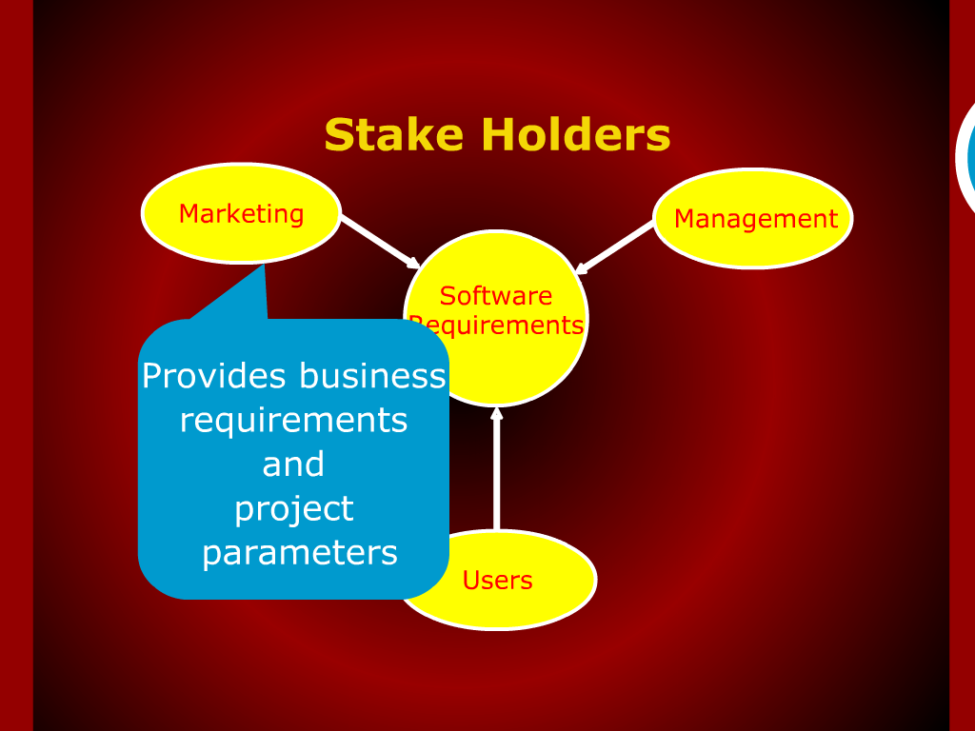

Slide 27
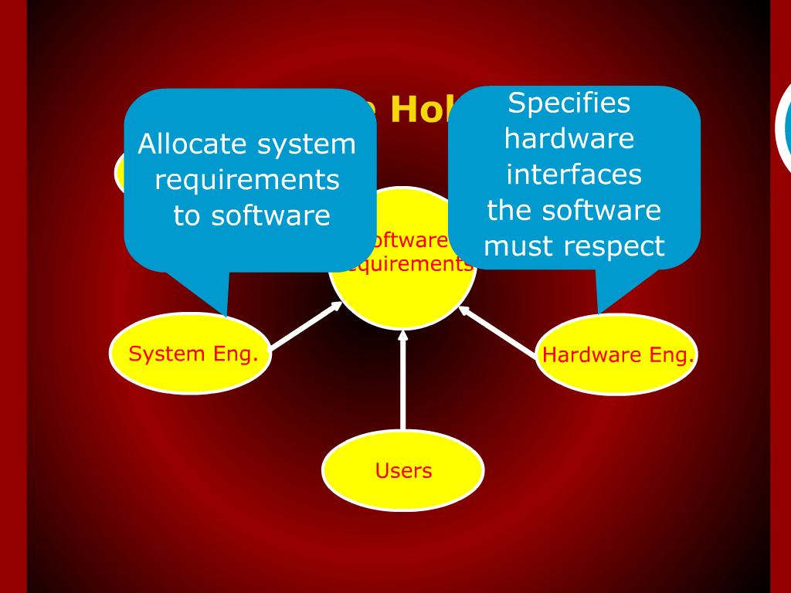

Slide 28
