Slide 1
CSC 301 – Design and Analysis of Algorithms
Instructor: Dr. M. Hasan Jamal
Lecture# 03: Sorting Algorithms

Slide 2
Types of Sorting Algorithms
Non-recursive/Incremental comparison sorting
Selection sort
Bubble sort
Insertion sort
Recursive comparison sorting
Merge sort
Quick sort
Heap sort
Non-comparison linear sorting
Count sort
Radix sort
Bucket sort

Slide 3
Selection Sort
Idea:
Find the smallest element in the array
Exchange it with the element in the first position
Find the second smallest element and exchange it with the element in the second position
Continue until the array is sorted
8
4
6
9
2
3
1
1
2
3
4
9
6
8
1
4
6
9
2
3
8
1
2
3
4
6
9
8
1
2
6
9
4
3
8
1
2
3
4
6
8
9
1
2
3
9
4
6
8
1
2
3
4
6
8
9

Slide 4
Selection Sort Analysis
Alg.: SELECTION-SORT(A)
n ← length[A]
for j ← 0 to n - 2
smallest ← j
for i ← j + 1 to n-1
if A[i] < A[smallest]
smallest ← i
exchange A[j] ↔ A[smallest]
Cost Steps
c₁ 1
c₂ n-1
c₃ n-1
c₄
c₅
c₆
c₇ n-1
t_{j}: # of times the inner for loop statement is executed at iteration j

Slide 5
Best/Worst/Average Case Analysis
T(n) = Θ(n²)
Disadvantage:
Θ(n²) running time in all cases

Slide 6
Bubble Sort
Given a list of N elements, repeat the following steps N-1 times:
For each pair of adjacent numbers, if number on the left is greater than the number on the right, swap them.
“Bubble” the largest value to the end using pair-wise comparisons and swapping.
12
12
6
6
6
12
12
6
22
14
14
22
8
8
17
22
17
22
14
8
14
8
17
22
17
22
6
14
6
12
12
8
14
14
8
8
17
22
8
14
17
22
6
6
14
17
12
8
14
17
12
8
8
8
12
12
22
22
8
6
8
12
6
12
14
17
22
14
17
22

Slide 7
Bubble Sort Analysis
cost times
c₁ 1
c₂ n-1
c₃
c₄
c₅
c₆
c₇
c₈ 1
BubbleSort(A)
n = Length[A];
for j = 0 to n-2
for i = 0 to n-j-2
if A[i] > A[i+1]
temp = A[i]
A[i] = A[i+1]
A[i+1] = temp
return A;
t_{j}: # of times the inner for loop statement is executed at iteration j

Slide 8
Best/Worst/Average Case Analysis
Since we don’t know at which iteration the list is completely sorted, the nested loop will execute completely.
a quadratic function of n
T(n) = Θ(n²) order of growth in n²

Slide 9
Bubble Sort Modified
BubbleSort(A)
n = Length[A];
for j = 0 to n-2
swap = 0;
for i = 0 to n-j-2
if A[i] > A[i+1]
temp = A[i]
A[i] = A[i+1]
A[i+1] = temp
swap = swap + 1;
if swap = 0
break;
return A;

Slide 10
Best Case Analysis (Modified)
The array is already sorted
Keep track of no. of swaps done in an iteration
Can finish early if no swapping occurs
t_{j} = 1 ➔ n – 1 comparisons in a single iteration
T(n) = c₁ + c₂(n -1) + c₃(n -1) + c₄(n -1) + c₈
= (c₂ + c₃ + c₄)n + (c₁ – c₂ – c₃ – c₄ + c₈)
= an + b = Θ(n)

Slide 11
Worst Case Analysis (Modified)
The array is in reverse sorted order
Always A[i] > A[i+1]
a quadratic function of n
T(n) = Θ(n²) order of growth in n²
Advantages
Simple to code
Requires little memory (in-place)
Disadvantages
Θ(n²) running time in worst & average case
Nobody “EVER” uses bubble sort (EXTREMELY INEFFICIENT)

Slide 12
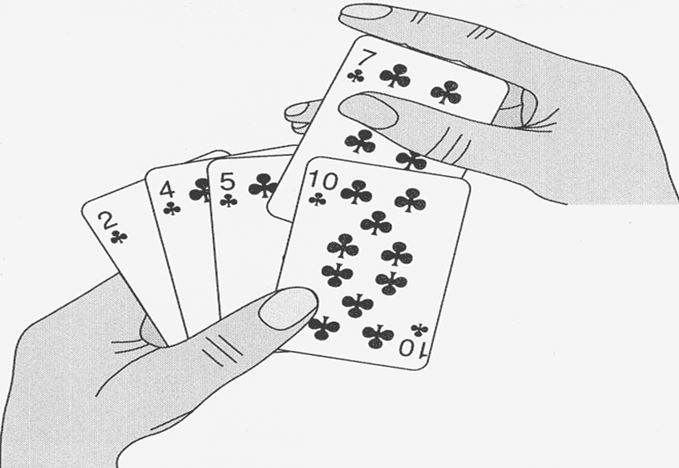
Insertion Sort
Idea: like sorting a hand of playing cards
Start with empty left hand and cards face down on the table.
Remove one card at a time from the table, and insert it into the correct position in the left hand
compare it with each card already in the hand, from right to left
The cards held in the left hand are sorted
these cards were originally the top cards of the pile on the table

Slide 13
Insertion Sort
InsertionSort(A, n)
for i = 1 to n-1
key = A[i]
j = i – 1
while (j >= 0) and (A[j] > key)
A[j+1] = A[j]
j = j – 1
A[j+1] = key
Array index
0
1
2
3
4
5
6
7
8
9
Value
2.78
7.42
0.56
1.12
1.17
0.32
6.21
4.42
3.14
7.71
Iteration 0: step 0.

Slide 14
Insertion Sort
InsertionSort(A, n)
for i = 1 to n-1
key = A[i]
j = i – 1
while (j >= 0) and (A[j] > key)
A[j+1] = A[j]
j = j – 1
A[j+1] = key
Array index
0
1
2
3
4
5
6
7
8
9
Value
2.78
7.42
0.56
1.12
1.17
0.32
6.21
4.42
3.14
7.71
Iteration 1: step 0.

Slide 15
Insertion Sort
InsertionSort(A, n)
for i = 1 to n-1
key = A[i]
j = i – 1
while (j >= 0) and (A[j] > key)
A[j+1] = A[j]
j = j – 1
A[j+1] = key
Array index
0
1
2
3
4
5
6
7
8
9
Value
2.78
7.42
0.56
0.56
7.42
1.12
1.17
0.32
6.21
4.42
3.14
7.71
Iteration 2: step 0.

Slide 16
Insertion Sort
InsertionSort(A, n)
for i = 1 to n-1
key = A[i]
j = i – 1
while (j >= 0) and (A[j] > key)
A[j+1] = A[j]
j = j – 1
A[j+1] = key
Array index
0
1
2
3
4
5
6
7
8
9
Value
2.78
0.56
0.56
2.78
7.42
1.12
1.17
0.32
6.21
4.42
3.14
7.71
Iteration 2: step 1.

Slide 17
Insertion Sort
InsertionSort(A, n)
for i = 1 to n-1
key = A[i]
j = i – 1
while (j >= 0) and (A[j] > key)
A[j+1] = A[j]
j = j – 1
A[j+1] = key
Array index
0
1
2
3
4
5
6
7
8
9
Value
2.78
0.56
0.56
2.78
7.42
1.12
1.17
0.32
6.21
4.42
3.14
7.71
Iteration 2: step 2.

Slide 18
Insertion Sort
InsertionSort(A, n)
for i = 1 to n-1
key = A[i]
j = i – 1
while (j >= 0) and (A[j] > key)
A[j+1] = A[j]
j = j – 1
A[j+1] = key
Array index
0
1
2
3
4
5
6
7
8
9
Value
0.56
2.78
7.42
1.12
1.12
7.42
1.17
0.32
6.21
4.42
3.14
7.71
Iteration 3: step 0.

Slide 19
Insertion Sort
InsertionSort(A, n)
for i = 1 to n-1
key = A[i]
j = i – 1
while (j >= 0) and (A[j] > key)
A[j+1] = A[j]
j = j – 1
A[j+1] = key
Array index
0
1
2
3
4
5
6
7
8
9
Value
0.56
2.78
1.12
1.12
2.78
7.42
1.17
0.32
6.21
4.42
3.14
7.71
Iteration 3: step 1.

Slide 20
Insertion Sort
InsertionSort(A, n)
for i = 1 to n-1
key = A[i]
j = i – 1
while (j >= 0) and (A[j] > key)
A[j+1] = A[j]
j = j – 1
A[j+1] = key
Array index
0
1
2
3
4
5
6
7
8
9
Value
0.56
2.78
1.12
1.12
2.78
7.42
1.17
0.32
6.21
4.42
3.14
7.71
Iteration 3: step 2.

Slide 21
Insertion Sort
InsertionSort(A, n)
for i = 1 to n-1
key = A[i]
j = i – 1
while (j >= 0) and (A[j] > key)
A[j+1] = A[j]
j = j – 1
A[j+1] = key
Array index
0
1
2
3
4
5
6
7
8
9
Value
0.56
1.12
2.78
7.42
1.17
1.17
7.42
0.32
6.21
4.42
3.14
7.71
Iteration 4: step 0.

Slide 22
Insertion Sort
InsertionSort(A, n)
for i = 1 to n-1
key = A[i]
j = i – 1
while (j >= 0) and (A[j] > key)
A[j+1] = A[j]
j = j – 1
A[j+1] = key
Array index
0
1
2
3
4
5
6
7
8
9
Value
0.56
1.12
2.78
1.17
1.17
2.78
7.42
0.32
6.21
4.42
3.14
7.71
Iteration 4: step 1.

Slide 23
Insertion Sort
InsertionSort(A, n)
for i = 1 to n-1
key = A[i]
j = i – 1
while (j >= 0) and (A[j] > key)
A[j+1] = A[j]
j = j – 1
A[j+1] = key
Array index
0
1
2
3
4
5
6
7
8
9
Value
0.56
1.12
1.17
2.78
7.42
0.32
6.21
4.42
3.14
7.71
Iteration 4: step 2.

Slide 24
Insertion Sort
InsertionSort(A, n)
for i = 1 to n-1
key = A[i]
j = i – 1
while (j >= 0) and (A[j] > key)
A[j+1] = A[j]
j = j – 1
A[j+1] = key
Array index
0
1
2
3
4
5
6
7
8
9
Value
0.56
1.12
1.17
2.78
7.42
0.32
0.32
7.42
6.21
4.42
3.14
7.71
Iteration 5: step 0.

Slide 25
Insertion Sort
InsertionSort(A, n)
for i = 1 to n-1
key = A[i]
j = i – 1
while (j >= 0) and (A[j] > key)
A[j+1] = A[j]
j = j – 1
A[j+1] = key
Array index
0
1
2
3
4
5
6
7
8
9
Value
0.56
1.12
1.17
2.78
0.32
0.32
2.78
7.42
6.21
4.42
3.14
7.71
Iteration 5: step 1.

Slide 26
Insertion Sort
InsertionSort(A, n)
for i = 1 to n-1
key = A[i]
j = i – 1
while (j >= 0) and (A[j] > key)
A[j+1] = A[j]
j = j – 1
A[j+1] = key
Array index
0
1
2
3
4
5
6
7
8
9
Value
0.56
1.12
1.17
0.32
0.32
1.17
2.78
7.42
6.21
4.42
3.14
7.71
Iteration 5: step 2.

Slide 27
Insertion Sort
InsertionSort(A, n)
for i = 1 to n-1
key = A[i]
j = i – 1
while (j >= 0) and (A[j] > key)
A[j+1] = A[j]
j = j – 1
A[j+1] = key
Array index
0
1
2
3
4
5
6
7
8
9
Value
0.56
1.12
0.32
0.32
1.12
1.17
2.78
7.42
6.21
4.42
3.14
7.71
Iteration 5: step 3.

Slide 28
Insertion Sort
InsertionSort(A, n)
for i = 1 to n-1
key = A[i]
j = i – 1
while (j >= 0) and (A[j] > key)
A[j+1] = A[j]
j = j – 1
A[j+1] = key
Array index
0
1
2
3
4
5
6
7
8
9
Value
0.56
0.32
0.32
0.56
1.12
1.17
2.78
7.42
6.21
4.42
3.14
7.71
Iteration 5: step 4.

Slide 29
Insertion Sort
InsertionSort(A, n)
for i = 1 to n-1
key = A[i]
j = i – 1
while (j >= 0) and (A[j] > key)
A[j+1] = A[j]
j = j – 1
A[j+1] = key
Array index
0
1
2
3
4
5
6
7
8
9
Value
0.56
0.32
0.32
0.56
1.12
1.17
2.78
7.42
6.21
4.42
3.14
7.71
Iteration 5: step 5.

Slide 30
Insertion Sort
InsertionSort(A, n)
for i = 1 to n-1
key = A[i]
j = i – 1
while (j >= 0) and (A[j] > key)
A[j+1] = A[j]
j = j – 1
A[j+1] = key
Array index
0
1
2
3
4
5
6
7
8
9
Value
0.32
0.56
1.12
1.17
2.78
7.42
6.21
6.21
7.42
4.42
3.14
7.71
Iteration 6: step 0.

Slide 31
Insertion Sort
InsertionSort(A, n)
for i = 1 to n-1
key = A[i]
j = i – 1
while (j >= 0) and (A[j] > key)
A[j+1] = A[j]
j = j – 1
A[j+1] = key
Array index
0
1
2
3
4
5
6
7
8
9
Value
0.32
0.56
1.12
1.17
2.78
7.42
6.21
6.21
7.42
4.42
3.14
7.71
Iteration 6: step 1.

Slide 32
Insertion Sort
InsertionSort(A, n)
for i = 1 to n-1
key = A[i]
j = i – 1
while (j >= 0) and (A[j] > key)
A[j+1] = A[j]
j = j – 1
A[j+1] = key
Array index
0
1
2
3
4
5
6
7
8
9
Value
0.32
0.56
1.12
1.17
2.78
6.21
7.42
4.42
4.42
7.42
3.14
7.71
Iteration 7: step 0.

Slide 33
Insertion Sort
InsertionSort(A, n)
for i = 1 to n-1
key = A[i]
j = i – 1
while (j >= 0) and (A[j] > key)
A[j+1] = A[j]
j = j – 1
A[j+1] = key
Array index
0
1
2
3
4
5
6
7
8
9
Value
0.32
0.56
1.12
1.17
2.78
6.21
4.42
4.42
6.21
7.42
3.14
7.71
Iteration 7: step 1.

Slide 34
Insertion Sort
InsertionSort(A, n)
for i = 1 to n-1
key = A[i]
j = i – 1
while (j >= 0) and (A[j] > key)
A[j+1] = A[j]
j = j – 1
A[j+1] = key
Array index
0
1
2
3
4
5
6
7
8
9
Value
0.32
0.56
1.12
1.17
2.78
6.21
4.42
4.42
6.21
7.42
3.14
7.71
Iteration 7: step 2.

Slide 35
Insertion Sort
InsertionSort(A, n)
for i = 1 to n-1
key = A[i]
j = i – 1
while (j >= 0) and (A[j] > key)
A[j+1] = A[j]
j = j – 1
A[j+1] = key
Array index
0
1
2
3
4
5
6
7
8
9
Value
0.32
0.56
1.12
1.17
2.78
4.42
6.21
7.42
3.14
3.14
7.42
7.71
Iteration 8: step 0.

Slide 36
Insertion Sort
InsertionSort(A, n)
for i = 1 to n-1
key = A[i]
j = i – 1
while (j >= 0) and (A[j] > key)
A[j+1] = A[j]
j = j – 1
A[j+1] = key
Array index
0
1
2
3
4
5
6
7
8
9
Value
0.32
0.56
1.12
1.17
2.78
4.42
6.21
3.14
3.14
6.21
7.42
7.71
Iteration 8: step 1.

Slide 37
Insertion Sort
InsertionSort(A, n)
for i = 1 to n-1
key = A[i]
j = i – 1
while (j >= 0) and (A[j] > key)
A[j+1] = A[j]
j = j – 1
A[j+1] = key
Array index
0
1
2
3
4
5
6
7
8
9
Value
0.32
0.56
1.12
1.17
2.78
4.42
3.14
3.14
4.42
6.21
7.42
7.71
Iteration 8: step 2.

Slide 38
Insertion Sort
InsertionSort(A, n)
for i = 1 to n-1
key = A[i]
j = i – 1
while (j >= 0) and (A[j] > key)
A[j+1] = A[j]
j = j – 1
A[j+1] = key
Array index
0
1
2
3
4
5
6
7
8
9
Value
0.32
0.56
1.12
1.17
2.78
4.42
3.14
3.14
4.42
6.21
7.42
7.71
Iteration 8: step 3.

Slide 39
Insertion Sort
InsertionSort(A, n)
for i = 1 to n-1
key = A[i]
j = i – 1
while (j >= 0) and (A[j] > key)
A[j+1] = A[j]
j = j – 1
A[j+1] = key
Array index
0
1
2
3
4
5
6
7
8
9
Value
0.32
0.56
1.12
1.17
2.78
3.14
4.42
6.21
7.42
7.71
Iteration 9: step 0.

Slide 40
Insertion Sort
InsertionSort(A, n)
for i = 1 to n-1
key = A[i]
j = i – 1
while (j >= 0) and (A[j] > key)
A[j+1] = A[j]
j = j – 1
A[j+1] = key
Array index
0
1
2
3
4
5
6
7
8
9
Value
0.32
0.56
1.12
1.17
2.78
3.14
4.42
6.21
7.42
7.71
Iteration 10: DONE!.

Slide 41
Insertion Sort Analysis
cost times
c₁ n-1
c₂ n-1
c₃ n-1
c₄
c₅
c₆
c₇ n-1
InsertionSort(A, n) {
for i = 1 to n-1 {
key = A[i]
j = i - 1;
while (j>=0) and (A[j] > key){
A[j+1] = A[j]
j = j – 1
}
A[j+1] = key
}
}
t_{i}: # of times the while statement is executed at iteration i
Notes:
₇

Slide 42
Best Case Analysis
“while j >= 0 and A[j] > key”
The array is already sorted in ascending order
Inner loop will not be executed
The number of moves: 2*(n-1)
The number of key comparisons: (n-1)
T(n) = c₁(n-1) + c₂(n -1) + c₃(n -1) + c₄(n -1) + c₇(n-1)
= (c₁ + c₂ + c₃ + c₄ + c₇)n - (c₁ + c₂ + c₃ + c₄ + c₇)
= an + b = Θ(n)

Slide 43
Worst Case Analysis
“while j >= 0 and A[j] > key”
The array is in reverse sorted order
The number of moves: 2*(n-1)+(1+2+...+n-1)= 2*(n-1)+ n*(n-1)/2
The number of key comparisons: (1+2+...+n-1)= n*(n-1)/2
Always A[j] > key in while loop test
Have to compare key with all elements to the left of the j-th position ⇒ compare with i-1 elements ⇒ t_{j} = i
a quadratic function of n
T(n) = Θ(n²) order of growth in n²

Slide 44
Insertion Sort Summary
Running time not only depends on the size of the array but also the contents of the array.
Average-case: ➔ O(n²)
We have to look at all possible initial data organizations.
Advantages
Good running time for “almost sorted” arrays Θ(n)
Disadvantages
Θ(n²) running time in worst and average case
≈ n²/2 comparisons and exchanges

Slide 45
Types of Sorting Algorithms
Non-recursive/incremental comparison sorting
Selection sort
Bubble sort
Insertion sort
Recursive comparison sorting
Merge sort
Quick sort
Heap sort
Non-comparison linear sorting
Count sort
Radix sort
Bucket sort

Slide 46
Recursive Comparison Sorting
There are many ways to design algorithms:
Insertion/Bubble/Selection sort uses an incremental approach
Having sorted to array A[i..j]
We insert the single element A[j+1] into its proper place, to get a sorted array A[i..j+1]
An alternative design approach is “Divide and Conquer”
Divide the problems into a number of sub-problems
Conquer the sub-problems by solving them recursively. If sub-problem sizes are small enough, just solve them in a straight forward manner.
Combine the solutions to the sub-problems into the solution for the original problem.

Slide 47
Merge Sort
Idea: Order a list of values by recursively dividing the list in half until each sub-list has one element, then recombining
More specifically:
Divide the n element sequence to be sorted into two subsequences of n/2 elements each.
Conquer: Sort the two subsequences to produce the sorted answer.
Combine: Merge the two sorted sub sequences to produce the sorted answer.
mergeSort(0, n/2-1)
mergeSort(n/2, n-1)
sort
merge(0, n/2, n-1)
sort

Slide 48
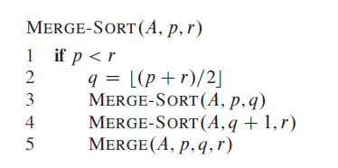
Merge Sort Pseudocode

Slide 49
Merge Sort
Base Case: When the sequences to be sorted has length 1.
66
12
108
14
56
34
14
56
89
66
12
89
34
108
Unsorted
Sorted
Divide
Merge
Divide
Merge
66
14
108
56
56
66
14
108
89
12
12
34
34
89
Divide
Divide
Merge
Divide
Merge
Merge
Divide
BCase
Merge
66
66
108
108
56
14
14
56
89
12
12
89
34
34
34
Merge
Divide
BCase
Divide
Merge
BCase
Divide
BCase
Merge
Divide
BCase
Merge
Divide
BCase
Merge
Divide
BCase
Merge
89
89
56
89
56
56
12
12
108
12
108
66
108
14
14
66
14
66

Slide 50
Merge Function
Given two sorted arrays, merge operation produces a sorted array with all the elements of the two arrays
8 | 1 | 4 | 3 | 2
Divide the array in half and conquer
...
1 | 4 | 8
2 | 3
Merge the halves
tempArray:
1
2
3
4
8
copy
Original Array:
1 | 2 | 3 | 4 | 8

Slide 51
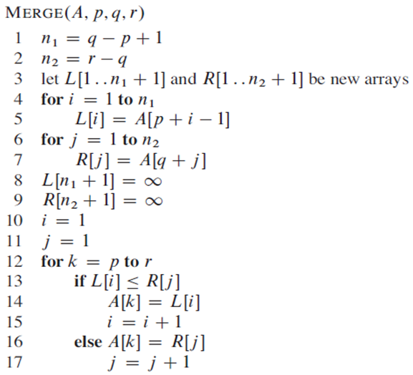
Merge Function Pseudocode
Complexity of Merge Function?
O(n)

Slide 52
Merge Sort Analysis
Let T(n) be the time taken by this algorithm to sort an array of n elements dividing A into sub-arrays A₁ and A₂. Merge operation takes the linear time. Consequently,
T(n) = T(n/2) + T(n/2) + θ(n)
T(n) = 2T (n/2) + θ(n)
The above recurrence relation is non-homogenous and can be solved by any of the methods:
Substitution
Recursion tree
Master method

Slide 53
Merge Sort Analysis
Merge n items:
O(n)
n
Level 0
n/2
n/2
Level 1
Merge two n/2 items:
O(n)
n/4
n/4
n/4
n/4
Level 2
Each level requires
O(n) operations
. . .
1
1
1
1
1
1
Tree Height : log₂n
Each level O(n) operations & O(log₂n) levels → O(n*log₂n)

Slide 54
Merge Sort Analysis
Worst case:
Average case:
Performance is independent of the initial order of the array items.
Advantage:
Mergesort is an extremely fast algorithm.
Disadvantage:
Mergesort requires a second array as large as the original array.
O(n * log₂n).
O(n * log₂n).

Slide 55
Quick Sort
Quick Sort: orders a list of values by partitioning the list around one element called a pivot, then sorting each partition. It is based on divide and conquer approach.
Key Points: Given an array S to be sorted
Pick any element v in array S as the pivot (i.e. partition element)
Partition the remaining elements in S into two groups
S1 = {all elements in S-{v} that are smaller than v}
S2 = {all elements in S-{v} that are larger than v}
apply the quick sort algorithm (recursively) to both partitions
Trick lies in handling the partitioning
i.e. picking a good pivot is essential to performance

Slide 56
Quick Sort Illustrated
pick a pivot
40
37
2
10
18
32
35
12
17
6
partition
6
40
10
12
2
17
18
37
32
35
quicksort
quicksort
2
6
10
12
17
18
32
35
37
40
combine
2
6
10
12
17
18
32
35
37
40

Slide 57
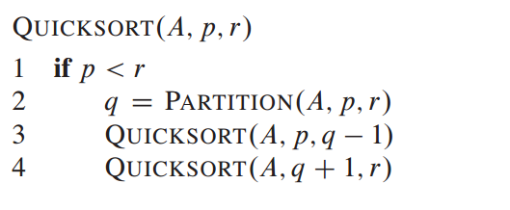
Quick Sort Pseudocode

Slide 58
Partitioning Algorithm
Original input : S = {6, 1, 4, 9, 0, 3, 5, 2, 7, 8}
Pick the first element as pivot
Have two ‘iterators’ – i and j
i starts at first element and moves forward
j starts at last element and moves backwards
While (i < j)
Move i to the right till we find a number greater than pivot
Move j to the left till we find a number smaller than pivot
If (i<j) swap(S[i], S[j])
The effect is to push larger elements to the right and smaller elements to the left
Swap the pivot with S[i]
8 1 4 9 0 3 5 2 7 6
pivot
8 1 4 9 0 3 5 2 7 6
i
j
pivot

Slide 59
Partitioning Algorithm Illustrated
i
j
pivot
8 1 4 9 0 3 5 2 7 6
Move
i
j
pivot
8 1 4 9 0 3 5 2 7 6
swap
i
j
pivot
2 1 4 9 0 3 5 8 7 6
move
i
j
pivot
2 1 4 9 0 3 5 8 7 6
swap
i
j
pivot
2 1 4 5 0 3 9 8 7 6
move
j
i
pivot
i and j
have crossed
2 1 4 5 0 3 9 8 7 6
Swap S[i]
with pivot
2 1 4 5 0 3 6 8 7 9
j
i
pivot

Slide 60
Partitioning Pseudocode
PARTITION(A, p, r)
pivot = A[p];
leftPointer = p + 1
rightPointer = r
while (True)
while (A[leftPointer] < pivot)
leftPointer++;
while (A[rightPointer] >= pivot)
rightPointer--;
if leftPointer >= rightPointer
break;
else
A[leftPointer] ←→ A[rightPointer]
A[leftPointer] ←→ pivot
What is the running time of partition()?
partition() runs in O(n) time

Slide 61
Partitioning Algorithm Illustrated
choose pivot: 4 3 6 9 2 4 3 1 2 1 8 9 3 5 6
search: 4 3 6 9 2 4 3 1 2 1 8 9 3 5 6
swap: 4 3 3 9 2 4 3 1 2 1 8 9 6 5 6
search: 4 3 3 9 2 4 3 1 2 1 8 9 6 5 6
swap: 4 3 3 1 2 4 3 1 2 9 8 9 6 5 6
search: 4 3 3 1 2 4 3 1 2 9 8 9 6 5 6
swap: 4 3 3 1 2 2 3 1 4 9 8 9 6 5 6
search: 4 3 3 1 2 2 3 1 4 9 8 9 6 5 6 (left > right)
swap with pivot: 1 3 3 1 2 2 3 4 4 9 8 9 6 5 6

Slide 62
Quick Sort: Best Case Analysis
Assuming that keys are random, uniformly distributed.
The best case running time occurs when pivot is the median
Partition splits array in two sub-arrays of size n/2 at each step
Partition Comparisons
n
n
Nodes contain problem size
n
n/2
n/2
n/4
n/4
n/4
n/4
n
n/8
n/8
n/8
n/8
n/8
n/8
n/8
n/8
n
T(n) = 2 T(n/2) + cn
T(n) = cn log n + n = O(n log n)

Slide 63
Quick Sort: Worst Case Analysis
Assuming that keys are random, uniformly distributed.
The worst case running time occurs when pivot is the smallest (or largest) element all the time
One of the two sub-arrays will have zero elements at each step
Height of Tree =
n
n-1
n-1
Total Cost =
0
n-2
n-2
T(n) = T(n-1) + cn
T(n-1) = T(n-2) + c(n-1)
T(n-2) = T(n-3) + c(n-2)
…
T(2) = T(1) + 2c
0
n-3
n-3
.
.
.
0
1
1

Slide 64
Quick Sort: Average Case Analysis
Assuming that keys are random, uniformly distributed.
The average case running time occurs when pivot can take any position at each step
The size of two sub-arrays will vary at each step
Per level Cost =
Height of Tree =
n
log_{x}n (x depends on how the partition is split)
O (n lg n)

Slide 65
Picking the Pivot
How would you pick one?
Strategy 1: Pick the first element in S
Works only if input is random
What if input S is sorted, or even mostly sorted?
All the remaining elements would go into either S1 or S2!
Terrible performance!
Why worry about sorted input?
Remember → Quicksort is recursive, so sub-problems could be sorted
Plus mostly sorted input is quite frequent

Slide 66
Picking the Pivot (contd.)
Strategy 2: Pick the pivot randomly
Would usually work well, even for mostly sorted input
Unless the random number generator is not quite random!
Plus random number generation is an expensive operation
Strategy 3: Median-of-three Partitioning
Ideally, the pivot should be the median of input array S
Median = element in the middle of the sorted sequence
Would divide the input into two almost equal partitions
Unfortunately, harder to calculate median quickly, without sorting first!
So find the approximate median
Pivot = median of the left-most, right-most and center elements of array S
Solves the problem of sorted input

Slide 67
Picking the Pivot (contd.)
Example: Median-of-three Partitioning
Let input S = {6, 1, 4, 9, 0, 3, 5, 2, 7, 8}
Left = 0 and S[left] = 6
Right = 9 and S[right] = 8
center = (left + right)/2 = 4 and S[center] = 0
Pivot
= Median of S[left], S[right], and S[center]
= median of 6, 8, and 0
= S[left] = 6

Slide 68
Quick Sort: Final Comments
What happens when the array contains many duplicate elements?
Not stable
What happens when the size of the array is small?
For small arrays (N ≤ 50), Insertion sort is faster than quick sort due to recursive function call overheads of quick sort. Use hybrid algorithm; quick sort followed by insertion sort when N ≤ 50
However, Quicksort is usually O(n log₂n)
Constants are so good that it is generally the fastest algorithm known
Most real-world sorting is done by Quicksort
For optimum efficiency, the pivot must be chosen carefully
“Median of three” is a good technique for choosing the pivot
However, no matter what you do, some bad cases can be constructed where Quick Sort runs in O(n²) time

Slide 69
Heap Sort
Uses Heap data structure to manage data during algorithm execution
A (Max/Min)-Heap is a balanced, left-justified binary tree in which no node has a value greater/lesser than the value in its parent
A[parent[i]] ≥ A[i] (max-heap)
A[parent[i]] ≤ A[i] (min-heap)
Largest/Smallest element is stored at the root.
Subtree rooted at a node contains values no larger/smaller than that at the node.

Slide 70
Heap Property
20
Larger than its parent
15
8
Not a Heap
4
10
7
9
25
Not left-justified
10
12
9
5
11
7
1
6
3
8

Slide 71
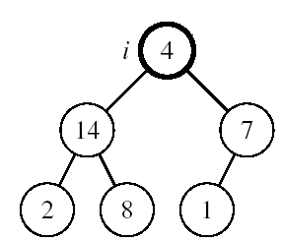
Maintaining the Heap Property
Suppose a node is smaller than a child, violating heap property. To maintain heap property, exchange the node with the larger child, moving the node down the tree until it is not smaller than its children
Alg: MAX-HEAPIFY(A, i, n)
l ← LEFT(i)
r ← RIGHT(i)
if l ≤ n and A[l] > A[i]
then largest ←l
else largest ←i
if r ≤ n and A[r] > A[largest]
then largest ←r
if largest ≠ i
then exchange A[i] ↔ A[largest]
MAX-HEAPIFY(A, largest, n)
Complexity of MAX-HEAPIFY()?
O(lg n) where lg n is the height of the tree

Slide 72
Array Representation of Heaps
A heap can be stored as an array A.
Root of tree is A[1]
Left child of A[i] = A[2i]
Right child of A[i] = A[2i + 1]
Parent of A[i] = A[⎣i/2⎦]
Heapsize[A] ≤ length[A]
The elements in the subarray A[(⎣n/2⎦+1) .. n] are leaves
1 2 3 4 5 6 7 8 9 10
26
24
20
18
17
19
13
12
14
11
Max-heap as an array
26
24
20
18
17
19
13
Max-heap as a binary tree
12
14
11
Node Insertion: Insert in last row from left to right
Node Deletion: Delete from last row from right to left

Slide 73
Building a Heap
A given array containing n elements can be converted into a max-heap by applying MAX-HEAPIFY on all interior nodes
The elements in the subarray A[1 … ⎣n/2⎦] are interior nodes
The elements in the subarray A[(⎣n/2⎦+1) .. n] are leaves
Alg: BUILD-MAX-HEAP(A)
n = length[A]
for i ← ⎣n/2⎦ downto 1
do MAX-HEAPIFY(A, i, n)
O(n)
O(lgn)
1
4
Complexity of BUILD-MAX-HEAP?
O(n lgn)
2
3
1
3
A:
4 | 1 | 3 | 2 | 16 | 9 | 10 | 14 | 8 | 7
4
5
6
7
2
16
9
10
8
9
10
14
8
7

Slide 74
Example: A:
4 | 1 | 3 | 2 | 16 | 9 | 10 | 14 | 8 | 7
i = 5
i = 4
i = 3
1
1
1
4
4
4
2
3
2
3
2
3
1
3
1
3
1
3
4
5
6
7
4
5
6
7
4
5
6
7
2
16
9
10
2
16
9
10
14
16
9
10
8
9
10
8
9
10
8
9
10
14
8
7
14
8
7
2
8
7
i = 2
i = 1
1
1
1
4
4
16
2
3
2
3
2
3
1
10
16
10
14
10
4
5
6
7
4
5
6
7
4
5
6
7
14
16
9
3
14
7
9
3
8
7
9
3
8
9
10
8
9
10
8
9
10
2
8
7
2
8
1
2
4
1
74

Slide 75
Heap Sort
A given array which has been heapified does not mean it is sorted
Notice that the largest number is at the root. It can be swapped with the rightmost leaf at the deepest level (its original position) and heap size decreased.
The new root has lost heap property. Heapify the new root and repeat this process until only one node remain.
25
22
17
14
21
9
11

Slide 76
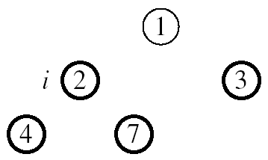
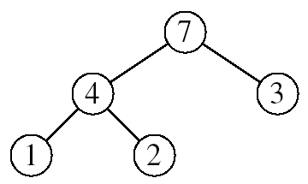
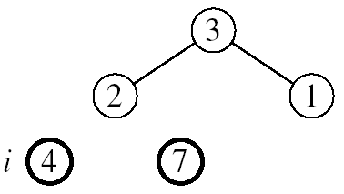
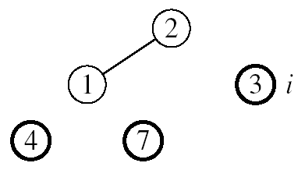

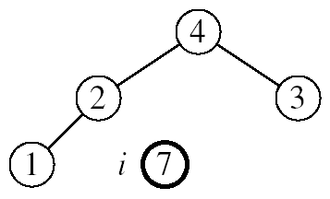
Example: A=[7, 4, 3, 1, 2]
MAX-HEAPIFY(A, 1, 4)
MAX-HEAPIFY(A, 1, 3)
MAX-HEAPIFY(A, 1, 2)
MAX-HEAPIFY(A, 1, 1)

Slide 77
Heap Sort Pseudocode
HEAPSORT(A)
BUILD-MAX-HEAP(A)
for i ← length[A] downto 2
do exchange A[1] ↔ A[i]
MAX-HEAPIFY(A, 1, i - 1)
O(n lgn)
n-1 times
O(lgn)
What is the running time of HEAPSORT()?
O(n lgn)
Why Heap Sort?
Heap Sort is always O(n lgn) and is in-place
Quicksort is usually O(n lgn) but in the worst case slows to O(n²)
Quicksort is generally faster, but Heapsort is better in time-critical applications

Slide 78
How Fast Can We Sort?
Selection Sort, Bubble Sort, Insertion Sort ➔ O(n²)
Merge Sort, Quick Sort, Heap Sort ➔ O(n lg n)
What is common to all these algorithms?
Make comparisons between input elements
Lower bound for comparison based sorting
Theorem: To sort n elements, comparison sorts must make Ω(nlgn) comparisons in the worst case.
Proof: Draw decision tree and calculate asymptotic height of any decision tree for sorting n elements

Slide 79
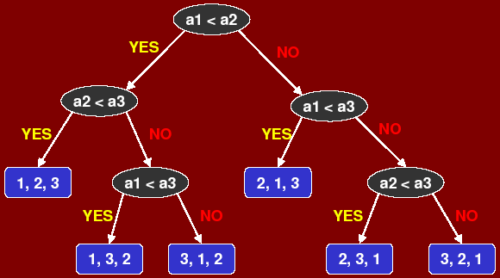
Lower Bound For Comparison Sorting
Consider sorting three numbers a1, a2, a3.
There are 3! = 6 possible combinations:
(a1, a2, a3), (a1, a3, a2) , (a3, a2, a1) (a3, a1, a2), (a2, a1, a3) , (a2, a3, a1)
What’s the minimum # of leaves? n!
What’s the maximum # of leaves of a binary tree of height h? 2^{h}
minimum # of leaves ≤ maximum # of leaves

Slide 80
Lower Bound For Comparison Sorting
So we have… n! ≤ 2^{h}
Taking logarithms: lg (n!) ≤ h
Stirling’s approximation tells us:
Thus the minimum height of a decision tree is Ω(n lg n) therefore the time to comparison sort n elements is Ω(n lg n)
Corollary: Quick Sort, Heap Sort and Merge Sort are asymptotically optimal comparison sorts. Can we do any better than Ω(n lg n)?

Slide 81
Types of Sorting Algorithms
Non-recursive/incremental comparison sorting
Selection sort
Bubble sort
Insertion sort
Recursive comparison sorting
Merge sort
Quick sort
Heap sort
Non-comparison linear sorting
Count sort
Radix sort
Bucket sort

Slide 82
Counting Sort
Assumptions:
n integers which are in the range [0,k]
k is in the order of n, that is, k=O(n).
Idea:
For each element x, find the number of elements ≤ x
Place x into its correct position in the output array
https://www.cs.usfca.edu/~galles/visualization/CountingSort.html

Slide 83
Counting Sort
1
2
3
4
5
6
7
8
A
2
5
3
0
2
3
0
3
Input Array
0
1
2
3
4
5
C
2
0
2
3
0
1
Auxiliary Array
0
1
2
3
4
5
C
2
2
4
7
7
8
1
2
3
4
5
6
7
8
B
0
0
2
2
3
3
3
5
Output Array
0
1
2
3
4
5
C
2
2
4
7
7
8
1
0
3
2
6
5
4
7

Slide 84
Counting Sort
Counting-Sort(A, B, k)
for i = 1 to k
do C[i] = 0
for j = 1 to length[A]
do C[A[j]] = C[A[j]] + 1
// C[i] now contains the number of elements = i
for i = 2 to k
do C[i] = C[i] + C[i-1]
// C[i] now contains the number of elements ≤ i
for j = length[A] downto 1
do B[C[A[j]]] = A[j]
C[A[j]] = C[A[j]] - 1
Θ(k)
Θ(n)
Θ(k)
Θ(n)
Running time is Θ(n+k) (or Θ(n) if k = O(n))!

Slide 85
Counting Sort
Is counting sort stable
The input order is maintained among items with equal keys
Cool! Why don’t we always use counting sort?
Because it depends on range k of elements
Could we use counting sort to sort 32 bit integers? Why or why not?
Answer: no, k too large (2³² = 4,294,967,296)

Slide 86

Radix Sort
Represents keys as d-digit numbers in some base-k
key = x₁x₂...x_{d} where 0≤x_{i}≤k-1
Example: key=15
key₁₀ = 15, d=2, k=10 where 0≤x_{i}≤9
key₂ = 1111, d=4, k=2 where 0≤x_{i}≤1
Assumptions: d=O(1) and k =O(n)
Sorting looks at one column at a time
For a d digit number, sort the least significant digit first
Continue sorting on the next least significant digit, until all digits have been sorted
Requires only d passes through the list
https://www.cs.usfca.edu/~galles/visualization/RadixSort.html

Slide 87
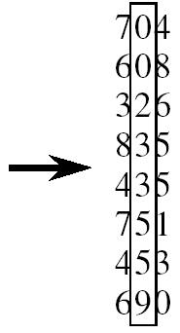

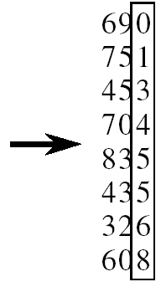
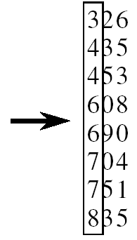
Radix Sort
RadixSort(A, d)
for i=1 to d
StableSort(A) on digit i
d times
Θ(n+k)
Running time is Θ(dn+dk) (or Θ(n) if k = O(n) and d = O(1))
(stable sort: preserves order of identical elements)

Slide 88
Radix Sort
Problem: sort 1 million 64-bit numbers
Treat as four-digit radix 2¹⁶ numbers
Can sort in just four passes with radix sort!
So why would we ever use anything but radix sort?

Slide 89
Bucket Sort
Assumption:
Input numbers are uniformly distributed in [0,1).
Suppose input size is n.
Idea:
Divide [0,1) into n equal-sized buckets (k= Θ(n))
Distribute the n input values into the buckets
Sort each bucket (insertion sort as default).
Go through the buckets in order, listing elements in each one
Input: A[1 . . n], where 0 ≤ A[i] < 1 for all i
Output: elements A[i] sorted

Slide 90
Bucket Sort
Step 1: Distribute into Buckets
.78
0
.17
1
.12
.17
.39
2
.21
.23
.26
.26
3
.39
.72
4
Step 2: Sort within each Bucket
.94
5
.21
6
.68
.12
7
.72
.78
.23
8
.68
9
.94
Step 3: Concatenate all Buckets
.12
.17
.21
.23
.26
.39
.68
.72
.78
.94 /

Slide 91
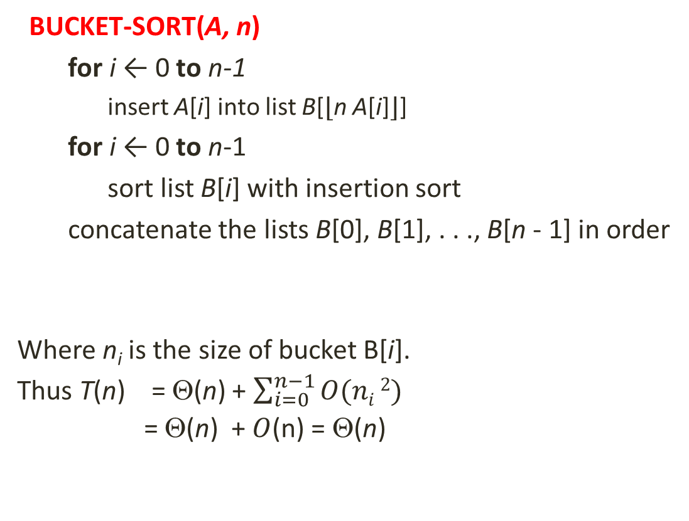
Bucket Sort
BUCKET-SORT(A, n)
for i ← 0 to n-1
insert A[i] into list B[⌊n A[i]⌋]
for i ← 0 to n-1
sort list B[i] with insertion sort
concatenate the lists B[0], B[1], . . ., B[n - 1] in order
Where n_{i} is the size of bucket B[i].
Thus T(n) = Θ(n) + $\sum_{i=0}^{n−1}{O(ni}2)$
= Θ(n) + $O$(n) = Θ(n)
O(n)
O(n_{i}²)
O(n)

Slide 92
Summary: Sorting Algorithms
Insertion Sort: Suitable only for small n ≤ 50 or nearly sorted inputs
Merge Sort: Guaranteed to be fast even in its worst case; stable
Quick Sort: Most useful general-purpose sorting for very little memory
requirement and fastest average time. (Choose the median of
three elements as pivot in practice
Heap Sort: Requiring minimum memory and guaranteed to run fast;
average and maximum time both roughly twice the average
time of quick sort. Useful for time-critical applications
Counting Sort: Very useful when the keys have small range; stable;
memory space for counters and for 2n records.
Radix Sort: Appropriate for keys either rather short or with an
lexicographic collating sequence.
Bucket Sort: Assuming keys to have uniform distribution.

