Slide 1
CSC 301 – Design and Analysis of Algorithms
Instructor: Dr. M. Hasan Jamal
Lecture# 01(a): Introduction to Algorithms

Slide 2
What are Algorithms?
An Algorithm is a step-by-step procedure for solving a particular problem in finite amount of time.
Typically, an algorithm takes input data and produces an output based upon it.
Important Problem Types:
Sorting
Searching
String Processing
Graph Problems
Etc.
Input
X
ALGORITHM
F: X→Y
Output
Y = F(X)

Slide 3
Why Study Algorithms?
As a computer professional you should be aware of a standard set of important algorithms from different areas of computing.
You should be able to design new algorithms and analyze their efficiency.
A problem can be solved by several algorithms that differ in their ideas, level of sophistication, and efficiency. You should be able to determine which algorithm to use for a particular situation.
All the knowledge required for solving a problem in present in the algorithm so once we find an algorithm, we do not need to rediscover it the next time we are faced with the same problem.
Notes:
One Problem, Many algorithms: Give Sorting example

Slide 4
Algorithms as a Technology
Suppose computers were infinitely fast and computer memory was free. Would you have any reason to study algorithms?
The answer is YES.
You would still like to demonstrate that your solution method terminates and does so with the correct answer.
If computers were infinitely fast, any correct method for solving a problem would do. You would probably want your implementation to be within the bounds of good software engineering practices, but you would most often use whichever method was the easiest to implement.
Of course, computers are fast, but not infinitely fast. And memory may be inexpensive but not free. Therefore, computing time and memory space is a bounded resource that need to be used wisely.

Slide 5
Components of an Algorithm
Statements
input statements: e.g., input a, b, and c
assignment statements
output statements
return statements
Sequences: A sequence of statements which are also statements
Selections: if-then-else statements.
Repetitions: Iterations of a sequence of statements.

Slide 6
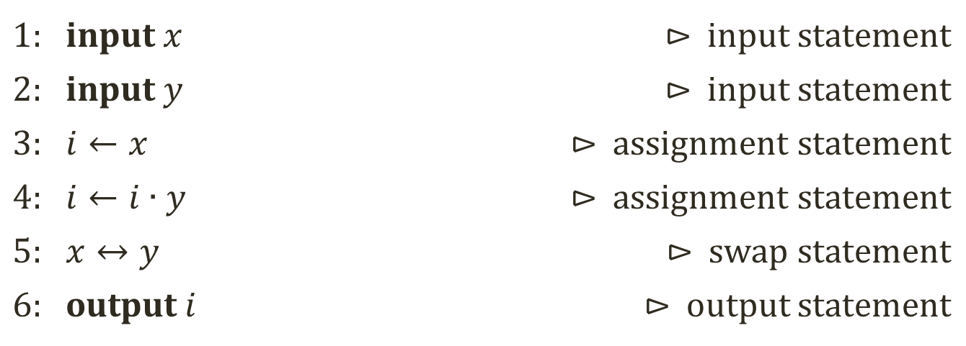
Components of an Algorithm
Statements & Sequences Example:
1: input $x$ | ⊳ input statement
2: input $y$ | ⊳ input statement
3: $i←x$ | ⊳ assignment statement
4: $i←i∙y$ | ⊳ assignment statement
5: $x↔y$ | ⊳ swap statement
6: output $i$ | ⊳ output statement

Slide 7
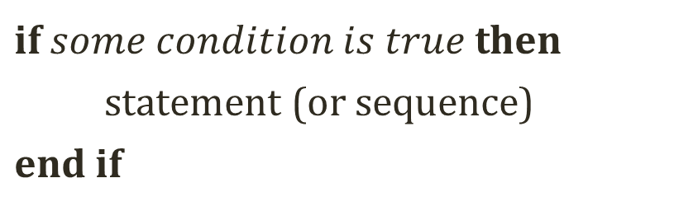
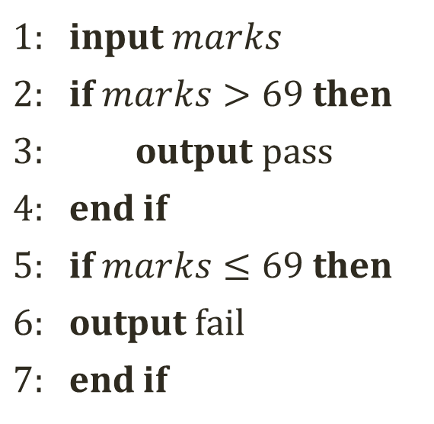
Components of an Algorithm
Selections Example:
if $some condition is true$ then
statement (or sequence)
end if
1: input $marks$
2: if $marks>69$ then
3: output $pass$
4: end if
5: if $marks≤69$ then
6: output $fail$
7: end if
condition
false
true
statement

Slide 8
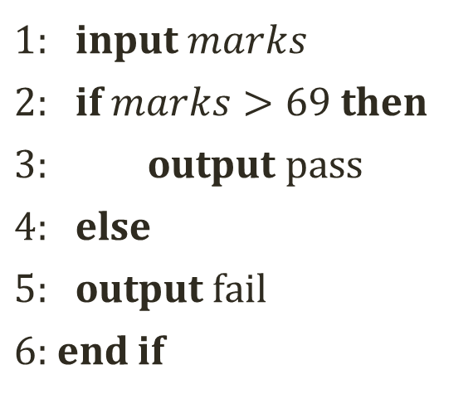
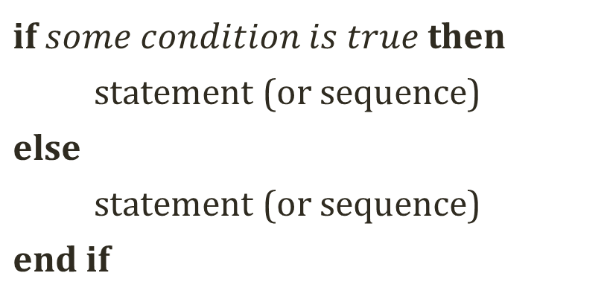
Components of an Algorithm
Selections Example:
if $some condition is true$ then
statement (or sequence)
else
statement (or sequence)
end if
1: input $marks$
2: if $marks>69$ then
3: output $pass$
4: else
5: output $fail$
6: end if
condition
false
true
statement
statement

Slide 9
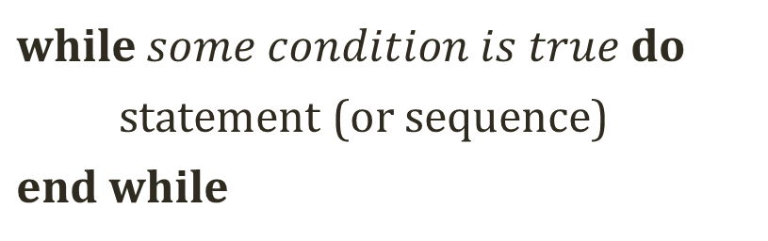
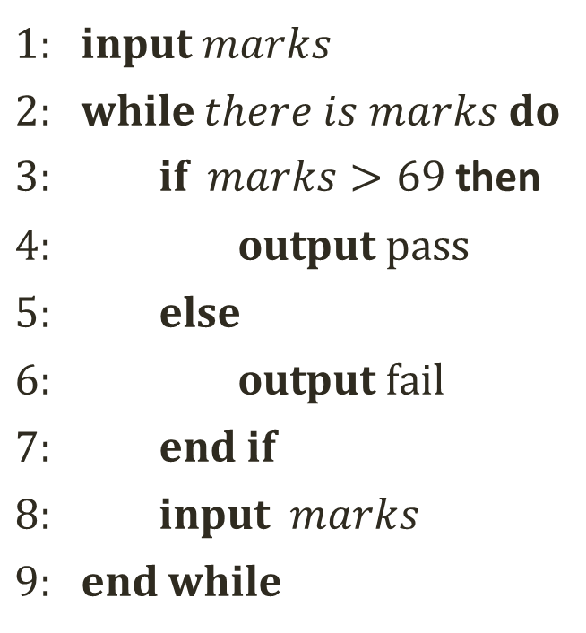
Components of an Algorithm
Repetitions Example:
while $some condition is true$ do
statement (or sequence)
end while
1: input $marks$
2: while $there is marks$ do
3: if $marks>69$ then
4: output pass
5: else
6: output $fail$
7: end if
8: input $marks$
9: end while
false
condition
true
statement

Slide 10
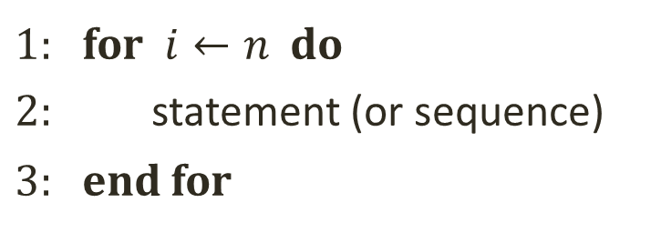
Components of an Algorithm
Repetitions Example:
repeat
statement (or sequence)
until some condition is true
1: for $i←n$ do
2: statement (or sequence)
3: end for
false
condition
true
statement

Slide 11
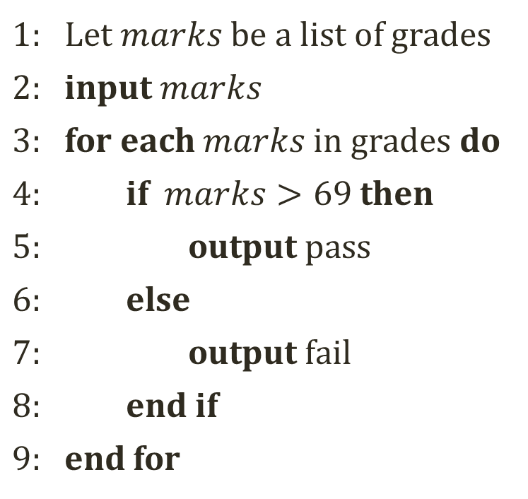
Components of an Algorithm
Repetitions Example:
for each elements of some collection do
statement (or sequence)
end for
1: Let $marks$ be a list of grades
2: input $marks$
3: for each $marks$ in grades do
4: if $marks>69$ then
5: output pass
6: else
7: output $fail$
8: end if
9: end for
false
condition
true
statement

Slide 12
How to Represent an Algorithm?
An algorithm is represented using Pseudocode which is more structured than English language but less detailed than a program.
A computer program is a concrete representation of an algorithm in some programming language.
Set of instructions which the computer follows to solve a problem
Pseudocode is high-level description of an algorithm that hides program design issues.
Algorithm represented using Pseudocode
Program
represented using Programming Language
Problem

Slide 13
How to Represent an Algorithm?
Indentation indicates a block of statements or structure. e.g., body of a loop
The symbol // indicates that the reminder of the line is a comment.
Arithmetic & Logical Operators: ( + , – , * , / ) (and, or and not)
Relational Operators: ( > , < , <= , >=, != )
FIND-MAX(A)
// Input: A list A[n] of unsorted numbers
// Output: Find the maximum element of A
n ← length[A]
max ← A[0]
for i ← 1 to n – 1
if A[ i ] > max
max ← A[ i ]
return max

Slide 14
How to Represent an Algorithm?
If A is a Structure, then |A| is size of the structure.
A[i] accesses the i^{th} element of the array and length[A] is the size of array.
All variables are considered Local Variables unless defined global explicitly
Parameters are passed to a procedure by values only
FIND-MAX(A)
// Input: A list A[n] of unsorted numbers
// Output: Find the maximum element of A
n ← length[A]
max ← A[0]
for i ← 1 to n – 1
if A[ i ] > max
max ← A[ i ]
return max

Slide 15
Properties of Algorithms
Inputs: An algorithm should have one or more inputs of different sizes for each instance of a problem.
Outputs: An algorithm must have at least one output. A correct algorithm always produces the correct output for a computation problem.
Definiteness: The execution sequence of instructions of an algorithm must be definite/unambiguous. Otherwise, the algorithm may not terminate or produce the incorrect output.
Finiteness: An algorithm must have finite number of well-defined steps.
Effectiveness: An algorithm should have good method that produces effective output with less time and less storage capacity, or in other words, the algorithm should be efficient.
Notes:
Constraints may be placed on input values; e.g., positive integers, negative values, etc.
Output can be a single value or an array of quantities.

Slide 16
Properties of Algorithms
An algorithm is only considered correct if its semantics and syntax are correct.
Semantics is the logic of the algorithm.
Syntax is the actual representation of an algorithm.
WARNING:
An algorithm can be syntactically correct, yet semantically incorrect (dangerous situation!
Syntactic correctness is easier to check as compared to semantic correctness
Colorless green ideas sleep furiously!

Slide 17
Origin of the word Algorithm
In the 9th century, the influential Persian scholar and scientist Muhammad ibn Musa al-Khwarizmi became known for his contributions to the study of algebra while working at Bayt al-Hikmah in Baghdad.
Bayt al-Hikmah acquired and translated books on science and philosophy from Greece, India and Persia, as well as publishing original research.
Al-Khwarizmi is credited as the man who introduced sophisticated mathematics to the West. His work was translated into Latin. Al-Khwarizmi became Algoritmi in Latin which was then translated into English as 'algorithm’.
Today, the meaning of the term algorithm has been broadened to include any method of computation, especially from the mid-20th Century onwards where it is commonly used with reference to computing.

Slide 18
Fundamentals of Algorithmic Problem Solving
STAIR model for problem solving.
S – State the Problem
T – Tools for the Job
A – Algorithm Development
I – Implementation of the Algorithm
R – Refinement
Understand the Problem
Decide on:
Computational means, exact vs. approx. solving,
Algorithm design technique
Design an Algorithm
Prove Correctness
Analyze the Algorithm
Code the Algorithm
Verify the Algorithm

Slide 19
Fundamentals of Algorithmic Problem Solving
STAIR model for problem solving.
S – State the Problem
Decide exactly what you are trying to accomplish
Resist the urge to get technical here
Describe the problem in HUMAN language
How will you know when you have succeeded?
This is actually the hardest step and skipping it may result in confusion and wasted time
Understand the Problem
Decide on:
Computational means, exact vs. approx. solving,
Algorithm design technique
Design an Algorithm
Prove Correctness
Analyze the Algorithm
Code the Algorithm
Slides adapted from https://itproblemsolving.blogspot.com/2013/07/stair.html
Verify the Algorithm

Slide 20
Fundamentals of Algorithmic Problem Solving
STAIR model for problem solving.
T – Tools for the Job
List down appropriate Algorithm Design Technique
List down appropriate Data Structures
List down the target Resources
Understand the Problem
Decide on:
Computational means, exact vs. approx. solving,
Algorithm design technique
Design an Algorithm
Prove Correctness
Analyze the Algorithm
Code the Algorithm
Slides adapted from https://itproblemsolving.blogspot.com/2013/07/stair.html
Verify the Algorithm
Notes:
A retrieve operation on an array takes at most one operation while for linked-list retrieve operation takes at most “n” operations.
But insert and delete operations are much easier on a linked-list-based implementation.
Determine how frequently particular operations occur in each application.

Slide 21
Fundamentals of Algorithmic Problem Solving
STAIR model for problem solving.
A – Algorithm Development
Develop a strategy and define the steps
Translate each step into action
Choose the appropriate tool(s)
Write it Down
Easier to modify and improve
Easier to explain the process to others
Understand the Problem
Decide on:
Computational means, exact vs. approx. solving,
Algorithm design technique
Design an Algorithm
Prove Correctness
Analyze the Algorithm
Code the Algorithm
Slides adapted from https://itproblemsolving.blogspot.com/2013/07/stair.html
Verify the Algorithm

Slide 22
Fundamentals of Algorithmic Problem Solving
STAIR model for problem solving.
I – Implementation of the Algorithm
Translate the defined steps into something the computer can understand
This is easy if the other steps have been taken
We usually try to start here
It should happen late in the process
Understand the Problem
Decide on:
Computational means, exact vs. approx. solving,
Algorithm design technique
Design an Algorithm
Prove Correctness
Analyze the Algorithm
Code the Algorithm
Slides adapted from https://itproblemsolving.blogspot.com/2013/07/stair.html
Verify the Algorithm

Slide 23
Fundamentals of Algorithmic Problem Solving
STAIR model for problem solving.
R – Refinement
It NEVER works right the first time
Expect problems - don't stress
Errors are opportunities to gather information
Revisit earlier steps to see what went wrong
Refinement could mean rejection!
Understand the Problem
Decide on:
Computational means, exact vs. approx. solving,
Algorithm design technique
Design an Algorithm
Prove Correctness
Analyze the Algorithm
Code the Algorithm
Slides adapted from https://itproblemsolving.blogspot.com/2013/07/stair.html
Verify the Algorithm

Slide 24
Instance of a Problem
An input sequence is called an instance of a Problem.
A problem can have many instances.
An algorithm must work correctly on all instances of the problem it claims to solve.
Many interesting problems have infinitely many instances
Since resources are finite, we usually need to limit the number and/or size of possible instances
This restriction does not prevent us from doing analysis in the abstract

Slide 25
Algorithms Designing Techniques
Brute Force: Straightforward, naive approach – Mostly expensive
Divide and Conquer: Divide into smaller sub-problems approach (e.g., merge sort)
Iterative Improvement: Improve one change at a time (e.g., greedy algorithms)
Decrease and Conquer: Decrease instance size (e.g., Fibonacci sequence)
Transform and Conquer: Modify the problem first and then solve it
(e.g., repeating numbers in an array)
Dynamic Programming: Dependent sub-problems, reuse results

Slide 26
Algorithm Design Practices
Design an algorithm that is easier to understand, code, and debug.
Design an algorithm that makes efficient use of computing resources.
Apply the 90/10 rule of program optimization which states that 90% of the execution time of a program is spent in executing 10% of the code.
i.e., loop execution and function calls
Apply good programming practices
Move instructions out of the loops that does not belong there.
Remove unnecessary I/O operations
Replace an inefficient algorithm (best solution)
Notes:
Moral - Choose the most appropriate algorithm(s) BEFORE program implementation.

