Slide 1
CSC 301 – Design and Analysis of Algorithms
Instructor: Dr. M. Hasan Jamal
Lecture# 06(a): Graphs
Slides adapted from T. M. Murali
http://courses.cs.vt.edu/~cs4104/murali/spring2017/

Slide 2
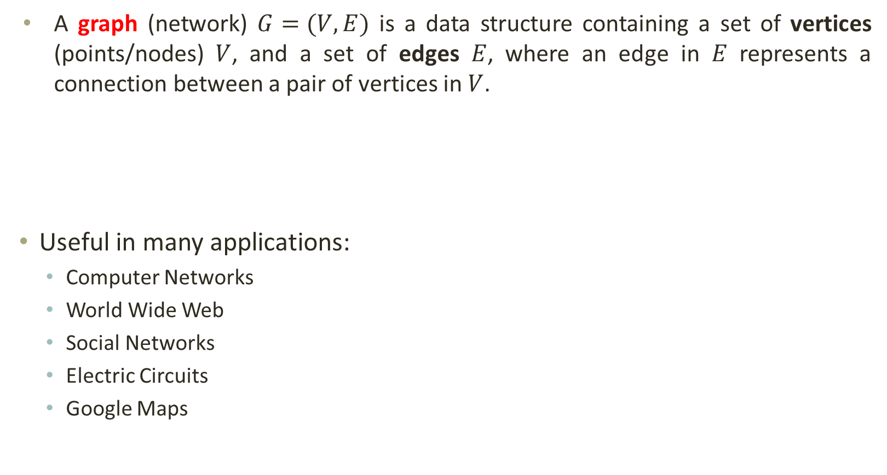
Graphs
A graph (network) $G=(V,E)$ is a data structure containing a set of vertices (points/nodes) $V$, and a set of edges $E$, where an edge in $E$ represents a connection between a pair of vertices in $V$.
Useful in many applications:
Computer Networks
World Wide Web
Social Networks
Electric Circuits
Google Maps
V (G)= { A, B, C, D}
A
E (G)= { (A, B), (A, C), (B, C), (B, D) }
C
B
D

Slide 3
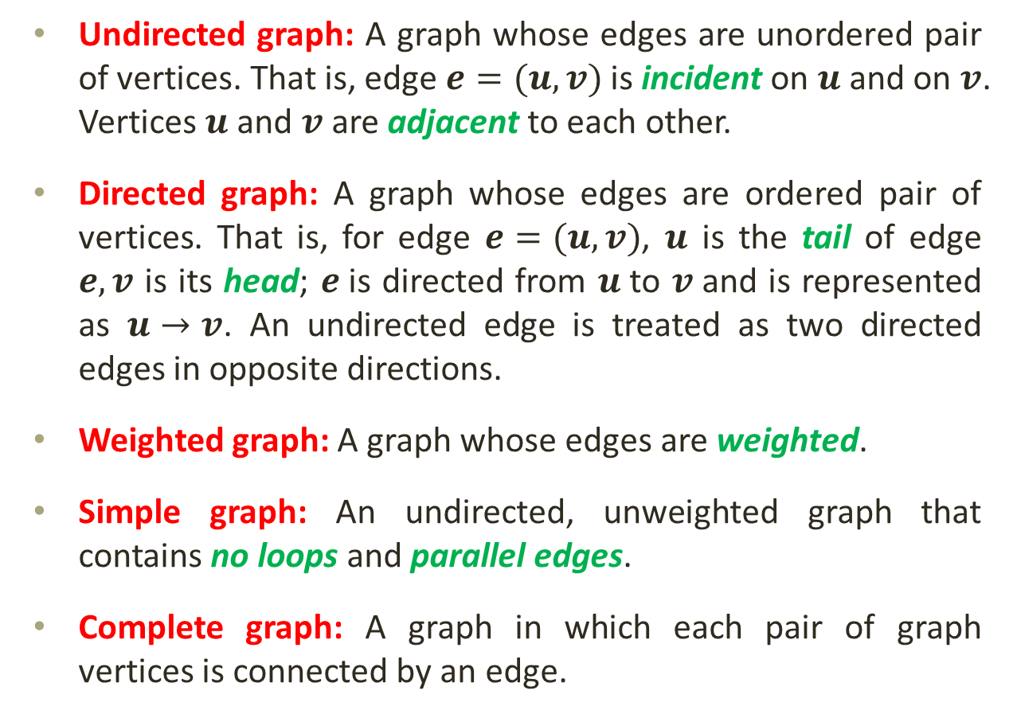
Graphs: Definitions
A
Undirected graph: A graph whose edges are unordered pair of vertices. That is, edge $e=(u,v)$ is incident on $u$ and on $v$. Vertices $u$ and $v$ are adjacent to each other.
Directed graph: A graph whose edges are ordered pair of vertices. That is, for edge $e=(u,v)$, $u$ is the tail of edge $e,v$ is its head; $e$is directed from $u$to $v$and is represented as $u→v$. An undirected edge is treated as two directed edges in opposite directions.
Weighted graph: A graph whose edges are weighted.
Simple graph: An undirected, unweighted graph that contains no loops and parallel edges.
Complete graph: A graph in which each pair of graph vertices is connected by an edge.
C
B
D
A
C
B
D
A
6
4
C
A
B
8
C
2
D
B
A
D
C
B
D

Slide 4
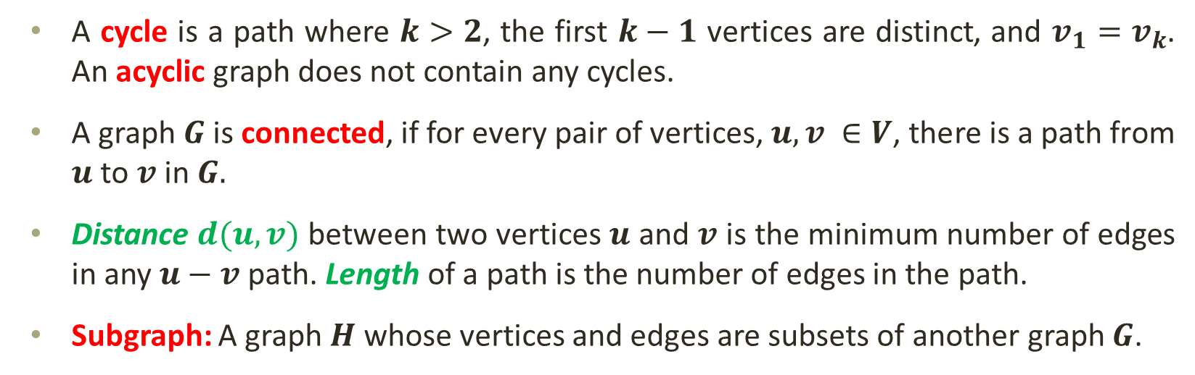
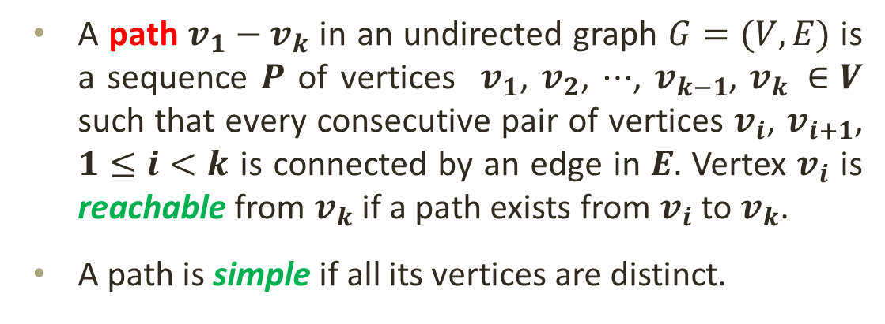
Graphs: Definitions
a
b
c
a
b
A path $v_{1}−v_{k}$ in an undirected graph $G=(V,E)$ is a sequence $P$ of vertices $v_{1}$, $v_{2}$, $⋯$, $v_{k−1}$, $v_{k} ∈V$ such that every consecutive pair of vertices $v_{i}$, $v_{i+1}$, $1≤i<k$ is connected by an edge in $E.$ Vertex $v_{i}$ is reachable from $v_{k}$ if a path exists from $v_{i}$ to $v_{k}$.
A path is simple if all its vertices are distinct.
d
d
e
f
e
g
h
i
A cycle is a path where $k>2$, the first $k−1$ vertices are distinct, and $v_{1}=v_{k}$. An acyclic graph does not contain any cycles.
A graph $G$ is connected, if for every pair of vertices, $u, v ∈V$, there is a path from $u$ to $v$ in $G.$
Distance $d(u,v)$ between two vertices $u$ and $v$ is the minimum number of edges in any $u−v$ path. Length of a path is the number of edges in the path.
Subgraph: A graph $H$ whose vertices and edges are subsets of another graph $G$.

Slide 5
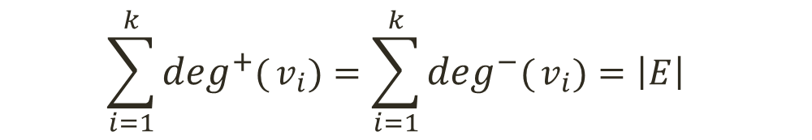

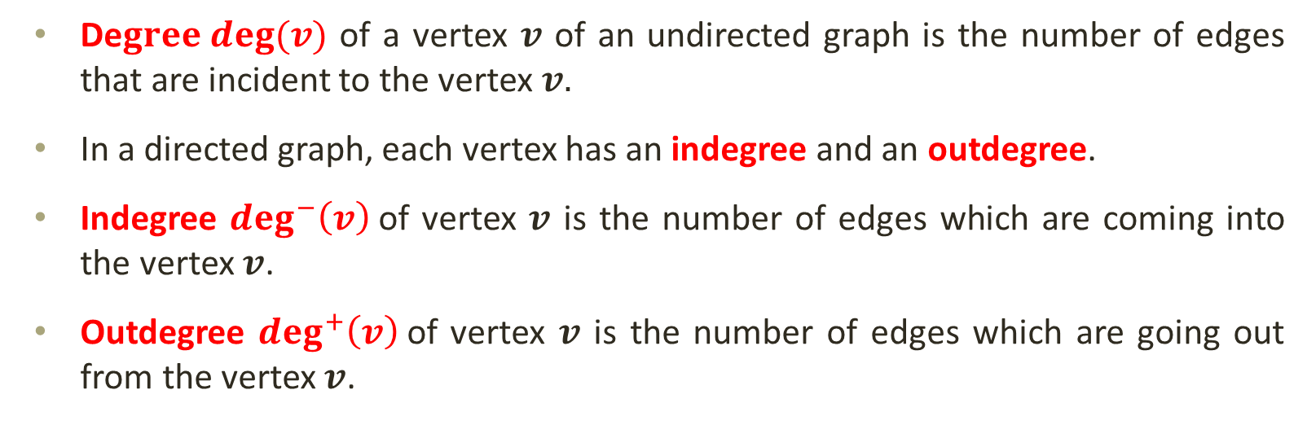
Graphs: Definitions
De$gree deg(v)$ of a vertex $v$ of an undirected graph is the number of edges that are incident to the vertex $v.$
In a directed graph, each vertex has an indegree and an outdegree.
Indegree $\deg^{−}\left(v\right)$of vertex $v$ is the number of edges which are coming into the vertex $v$.
Outdegree $\deg^{+}\left(v\right)$of vertex $v$ is the number of edges which are going out from the vertex $v$.
$$\sum_{i=1}^{k}{deg(}v_{i})=2∙\left|E\right|$$
$$\sum_{i=1}^{k}{\deg^{+}(}v_{i})=\sum_{i=1}^{k}{\deg^{−}(}v_{i})=\left|E\right|$$

Slide 6
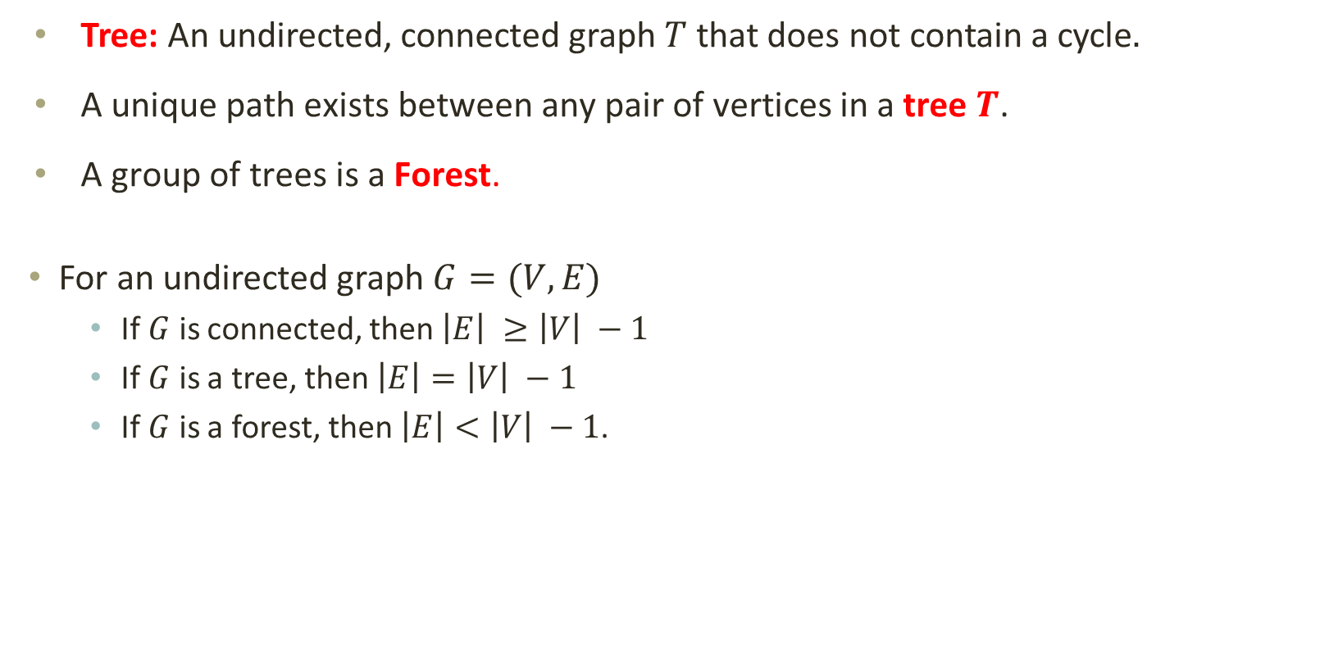
Graphs: Definitions
Tree: An undirected, connected graph $T$ that does not contain a cycle$.$
A unique path exists between any pair of vertices in a tree $T$.
A group of trees is a Forest.
For an undirected graph $G=(V,E)$
If $G$ is connected, then $\left|E\right| ≥\left|V\right| −1$
If $G$ is a tree, then $\left|E\right|=\left|V\right| −1$
If $G$ is a forest, then $\left|E\right|<\left|V\right| −1$.
5
1
2
4
6
3
7

Slide 7
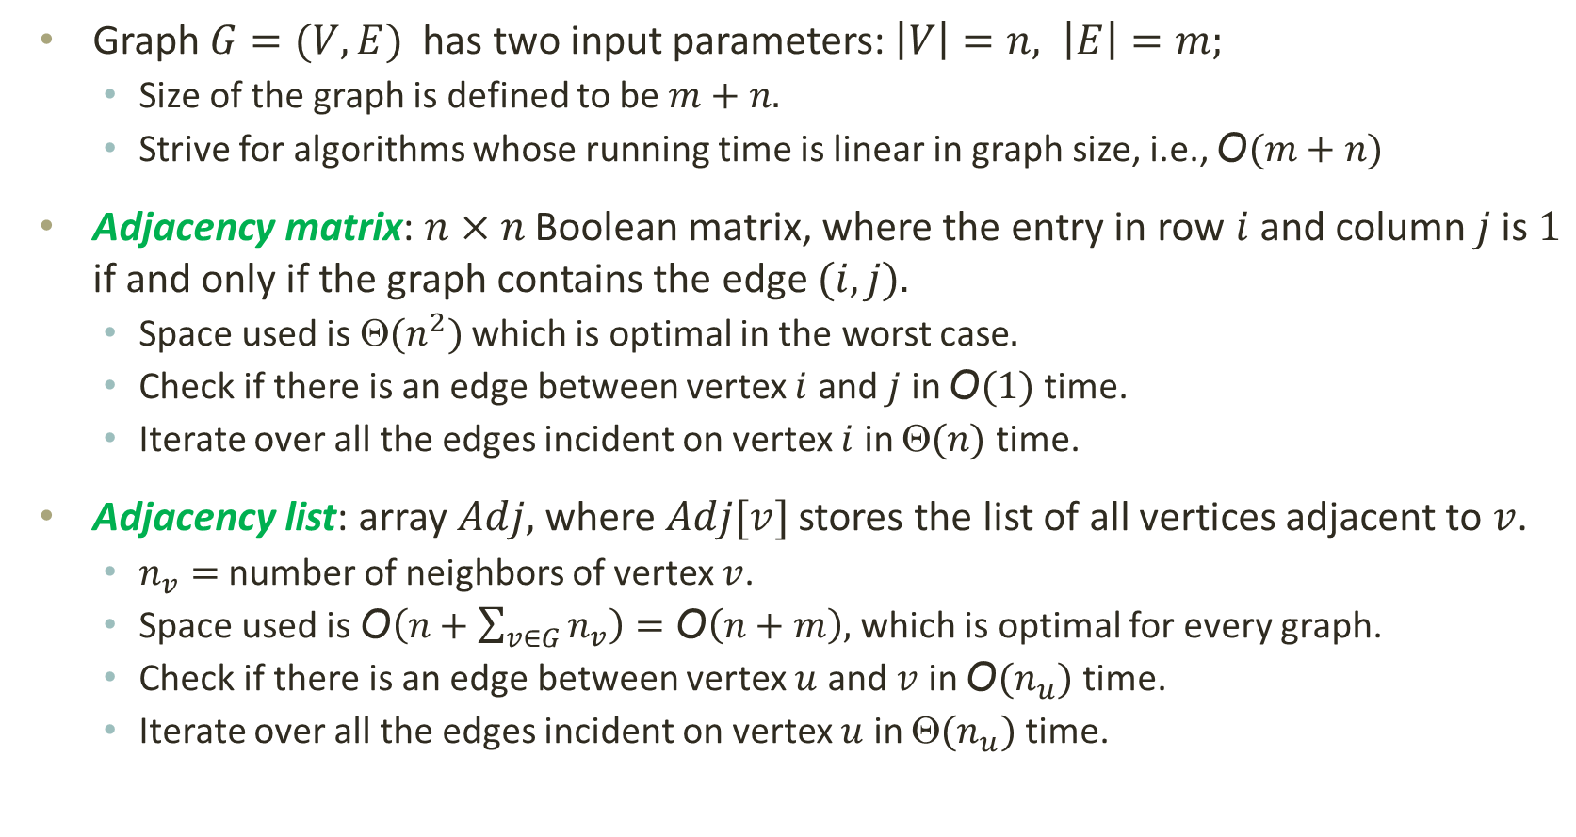
Graphs Representation
Graph $G=(V,E)$ has two input parameters: $\left|V\right|=n, \left|E\right|=m;$
Size of the graph is defined to be $m+n.$
Strive for algorithms whose running time is linear in graph size, i.e., $\text{O}(m+n)$
Adjacency matrix: $n×n$ Boolean matrix, where the entry in row $i$ and column $j$is $1$ if and only if the graph contains the edge $(i,j).$
Space used is $\text{}(n^{2})$ which is optimal in the worst case$.$
Check if there is an edge between vertex $i$ and $j$ in $\text{O}(1)$ time.
Iterate over all the edges incident on vertex $i$ in $\text{}(n)$ time.
Adjacency list: array $Adj,$ where $Adj[v]$ stores the list of all vertices adjacent to $v$.
$n_{v}=$ number of neighbors of vertex $v$.
Space used is $\text{O}\left(n+\sum_{v∈G}{n_{v}}\right)=\text{O}\left(n+m\right),$ which is optimal for every graph.
Check if there is an edge between vertex $u$ and $v$ in $\text{O}(n_{u})$ time.
Iterate over all the edges incident on vertex $u$ in $\text{}(n_{u})$ time.

Slide 8
Graph Traversals
Most graph algorithms involve searching for a path from one vertex to another. Sometimes we want to:
just find any path or know if there is a path
minimize path length (# of edges)
minimize path cost (sum of edge weights)
visit every vertex in the graph exactly once
The order in which the vertices are visited may be important and may depend on the particular algorithm.
The two, common traversals are:
Breadth-first
Depth-first
During a traversal we must keep track of which vertices have been visited; the most common approach is to provide some sort of “marking” support.

Slide 9
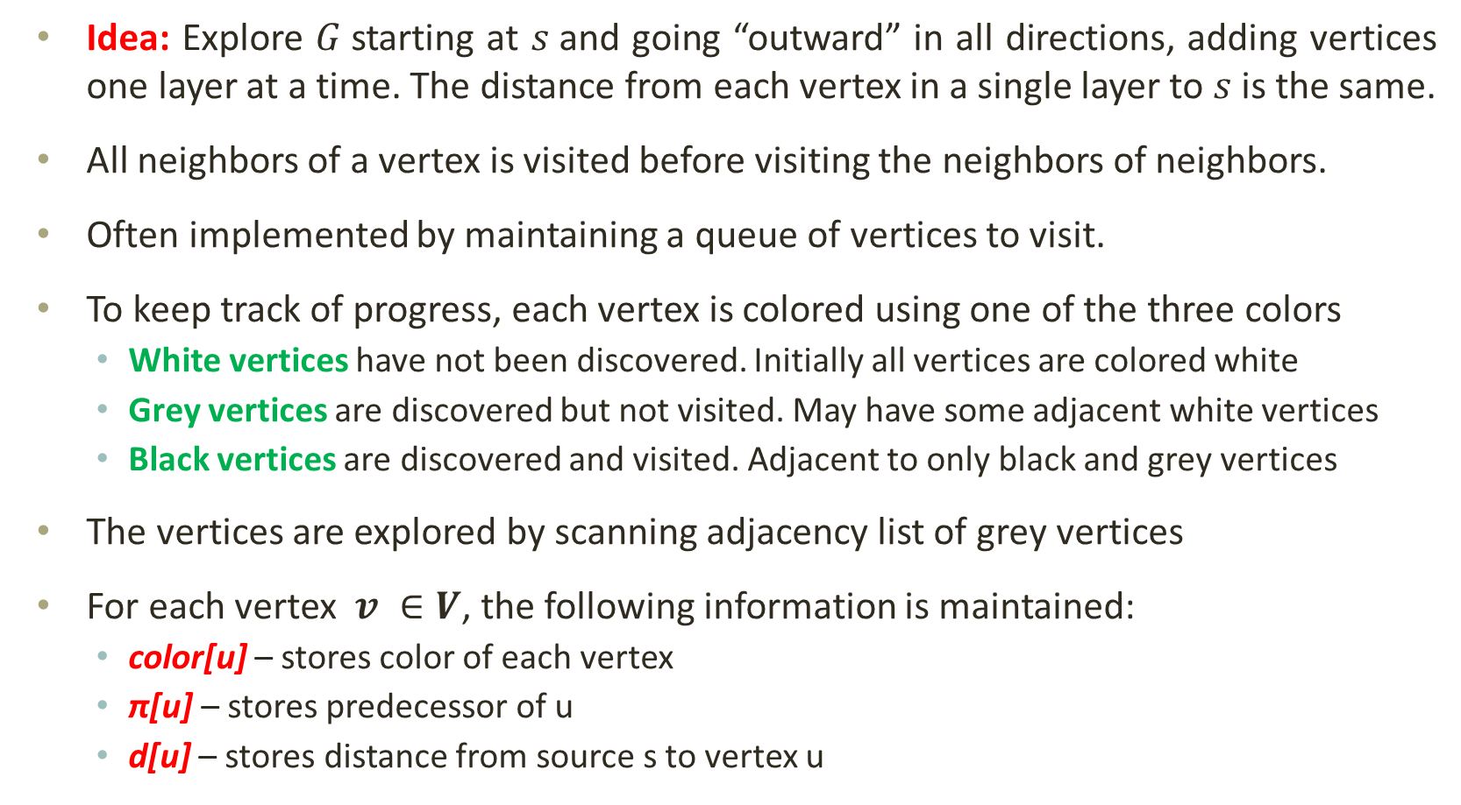
Graph Traversals: Breadth-First Search (BFS)
Idea: Explore $G$starting at $s$and going “outward” in all directions, adding vertices one layer at a time. The distance from each vertex in a single layer to $s$ is the same.
All neighbors of a vertex is visited before visiting the neighbors of neighbors.
Often implemented by maintaining a queue of vertices to visit.
To keep track of progress, each vertex is colored using one of the three colors
White vertices have not been discovered. Initially all vertices are colored white
Grey vertices are discovered but not visited. May have some adjacent white vertices
Black vertices are discovered and visited. Adjacent to only black and grey vertices
The vertices are explored by scanning adjacency list of grey vertices
For each vertex $v ∈V$, the following information is maintained:
color[u] – stores color of each vertex
π[u] – stores predecessor of u
d[u] – stores distance from source s to vertex u

Slide 10
Graph Traversals: BFS
BFS(G, s)
for each vertex u ∈ V [G] – {s}
color [u] ← WHITE
d [u] ← ∞
π[u] ← NIL
Q ← Ø /* Q always contains the set of GREY vertices */
d [s] ← 0
π[s] ← NIL
color[s] ← GREY
ENQUEUE (Q, s)
while (Q ≠ Ø)
u ← DEQUEUE (Q)
for each v ∈ Adj[u]
do if color [v] = WHITE /* For undiscovered vertex. */
color [v] ← GREY
d [v] ← d [u] + 1
π[v] ← u
ENQUEUE(Q, v)
color [u] ← BLACK

Slide 11
Graph Traversals: BFS
r
s
t
u
BFS(G, s)
for each vertex u ∈ V [G] – {s}
color [u] ← WHITE
d [u] ← ∞
π[u] ← NIL
Q ← Ø
d [s] ← 0
π[s] ← NIL
color[s] ← GREY
ENQUEUE (Q, s)
while (Q ≠ Ø)
u ← DEQUEUE (Q)
for each v ∈ Adj[u]
do if color [v] = WHITE
color [v] ← GREY
d [v] ← d [u] + 1
π[v] ← u
ENQUEUE(Q, v)
color [u] ← BLACK
∞
∞
∞
∞
∞
∞
∞
v
w
x
y
Q
Ø

Slide 12
Graph Traversals: BFS
r
s
t
u
BFS(G, s)
for each vertex u ∈ V [G] – {s}
color [u] ← WHITE
d [u] ← ∞
π[u] ← NIL
Q ← Ø
d [s] ← 0
π[s] ← NIL
color[s] ← GREY
ENQUEUE (Q, s)
while (Q ≠ Ø)
u ← DEQUEUE (Q)
for each v ∈ Adj[u]
do if color [v] = WHITE
color [v] ← GREY
d [v] ← d [u] + 1
π[v] ← u
ENQUEUE(Q, v)
color [u] ← BLACK
∞
0
∞
∞
∞
∞
∞
∞
v
w
x
y
Q
s

Slide 13
Graph Traversals: BFS
r
s
t
u
BFS(G, s)
for each vertex u ∈ V [G] – {s}
color [u] ← WHITE
d [u] ← ∞
π[u] ← NIL
Q ← Ø
d [s] ← 0
π[s] ← NIL
color[s] ← GREY
ENQUEUE (Q, s)
while (Q ≠ Ø)
u ← DEQUEUE (Q)
for each v ∈ Adj[u]
do if color [v] = WHITE
color [v] ← GREY
d [v] ← d [u] + 1
π[v] ← u
ENQUEUE(Q, v)
color [u] ← BLACK
∞
1
0
0
∞
∞
∞
∞
1
∞
∞
v
w
x
y
Q
w
r

Slide 14
Graph Traversals: BFS
r
s
t
u
BFS(G, s)
for each vertex u ∈ V [G] – {s}
color [u] ← WHITE
d [u] ← ∞
π[u] ← NIL
Q ← Ø
d [s] ← 0
π[s] ← NIL
color[s] ← GREY
ENQUEUE (Q, s)
while (Q ≠ Ø)
u ← DEQUEUE (Q)
for each v ∈ Adj[u]
do if color [v] = WHITE
color [v] ← GREY
d [v] ← d [u] + 1
π[v] ← u
ENQUEUE(Q, v)
color [u] ← BLACK
∞
1
0
0
∞
2
∞
∞
∞
1
1
∞
2
∞
v
w
x
y
Q
r
t
x

Slide 15
Graph Traversals: BFS
r
s
t
u
BFS(G, s)
for each vertex u ∈ V [G] – {s}
color [u] ← WHITE
d [u] ← ∞
π[u] ← NIL
Q ← Ø
d [s] ← 0
π[s] ← NIL
color[s] ← GREY
ENQUEUE (Q, s)
while (Q ≠ Ø)
u ← DEQUEUE (Q)
for each v ∈ Adj[u]
do if color [v] = WHITE
color [v] ← GREY
d [v] ← d [u] + 1
π[v] ← u
ENQUEUE(Q, v)
color [u] ← BLACK
∞
1
1
0
0
∞
2
∞
∞
2
∞
1
1
∞
2
∞
v
w
x
y
Q
t
x
v

Slide 16
Graph Traversals: BFS
r
s
t
u
BFS(G, s)
for each vertex u ∈ V [G] – {s}
color [u] ← WHITE
d [u] ← ∞
π[u] ← NIL
Q ← Ø
d [s] ← 0
π[s] ← NIL
color[s] ← GREY
ENQUEUE (Q, s)
while (Q ≠ Ø)
u ← DEQUEUE (Q)
for each v ∈ Adj[u]
do if color [v] = WHITE
color [v] ← GREY
d [v] ← d [u] + 1
π[v] ← u
ENQUEUE(Q, v)
color [u] ← BLACK
∞
2
3
1
1
0
0
∞
2
∞
∞
2
∞
1
1
∞
2
∞
v
w
x
y
Q
x
v
u

Slide 17
Graph Traversals: BFS
r
s
t
u
BFS(G, s)
for each vertex u ∈ V [G] – {s}
color [u] ← WHITE
d [u] ← ∞
π[u] ← NIL
Q ← Ø
d [s] ← 0
π[s] ← NIL
color[s] ← GREY
ENQUEUE (Q, s)
while (Q ≠ Ø)
u ← DEQUEUE (Q)
for each v ∈ Adj[u]
do if color [v] = WHITE
color [v] ← GREY
d [v] ← d [u] + 1
π[v] ← u
ENQUEUE(Q, v)
color [u] ← BLACK
∞
2
3
1
1
0
0
∞
2
∞
∞
2
∞
1
1
∞
2
∞
2
3
v
w
x
y
Q
v
u
y

Slide 18
Graph Traversals: BFS
r
s
t
u
BFS(G, s)
for each vertex u ∈ V [G] – {s}
color [u] ← WHITE
d [u] ← ∞
π[u] ← NIL
Q ← Ø
d [s] ← 0
π[s] ← NIL
color[s] ← GREY
ENQUEUE (Q, s)
while (Q ≠ Ø)
u ← DEQUEUE (Q)
for each v ∈ Adj[u]
do if color [v] = WHITE
color [v] ← GREY
d [v] ← d [u] + 1
π[v] ← u
ENQUEUE(Q, v)
color [u] ← BLACK
∞
2
3
1
1
0
0
∞
2
∞
∞
2
∞
1
1
∞
2
2
∞
2
3
v
w
x
y
Q
u
y

Slide 19
Graph Traversals: BFS
r
s
t
u
BFS(G, s)
for each vertex u ∈ V [G] – {s}
color [u] ← WHITE
d [u] ← ∞
π[u] ← NIL
Q ← Ø
d [s] ← 0
π[s] ← NIL
color[s] ← GREY
ENQUEUE (Q, s)
while (Q ≠ Ø)
u ← DEQUEUE (Q)
for each v ∈ Adj[u]
do if color [v] = WHITE
color [v] ← GREY
d [v] ← d [u] + 1
π[v] ← u
ENQUEUE(Q, v)
color [u] ← BLACK
2
3
∞
3
1
1
0
0
∞
2
∞
∞
2
∞
1
1
∞
2
2
∞
2
3
v
w
x
y
Q
y

Slide 20
Graph Traversals: BFS
r
s
t
u
BFS(G, s)
for each vertex u ∈ V [G] – {s}
color [u] ← WHITE
d [u] ← ∞
π[u] ← NIL
Q ← Ø
d [s] ← 0
π[s] ← NIL
color[s] ← GREY
ENQUEUE (Q, s)
while (Q ≠ Ø)
u ← DEQUEUE (Q)
for each v ∈ Adj[u]
do if color [v] = WHITE
color [v] ← GREY
d [v] ← d [u] + 1
π[v] ← u
ENQUEUE(Q, v)
color [u] ← BLACK
2
3
∞
3
1
1
0
0
∞
2
∞
∞
2
∞
1
1
∞
2
2
∞
2
3
3
v
w
x
y
Q
Ø

Slide 21
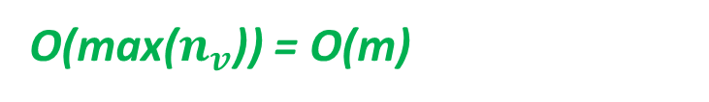

Graph Traversals: BFS Analysis
BFS(G, s)
for each vertex u ∈ V [G] – {s}
color [u] ← WHITE
d [u] ← ∞
π[u] ← NIL
Q ← Ø
d [s] ← 0
π[s] ← NIL
color[s] ← GREY
ENQUEUE (Q, s)
while (Q ≠ Ø)
u ← DEQUEUE (Q)
for each v ∈ Adj[u]
do if color [v] = WHITE
color [v] ← GREY
d [v] ← d [u] + 1
π[v] ← u
ENQUEUE(Q, v)
color [u] ← BLACK
Touch every vertex: O(n)
What will be the running time?
Total running time: O(n + m)
Additional space used?
O(max($n_{v}$)) = O(m)
Each vertex is dequeued only once : O(n)
$$\sum_{v∈G}{n_{v}}=\text{O}\text{(}\text{m}\text{)}$$

Slide 22
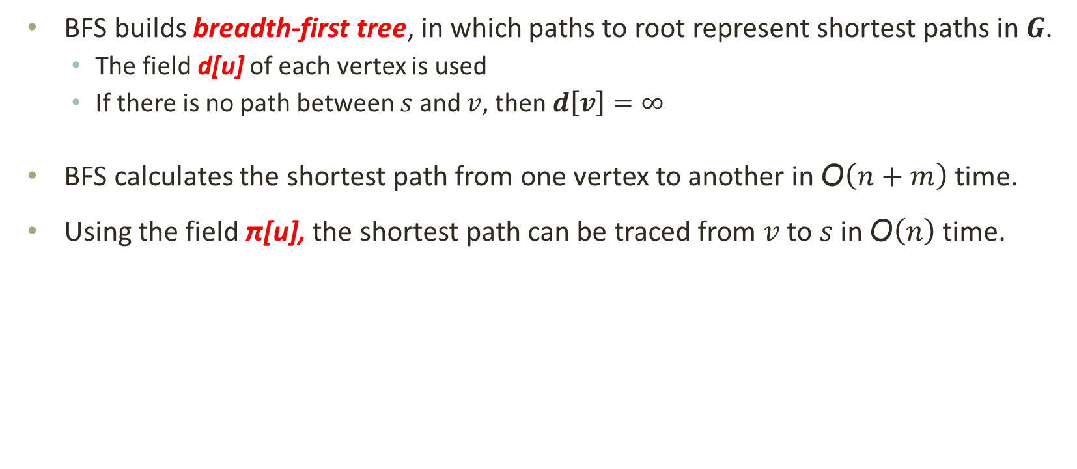
Graph Traversals: BFS Properties
BFS builds breadth-first tree, in which paths to root represent shortest paths in $G.$
The field d[u] of each vertex is used
If there is no path between $s$ and $v$, then $d\left[v\right]=∞$
BFS calculates the shortest path from one vertex to another in $\text{O}\left(n+m\right)$ time.
Using the field π[u], the shortest path can be traced from $v$ to $s$ in $\text{O}\left(n\right)$ time.

Slide 23
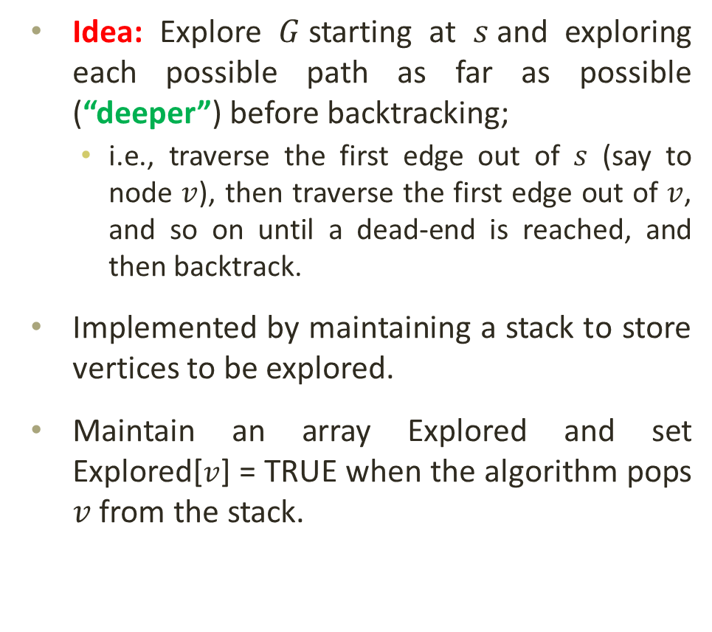
Graph Traversals: Depth-First Search (DFS)
DFS(G, s)
for each vertex u ∈ V [G]
Explored [u] ← FALSE
S ← Ø
PUSH (S, s)
while (S ≠ Ø)
u ← POP(S)
do if Explored [u] = FALSE
Explored [u] ← TRUE
for each v ∈ Adj[u]
PUSH(S, v)
Idea: Explore $G$starting at $s$and exploring each possible path as far as possible (“deeper”) before backtracking;
i.e., traverse the first edge out of $s$ (say to node $v$), then traverse the first edge out of $v$, and so on until a dead-end is reached, and then backtrack.
Implemented by maintaining a stack to store vertices to be explored.
Maintain an array Explored and set Explored[$v$] = TRUE when the algorithm pops $v$ from the stack.

Slide 24
Graph Traversals: DFS
DFS(G, s)
for each vertex u ∈ V [G]
Explored [u] ← FALSE
S ← Ø
PUSH (S, s)
while (S ≠ Ø)
u ← POP(S)
do if Explored [u] = FALSE
Explored [u] ← TRUE
for each v ∈ Adj[u]
PUSH(S, v)
1
7
2
3
8
4
5
6
1

Slide 25
Graph Traversals: DFS
Add parent pointer when pushing to stack.
DFS(G, s)
for each vertex u ∈ V [G]
Explored [u] ← FALSE
S ← Ø
PUSH (S, s)
while (S ≠ Ø)
u ← POP(S)
do if Explored [u] = FALSE
Explored [u] ← TRUE
for each v ∈ Adj[u]
PUSH(S, v)
1
7
2
3
8
4
5
6
3
1
2

Slide 26
Graph Traversals: DFS
DFS(G, s)
for each vertex u ∈ V [G]
Explored [u] ← FALSE
S ← Ø
PUSH (S, s)
while (S ≠ Ø)
u ← POP(S)
do if Explored [u] = FALSE
Explored [u] ← TRUE
for each v ∈ Adj[u]
PUSH(S, v)
1
7
8
2
3
8
7
5
4
5
6
2
Overwrite parent pointer if pushing node again.
3
2
Vertex may be on stack more than once.

Slide 27
Graph Traversals: DFS
DFS(G, s)
for each vertex u ∈ V [G]
Explored [u] ← FALSE
S ← Ø
PUSH (S, s)
while (S ≠ Ø)
u ← POP(S)
do if Explored [u] = FALSE
Explored [u] ← TRUE
for each v ∈ Adj[u]
PUSH(S, v)
1
7
7
2
3
8
7
5
4
5
6
2
8
2

Slide 28
Graph Traversals: DFS
DFS(G, s)
for each vertex u ∈ V [G]
Explored [u] ← FALSE
S ← Ø
PUSH (S, s)
while (S ≠ Ø)
u ← POP(S)
do if Explored [u] = FALSE
Explored [u] ← TRUE
for each v ∈ Adj[u]
PUSH(S, v)
1
7
2
3
8
7
5
4
5
6
2
7
2

Slide 29
Graph Traversals: DFS
DFS(G, s)
for each vertex u ∈ V [G]
Explored [u] ← FALSE
S ← Ø
PUSH (S, s)
while (S ≠ Ø)
u ← POP(S)
do if Explored [u] = FALSE
Explored [u] ← TRUE
for each v ∈ Adj[u]
PUSH(S, v)
1
7
6
2
3
8
4
2
4
5
6
2
5
2

Slide 30
Graph Traversals: DFS
DFS(G, s)
for each vertex u ∈ V [G]
Explored [u] ← FALSE
S ← Ø
PUSH (S, s)
while (S ≠ Ø)
u ← POP(S)
do if Explored [u] = FALSE
Explored [u] ← TRUE
for each v ∈ Adj[u]
PUSH(S, v)
1
7
2
3
8
4
2
4
5
6
2
6
2

Slide 31
Graph Traversals: DFS
DFS(G, s)
for each vertex u ∈ V [G]
Explored [u] ← FALSE
S ← Ø
PUSH (S, s)
while (S ≠ Ø)
u ← POP(S)
do if Explored [u] = FALSE
Explored [u] ← TRUE
for each v ∈ Adj[u]
PUSH(S, v)
1
7
2
3
8
2
2
4
5
6
2
4
2

Slide 32
Graph Traversals: DFS
DFS(G, s)
for each vertex u ∈ V [G]
Explored [u] ← FALSE
S ← Ø
PUSH (S, s)
while (S ≠ Ø)
u ← POP(S)
do if Explored [u] = FALSE
Explored [u] ← TRUE
for each v ∈ Adj[u]
PUSH(S, v)
1
7
2
3
8
2
4
5
6
2
2
2

Slide 33

Graph Traversals: DFS Analysis
DFS(G, s)
for each vertex u ∈ V [G]
Explored [u] ← FALSE
S ← Ø
PUSH (S, s)
while (S ≠ Ø)
u ← POP(S)
do if Explored [u] = FALSE
Explored [u] ← TRUE
for each v ∈ Adj[u]
PUSH(S, v)
Touch every vertex: O(n)
Adjacency list of a vertex is scanned only once : O(n)
$$\sum_{v∈G}{n_{v}}=\text{O}\text{(}\text{m}\text{)}$$
What will be the running time?
Total running time: O(n + m)

Slide 34
Graph Traversals: BFS vs. DFS
Both visit the same set of vertices but in a different order.
Both traverse all the edges in the connected component but in a different order.
BFS store visited vertices in a queue (FIFO)
DFS store visited vertices in a stack (LIFO)
Optimality
BFS always finds the shortest path (fewest edges)
DFS guarantees to find a path, not necessarily the best/shortest path
DFS uses less memory than BFS and it is easier to reconstruct the path once found.

Slide 35
THANK YOU

