Slide 1
CSC 301 – Design and Analysis of Algorithms
Instructor: Dr. M. Hasan Jamal
Lecture# 09: Dynamic Programming – Assembly Line Scheduling

Slide 2
Dynamic Programming: Introduction
An optimization problem is one that has multiple feasible solutions, each having a specific cost. Our objective is to find the best of all possible solutions.
Dynamic Programming is typically used to solve optimization problems.
Introduced by Richard Bellman in 1955, the word dynamic reflects the time-varying aspect of the problems. The word programming refers to tabular method (like linear programming) to solve a problem. Doesn't really refer to computer programming.
Solves every sub problem just once and save the solution in a table. Avoids recomputing the solution every time the sub-problem is encountered.
Its not actually an algorithm but a meta-technique/strategy for designing algorithms.

Slide 3
Dynamic Programming: Properties
How to know if an optimization problem can be solved by applying dynamic programming?
Dynamic programming works if a problem exhibits the following two properties:
Optimal sub-structure: An optimal solution to the problem contains within it, optimal solutions to sub-problems
Overlapping sub-problems: When a recursive algorithm revisits the same problem repeatedly, then the optimization problem has overlapping sub-problems

Slide 4
Dynamic Programming: Properties
Dynamic programming, like divide-and-conquer method, solves problems by combining the solutions to sub-problems.
Divide-and-conquer algorithms have independent sub-problems while dynamic programming is applicable when the sub-problems are not independent.
Prob
Prob
Subprob1
…
Subprob2
Subprob
Subprob
Subprob3
Subprob4
…
…
Subprob7
Independent sub-problems
(no overlapping work).
Subprob5
Subprob6
Subproblem sharing

Slide 5
Dynamic Programming: Steps
Steps to design a Dynamic Programming algorithm:
Characterize the structure of an optimal solution
Recursively define the value of an optimal solution
Compute the value of an optimal solution, typically in a bottom-up fashion
Construct an optimal solution from computed information

Slide 6
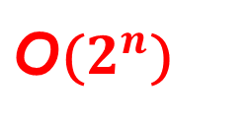
Dynamic Programming
What is the drawback of recursive algorithms like Fibonacci sequence?
Fib(n)
if ( n <= 1)
return n;
return ( Fib(n-1) + Fib(n-2));
F(n)
F(n-1)
F(n-2)
F(n-2)
F(n-3)
F(n-3)
F(n-4)
$\text{O}$($2^{n}$)
F(0)
F(1)
F(1)
F(0)

Slide 7
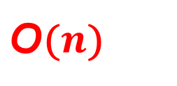
Dynamic Programming
Solving Fibonacci sequence using dynamic programming.
Fib_DP(n)
f[0] = 0;
f[1] = 1;
for i = 2 to n
f[i] = f[i-1] + f[i-2];
return f[n];
F(0)
F(1)
F(2)
F(3)
…
$\text{O}$($n$)
F(n-1)
F(n-2)
F(n)

Slide 8
Assembly Line Scheduling Problem

Slide 9
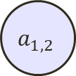
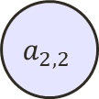




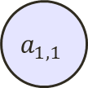
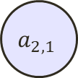




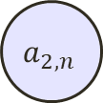

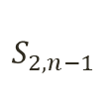
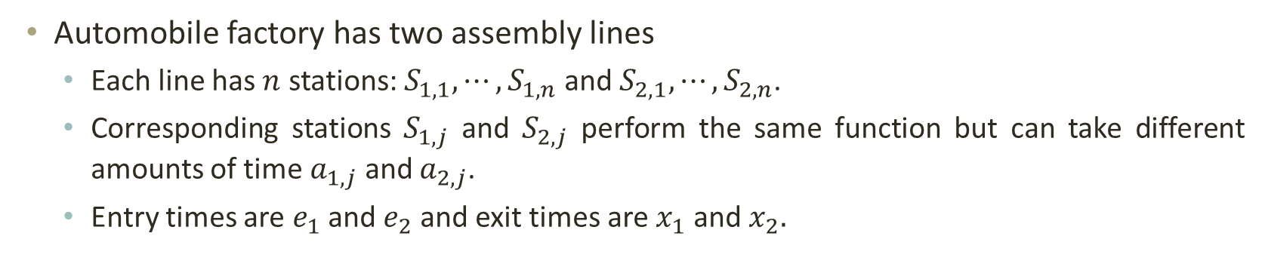
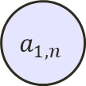
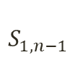


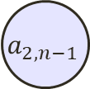



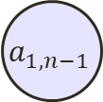


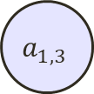
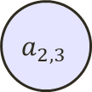


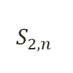

Dynamic Programming: Assembly Line Scheduling
Automobile factory has two assembly lines
Each line has$n$ stations: $S_{1,1}, ⋯,S_{1,n}$ and $S_{2,1}, ⋯,S_{2,n}$.
Corresponding stations $S_{1,j}$ and $S_{2,j}$ perform the same function but can take different amounts of time $a_{1,j}$ and $a_{2,j}$.
Entry times are $e_{1}$ and $e_{2}$ and exit times are $x_{1}$ and $x_{2}.$
$$S_{1,1}$$
$$S_{1,2}$$
$$S_{1,3}$$
$$S_{1,n−1}$$
$$S_{1,n}$$
assembly line 1
$$a_{1,1}$$
$$a_{1,2}$$
$$a_{1,3}$$
$$a_{1,n−1}$$
$$a_{1,n}$$
$$e_{1}$$
$$x_{1}$$
$$t_{1,1}$$
$$t_{1,2}$$
$$t_{1,n−1}$$
chassis enters
completed auto exits
$$⋯$$
$$e_{2}$$
$$t_{2,1}$$
$$t_{2,2}$$
$$t_{2,n−1}$$
$$S_{2,n}$$
$$x_{2}$$
assembly line 2
$$a_{2,1}$$
$$a_{2,2}$$
$$a_{2,3}$$
$$a_{2,n−1}$$
$$a_{2,n}$$
$$S_{2,1}$$
$$S_{2,2}$$
$$S_{2,3}$$
$$S_{2,n−1}$$
$$S_{2,n}$$

Slide 10

Dynamic Programming: Assembly Line Scheduling
After going through a station, car can either:
Stay on same line at no cost, or
Transfer to other line: cost after $S_{i,j}$is $t_{i,j}, j=1, ⋯, n−1$
Problem: what stations should be chosen from line 1 and line 2 in order to minimize the total time through the factory for one car?
$$S_{1,1}$$
$$S_{1,2}$$
$$S_{1,3}$$
$$S_{1,n−1}$$
$$S_{1,n}$$
assembly line 1
$$a_{1,1}$$
$$a_{1,2}$$
$$a_{1,3}$$
$$a_{1,n−1}$$
$$a_{1,n}$$
$$e_{1}$$
$$x_{1}$$
$$t_{1,1}$$
$$t_{1,2}$$
$$t_{1,n−1}$$
chassis enters
completed auto exits
$$e_{2}$$
$$t_{2,1}$$
$$t_{2,2}$$
$$t_{2,n−1}$$
$$S_{2,n}$$
$$x_{2}$$
assembly line 2
$$a_{2,1}$$
$$a_{2,2}$$
$$a_{2,3}$$
$$a_{2,n−1}$$
$$a_{2,n}$$
$$S_{2,1}$$
$$S_{2,2}$$
$$S_{2,3}$$
$$S_{2,n−1}$$
$$S_{2,n}$$

Slide 11
Dynamic Programming: Assembly Line Scheduling
Brute force solution:
Enumerate all possibilities of selecting stations
Compute how long it takes in each case and choose the best one
There are 2^{n} possible ways to choose stations
Infeasible when n is large!!
1
2
3
4
n
1
0
0
1
1
0 if choosing line 2
at step j (= 3)
1 if choosing line 1
at step j (= n)

Slide 12
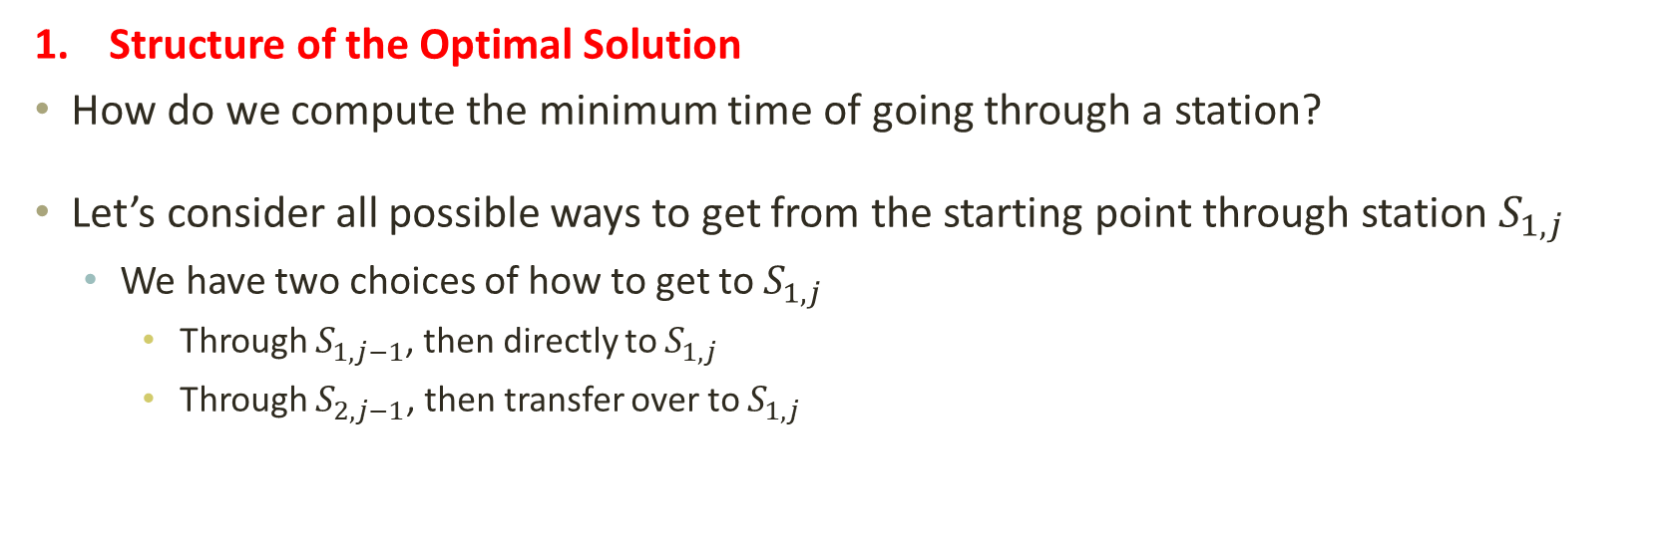
Dynamic Programming: Assembly Line Scheduling
Structure of the Optimal Solution
How do we compute the minimum time of going through a station?
Let’s consider all possible ways to get from the starting point through station $S_{1,j}$
We have two choices of how to get to $S_{1,j}$
Through $S_{1,j−1}$, then directly to $S_{1,j}$
Through $S_{2,j−1}$, then transfer over to $S_{1,j}$
S_{1,j-1}
S_{1,j}
Line 1
a_{1,j-1}
a_{1,j}
t_{2,j-1}
Line 2
a_{2,j-1}
S_{2,j-1}

Slide 13
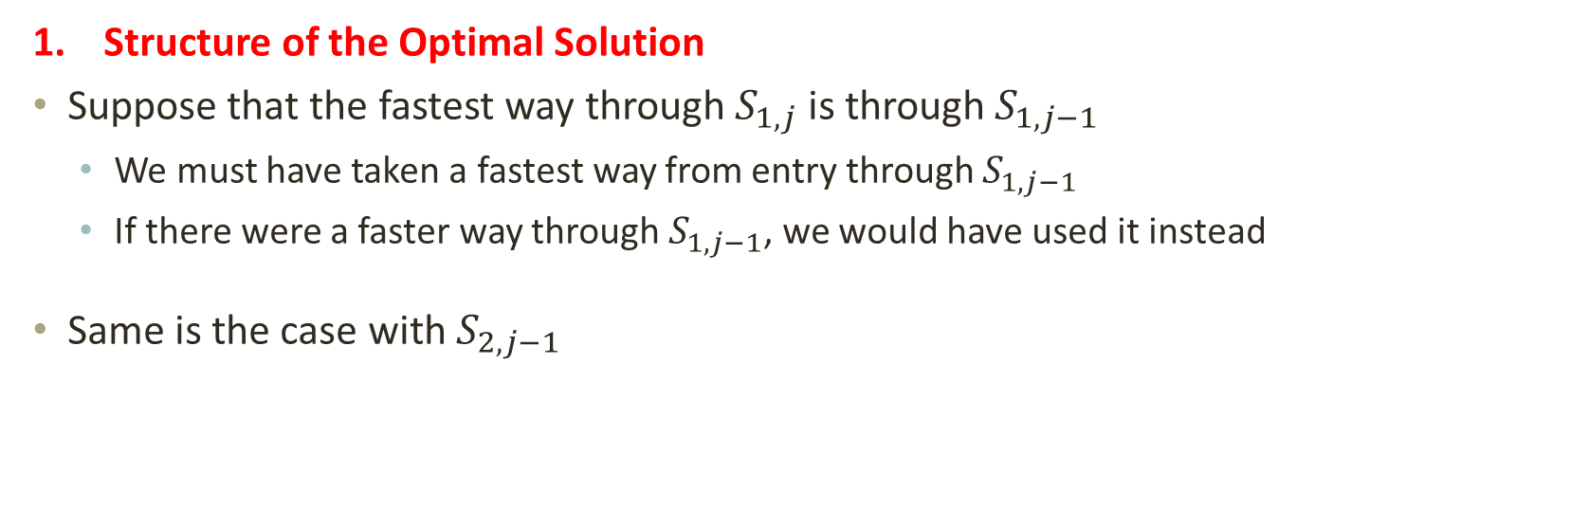
Dynamic Programming: Assembly Line Scheduling
Structure of the Optimal Solution
Suppose that the fastest way through $S_{1,j}$ is through $S_{1,j−1}$
We must have taken a fastest way from entry through $S_{1,j−1}$
If there were a faster way through $S_{1,j−1}$, we would have used it instead
Same is the case with $S_{2,j−1}$
S_{1,j-1}
S_{1,j}
Line 1
a_{1,j-1}
a_{1,j}
t_{2,j-1}
Optimal Substructure
Line 2
a_{2,j-1}
S_{2,j-1}

Slide 14
Dynamic Programming: Assembly Line Scheduling
Generalization: an optimal solution to the problem “find the fastest way through S_{1, j}” contains within it an optimal solution to subproblems: “find the fastest way through S_{1, j - 1} or S_{2, j – 1}”.
This is referred to as the optimal substructure property
We use this property to construct an optimal solution to a problem from optimal solutions to subproblems

Slide 15
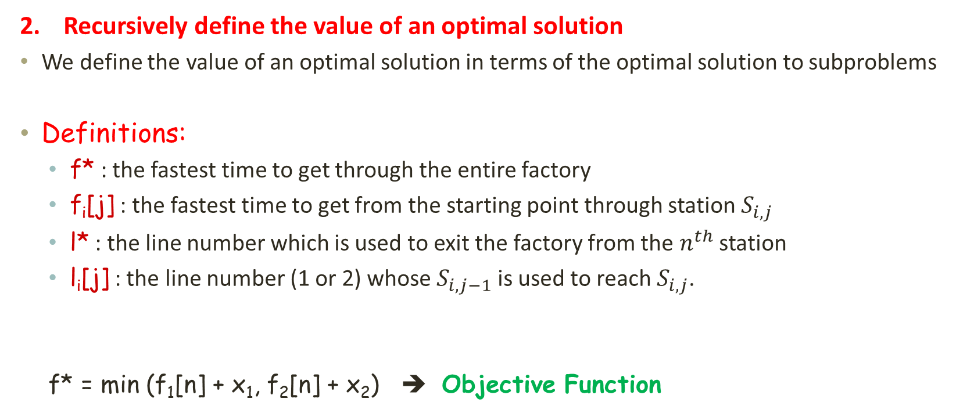
Dynamic Programming: Assembly Line Scheduling
Recursively define the value of an optimal solution
We define the value of an optimal solution in terms of the optimal solution to subproblems
Definitions:
f* : the fastest time to get through the entire factory
f_{i}[j] : the fastest time to get from the starting point through station $S_{i,j}$
l* : the line number which is used to exit the factory from the $n^{th}$ station
l_{i}[j] : the line number (1 or 2) whose $S_{i,j−1}$ is used to reach $S_{i,j}$.
f* = min (f₁[n] + x₁, f₂[n] + x₂) ➔ Objective Function
Notes:
Our strategy is to build a table to save previous results so that they don’t have to be recomputed each time

Slide 16
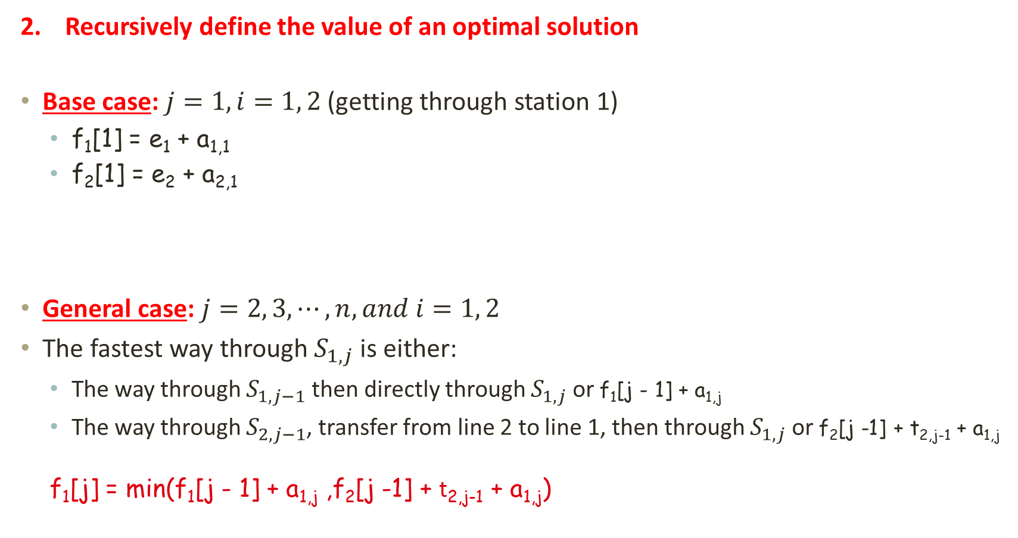
Dynamic Programming: Assembly Line Scheduling
Recursively define the value of an optimal solution
Base case: $j=1, i=1, 2$(getting through station 1)
f₁[1] = e₁ + a_{1,1}
f₂[1] = e₂ + a_{2,1}
General case: $j=2, 3, ⋯, n, and i=1, 2$
The fastest way through $S_{1,j}$ is either:
The way through $S_{1,j−1}$ then directly through $S_{1,j}$ or f₁[j - 1] + a_{1,j}
The way through $S_{2,j−1}$, transfer from line 2 to line 1, then through $S_{1,j}$ or f₂[j -1] + t_{2,j-1} + a_{1,j}
f₁[j] = min(f₁[j - 1] + a_{1,j} ,f₂[j -1] + t_{2,j-1} + a_{1,j})
S_{1,j-1}
S_{1,j}
a_{1,j-1}
a_{1,j}
Line 1
t_{2,j-1}
Line 2
a_{2,j-1}
S_{2,j-1}

Slide 17
Dynamic Programming: Assembly Line Scheduling
Recursively define the value of an optimal solution
e₁ + a_{1,1} if j = 1
f₁[j] =
min(f₁[j - 1] + a_{1,j} ,f₂[j -1] + t_{2,j-1} + a_{1,j}) if j ≥ 2
e₂ + a_{2,1} if j = 1
f₂[j] =
min(f₂[j - 1] + a_{2,j} ,f₁[j -1] + t_{1,j-1} + a_{2,j}) if j ≥ 2

Slide 18
Dynamic Programming: Assembly Line Scheduling
Compute the Optimal Solution
Using bottom-up approach, first find optimal solutions to subproblems, and then use them to find an optimal solution to the problem.
For j ≥ 2, each value f_{i}[j] depends only on the values of f₁[j – 1] and f₂[j - 1]
Idea: compute the values of f_{i}[j] as follows:
in increasing order of j
1
2
3
4
5
f₁[j]
f₁(1)
f₁(2)
f₁(3)
f₁(4)
f₁(5)
f₂[j]
f₂(1)
f₂(2)
f₂(3)
f₂(4)
f₂(5)

Slide 19
Dynamic Programming: Assembly Line Scheduling
Example:
2
7
9
3
4
8
4
3
2
3
1
3
4
Enter
Exit
2
1
2
2
1
4
2
8
5
6
4
5
7
f* = 38
e₁ + a_{1,1} if j = 1
f₁[j] =
min(f₁[j - 1] + a_{1,j} ,f₂[j -1] + t_{2,j-1} + a_{1,j}) if j ≥ 2
l* = 1
1
2
3
4
5
6
1
2
3
4
5
6
f₁[j]
9
18
20
24
32
35
l₁[j]
1
1
2
1
1
2
f₂[j]
12
16
22
25
30
37
l₂[j]
2
1
2
1
2
2

Slide 20
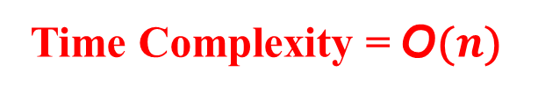
Dynamic Programming: Assembly Line Scheduling
FASTEST-WAY(a, t, e, x, n)
1 ƒ₁[1] ← e₁ + a_{1,1}
ƒ₂[1] ← e₂ + a_{2,1}
for j ← 2 to n
do if ƒ₁[ j - 1] + a_{1, j} ≤ ƒ₂[ j - 1] + t_{2, j - 1} + a_{1, j}
then ƒ₁[ j] ← ƒ₁[ j - 1] + a_{1, j}
l₁[ j] ← 1
else ƒ₁[ j] ← ƒ₂[ j - 1] + t_{2, j - 1} + a_{1, j}
l₁[ j] ← 2
if ƒ₂[ j - 1] + a_{2, j} ≤ ƒ₁[ j - 1] + t_{1, j - 1} + a _{2, j}
then ƒ₂[ j] ← ƒ₂[ j - 1] + a_{2, j}
l₂[ j] ← 2
else ƒ₂[ j] ← ƒ₁[ j - 1] + t_{1, j - 1} + a_{2, j}
l₂[ j] ← 1
if ƒ₁[n] + x₁ ≤ ƒ₂[n] + x₂
then ƒ* ₌ ƒ₁[n] + x₁
l* = 1
else ƒ* ₌ ƒ₂[n] + x₂
l* = 2
Compute initial values of f₁ and f₂
Time Complexity = $\text{O}$($n$)
Compute the values of f₁[j] and l₁[j]
Compute the values of f₂[j] and l₂[j]
Compute the values of the fastest time through the entire factory.

Slide 21
Dynamic Programming: Assembly Line Scheduling
Construct an Optimal Solution
1
2
3
4
5
6
Print-Stations (l, n)
i ← l*
print “line” i “, station” n
for j ← n downto 2
do i ← l_{i}[j]
print “line” i “, station” j - 1
l₁[j]
1
1
2
1
1
2
l* = 1
l₂[j]
2
1
2
1
2
2
2
7
9
3
4
8
4
3
2
3
1
3
4
Enter
Exit
2
1
2
2
1
4
2
8
5
6
4
5
7

Slide 22
THANK YOU

