Slide 1
CSC 301 – Design and Analysis of Algorithms
Instructor: Dr. M. Hasan Jamal
Lecture# 09(c): Dynamic Programming – Edit Distance

Slide 2
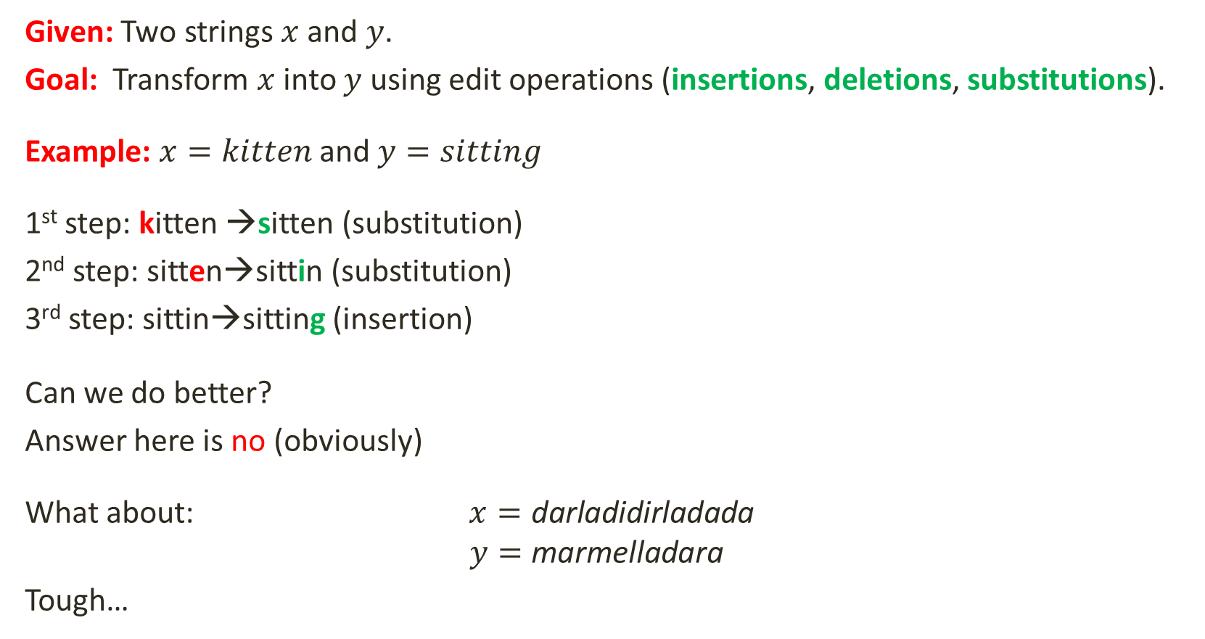
What is Edit Distance?
Given: Two strings $x$ and $y$.
Goal: Transform $x$ into $y$ using edit operations (insertions, deletions, substitutions).
Example: $x=kitten$ and $y=sitting$
1st step: kitten →sitten (substitution)
2nd step: sitten→sittin (substitution)
3rd step: sittin→sitting (insertion)
Can we do better?
Answer here is no (obviously)
What about: $x=\text{darladidirladada}$
$$y=\text{marmelladara}$$
Tough…
k | i | t | t | e | n | -
s | i | t | t | i | n | g
S |  |  |  | S |  | I
Edit Distance = 3

Slide 3


Why do we care?
A lot of applications depend on the similarity of two strings.
Computational Biology:
Align two sequences of nucleotides
Resulting alignment:
Spelling Correction
The user typed “Graffe”
Which is the closest?
graf
graft
grail
Giraffe
Also for Machine Translation, Information Extraction, Speech Recognition
AGGCTATCACCTGACCTCCAGGCCGATGCCC
TAGCTATCACGACCGCGGTCGATTTGCCCGAC
Animal species from the same family are bound to have more similar DNAs
-AGGCTATCACCTGACCTCCAGGCCGA--TGCCC---
TAG-CTATCAC--GACCGC--GGTCGATTTGCCCGAC

Slide 4
Edit Distance
Levenshtein (1965) introduced edit distance between two strings as the minimum number of elementary operations (insertions, deletions, and substitutions) to transform one string into the other. Matches are not included in the count.
Example: transform vintner to writers
vintner replace v with w → wintner
wintner insert r after w → wrintner
wrintner match i → wrintner
wrintner delete n → writner
writner match t → writner
writner delete n → writer
writer match e → writer
writer match r → writer
writer insert s → writers
If each operation has cost of 1
Edit Distance = 5
If substitutions cost 2 (Levenshtein)
Edit Distance = 6

Slide 5
Minimum Edit Distance
But the space of all edit sequences is huge!
We can’t afford to navigate naïvely
Lots of distinct path wind up at the same state.
We don’t have to keep track of all of them
Dynamic programming: A bottom-up tabular computation of D(n,m)
We compute D(i,j) for small i,j
And compute larger D(i,j) based on previously computed smaller values
i.e., compute D(i,j) for all i (0 < i < n) and j (0 < j < m)
use a traceback algorithm to find the optimal alignment
Notice that we can solve D(i,j) for all combination of lengths of prefixes of X and Y.

Slide 6
Edit Distance: Dynamic Programming Algorithm
EditDistance(x, y)
for i from 0 to n
d[i][0] = i;
for j from 0 to m
d[0][j] = j;
for i from 1 to n
for j from 1 to m
if x[i-1] == y[j-1]
cost = 0
else
cost = 1
d[i][j] = min( d[i-1][j] + 1, // deletion
d[i][j-1] + 1, // insertion
d[i-1][j-1] + cost) // substitution
return d[n][m]

Slide 7
Edit Distance: Example
Given two strings: EXECUTION and INTENTION, determine the minimum edit distance using dynamic programming.
 | # | E | X | E | C | U | T | I | O | N
# | 0 | 1 | 2 | 3 | 4 | 5 | 6 | 7 | 8 | 9
I | 1
N | 2
T | 3
E | 4
N | 5
T | 6
I | 7
O | 8
N | 9
d[i][j] = min( d[i-1][j] + 1, // deletion
d[i][j-1] + 1, // insertion
d[i-1][j-1] + cost) // substitution

Slide 8
Edit Distance: Example
Given two strings: EXECUTION and INTENTION, determine the minimum edit distance using dynamic programming.
 | # | E | X | E | C | U | T | I | O | N
# | 0 | 1 | 2 | 3 | 4 | 5 | 6 | 7 | 8 | 9
I | 1
N | 2
T | 3
E | 4
N | 5
T | 6
I | 7
O | 8
N | 9

Slide 9
Edit Distance: Example
Given two strings: EXECUTION and INTENTION, determine the minimum edit distance using dynamic programming.
 | # | E | X | E | C | U | T | I | O | N
# | 0 | 1 | 2 | 3 | 4 | 5 | 6 | 7 | 8 | 9
I | 1 | 1 | 2 | 3 | 4 | 5 | 6 | 6 | 7 | 8
N | 2 | 2 | 2 | 3 | 4 | 5 | 6 | 7 | 7 | 7
T | 3 | 3 | 3 | 3 | 4 | 5 | 5 | 6 | 7 | 8
E | 4 | 3 | 4 | 3 | 4 | 5 | 6 | 6 | 7 | 8
N | 5 | 4 | 4 | 4 | 4 | 5 | 6 | 7 | 7 | 7
T | 6 | 5 | 5 | 5 | 5 | 5 | 5 | 6 | 7 | 8
I | 7 | 6 | 6 | 6 | 6 | 6 | 6 | 5 | 6 | 7
O | 8 | 7 | 7 | 7 | 7 | 7 | 7 | 6 | 5 | 6
N | 9 | 8 | 8 | 8 | 8 | 8 | 8 | 7 | 6 | 5

Slide 10
Computing Alignments
Edit distance isn’t sufficient
We often need to align each character of the two strings to each other
We do this by keeping a “backtrace”
Every time we enter a cell, remember where we came from
When we reach the end,
Trace back the path from the upper right corner to read off the alignment

Slide 11
Edit Distance: Example
Given two strings: EXECUTION and INTENTION, determine the minimum edit distance using dynamic programming.
 | # | E | X | E | C | U | T | I | O | N
# | 0 | 1 | 2 | 3 | 4 | 5 | 6 | 7 | 8 | 9
I | 1 | 1 | 2 | 3 | 4 | 5 | 6 | 6 | 7 | 8
N | 2 | 2 | 2 | 3 | 4 | 5 | 6 | 7 | 7 | 7
T | 3 | 3 | 3 | 3 | 4 | 5 | 5 | 6 | 7 | 8
E | 4 | 3 | 4 | 3 | 4 | 5 | 6 | 6 | 7 | 8
N | 5 | 4 | 4 | 4 | 4 | 5 | 6 | 7 | 7 | 7
T | 6 | 5 | 5 | 5 | 5 | 5 | 5 | 6 | 7 | 8
I | 7 | 6 | 6 | 6 | 6 | 6 | 6 | 5 | 6 | 7
O | 8 | 7 | 7 | 7 | 7 | 7 | 7 | 6 | 5 | 6
N | 9 | 8 | 8 | 8 | 8 | 8 | 8 | 7 | 6 | 5

Slide 12
Edit Distance: Example
Given two strings: EXECUTION and INTENTION, determine the minimum edit distance using dynamic programming.
 | # | E | X | E | C | U | T | I | O | N
# | 0 | 1 | 2 | 3 | 4 | 5 | 6 | 7 | 8 | 9
I | 1 | 1 | 2 | 3 | 4 | 5 | 6 | 6 | 7 | 8
N | 2 | 2 | 2 | 3 | 4 | 5 | 6 | 7 | 7 | 7
T | 3 | 3 | 3 | 3 | 4 | 5 | 5 | 6 | 7 | 8
E | 4 | 3 | 4 | 3 | 4 | 5 | 6 | 6 | 7 | 8
N | 5 | 4 | 4 | 4 | 4 | 5 | 6 | 7 | 7 | 7
T | 6 | 5 | 5 | 5 | 5 | 5 | 5 | 6 | 7 | 8
I | 7 | 6 | 6 | 6 | 6 | 6 | 6 | 5 | 6 | 7
O | 8 | 7 | 7 | 7 | 7 | 7 | 7 | 6 | 5 | 6
N | 9 | 8 | 8 | 8 | 8 | 8 | 8 | 7 | 6 | 5

Slide 13
Edit Distance: Example
- | E | X | E | C | U | T | I | O | N
I | N | T | E | - | N | T | I | O | N
I | S | S |  | D | S
 | # | E | X | E | C | U | T | I | O | N
# | 0 | 1 | 2 | 3 | 4 | 5 | 6 | 7 | 8 | 9
I | 1 | 1 | 2 | 3 | 4 | 5 | 6 | 6 | 7 | 8
N | 2 | 2 | 2 | 3 | 4 | 5 | 6 | 7 | 7 | 7
T | 3 | 3 | 3 | 3 | 4 | 5 | 5 | 6 | 7 | 8
E | 4 | 3 | 4 | 3 | 4 | 5 | 6 | 6 | 7 | 8
N | 5 | 4 | 4 | 4 | 4 | 5 | 6 | 7 | 7 | 7
T | 6 | 5 | 5 | 5 | 5 | 5 | 5 | 6 | 7 | 8
I | 7 | 6 | 6 | 6 | 6 | 6 | 6 | 5 | 6 | 7
O | 8 | 7 | 7 | 7 | 7 | 7 | 7 | 6 | 5 | 6
N | 9 | 8 | 8 | 8 | 8 | 8 | 8 | 7 | 6 | 5

Slide 14
Edit Distance Performance
Time:
O(nm)
Space:
O(nm)
Can be improved to O(n+m) using Hirschberg’s algorithm
Backtrace:
O(n+m)

Slide 15
Some Interesting Properties
Triangle Inequality: for any three strings x,y,z of arbitrary lengths:
ED(x,y) ≤ ED(x,z) + ED(z,y)
Splitting Inequality: Let x, y be strings of lengths n and m respectively. For all i,j: ED(x,y) ≤ ED(x[1..i],y[1..j])+ED(x[i+1..n],y[j+1..m])
Upper and Lower Bounds: Let x, y be strings of lengths n, m (n ≤ m). Then:
ED(x,y) ≤ m
ED(x,y) ≥ m-n
ED(x,y)=0 iff x=y
if m=n, ED(x,y) ≤ HD(x,y)
ED(x,y) ≥ number of characters (not counting duplicates) found in x but not in y

Slide 16
Types of Edit Distance Metrics
The Levenshtein distance allows deletion, insertion and substitution.
The Longest common subsequence (LCS) distance allows only insertion and deletion, not substitution.
The Hamming distance allows only substitution; hence, it only applies to strings of the same length.
The Damerau–Levenshtein distance allows insertion, deletion, substitution, and the transposition of two adjacent characters.
The Jaro distance allows only transposition.

Slide 17
THANK YOU

