Slide 1
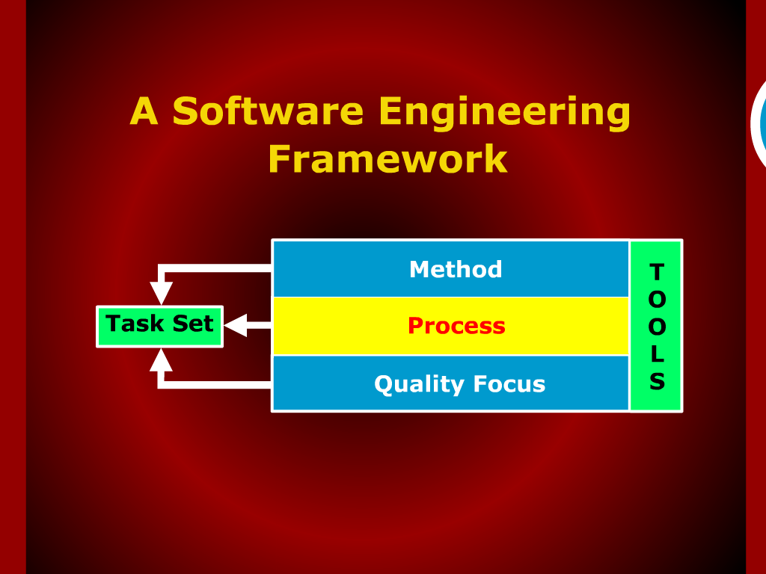

Slide 2
Software Engineering
Lecture 02
Dr. Fakhar Lodhi

Slide 3
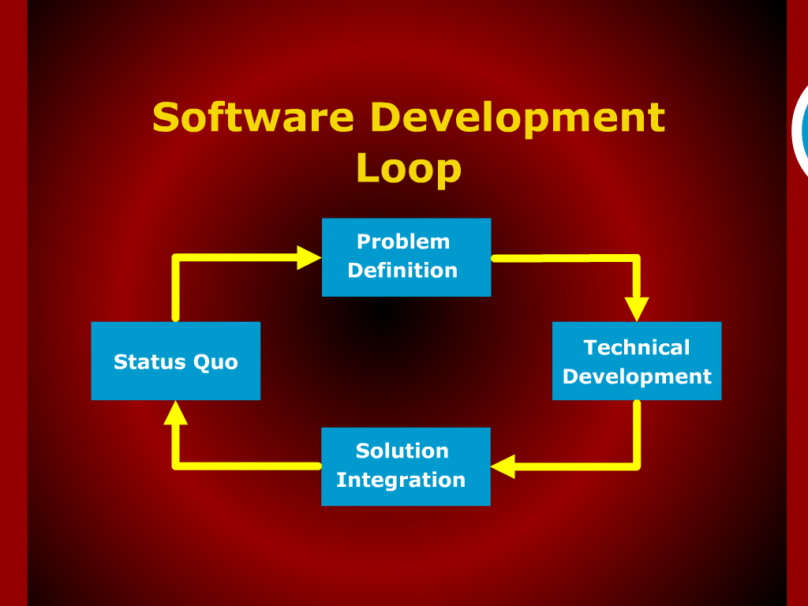

Slide 4
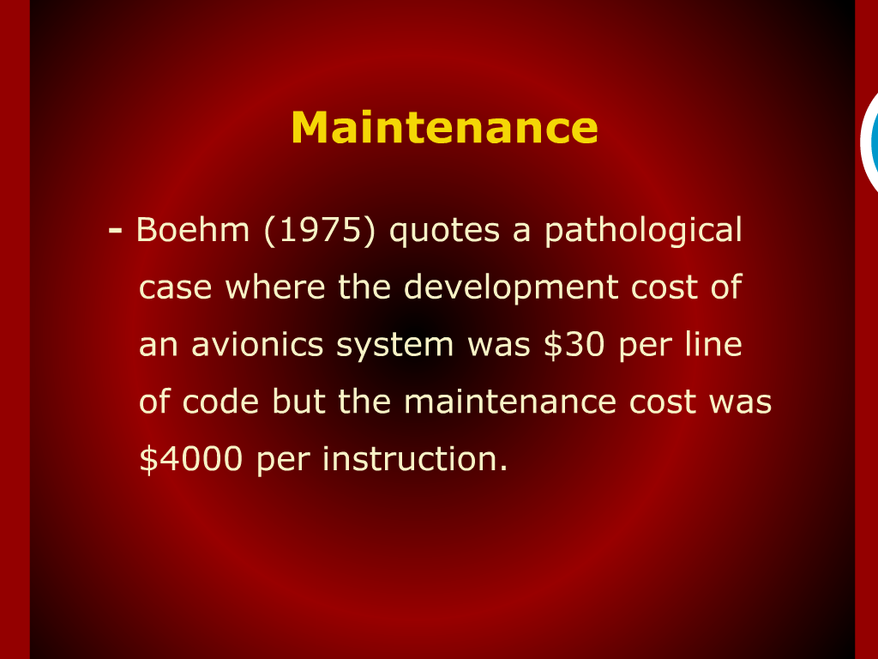

Slide 5
