Slide 1
Software Engineering
Lecture #2
Fakhar Lodhi

Slide 2
Requirement 08.34%
Design 13.61%
Coding 18.00%
Unit Testing 09.00%
Integration Testing 09.93%
Project Management 08.08%
Configuration Management 08.65%
Software Quality assurance 04.50%
Use Documentation 09.67%
Rest of the activities 10.22%

Slide 3
A Software Engineering Framework
Method
T
O
O
L
S
Task Set
Process
Quality Focus
Notes:
Any Engineering approach must be founded on organizational commitment to quality.
The quality focus demands that processes be defined for rational and timely development of software. The processes a framework for a set of key process areas (KPAs) for effectively manage and deliver quality software in a cost effective manner.
The processes define the tasks to be performed and the order in which they are to be performed along with the milestones and deliverables at these milestones.
Methods provide the technical “how-to’s” to carry-out these tasks.
The quality control defines the SQA points within those tasks and the quality parameters.
Tools provide automated or semi-automated support for software processes, methods, and quality control.
The difference between a tool and a method:
Standard deviation is a method to estimate and measure dispersion of data
Excel is a tool that can be used to calculate standard deviation

Slide 4
Software Development Loop
Problem
Definition
Status Quo
Technical
Development
Solution
Integration

Slide 5
Maintenance
Correction, adaptation, enhancement
  For most large, long life time software systems, maintenance cost normally exceeds development cost by factors ranging from 2 to 3.
  Boehm (1975) quotes a pathological case where the development cost of an avionics system was $30 per line of code but the maintenance cost was $4000 per instruction

Slide 6
Software Engineering Phases
Vision – focus on why
Definition – focus on what
2. Development – focus on how
3. Maintenance – focus on change
Vision
Definition
Development
Maintenance

Slide 7
Recap

Slide 8
Software Development
Construction
management

Slide 9
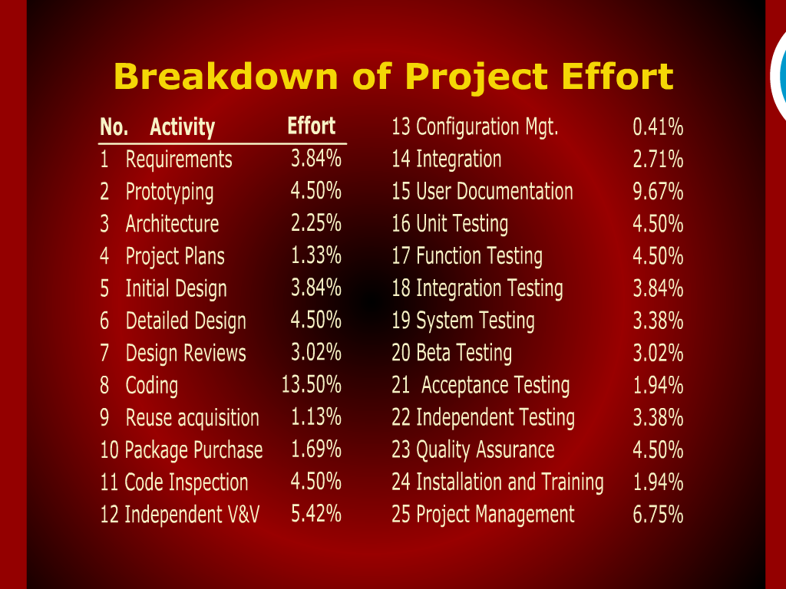

Slide 10
Task and Methods for Software Construction

Slide 11
Software Development Loop

Slide 12
Construction

Slide 13
Software Engineering Phases

Slide 14
Maintenance

Slide 15
Software Development Construction and
Management

Slide 16
Summary of today’s discussion

