Slide 1
Software Engineering
Lecture #25
Fakhar Lodhi

Slide 2
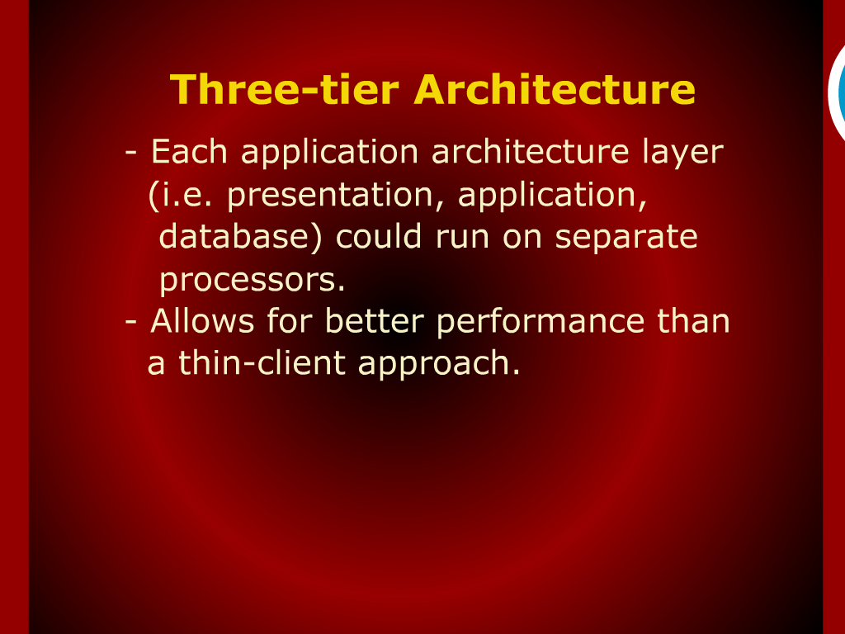
Three-tier Architecture

Slide 3
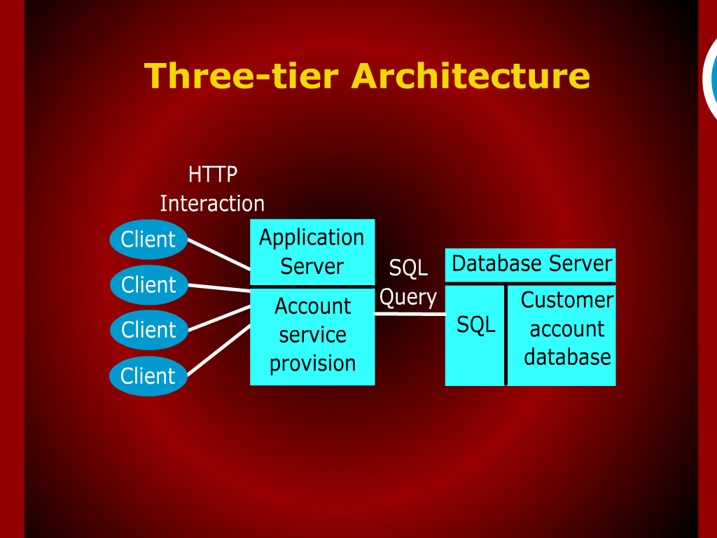
Three-tier Architecture

Slide 4
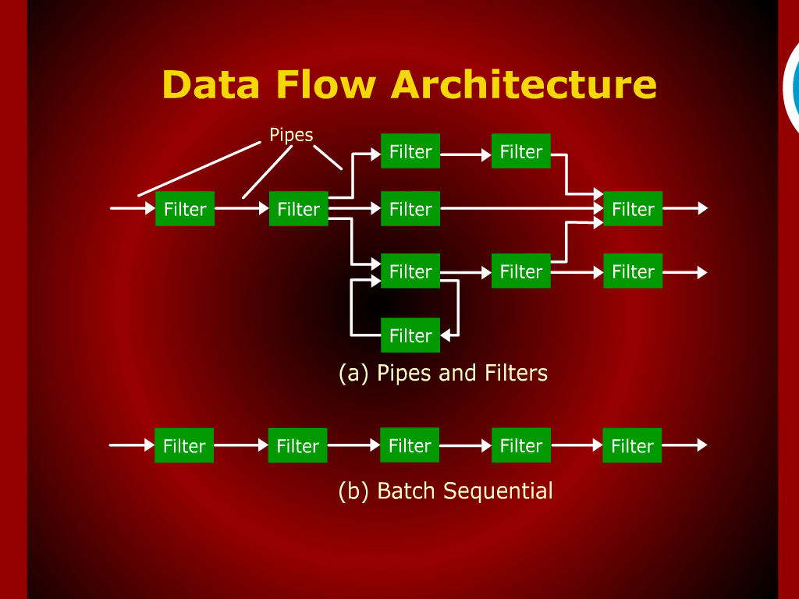
Data Flow Architecture

Slide 5
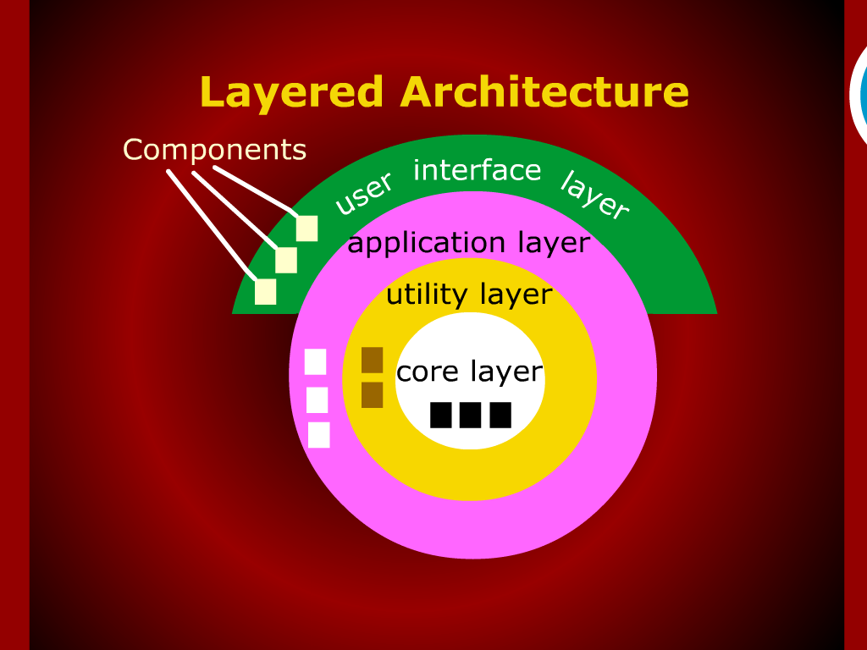
Layered Architecture

Slide 6
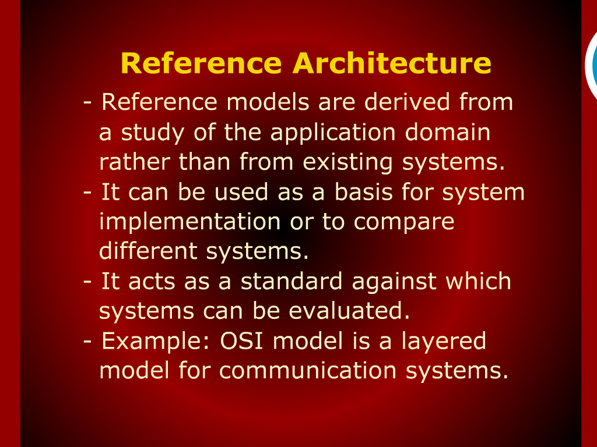
Reference Architecture

Slide 8
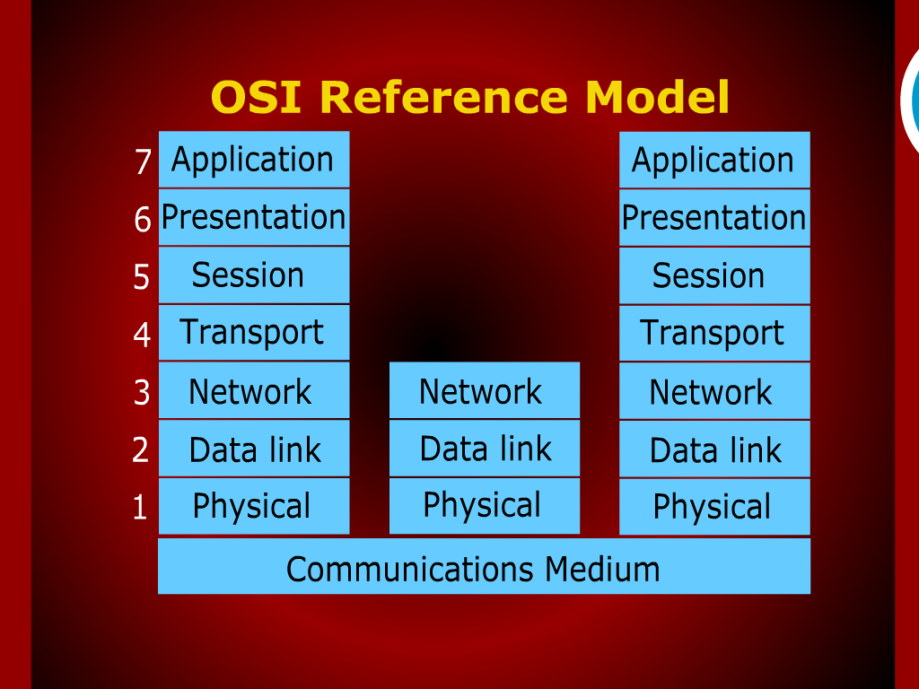
OSI Reference Model

Slide 9
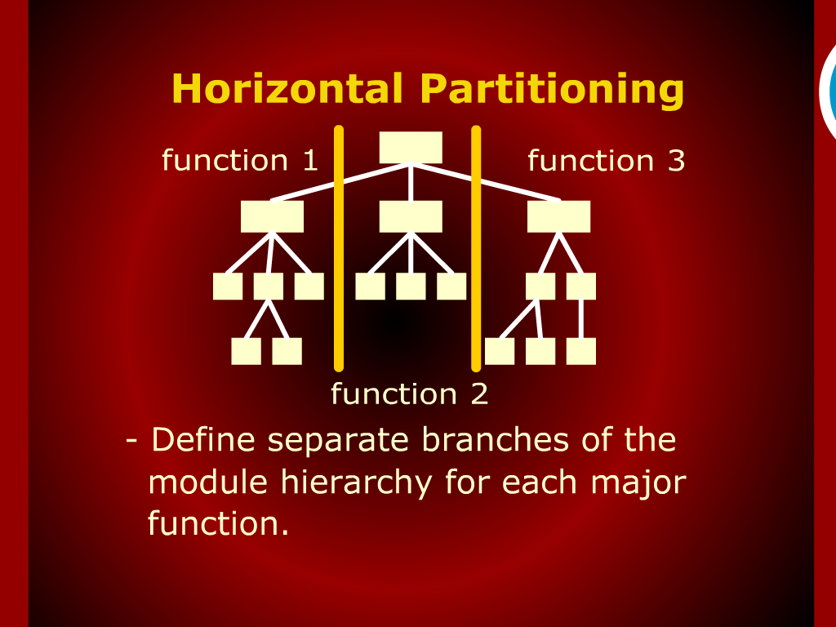
Horizontal Partitioning

Slide 10
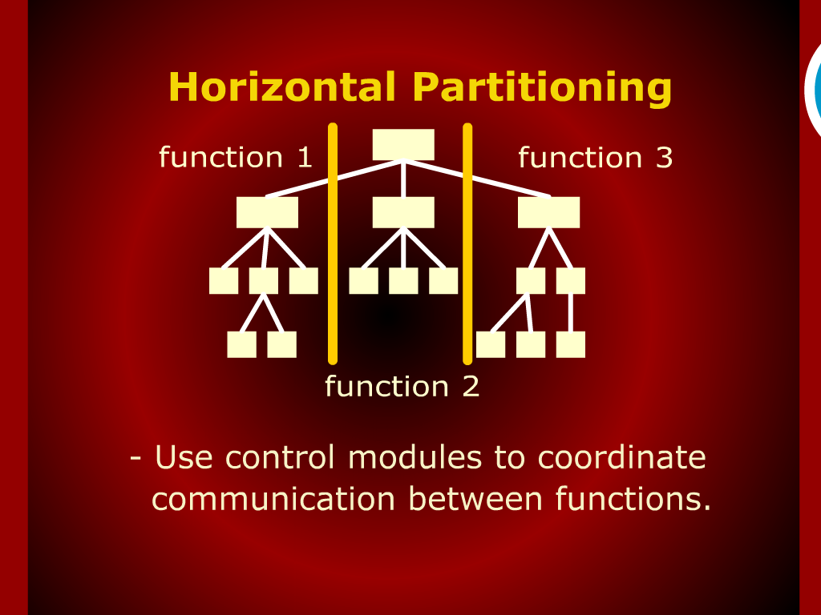
Horizontal Partitioning

Slide 11
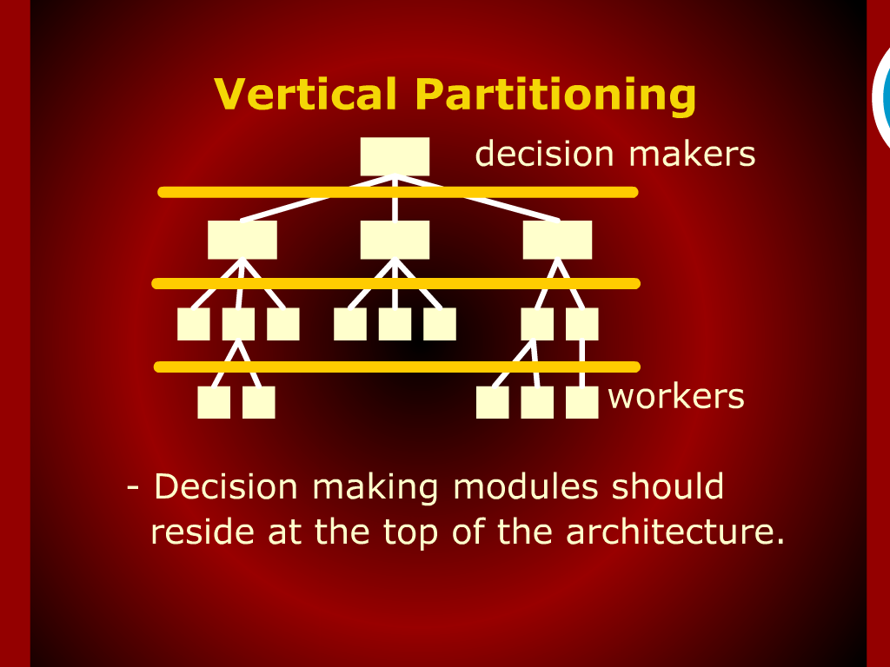
Vertical Partitioning

Slide 12
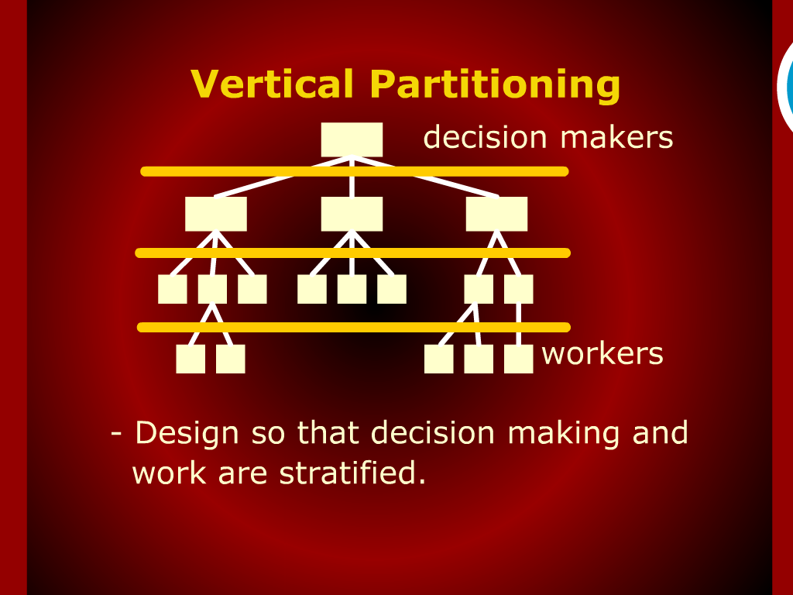
Vertical Partitioning

Slide 13
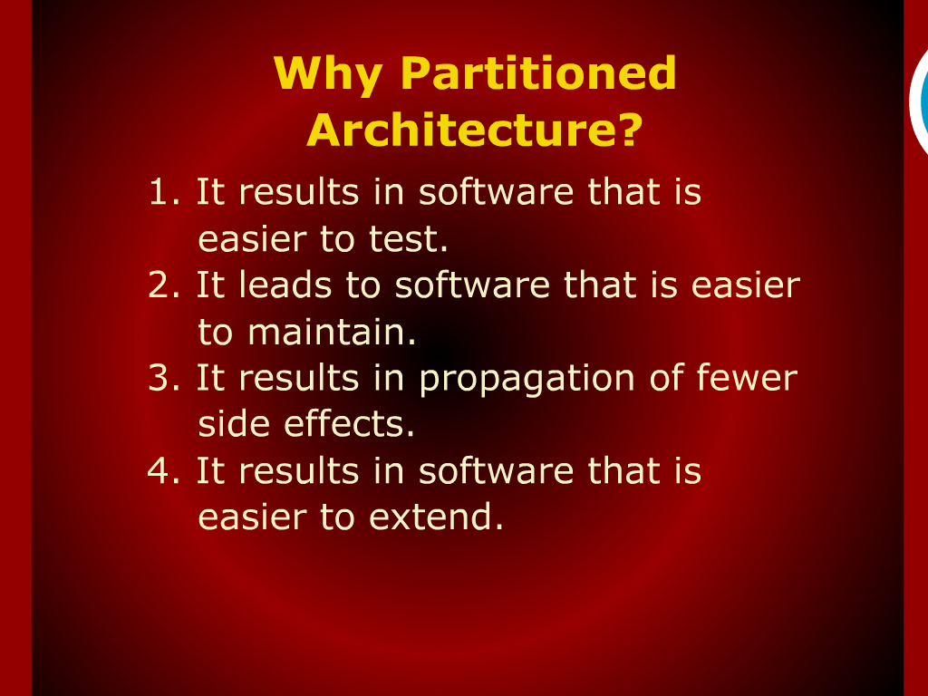
Why Partitioned Achitecture?

Slide 14
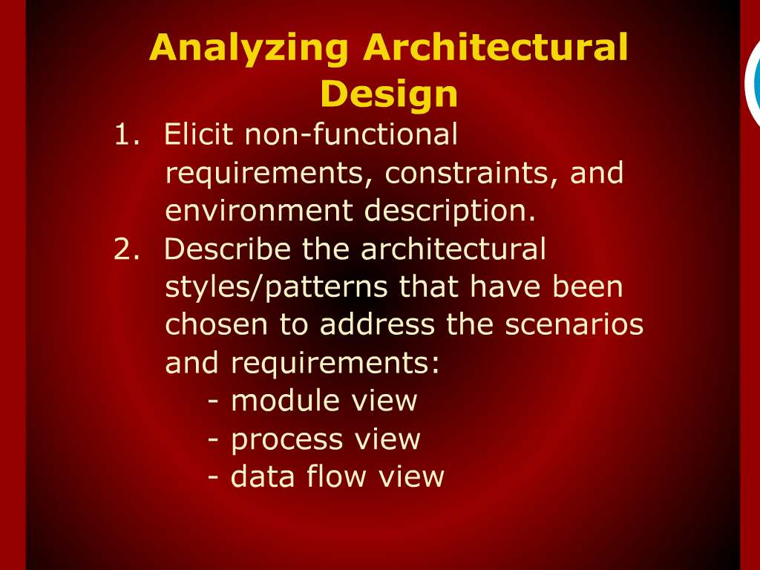
Analyzing Architectural Design

Slide 15
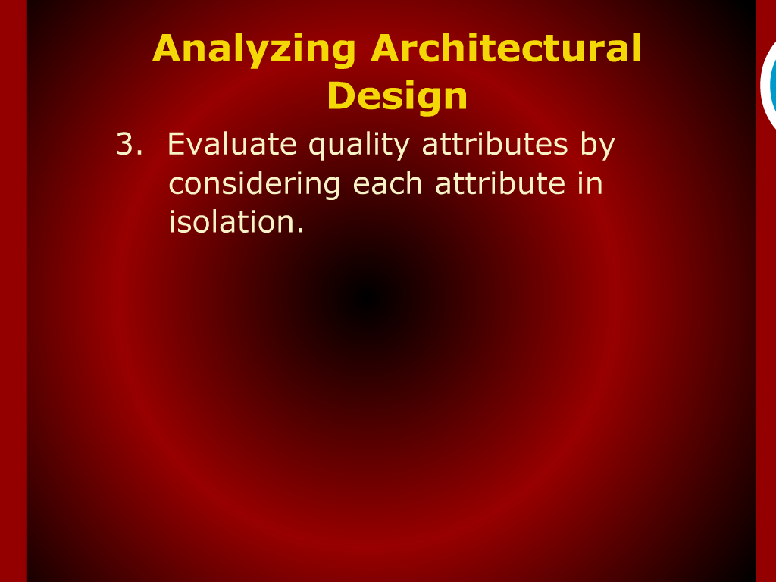
Analyzing Architectural Design

Slide 16
Recap

Slide 17
N-Tier Architecture

Slide 18
Data Flow Architecture

Slide 19
Layered Architecture

Slide 20
Reference Architecture

Slide 21
Architecture Portioning

Slide 22
Analyzing Architecture Design

Slide 23
Summary of Today’s Lecture

