Slide 1
Software Engineering
Lecture #41
Fakhar Lodhi

Slide 2
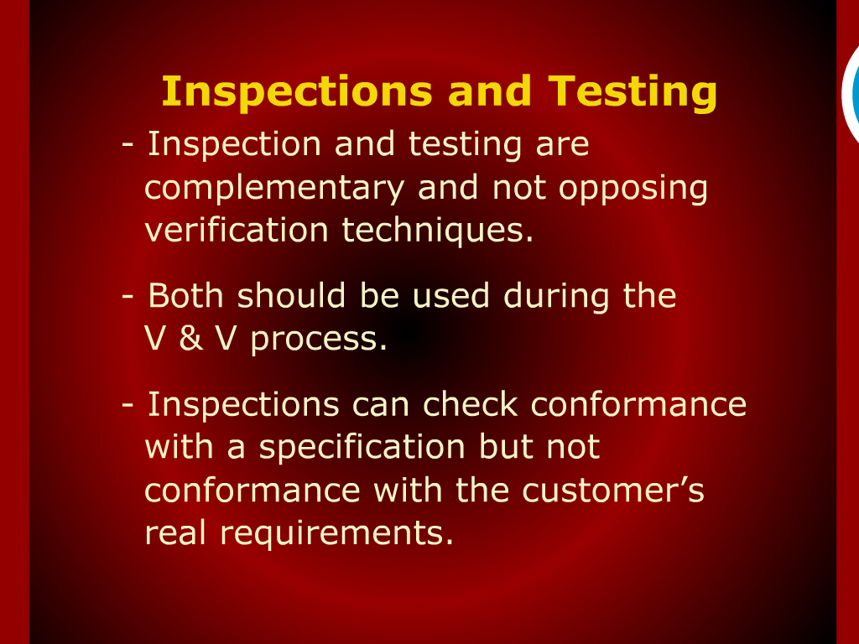
Inspection Checklist

Slide 3
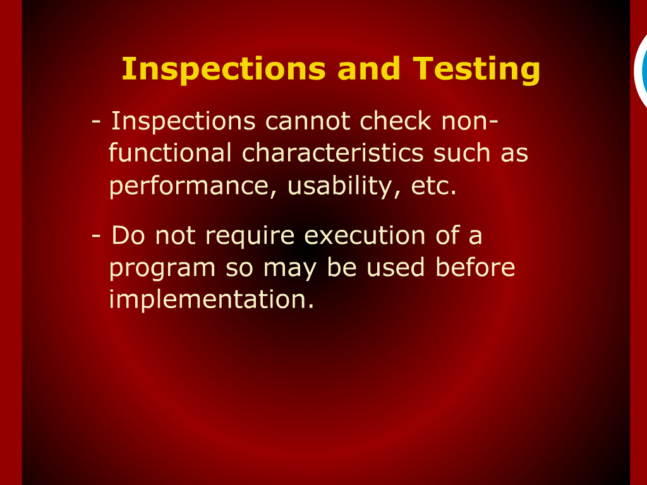
Inspection and Testing

Slide 4
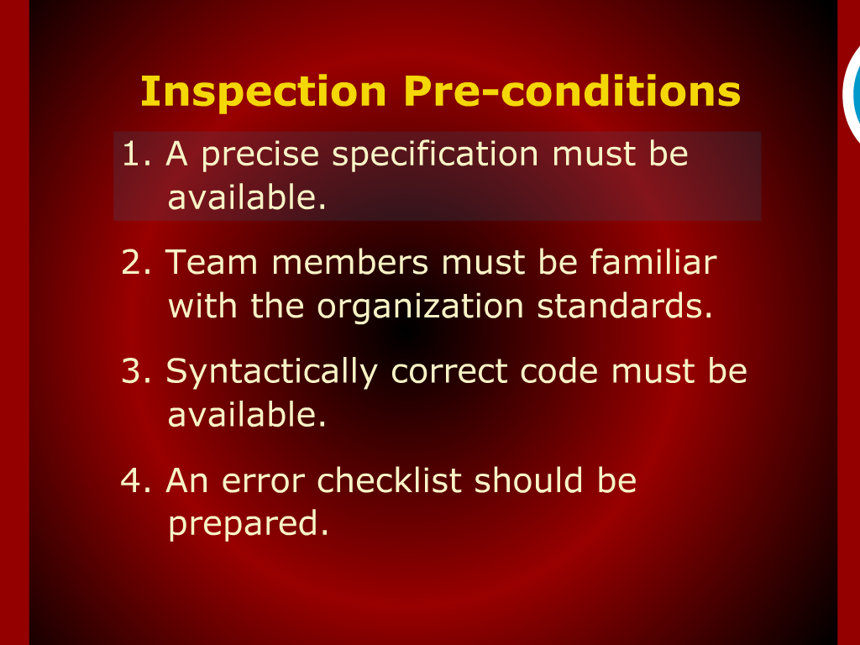
Inspection Checklist

Slide 5
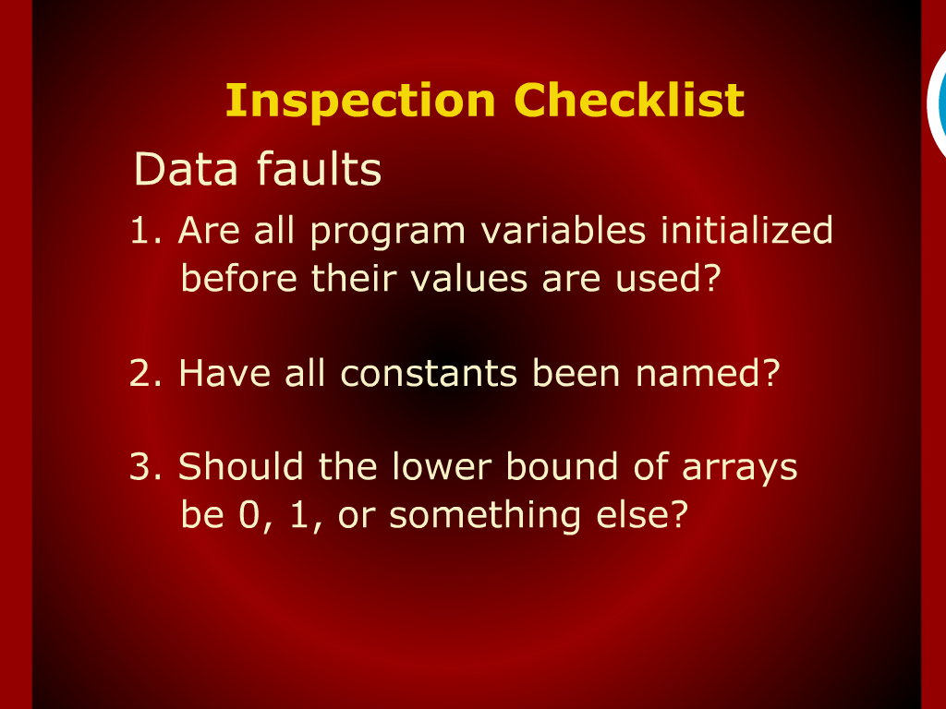
Inspection Checklist

Slide 6
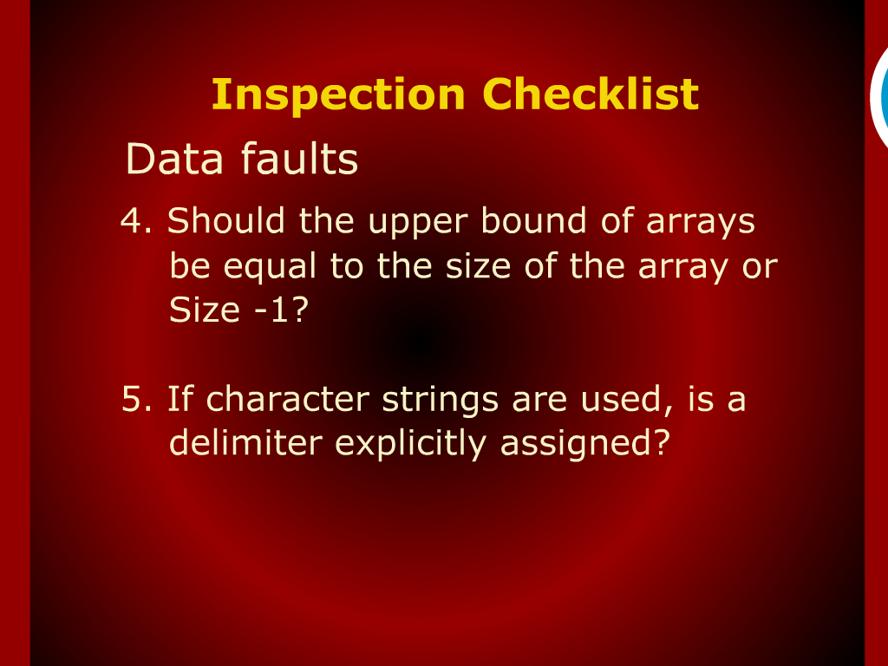
Inspection Checklist

Slide 7
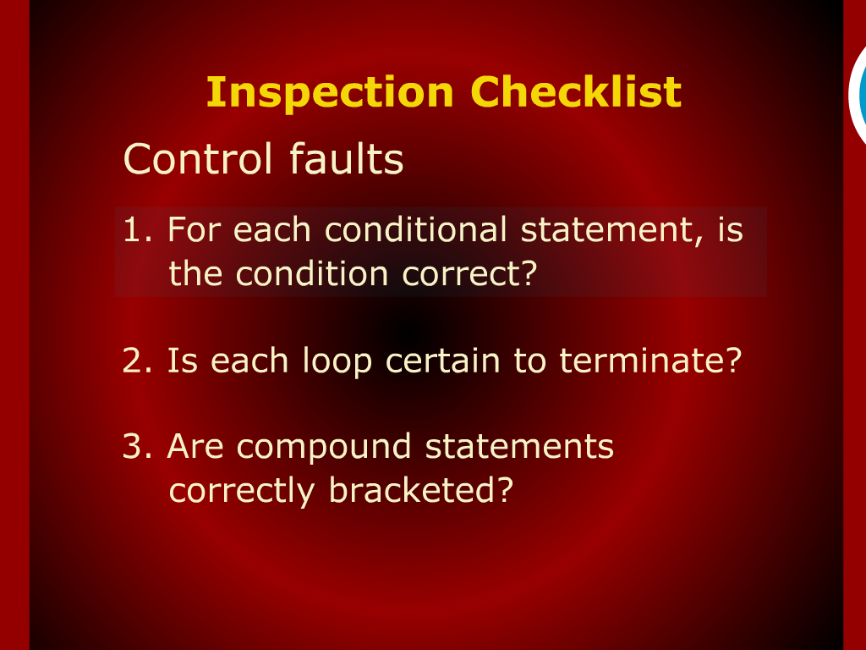
Inspection Checklist

Slide 8
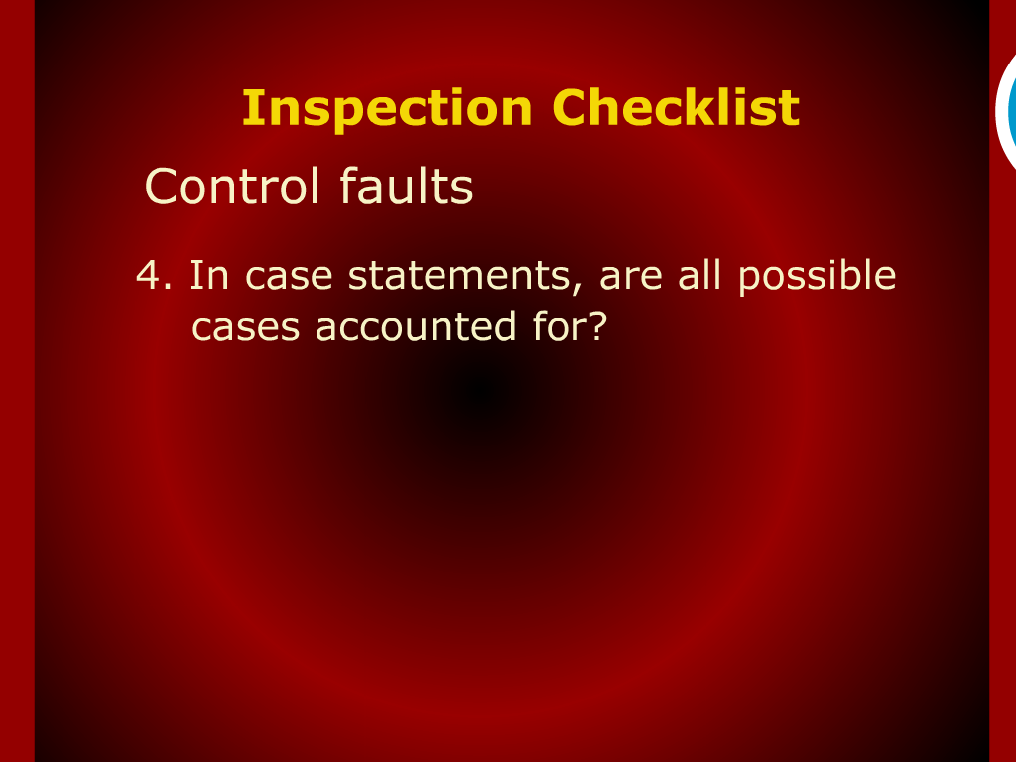
Inspection Checklist

Slide 9
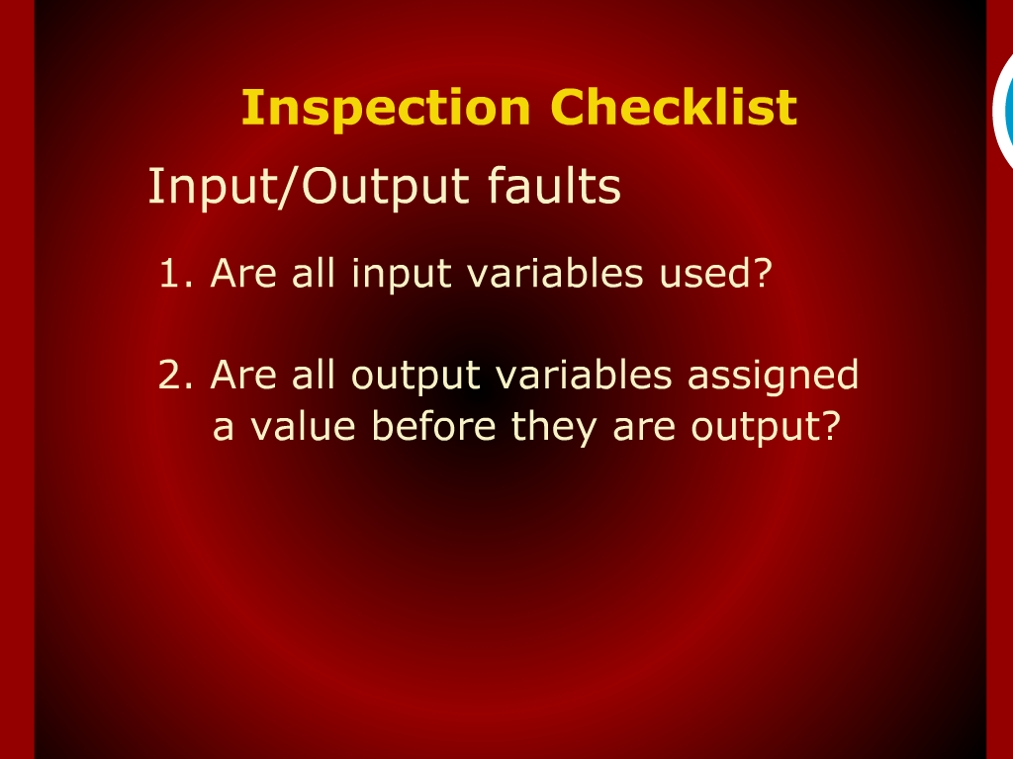
Inspection Checklist

Slide 10
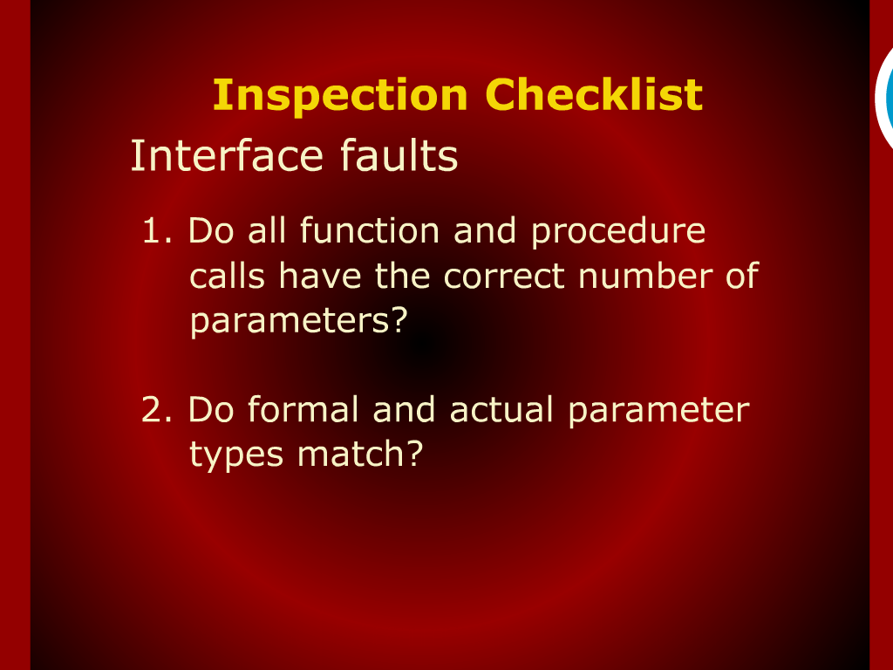
Inspection Checklist

Slide 11
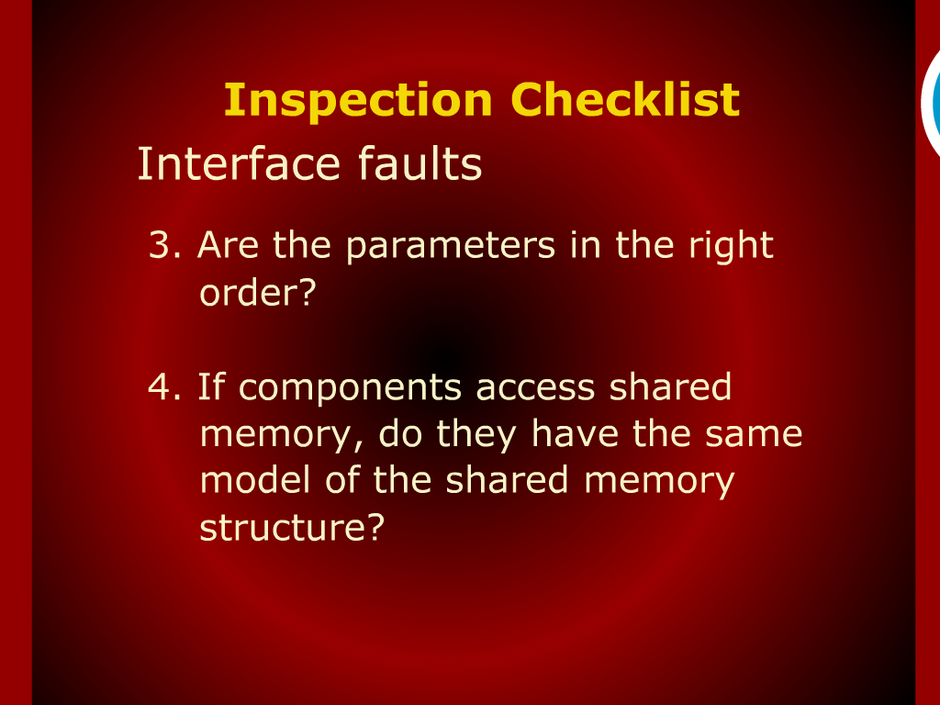
Inspection Checklist

Slide 12
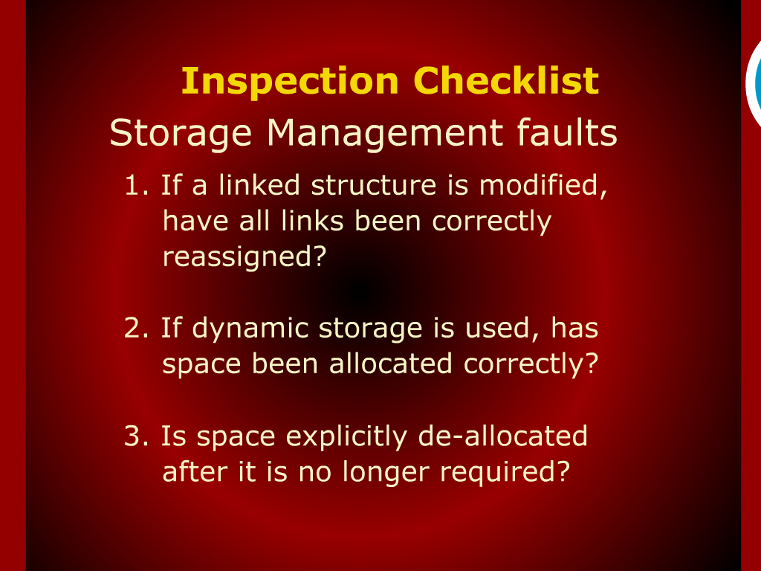
Inspection Checklist

Slide 13
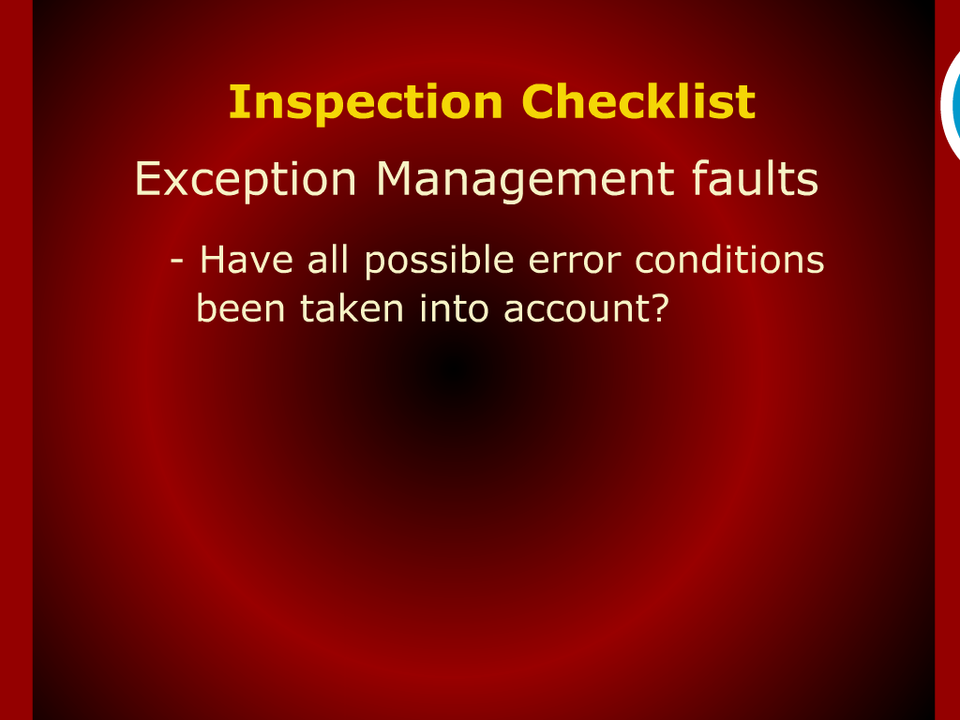
Inspection Checklist

Slide 14
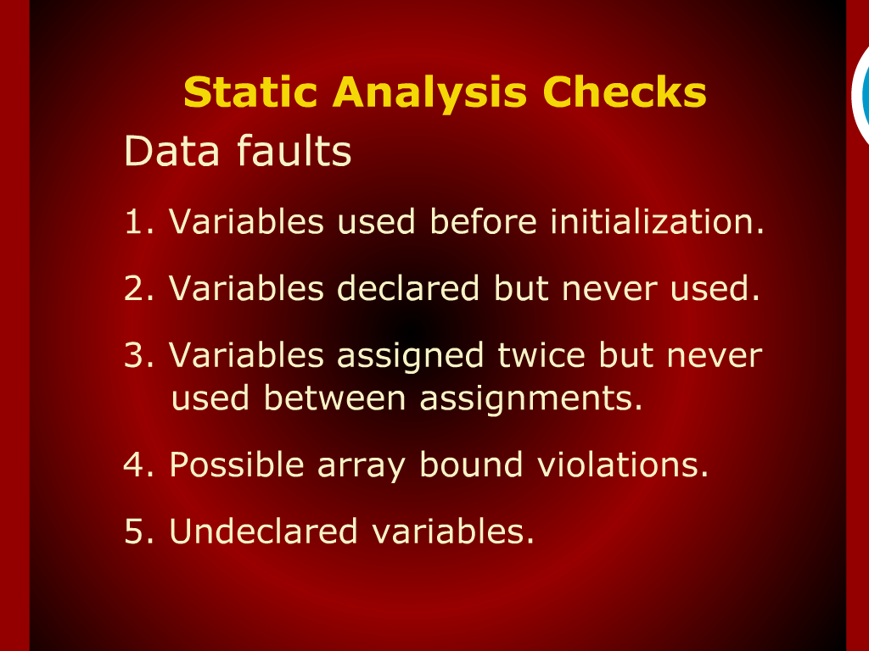
Static Analysis Checks

Slide 15
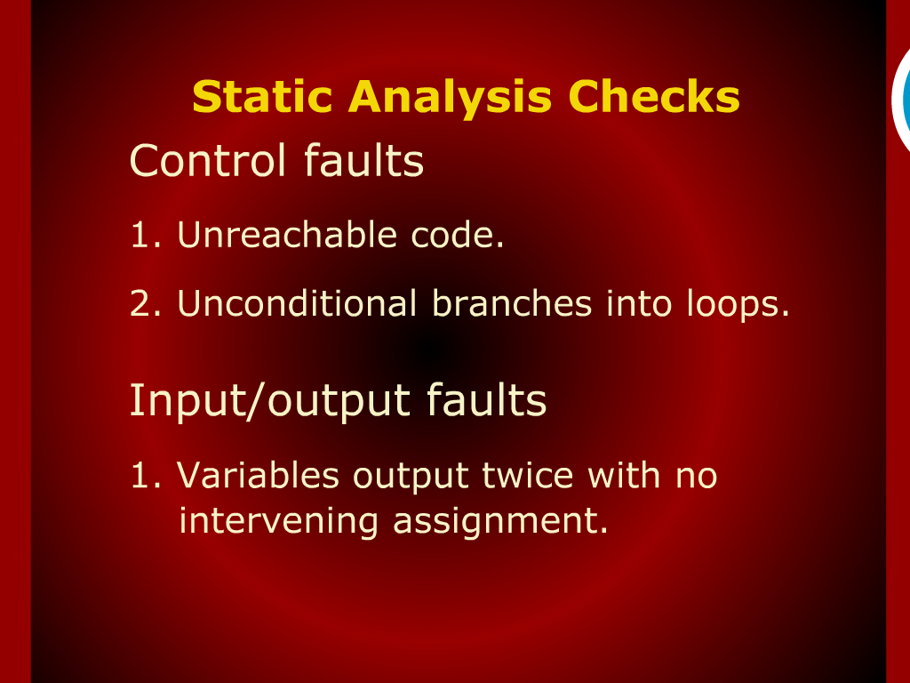
Static Analysis Checks

Slide 16
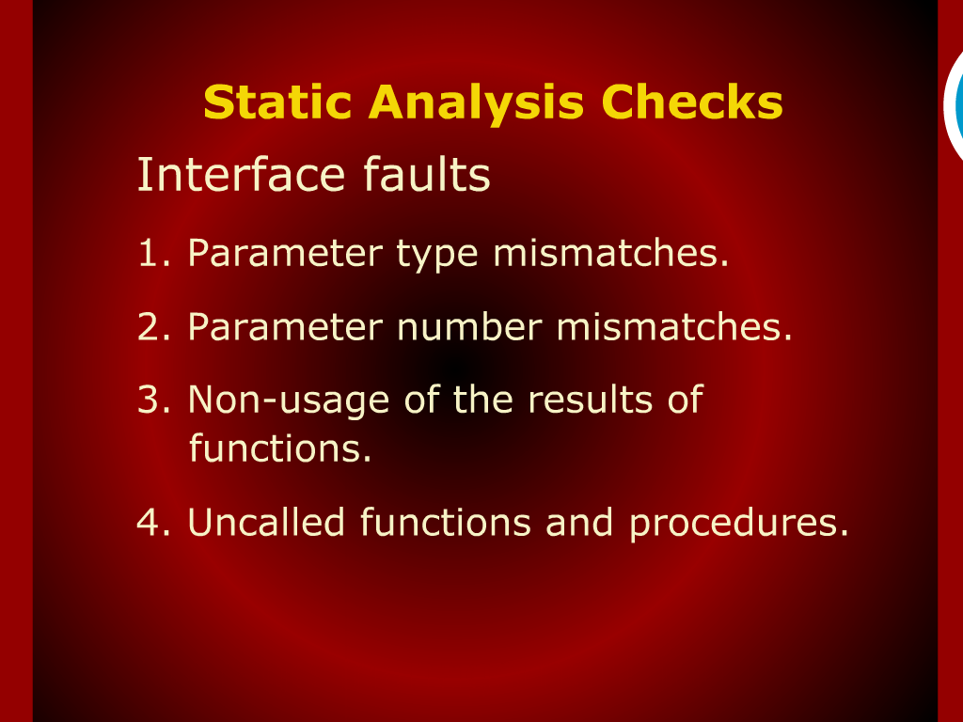
Static Analysis Checks

Slide 17
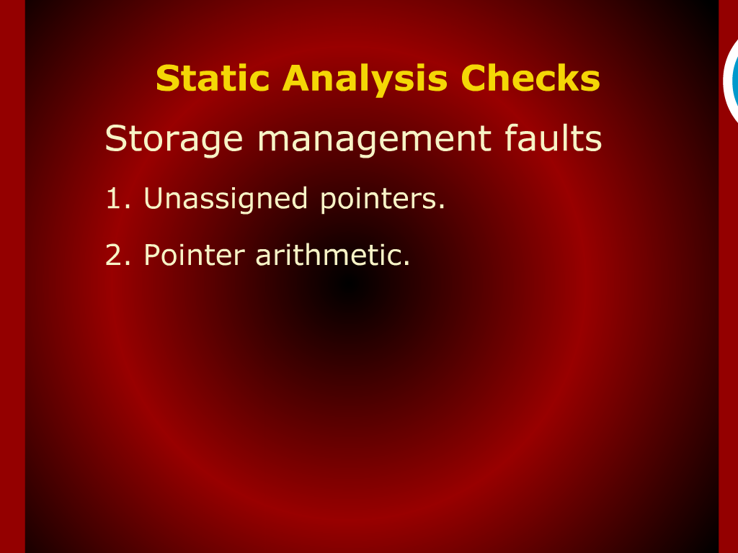
Static Analysis Checks

Slide 18
Recap

Slide 19
Summary of Today’s Discussion

Slide 20
Program Inspection

Slide 21
Inspection versus Testing

Slide 22
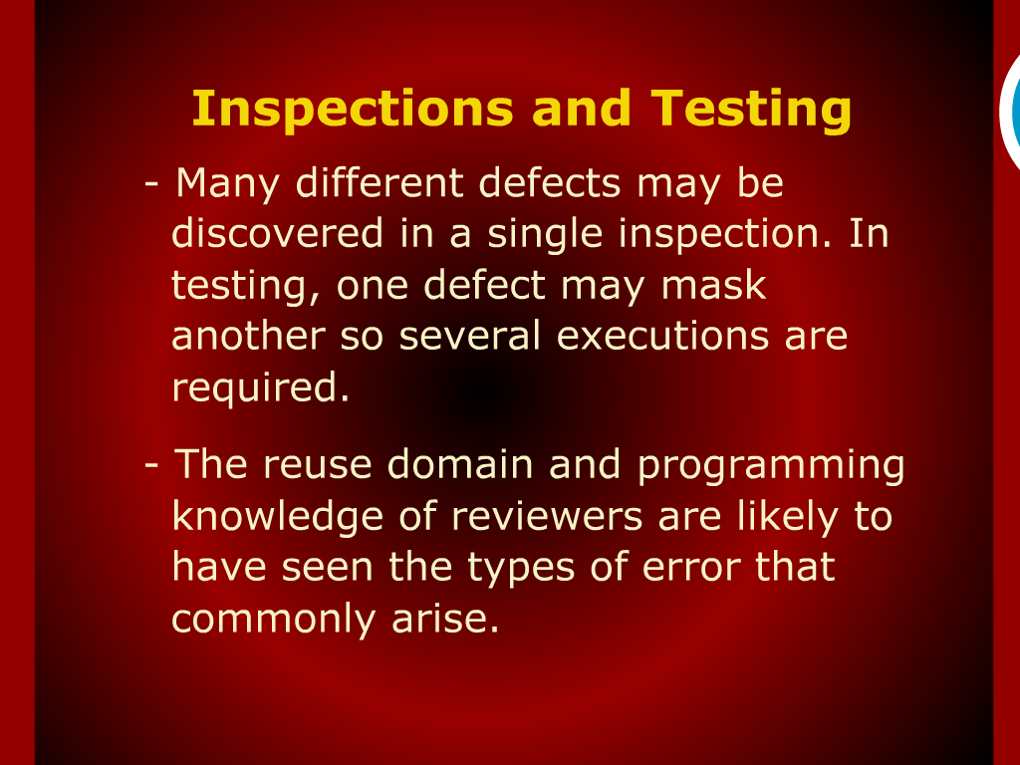
Inspection and Testing

Slide 23
Inspection Check Lists

