Slide 1

Data Mining
Week 5: Artificial Neural Networks
Pabitra Mitra
Computer Science and Engineering, IIT Kharagpur

Slide 2
Neural networks
Networks of processing units (neurons) with connections (synapses) between them
Large number of neurons: 10¹⁰
Large connectitivity: 10⁵
Parallel processing
Distributed computation/memory
Robust to noise, failures

Slide 3
Connectionism
Alternative to symbolism
Humans and evidence of connectionism/parallelism:
Physical structure of brain:
Neuron switching time: 10⁻³ second
Complex, short-time computations:
Scene recognition time: 10⁻¹ second
100 inference steps doesn’t seem like enough
much parallel computation
Artificial Neural Networks (ANNs)
Many neuron-like threshold switching units
Many weighted interconnections among units
Highly parallel, distributed process
Emphasis on tuning weights automatically (search in weight space)

Slide 4
Biological neuron

Slide 5
Biological neuron
dendrites: nerve fibres carrying electrical signals to the cell
cell body: computes a non-linear function of its inputs
axon: single long fiber that carries the electrical signal from the cell body to other neurons
synapse: the point of contact between the axon of one cell and the dendrite of another, regulating a chemical connection whose strength affects the input to the cell.

Slide 6
Biological neuron
A variety of different neurons exist (motor neuron, on-center off-surround visual cells…), with different branching structures
The connections of the network and the strengths of the individual synapses establish the function of the network.

Slide 7
When to consider ANNs
Input is
high-dimensional
discrete or real-valued
e.g., raw sensor inputs
noisy
Long training times
Form of target function is unknown
Human readability is unimportant
Especially good for complex recognition problems
Speech recognition
Image classification
Financial prediction

Slide 8
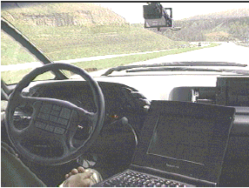
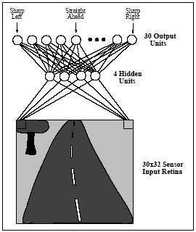
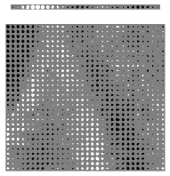
Problems too hard to program
ALVINN: a perception system which learns to control the NAVLAB vehicles by watching a person drive

Slide 9
Perceptron
x₀=1
x₁
w₁
w₀
x₂
w₂
: :
Σ
f
w_{n}
x_{n}
−w₀: threshold value or bias
f (or o()) : activation function (thresholding unit), typically:

Slide 10
Decision surface of a perceptron
Decision surface is a hyperplane given by
2D case: the decision surface is a line
Represents many useful functions: for example, x₁ ∧ x₂ ?
x₁ ∨ x₂ ?
x₁ XOR x₂ ? Not linearly separable!
Generalization to higher dimensions
Hyperplanes as decision surfaces
−1.5+x₁+x₂=0

Slide 11
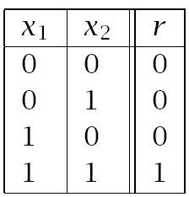
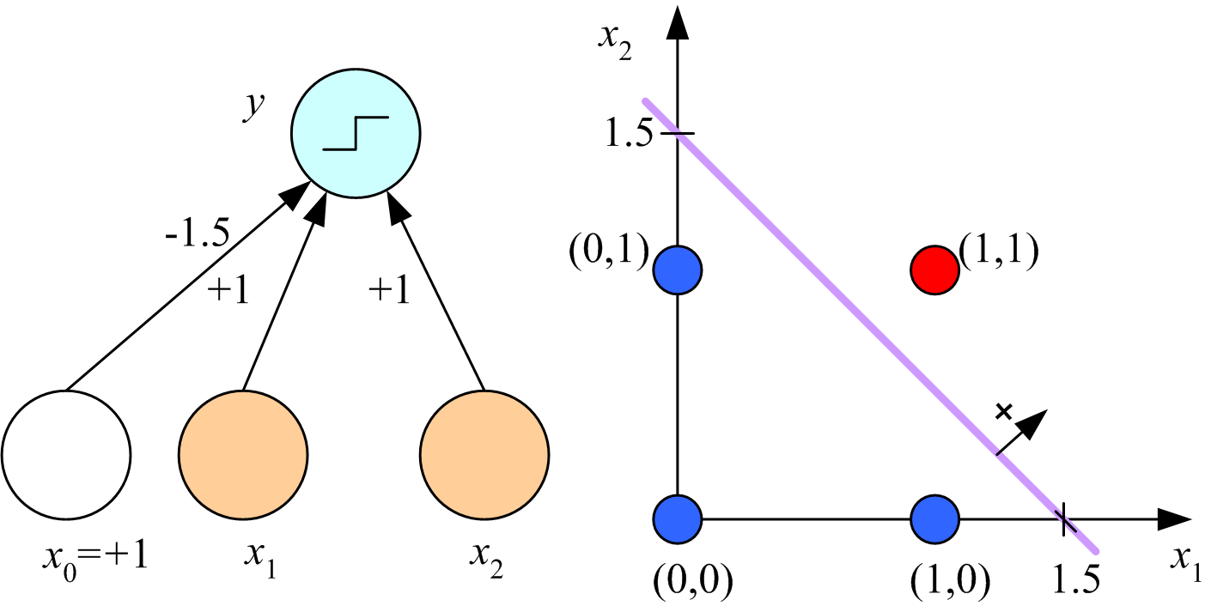
Learning Boolean AND

Slide 12
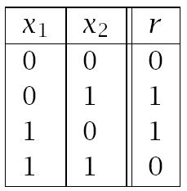
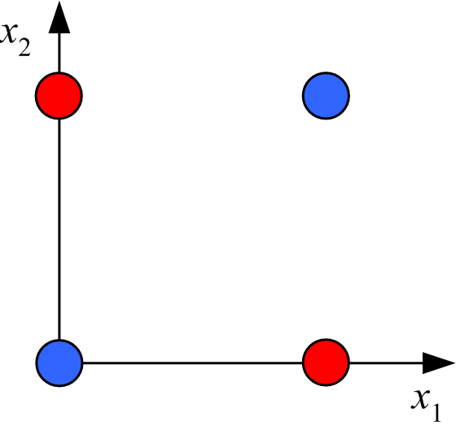
XOR
No w₀, w₁, w₂ satisfy:
(Minsky and Papert, 1969)

Slide 13
Boolean functions
Solution:
network of perceptrons
Any boolean function representable as DNF
2 layers
Disjunction (layer 1) of conjunctions (layer 2)
Example of XOR
(X1=1 AND X2=0) OR (X1=0 AND X2=1)
Practical problem of representing high-dimensional functions

Slide 14
Training rules
Finding learning rules to build networks from TEs
Will examine two major techniques
Perceptron training rule
Delta (gradient search) training rule (for more perceptrons as well as general ANNs)
Both focused on learning weights
Hypothesis space can be viewed as set of weights

Slide 15
Perceptron training rule
ITERATIVE RULE: w_{i} := w_{i} + Δw_{i}
where Δw_{i} = η (t − o) x_{i}
t is the target value
o is the perceptron output for x
η is small positive constant, called the learning rate
Why rule works:
E.g., t = 1, o = -1, x_{i} = 0.8, η = 0.1
then Δw_{i} = 0.16 and w_{i} x_{i} gets larger
o converges to t

Slide 16
Perceptron training rule
The process will converge if
training data is linearly separable, and
η is sufficiently small
But if the training data is not linearly separable, it may not converge (Minsky & Pappert)
Basis for Minsky/Pappert attack on NN approach
Question: how to overcome problem:
different model of neuron?
different training rule?
both?

Slide 17
Gradient descent
Solution: use alternate rule
More general
Basis for networks of units
Works in non-linearly separable cases
Let o(x) = w₀ + w₁x₁ + … + w_{n}x_{n}
Simple example of linear unit (will generalize)
Omit the thresholding initially
D is the set of training examples {d = ⟨x, t_{d}⟩}
We will learn w_{i}’s that minimize the squared error

Slide 18
Error minimization
Look at error E as a function of weights {wi}
Slide down gradient of E in weight space
Reach values of {wi} that correspond to minimum error
Look for global minimum
Example of 2-dimensional case:
E = w1*w1 + w2*w2
Minimum at w1=w2=0
Look at general case of n-dimensional space of weights

Slide 19
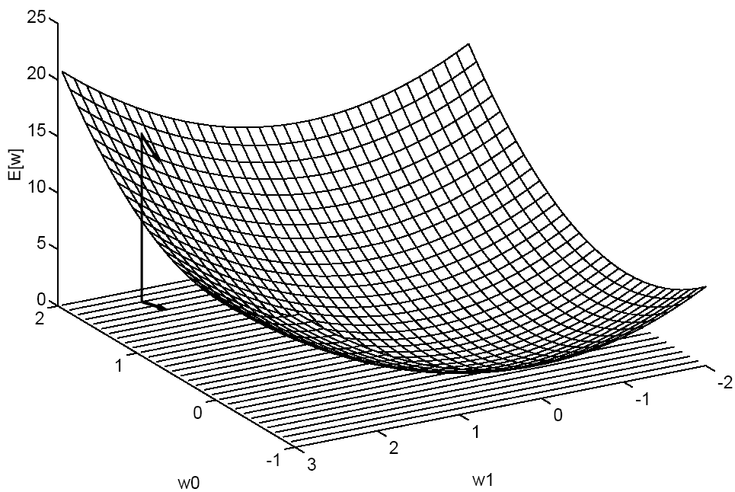
Gradient descent
Gradient “points” to the steepest increase:
Training rule: where η is a positive constant (learning rate)
How might one interpret this update rule?
Parabola with a single minima

Slide 20
Gradient descent

Slide 21
Gradient descent algorithm
Gradient-Descent (training examples, η)
Each training example is a pair ⟨x, t⟩: x is the vector of input values, and t is the target output value. η is the learning rate (e.g., .05).
Initialize each w_{i} to some small random value
Repeat until the termination condition is met
Initialize each Δw_{i} to zero
For each training example ⟨x, t⟩
Input x to the unit and compute the output o
For each linear unit weight w_{i} Δw_{i} ← Δw_{i} + η (t - o) x_{i}
For each linear unit weight w_{i} w_{i} ← w_{i} + Δw_{i}
At each iteration, consider reducing η
Also called
LMS (Least Mean Square) rule
Delta rule

Slide 22
Incremental (Stochastic) Gradient Descent
Batch mode Gradient Descent:
Repeat
Compute the gradient
Incremental mode Gradient Descent:
Repeat
For each training example d in D
Compute the gradient
Incremental can approximate batch if η is small enough

Slide 23
Incremental Gradient Descent Algorithm
Incremental-Gradient-Descent (training examples, η)
Each training example is a pair ⟨x, t⟩: x is the vector of input values, and t is the target output value. η is the learning rate (e.g., .05).
Initialize each w_{i} to some small random value
Repeat until the termination condition is met
Initialize each Δw_{i} to zero
For each ⟨x, t⟩
Input x to the unit and compute output o
For each linear unit weight w_{i} w_{i} ← w_{i} + η (t - o) x_{i}

Slide 24
Perceptron vs. Delta rule training
Perceptron training rule guaranteed to succeed if
Training examples are linearly separable
Sufficiently small learning rate
Delta training rule uses gradient descent
Guaranteed to converge to hypothesis with minimum squared error
Given sufficiently small learning rate
Even when training data contains noise
Even when training data not linearly separable
Can generalize linear units to units with threshold
Just threshold the results

Slide 25
Perceptron vs. Delta rule training
Delta/perceptron training rules appear same but
Perceptron rule trains discontinuous units
Guaranteed to converge under limited conditions
May not converge in general
Gradient rules trains over continuous response (unthresholded outputs)
Gradient rule always converges
Even with noisy training data
Even with non-separable training data
Gradient descent generalizes to other continuous responses
Can train perceptron with LMS rule
get prediction by thresholding outputs

Slide 26
Multilayer networks of sigmoid units
Needed for relatively complex (i.e., typical) functions
Want non-linear response units in many systems
Example (next slide) of phoneme recognition
Cascaded nets of linear units only give linear response
Sigmoid unit as example of many possibilities
Want differentiable functions of weights
So can apply gradient descent
Minimization of error function
Step function perceptrons non-differentiable

Slide 27
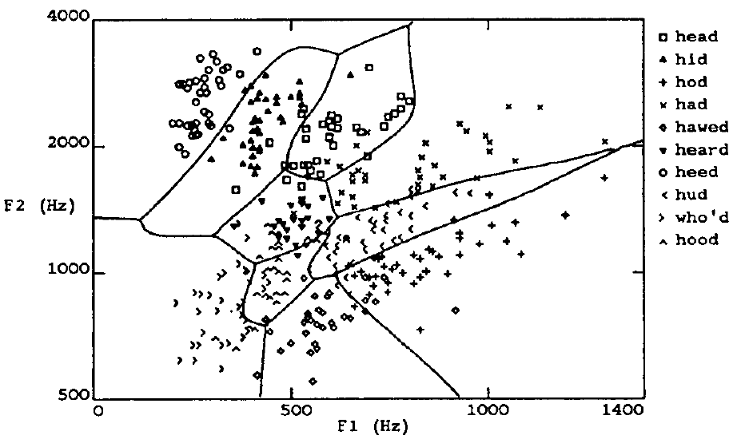
Speech recognition example

Slide 28
Multilayer networks
. . . . . .
Hidden layer
F1 F2
Can have more than one hidden layer

Slide 29
Sigmoid unit
x₀=1
x₁
w₁
w₀
x₂
w₂
: :
Σ
f
w_{n}
x_{n}
f is the sigmoid function
Derivative can be easily computed:
Logistic equation
used in many applications
other functions possible (tanh)
Single unit:
apply gradient descent rule
Multilayer networks: backpropagation

Slide 30
Error Gradient for a Sigmoid Unit
net: linear combination
o (output): logistic function

Slide 31
… Incremental Version
Batch gradient descent for a single Sigmoid unit
Stochastic approximation

Slide 32
Backpropagation procedure
Create FFnet
n_i inputs
n_o output units
Define error by considering all output units
n hidden units
Train the net by propagating errors backwards from output units
First output units
Then hidden units
Notation: x_ji is input from unit i to unit j
w_ji is the corresponding weight
Note: various termination conditions : Error, # iterations,…

Slide 33
Backpropagation (stochastic case)
Initialize all weights to small random numbers
Repeat
For each training example
Input the training example to the network and compute the network outputs
For each output unit k δ_{k} ← o_{k} (1 − o_{k}) (t_{k} − o_{k})
For each hidden unit h δ_{h} ← o_{h} (1 − o_{h}) Σ_{k∈outputs} w_{k,h}δ_{k}
Update each network weight w_{j,i} w_{j,i} ← w_{j,i} + Δw_{j,i}
where Δw_{j,i} = η δ_{j} x_{j,i}

Slide 34
Errors propagate backwards
1
1
2
3
4
w_{2,5}
w_{1,5}
w_{,,4,9}
w_{,2,7}
w_{,3,7}
w_{1,7}
w_{,4,7}
5
6
7
8
9
w_{1,7} updated based on δ₁ and x_{1,7}
Same process repeats if we have more layers

Slide 35
Properties of Backpropagation
Easily generalized to arbitrary directed (acyclic) graphs
Backpropagate errors through the different layers
Training is slow but applying network after training is fast

Slide 36
Convergence of Backpropagation
Convergence
Training can take thousands of iterations → slow!
Gradient descent over entire network weight vector
Speed up using small initial values of weights:
Linear response initially
Generally will find local minimum
Typically can find good approximation to global minimum
Solutions to local minimum trap problem
Stochastic gradient descent
Can run multiple times
Over different initial weights
Committee of networks
Can modify to find better approximation to global minimum
include weight momentum α Δw_{i,j}(t_{n} ) = η δ_{j} x_{i,j} + α Δw_{i,j} (t_{n-1} )
Momentum avoids local max/min and plateaus

Slide 37
Example of face recognition
Task: recognize faces from sample of
20 people in 32 poses
Choose output of 4 values for direction of gaze
120x128 images (256 gray levels)
Can compute many functions
Identity/direction of face (used in book)/…
Design issues
Input encoding (pixels/features/?)
Reduced image encoding (30x32)
Output encoding (1 or 4 values?)
Convergence to .1/.9 and not 0/1
Network structure (1 layer of 3 hidden units)
Algorithm parameters
Eta=.3; alpha=.3; stochastic descent method
Training/validation sets
Results: 90% accurate for head pose

Slide 38
Some issues with ANNs
Interpretation of hidden units
Hidden units “discover” new patterns/regularities
Often difficult to interpret
Overfitting
Expressiveness
Generalization to different classes of functions

Slide 39
Dealing with overfitting
Complex decision surface
Divide sample into
Training set
Validation set
Solutions
Return to weight set occurring near minimum over validation set
Prevent weights from becoming too large
Reduce weights by (small) proportionate amount at each iteration

Slide 40
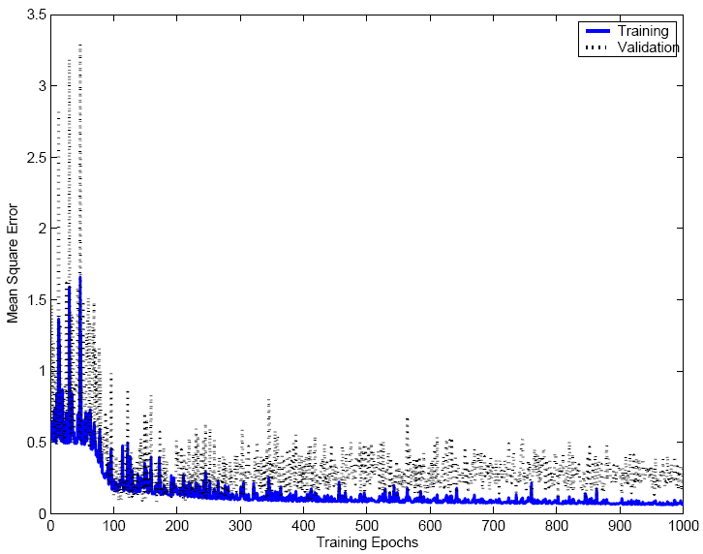

Slide 41
Expressiveness
Every Boolean function can be represented by network with a single hidden layer
Create 1 hidden unit for each possible input
Create OR-gate at output unit
but might require exponential (in number of inputs) hidden units

Slide 42
Expressiveness
Every bounded continuous function can be approximated with arbitrarily small error, by network with one hidden layer (Cybenko et al ‘89)
Hidden layer of sigmoid functions
Output layer of linear functions
Any function can be approximated to arbitrary accuracy by a network with two hidden layers (Cybenko ‘88)
Sigmoid units in both hidden layers
Output layer of linear functions

Slide 43
Extension of ANNs
Many possible variations
Alternative error functions
Penalize large weights
Add weighted sum of squares of weights to error term
Structure of network
Start with small network, and grow
Start with large network and diminish
Use other learning algorithms to learn weights

Slide 44
Extensions of ANNs
Recurrent networks
Example of time series
Would like to have representation of behavior at t+1
from arbitrary past intervals (no set number)
Idea of simple recurrent network
hidden units that have feedback to inputs
Dynamically growing and shrinking networks

Slide 45
Summary
Practical method for learning continuous functions over continuous and discrete attributes
Robust to noise
Slow to train but fast afterwards
Gradient descent search over space of weights
Overfitting can be a problem
Hidden layers can invent new features

Slide 46
End of Artificial Neural Networks

