Slide 1

Paradigm Shift, Expert Systems, People
Paradigm Shift, GPS, People realized that all the
realized that software programs can act as
problems can NOT be solved with the same
EXPERTS
approach
The name
First work in AI
“Artificial
Development of
Microworlds
1943
Intelligence”
Lisp
1963
coined
1958
1956
Paradigm Shift, ANN, People realized that
software programs can LEARN
AI a booming
Neural Networks
AI becomes an
Realization of
Industry TODAY
reinvented
Industry
hurdles
1986
1981

Slide 2
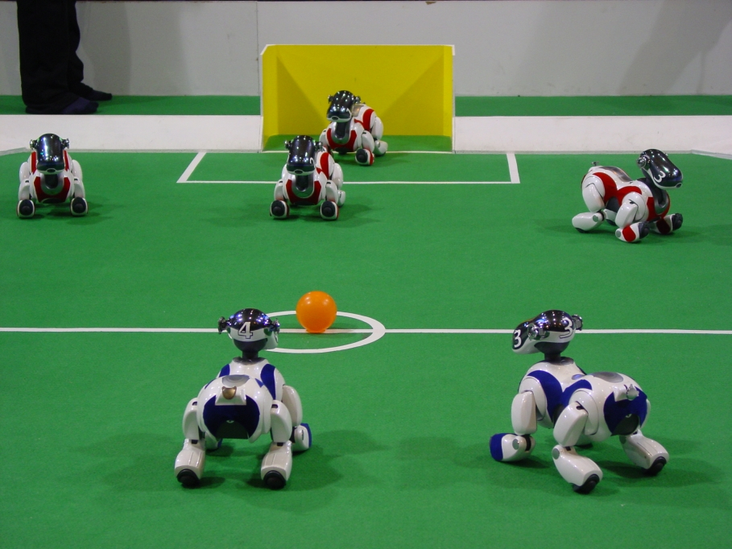
Robot Control

Slide 3
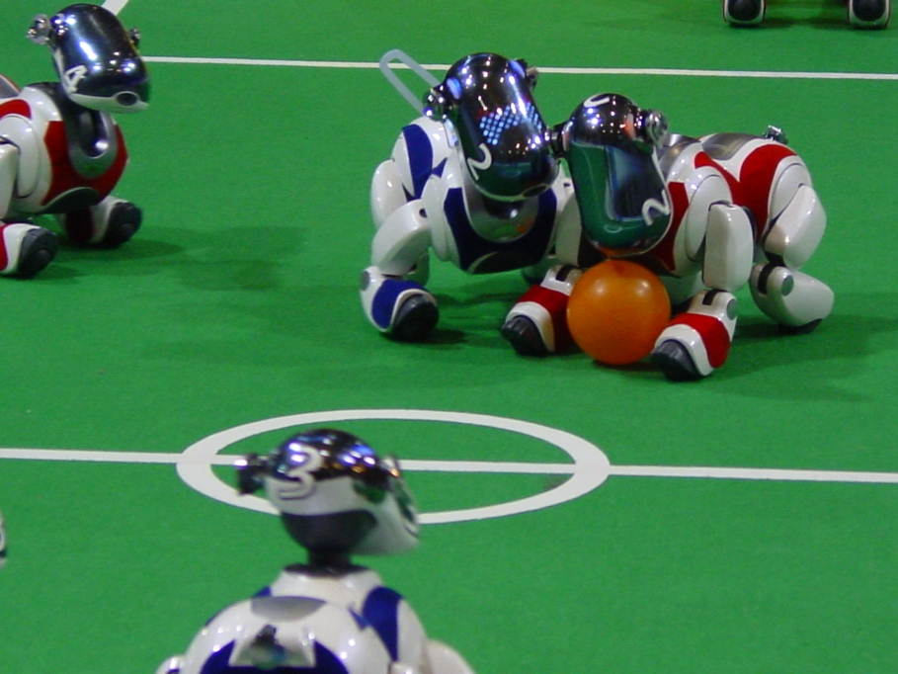
Robot Control

Slide 4
Course Outline
Introduction
Expert Systems
Advanced
Topics
Problem
Solving
Uncertainty
Conclusion
Genetic
Learning
Algorithms
Knowledge
Representation
Planning
& Reasoning

