Slide 1

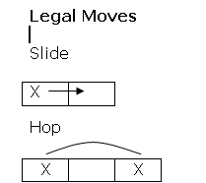
Two – One Problem
Start
Goal
1
1 ? 2 2
2
2 ? 1 1
Legal Moves:
Slide
Hop
Rules:
1s’ move right
2s’ move left
Only one move at a time
No backing up

Slide 2
Two – One Problem
Trials to solve the problem
Trial One
Trial Two
1
1 ? 2 2
1
1 ? 2 2
1
1 2 ? 2
1
? 1 2 2
1
? 2 1 2
?
1 1 2 2
1
2 ? 1 2
Stuck!!!
1
2 2 1 ?
1
2 2 ? 1
Stuck!!!

Slide 3
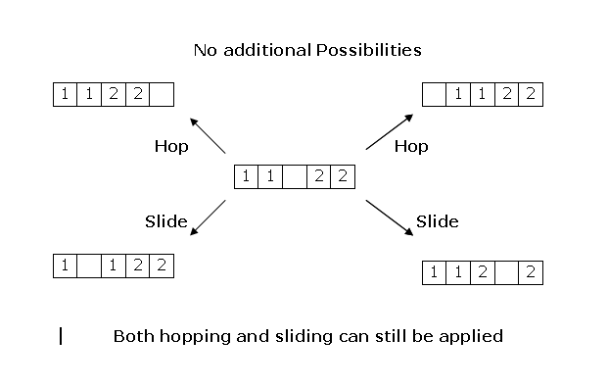
Two – One Problem
Five States

Slide 4
Two – One Problem
Solution Space
H
H
?
1 1 2 2
1 1
?
2 2
1 1 2 2
?
S
S
1
?
1 2 2
1 1 2
?
2
S
H
H
S
? 1 1 2 2
1 2 1
?
2
1
?
2 1 2
1 1 2 2
?
S
S
S
S
1 2 1 2
?
1 2
?
1 2
?
1 2 1 2
H
H
H
H
1 2
?
2 1
?
2 1 1 2
1 2 2 1
?
2 1
?
1 2
S
H
S
S
H
S
1 2 2
?
1
?
2 1 2 1
2
?
1 1 2
1 2 2
?
1
2 1 1 2
?
2
?
1 1 2
S
S
2
?
1 2 1
2 1 2
?
1
H
H
2 2 1
?
1
2
?
2 1 1
S
S
2 2
?
1 1

Slide 5
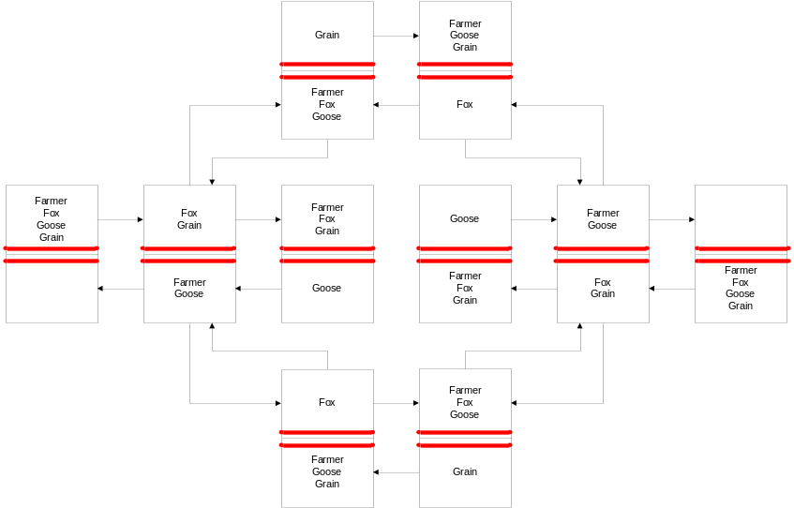
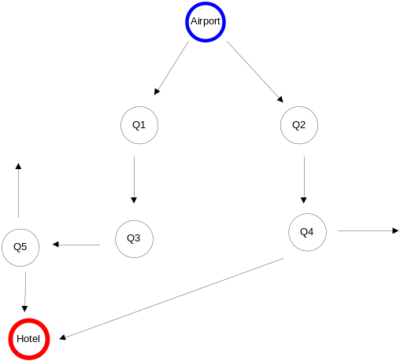
Solution to Problem Solving : Searching
?
1 1 2 2
H
1 1
?
2 2
H
1 1 2 2
?
S
S
1
?
1 2 2
1 1 2
?
2
S
H
H
S
? 1 1 2 2
1 2 1
?
2
1
?
2 1 2
1 1 2 2
?
S
S
S
S
1 2 1 2
?
1 2
?
1 2
?
1 2 1 2
H
H
H
H
1 2
?
2 1
?
2 1 1 2
1 2 2 1
?
2 1
?
1 2
S
H
S
S
H
S
1 2 2
?
1
?
2 1 2 1
2
?
1 1 2
1 2 2
?
1
2 1 1 2
?
2
?
1 1 2
S
S
2
?
1 2 1
2 1 2
?
1
2 2 1
H
?
1
2
?
H
2 1 1
S
S
2 2
?
1 1

Slide 6
Tree and Graph Terminology
A
B
C
D
E
F
G
H
“A” is the “root node”
“A, B, C …. J” are “nodes”
“B” is a “child” of “A”
“A” is ancestor of “D”
“D” is a descendant of “A”
“D, E, F, G, I, J” are “leaf nodes”
Arrows represent “edges” or “links”
I
J

Slide 7
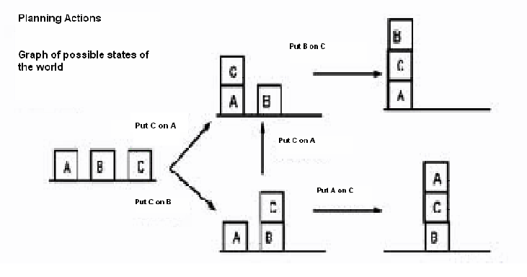
Examples of Graphs
Notes:
However, graphs can also be much more abstract. Think of the graph defined as
follows: the nodes denote descriptions of a state of the world, e.g. which blocks are
on top of what in a blocks scene, and where the links represent actions that change
from one state to the other.
A path through such a graph (from a start node to a goal node) is a "plan of action"
to achieve some desired goal state from some known starting state. It is this type of
graph that is of more general interest in AI.

Slide 8
Problem Formulation using Graphs
The search methods we’ll be dealing with are defined on trees and graphs
A
3
B
3
C
2
S
4
4
G
3
2
D
1
E
3
F
Notes:
Comment on it from Winston Figure 4.1

Slide 9
Tree Search
Graph search is really tree search
S
A
3
3
2
B
C
A
D
B
D
A
E
4
4
G
S
C
E
E
B
B
F
3
D
E
F
2
D
F
B
F
C
E
A
C
G
1
3
G
C
G
F
G

