Slide 1
Lecture 15

Slide 2
Recap
Types of Knowledge: Declarative, Procedural, Meta, Heuristic, Structural.
Knowledge Representation Techniques
  Facts
    Types of Facts: Single/Multi- valued, Uncertain, Fuzzy
  Object-Attribute Value Triplets
  Rules
    Types of Rules: Relationship, Recommendation, Directive

Slide 3
Types of Rules (Cont.)
Variable Rules
  If the same type of rule is to be applied to multiple objects, we use variable rules, i.e. rules with variables
  e.g.
  If X is a Student
  AND X’s GPA>3.7
  THEN place X on honor roll.
Such rules are called pattern-matching rules.
The rule is matched with known facts and different possibilities for the variables are tested, to determine the truth of the fact.

Slide 4
Types of Rules (Cont.)
Uncertain Rules
  e.g. IF you have never won a match THEN you will most probably not win this time.
Meta Rules
  Rules that describe how to use other rules
  e.g. IF You are coughing AND you have chest congestion THEN use the set of respiratory disease rules.
Rule Sets
  As in the previous example, we may group rules into categories in our knowledge representation, e.g. the set of respiratory disease rules

Slide 5
Semantic Networks
Graphs, with nodes representing objects and arcs representing relationships between objects
Various types of relationships may be defined.
  IS-A (Inheritance relationship)
  HAS (Ownership)

Slide 6
Semantic Network example
IS-A
IS-A
IS-A
IS-A
Suzuki
Car
Vehicle
Truck
Bedford
Travels by
Road
Network Operation: How to infer new information from semantic networks. We can ask nodes questions
  Ask node vehicle: ‘How do you travel’
    Looks at arc and replies: road
  Ask node Car X: ‘How do you travel’
    Asks node Car (because of IS-A relationship)
    Asks node Vehicle (IS-A relationship)
    Node Vehicle Replies: road

Slide 7
Problems with Semantic Networks
Computationally expensive at run-time. In the worst case, we may need to traverse entire network and then discover that the requested info does not exist.
They try to model human associative memory (store info using associations), but in the human brain the number of neurons and links are in the order of 10¹⁵. Such numbers are computationally prohibitive in semantic networks.
Are logically inadequate. Have no analogues to quantifiers (for all, for some, none).

Slide 8
Frames
“Frames are data structures for representing stereotypical knowledge of some concept or object” Durkin
Like a schema
Extended to Classes and Objects
e.g. for the object Student, the frame will look like this:
Frame Name: Student
Properties:
Age: 19
GPA: 4.0
Ranking: 1

Slide 9
Facets
A feature of frames that allows us to put in constraints
IF-NEEDED Facets
IF-CHANGED Facets

Slide 10
Logic
Logic representation techniques:
  Propositional Logic
  Predicate Calculus
Algebra is a type of formal logic that deals with numbers, e.g. 2+4 = 6
Similarly, propositional logic and predicate calculus are forms of formal logic for dealing with propositions.

Slide 11
Propositional Logic
Proposition: Statement of a fact
Assign a Symbolic Variable to represent a proposition. e.g.
  p = It is raining
  q = I carry an umbrella
A declarative sentence may be classified as either True of False.
  the proposition ‘A rectangle has four sides’ is true
  the proposition ‘The world is a cube’ is false.
A proposition is a sentence whose truth values may be determined. So, each variable has a truth value.

Slide 12
Compound Statements
Different propositions may be logically related.
We can form compound statements using logical connectives:
  ∧ AND (Conjunction)
  ∨ OR (Disjunction)
  ~ NOT (Negation)
  ⇒ If … then (Conditional)
  ⇔ If and only if (bi-conditional)

Slide 13
Compound statements
  p = It is raining
  q = I carry an umbrella
  r = It is cloudy
s = IF it is raining THEN carry an umbrella
  p ⇒ q
t = IF it is raining OR it is cloudy, THEN carry an umbrella
(p ∨ r ) ⇒ q

Slide 14
Truth Table of Binary Logical Connectives
p
q
p ∧q
p ∨ q
p ⇒ q
p ⇔ q
T
T
T
T
T
T
T
F
F
T
F
F
F
T
F
T
T
F
F
F
F
F
T
T

Slide 15
Limitations of Propositional Logic
Can only represent knowledge as complete sentences, e.g. a = the ball’s color is blue.
Cannot analyze the internal structure of the sentence.
No quantifiers e.g. For all, There exists
Propositional logic provides no framework for proving statements such as:
  All humans are mortal
  All women are humans
  Therefore, all women are mortals
This is a limitation in its representational power.

Slide 16
Predicate Calculus
Extension of Propositional logic
Allows structure of facts/sentences to be defined
  With predicate logic, we can say
  color( ball, blue)
Provides a mechanism for proving statements
Has greater representation power as we will see shortly

Slide 17
The Universal Quantifier
Symbol ∀
“for every” or “for all”
Used in formulae to assign the same truth value to all variables in the domain
e.g. Domain: numbers
  (∀x) ( x + x = 2x)
  In words: for every x (where x is a number), x + x = 2x is true
e.g. Shapes
  (∀x) ( x = square ⇒ x = polygon)
  In words: every square is a polygon.
  For every x (where x is a shape), if x is a square, then x is a polygon (it implies that x is a p polygon).

Slide 18
Existential Quantifier
Symbol: ∃
Used in formulae to say that something is true for at least one value in the domain
“there exists”, “ for some” “for at least one” “there is one”
e.g.
  (∃ x) ( person (x) ∧ father (x,ahmed) )
  In words: there exists some person, x who is Ahmed’s father.

Slide 19
First Order Predicate Logic
First Order Predicate logic is the simplest form.
Uses symbols. These may be
  Constants: Used to name specific objects or properties. e.g. Ali, Ayesha, blue, ball.
  Predicates: A fact or proposition is divided into two parts
    Predicate: the assertion of the proposition
    Argument: the object of the proposition
    e.g. Ali likes bananas becomes Likes (ali, bananas)
  Variables: Used to represent general class of objects/properties. e.g. likes (X, Y). X and Y are variables that assume the values X=Ali and Y=bananas
  Formulae: Use predicates and quantifiers

Slide 20
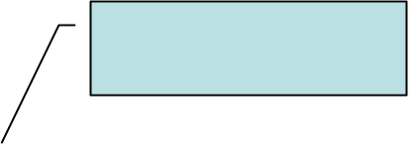
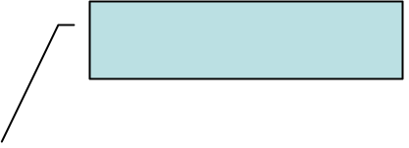


Predicate Logic Example
  man(ahmed)
  father(ahmed, belal)
  brother(ahmed, chand)
  owns(belal, car)
  tall(belal)
  hates(ahmed, chand)
  family()
Predicates
  ∀ Y (¬sister(Y,ahmed))
  ∀X,Y,Z(man(X) ∧ man(Y) man(Z) ∧ father(Z,Y) ∧ father(Z,X) ⇒ brother(X,Y))
Formulae
  X, Y and Z
Variables
ahmed, belal, chand and car
Constants
Notes:
Use this slide to introduce the concept of predicates, formulae, variables and constants.

Slide 21
Lecture 16

Slide 22
Reasoning
Deriving logical conclusions from given facts.
‘The process of working with knowledge, facts and problem solving strategies to draw conclusions’ Durkin

Slide 23
Deductive Reasoning
Deduce new information from logically related known information
A deductive argument offers assertions that lead automatically to a conclusion.
  If there is dry wood, oxygen and a spark, there will be a fire
  Given: There is dry wood, oxygen and a spark
  We can deduce: There will be a fire.
  All men are mortal. Socrates is a man.
  We can deduce: Socrates is mortal
Modus Ponens is the basic form of deductive reasoning
  Modus Ponens: If A is true and if A implies B is true, then B is true.
Notes:
Modus Ponens is a commonly used rule of deductive reasoning

Slide 24
Inductive Reasoning
From a limited set of observations, we form a ‘generalization’.
e.g.
  Observation: All the crows that I have seen in my life are black.
  Conclusion: All crows are black
Notes:
It only finds the most likely conclusion. In itself, it cannot be used as a method of proof.

Slide 25
Comparison
Comparing deductive and inductive reasoning:
  Inductive: By experience, every time I have let a ball go, it falls downwards. Therefore I conclude that the next time I let a ball go, it will also come down.
  Deductive: I know Newton's Laws. So I conclude, if I let a ball go, it will certainly fall downwards.

Slide 26
Abductive Reasoning
Deduction is exact in that the deductions follow in a logically provable way from the axioms.
Abduction is a form of deduction that allows for plausible inference, i.e. the conclusion might be wrong, e.g.
  Implication: She carries an umbrella if it is raining
  Axiom: she is carrying an umbrella
  Conclusion: It is raining
This conclusion might be false, because there could be other reasons that she is carrying an umbrella, e.g. she might be carrying it to protect herself from the sun.

Slide 27
Analogical Reasoning
Draw analogy between two situations, looking for similarities and differences.
e.g. when you say driving a truck is just like driving a car
  By analogy you know that there are some similarities, same basic concepts
  But you also know that there are certain other distinguishing characteristics of each

Slide 28
Common-sense Reasoning
Gained through experience, rule-of-thumb
Operates on heuristic knowledge and heuristic rules.

Slide 29
Non-Monotonic Reasoning
Used when the facts of the case are not static, e.g.
  Rule:
    IF the wind blows
    THEN the curtains sway
    When the wind stops blowing, the curtains should sway no longer.
    However, if we use monotonic reasoning, this would not happen. The fact that the curtains are swaying would be retained even after the wind stopped blowing
  In non-monotonic reasoning, we have a ‘truth maintenance system’. It keeps track of what caused a fact to become true. If the cause is removed, that fact is removed (retracted) also.

Slide 30
Inference
Inference is the process of deriving new information from known information
In the domain of AI, the component of the system that performs inference is called an inference engine.
We will look at inference within the framework of ‘logic’, which we introduced earlier

Slide 31
Logic
Logic is a formal language
  Syntax:
    A description of valid statements, the expressions that are legal in that language. We have already looked at the syntax of two type of logic system called propositional logic and predicate logic.
      Propositions: p, q, r
      Associated truth value
      Logical connectives
  Semantics: what expressions mean.
    e.g. the expression ‘the cat drove the car’ is syntactically correct, but semantically non-sensible.
  Proof systems:
    A logic comes with a proof system, which is a way of manipulating given statements to arrive at new statements. The idea is to derive ‘new’ information from the given information

Slide 32
Proof
Recall proofs in math class. You write down all you know about the situation and then try to apply all the rules you know repeatedly until you come up with the statement you were supposed to prove.
A proof is a sequence of statements aiming at inferring some information.
Steps:
  Initial statements are called premises of the proof (or knowledge base)
  Use rules
  Add new statements
  Till you arrive at the statement you wished to prove.

Slide 33
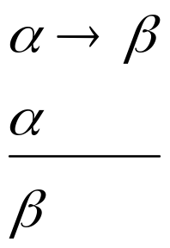
Rules of Inference
“Modus Ponens", which means "affirming method“
From now onwards, anything that is written down in a proof, is a statement that is true.
If you know that alpha implies beta, and you know alpha to be true, you can automatically say that beta is true
Modus
Ponens

Slide 34
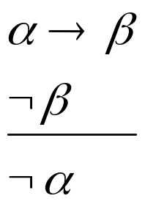
Rules of Inference
Modus Tolens: "alpha implies beta" and "not beta" you can conclude "not alpha".
If Alpha implies beta is true and beta is known to be not true, then alpha could not have been true. Had alpha been true, beta would automatically have been true due to the implication.
Modus Tolens

Slide 35
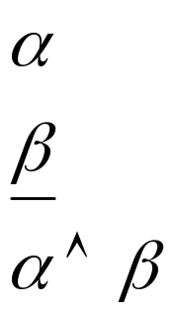
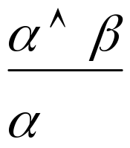
Rules of Inference
And-introduction say that from "Alpha" and from "Beta" you can conclude "Alpha and Beta". That seems pretty obvious.
Conversely, and-elimination says that from "Alpha and Beta" you can conclude "Alpha".
And-
Introduction
And-
elimination

Slide 36
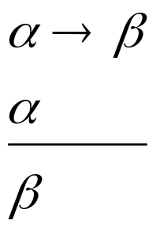
Rules of Inference
Modus
Ponens
Modus Tolens
And-
Introduction
And-
elimination

Slide 37
Inference Example
Prove S
Step | Formula | Derivation
1 | P ∧ Q | Given
2 | P→R | Given
3 | (Q ∧ R) →S | Given

Slide 38
Inference Example
Prove S
Step | Formula | Derivation
1 | P ∧ Q | Given
2 | P→R | Given
3 | (Q ∧ R) →S | Given
4 | P | 1 And-elimination

Slide 39
Inference Example
Prove S
Step | Formula | Derivation
1 | P ∧ Q | Given
2 | P→R | Given
3 | (Q ∧ R) →S | Given
4 | P | 1 And-elimination
5 | R | 4, 2 Modus Ponens

Slide 40
Inference Example
Prove S
Step | Formula | Derivation
1 | P ∧ Q | Given
2 | P→R | Given
3 | (Q ∧ R) →S | Given
4 | P | 1 And-elimination
5 | R | 4, 2 Modus Ponens
6 | Q | 1 And-elimination

Slide 41
Inference Example
Prove S
Step | Formula | Derivation
1 | P ∧ Q | Given
2 | P→R | Given
3 | (Q ∧ R) →S | Given
4 | P | 1 And-elimination
5 | R | 4, 2 Modus Ponens
6 | Q | 1 And-elimination
7 | Q ∧R | 5, 6 And-introduction

Slide 42
Inference Example
Prove S
Step | Formula | Derivation
1 | P ∧ Q | Given
2 | P→R | Given
3 | (Q ∧ R) →S | Given
4 | P | 1 And-elimination
5 | R | 4, 2 Modus Ponens
6 | Q | 1 And-elimination
7 | Q ∧R | 5, 6 And-introduction
8 | S | 7, 3 Modus Ponens

Slide 43
Lecture Summary
Reasoning
Types of reasoning:
  Deductive
  Inductive
  Adbuctive
  Analogical
  common-sense
  non-monotonic reasoning
Logic: syntax, semantics, Proof systems
Rules of inference: Modus Ponens, Modus Tolens, And-introduction, And-elimination
Inference example

Slide 44
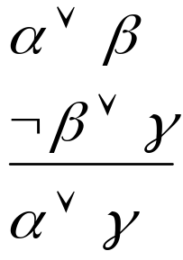
Resolution
The deduction mechanism we discussed may be used in practical systems, but is not feasible. It uses a lot of inference rules, which introduces a large branch factor in the search for a proof.
An alternative is Resolution, a strategy used to assert the determine the truth of an assertion.
Only one Resolution rule:
Notes:
We have talked a little bit about proof, with the idea that you write down some axioms -- statements that you're given -- and then you try to derive something from them. And we've all had practice doing that in high school geometry and we've talked a little bit about natural deduction. So what we're going to talk about now is resolution. Which is the way that pretty much every modern automated theoremprover is implemented. It seems to be the best way for computers to think about proving things. So here's the Resolution Inference Rule, in the propositional case. It says that if you know "alpha or beta", and you know "not beta or gamma", then you're allowed toconclude "alpha or gamma". OK.
Remember from when we looked at inference rules before that these Greek letters are meta-variables. They can stand for big chunks of propositional logic, as long as the parts match up in the right way. So if you know something of the form "alpha or beta", and you also know that "not beta or gamma", then you can conclude "alpha or gamma".
First, you convert all of your sentences to conjunctive normal form. You already know how to do this! Then, you write each clause down as a premise or given in you proof.
Then, you negate the desired conclusion -- so you have to say what you're trying to prove, but what we're going to do is essentially a proof by contradiction. You've all seen the strategy of proof by contradiction (or, if we're being fancy and Latin, reductio ad absurdum). You assert that the thing that you're trying to prove is false, and then you try to derive a contradiction. That's what we're going to do. So you negate the desired conclusion and convert that to CNF. And you add each of these clauses as a premise of your proof, as well.
And then we apply the Resolution Rule until either we derive "false" -- which means that the conclusion did, in fact, follow from the things that we had assumed. If you assert that the negation of the thing that you're interested in is true, and then you prove for a while and you manage to prove false, then you've succeeded in a proof by
contradiction of the thing that you were trying to prove in the first place. So you run the resolution rule until you derive false or until you can't apply it anymore.
What if you can't apply the Resolution Rule anymore? Is there anything in particular that you can conclude? In fact, you can conclude that the thing that you were trying to prove can't be proved. So resolution refutation for propositional logic is a complete proof procedure. If the thing that you're trying to prove is, in fact, entailed by the
things that you've assumed, then you can prove it using resolution refutation. It's guaranteed that you'll always either prove false, or run out of possible steps. It's complete, because it always generates an answer. Furthermore, the process is sound: the answer is always correct.

Slide 45







Resolution Rule
F | F | F | T | F | T | F
F | F | T | T | F | T | T
F | T | F | F | T | F | F
F | T | T | F | T | T | T
T | F | F | T | T | T | T
T | F | T | T | T | T | T
T | T | F | F | T | F | T
T | T | T | F | T | T | T

Slide 46
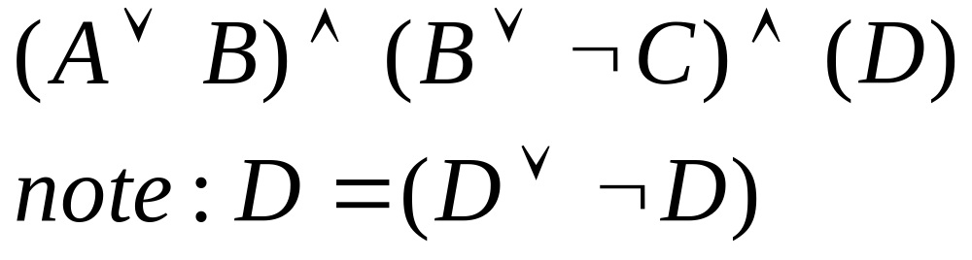
Conjunctive Normal Form
ANDs of ORs
Resolution requires all sentences to be converted into a special form called Conjunctive Normal Form (CNF)
A sentence written in CNF looks like
Outermost structure is made up of conjunctions. Inner units called clauses are made up of disjunctions
Notes:
A clause is the disjunction of many things. The units that make up a clause are called literals. And a literal is either a variable or the negation of a variable. So you get an expression where the negations are pushed in as tightly as possible, then you have ors, then you have ands. This is like saying that every assignment has to meet each of a set of requirements. You can think of each clause as a requirement. So somehow, the first clause has to be satisfied, and it has different ways that it can be satisfied, and the second one has to be satisfied, and the third one has to be satisfied, and so on.

Slide 47

Conjunctive Normal Form
Clause
  A clause is the disjunction of many things.
Literals
  The units that make up a clause are called literals. And a literal is either a variable or the negation of a variable. So you get an expression where the negations are pushed in as tightly as possible, then you have ors, then you have ands.
You can think of each clause as a requirement. Each clause has to be satisfied to satisfy the entire statement
Notes:
A clause is the disjunction of many things. The units that make up a clause are called literals. And a literal is either a variable or the negation of a variable. So you get an expression where the negations are pushed in as tightly as possible, then you have ors, then you have ands. This is like saying that every assignment has to meet each of a set of requirements. You can think of each clause as a requirement. So somehow, the first clause has to be satisfied, and it has different ways that it can be satisfied, and the second one has to be satisfied, and the third one has to be satisfied, and so on.

Slide 48
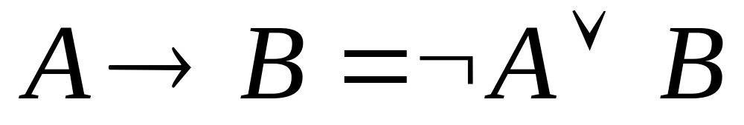
Convert to CNF
Eliminate arrows (implications)

Slide 49
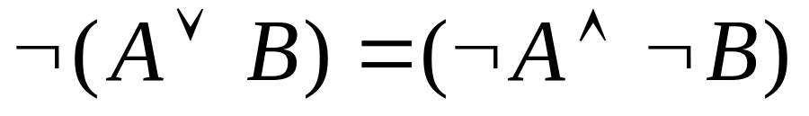
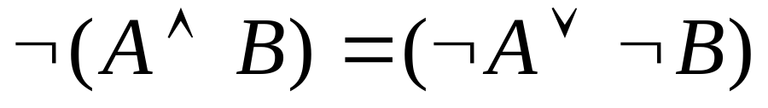
Convert to CNF
Drive in negations using De Morgan’s Laws

Slide 50
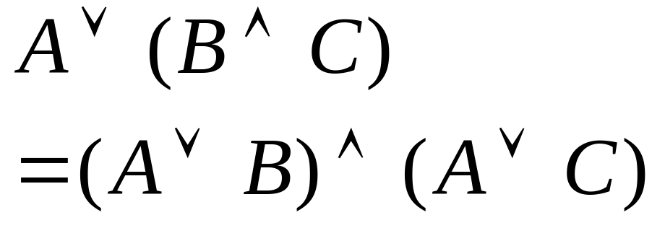
Convert to CNF
Distribute OR over AND

Slide 51
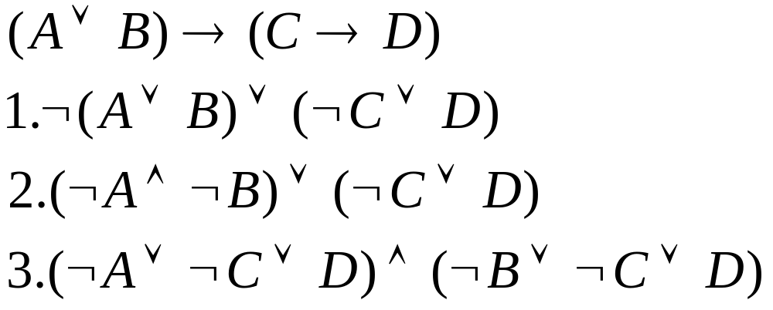
Convert to CNF Example

Slide 52
Resolution by Refutation
Proof strategy called Resolution Refutation
  Write all sentences in CNF
  Negate the desired conclusion
  Apply the resolution rule until you derive a contradiction or cannot apply the rule anymore.
If we derive a contradiction, then the conclusion follows from the given axioms
If we cannot apply anymore, then the conclusion cannot be proved from the given axioms
Notes:
We have talked a little bit about proof, with the idea that you write down some axioms -- statements that you're given -- and then you try to derive something from them. And we've all had practice doing that in high school geometry and we've talked a little bit about natural deduction. So what we're going to talk about now is resolution. Which is the way that pretty much every modern automated theoremprover is implemented. It seems to be the best way for computers to think about proving things. So here's the Resolution Inference Rule, in the propositional case. It says that if you know "alpha or beta", and you know "not beta or gamma", then you're allowed toconclude "alpha or gamma". OK.
Remember from when we looked at inference rules before that these Greek letters are meta-variables. They can stand for big chunks of propositional logic, as long as the parts match up in the right way. So if you know something of the form "alpha or beta", and you also know that "not beta or gamma", then you can conclude "alpha or gamma".
First, you convert all of your sentences to conjunctive normal form. You already know how to do this! Then, you write each clause down as a premise or given in you proof.
Then, you negate the desired conclusion -- so you have to say what you're trying to prove, but what we're going to do is essentially a proof by contradiction. You've all seen the strategy of proof by contradiction (or, if we're being fancy and Latin, reductio ad absurdum). You assert that the thing that you're trying to prove is false, and then you try to derive a contradiction. That's what we're going to do. So you negate the desired conclusion and convert that to CNF. And you add each of these clauses as a premise of your proof, as well.
And then we apply the Resolution Rule until either we derive "false" -- which means that the conclusion did, in fact, follow from the things that we had assumed. If you assert that the negation of the thing that you're interested in is true, and then you prove for a while and you manage to prove false, then you've succeeded in a proof by
contradiction of the thing that you were trying to prove in the first place. So you run the resolution rule until you derive false or until you can't apply it anymore.
What if you can't apply the Resolution Rule anymore? Is there anything in particular that you can conclude? In fact, you can conclude that the thing that you were trying to prove can't be proved. So resolution refutation for propositional logic is a complete proof procedure. If the thing that you're trying to prove is, in fact, entailed by the
things that you've assumed, then you can prove it using resolution refutation. It's guaranteed that you'll always either prove false, or run out of possible steps. It's complete, because it always generates an answer. Furthermore, the process is sound: the answer is always correct.

Slide 53
Resolution by Refutation
Step | Formula | Derivation
1 | P ∨ Q | Given
2 | ¬P ∨ R | Given
3 | ¬Q ∨ R | Given
Prove R
1 | P ∨ Q
2 | P→R
3 | Q →R

Slide 54
Resolution Example
Step | Formula | Derivation
1 | P ∨ Q | Given
2 | ¬P ∨ R | Given
3 | ¬Q ∨ R | Given
4 | ¬R | Negated Conclusion
Prove R
1 | P ∨ Q
2 | P→R
3 | Q →R

Slide 55
Resolution Example
Step | Formula | Derivation
1 | P ∨ Q | Given
2 | ¬P ∨ R | Given
3 | ¬Q ∨ R | Given
4 | ¬R | Negated Conclusion
5 | Q ∨ R | 1,2 Resolution Rule
Prove R
1 | P ∨ Q
2 | P→R
3 | Q →R

Slide 56
Resolution Example
Step | Formula | Derivation
1 | P ∨ Q | Given
2 | ¬P ∨ R | Given
3 | ¬Q ∨ R | Given
4 | ¬R | Negated Conclusion
5 | Q ∨ R | 1,2
6 | ¬P | 2,4
Prove R
1 | P ∨ Q
2 | P→R
3 | Q →R

Slide 57
Resolution Example
Step | Formula | Derivation
1 | P ∨ Q | Given
2 | ¬P ∨ R | Given
3 | ¬Q ∨ R | Given
4 | ¬R | Negated Conclusion
5 | Q ∨ R | 1,2
6 | ¬P | 2,4
7 | ¬Q | 3,4
Prove R
1 | P ∨ Q
2 | P→R
3 | Q →R

Slide 58
Resolution Example
Step | Formula | Derivation
1 | P ∨ Q | Given
2 | ¬P ∨ R | Given
3 | ¬Q ∨ R | Given
4 | ¬R | Negated Conclusion
5 | Q ∨ R | 1,2
6 | ¬P | 2,4
7 | ¬Q | 3,4
8 | R | 5,7 Contradiction!
Prove R
1 | P ∨ Q
2 | P→R
3 | Q →R
Notes:
Note that you could have come up with multiple ways to reaching this same conclusion

Slide 59
Resolution Example
Note that you could have come up with multiple ways of proving R
Step | Formula
1 | P ∨ Q | Given
2 | ¬P ∨ R | Given
3 | ¬Q ∨ R | Given
4 | ¬R
5 | ¬Q | 3,4
6 | P | 1,5
7 | R | 2,6
Step | Formula
1 | P ∨ Q | Given
2 | ¬P ∨ R | Given
3 | ¬Q ∨ R | Given
4 | ¬R
5 | Q ∨ R | 1,2
6 | ¬P | 2,4
7 | ¬Q | 3,4
8 | R | 5,7

Slide 60
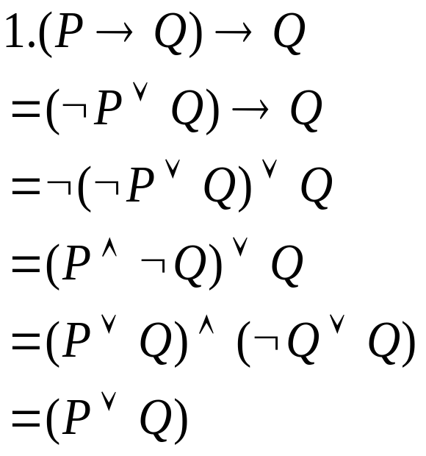


Resolution Example 2
1. (P→Q) →Q
2. P→R
3. ¬R → ¬Q
Convert to CNF:

Slide 61
Resolution Example 2
Step | Formula | Derivation
1 | Q ∨ P | Given
2 | ¬ P ∨ R | Given
3 | R ∨ ¬Q | Given
4 | ¬R
5 | P | 2,4
6 | R | 2,5
Step | Formula | Derivation
1 | Q ∨ P | Given
2 | ¬ P ∨ R | Given
3 | R ∨ ¬Q | Given
4 | ¬R
5 | ¬Q | 3,4
6 | P | 1,5
7 | R | 2,6

Slide 62
Proof Strategies
We may apply rules in an arbitrary order, but there are some rules of thumb
  Unit preference: prefer using a clause with one literal. Produces shorter clauses
  Set of support: try to involve the thing you are trying to prove. Chose a resolution involving the negated goal. These are relevant clauses. We move ‘towards solution’

Slide 63
Lecture Summary
Reasoning
Types of reasoning: Deductive, Inductive, Adbuctive, Analogical, common-sense, non-monotonic reasoning
Logic: syntax, semantics, Proof systems
Rules of inference: Modus ponens, Modus tolens, And-introduction, And-elimination
Inference example
Resolution Refutation
  Convert to CNF
    Remove arrows
    Drive in Negations (De Morgans)
    Distribute Or over And
  Add negation of Goal
  Repeatedly apply resolution rule

