Slide 1

Lecture 16

Slide 2
Recap
Types of Knowledge: declarative, procedural, meta, heuristic, structural.
Knowledge Representation Techniques
  Facts
    Types of facts: single/multi values, uncertain, fuzzy
  Object-attribute Value Triplets
  Rules
    Types of rules: relationship, recommendation, directive
    Variable rules, fuzzy rules, meta rules, fuzzy rules
  Object-attribute Value Triplets
  Semantic Networks
  Frames
  Logic
    Propositional Calculus
    Predicate Calculus

Slide 3
Reasoning
Deriving logical conclusions from given facts.
‘The process of working with knowledge, facts and problem solving strategies to draw conclusions’ Durkin

Slide 4
Deductive Reasoning
Deduce new information from logically related known information
A deductive argument offers assertions that lead automatically to a conclusion.
  If there is dry wood, oxygen and a spark, there will be a fire
  Given: There is dry wood, oxygen and a spark
  We can deduce: There will be a fire.
  All men are mortal. Socrates is a man.
  We can deduce: Socrates is mortal
Modus Ponens is the basic form of deductive reasoning
  Modus Ponens: If A is true and if A implies B is true, then B is true.
Notes:
Modus Ponens is a commonly used rule of deductive reasoning

Slide 5
Inductive Reasoning
From a limited set of observations, we form a ‘generalization’.
e.g.
  Observation: All the crows that I have seen in my life are black.
  Conclusion: All crows are black
Notes:
It only finds the most likely conclusion. In itself, it cannot be used as a method of proof.

Slide 6
Comparison
Comparing deductive and inductive reasoning:
  Inductive: By experience, every time I have let a ball go, it falls downwards. Therefore I conclude that the next time I let a ball go, it will also come down.
  Deductive: I know Newton's Laws. So I conclude, if I let a ball go, it will certainly fall downwards.

Slide 7
Abductive Reasoning
Deduction is exact in that the deductions follow in a logically provable way from the axioms.
Abduction is a form of deduction that allows for plausible inference, i.e. the conclusion might be wrong, e.g.
  Implication: She carries an umbrella if it is raining
  Axiom: she is carrying an umbrella
  Conclusion: It is raining
This conclusion might be false, because there could be other reasons that she is carrying an umbrella, e.g. she might be carrying it to protect herself from the sun.

Slide 8
Analogical Reasoning
Draw analogy between two situations, looking for similarities and differences.
e.g. when you say driving a truck is just like driving a car
  By analogy you know that there are some similarities, same basic concepts
  But you also know that there are certain other distinguishing characteristics of each

Slide 9
Common-sense Reasoning
Gained through experience, rule-of-thumb
Operates on heuristic knowledge and heuristic rules.

Slide 10
Non-Monotonic Reasoning
Used when the facts of the case are not static, e.g.
  Rule:
    IF the wind blows
    THEN the curtains sway
    When the wind stops blowing, the curtains should sway no longer.
    However, if we use monotonic reasoning, this would not happen. The fact that the curtains are swaying would be retained even after the wind stopped blowing
  In non-monotonic reasoning, we have a ‘truth maintenance system’. It keeps track of what caused a fact to become true. If the cause is removed, that fact is removed (retracted) also.

Slide 11
Inference
Inference is the process of deriving new information from known information
In the domain of AI, the component of the system that performs inference is called an inference engine.
We will look at inference within the framework of ‘logic’, which we introduced earlier

Slide 12
Logic
Logic is a formal language
  Syntax:
    A description of valid statements, the expressions that are legal in that language. We have already looked at the syntax of two type of logic system called propositional logic and predicate logic.
      Propositions: p, q, r
      Associated truth value
      Logical connectives
  Semantics: what expressions mean.
    e.g. the expression ‘the cat drove the car’ is syntactically correct, but semantically non-sensible.
  Proof systems:
    A logic comes with a proof system, which is a way of manipulating given statements to arrive at new statements. The idea is to derive ‘new’ information from the given information

Slide 13
Proof
Recall proofs in math class. You write down all you know about the situation and then try to apply all the rules you know repeatedly until you come up with the statement you were supposed to prove.
A proof is a sequence of statements aiming at inferring some information.
Steps:
  Initial statements are called premises of the proof (or knowledge base)
  Use rules
  Add new statements
  Till you arrive at the statement you wished to prove.

Slide 14
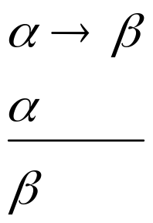
Rules of Inference
“Modus Ponens", which means "affirming method“
From now onwards, anything that is written down in a proof, is a statement that is true.
If you know that alpha implies beta, and you know alpha to be true, you can automatically say that beta is true
Modus
Ponens

Slide 15
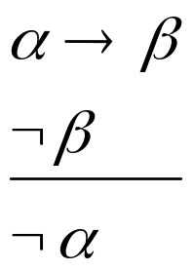
Rules of Inference
Modus Tolens: "alpha implies beta" and "not beta" you can conclude "not alpha".
If Alpha implies beta is true and beta is known to be not true, then alpha could not have been true. Had alpha been true, beta would automatically have been true due to the implication.
Modus Tolens

Slide 16
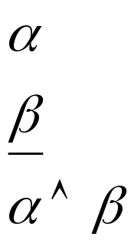
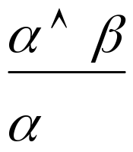
Rules of Inference
And-introduction say that from "Alpha" and from "Beta" you can conclude "Alpha and Beta". That seems pretty obvious.
Conversely, and-elimination says that from "Alpha and Beta" you can conclude "Alpha".
And-
Introduction
And-
elimination

Slide 17
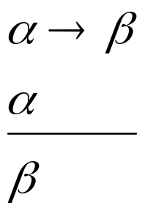
Rules of Inference
Modus
Ponens
Modus Tolens
And-
Introduction
And-
elimination

Slide 18
Inference Example
Prove S
Step | Formula | Derivation
1 | P ∧ Q | Given
2 | P→R | Given
3 | (Q ∧ R) →S | Given

Slide 19
Inference Example
Prove S
Step | Formula | Derivation
1 | P ∧ Q | Given
2 | P→R | Given
3 | (Q ∧ R) →S | Given
4 | P | 1 And-elimination

Slide 20
Inference Example
Prove S
Step | Formula | Derivation
1 | P ∧ Q | Given
2 | P→R | Given
3 | (Q ∧ R) →S | Given
4 | P | 1 And-elimination
5 | R | 4, 2 Modus Ponens

Slide 21
Inference Example
Prove S
Step | Formula | Derivation
1 | P ∧ Q | Given
2 | P→R | Given
3 | (Q ∧ R) →S | Given
4 | P | 1 And-elimination
5 | R | 4, 2 Modus Ponens
6 | Q | 1 And-elimination

Slide 22
Inference Example
Prove S
Step | Formula | Derivation
1 | P ∧ Q | Given
2 | P→R | Given
3 | (Q ∧ R) →S | Given
4 | P | 1 And-elimination
5 | R | 4, 2 Modus Ponens
6 | Q | 1 And-elimination
7 | Q ∧R | 5, 6 And-introduction

Slide 23
Inference Example
Prove S
Step | Formula | Derivation
1 | P ∧ Q | Given
2 | P→R | Given
3 | (Q ∧ R) →S | Given
4 | P | 1 And-elimination
5 | R | 4, 2 Modus Ponens
6 | Q | 1 And-elimination
7 | Q ∧R | 5, 6 And-introduction
8 | S | 7, 3 Modus Ponens

Slide 24
Lecture Summary
Reasoning
Types of reasoning:
  Deductive
  Inductive
  Adbuctive
  Analogical
  common-sense
  non-monotonic reasoning
Logic: syntax, semantics, Proof systems
Rules of inference: Modus Ponens, Modus Tolens, And-introduction, And-elimination
Inference example

