Slide 1
Expert System Structure
Human Expert
Expert System
Focused Area of Expertise
Domain
Specialized Knowledge (stored in LTM)
Domain Knowledge (stored in Knowledge Base)
Case Facts (stored in STM)
Case/Inferred Facts(stored in Working Memory)
Reasoning
Inference Engine
Solution
Conclusions
Notes:
1) 13:02

Slide 2
Expert System Structure
Expert System
Working Memory
Analogy: STM
Initial Case facts
Inferred facts
Inference Engine
USER
Knowledge Base
Analogy: LTM
- Domain Knowedge
Notes:
1-b)

Slide 3
Course Outline
Introduction
Expert Systems
Advanced
Topics
Problem
Solving
Uncertainty
Conclusion
Genetic
Learning
Algorithms
Knowledge
Representation
Planning
& Reasoning
Notes:
2) 16:34 to 19:26
Remove the green circle from the background

Slide 4
The AI Cycle
LEARNING
PERCEPTION
KNOWLEDGE
REPRESENTATION (KR)
REASONING
WITH UNCERTAINTY
PLANNING
EXECUTION
Notes:
2-b)

Slide 5
Classical/Crisp Sets
A classical set is a container that wholly includes or wholly excludes any given element
Monkeys
Monday
Wednesday
Fish
Computers
Friday
Days of the week
Notes:
4) ~ 33:00 ~ 33:30
Change the background color of the inner circle from green to something of your own choice

Slide 6
Fuzzy Sets
Weekend
Thursday
Monkeys
Saturday
Tuesday
Fish
Friday
Computers
Sunday
Monday
Days of the weekend
Notes:
3) 31:26 ~ 33:00
5) 33:30 to 35:55
The background color of the inner circle should not be green. The background color behind the text Friday should be faded.

Slide 7
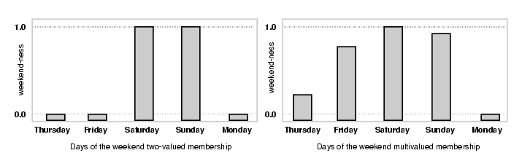
Weekend
Notes:
6) 36:30 Highlight the left side
7) 37:56 Highlight the right side
Redo the figures, make sure the spelling of the text remains same. The background color shouldn’t be white.

Slide 8
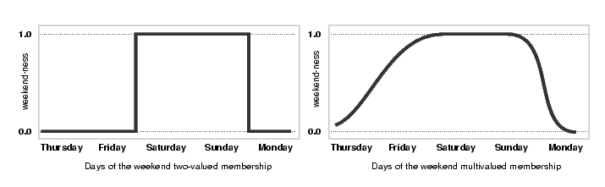
Weekend [continuous values]
Notes:
8) 39:13 Highlight the left side
9) 39:55 ~ 41:36 Highlight the right side

Slide 9
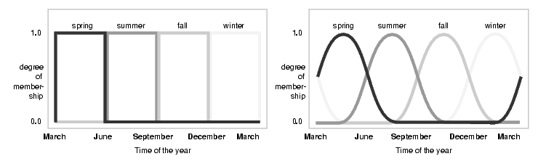
Seasons
Notes:
10) 44:57 Left side
11) ~ 45:50 ~ 48:35 Highlight the right side

Slide 10
Boolean vs Fuzzy
Strictly 0 or 1 output
Output varies between 0 and 1
Notes:
1) 12:24 Make the lines thicker

Slide 11
Boolean v/s Fuzzy
height
height
1.0
Tall (1.0)
1.0
Quite Tall (0.8)
Degree of
tallness
Degree of
tallness
0.0
Not Tall (0.0)
0.0
Not Very Tall (0.2)
Notes:
2) 13:33 Highlight the left side
3) 15:52 ~ 17:30 highlight the right side

Slide 12
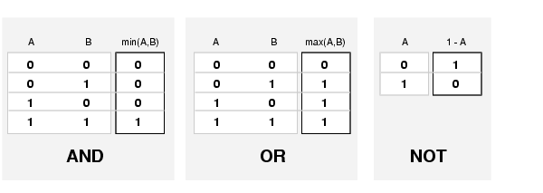
Logical Operators for Fuzzy
Notes:
4) 28:30 ~ 30:37 Highlight AND box
5) 30:38 ~ 31:28 Highlight OR box
6) 31:29 ~ 31:40 Highlight NOT box
7) ~ for sometime don’t highlight any of the boxes

Slide 13
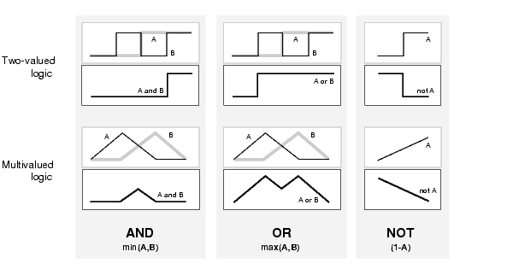
Logical Operators
Notes:
8) 33:10 ~ 38:33 Don’t highlight any box

Slide 14
Tall and Short
Membership value
[0-1]
Height
[0-7feet]
Tall
Short
Tall AND Short
(Medium)
Tall OR Short
(Extremes)
Notes:
9) 39:41
45:50 Highlight Medium Figure
49:00 ~ 50:00 Highlight Extremes Figure
Make the lines more bold

Slide 15
Fuzzy System Structure
Fuzzy Inference Engine
Working Memory
Knowledge base (Rules and fuzzy sets)
Notes:
1) 31:04 ~ 32:04

Slide 16
Linguistic Variables
Linguistic Variables | Typical Values
Temperature | Hot, cold
Height | Short, medium, tall
Speed | Slow, fast
Notes:
2) 32:48 ~ 34:00
Maybe change the table first row’s text color to any suitable color of your choice
No animation within the table rows required

Slide 17
Terminology
Ahmad is young
  We are saying that the implied linguistic variable age has the linguistic value young
  In fuzzy expert systems we use linguistic variables in fuzzy rules
Notes:
2-b) ~ 34:00 ~ 35:25
No animation within the text required

Slide 18
Fuzzy Set Representation
Fuzzy set of tall people may be represented as follows:
Tall = (0/5, 0.25/5.5, 0.7/6, 1/6.5, 1/7)
  Numerator: membership value
  Denominator: actual value of the variable
Notes:
3) ~ 35:25 ~ 38:20
No animation required within the text

Slide 19
Fuzzy Rules
If x is A then y is B
premise or
antecedent
conclusion or
consequent
If hotel service is good then tip is average
If Speed is slow Then make the acceleration high
If Temperature is low AND Pressure is medium Then make the speed very slow
Notes:
4) 41:17 continues with the next two slides

Slide 20
Fuzzy Rules…
Antecedents can have multiple parts
  If wind is mild and racquets are good then playing badminton is fun
  In this case all parts of the antecedent are resolved simultaneously and resolved to a single number using logical operators
Notes:
4-b)

Slide 21
Fuzzy Rules…
The consequent can have multiple parts as well
  if temperature is cold then hot water valve is open and cold water valve is shut
All consequents are affected equally by the result of the antecedent
Notes:
4-c) from last slides to ~ 44:50

Slide 22
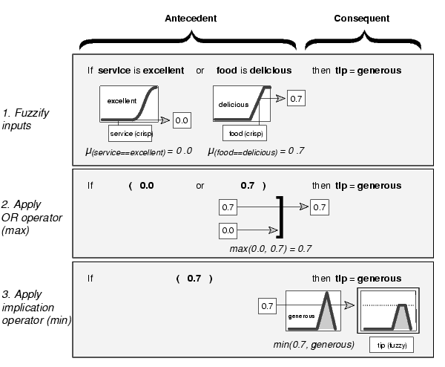
Notes:
5) ~ 44:50
~ 48:48 Highlight 1. Fuzzify inputs and the entire rectangular box in front of it
~ 53:00 Highlight 2. Apply OR operator (max) and the entire rectangular box in front of it
~ 53:20 Highlight 3. Apply implication operator and the entire rectangular box in front of it. (Remove (min) from diagram)

Slide 23
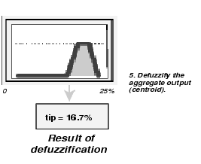
Defuzzify
Notes:
5-b) 53:59 ~ 54:30
Make the diagram more neat.

