Slide 1
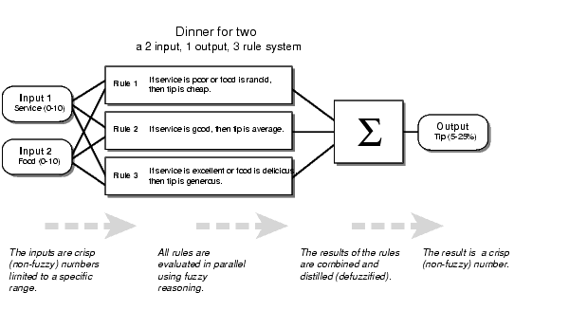
Dinner for Two
Notes:
12:55 ~ 22:42
Make sure there are no spelling mistakes, I’m writing the three rules for your ease
Rule 1 : If service is poor or food is rancid, then tip is average
Rule 2 : If service is good, then tip is average
Rule 3 : If service is excellent or food is delicious, then tip is generous

Slide 2
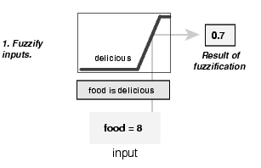
Fuzzify Inputs
Notes:
2) 24:12 ~ 24:42

Slide 3
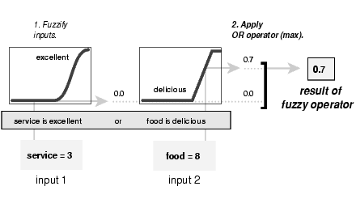
Apply Fuzzy Operator
Notes:
3) 24:43 ~ 26:22

Slide 4
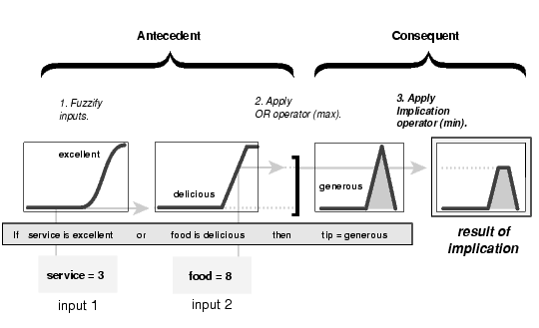
Apply Implication Method
Notes:
4) 26:23 ~ 28:02

Slide 5
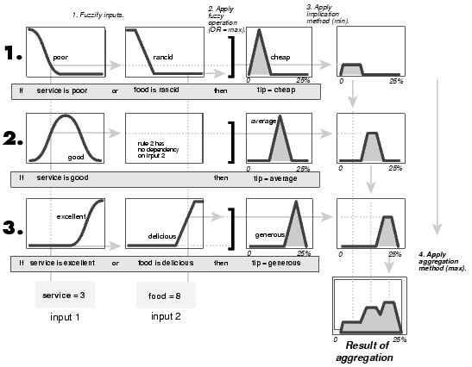
Aggregate all outputs
Notes:
5) 28:03 ~ 31:34

Slide 6
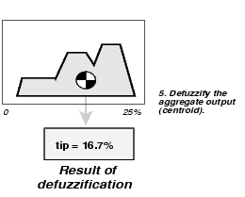
Defuzzify
Notes:
6) 31:35 ~ 32:23

Slide 7
Fuzzy Inference System
Five parts of the fuzzy inference process:
  Fuzzification of the input variables
  Application of fuzzy operator in the antecedent (premises)
  Implication from antecedent to consequent
  Aggregation of consequents across the rules
  Defuzzification of output

Slide 8
Rule No. 1
The minimum penalty for a murder is 3 years (and 1 lac), up to a maximum of 33 years (and 100 lac), or a death sentence depending upon the severity of murder. Severity is dependant upon the age and the intention. The extreme cases get a sentence of death penalty.

Slide 9
Fuzzy Severity Calculator
Input
  Victim Age (Fuzzy Sets: Child, Teenage,..Old)
  Intention (Low, Medium, Strong)
Output
  Severity (Low, Medium, High)

Slide 10
Define Fuzzy Rules
Rules are defined for the fuzzy inference engine
Sample Rules:
  If VictimeAge is child AND Intention is Strong THEN Severity is High
  If VictimeAge is old AND Intention is Low THEN Severity is Low

Slide 11
Actual Case Facts
Now you present the actual case facts to the Fuzzy Severity Calculator
For instance if the Victim age is 12 and the Intention of the suspect is found to be Strong, then the Rule 1 will have a maximum output and the Severity will be High
All the output of the rules are aggregated and finally defuzzified using centroid or some other method to give an output for severity ranging from 0-100

Slide 12
What is Fuzzy Logic?
Fuzzy logic is a superset of conventional (Boolean) logic that has been extended to handle the concept of partial truth -- truth values between "completely true" and "completely false". It was introduced by Dr. Lotfi Zadeh of UC/Berkeley in the 1960's as a means to model the uncertainty of natural language

Slide 13
Applications of Fuzzy Systems
Self-focusing cameras
Washing machines that adjust themselves according to how dirty the clothes are
Automobile engine controls
Anti-lock braking systems
Color film developing systems
Subway control systems
Computer programs trading successfully in the financial markets

Slide 14
Course Outline
Introduction
Expert Systems
Advanced
Topics
Problem
Solving
Uncertainty
Conclusion
Genetic
Learning
Algorithms
Knowledge
Representation
Planning
& Reasoning
Notes:
Get rid of the green oval

Slide 15
The AI Cycle
LEARNING
PERCEPTION
KNOWLEDGE
REPRESENTATION (KR)
REASONING
WITH UNCERTAINTY
PLANNING
EXECUTION

Slide 16
Systems that THINK Like Humans
“[The automation of] activities that we associate with human thinking, activities such as decision making, problem solving, learning …” (Bellman, 1978)

Slide 17
Systems that ACT Like Humans
“The study of how to make computers do things at which, at the moment, people are better” (Rich and Knight, 1991)

Slide 18
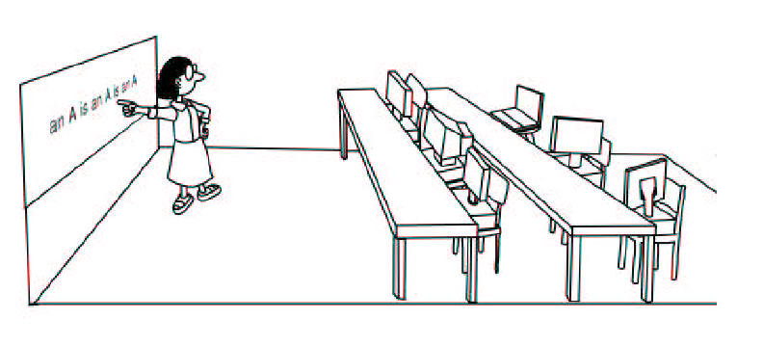
Machine Learning?
Notes:
You have to make the picture yourself. Copyright problems otherwise ☺

Slide 19
Behind the Picture
What is Machine Learning
History of Machine Learning
Applications of Machine Learning
Overview of Learning Strategies
Problem Solving using Learning Paradigm

Slide 20
Multidisciplinary Aspects of Machine Learning
Statistics
Pattern Recognition
Visualization
Robotics
Control

Slide 21
What is Learning?
Learning denotes changes in the system that are adaptive in the sense that they enable the system to do the same task or tasks drawn from the same population more effectively the next time (Simon, 1983).
A computer program learns if it improves its performance at some task through experience (Mitchell, 1997).

Slide 22
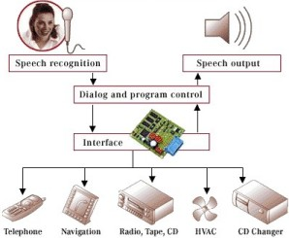
Intelligent Cars
Notes:
Kindly redo the picture, make sure there are no spelling mistakes

