Slide 1
Algorithm
Lecture #12
Dr.Sohail Aslam

Slide 2
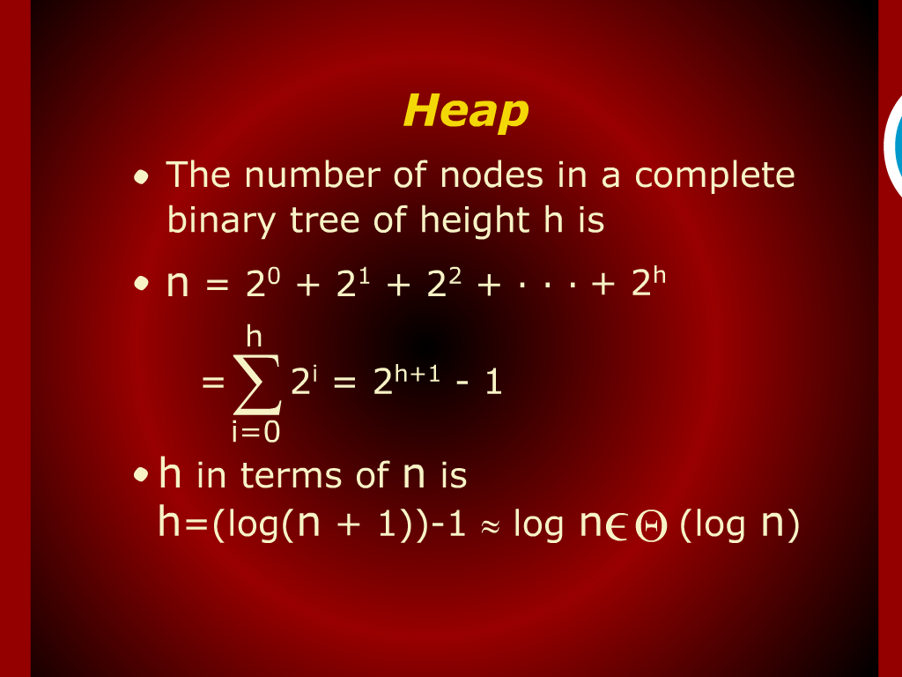
Heap

Slide 3
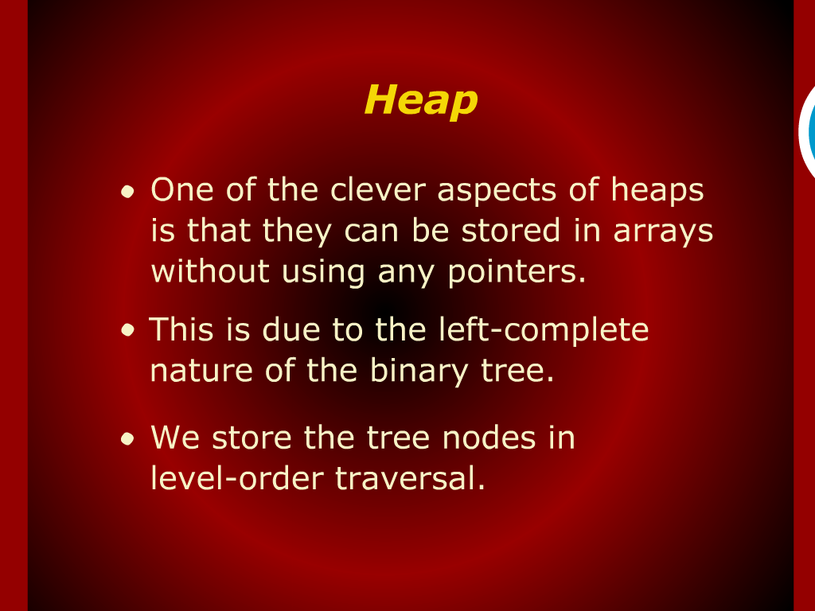
Heap

Slide 4
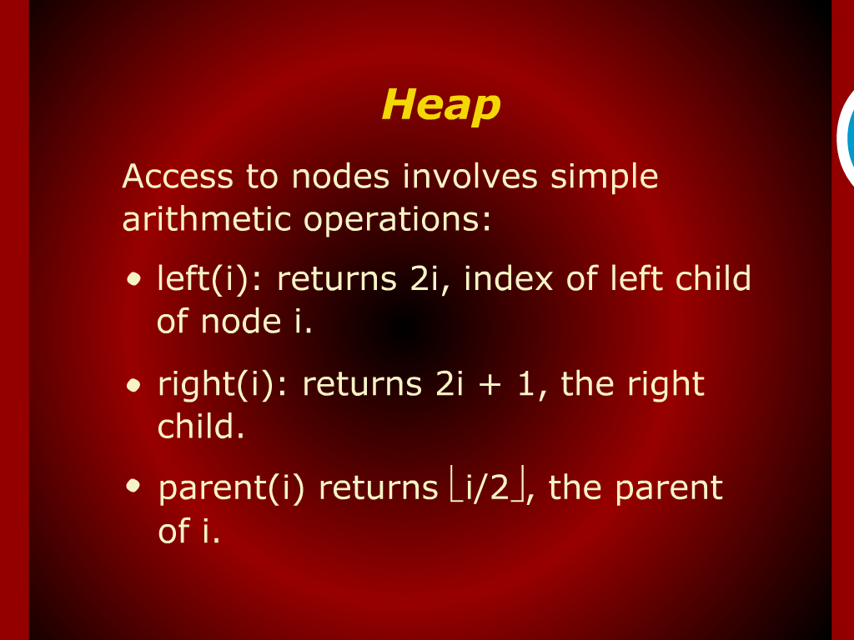
Heap

Slide 5
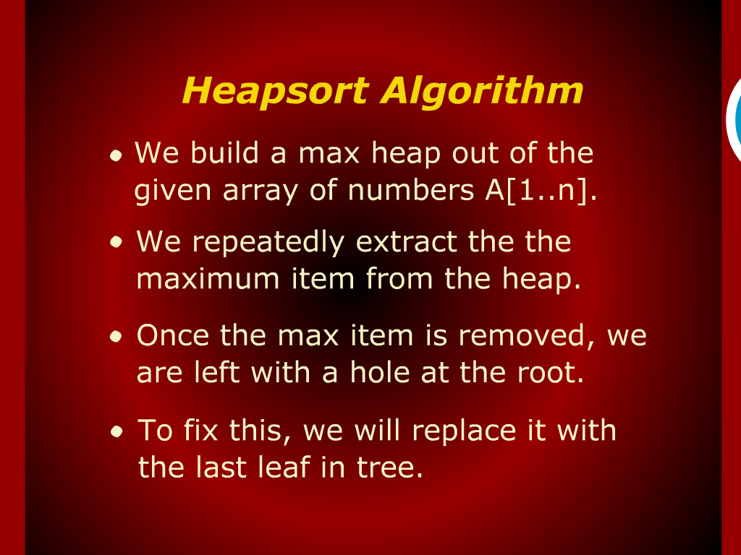
Heap sort Algorithm

Slide 6
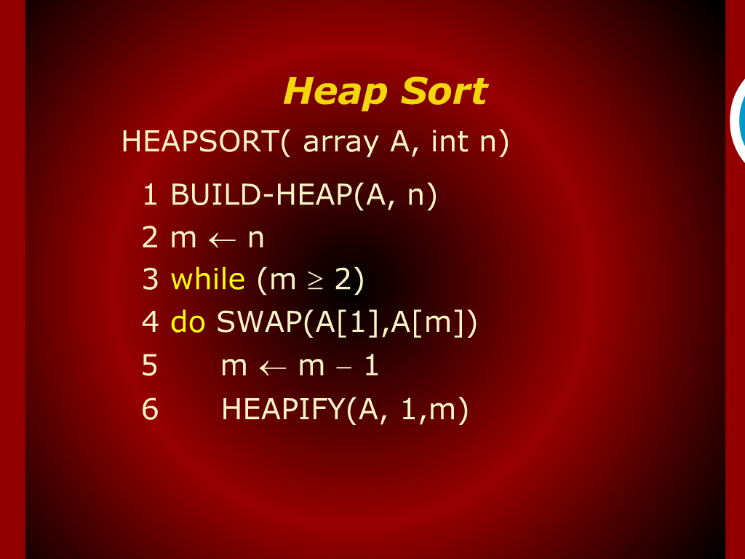
Heap sort Trace

Slide 7
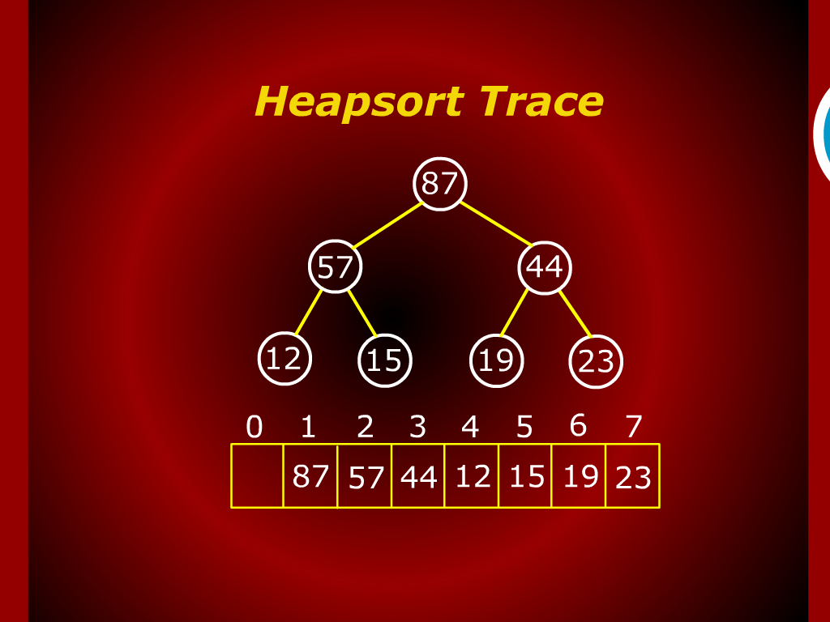
Heap sort Trace

Slide 8
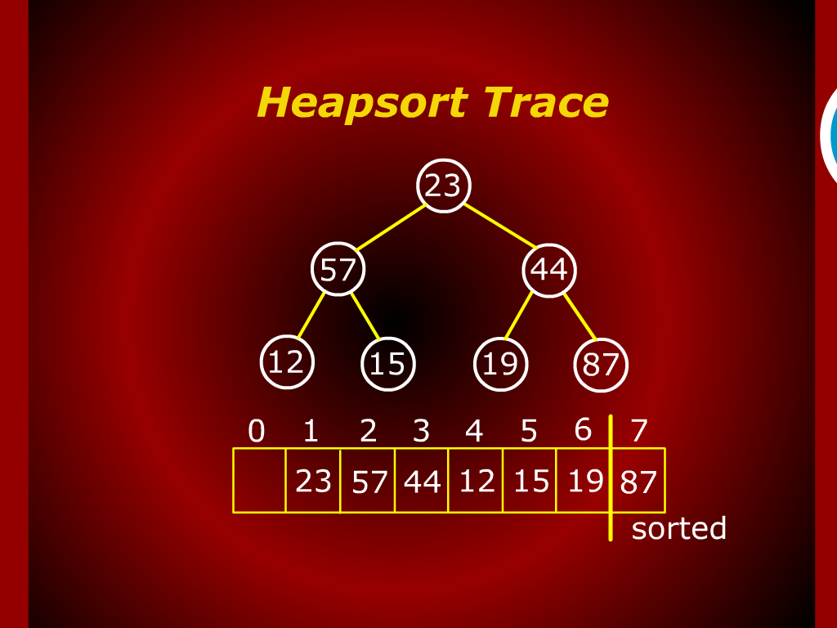
Heap sort Trace

Slide 9
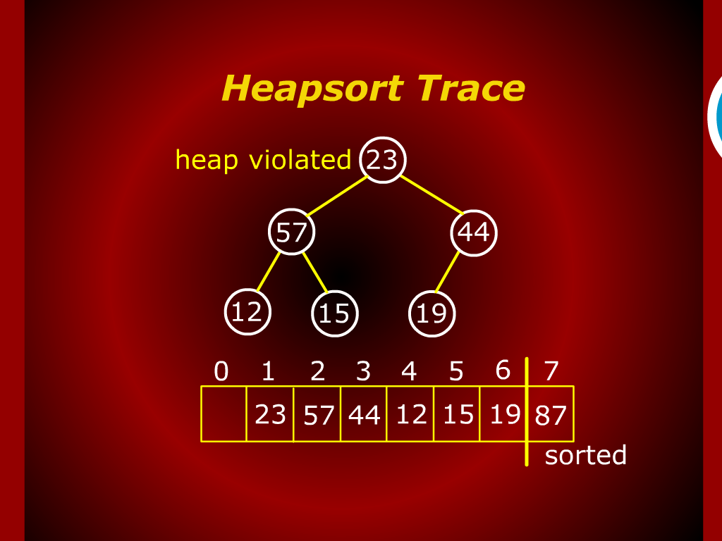
Heap sort Trace

Slide 10
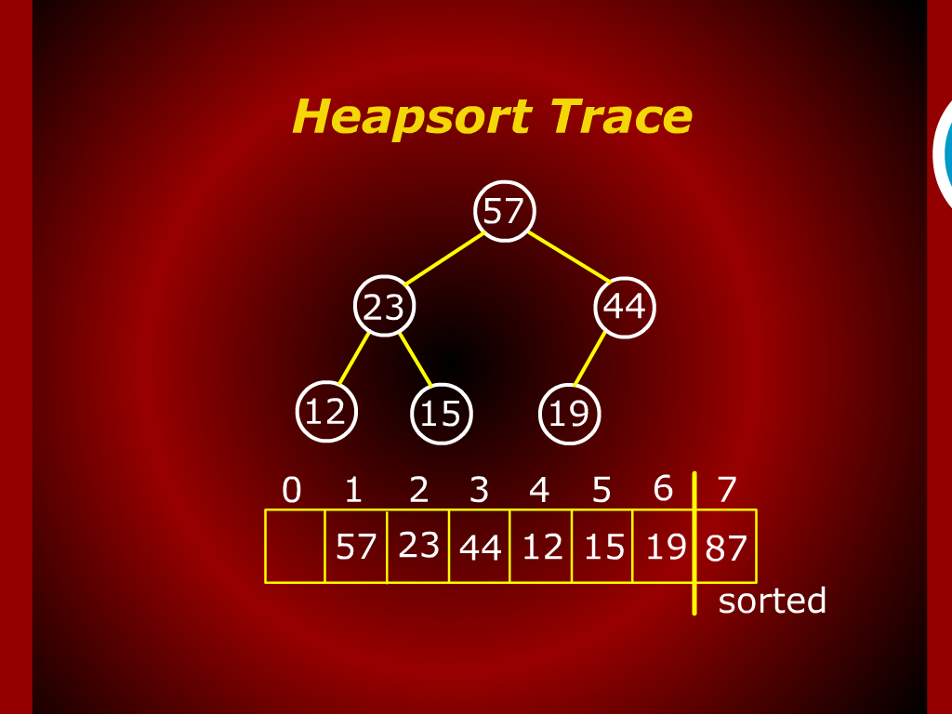
Heap sort Trace

Slide 11
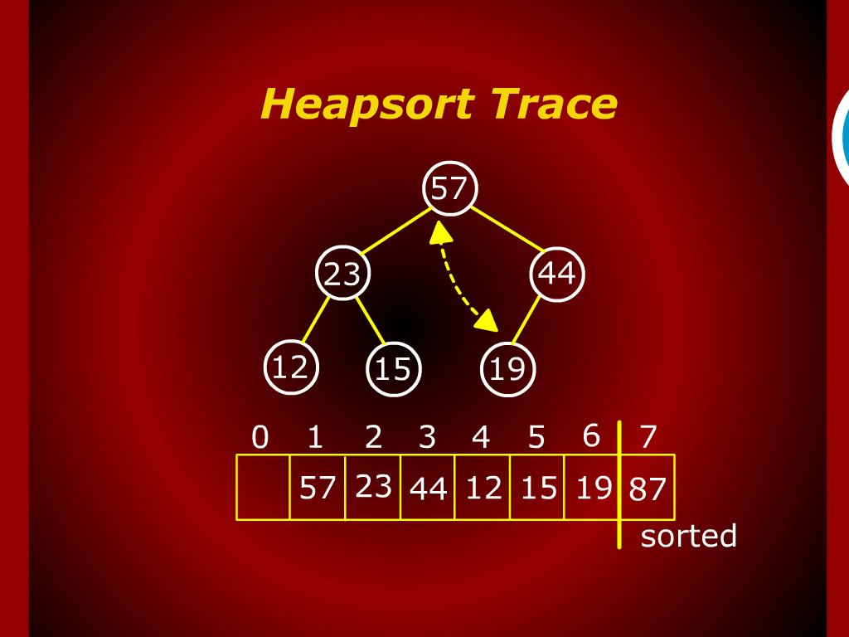
Heap sort Trace

Slide 12
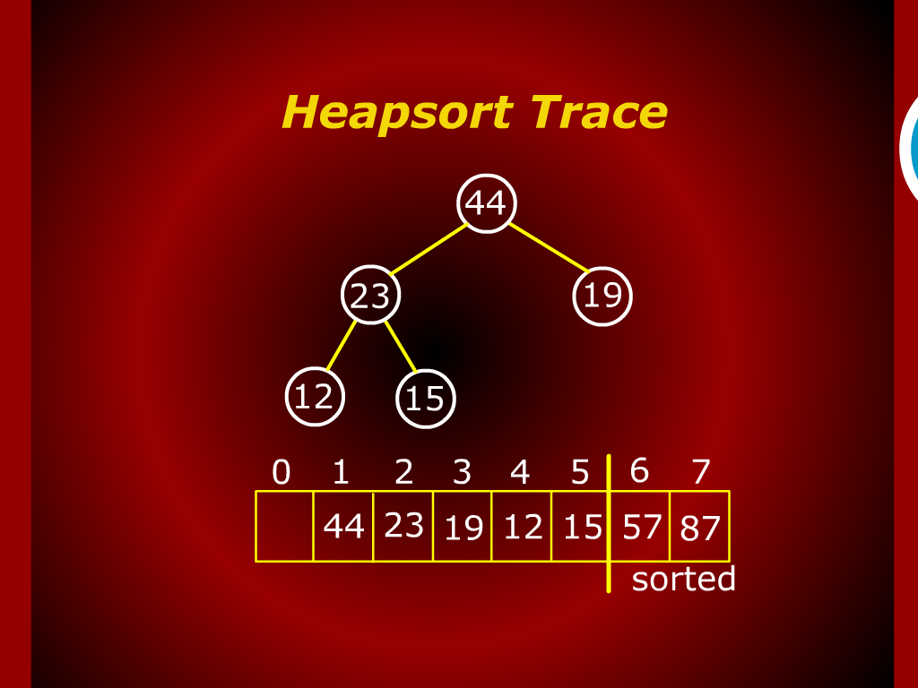
Heap sort Trace

Slide 13
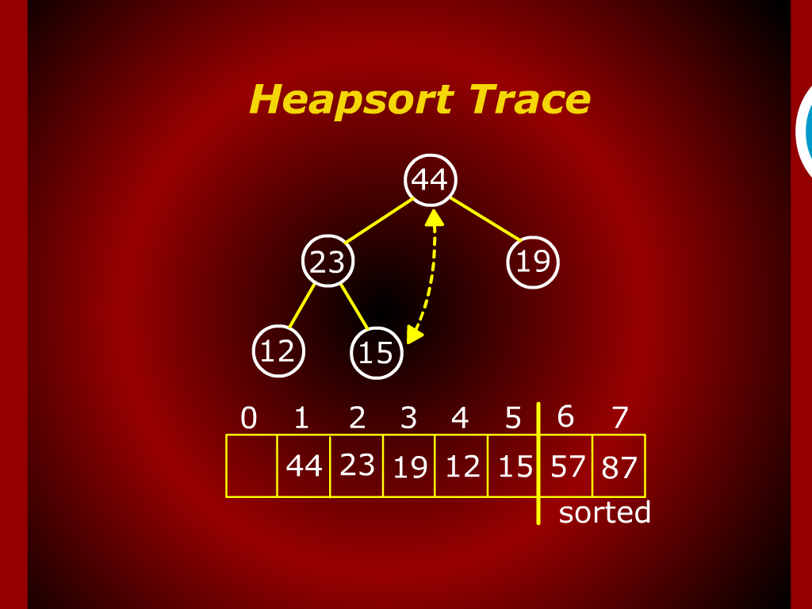
Heap sort Trace

Slide 14
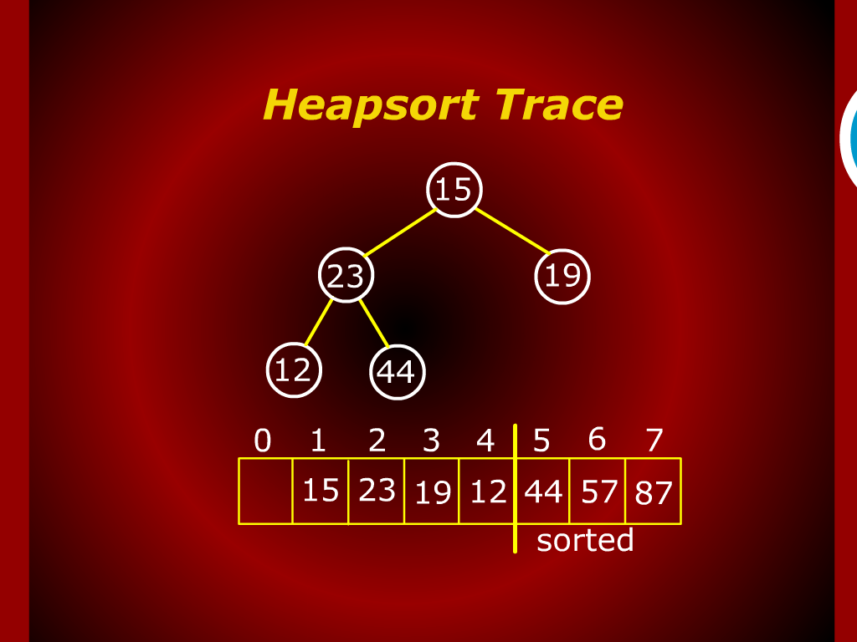
Heap sort Trace

Slide 15
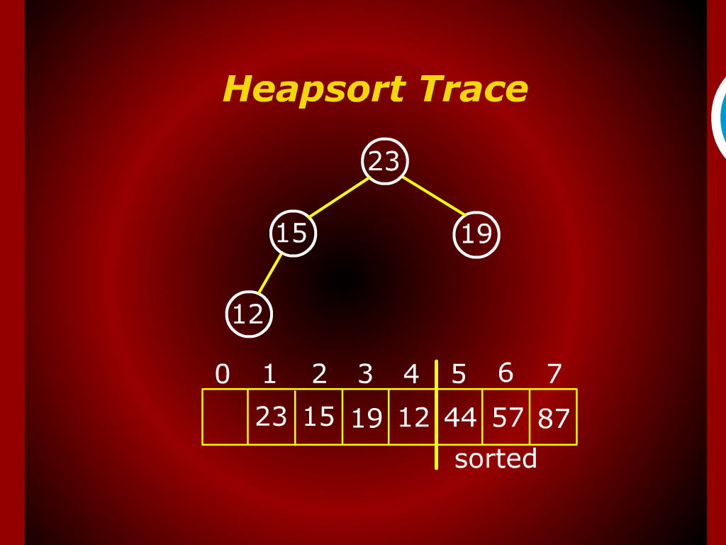
Heap sort Trace

Slide 16
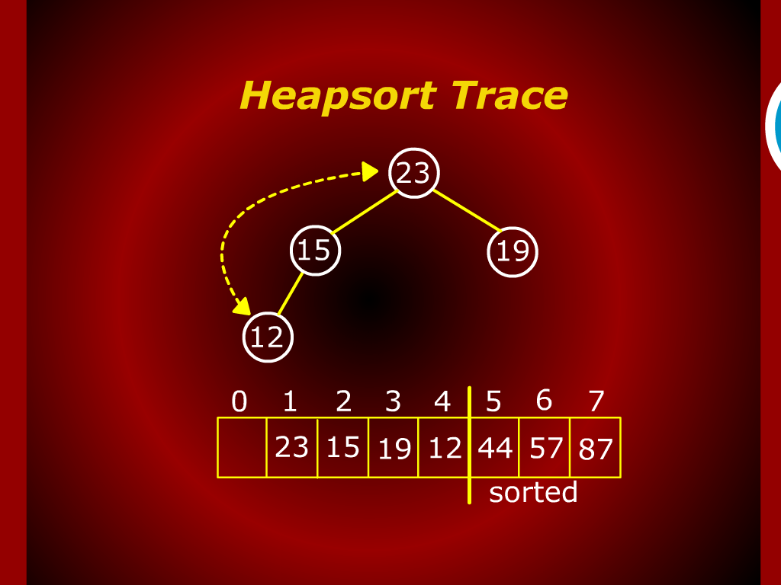
Heap sort Trace

Slide 17
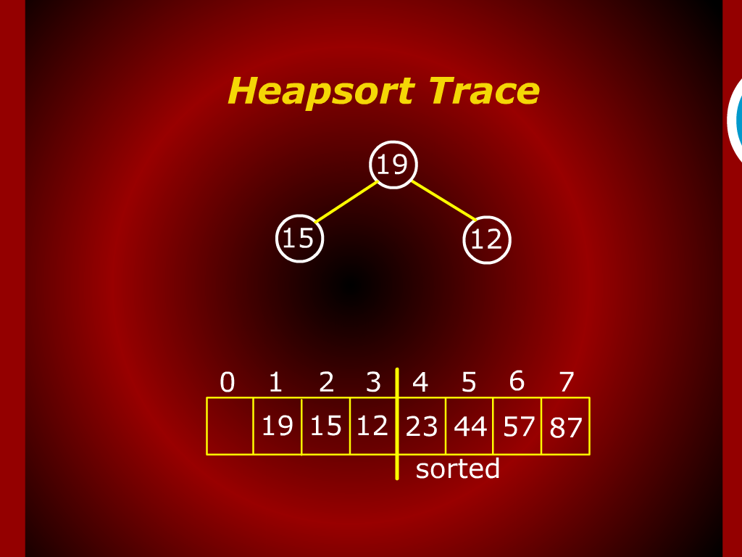
Heap sort Trace

Slide 18
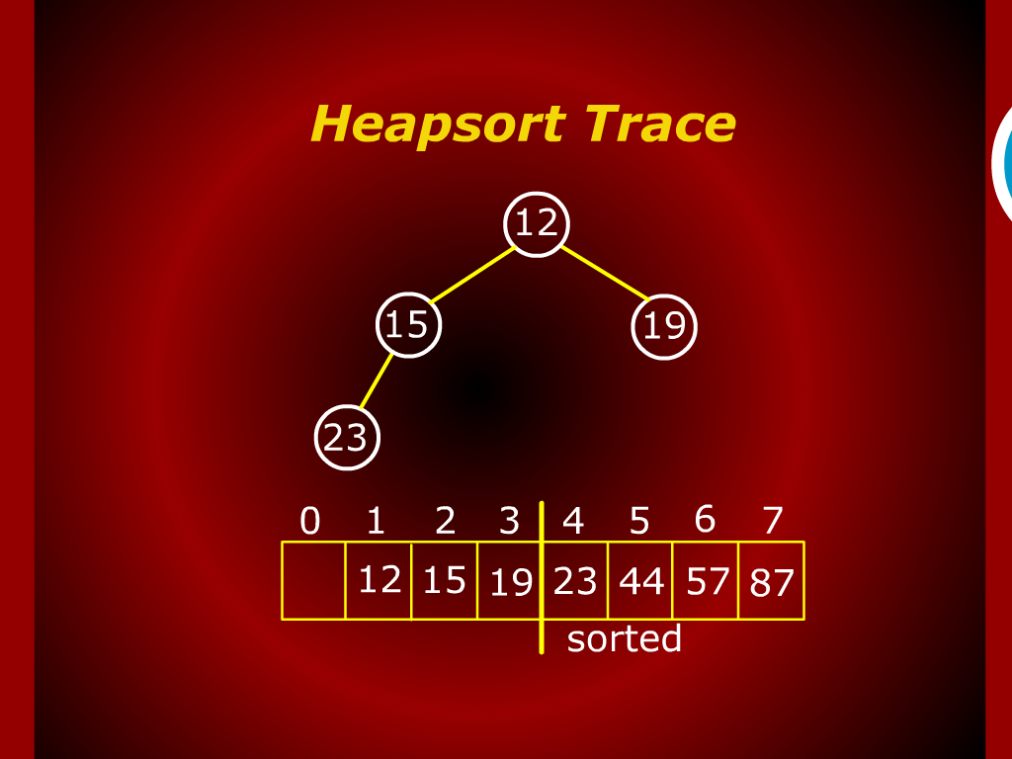
Heap sort Trace

Slide 19
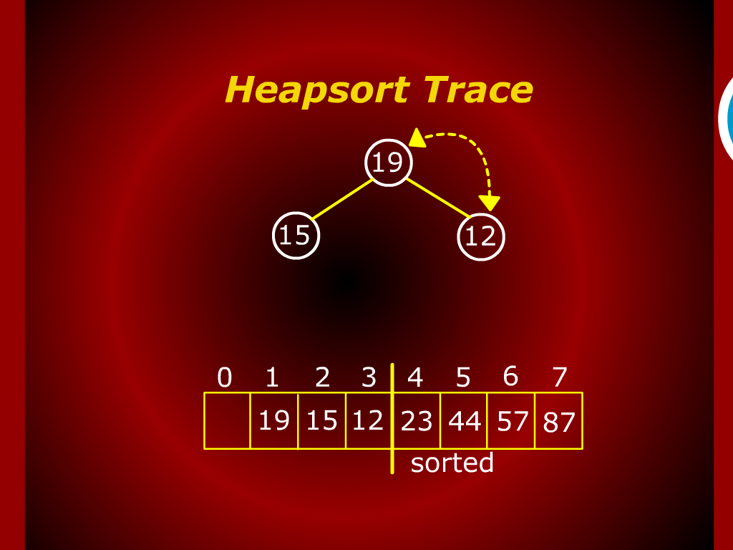
Heap sort Trace

Slide 20
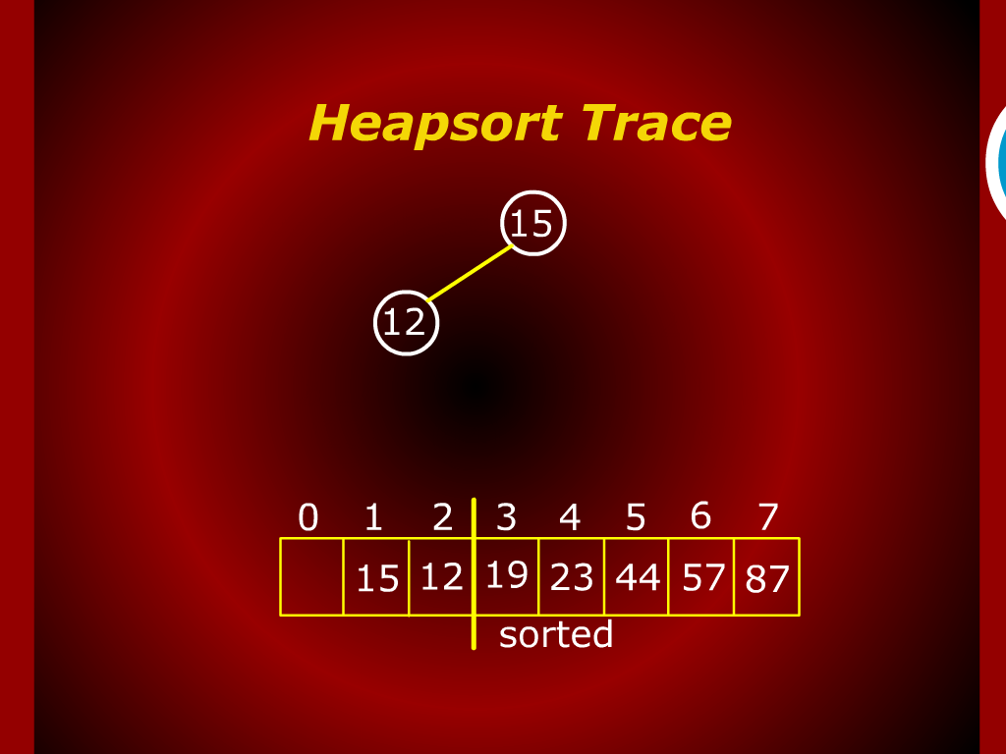
Heap sort Trace

Slide 21
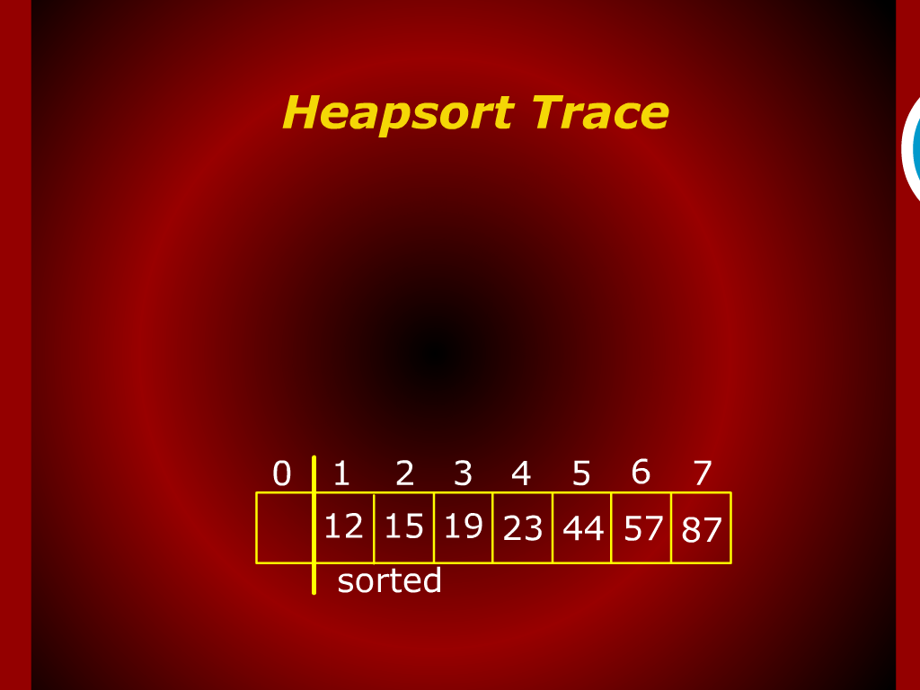
Heap sort Trace

Slide 22
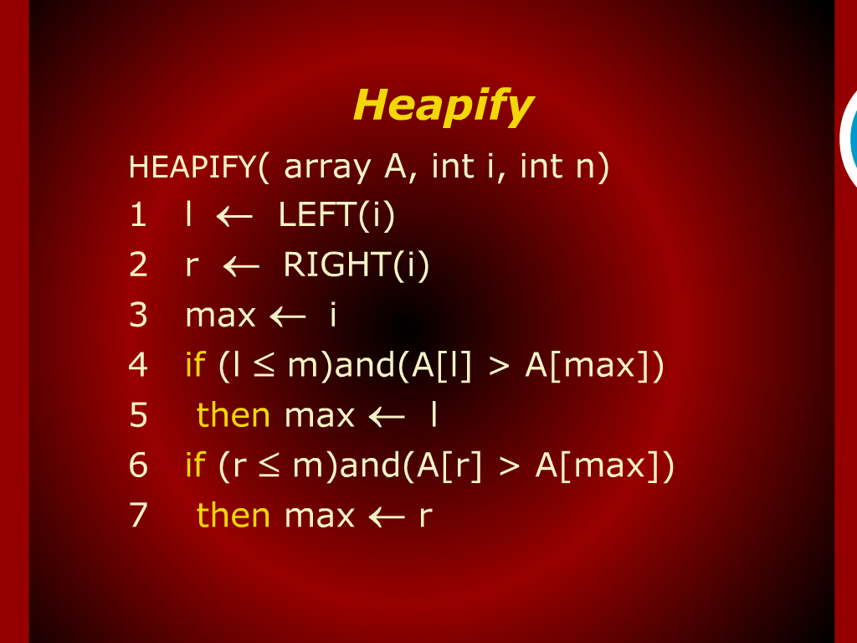
Heapify

Slide 23
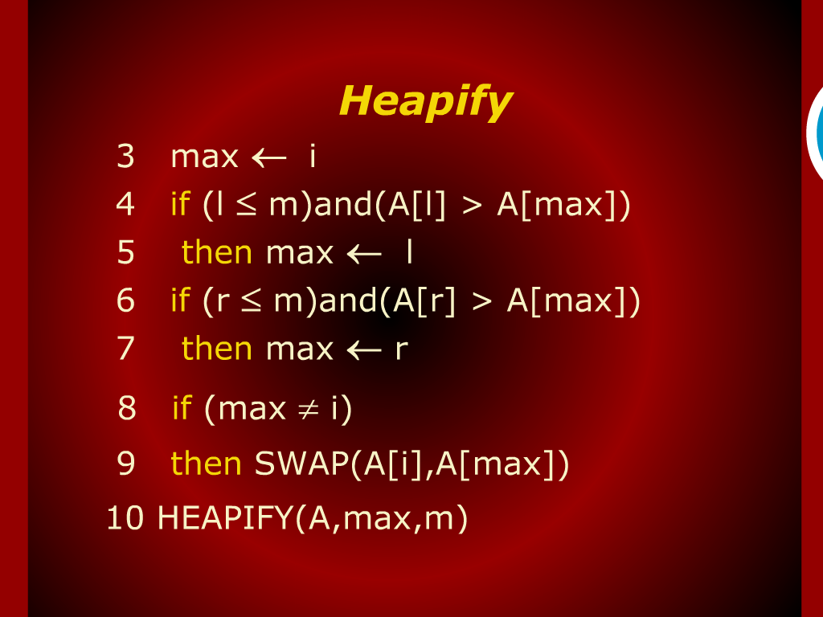
Heapify

Slide 24
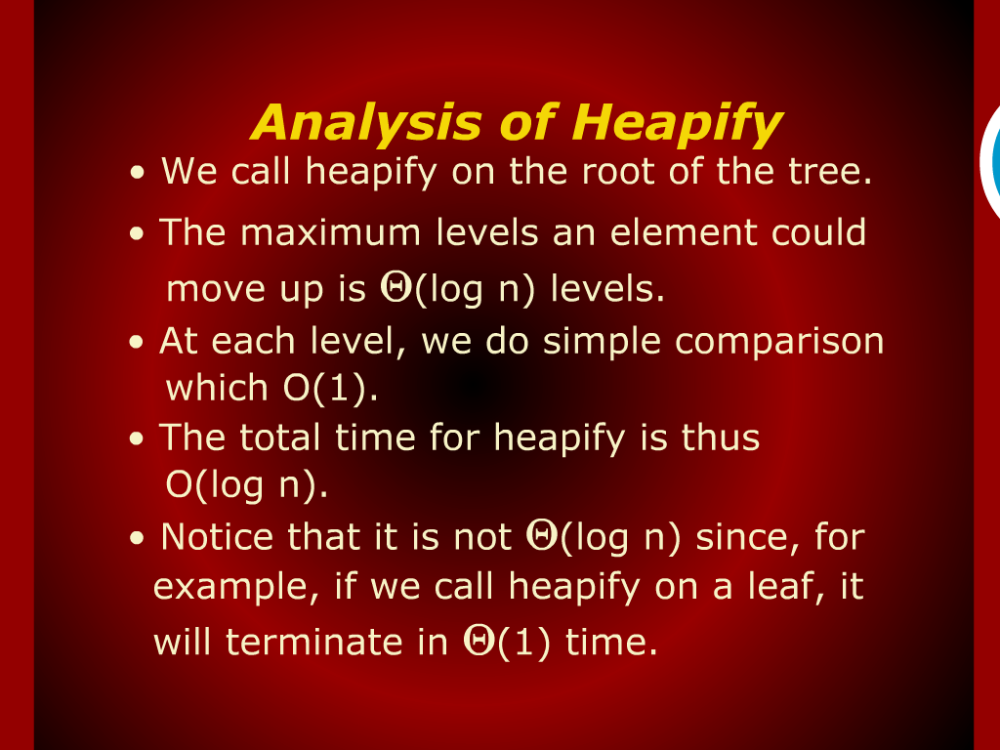
Analysis of Heapify

Slide 25
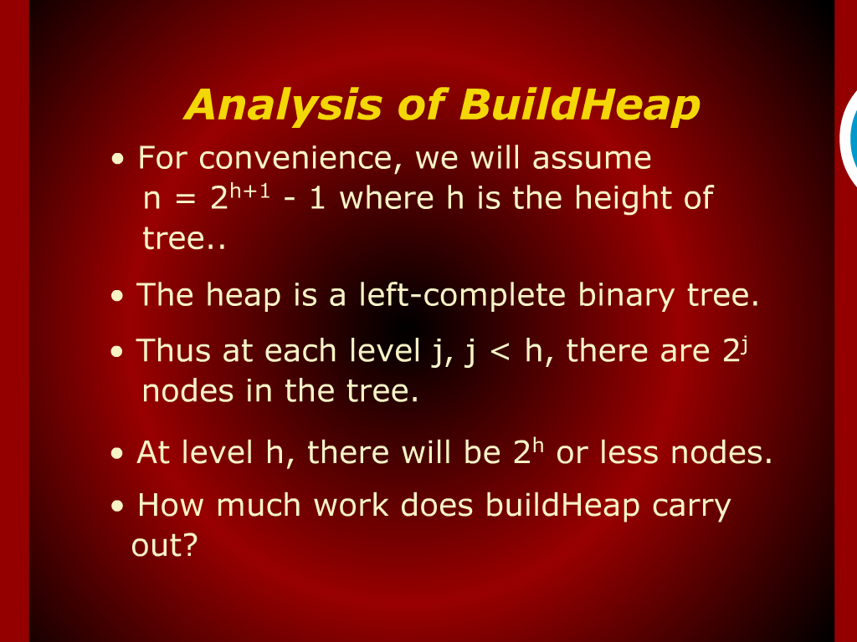
Analysis of BuildHeap

Slide 26
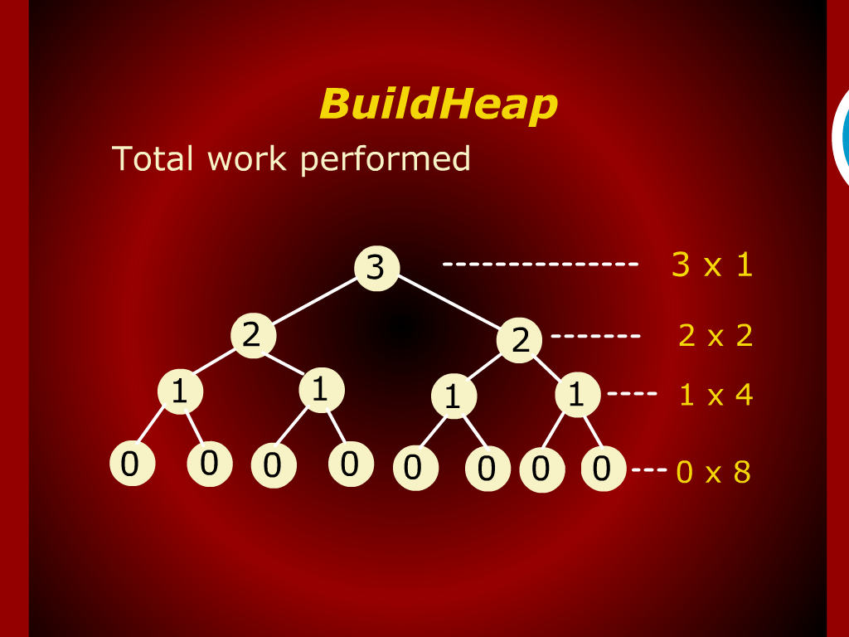
BuildHeap

Slide 27
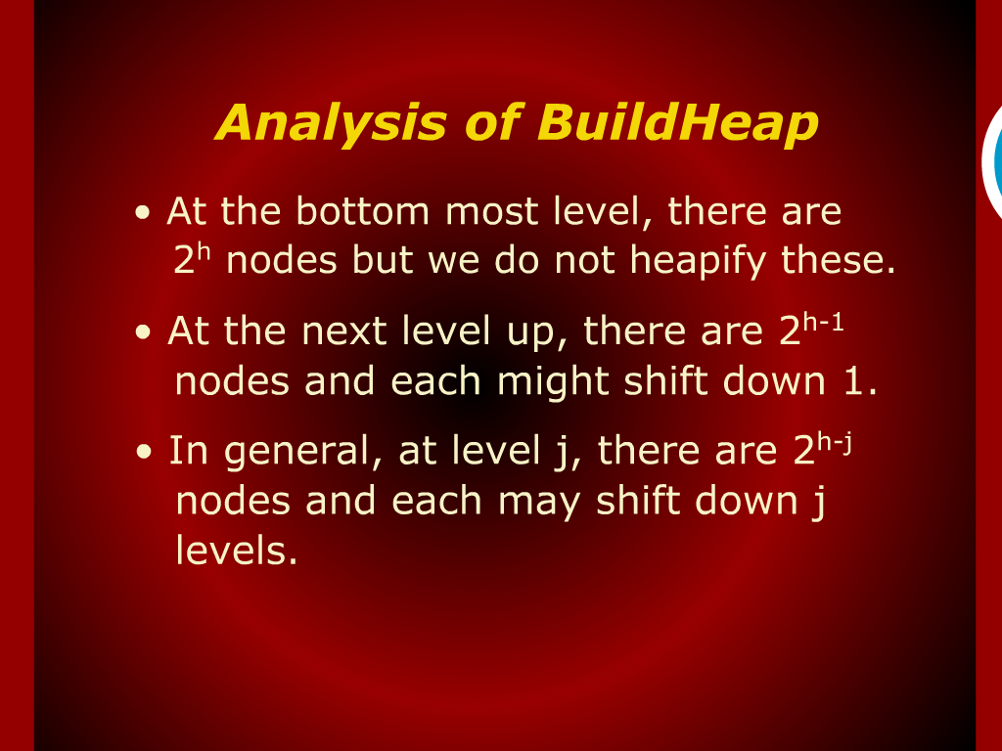
Analysis of BuildHeap

Slide 28
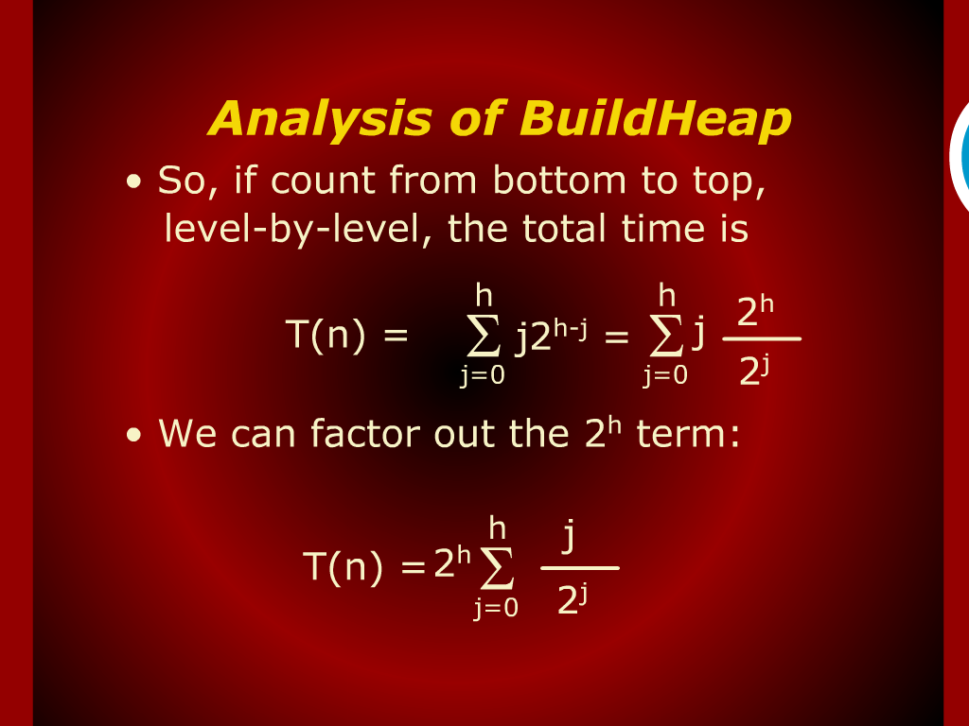
Analysis of BuildHeap

Slide 29
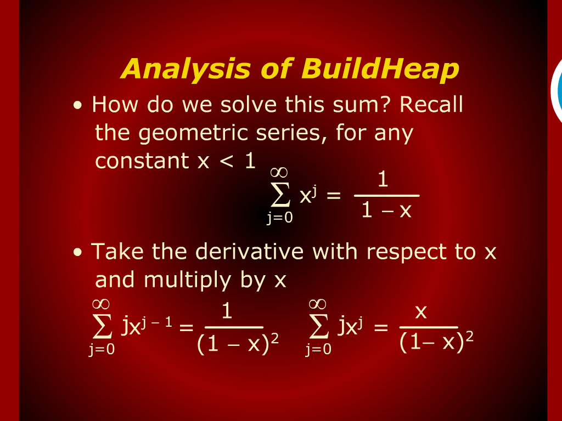
Analysis of BuildHeap

Slide 30
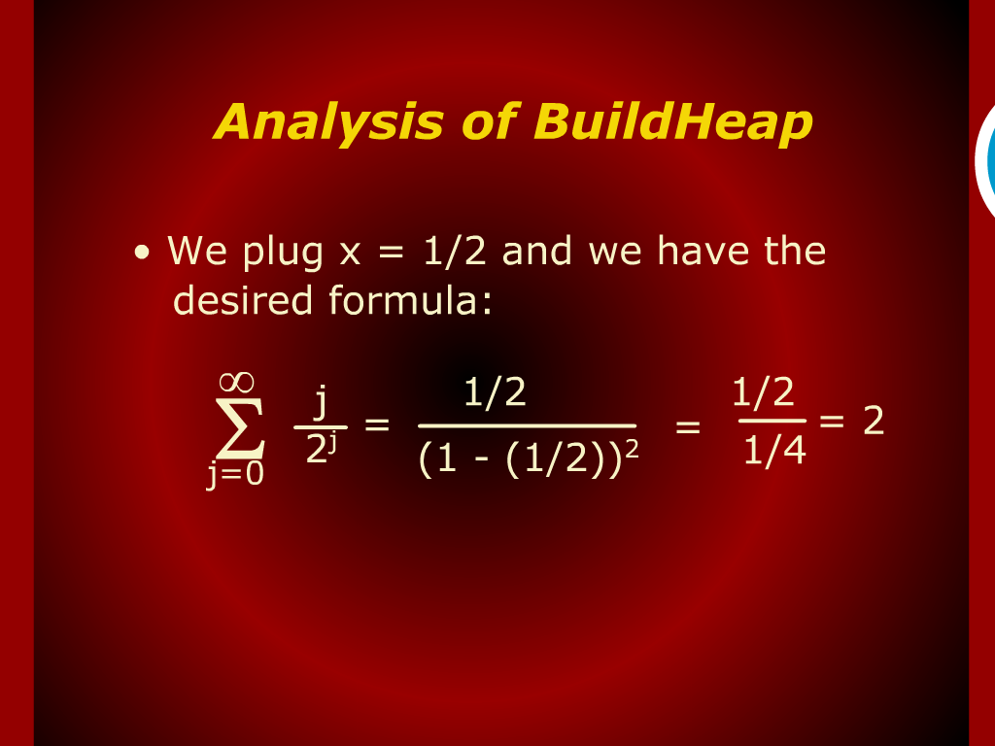
Analysis of BuildHeap

Slide 31
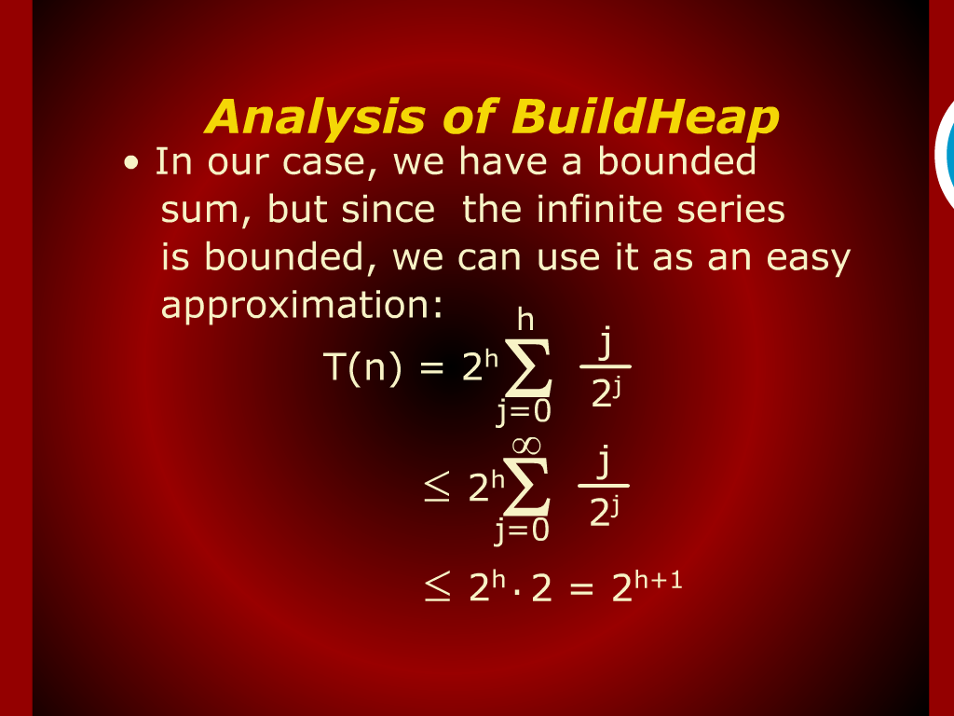
Analysis of BuildHeap

Slide 32
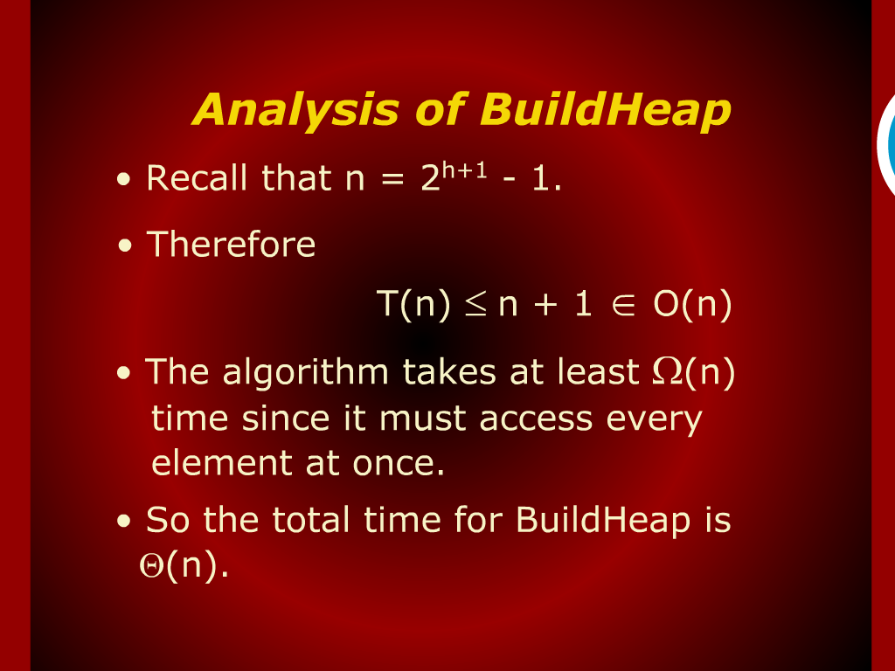
Analysis of BuildHeap

Slide 33
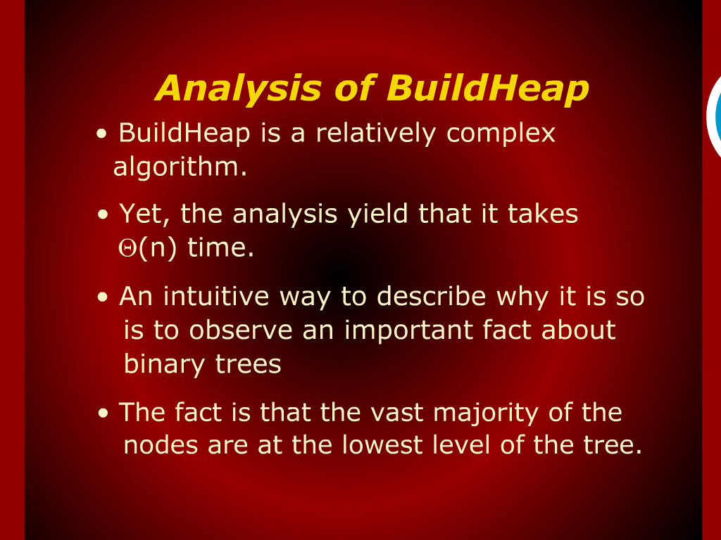
Analysis of BuildHeap

Slide 34
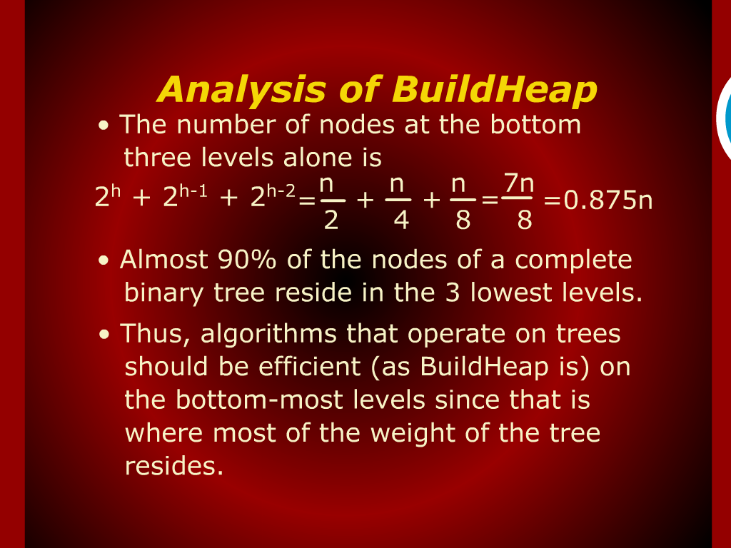
Analysis of BuildHeap

Slide 35
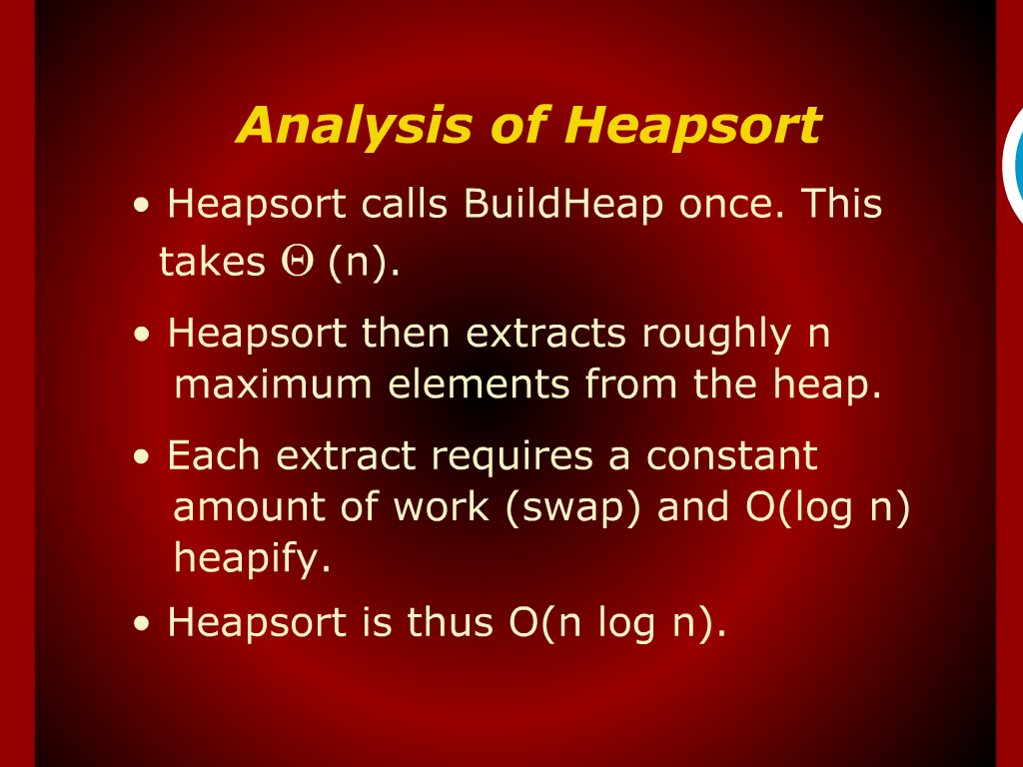
Analysis of Heapsort

Slide 36
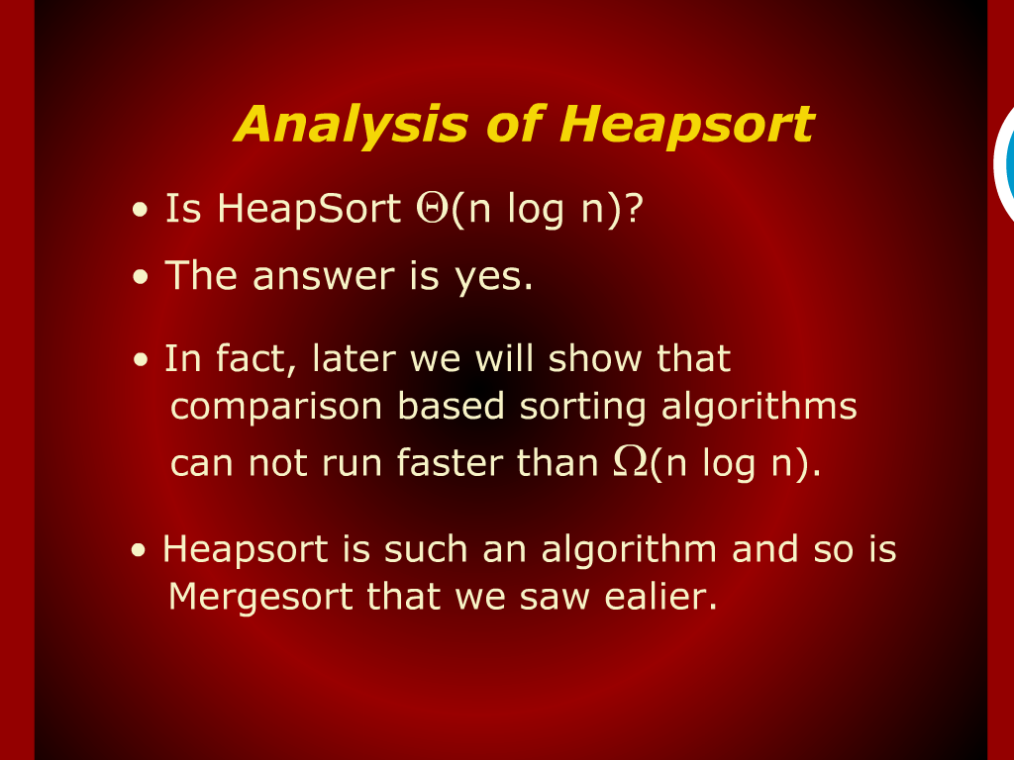
Analysis of Heapsort

