Slide 1
Algorithms
Lecture #13
Dr.Sohail Aslam

Slide 2
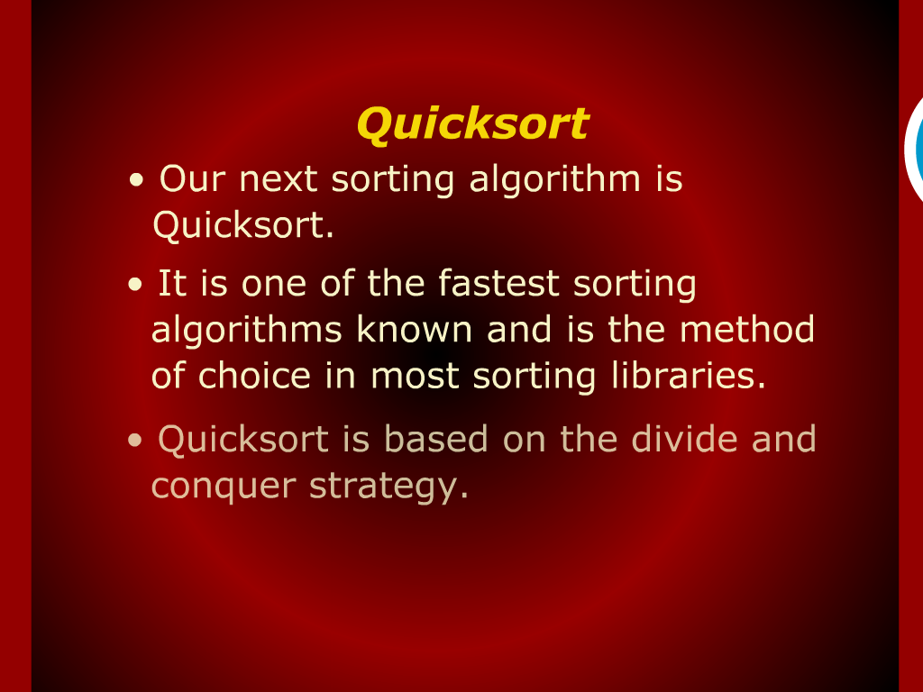
Quick sort

Slide 3
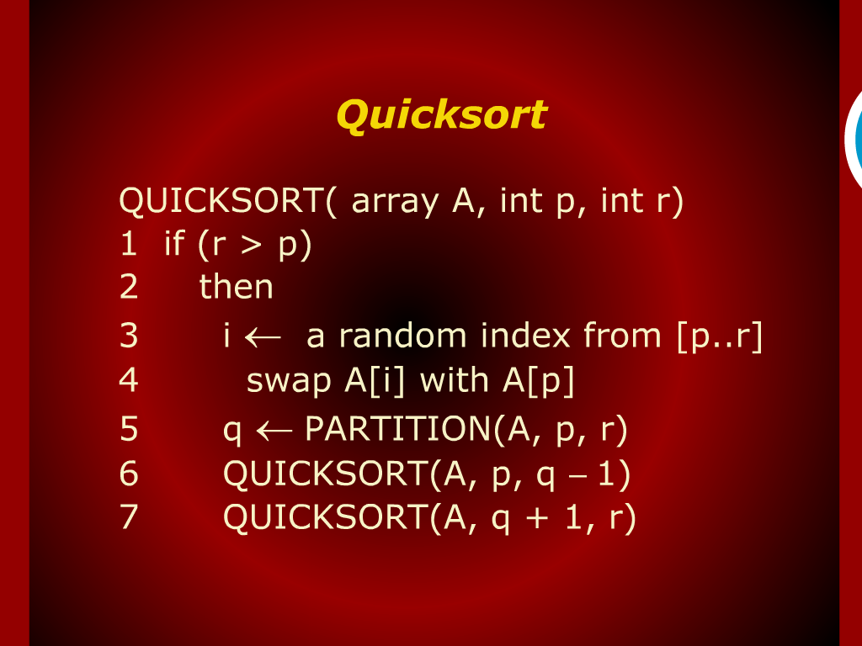
Quick sort

Slide 4
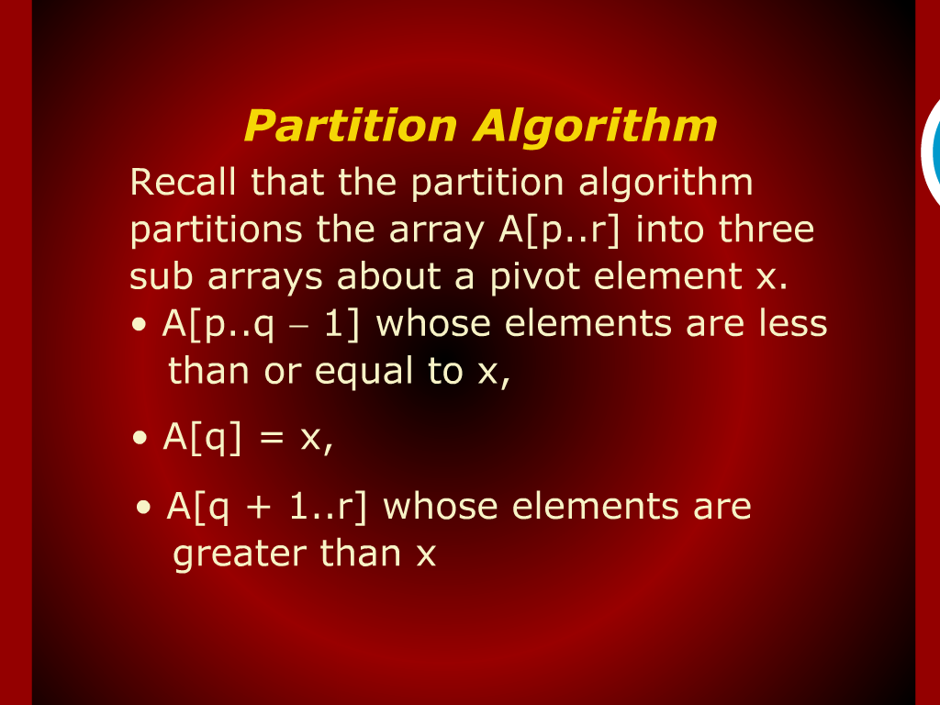
Partition algorithm

Slide 5
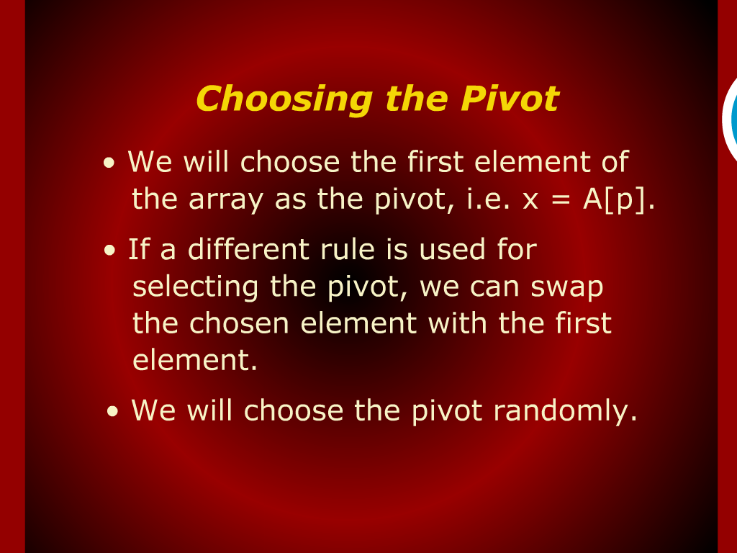
Choosing the Pivot

Slide 6
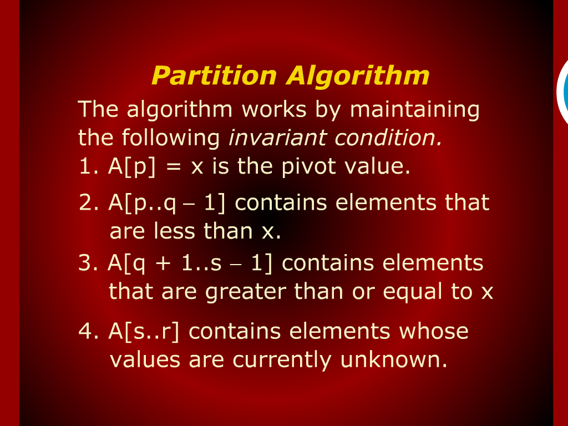
Partition algorithm

Slide 7
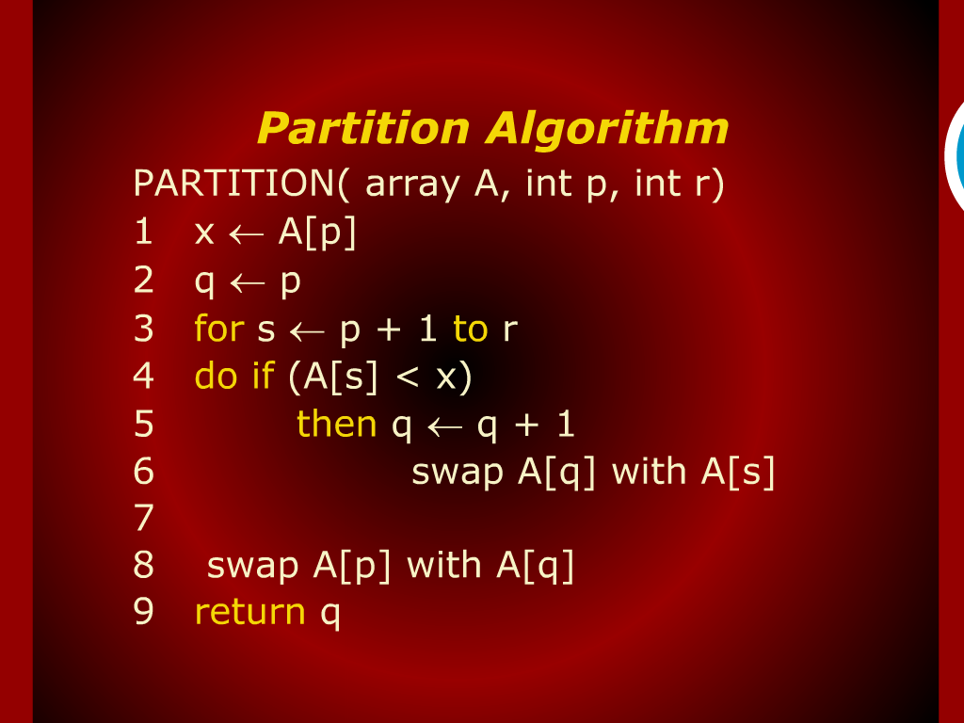
Partition algorithm

Slide 8
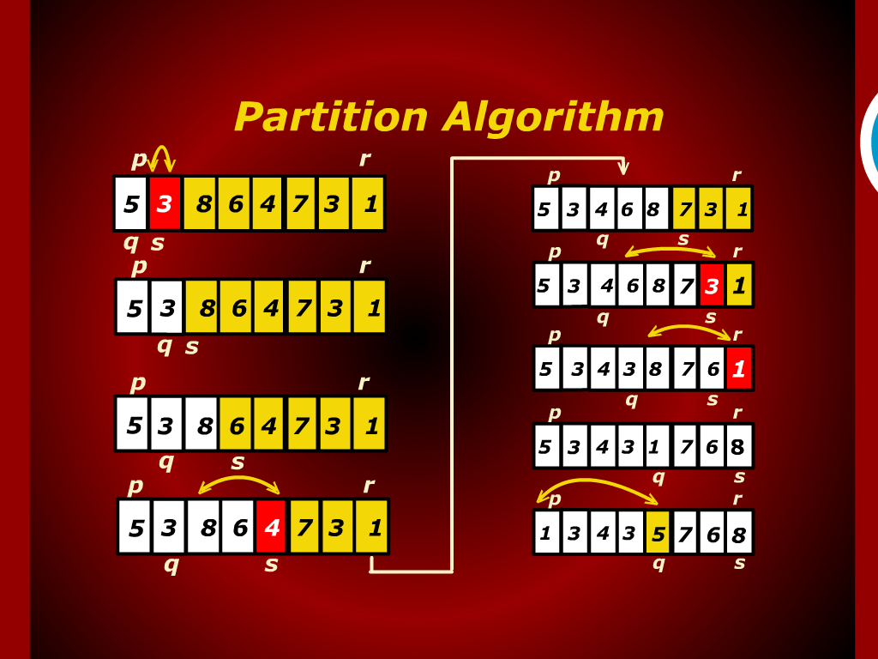
Partition algorithm

Slide 9
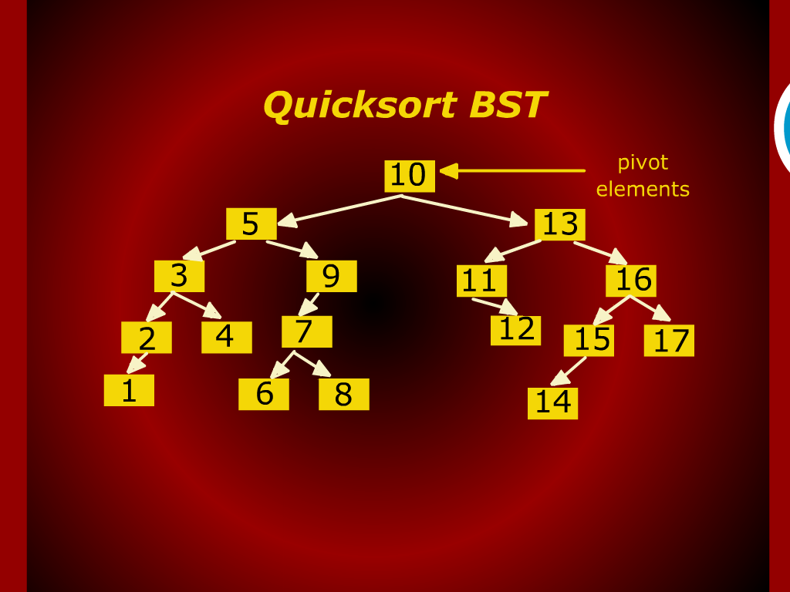
Quick Sort BST

Slide 10
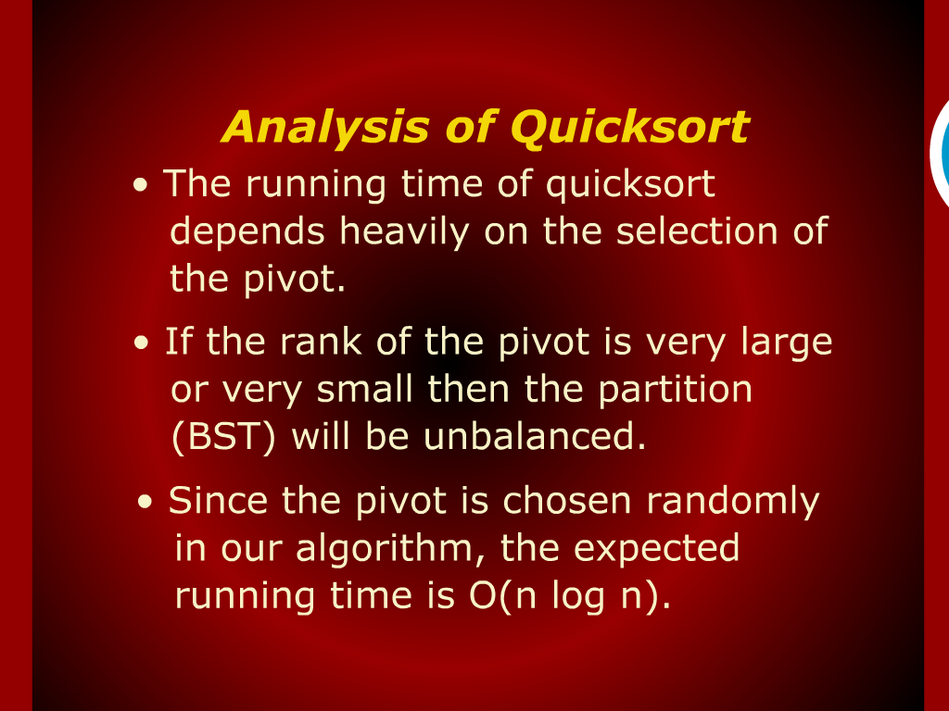
Analysis of Quick sort

Slide 11
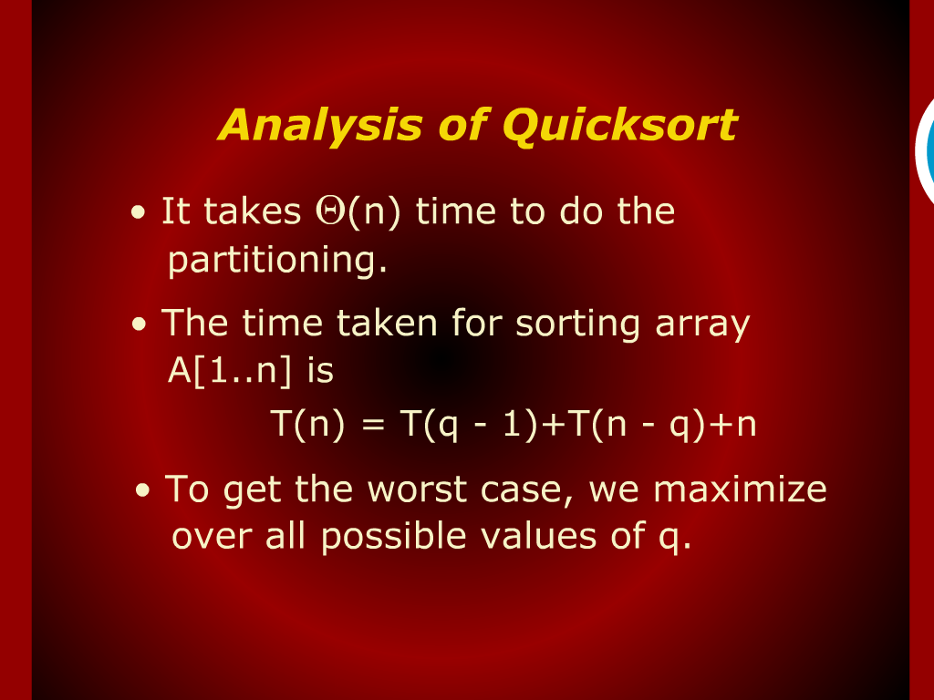
Analysis of Quick sort

Slide 12
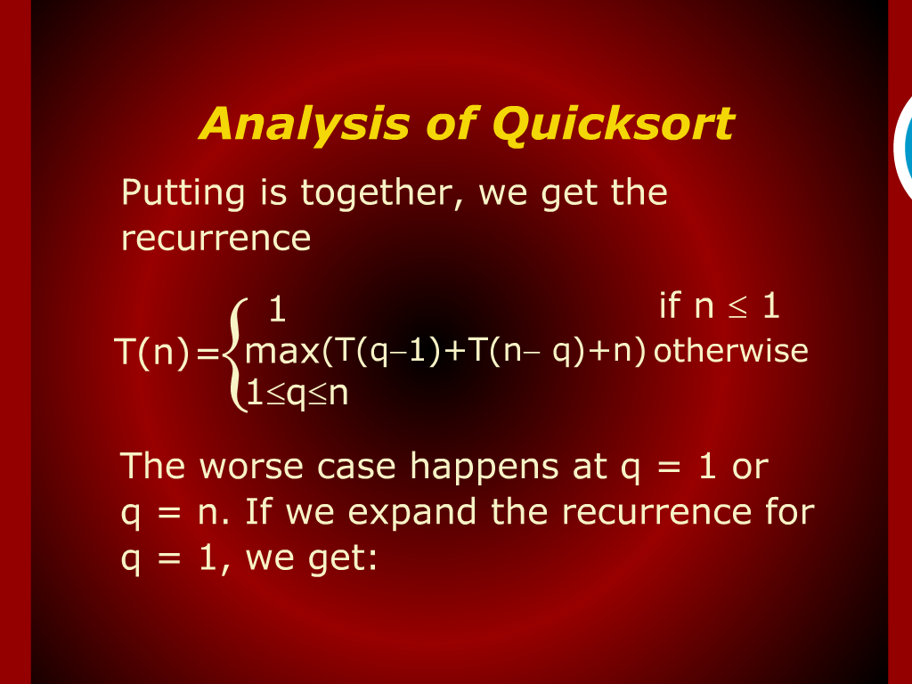
Analysis of Quick sort

Slide 13
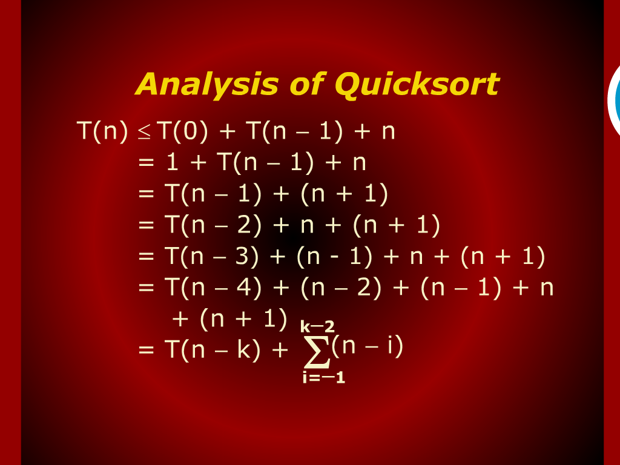
Analysis of Quick sort

Slide 14
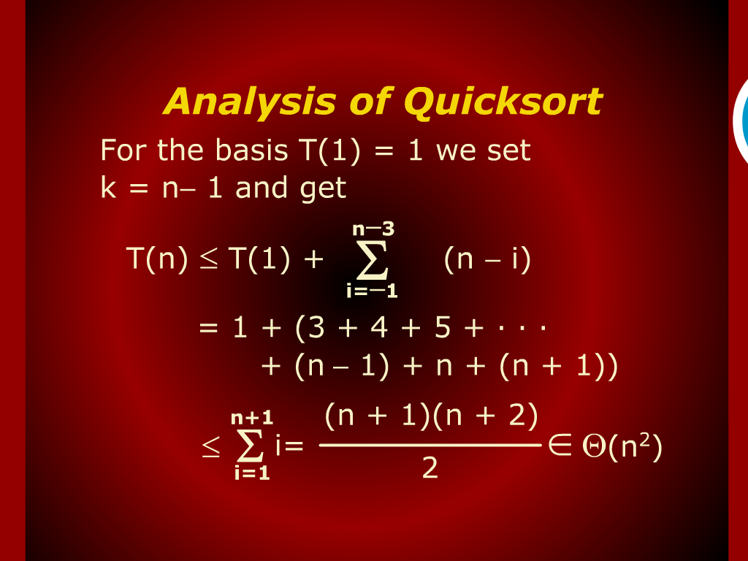
Analysis of Quick sort

Slide 15
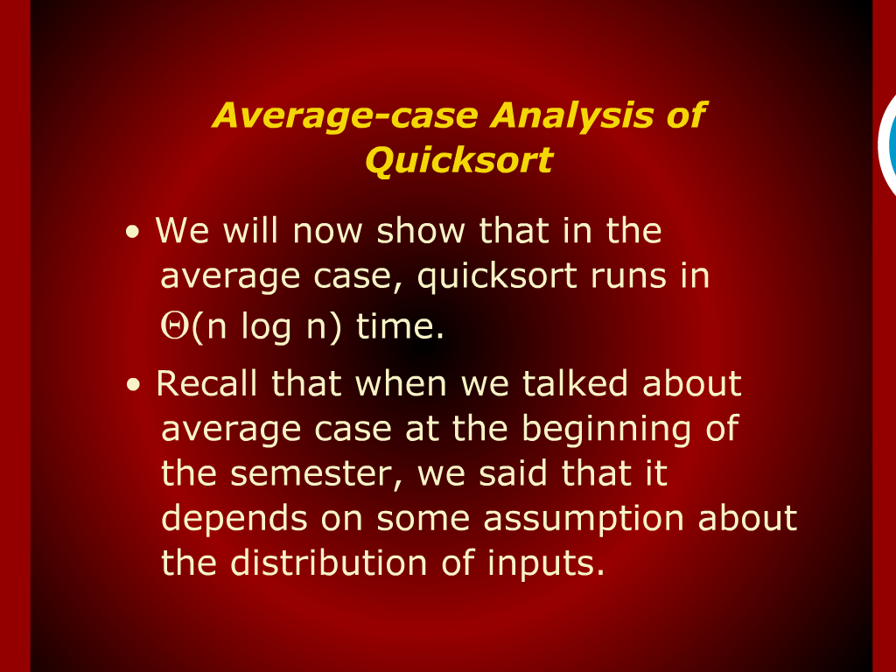
Average Case Analysis of Quick sort

Slide 16
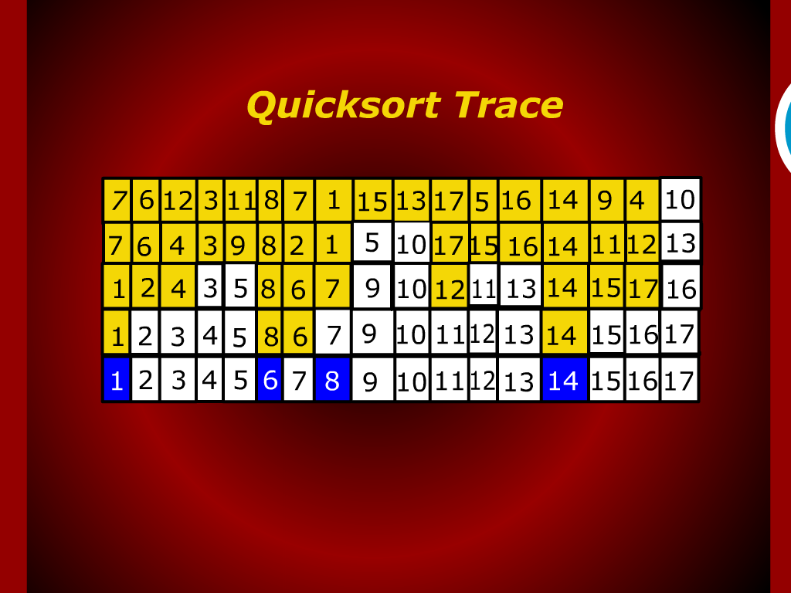
Quick sort Trace

Slide 17
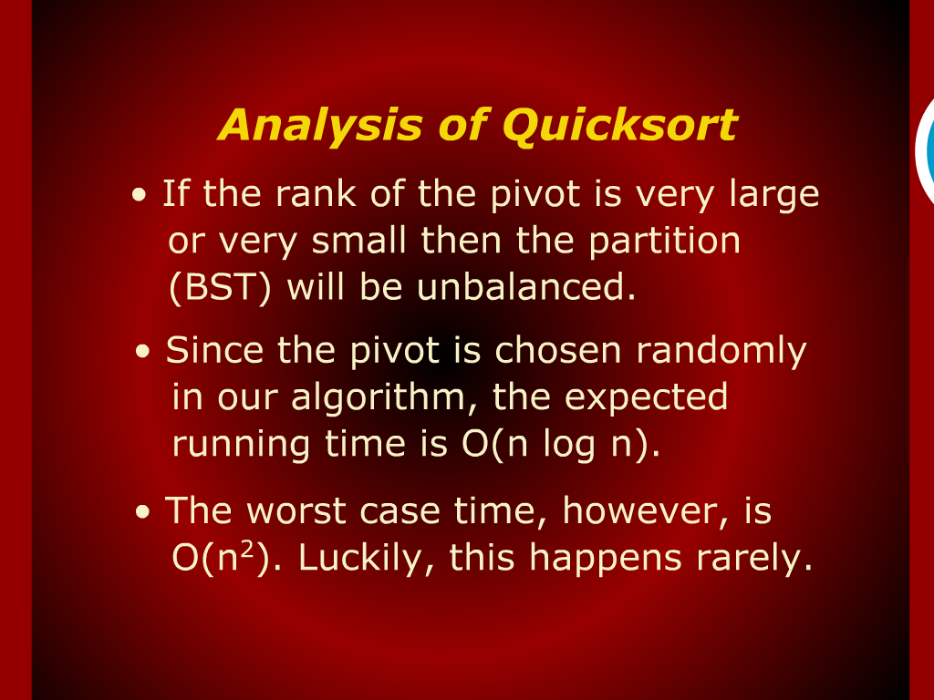
Analysis of Quicksort

Slide 18
Analysis of
Quick sort
worse case

Slide 19
Design and Analysis
of
Algorithms

Slide 20
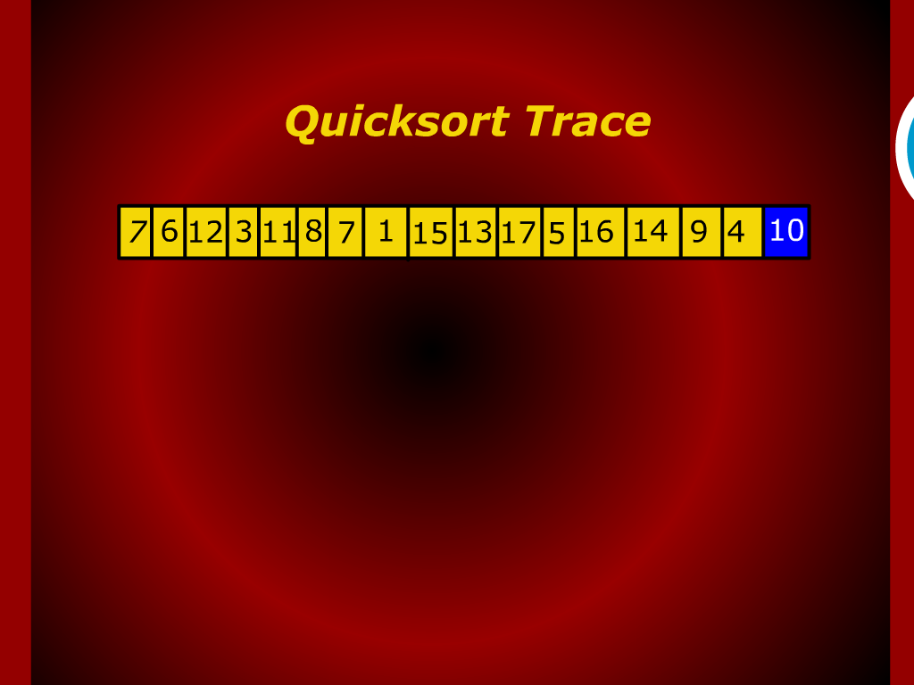

Slide 21
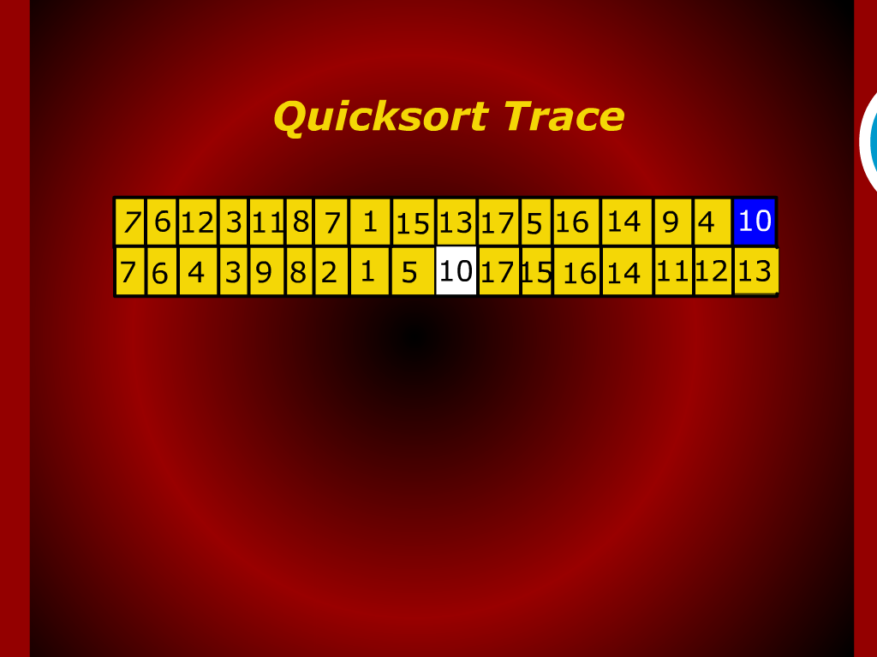

Slide 22
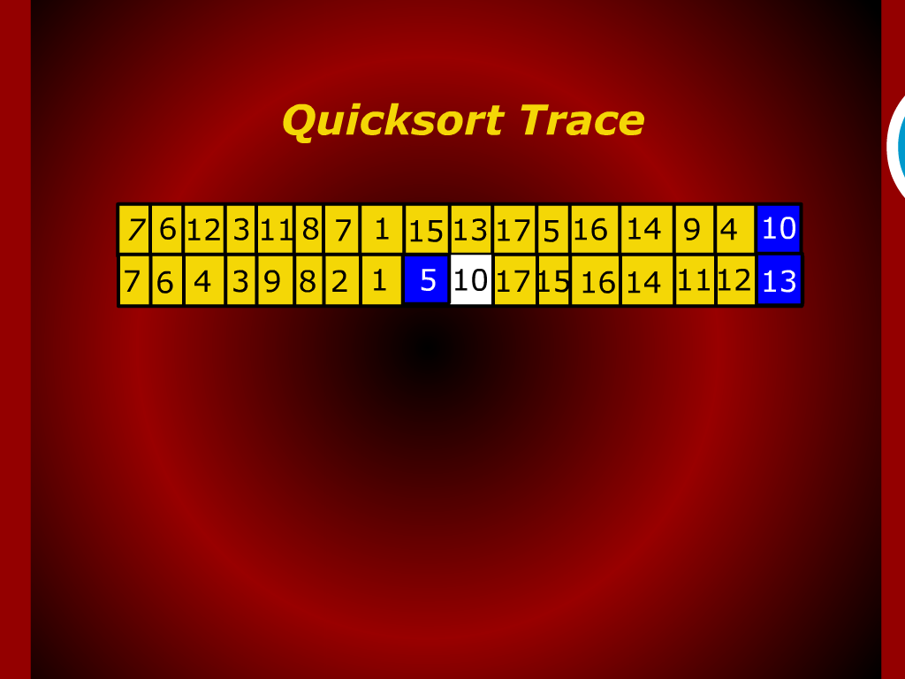

Slide 23
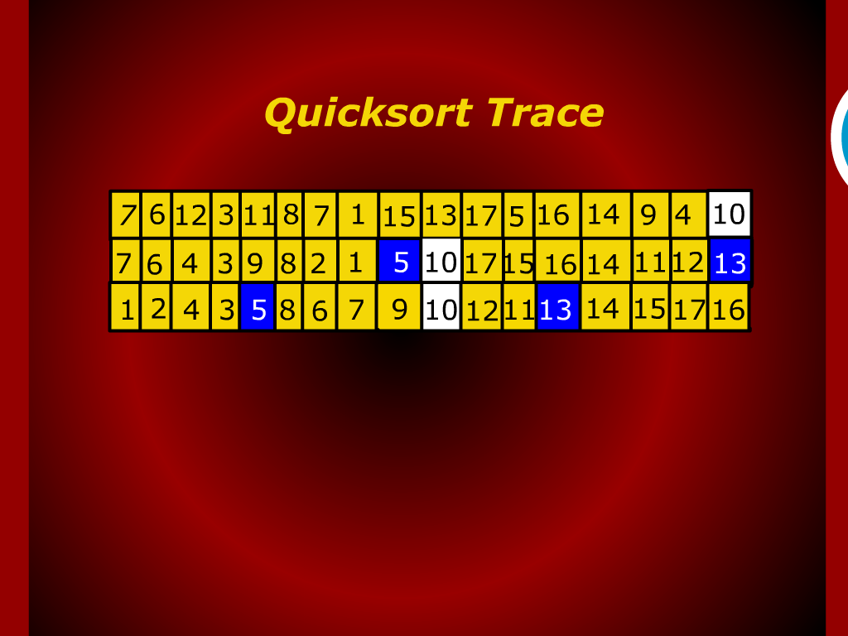

Slide 24
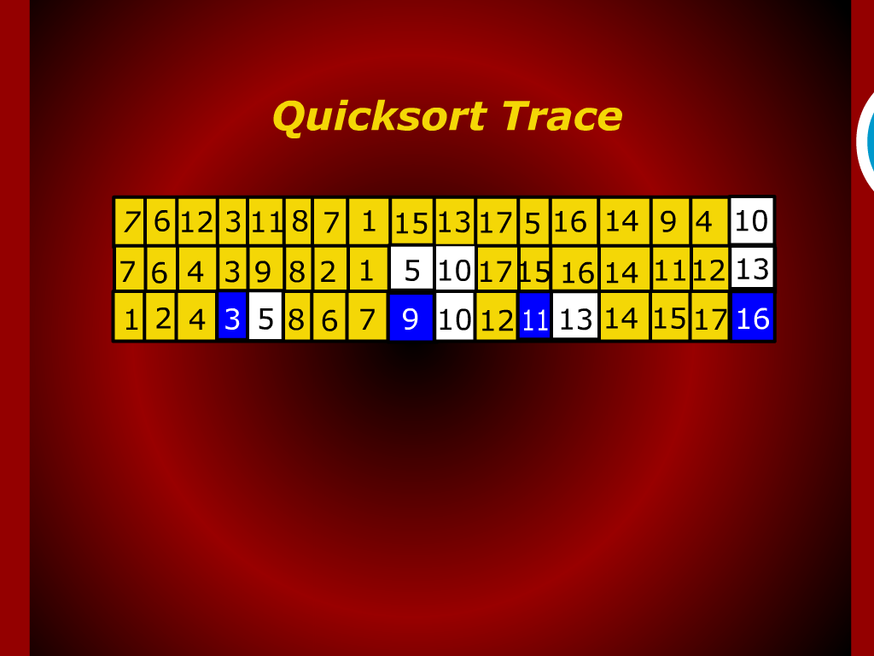

Slide 25
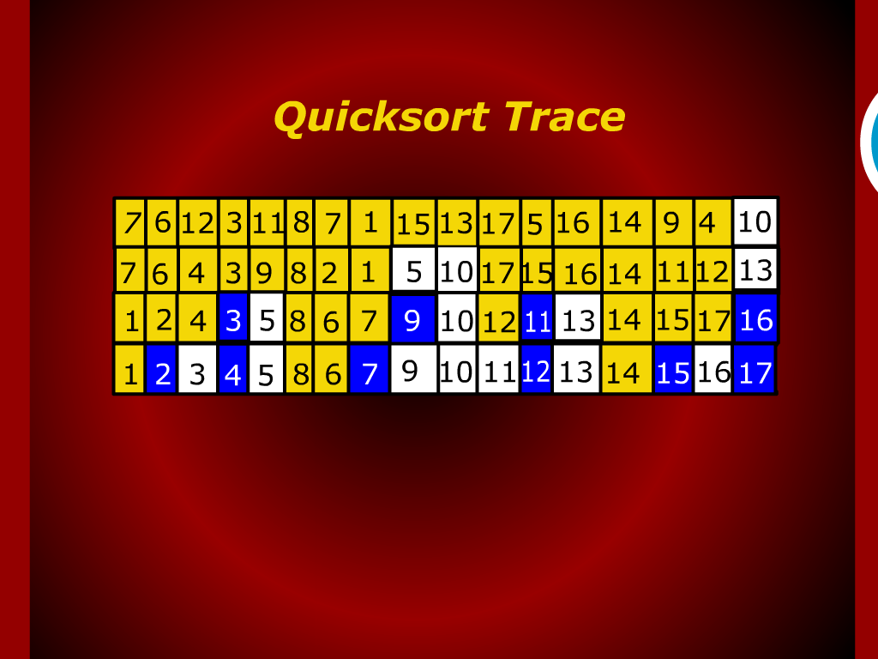

Slide 26
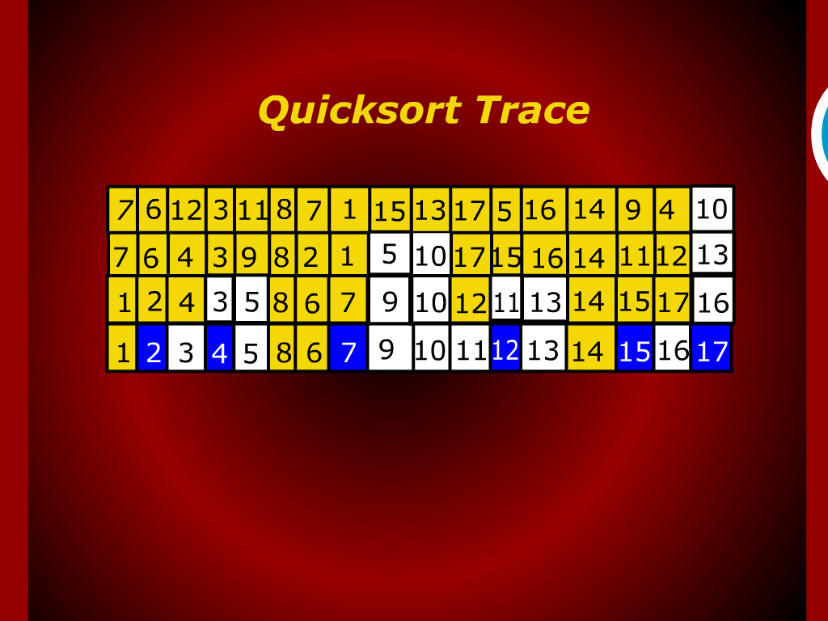

Slide 27
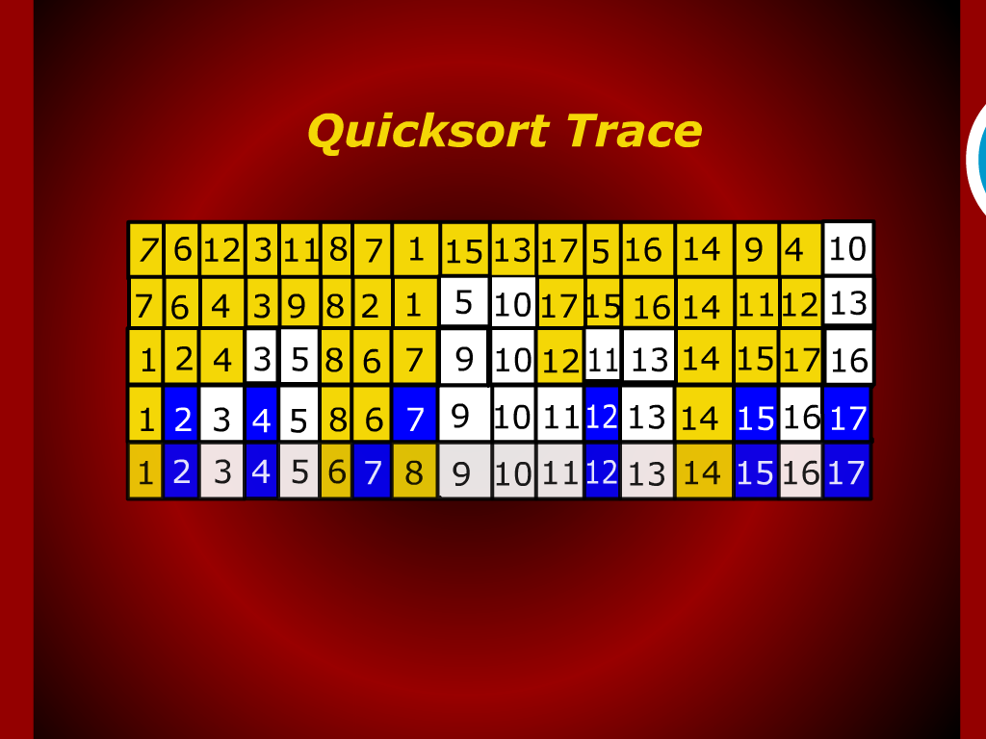

Slide 28


Slide 29
Analysis of Quicksort
Average case

