Slide 1
Algorithm
Lecture #14
Dr.Sohail Aslam

Slide 2
Design & Analysis of Algorithms

Slide 3
Analysis of Quick sort
average case

Slide 4
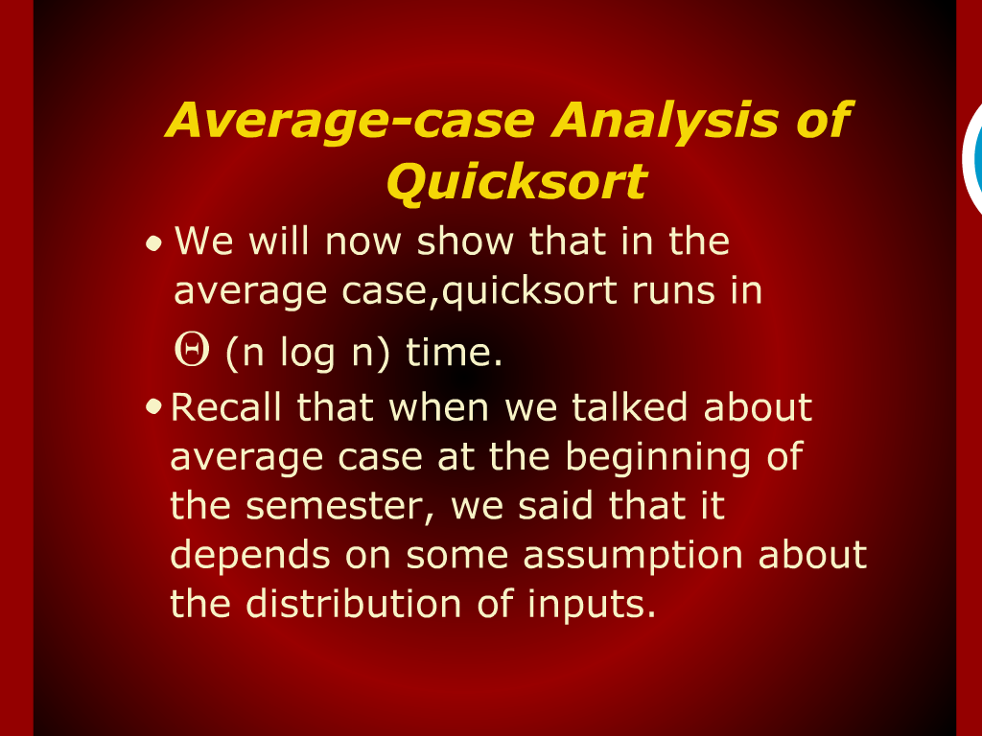
Average-Case Analysis of Quick sort

Slide 5
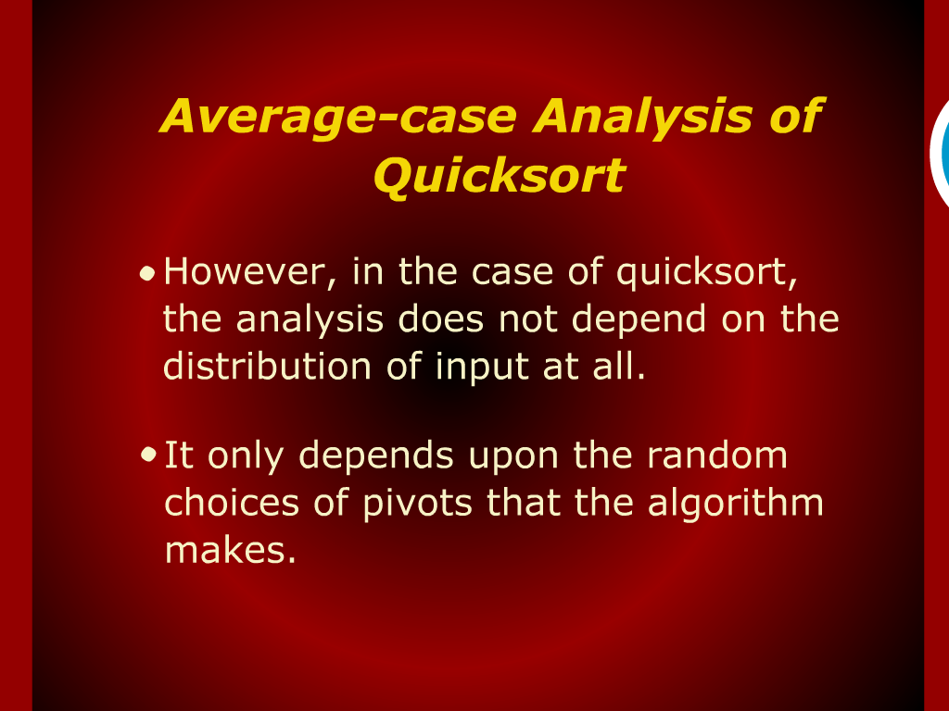
Average-Case Analysis of Quick sort

Slide 6
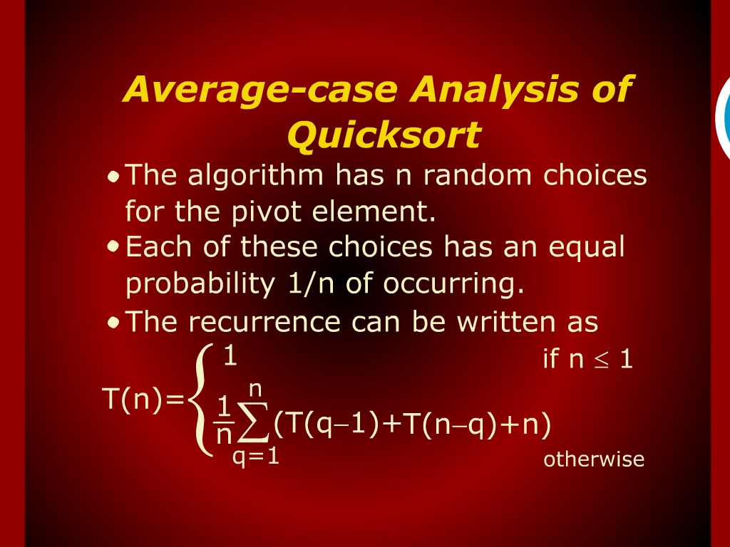
Average-Case Analysis of Quick sort

Slide 7
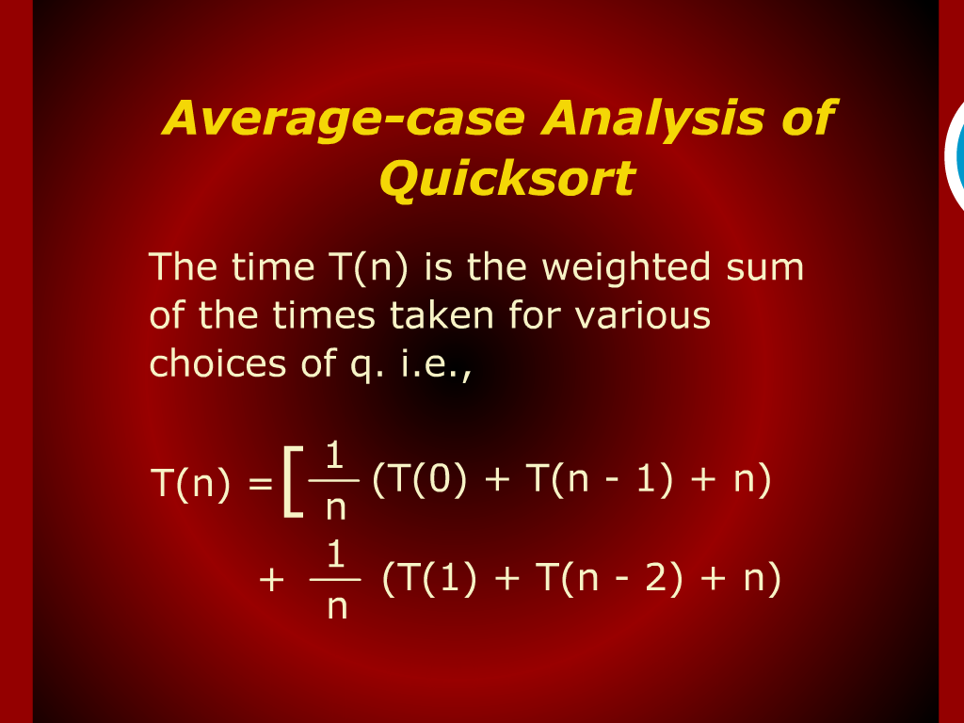
Average-Case Analysis of Quick sort

Slide 8
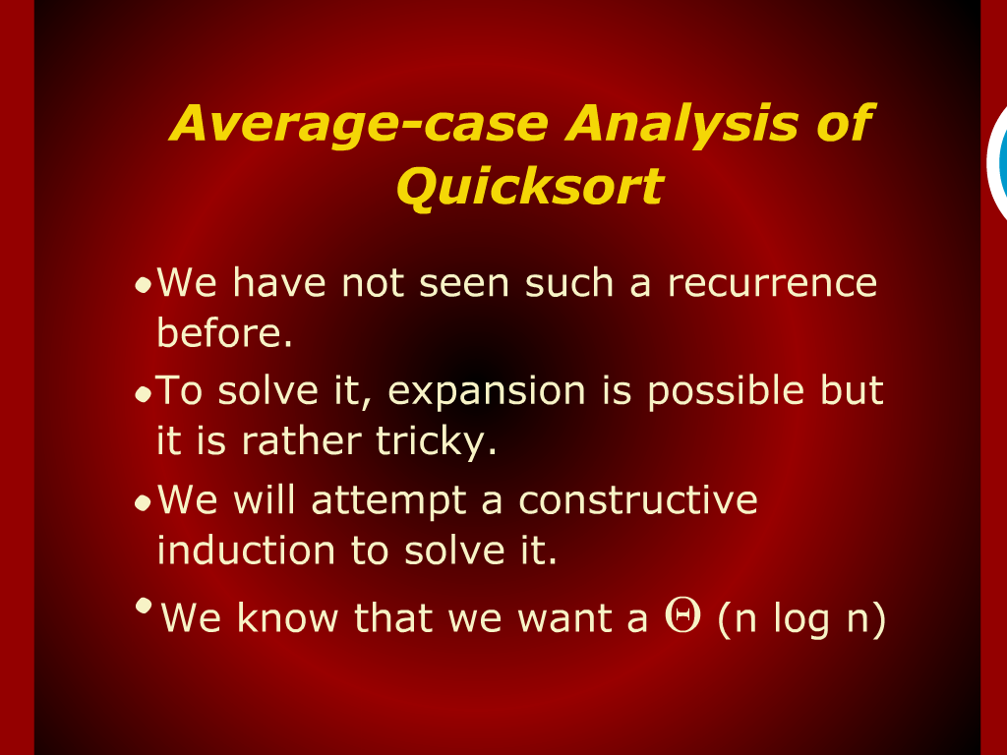
Average-Case Analysis of Quick sort
Let us assume that T (n) < c n log n for n > 2
where c is a Constant

Slide 9
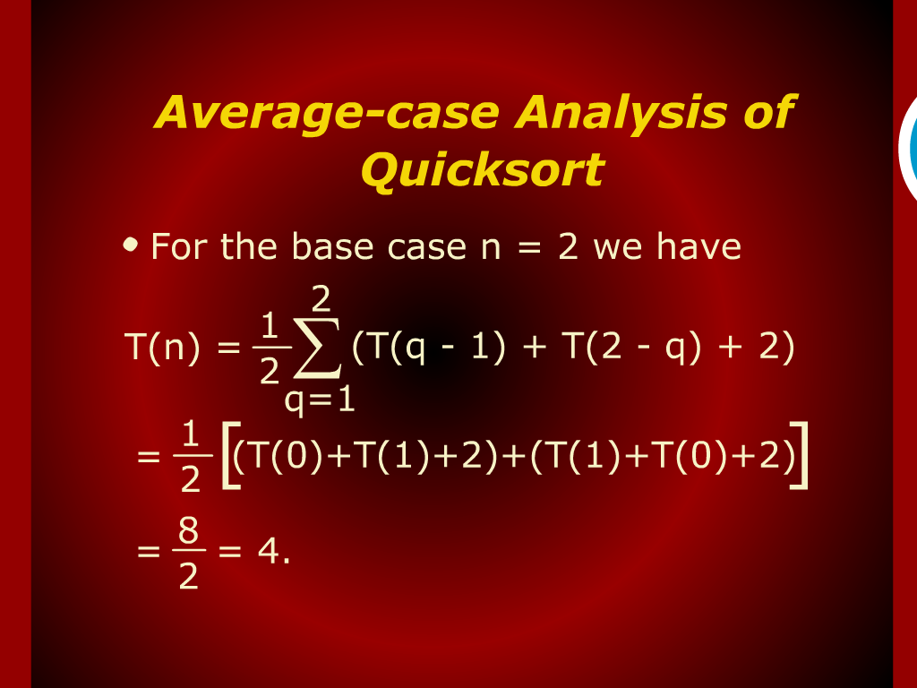
Average-Case Analysis of Quick sort

Slide 10
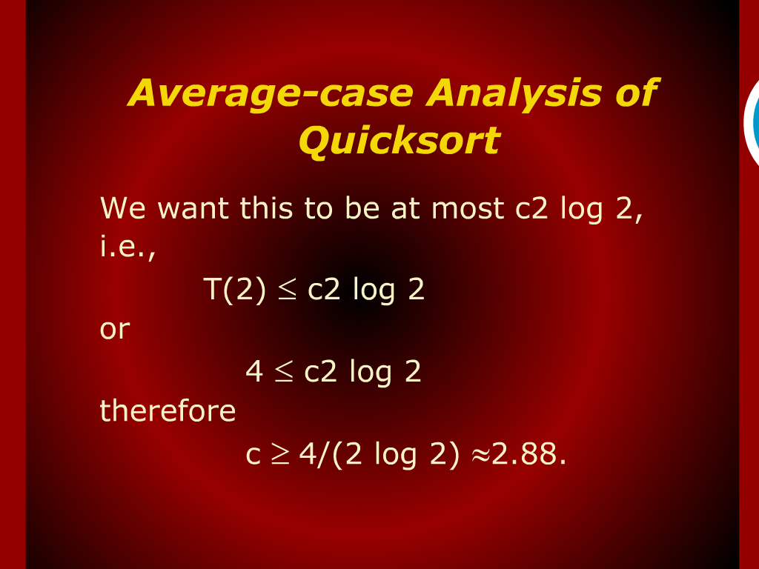
Average-Case Analysis of Quick sort

Slide 11
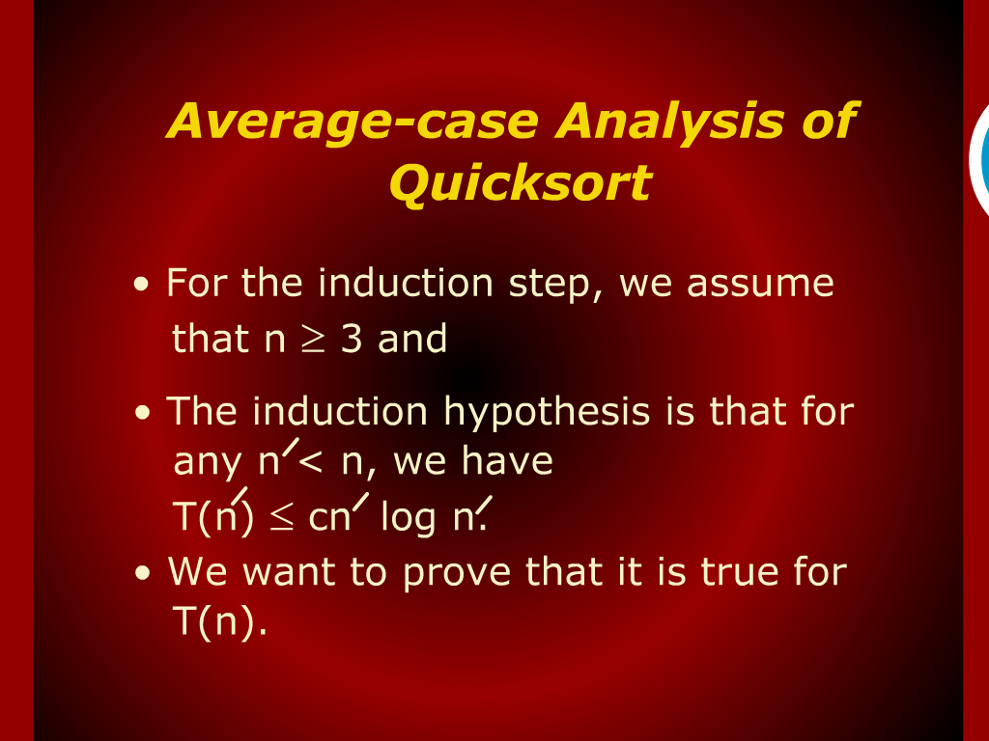
Average-Case Analysis of Quick sort

Slide 12
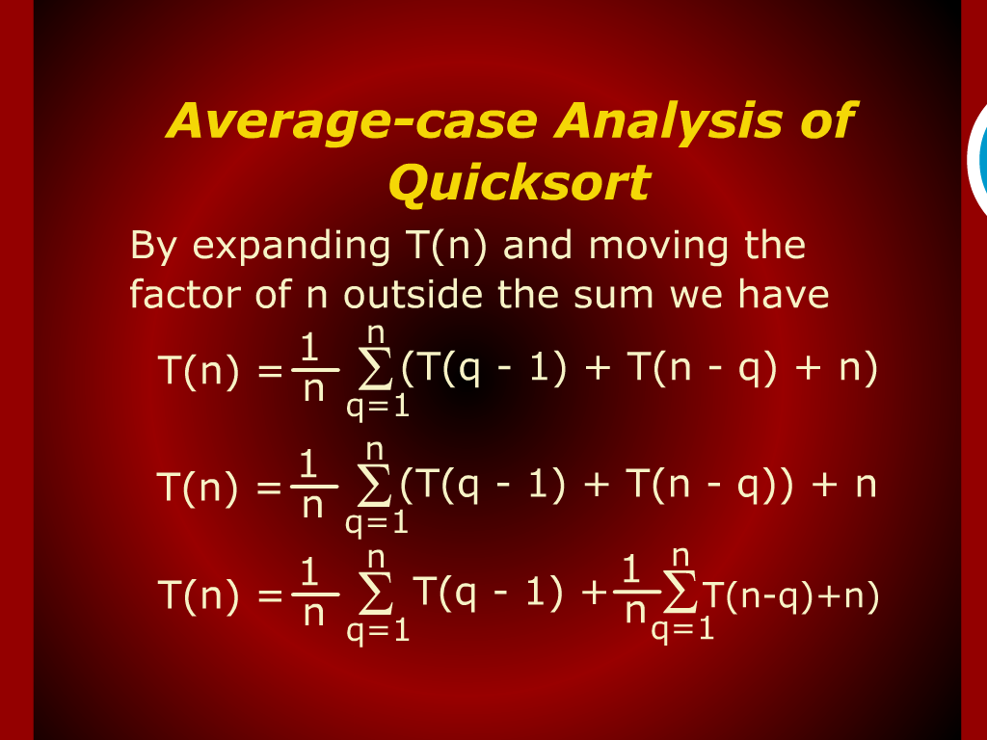
Average-Case Analysis of Quick sort

Slide 13
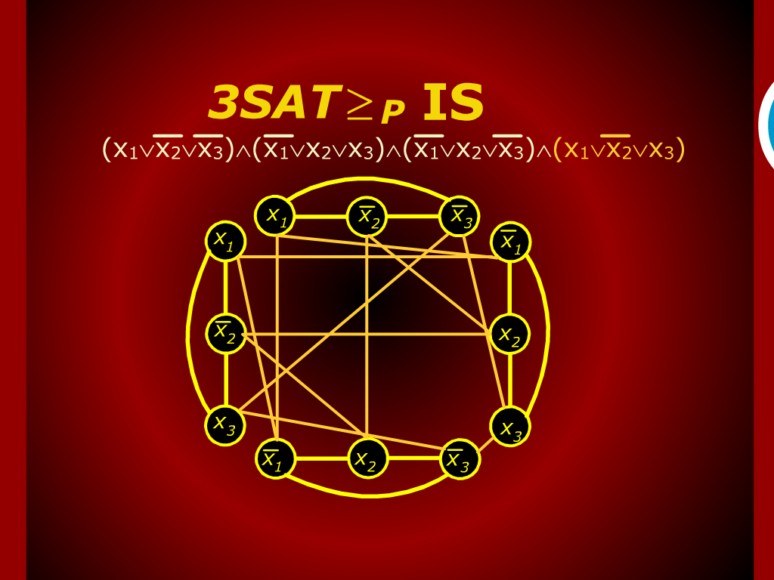
3SAT…

Slide 14
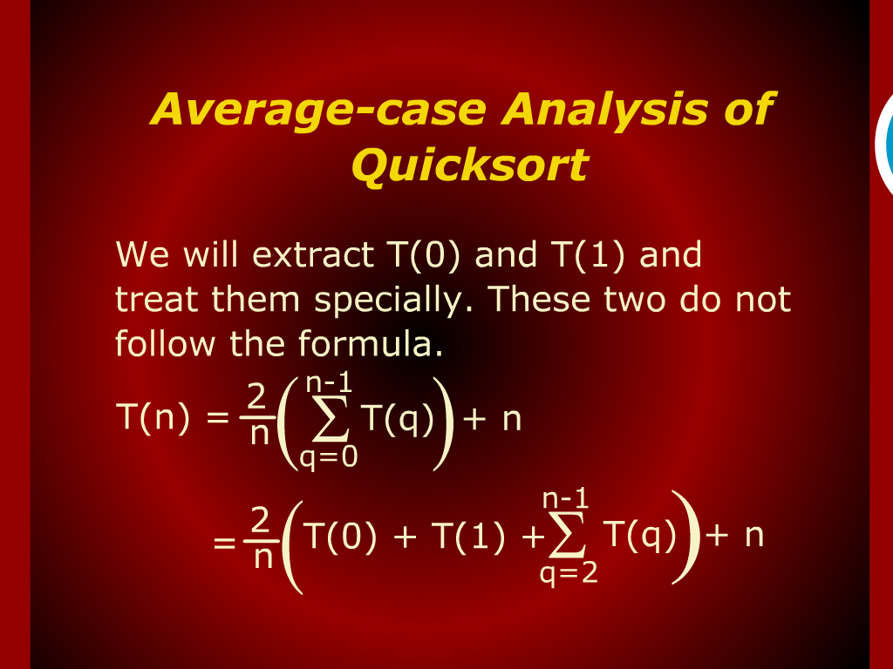
Average-Case Analysis of Quick sort

Slide 15
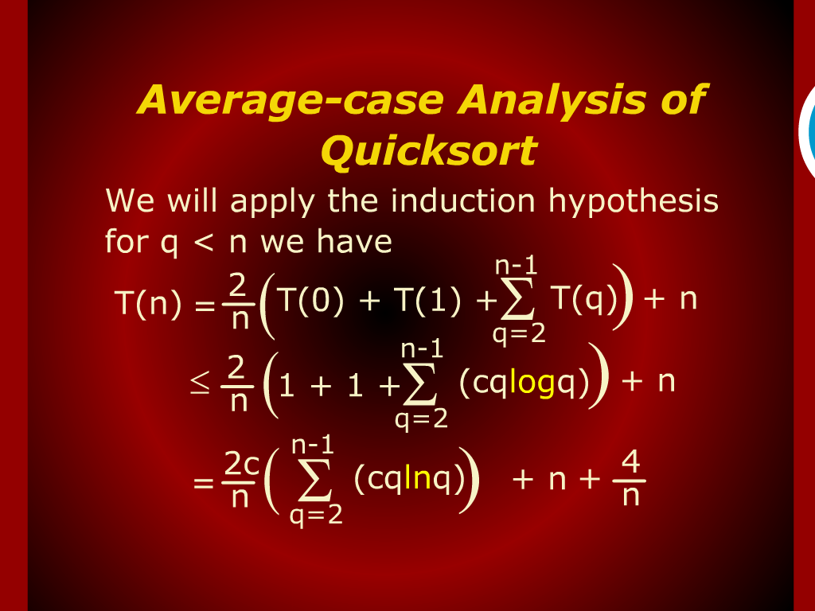
Average-Case Analysis of Quick sort

Slide 16
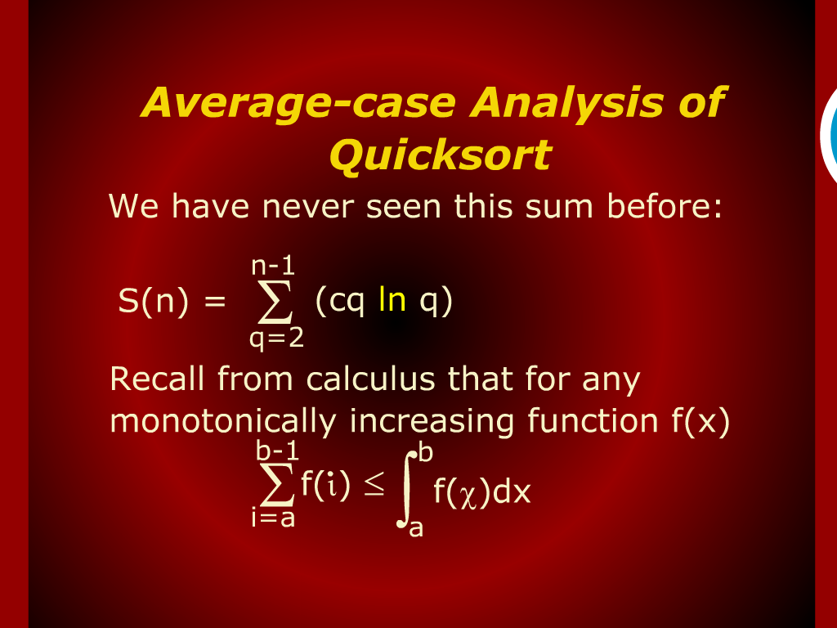
Average-Case Analysis of Quick sort

Slide 17
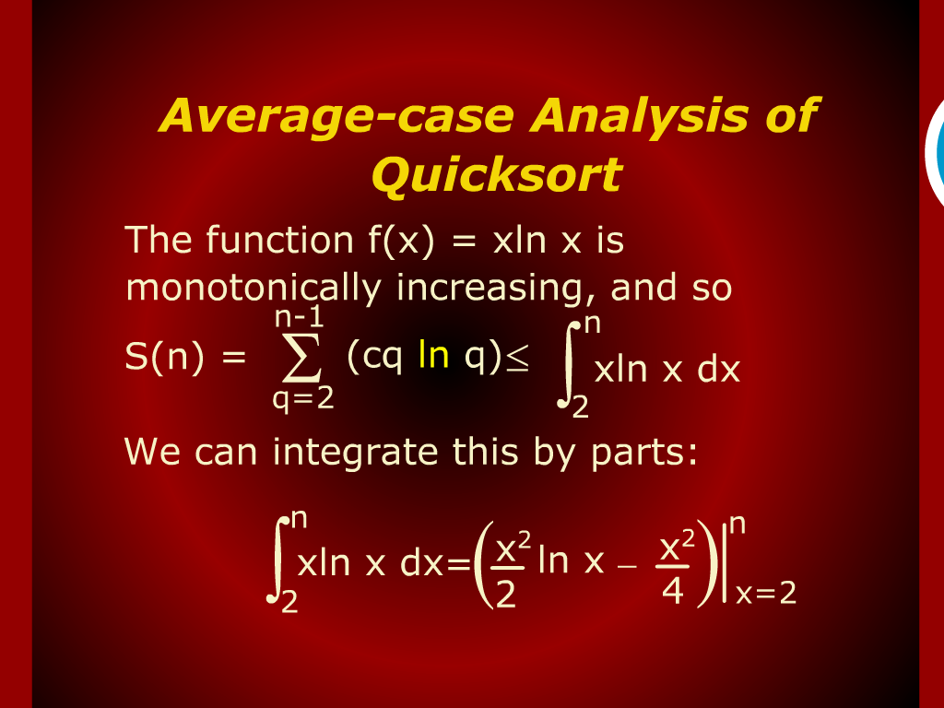
Average-Case Analysis of Quick sort

Slide 18
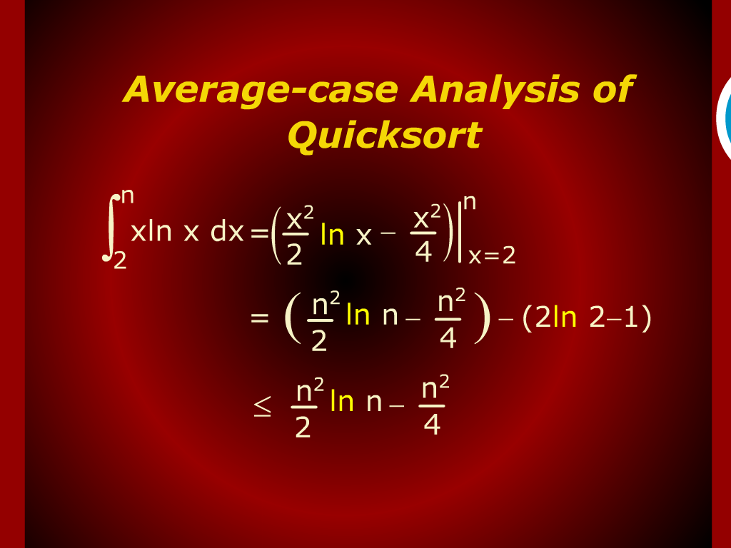
Average-Case Analysis of Quick sort

Slide 19
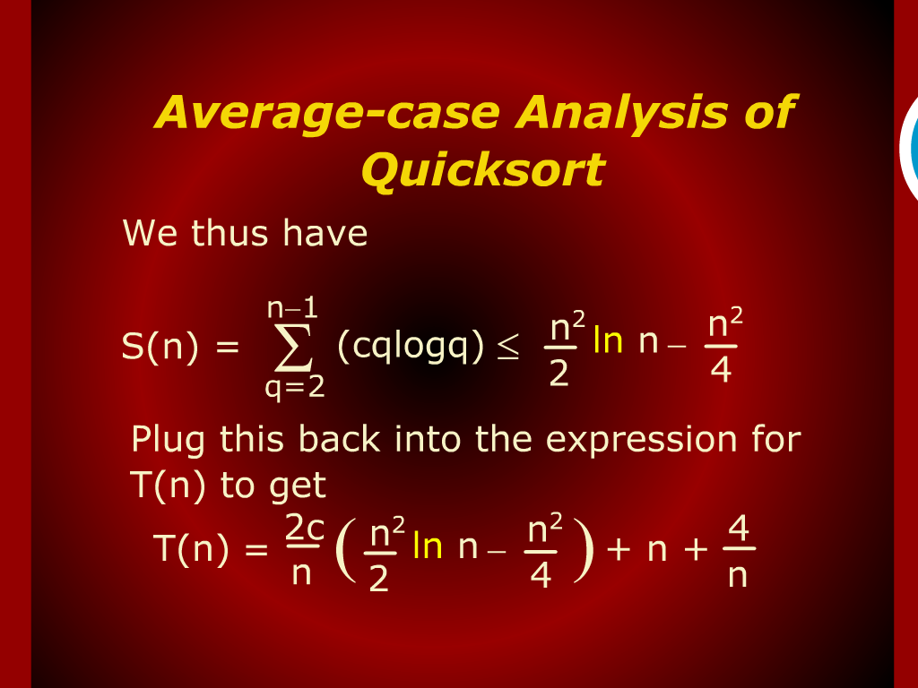
Average-Case Analysis of Quick sort

Slide 20
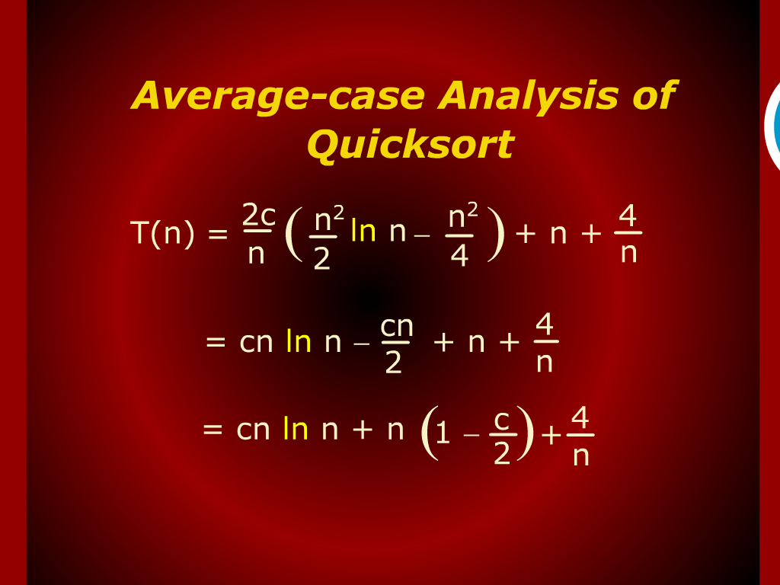
Average-Case Analysis of Quick sort

Slide 21
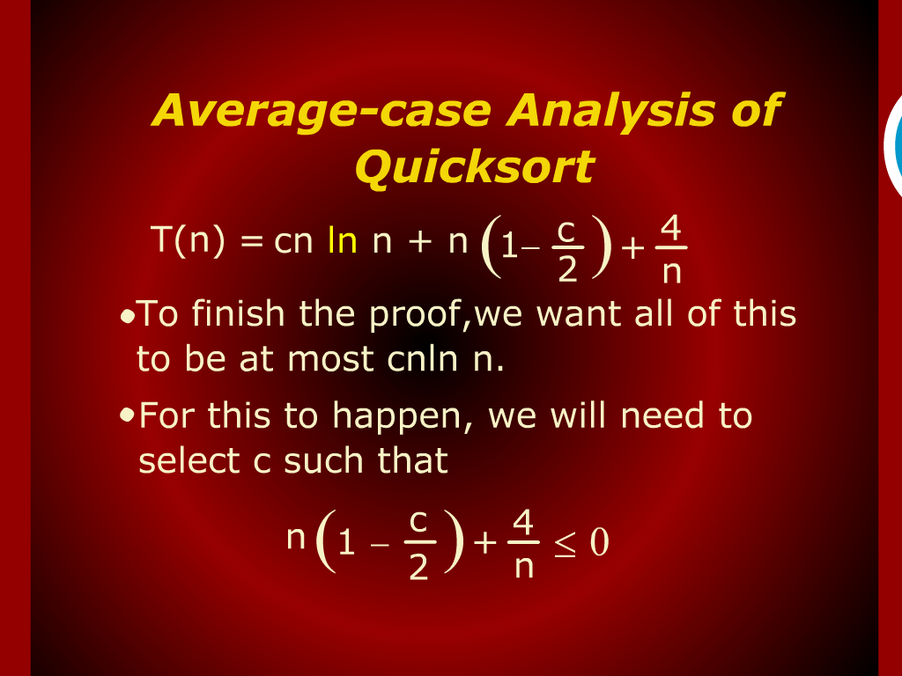
Average-Case Analysis of Quick sort

Slide 22
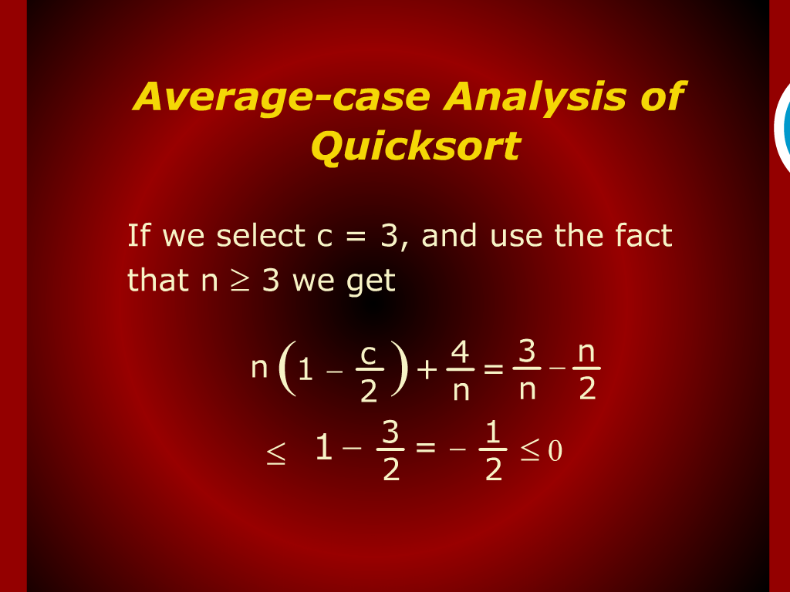
Average-Case Analysis of Quick sort

Slide 23
Average-Case Analysis of Quick sort

Slide 24
Design and Analysis
of
Algorithms

Slide 25
Analysis of Quicksort
Average case

Slide 26
Sort Demo

Slide 27
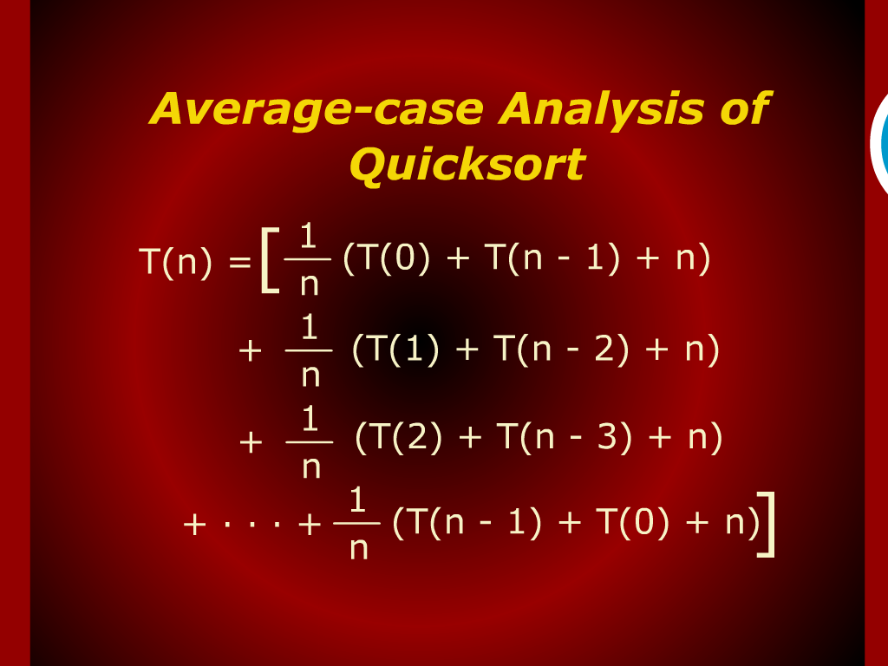
Average-Case Analysis of Quick sort

Slide 28
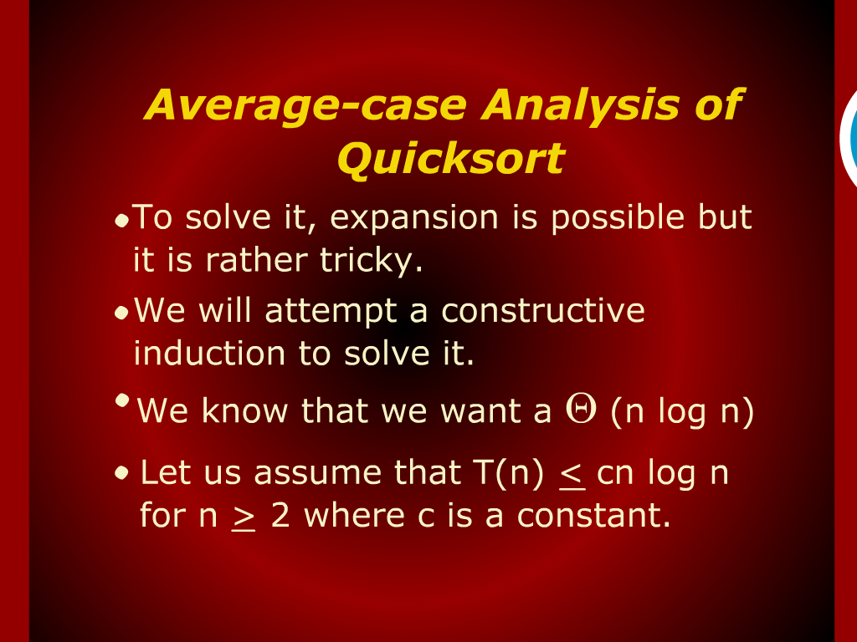
Average-Case Analysis of Quick sort

Slide 29
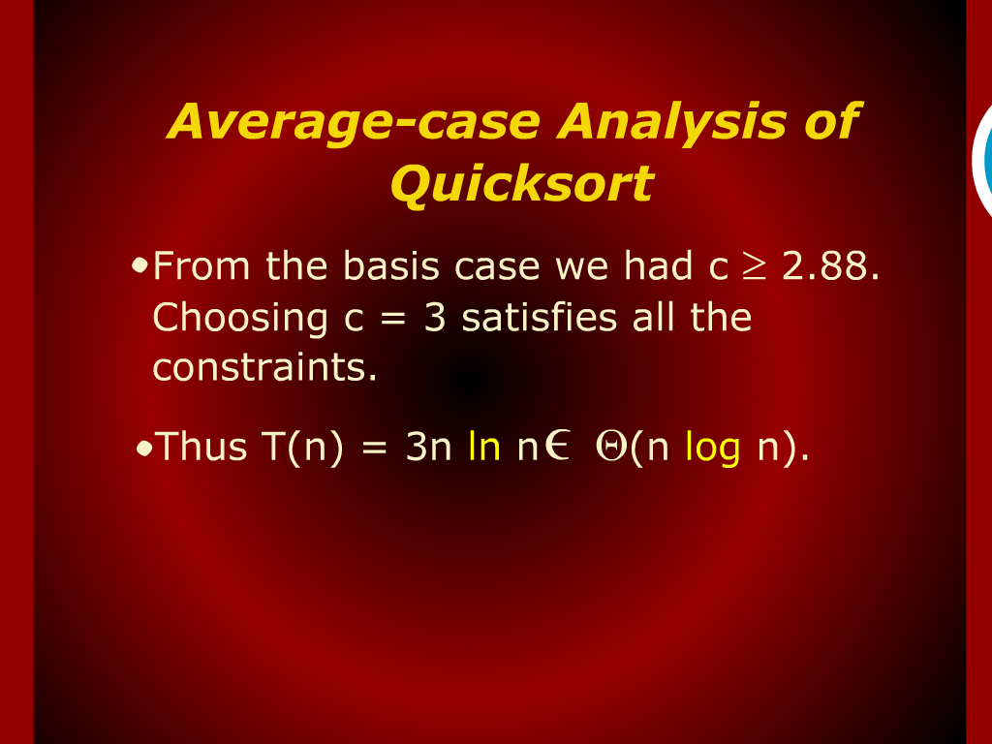
Average-Case Analysis of Quick sort

Slide 30
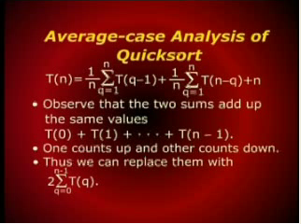
Average-Case Analysis of Quick sort

Slide 31

Average-Case Analysis of Quick sort

