Slide 1
Algorithms
Lecture #15
Dr.Sohail Aslam

Slide 2
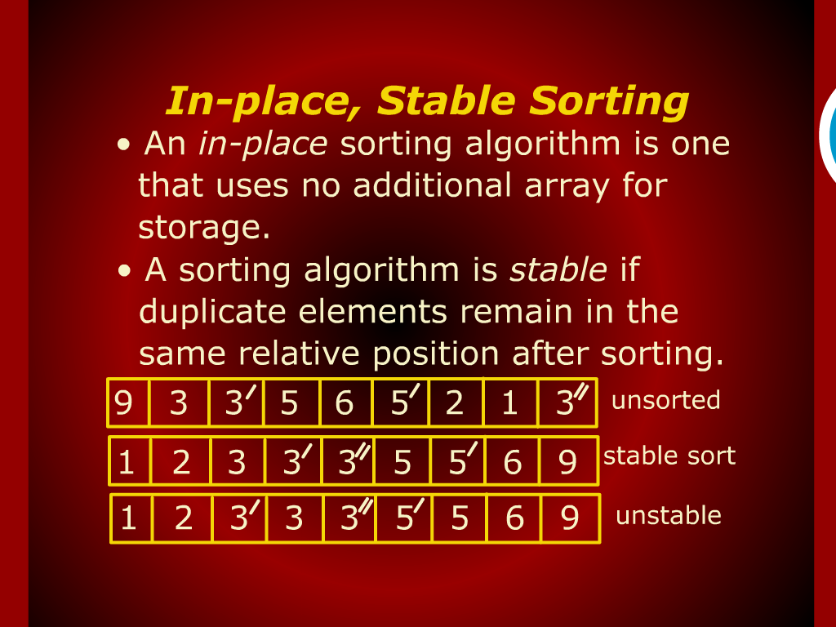
In-Place, Stable Sorting

Slide 3
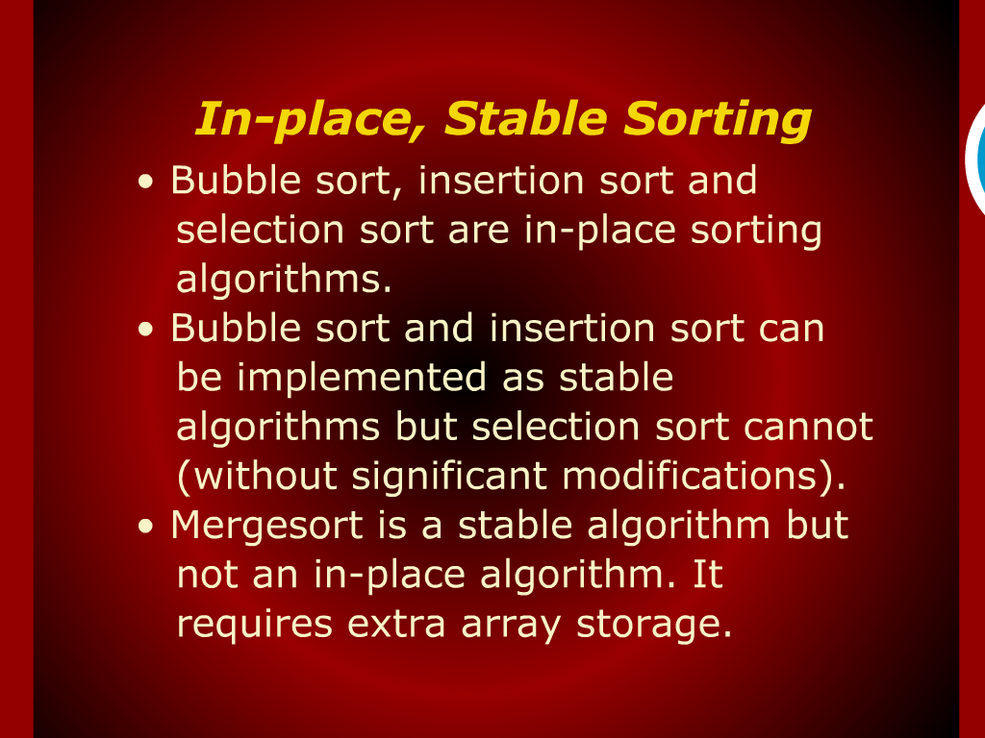
In-Place, Stable Sorting

Slide 4
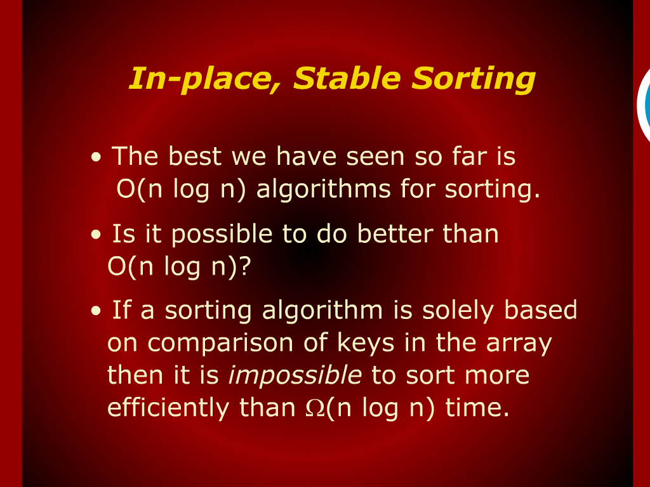
In-Place, Stable Sorting

Slide 5
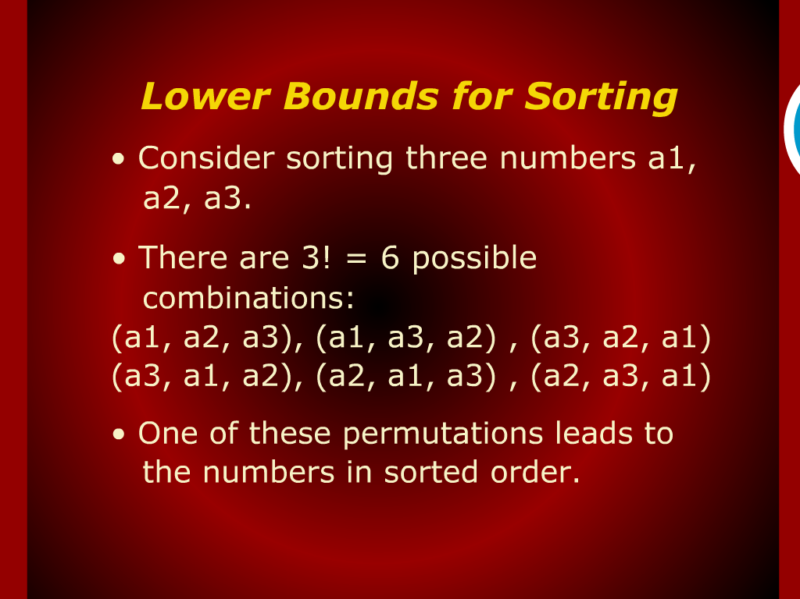
Lower Bounds for sorting

Slide 6
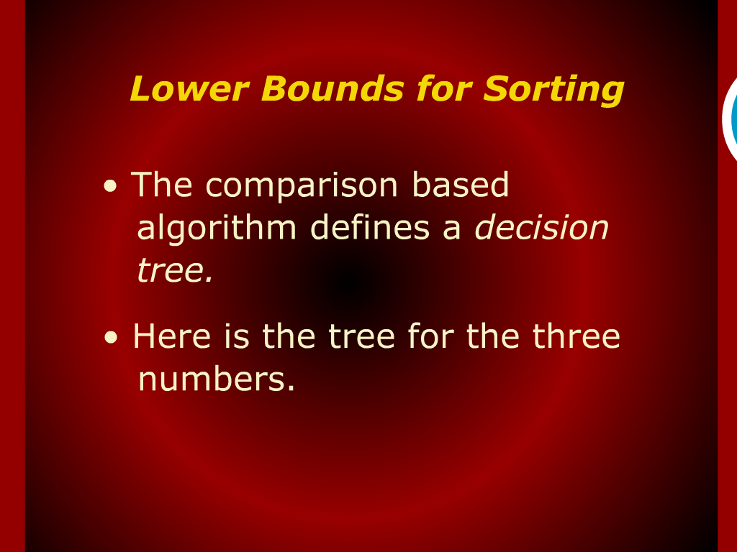
Lower Bounds for sorting

Slide 7
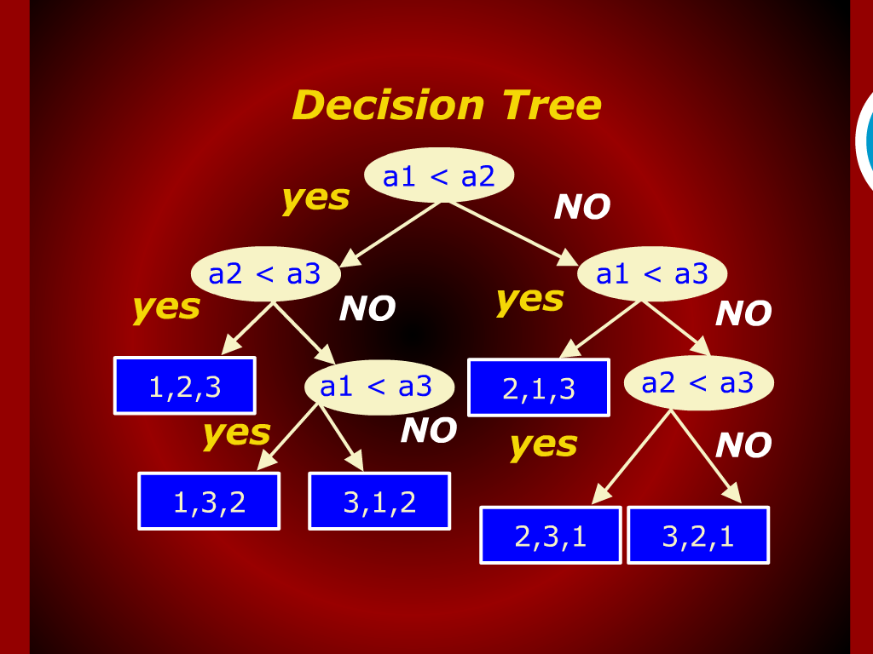
Decision Tree

Slide 8
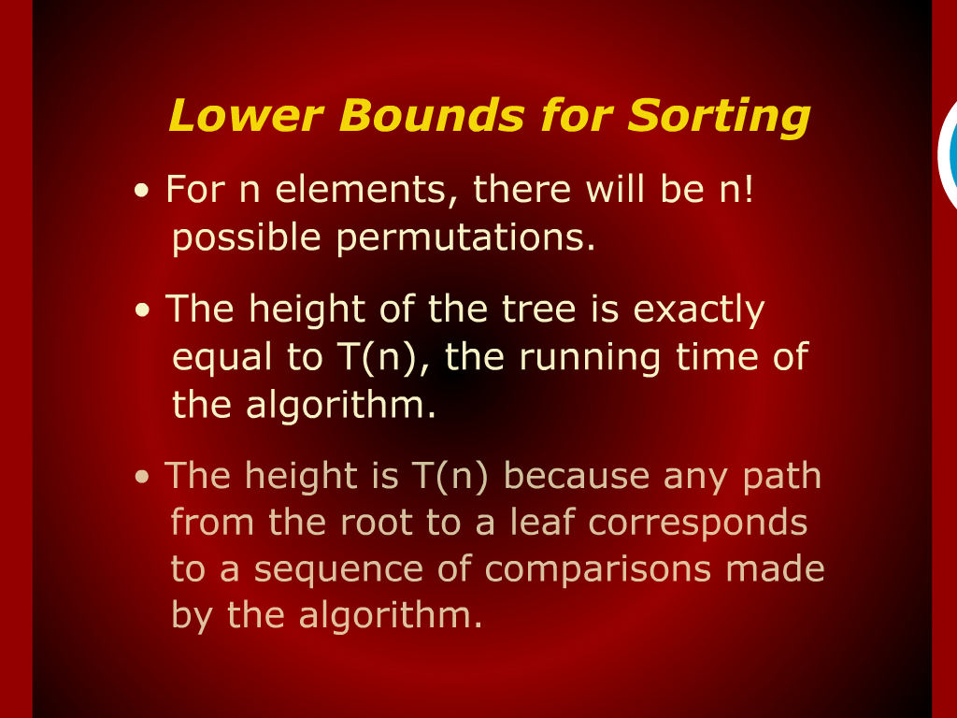
Lower Bounds for sorting

Slide 9
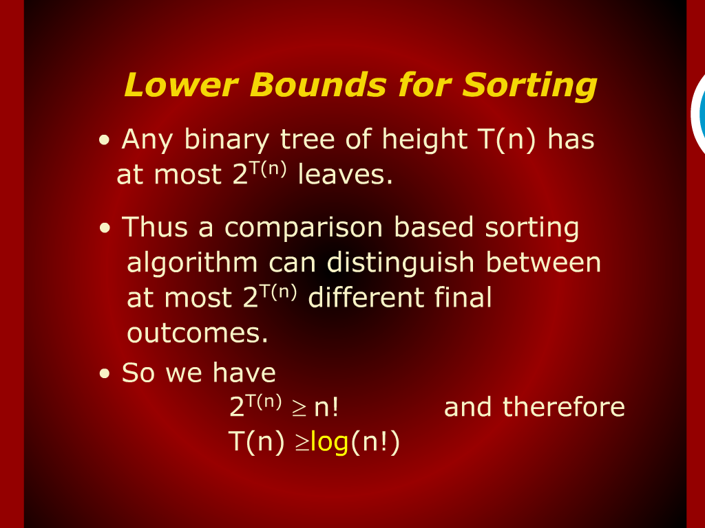
Lower Bounds for sorting

Slide 10
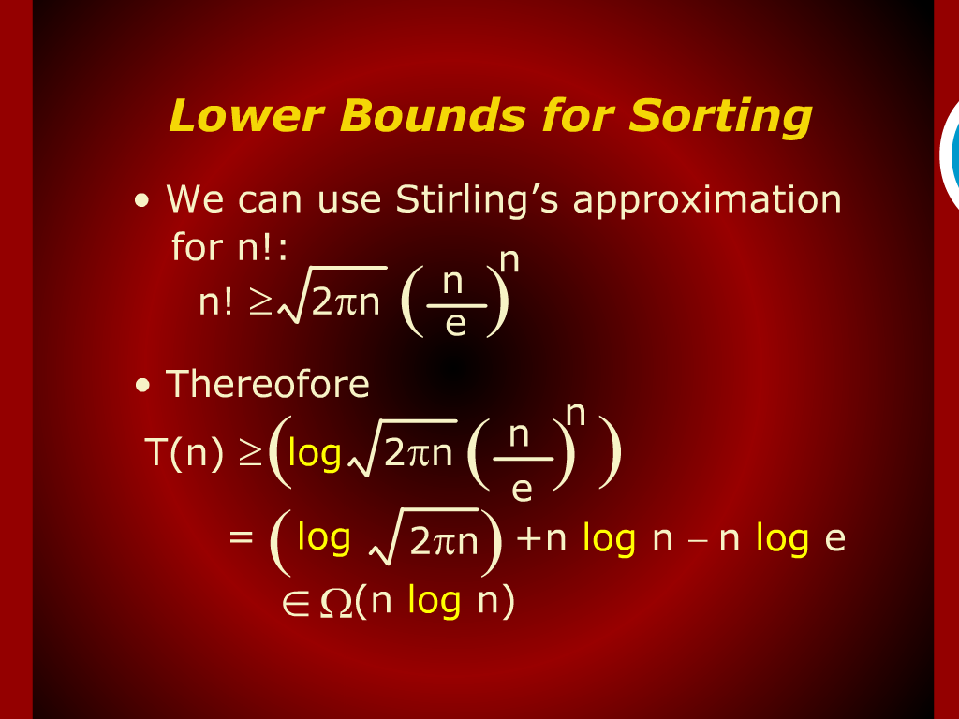
Lower Bounds for sorting

Slide 11
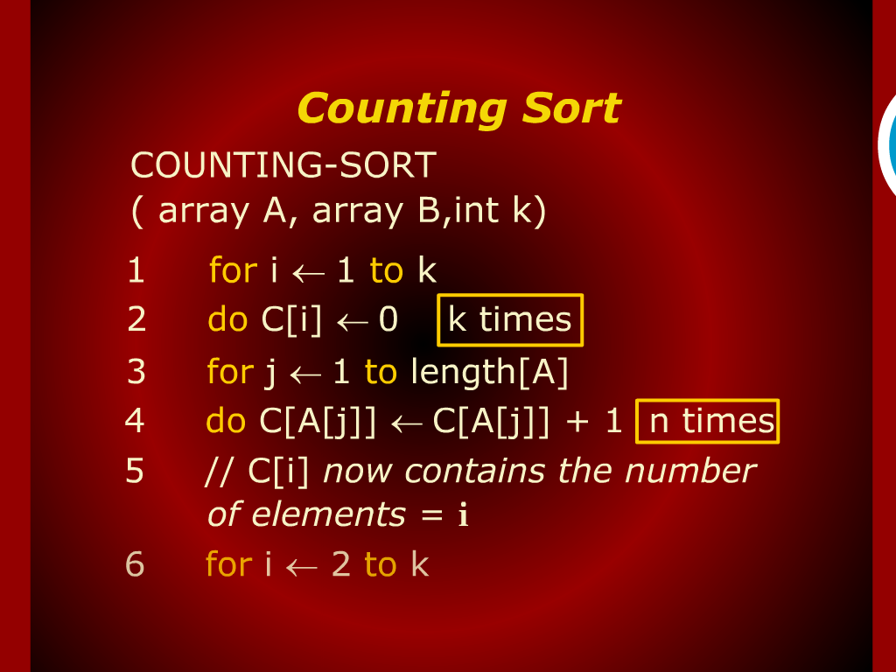
Counting Sort

Slide 12
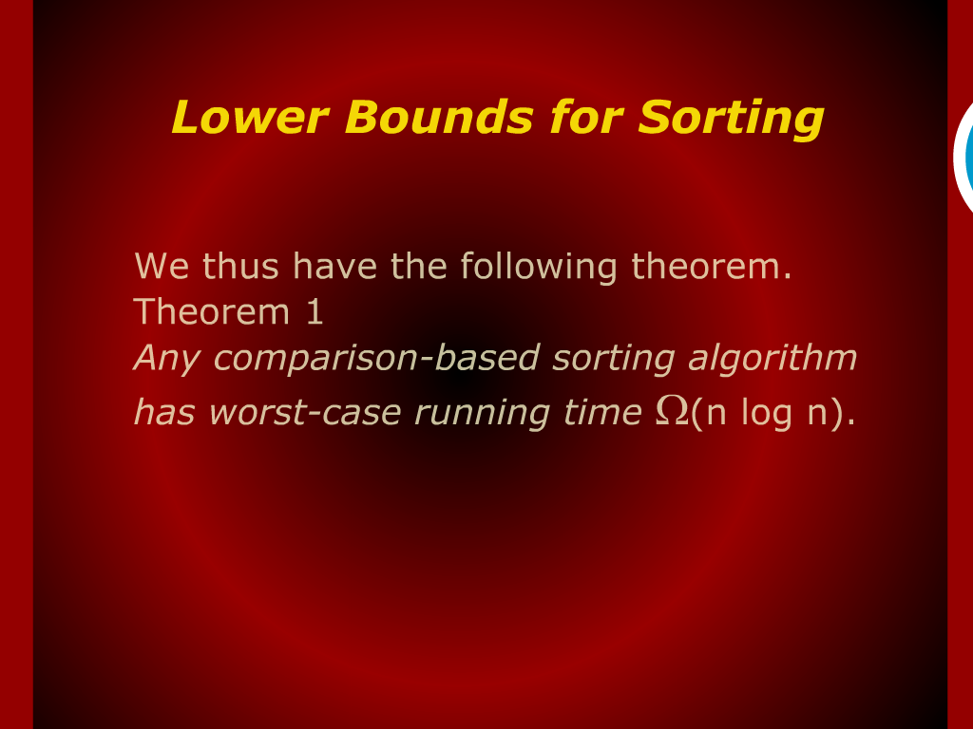
Lower Bounds for sorting

Slide 13
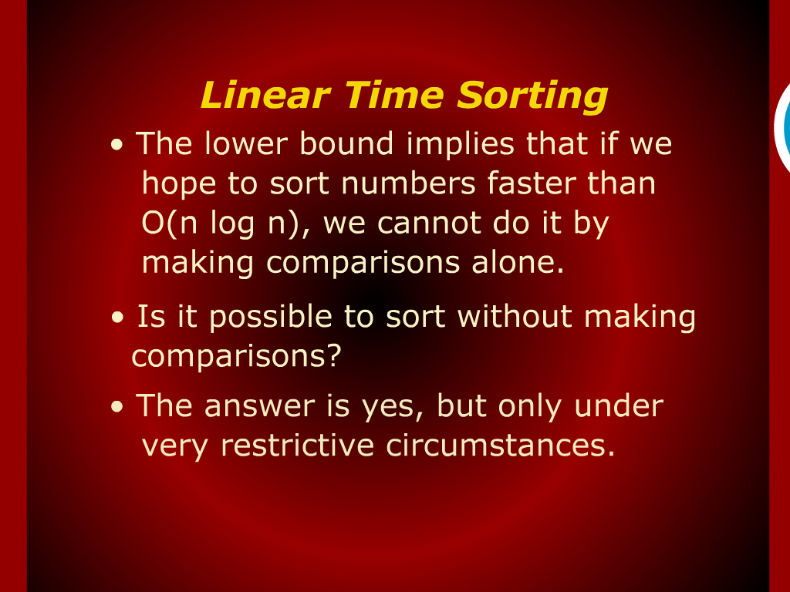
Linear time Sorting

Slide 14
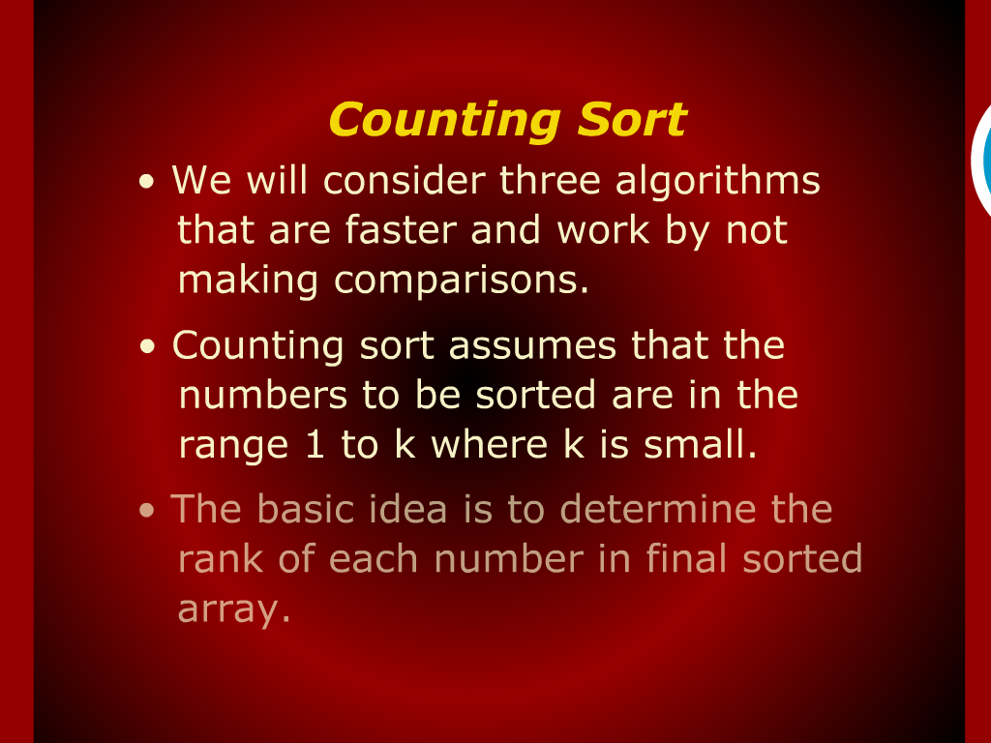
Counting Sort

Slide 15
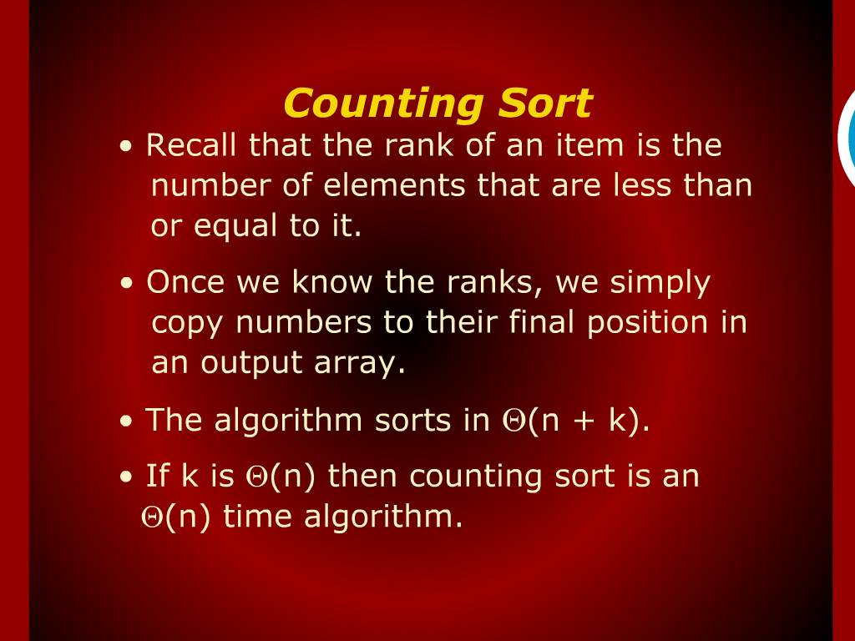
Counting Sort

Slide 16
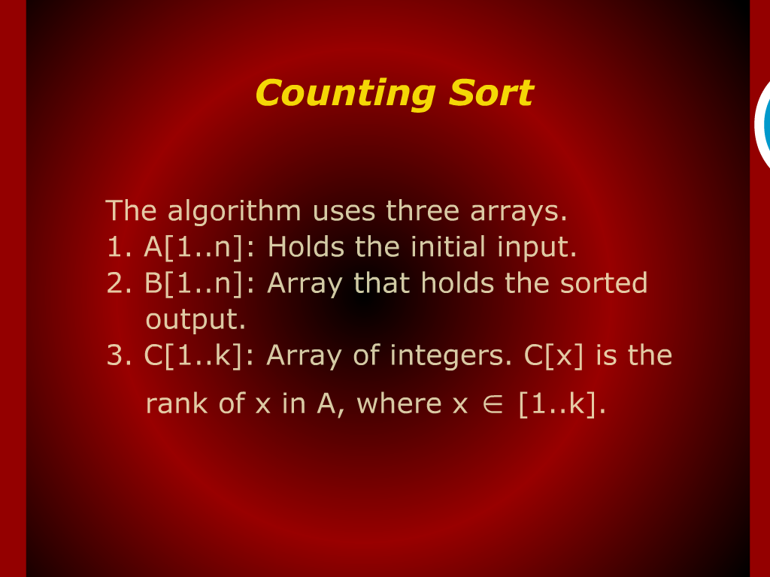
Counting S Counting sort ort

Slide 17
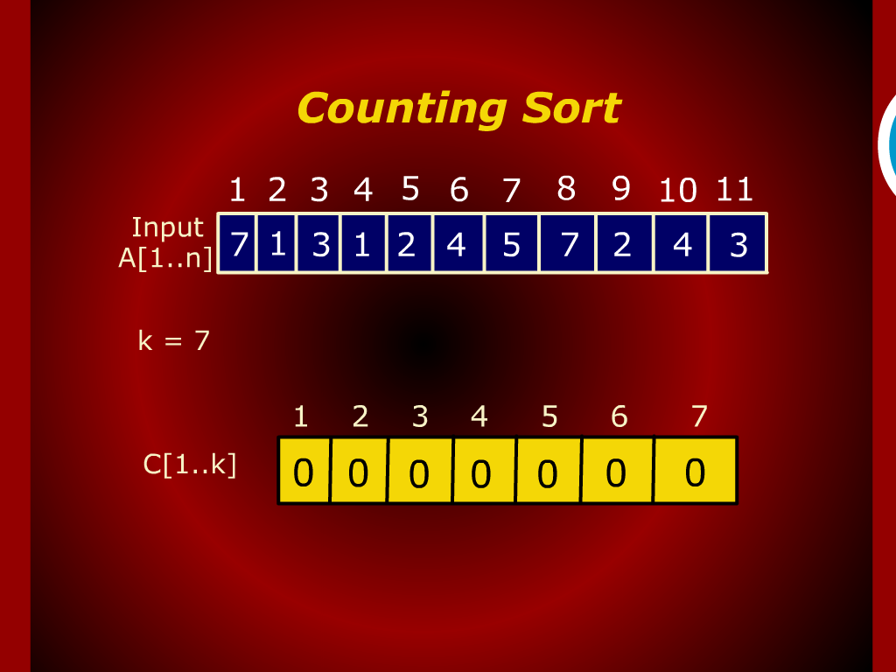
Counting sort

Slide 18

Counting sort

Slide 19
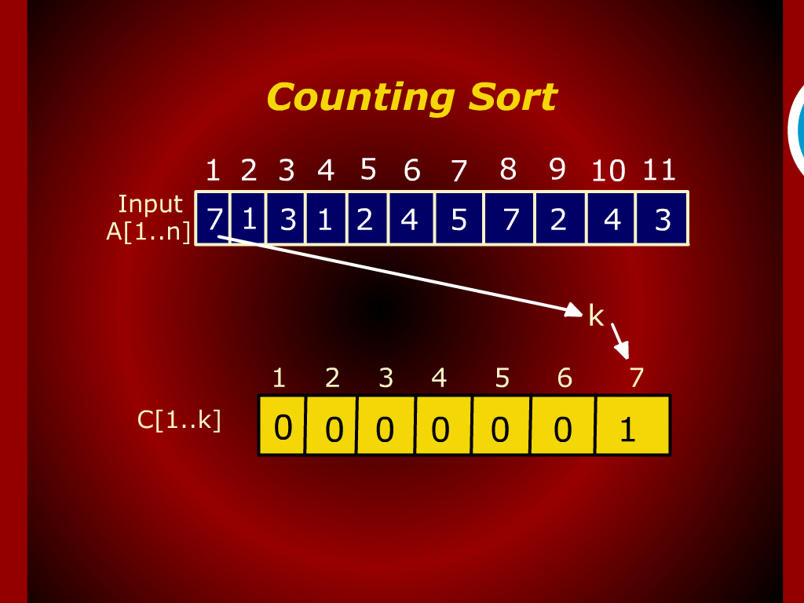
Counting sort

Slide 20
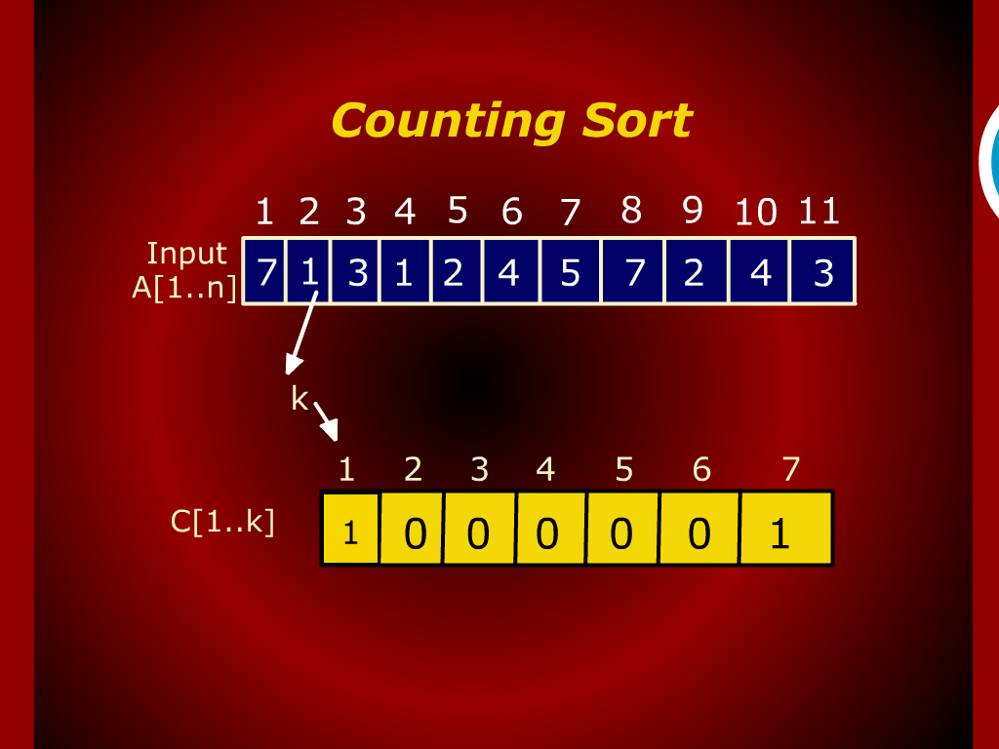
Counting sort

Slide 21
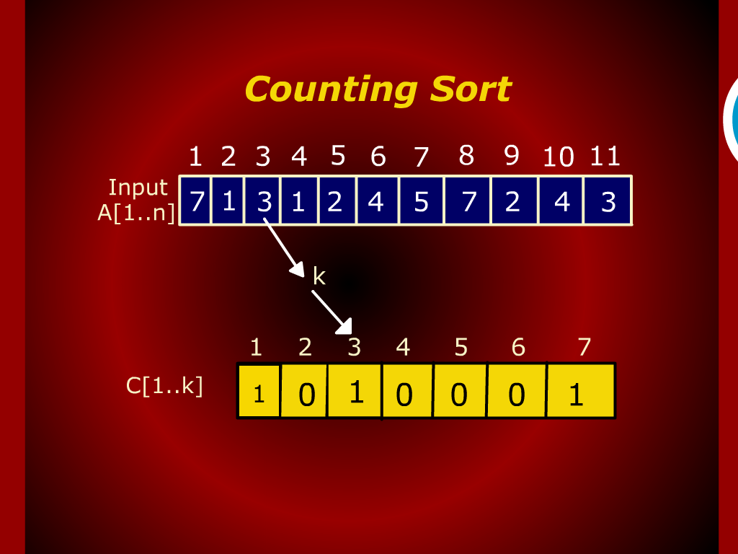
Counting sort

Slide 22

Counting sort

Slide 23
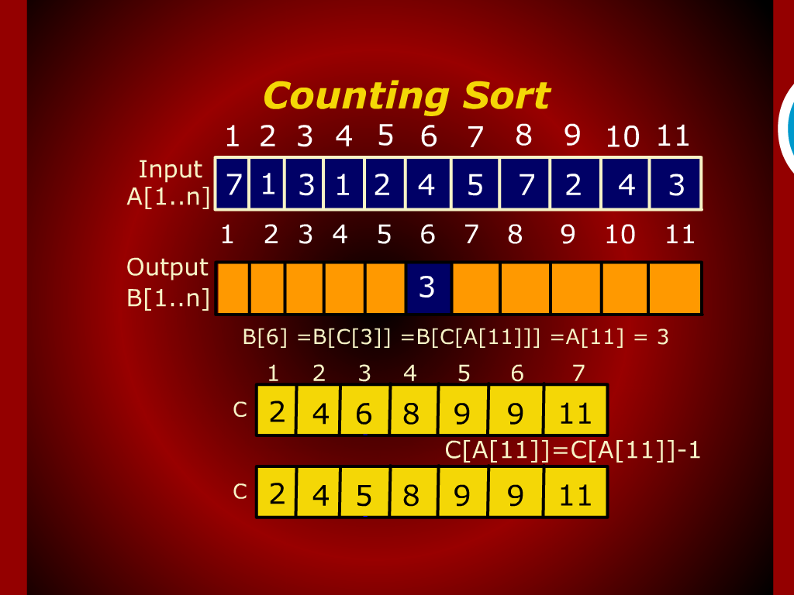
Counting sort

Slide 24

Counting sort

Slide 25
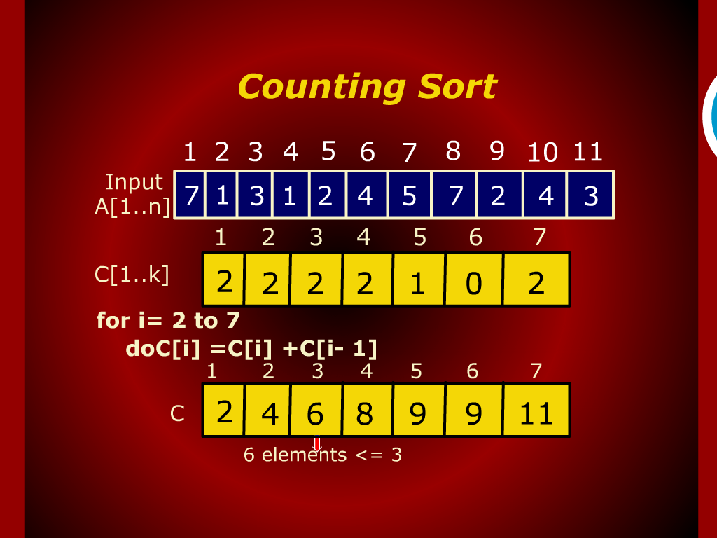
Counting sort

Slide 26

Counting sort

Slide 27
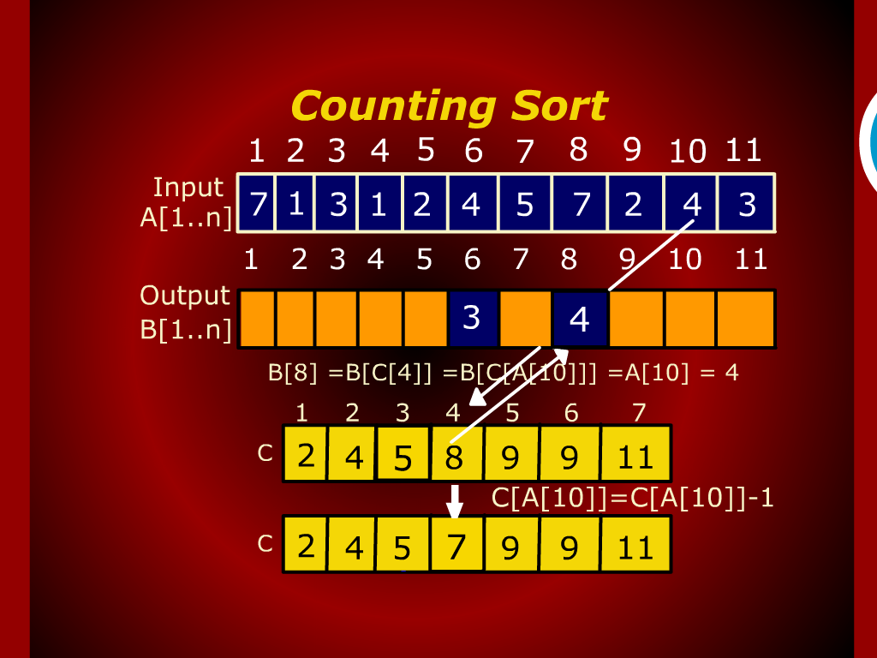
Counting sort

Slide 28
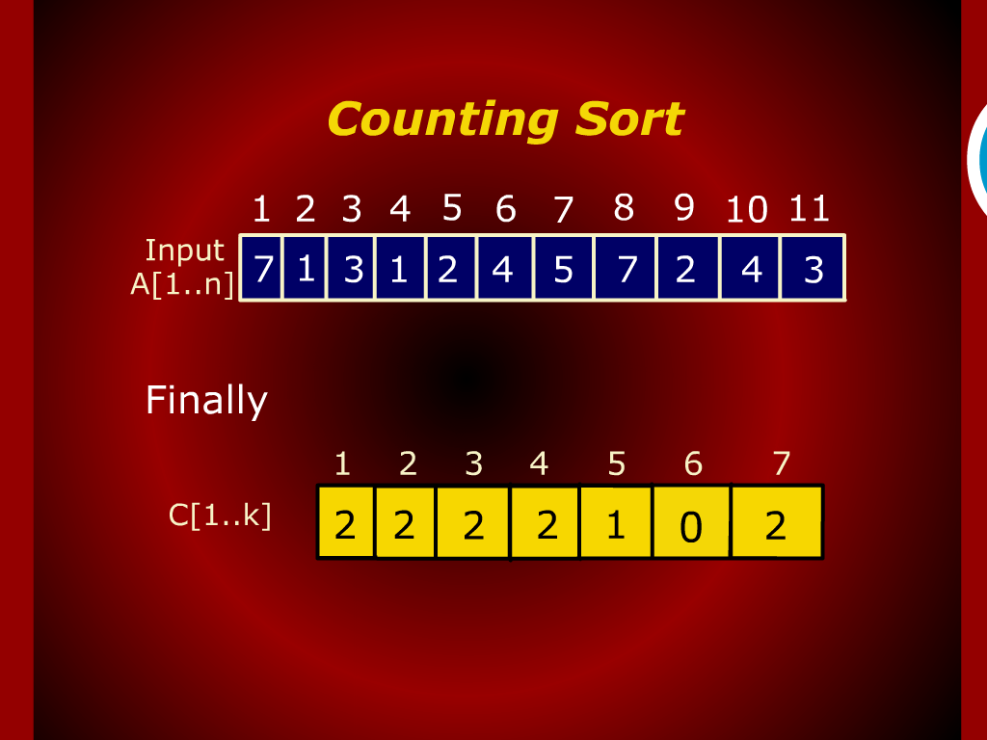
Counting sort

Slide 29
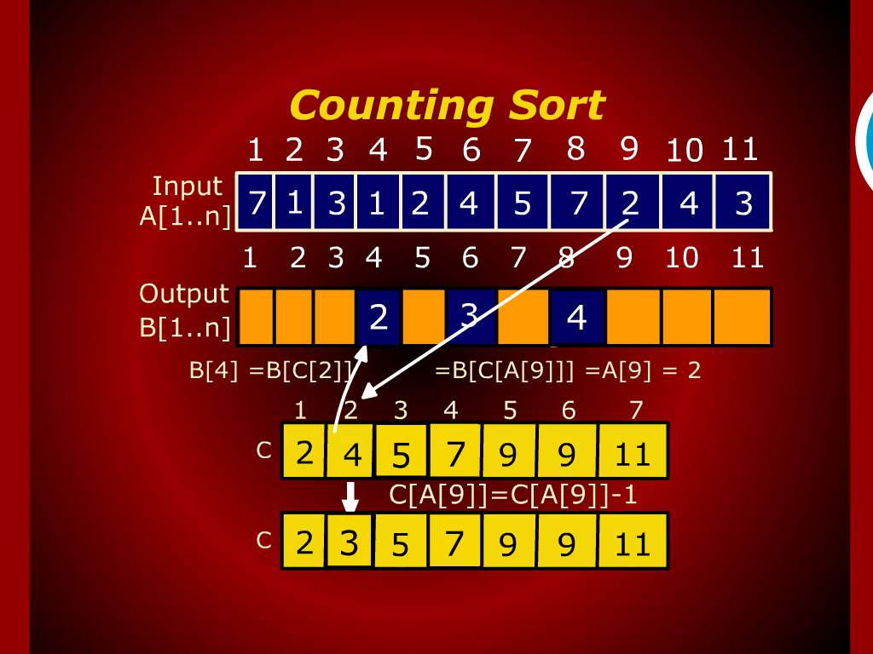
Counting sort

Slide 30
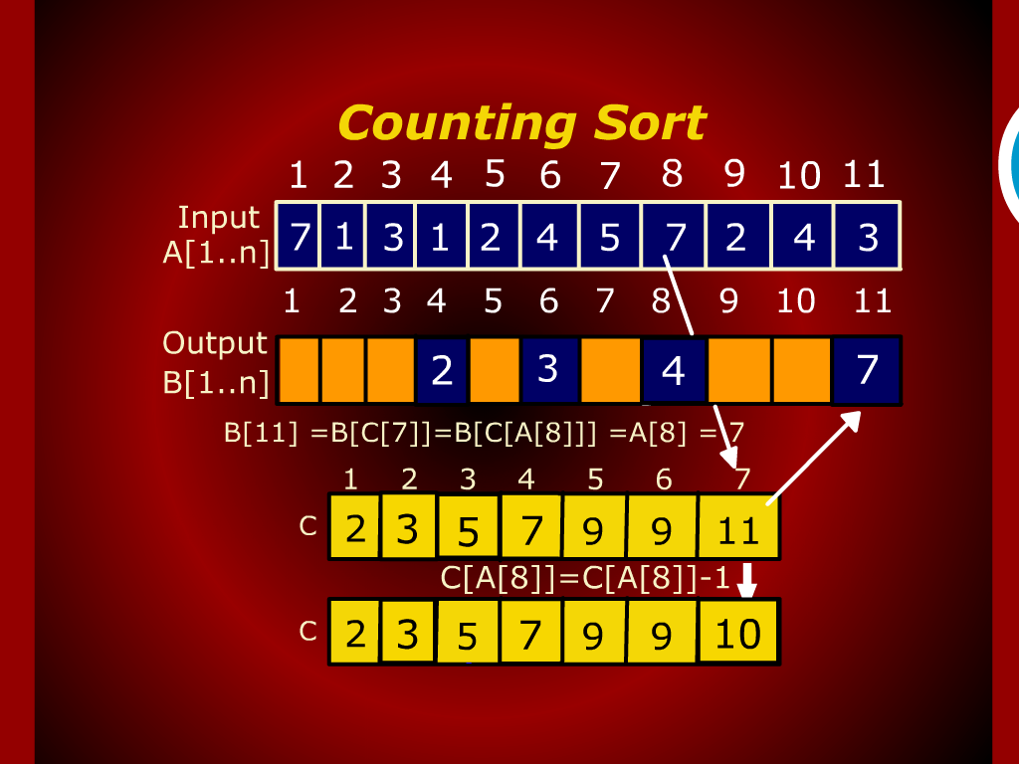
Counting sort

Slide 31
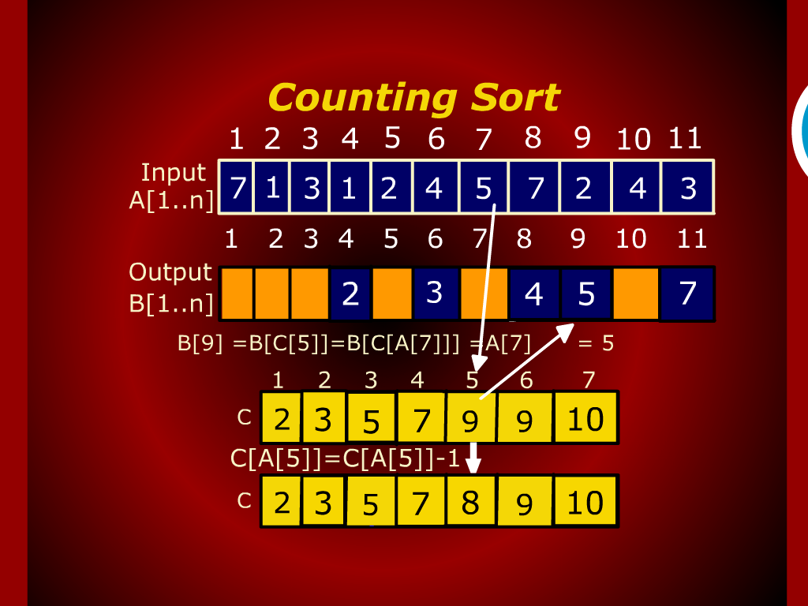
Counting sort

Slide 32
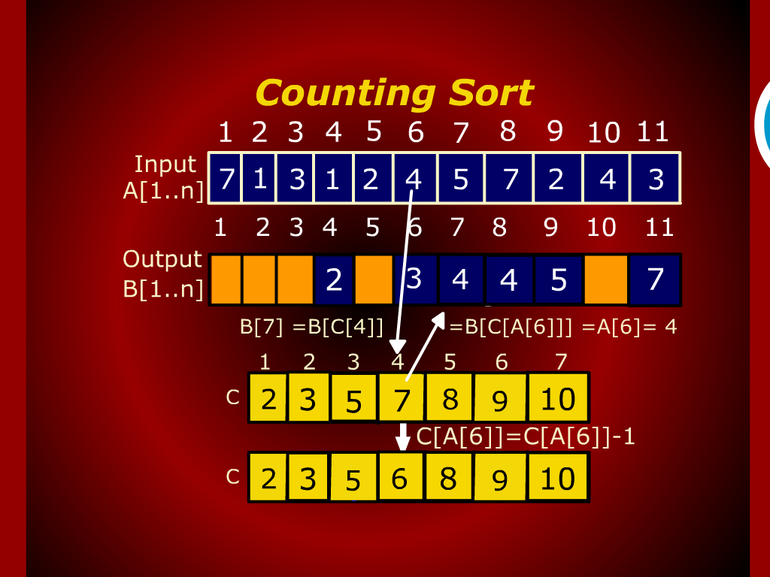
Counting sort

Slide 33
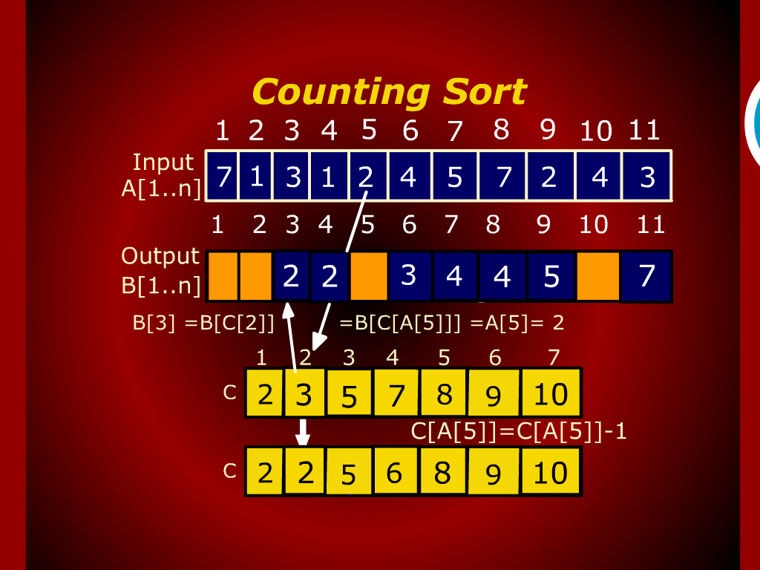
Counting sort

Slide 34
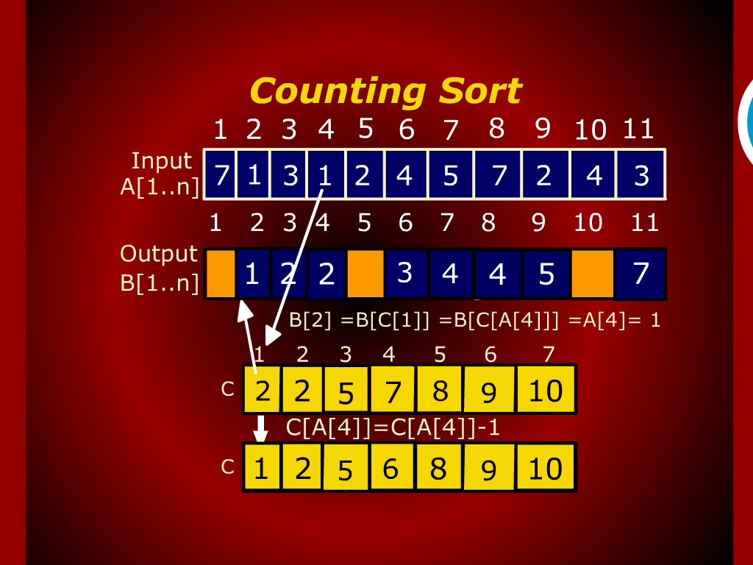
Counting sort

Slide 35
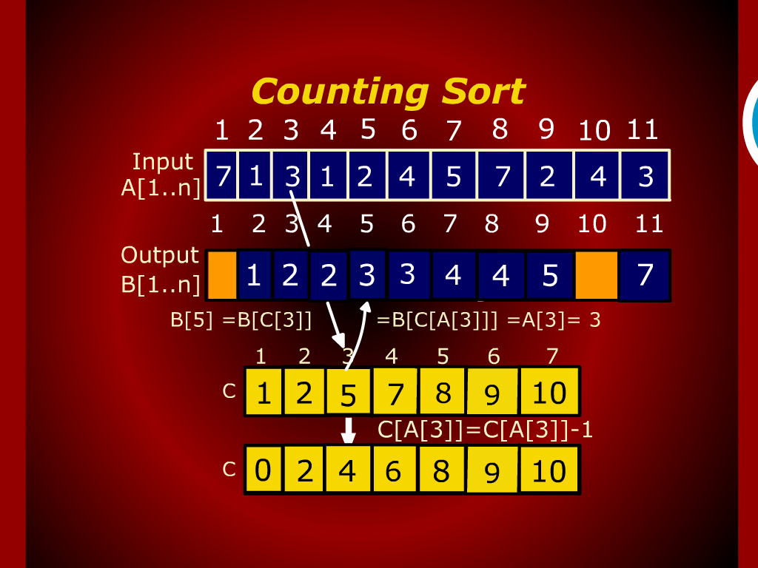
Counting sort

Slide 36
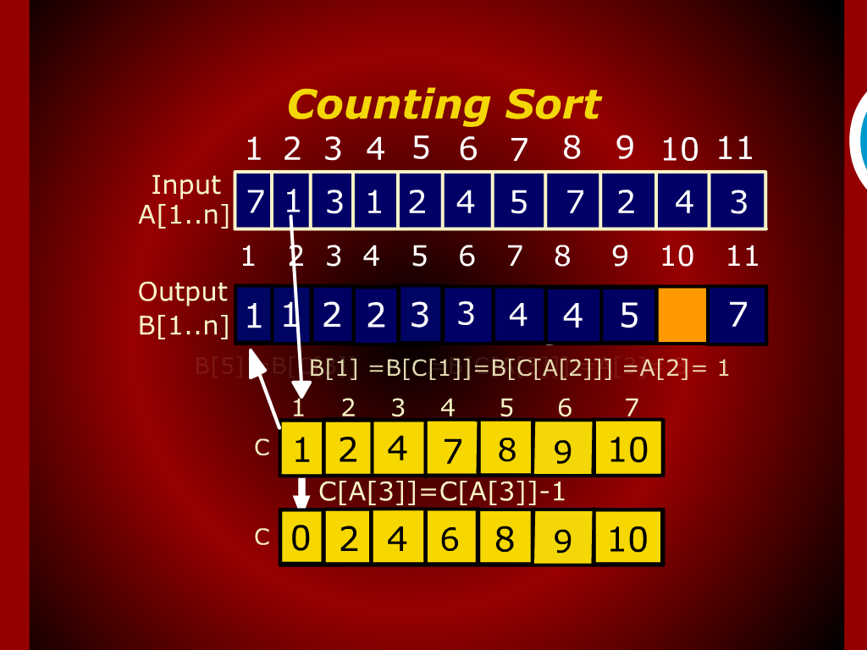
Counting sort

Slide 37
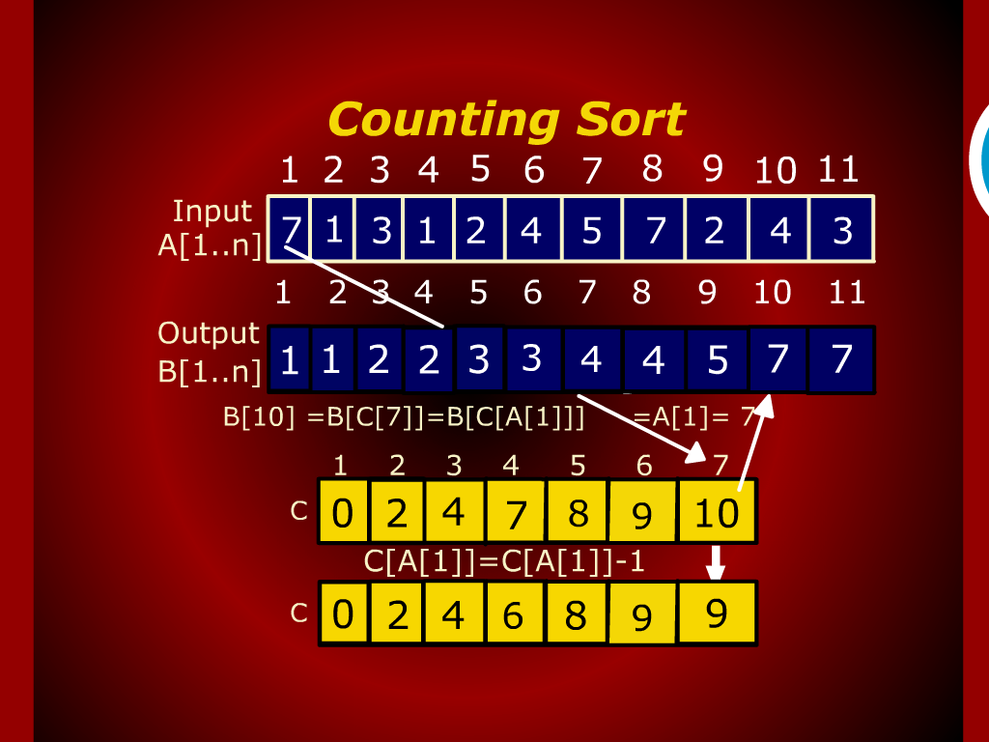
Counting sort

Slide 38
Counting sort

Slide 39

Counting sort

Slide 40
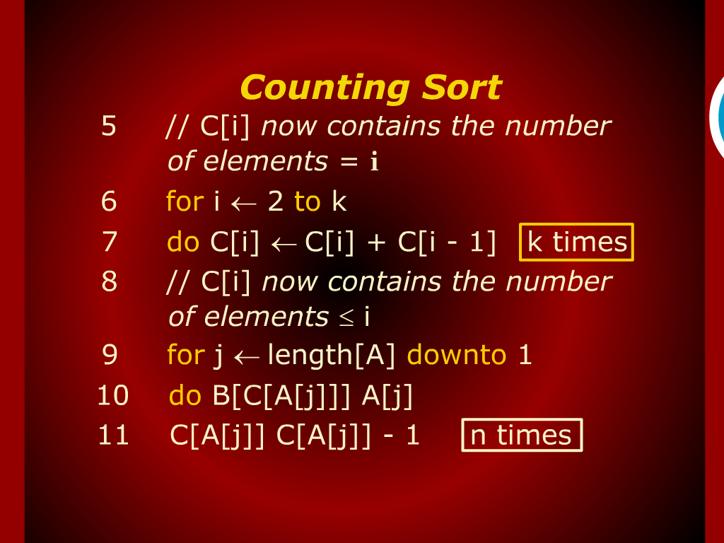
Counting sort

Slide 41
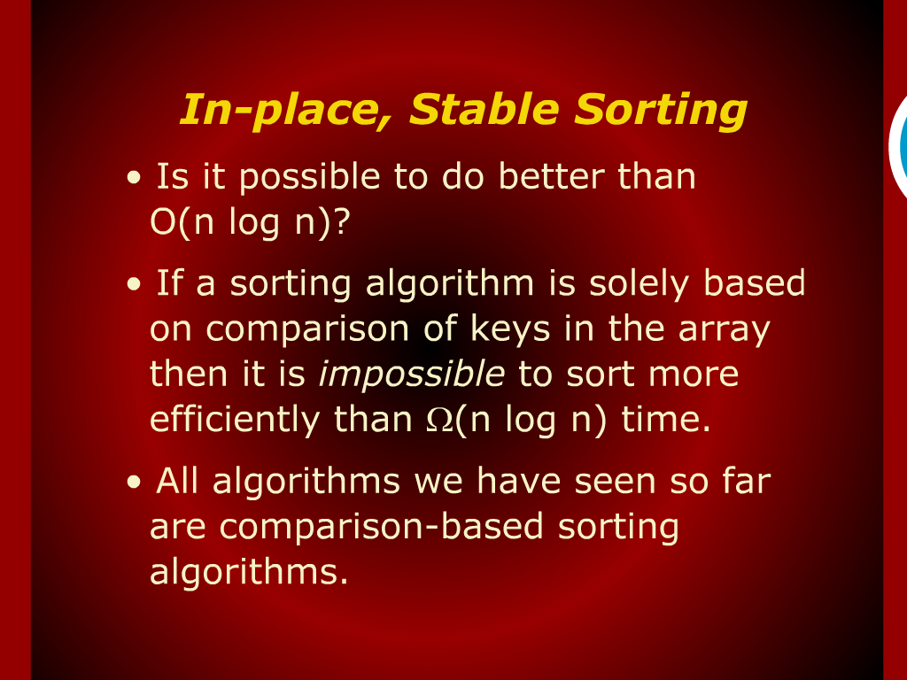
In-place, Stable Sorting

Slide 42
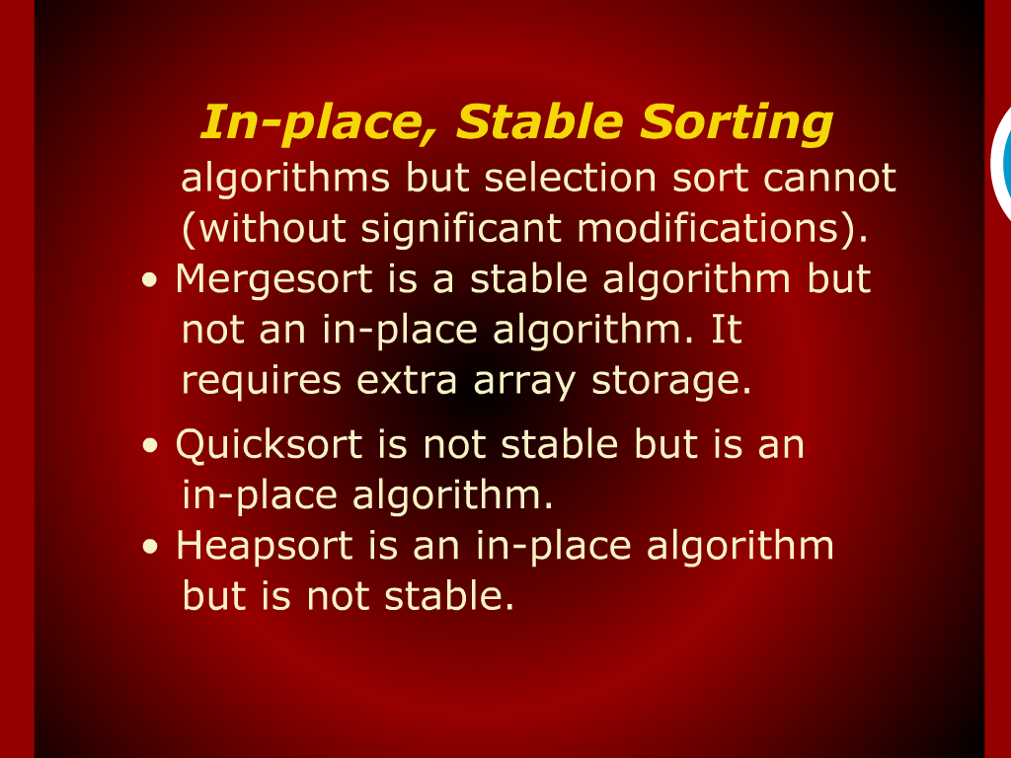
In-place, Stable Sorting

Slide 43
Lower Bound for Sorting

Slide 44
Stable sorting

Slide 46
Design and Analysis
of
Algorithms

