Slide 1
Algorithms
Lecture # 16
Dr.Sohail Aslam

Slide 2
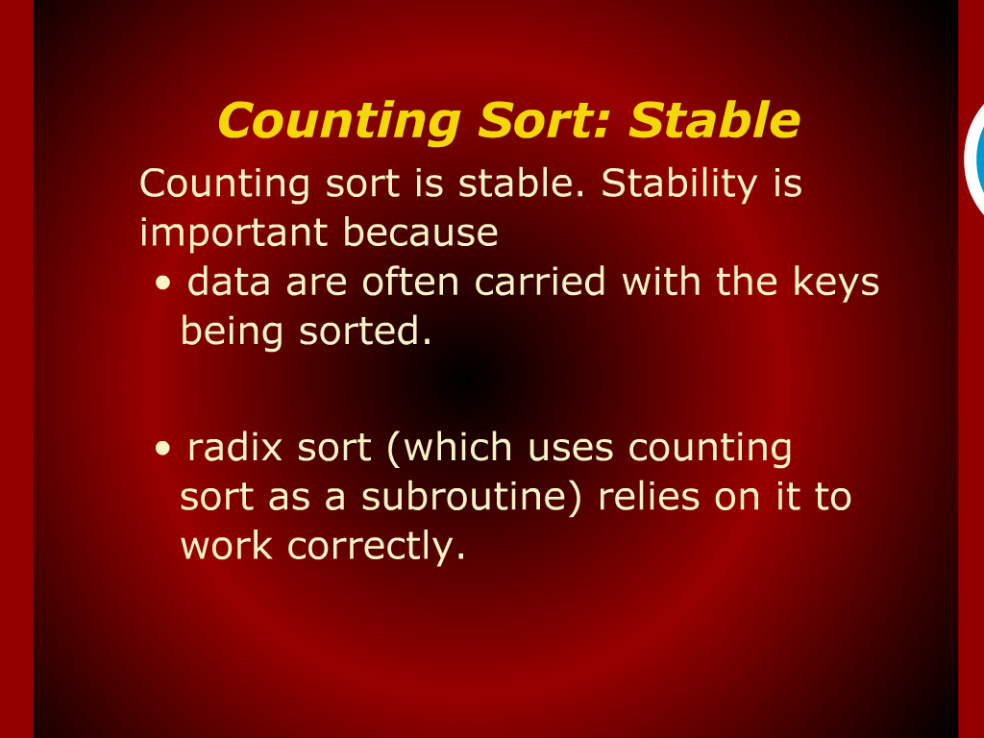
Counting Sort: Stable

Slide 3
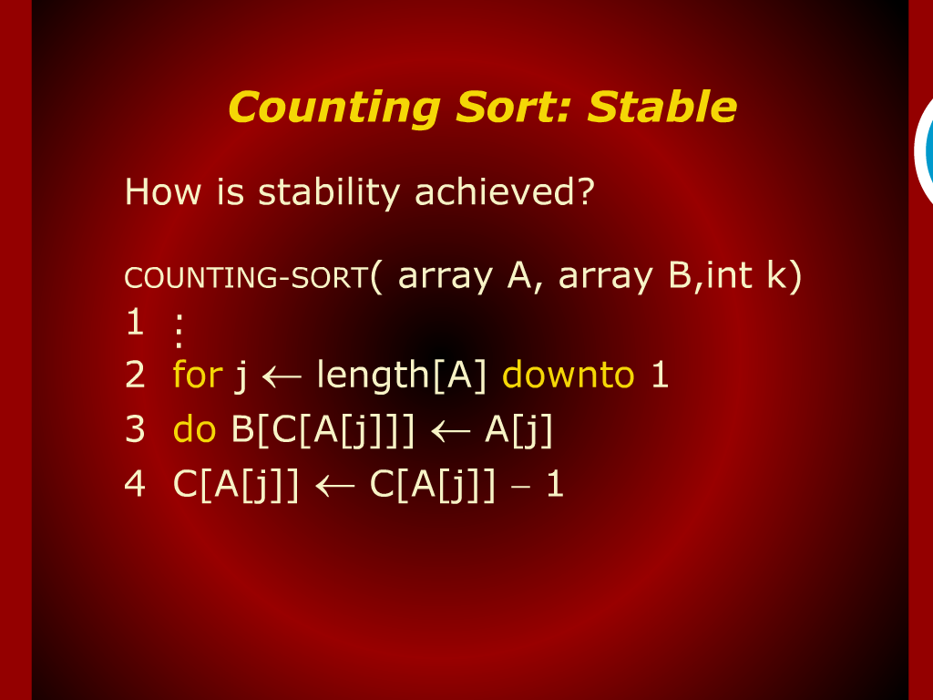
Counting Sort: Stable

Slide 4
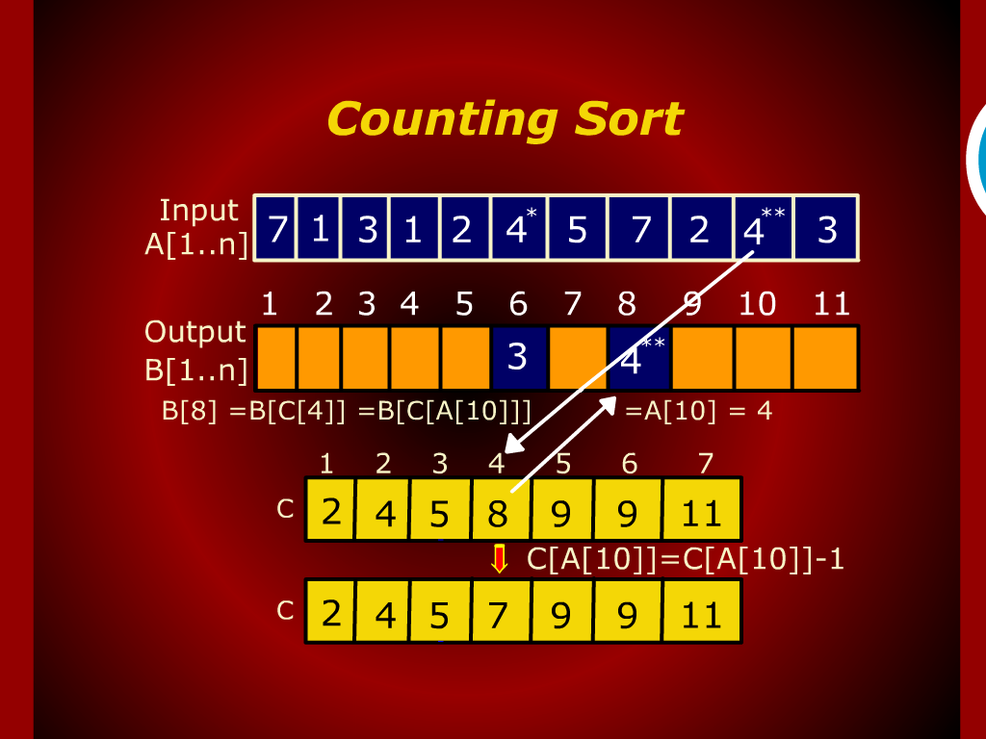
Counting Sort

Slide 5
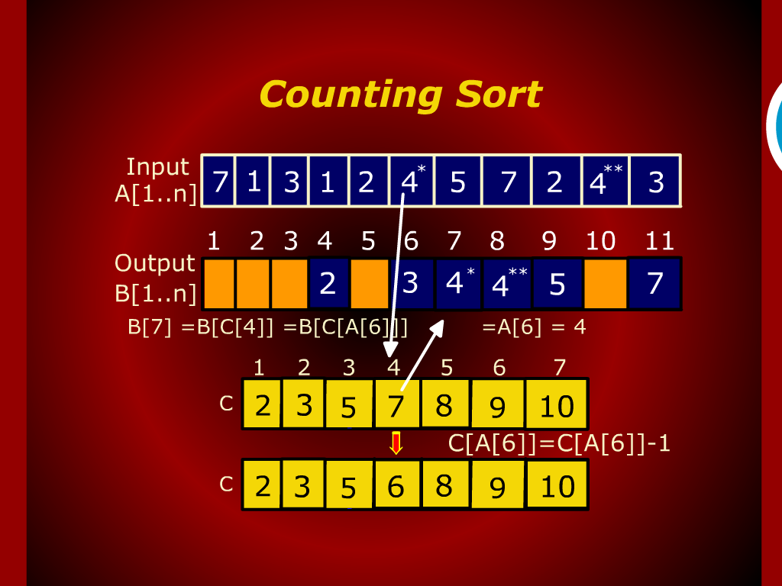
Counting Sort

Slide 6
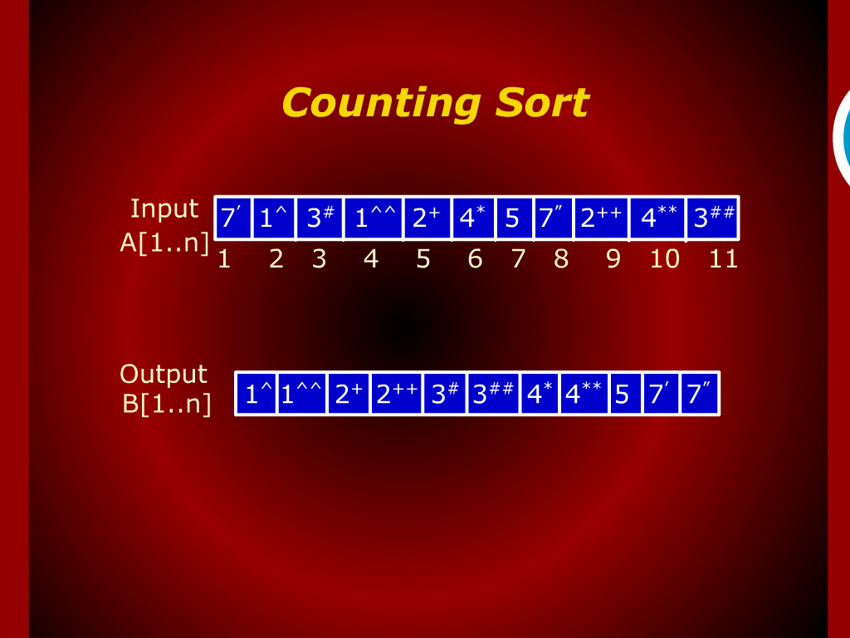
Counting Sort

Slide 7
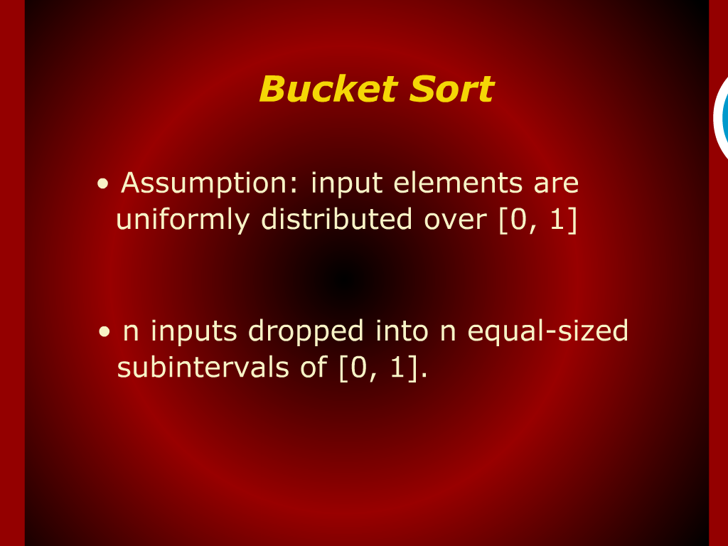
Bucket Sort

Slide 8
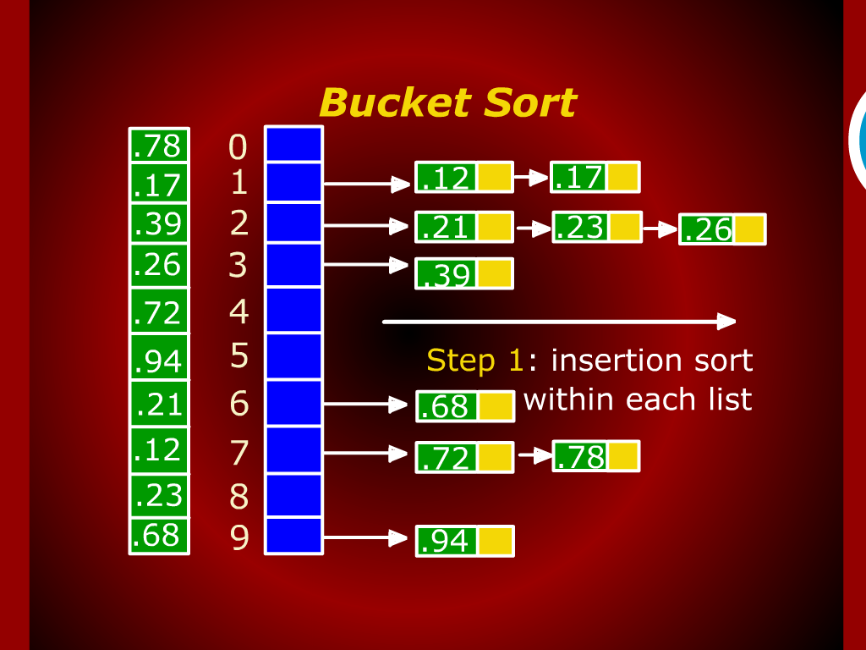
Bucket Sort

Slide 9
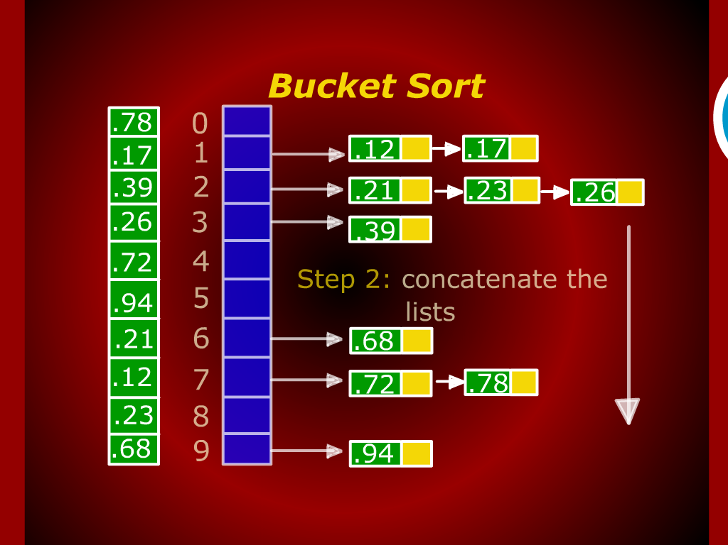
Bucket Sort

Slide 10
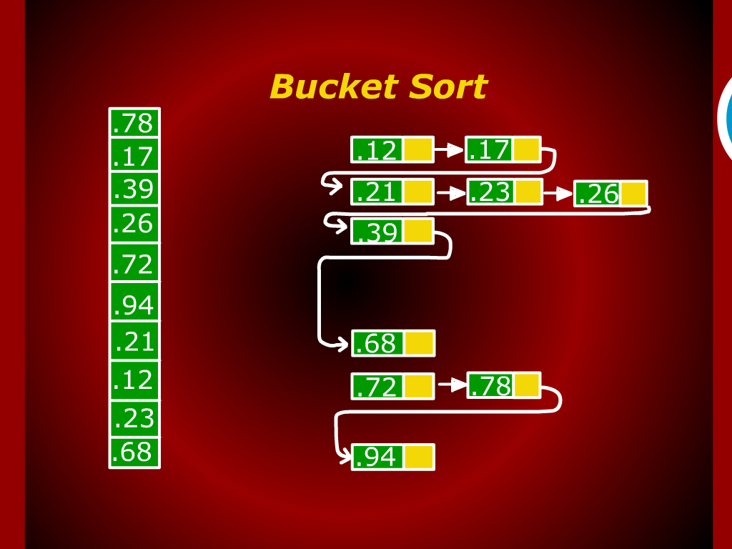
Bucket Sort

Slide 11
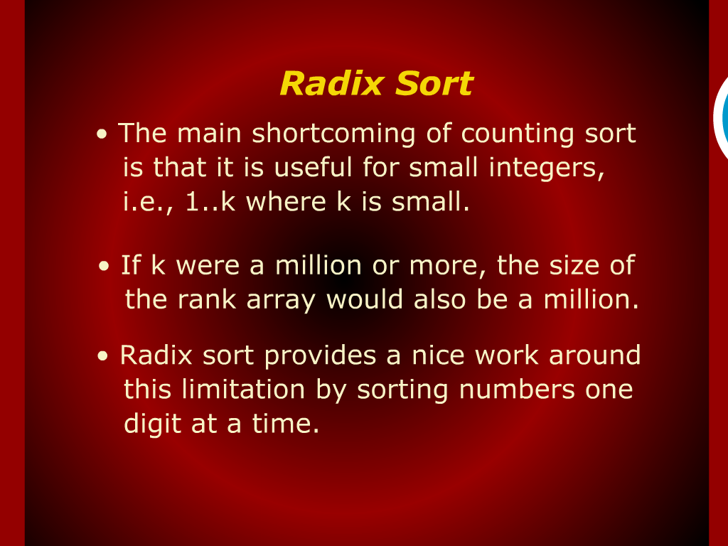
Radix Sort

Slide 12
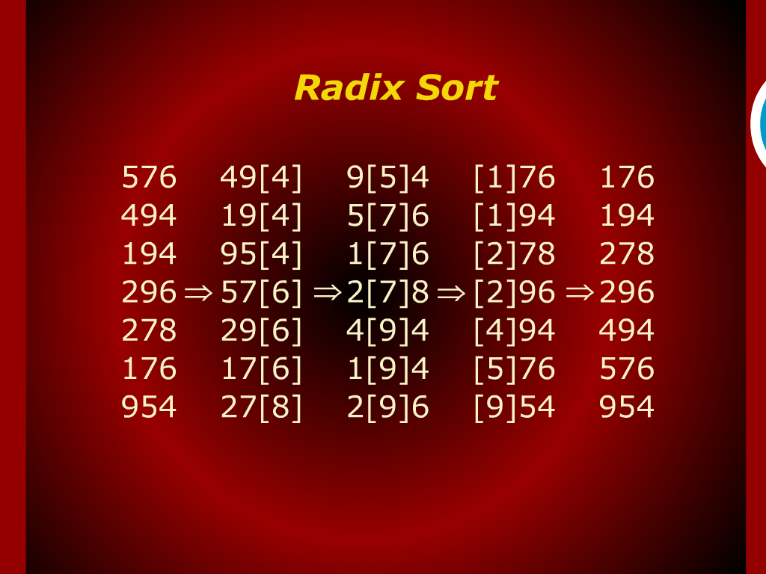
Radix Sort

Slide 13
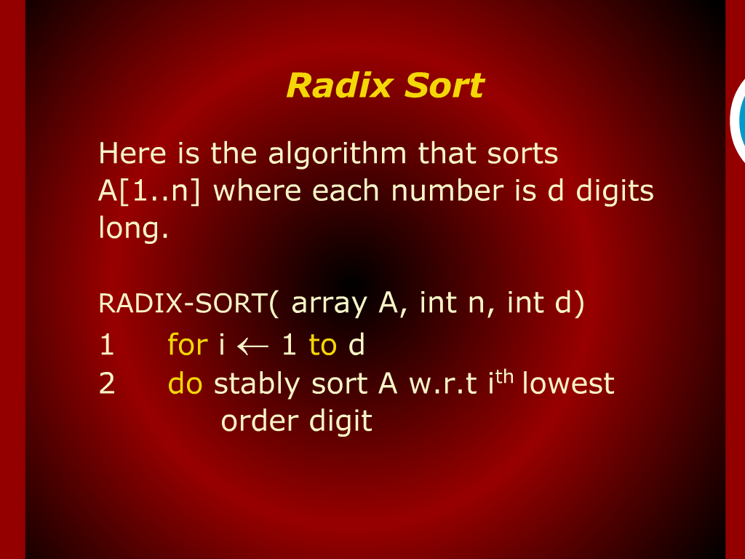
Radix Sort

Slide 14
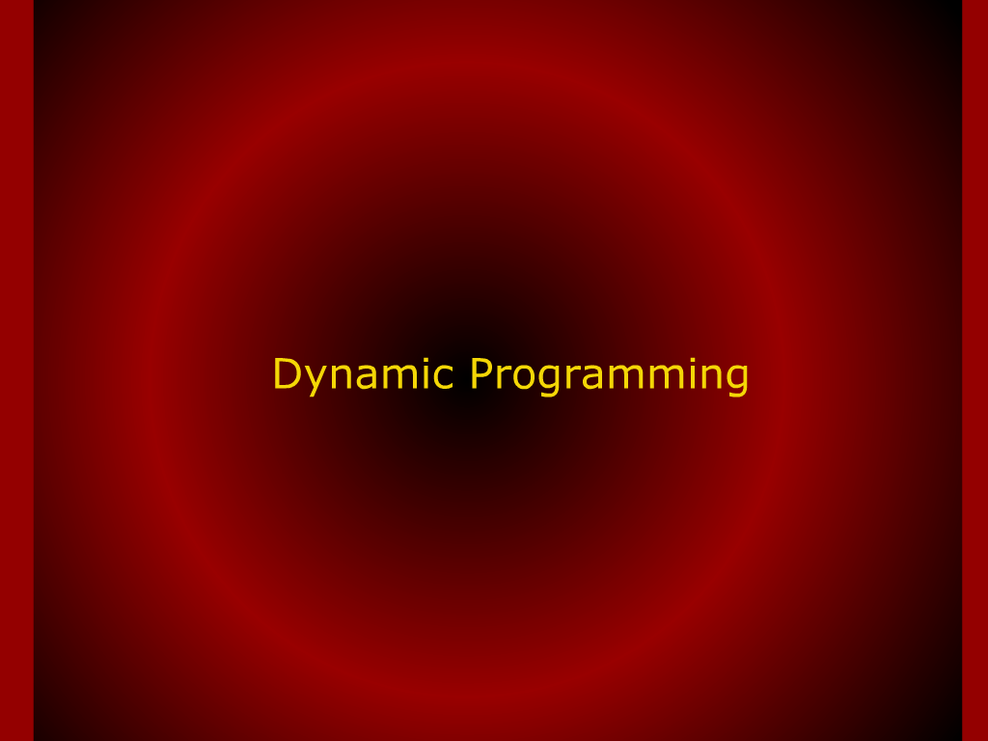
Dynamic Programming

Slide 15
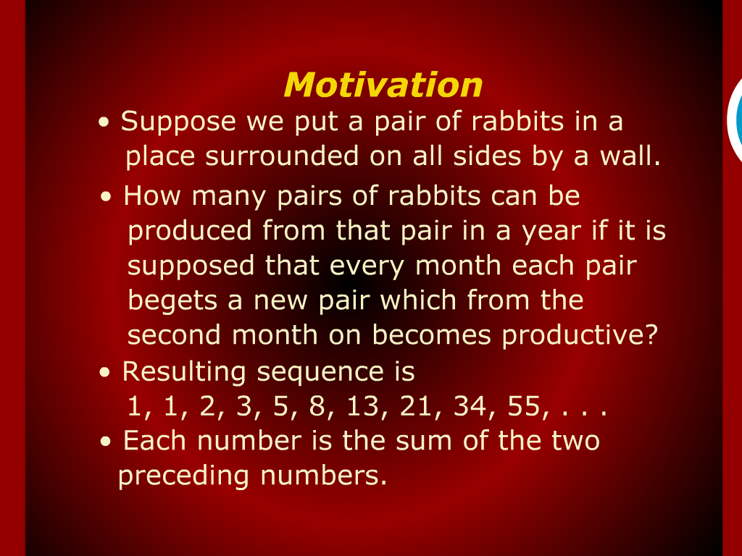
Motivation

Slide 16
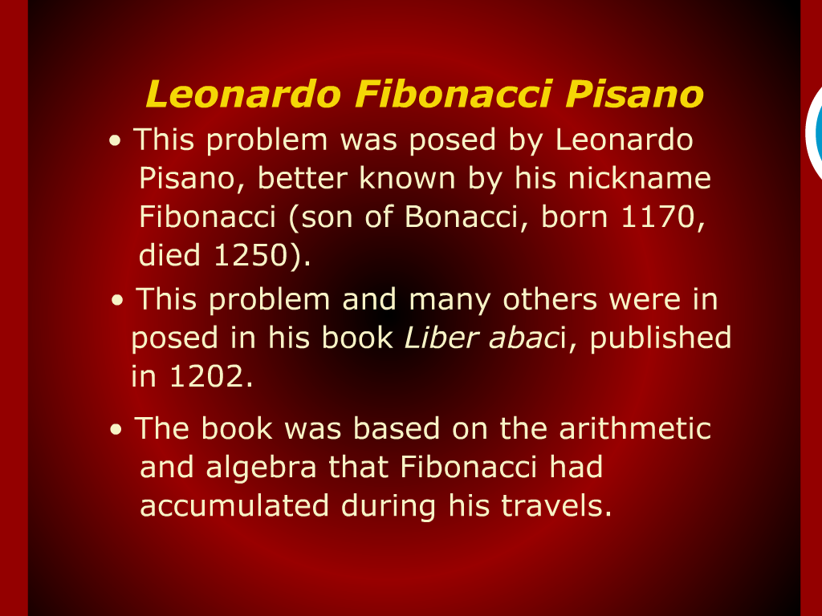
Leonardo Fibonacci Pisano

Slide 17
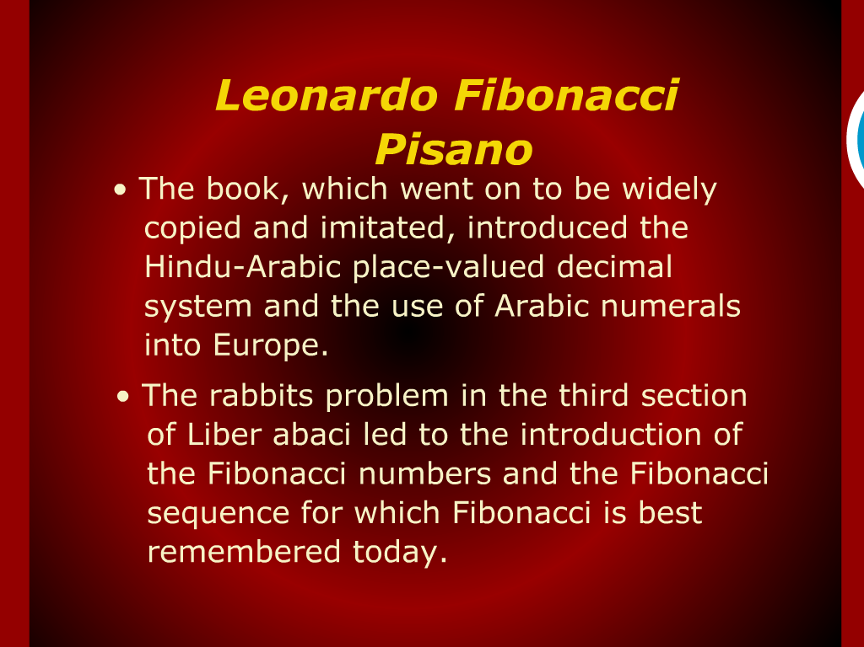
Leonardo Fibonacci Pisano

Slide 18
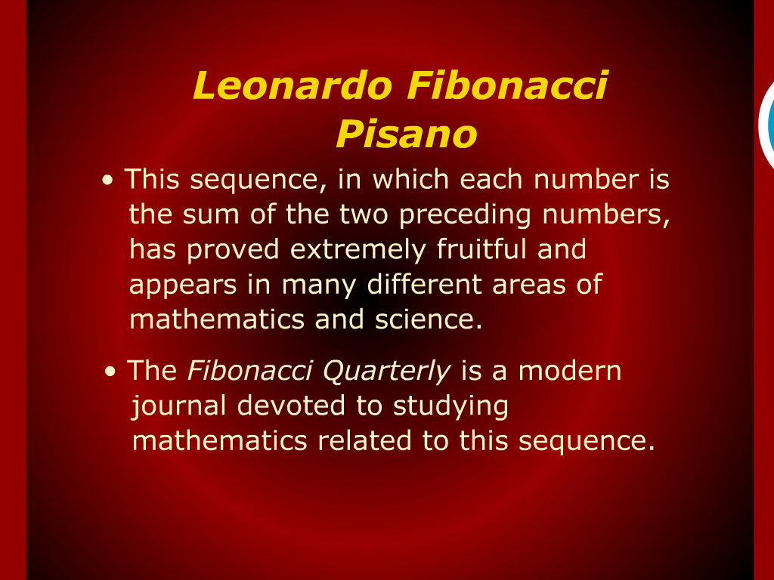
Leonardo Fibonacci Pisano

Slide 19
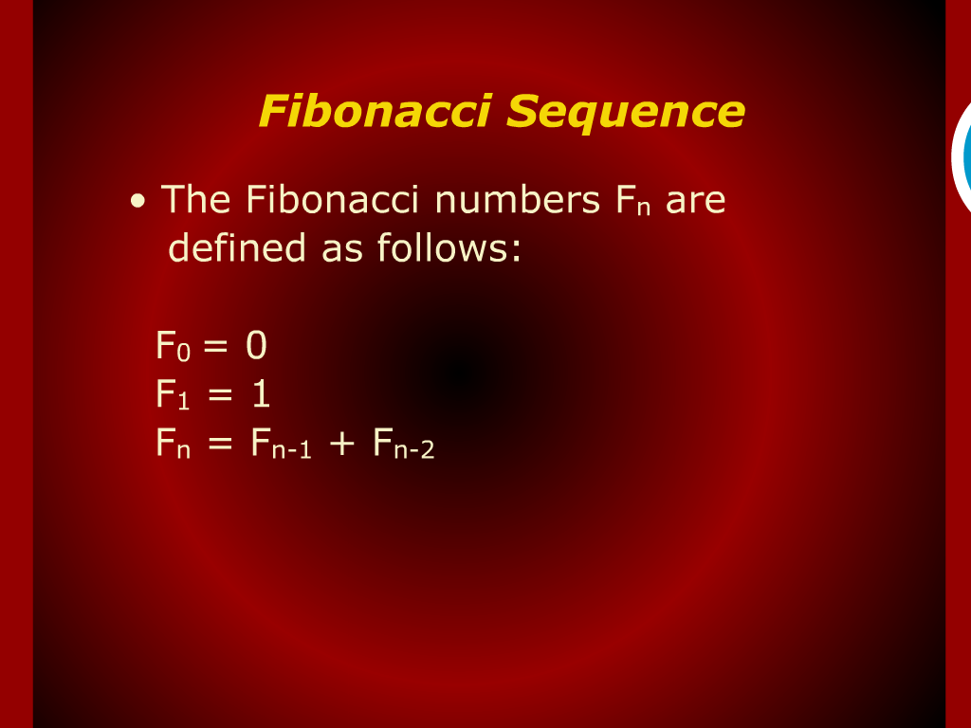
Fibonacci Sequence

Slide 20
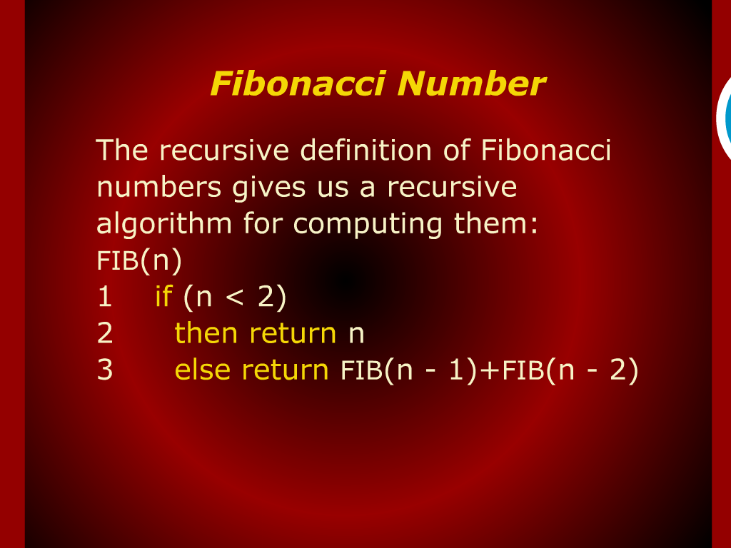
Fibonacci Number

Slide 21
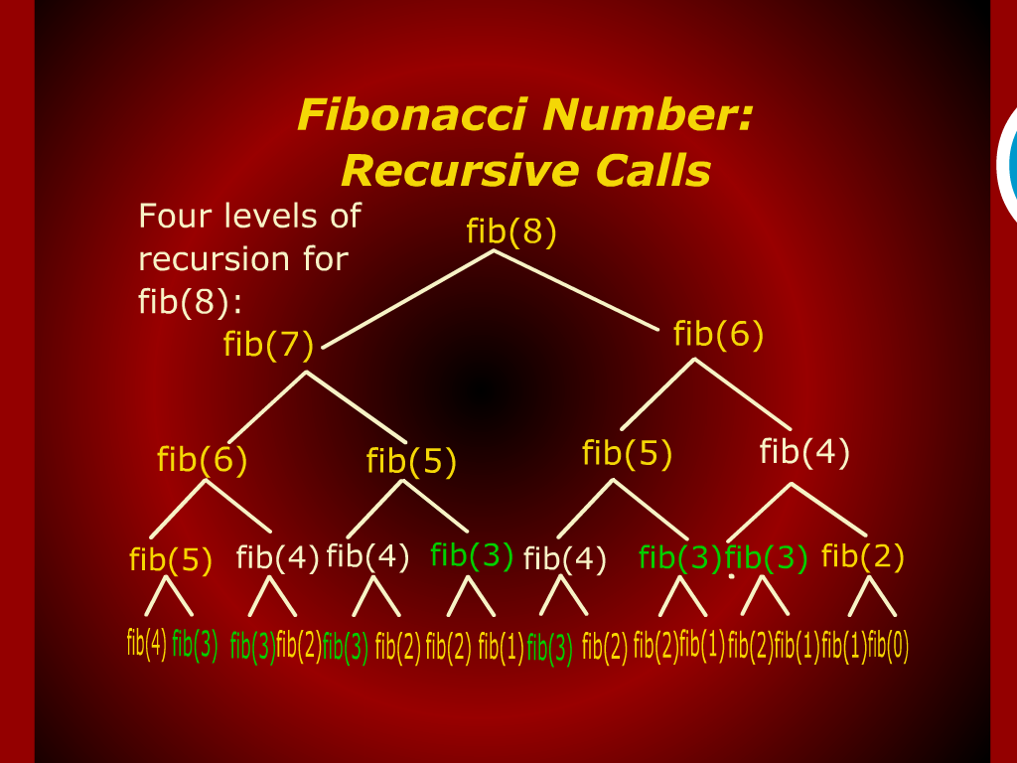
Fibonacci Number:
Recursive Calls

Slide 22
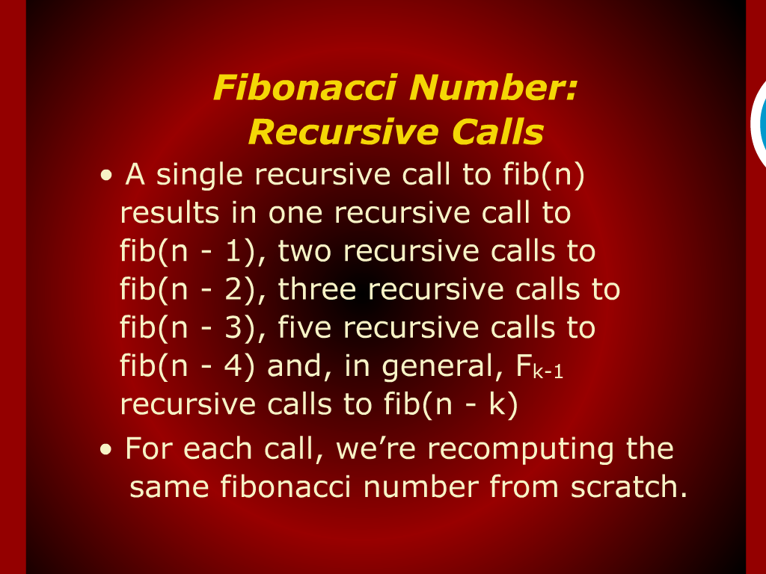
Fibonacci Number:
Recursive Calls

Slide 23
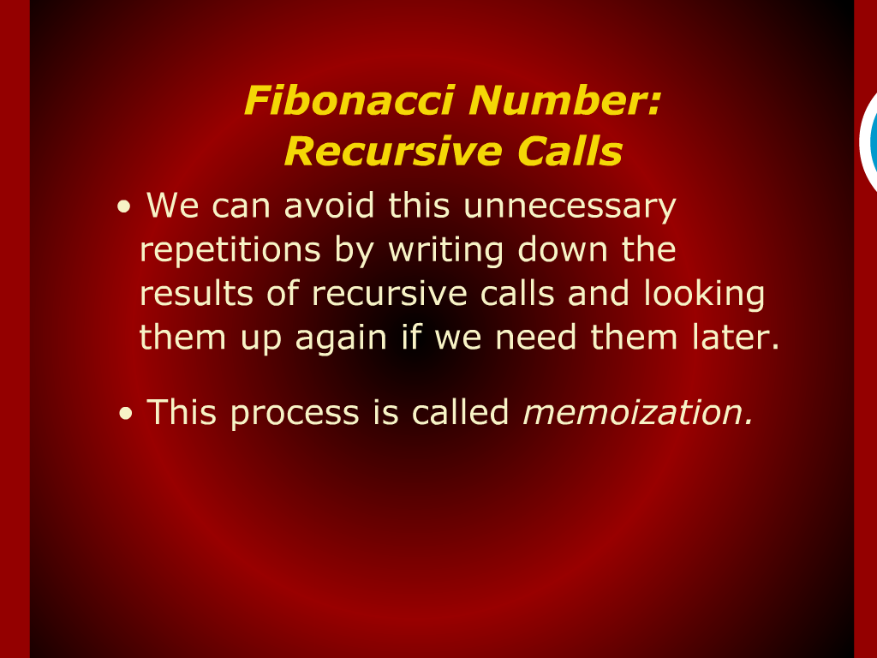
Fibonacci Number:
Recursive Calls

Slide 24
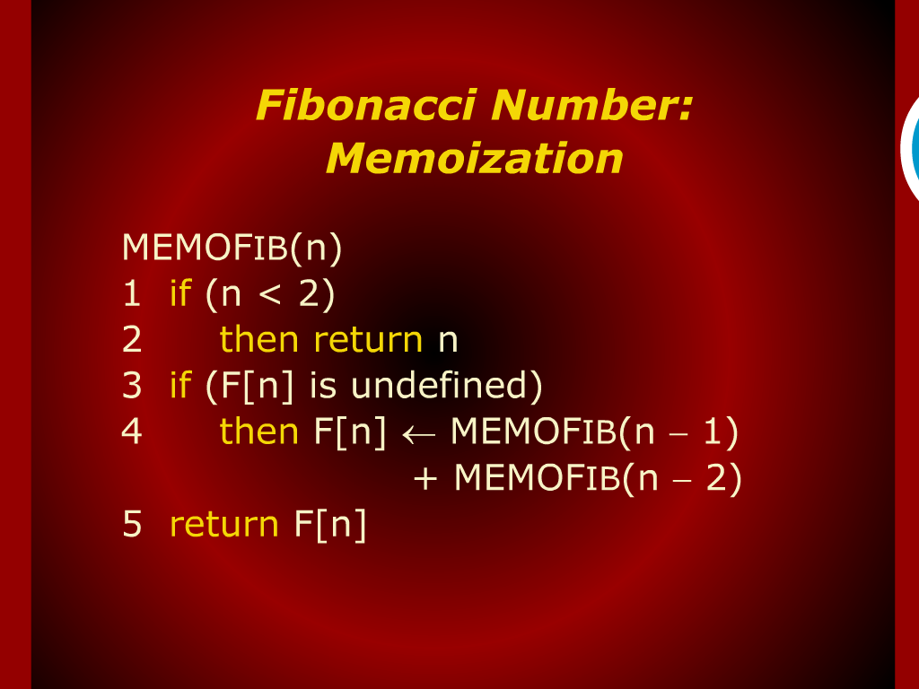
Fibonacci Number:
Memoization

Slide 25
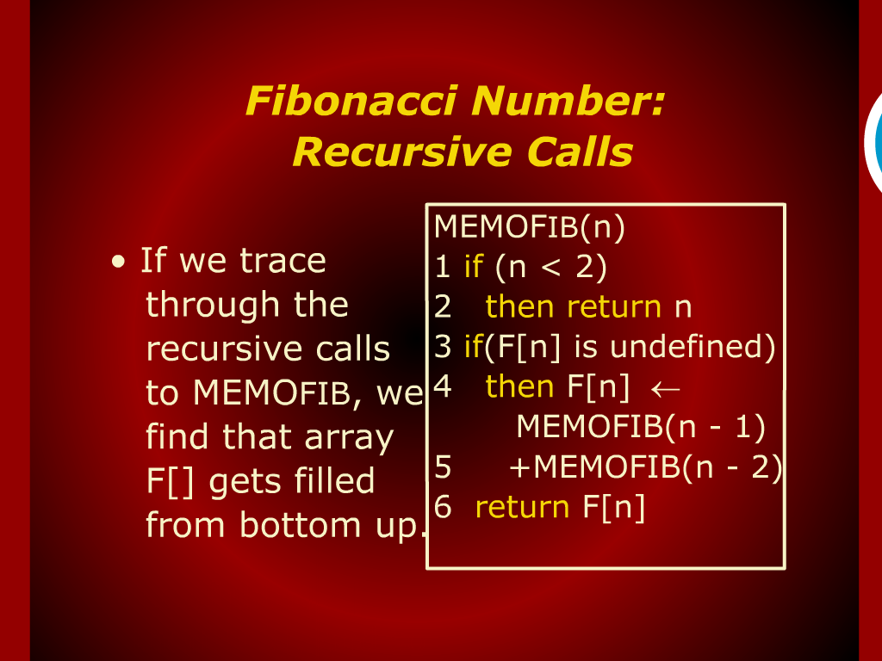
Fibonacci Number:
Recursive Calls

Slide 26
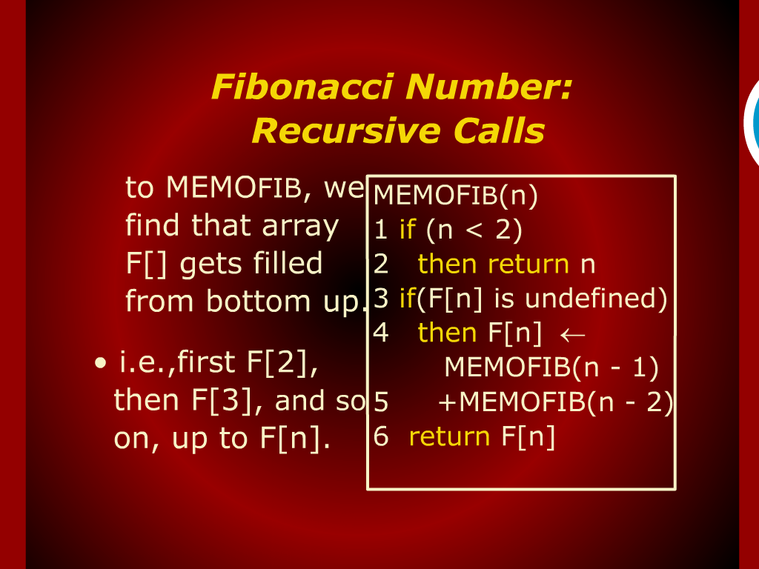
Fibonacci Number:
Recursive Calls

Slide 27
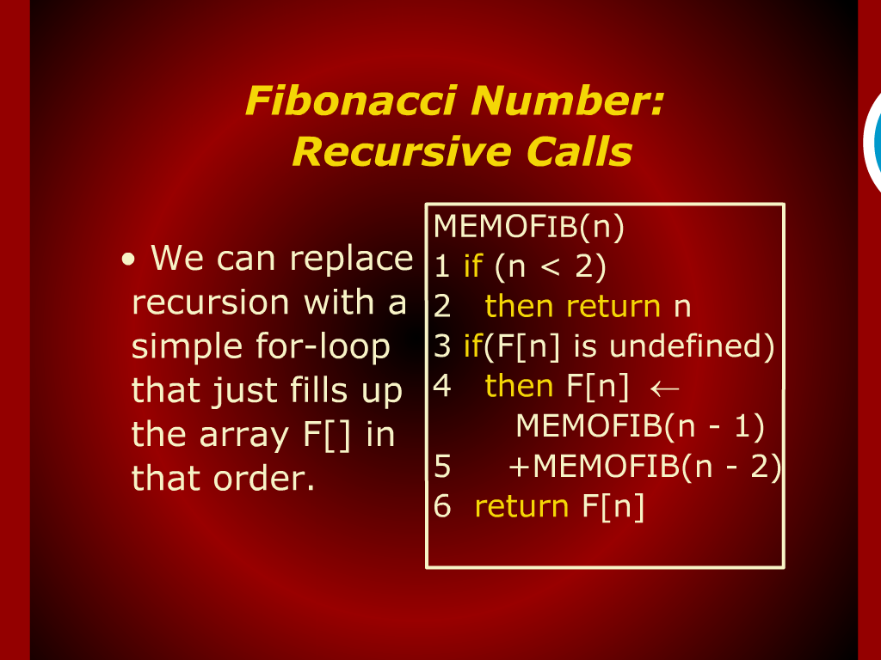
Fibonacci Number:
Recursive Calls

Slide 28
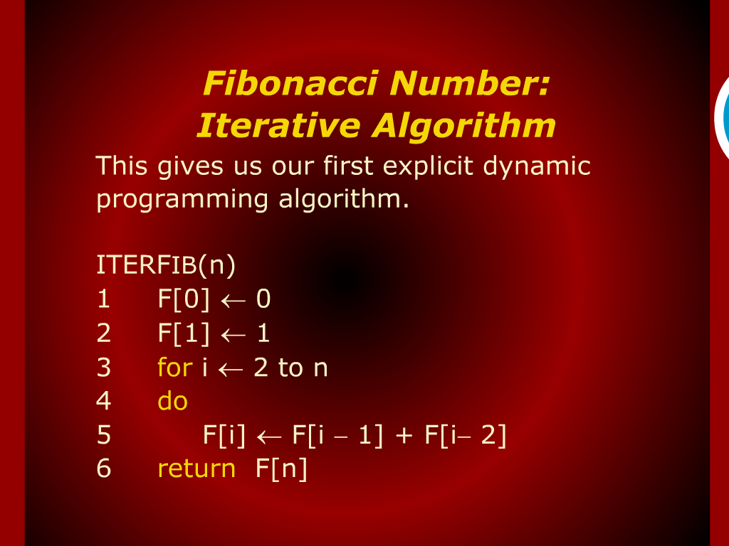
Fibonacci Number:
Iterative Algorithm

Slide 29
Counting Sort

Slide 30
Radix Sort

Slide 31
Fibonacci Sequence
Fn = Fn+1 + Fn+2

