Slide 1
Algorithms
Lecture #17
Dr.Sohail Aslam

Slide 2
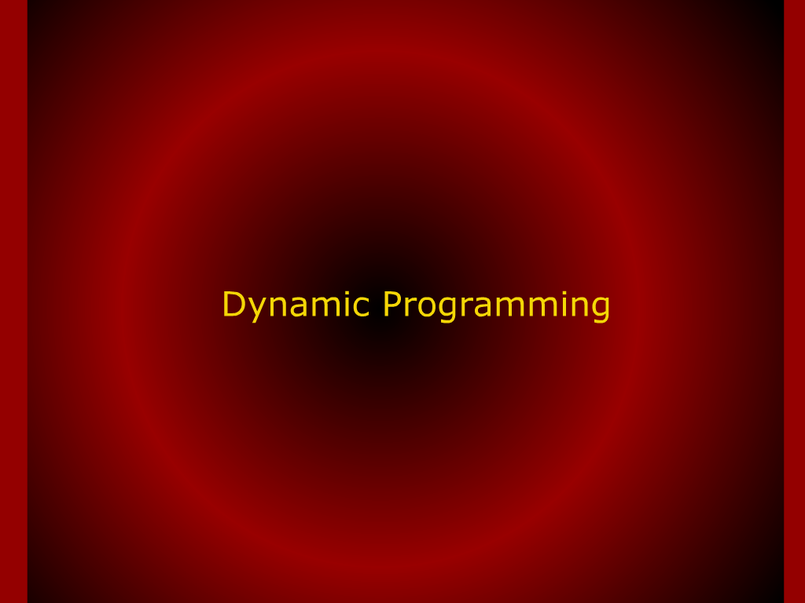
Dynamic Programming

Slide 3
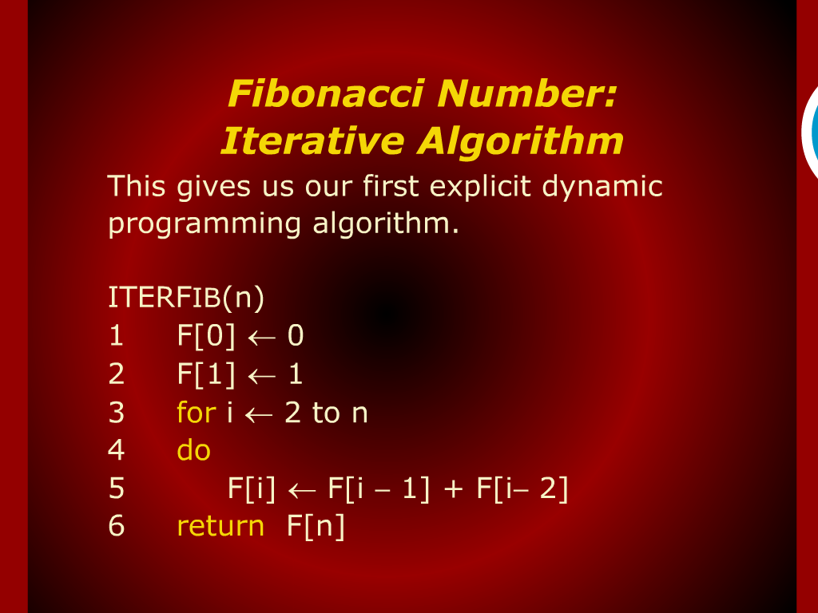
Fibonacci Number Iterative Algorithm

Slide 4
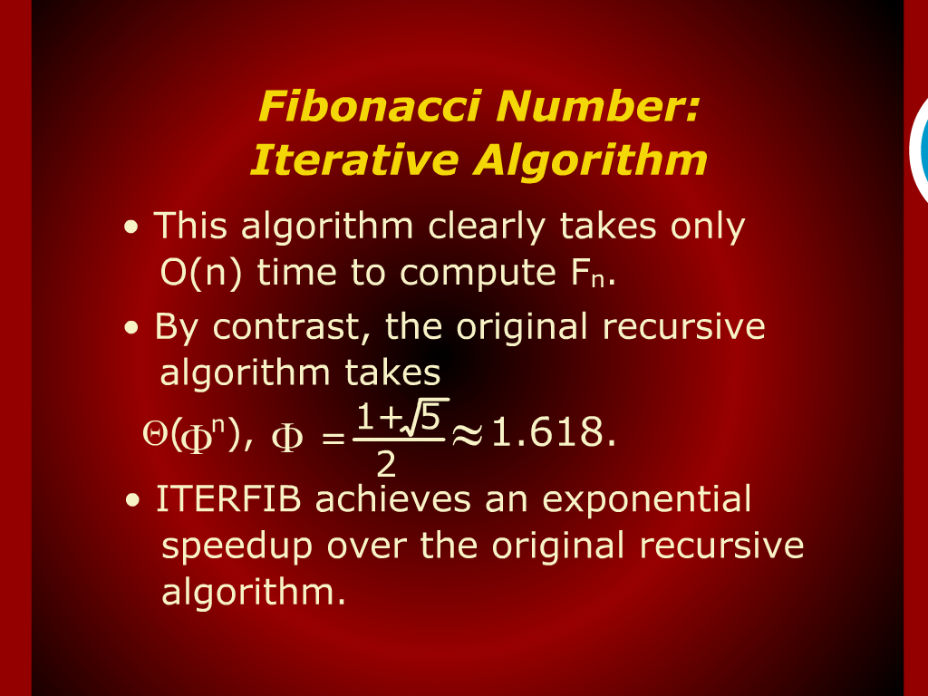
Fibonacci Number Iterative Algorithm

Slide 5
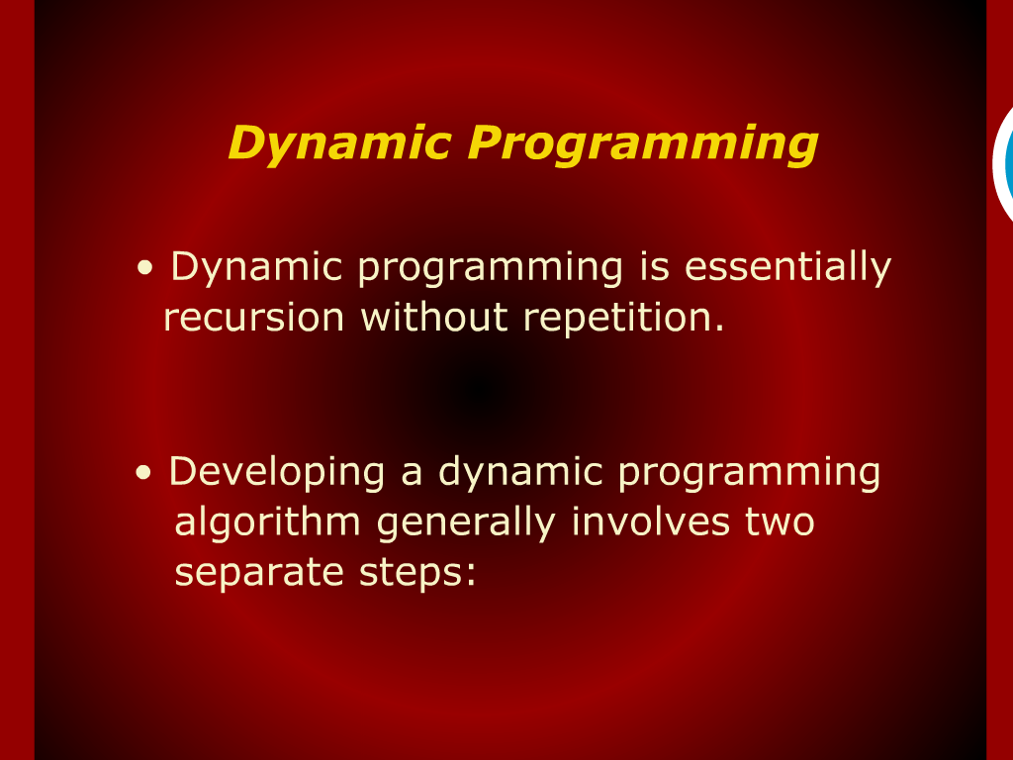
Dynamic Programming

Slide 6
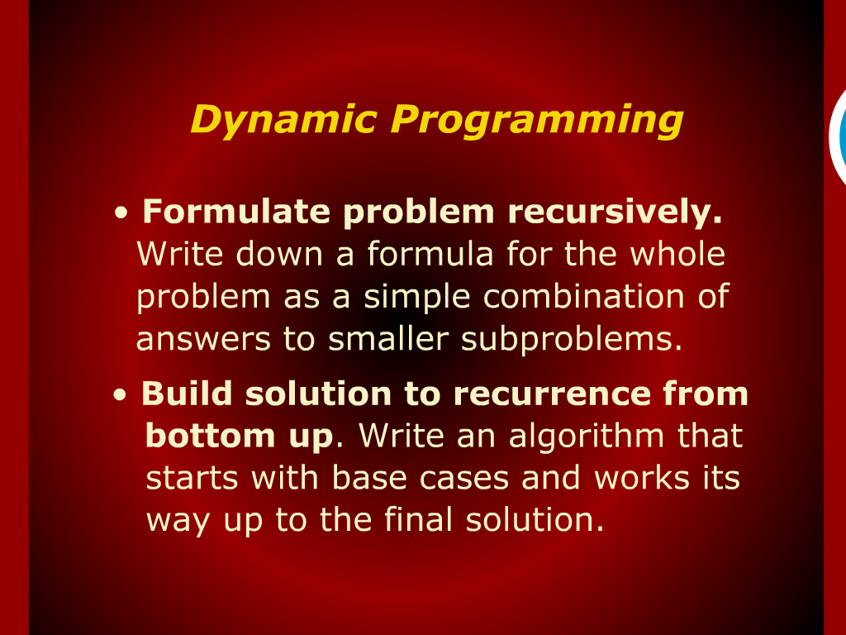
Dynamic Programming

Slide 7
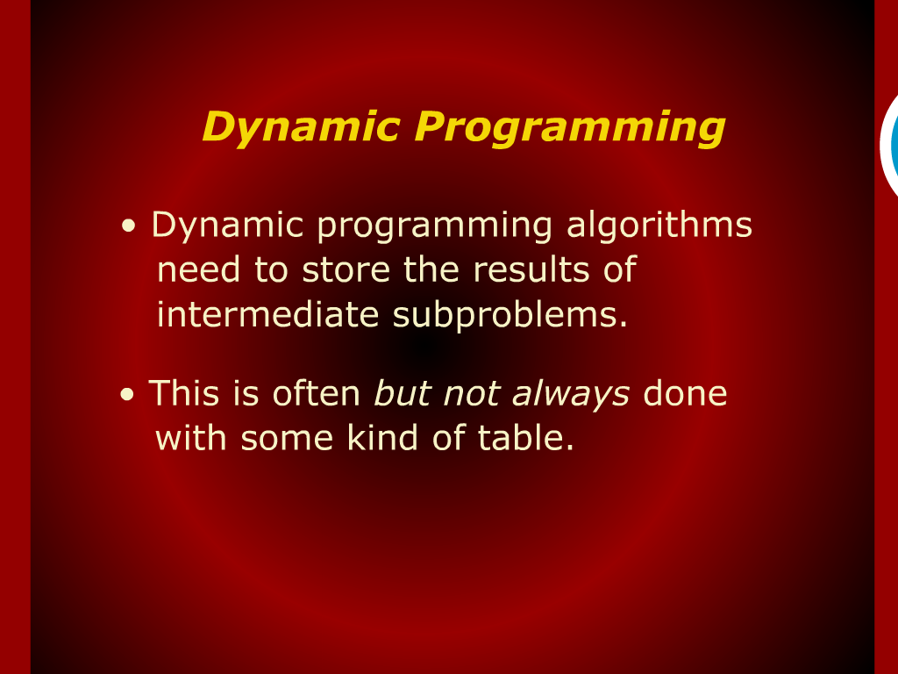
Dynamic Programming

Slide 8
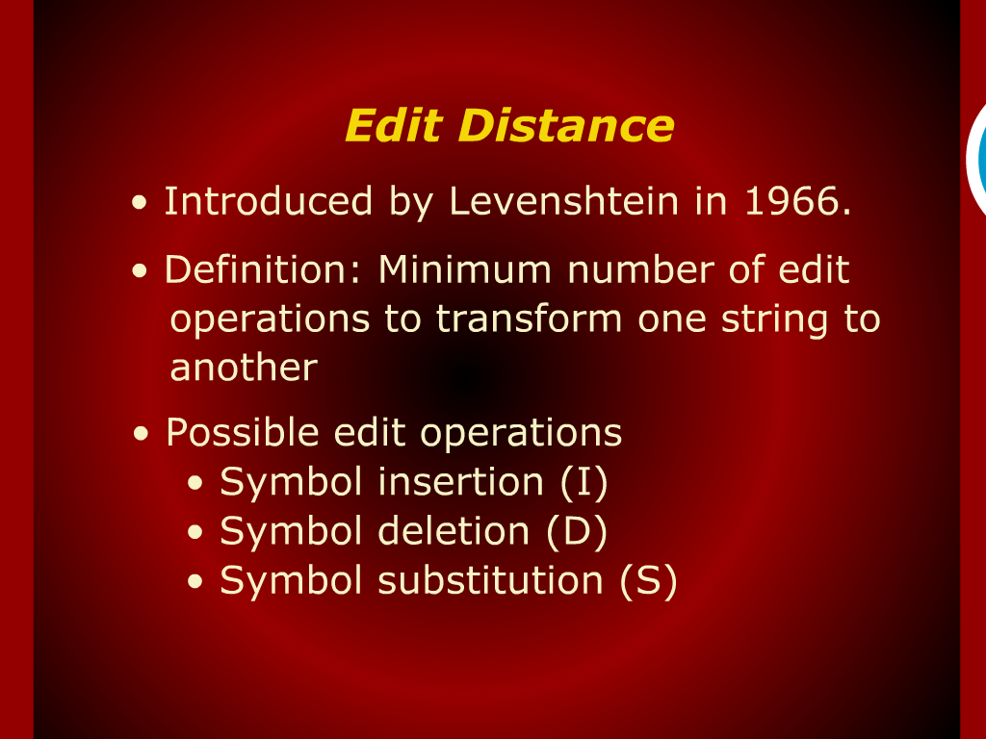
Edit Distance

Slide 9
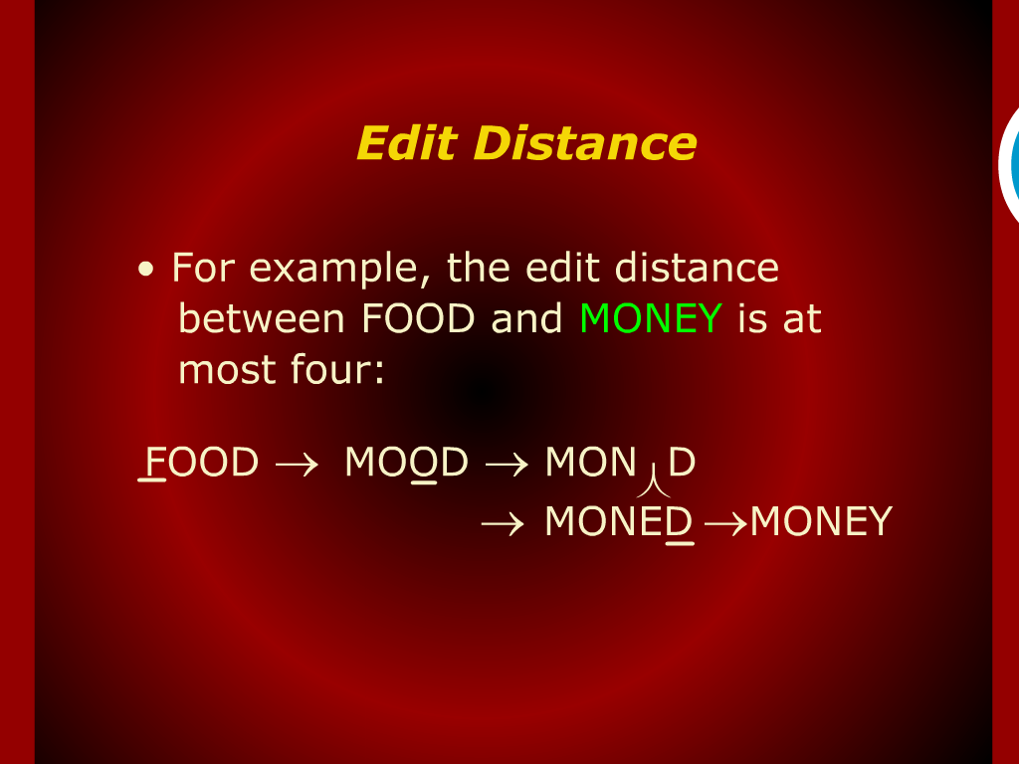
Edit Distance

Slide 10
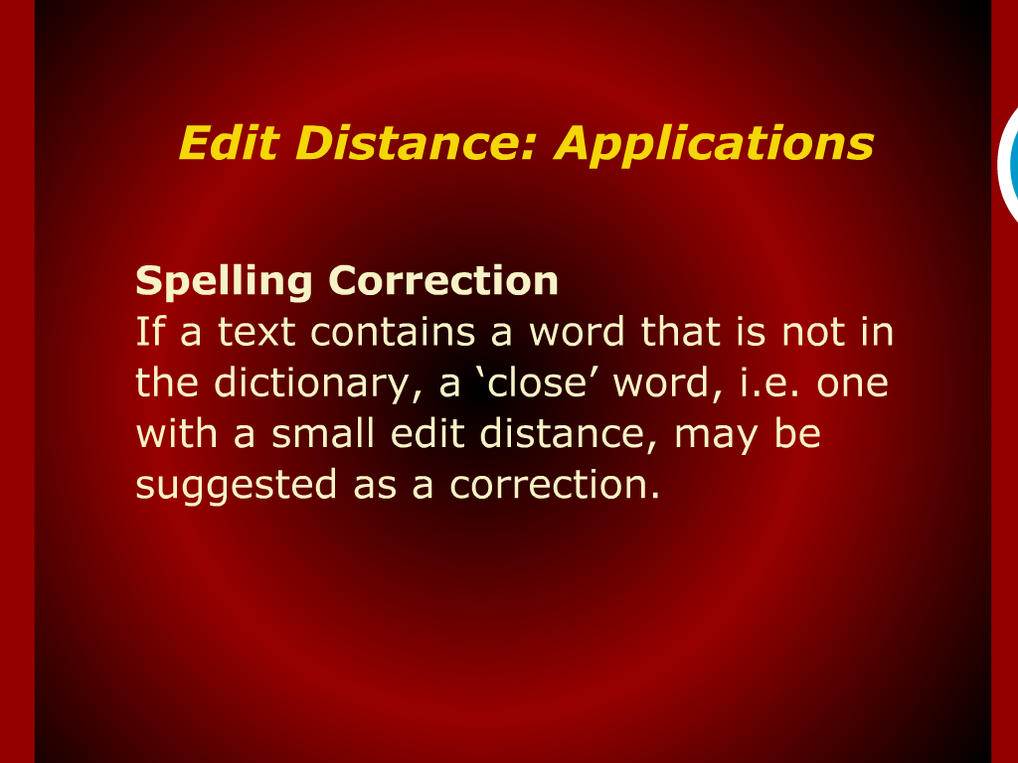
Edit Distance: Application

Slide 11
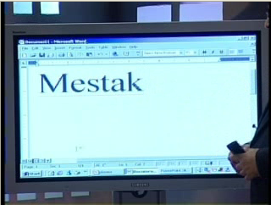

Slide 12
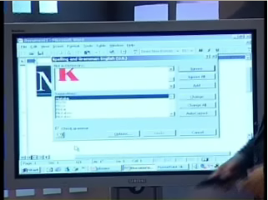

Slide 13
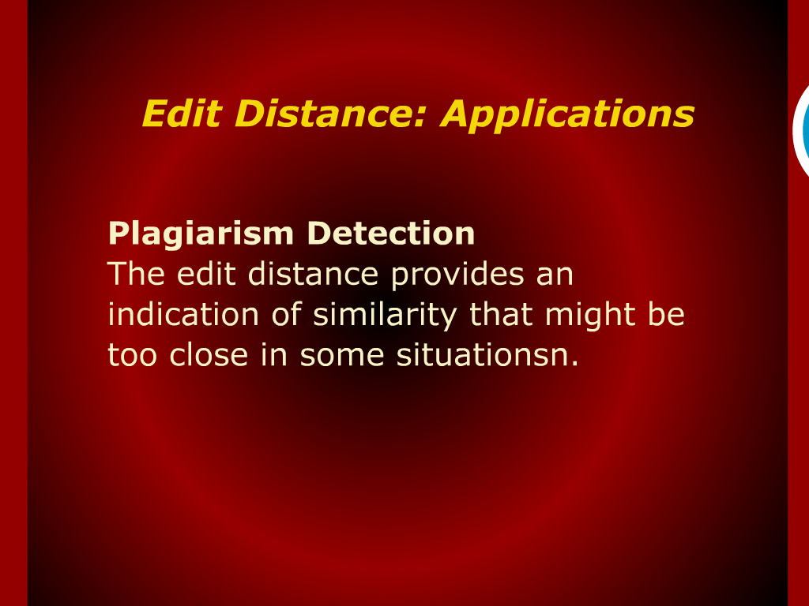
Edit Distance: Application

Slide 14
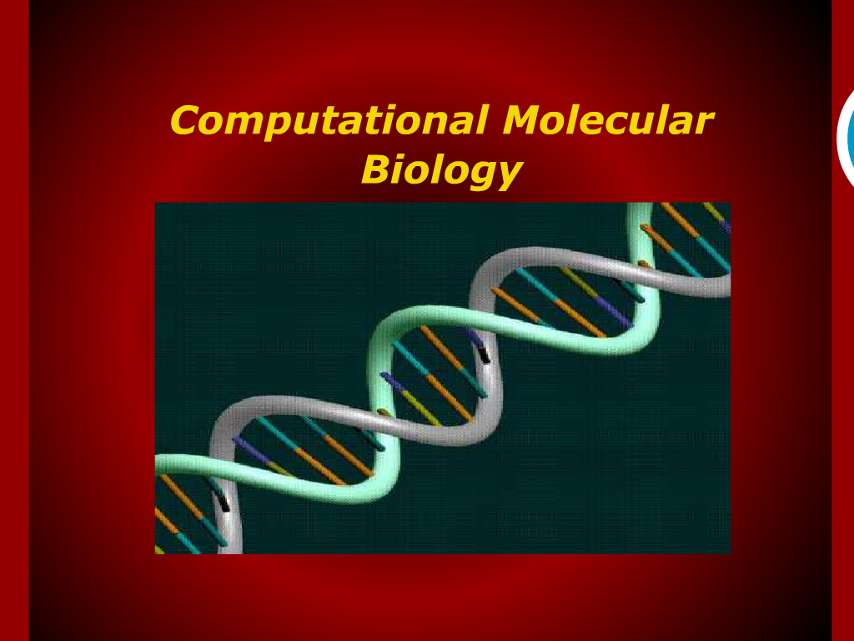
Computational Molecular Biology

Slide 15
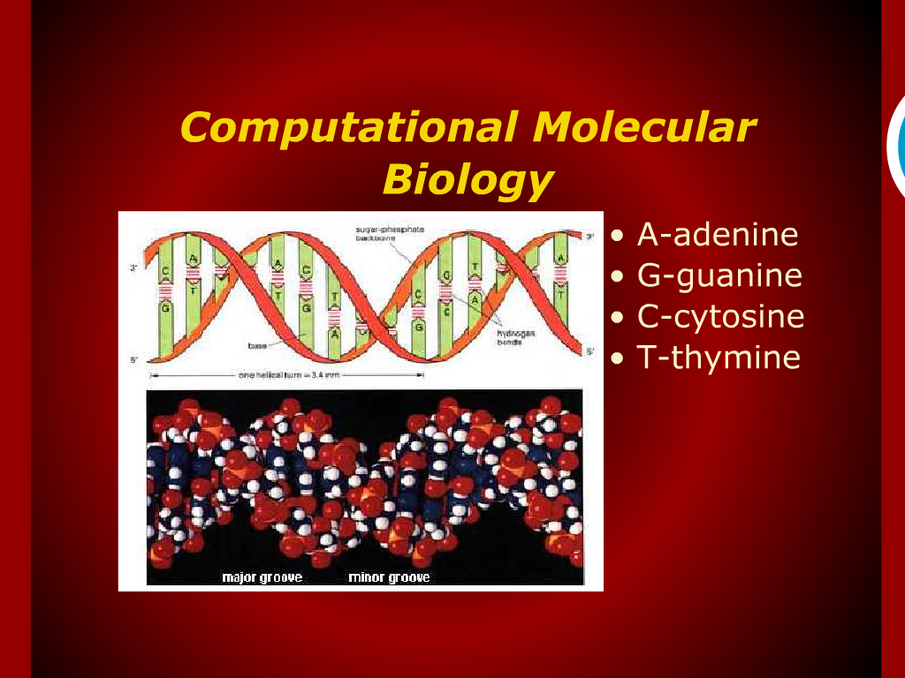
Computational Molecular Biology

Slide 16
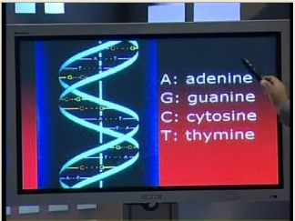

Slide 17
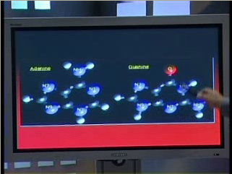

Slide 18
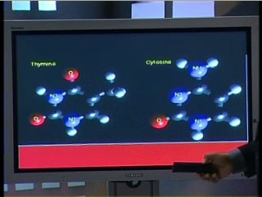

Slide 19
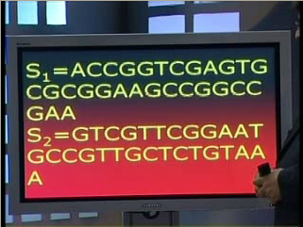
Longest Common Subsequence (LCS)

Slide 20
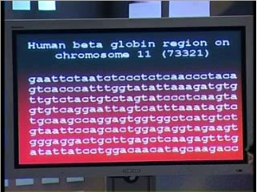

Slide 21
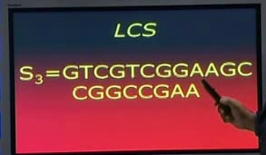

Slide 23
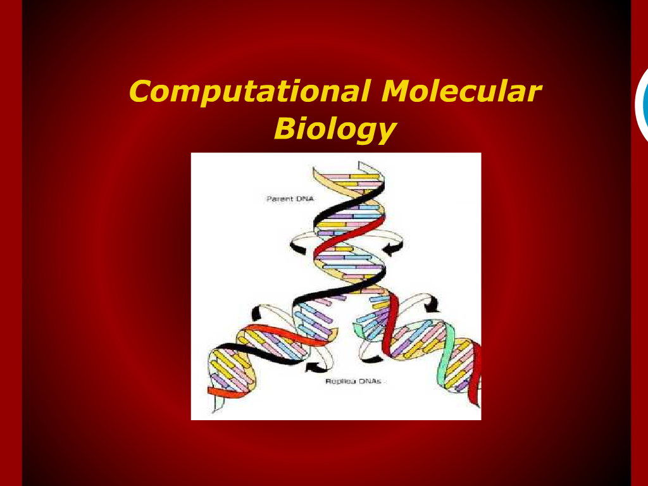
Computational Molecular Biology

Slide 24
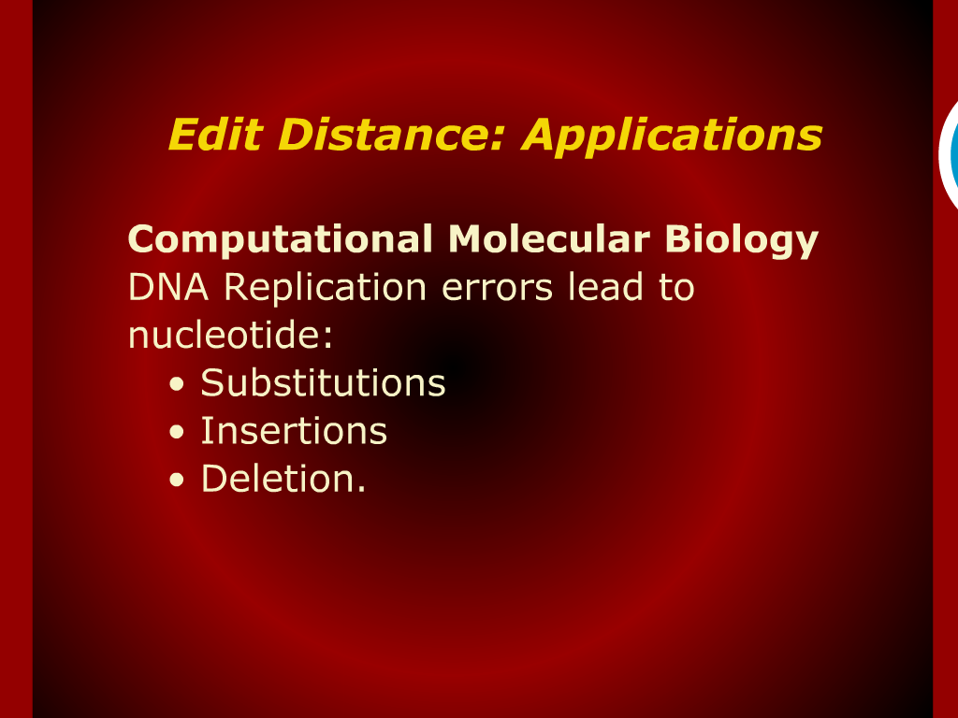
Edit Distance: Application

Slide 25
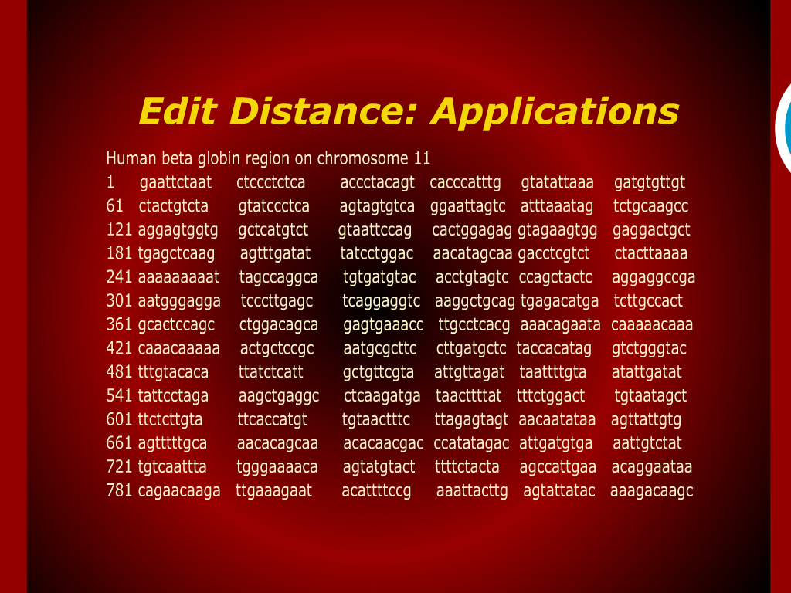
Edit Distance: Application

Slide 26
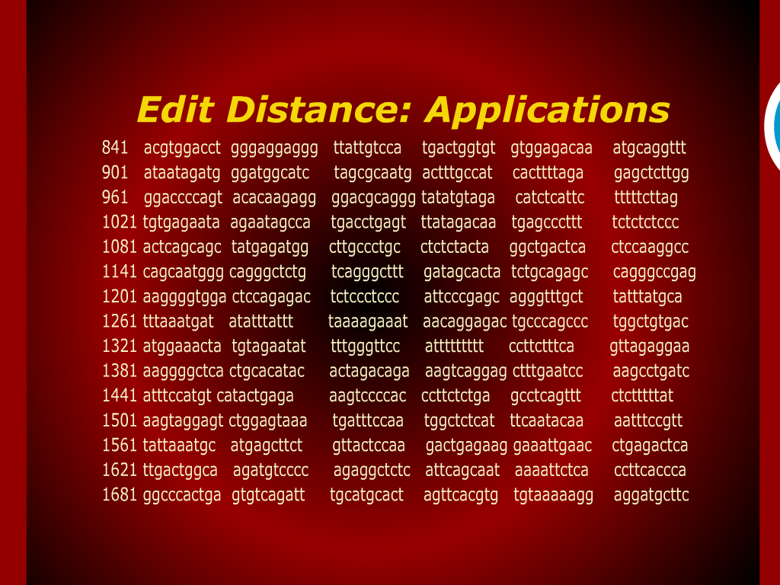
Edit Distance: Application

Slide 27
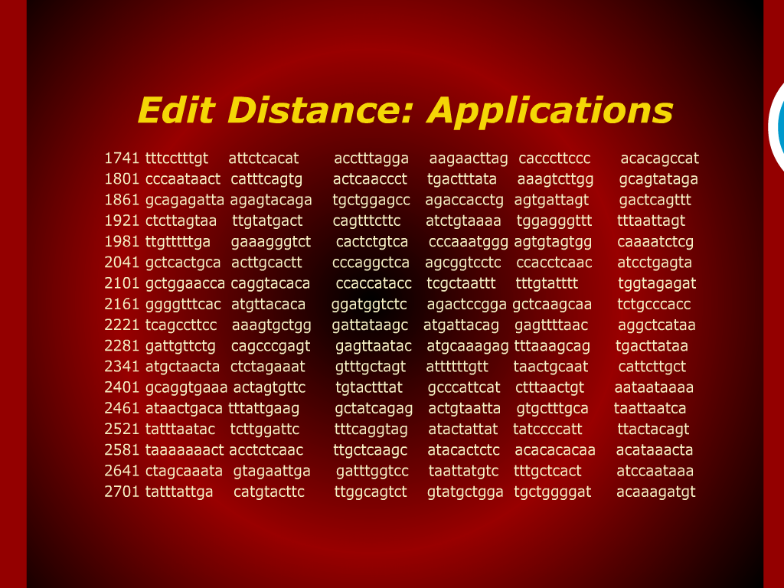
Edit Distance: Application

Slide 28
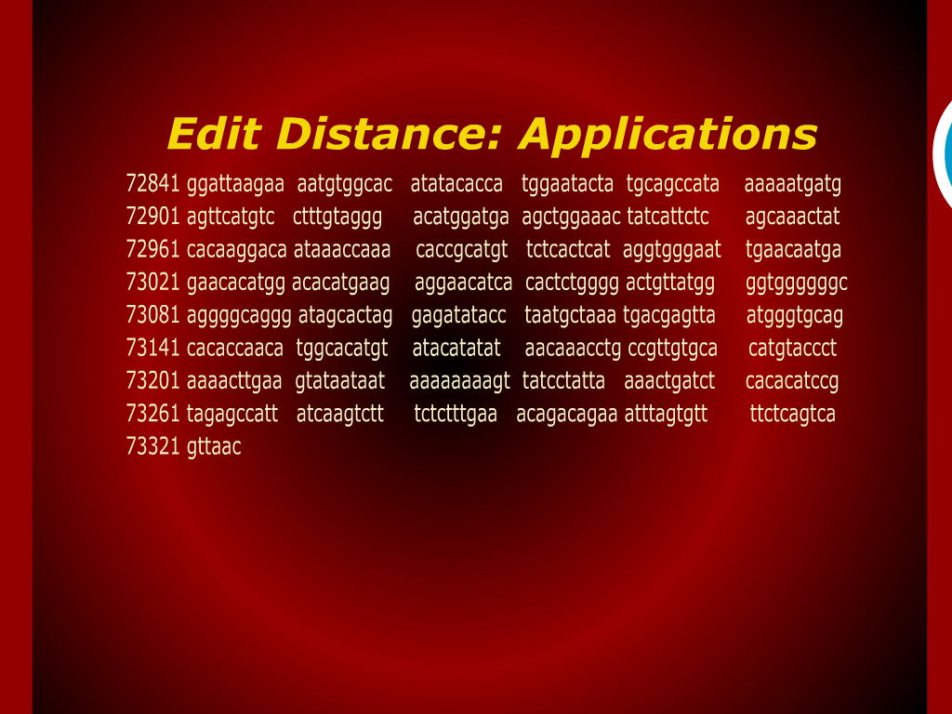
Edit Distance: Application

Slide 29
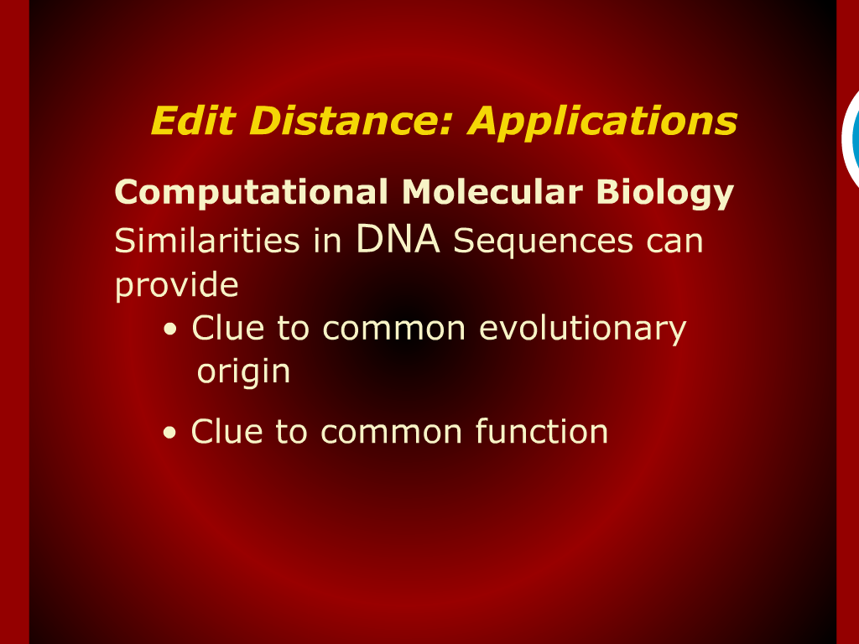
Edit Distance: Application

Slide 30
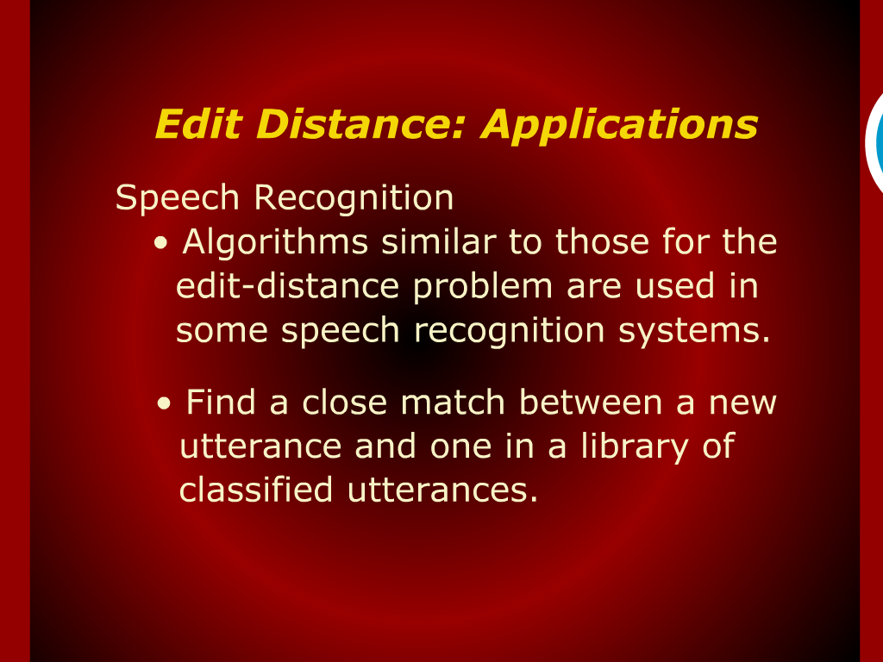
Edit Distance: Application

Slide 31
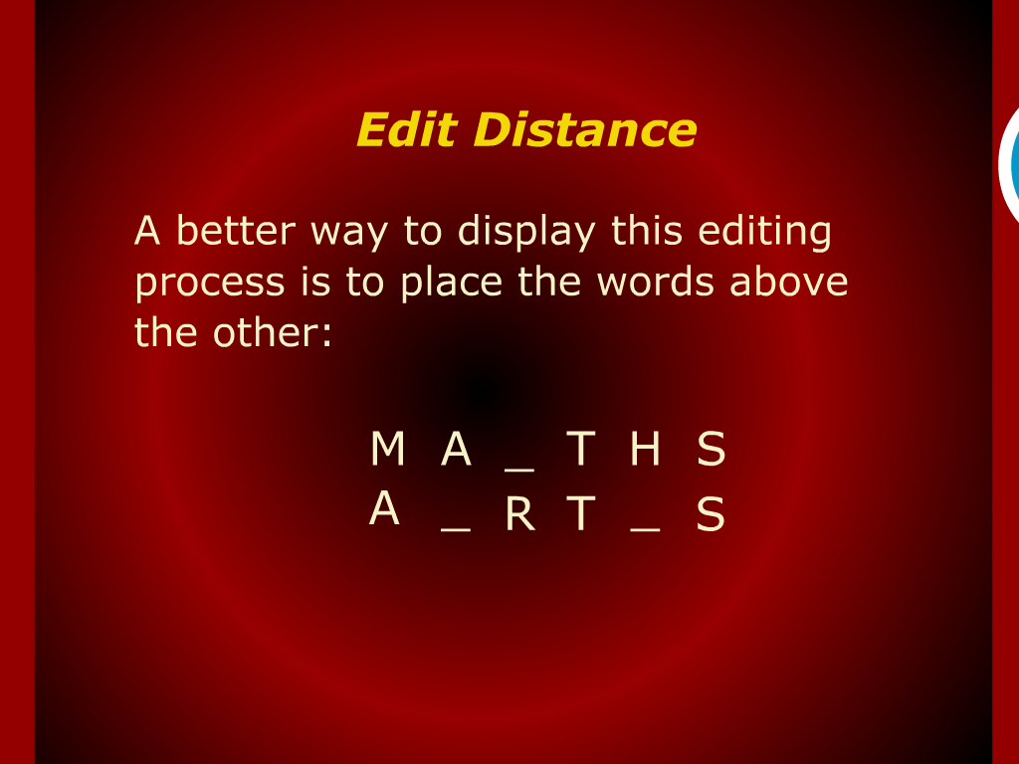
Edit Distance

Slide 32
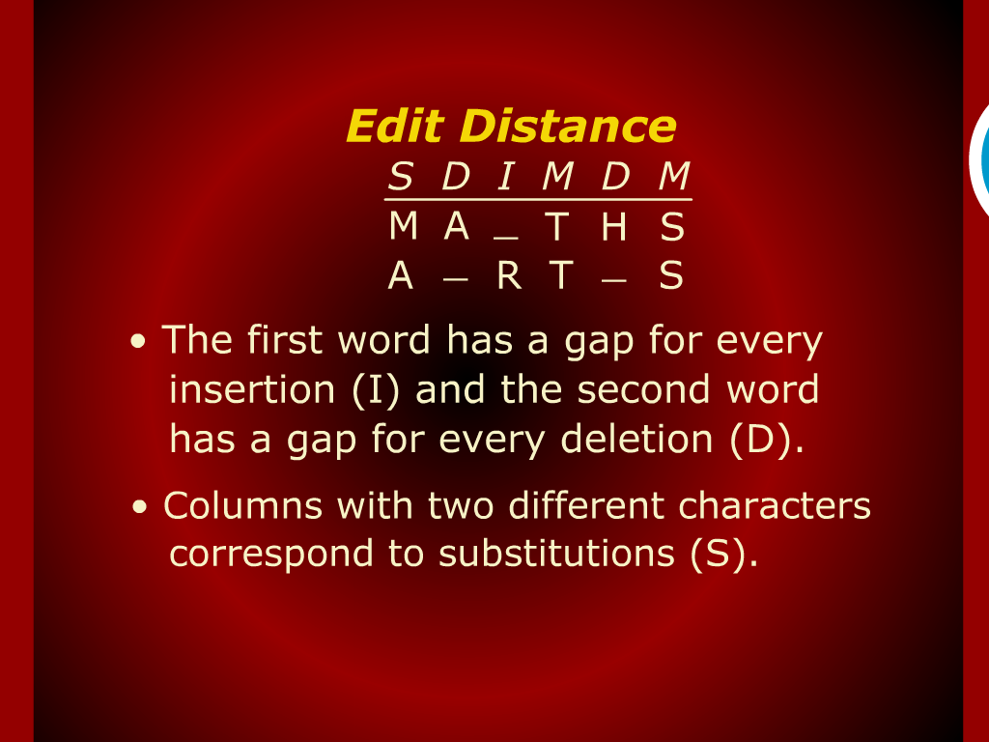
Edit Distance
Maches (M) do not Count

Slide 33
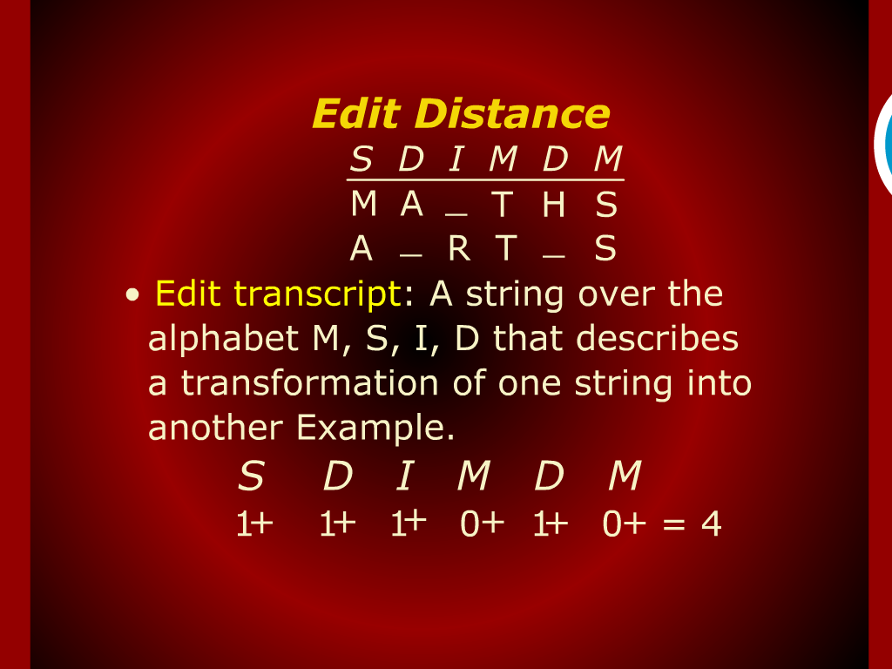
Edit Distance

Slide 34
Edit Distance
Edit Distance
DP
Formulation

Slide 35
Edit Distance

