Slide 1
Algorithms
Lecture #18
Dr.Sohail Aslam

Slide 2
Edit Distance
Edit Distance
DP
Formulation

Slide 3
Design & Analysis of Algorithms

Slide 4
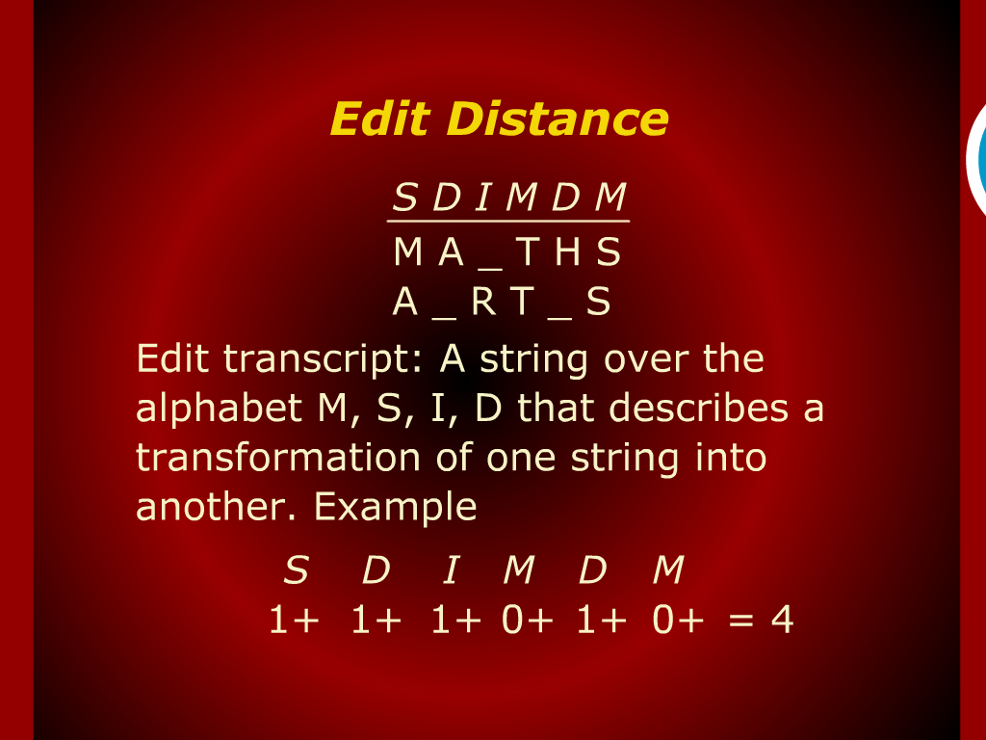
Edit Distance

Slide 5
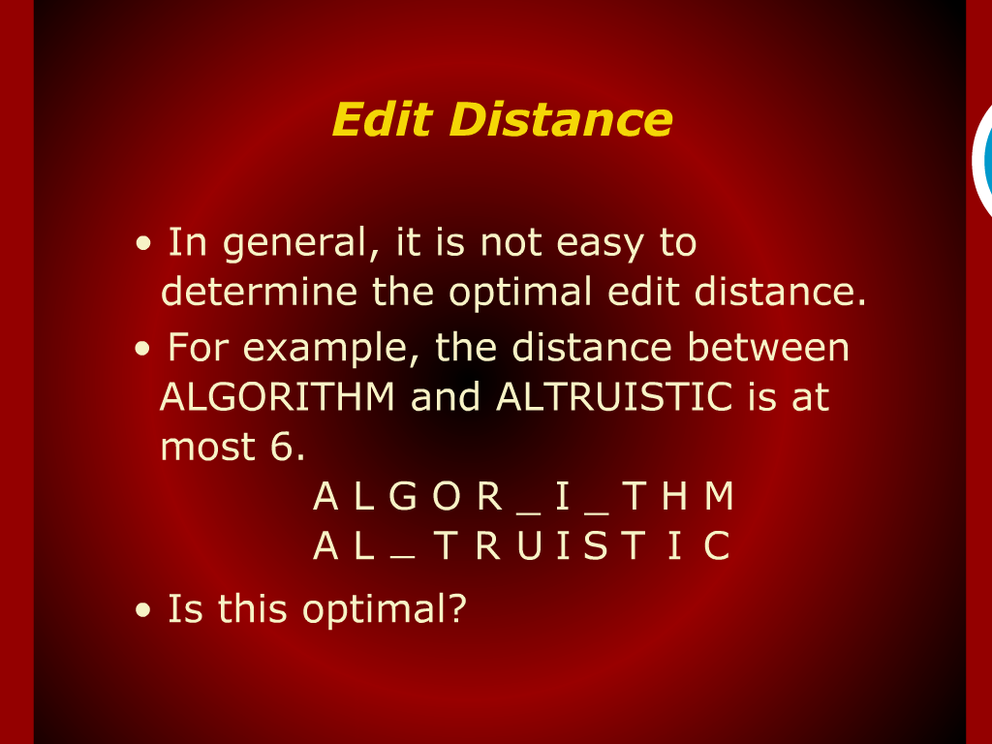
Edit Distance

Slide 6
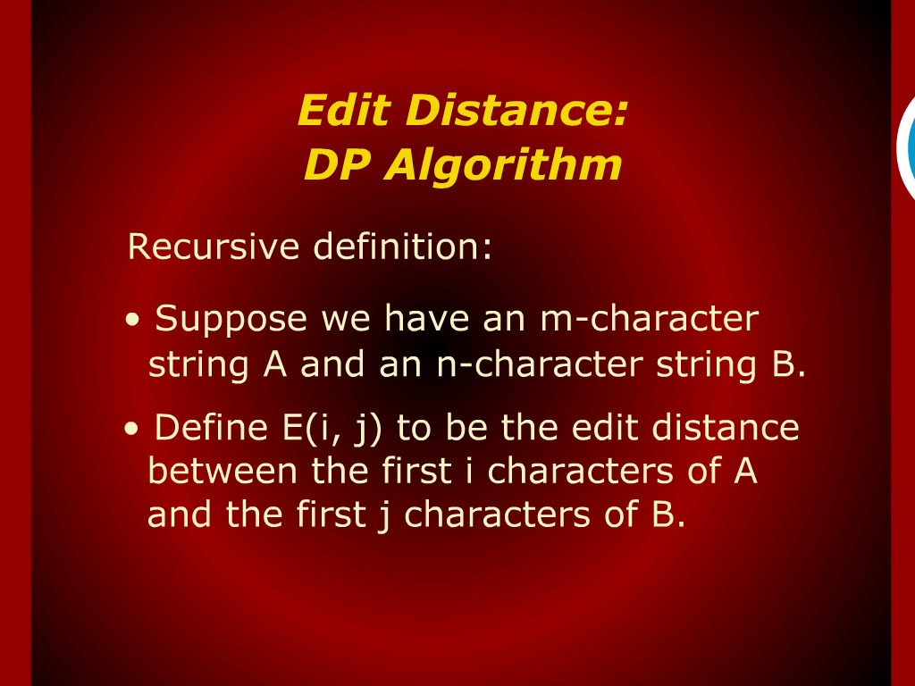
Edit Distance: DP Algorithm

Slide 7
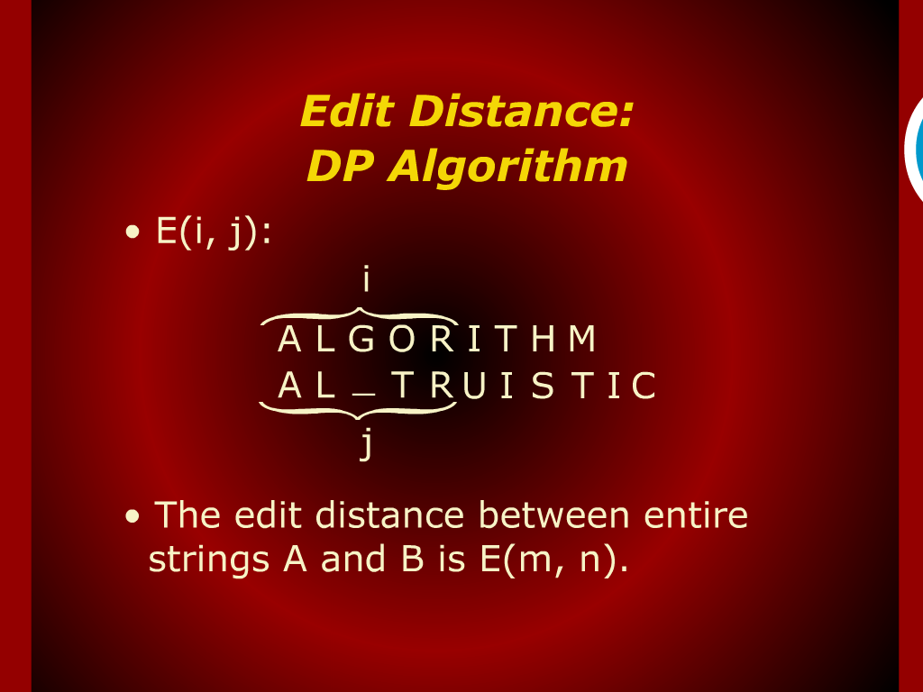
Edit Distance: DP Algorithm

Slide 8
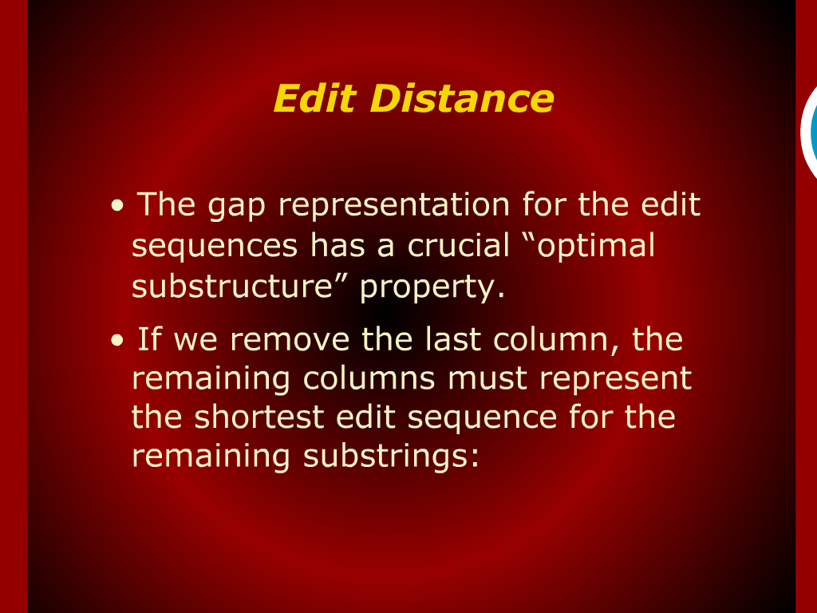
Edit Distance

Slide 9
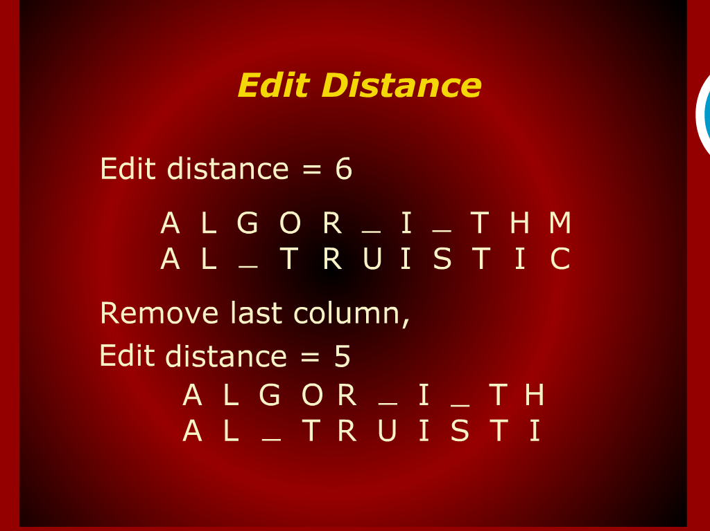
Edit Distance

Slide 10
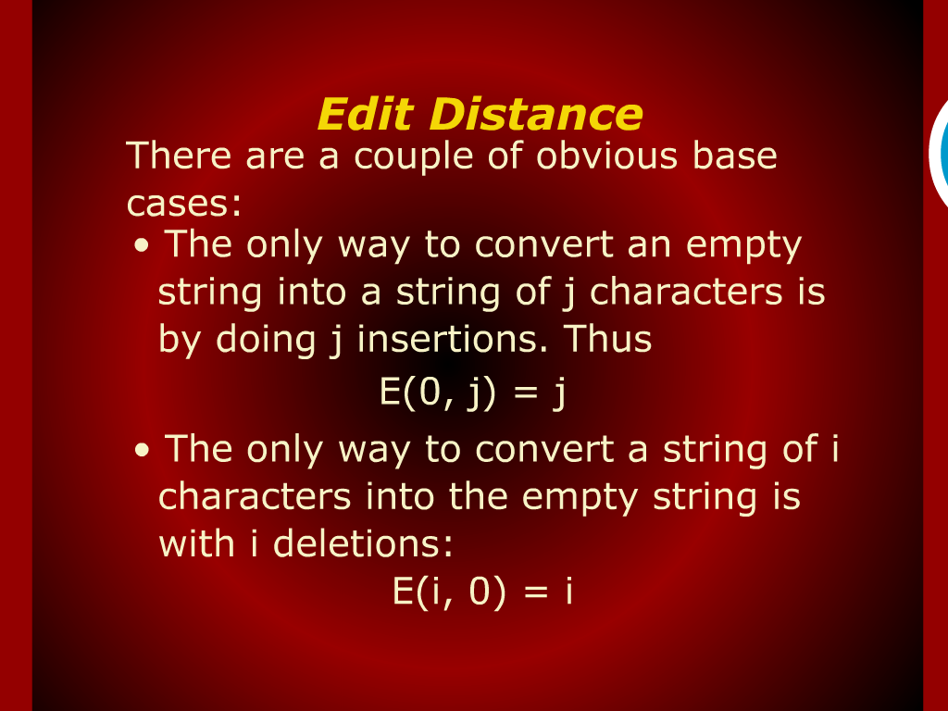
Edit Distance

Slide 11
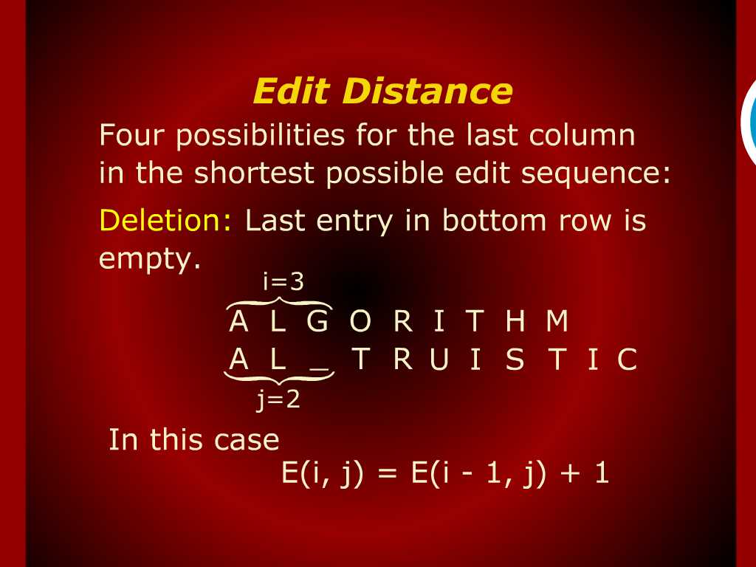
Edit Distance

Slide 12
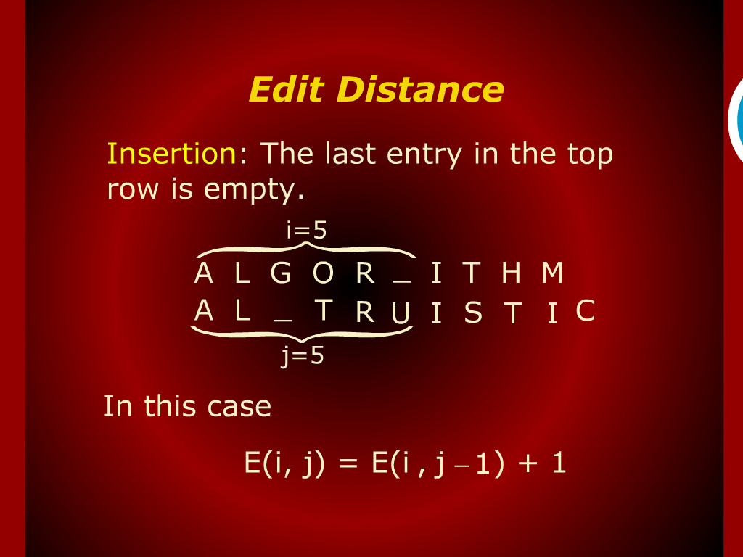
Edit Distance

Slide 13
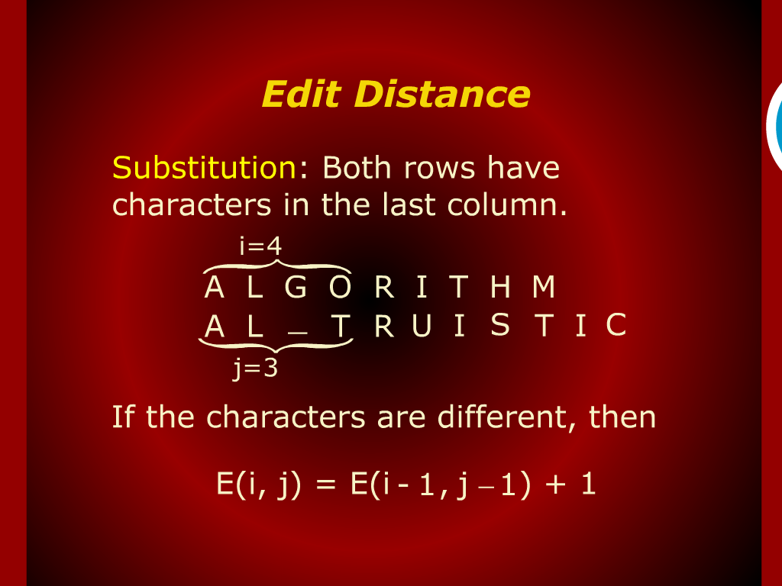
Edit Distance

Slide 14
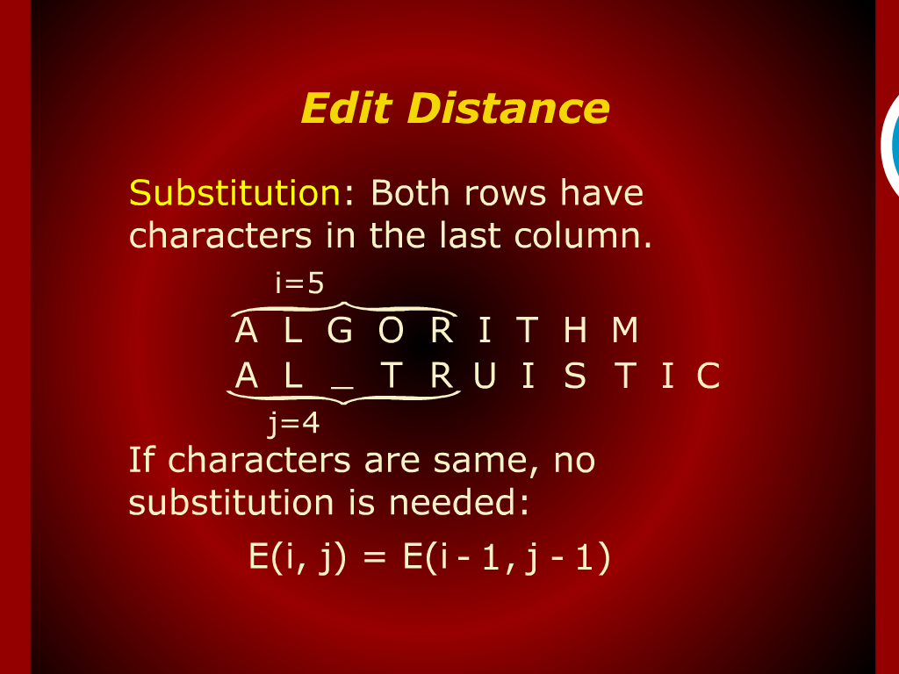
Edit Distance

Slide 15
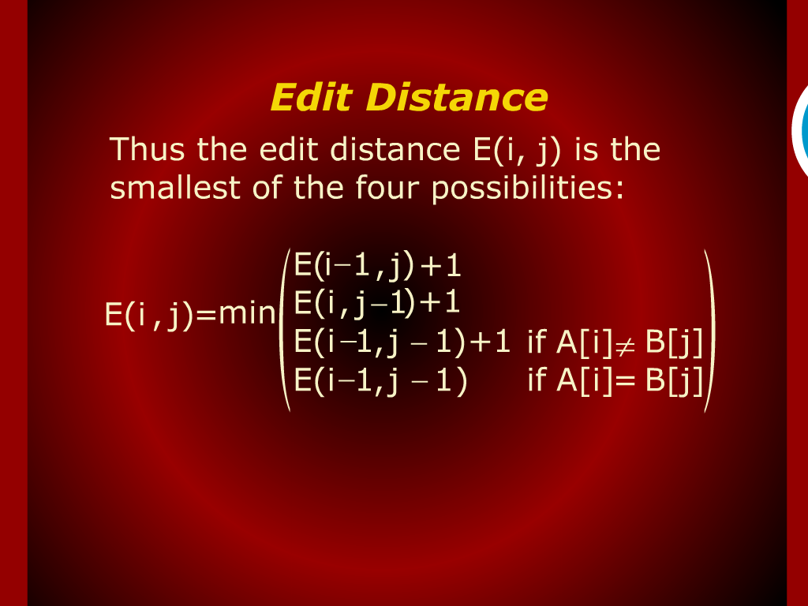
Edit Distance

Slide 16
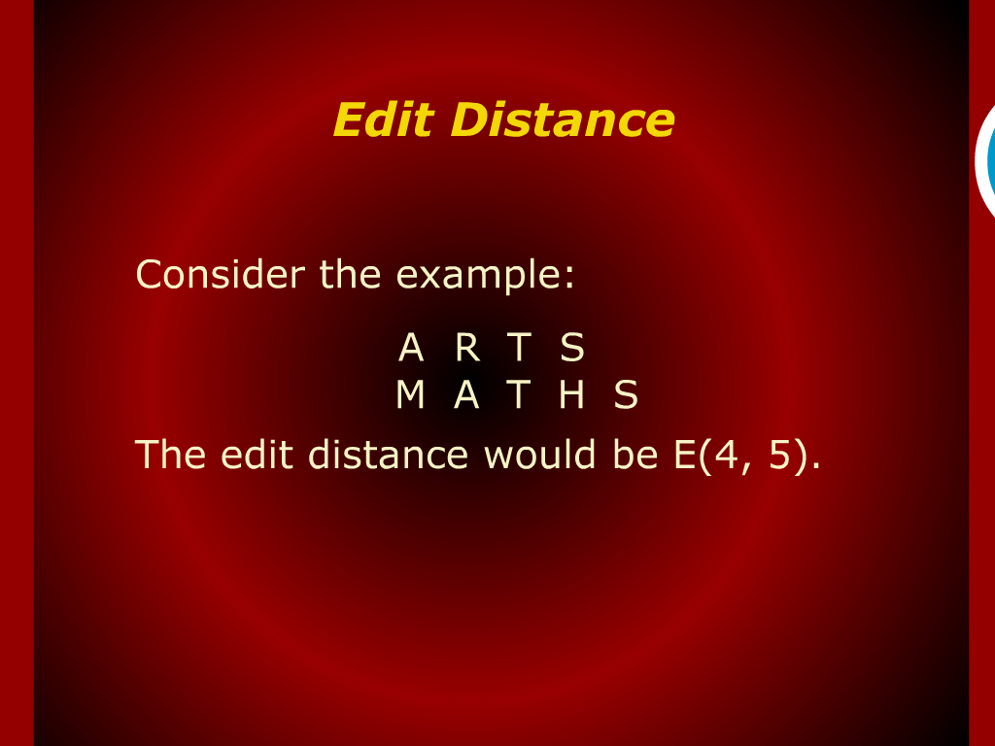
Edit Distance

Slide 17
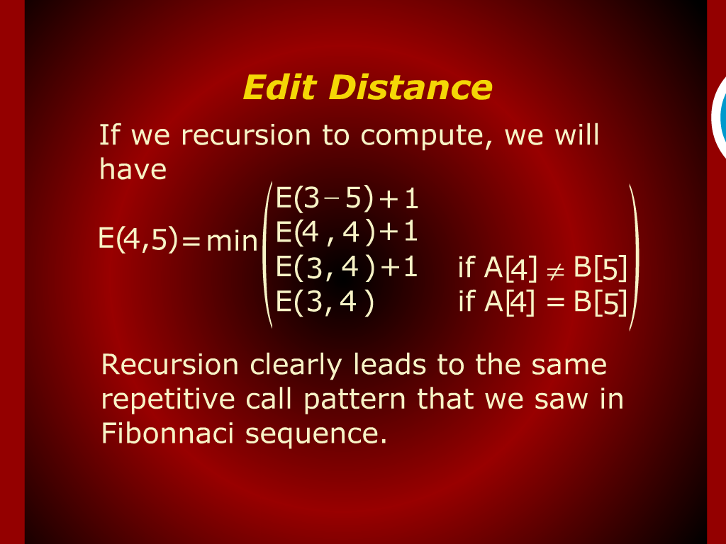
Edit Distance

Slide 18
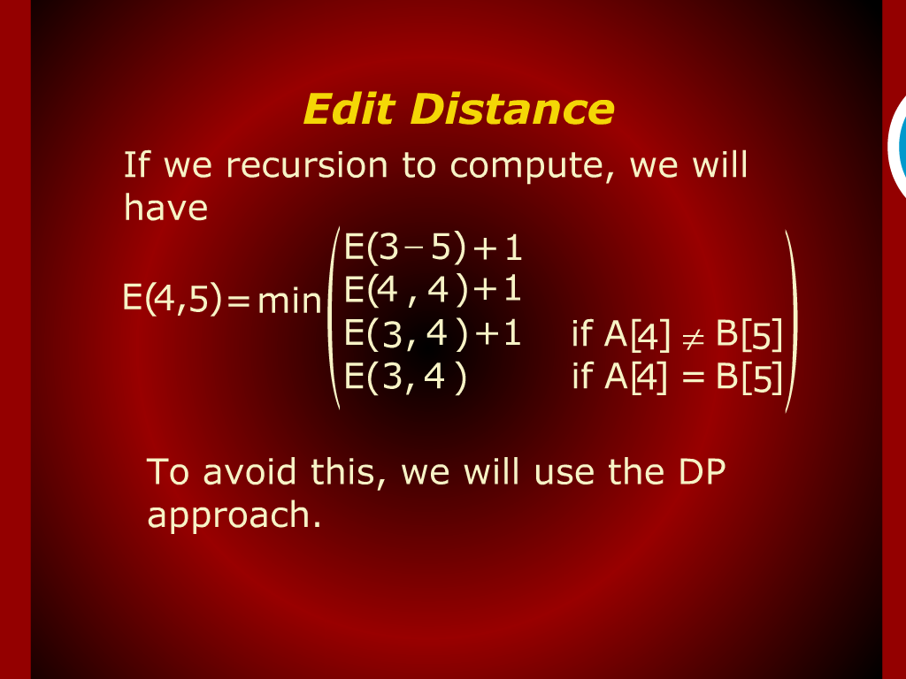
Edit Distance

Slide 19
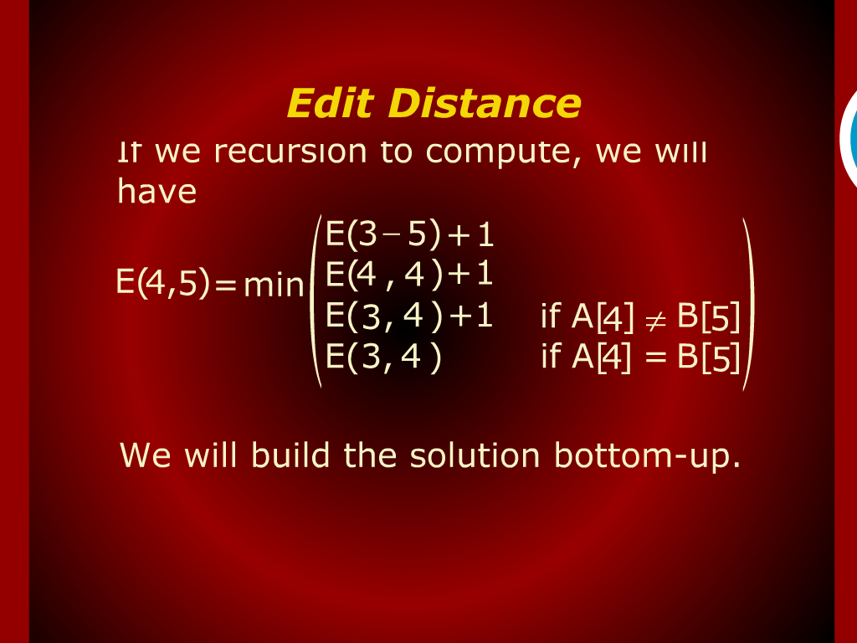
Edit Distance

Slide 20
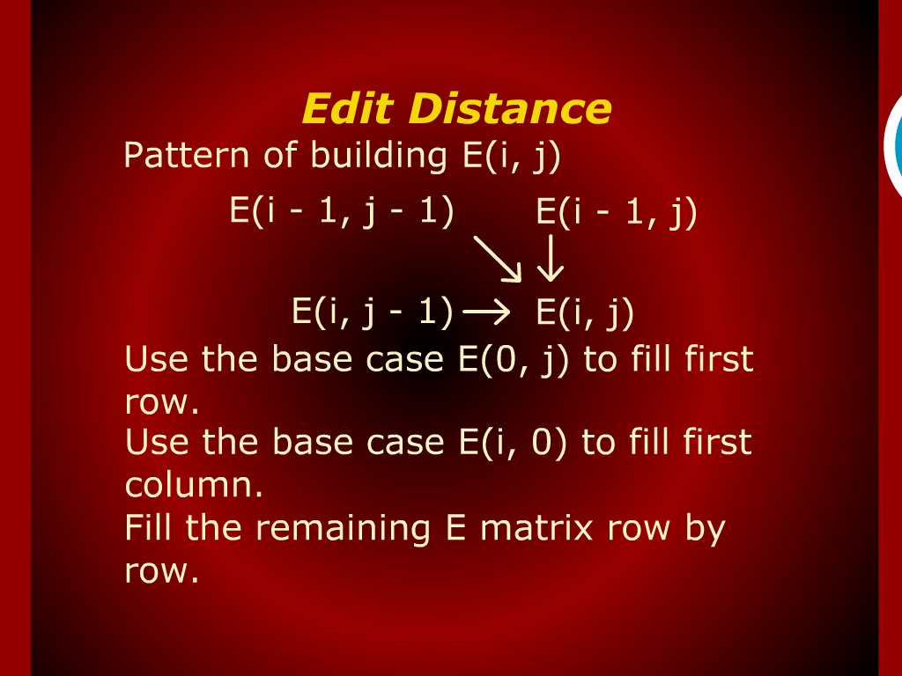
Edit Distance

Slide 21
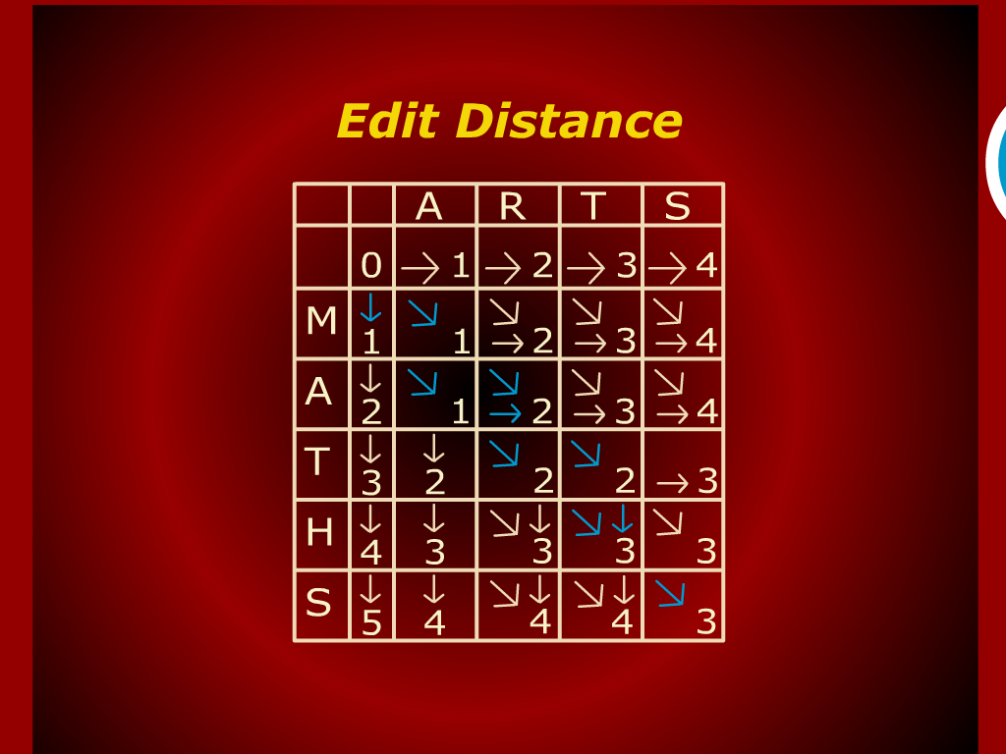
Edit Distance

Slide 22
Edit Distance

Slide 23
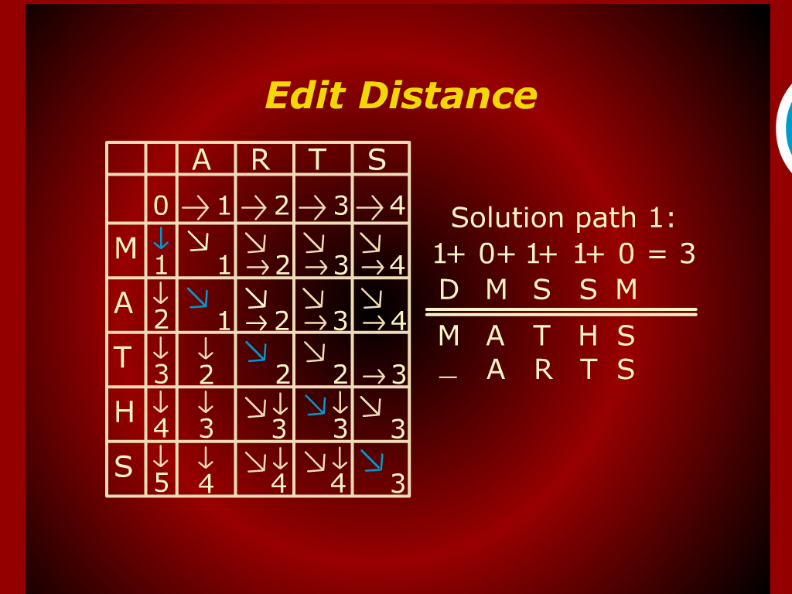
Edit Distance

Slide 24
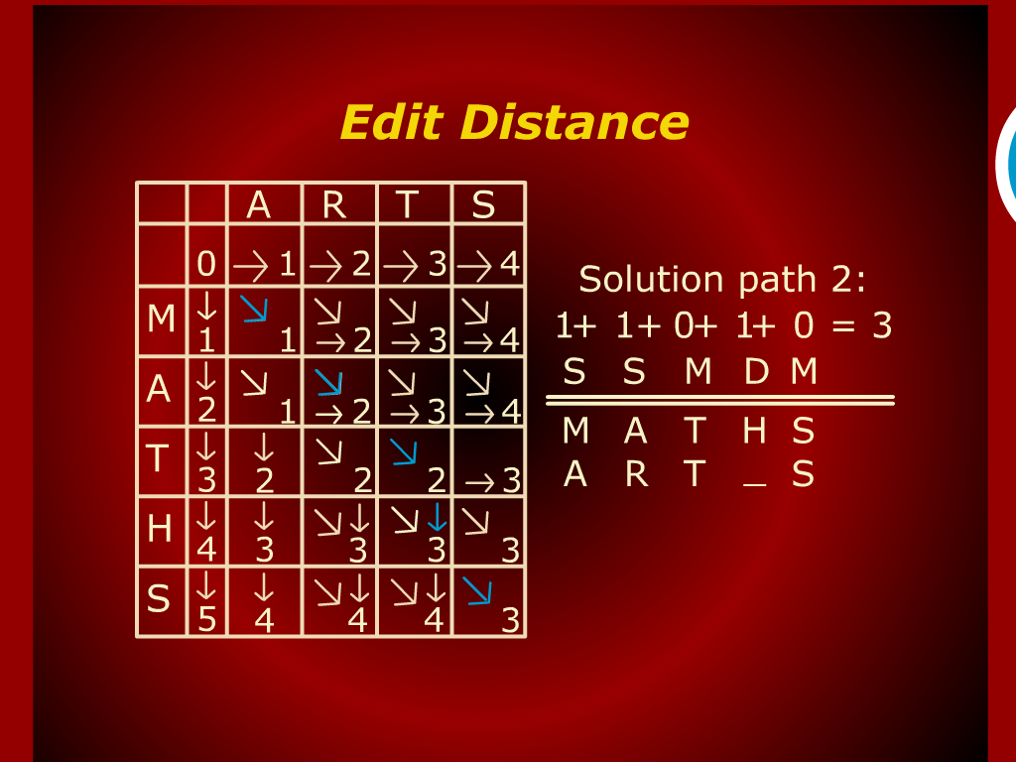
Edit Distance

Slide 25
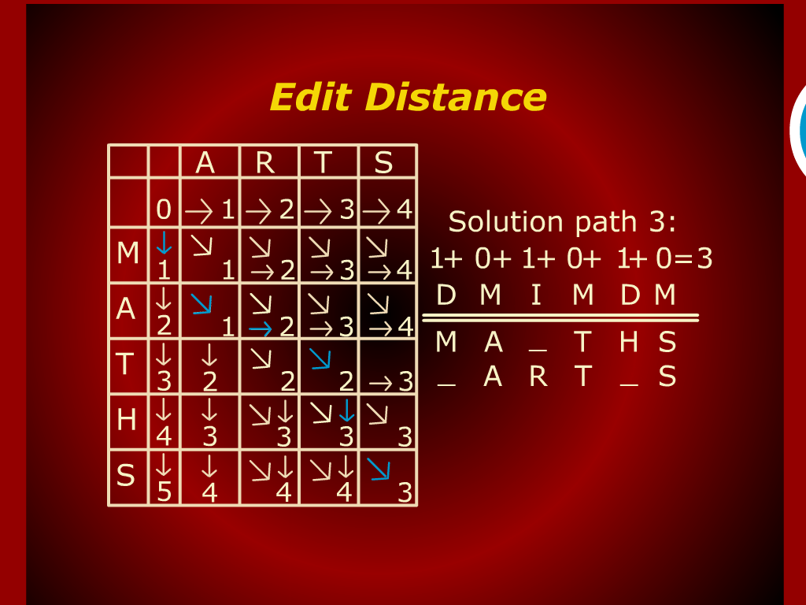
Edit Distance

Slide 26
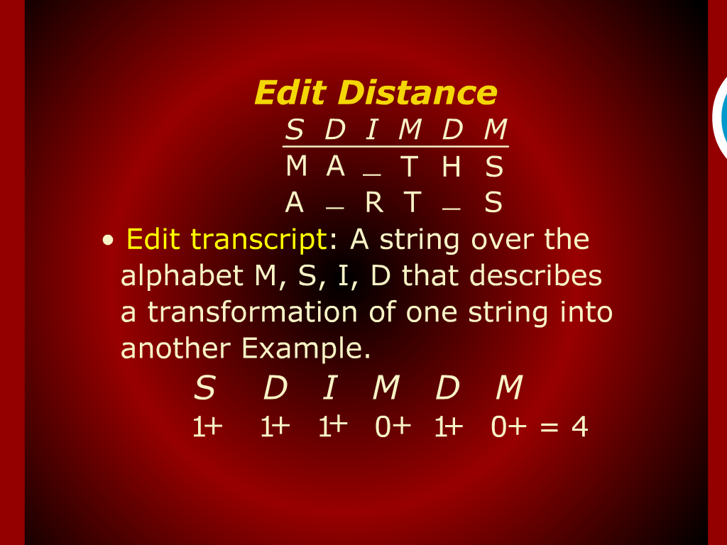
Edit Distance

Slide 27
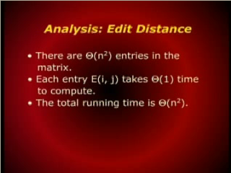
Analysis: Edit Distance

