Slide 1
Algorithms
Lecture #20
Dr.Sohail Aslam

Slide 2
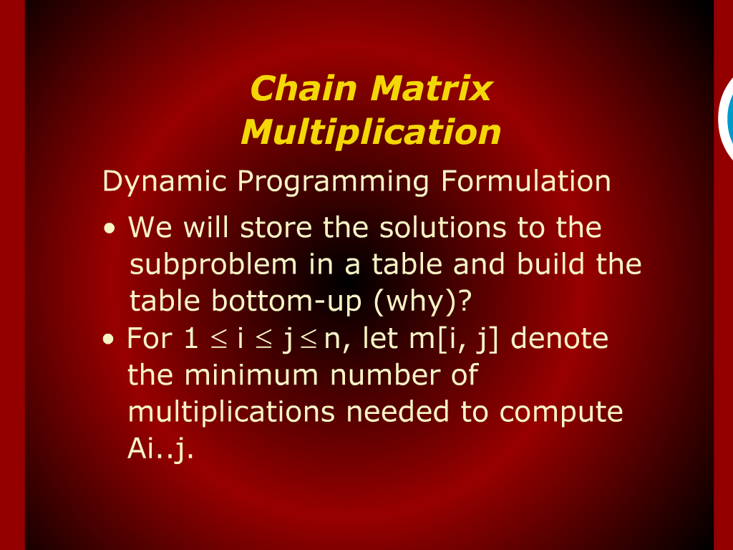
Chain Matrix Multiplication

Slide 3
Chain Matrix Multiplication

Slide 4
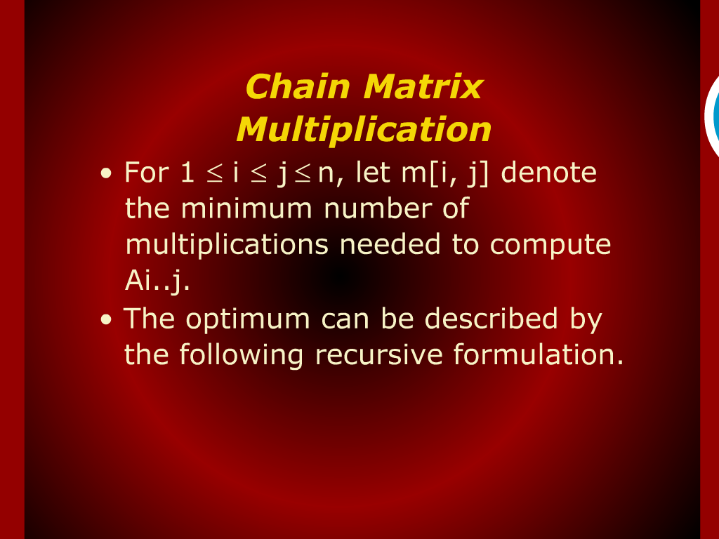
Chain Matrix Multiplication

Slide 5
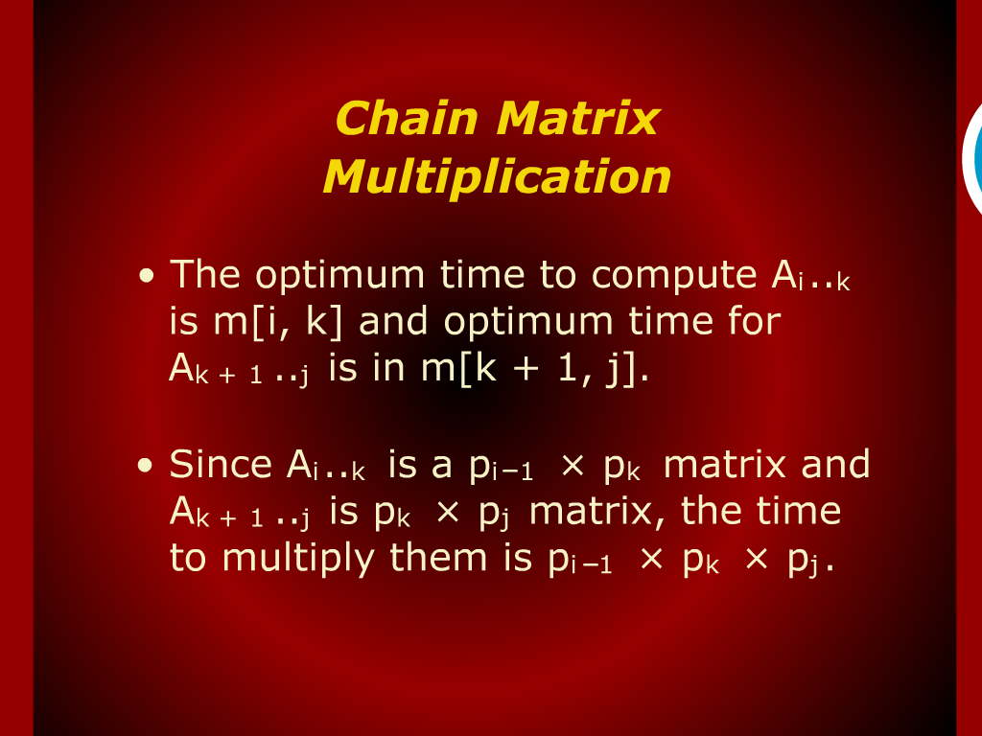
Chain Matrix Multiplication

Slide 6
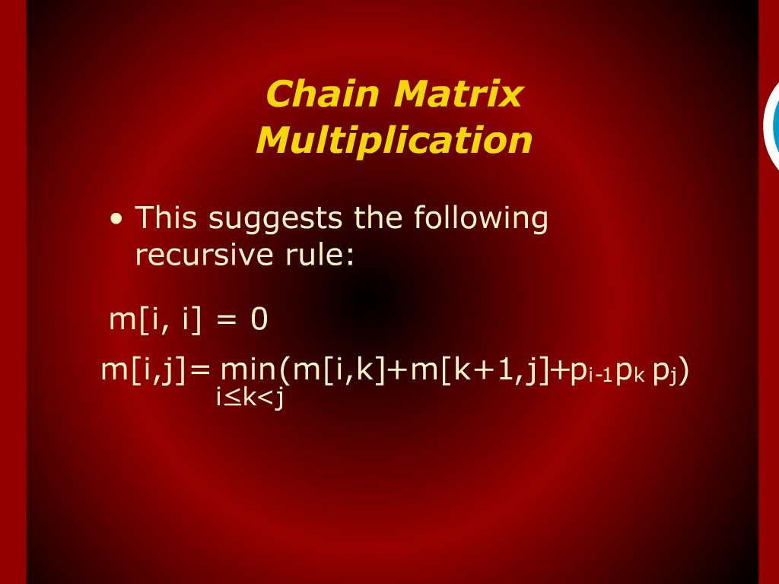
Chain Matrix Multiplication

Slide 7
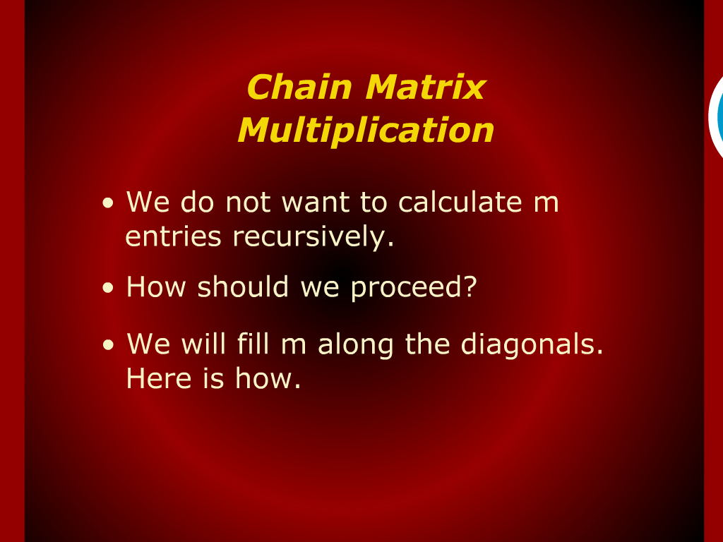
Chain Matrix Multiplication

Slide 8
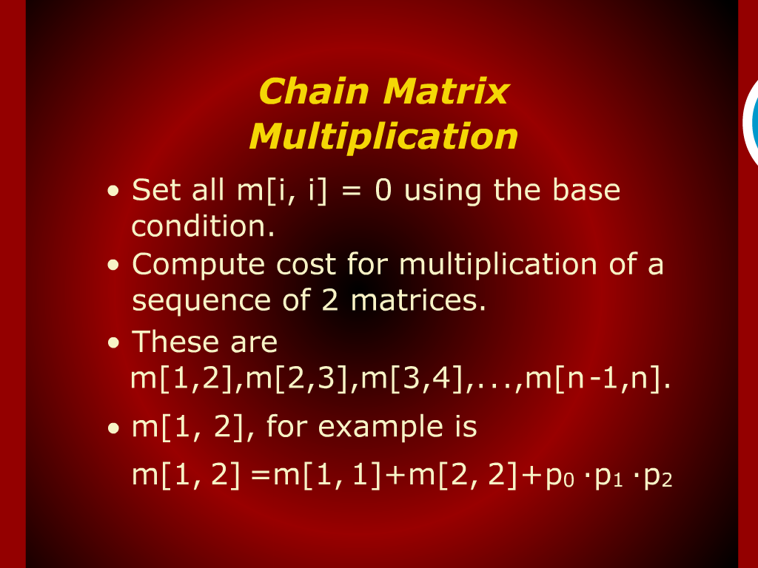
Chain Matrix Multiplication

Slide 9
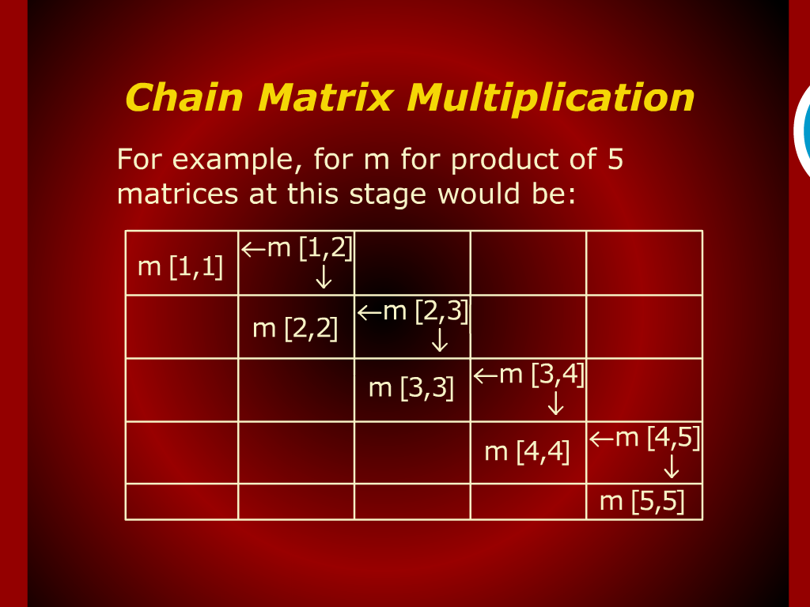
Chain Matrix Multiplication

Slide 10
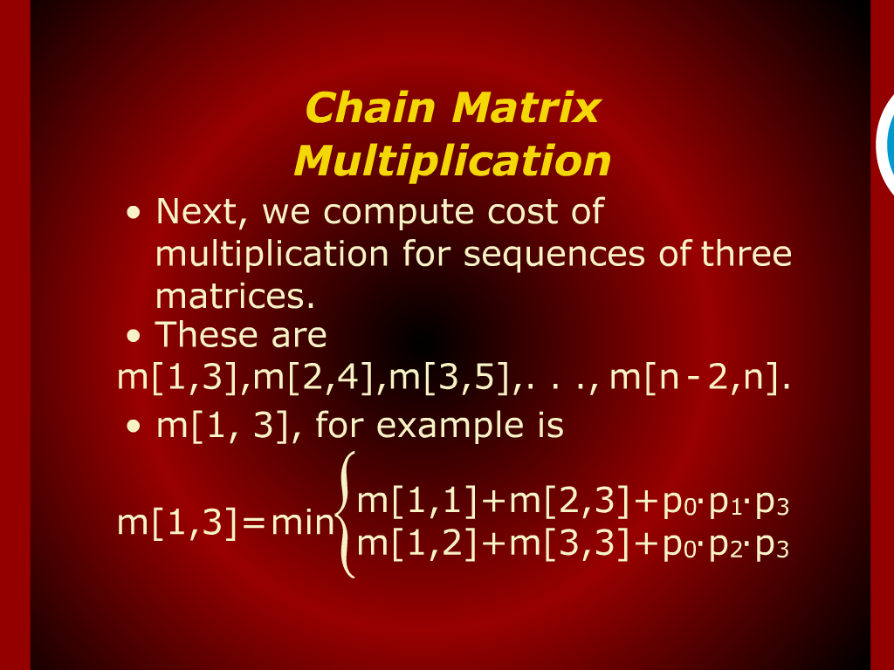
Chain Matrix Multiplication

Slide 11
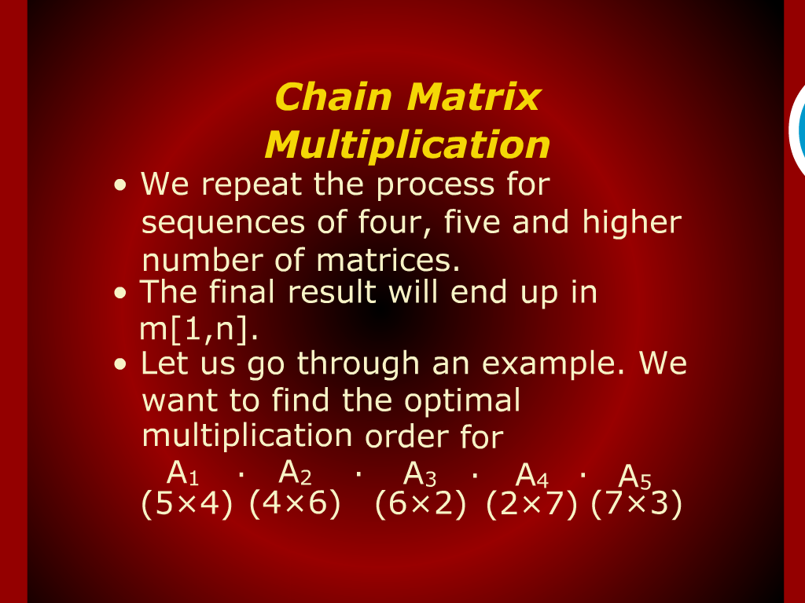
Chain Matrix Multiplication

Slide 12
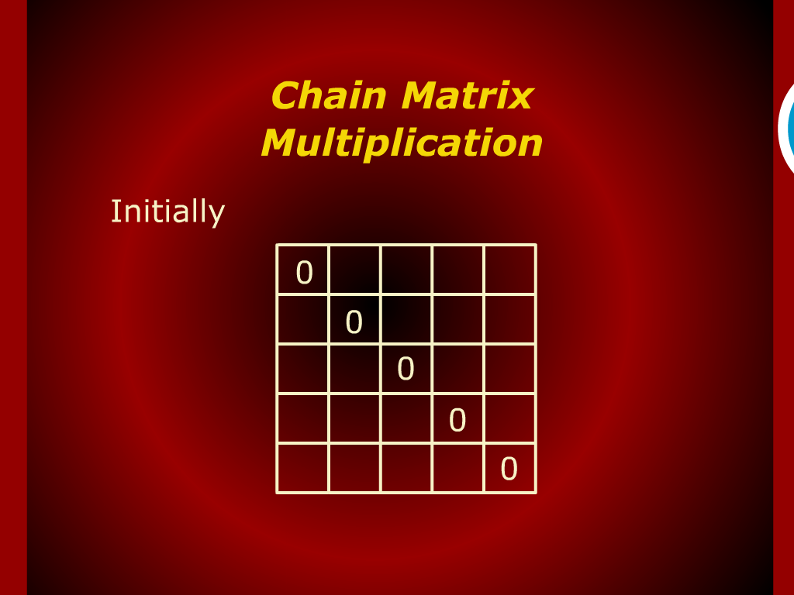
Chain Matrix Multiplication

Slide 13
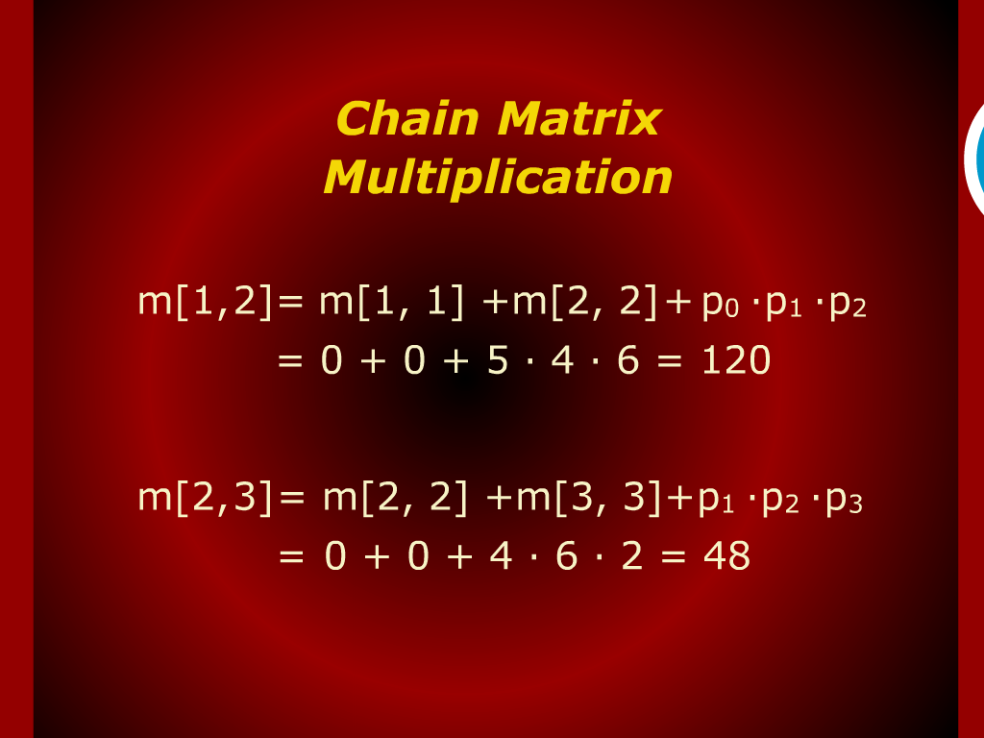
Chain Matrix Multiplication

Slide 14
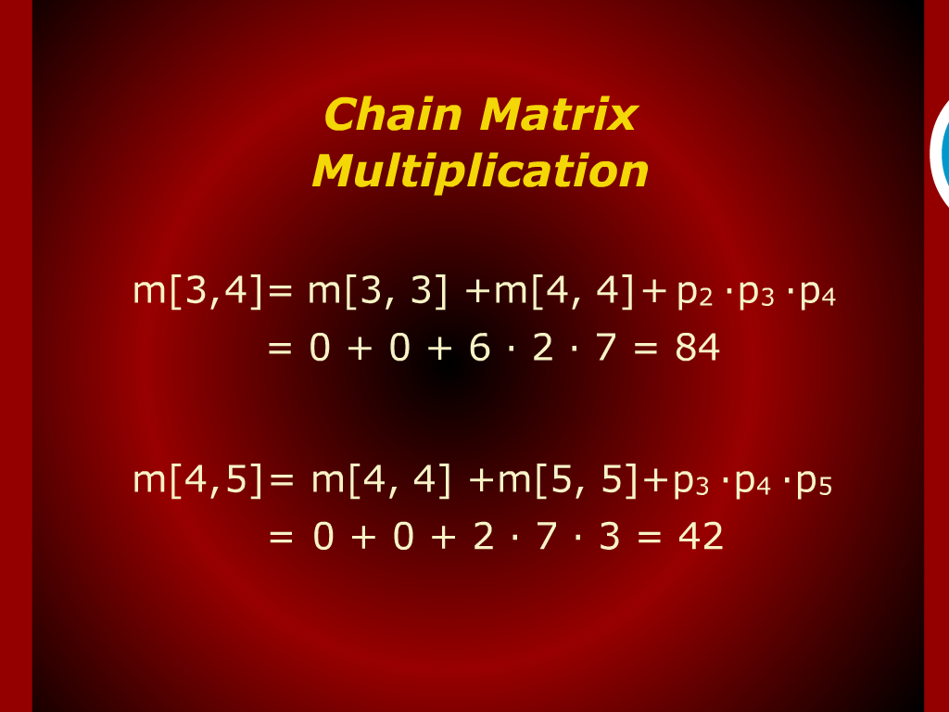
Chain Matrix Multiplication

Slide 15
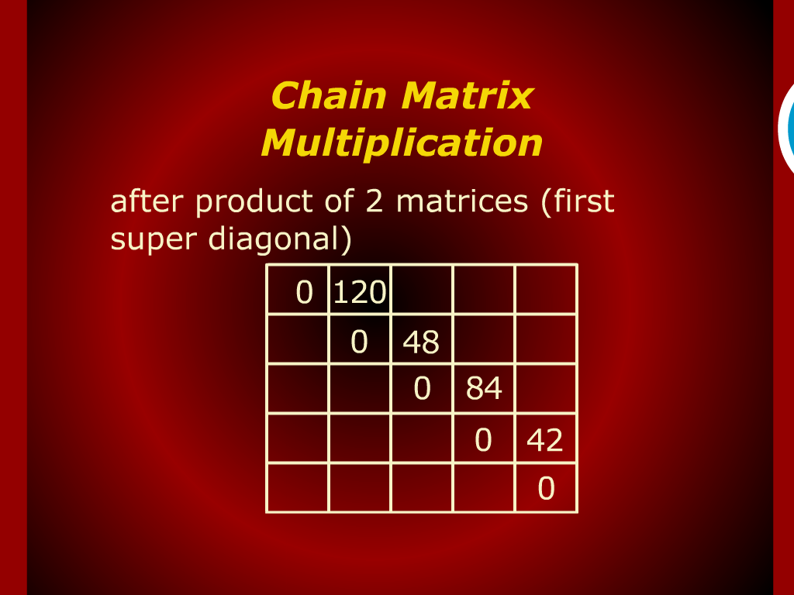
Chain Matrix Multiplication

Slide 16
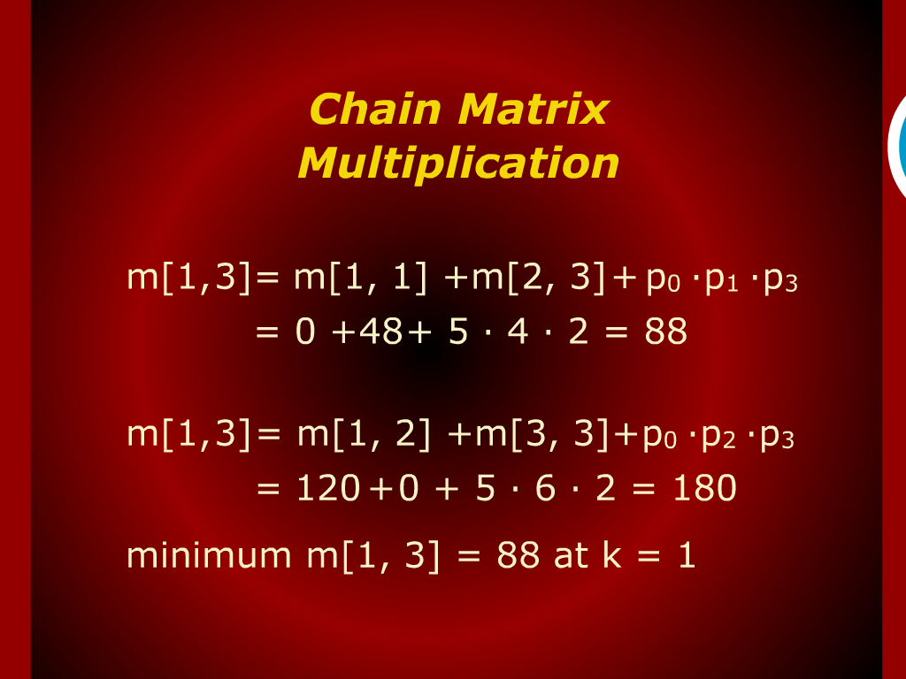
Chain Matrix Multiplication

Slide 17
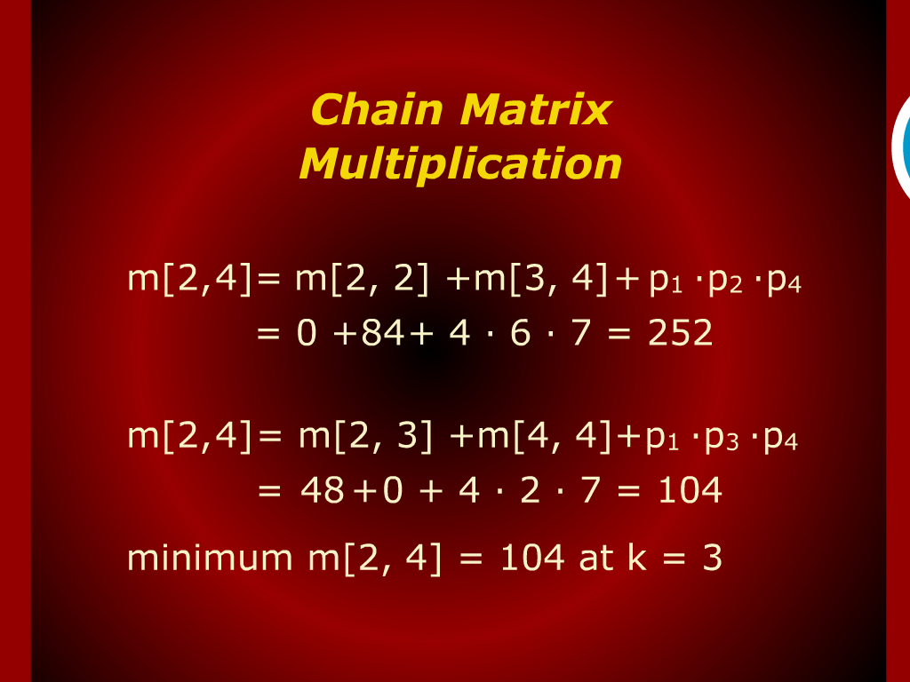
Chain Matrix Multiplication

Slide 18
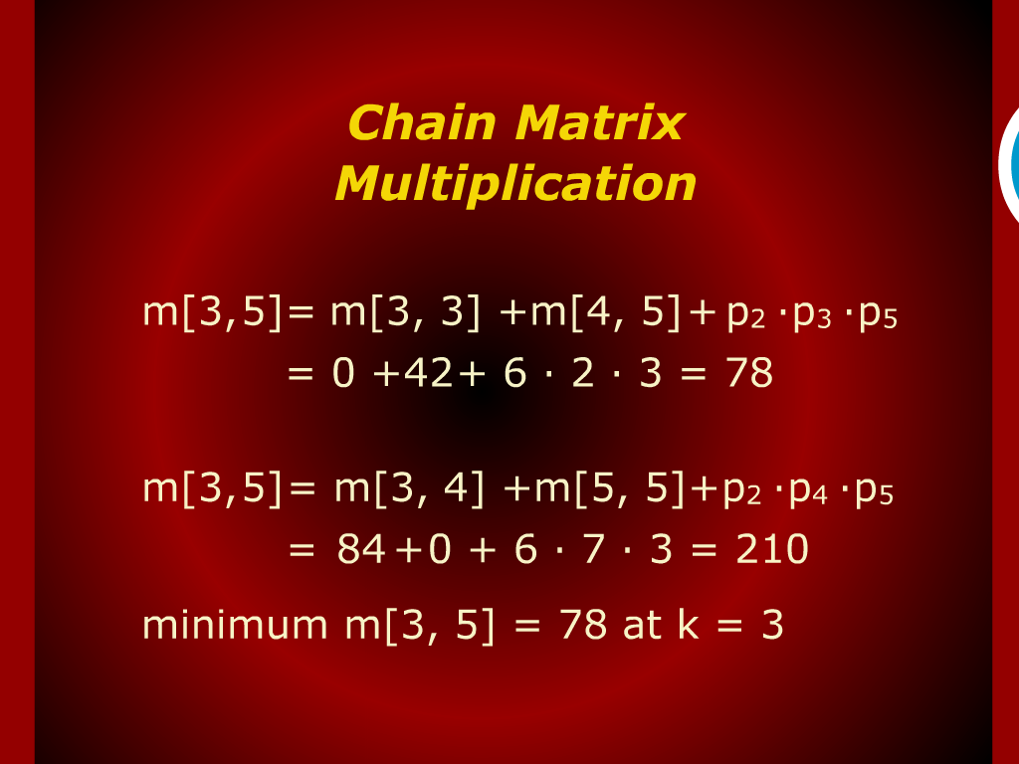
Chain Matrix Multiplication

Slide 19
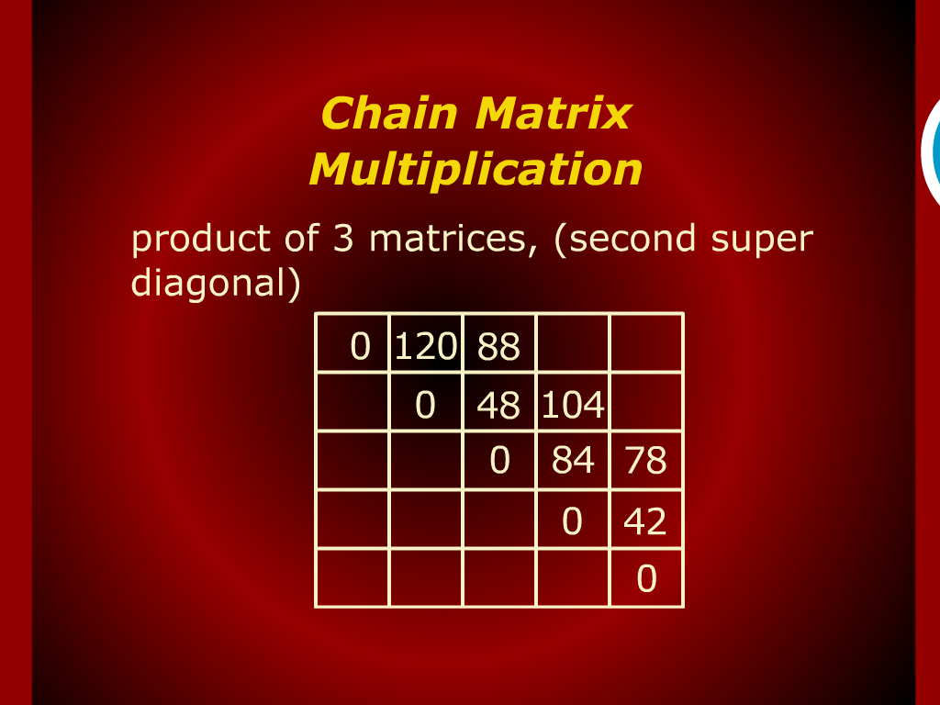
Chain Matrix Multiplication

Slide 20

Chain Matrix Multiplication

Slide 21

Chain Matrix Multiplication

Slide 22
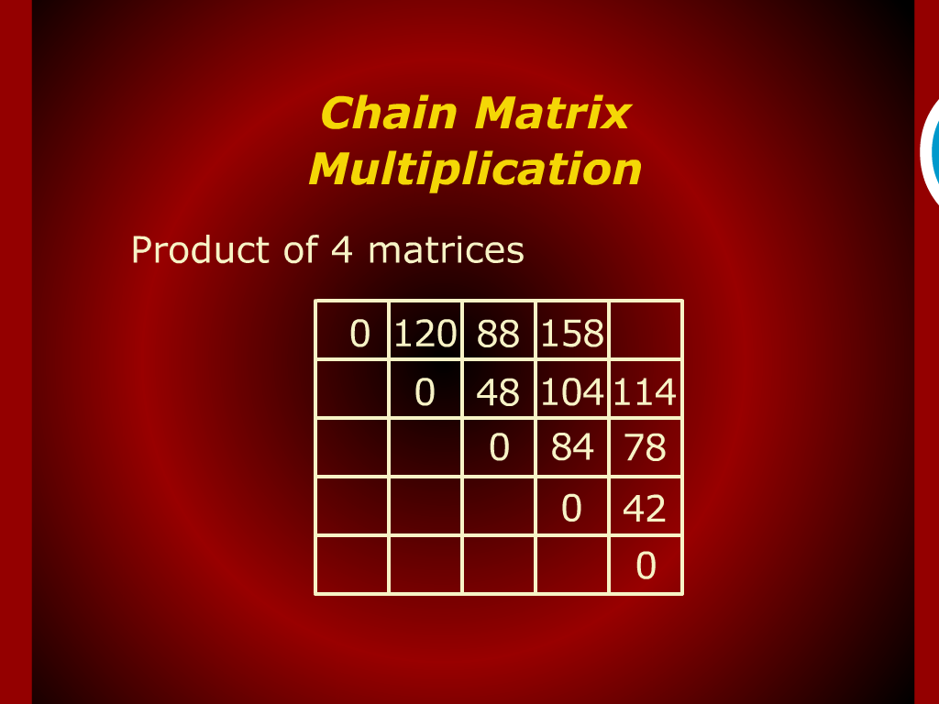
Chain Matrix Multiplication

Slide 23
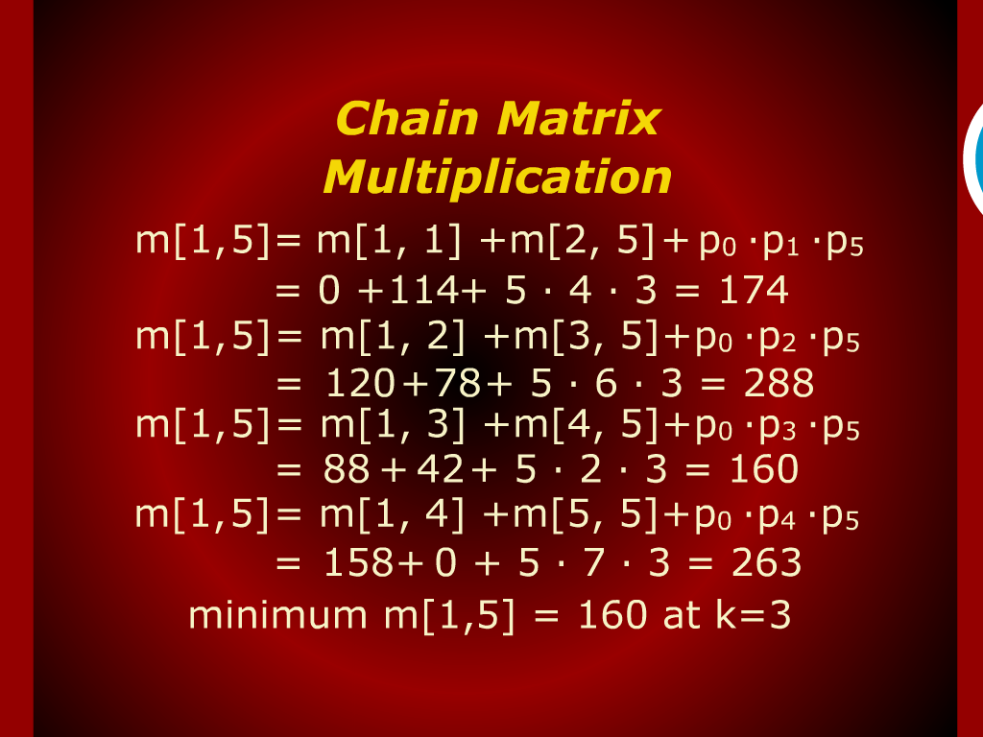
Chain Matrix Multiplication

Slide 24
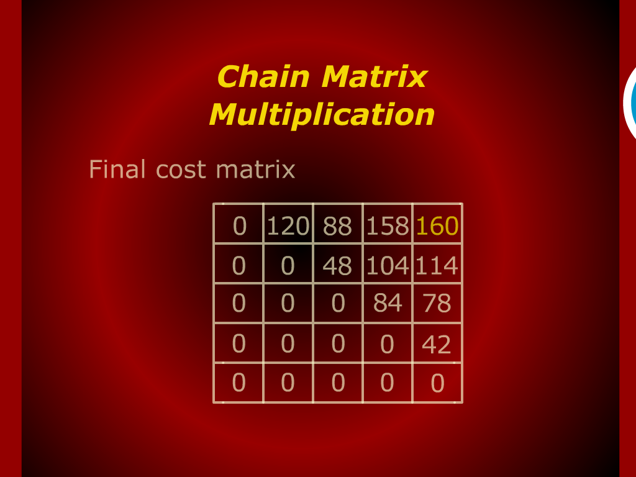
Chain Matrix Multiplication

Slide 25
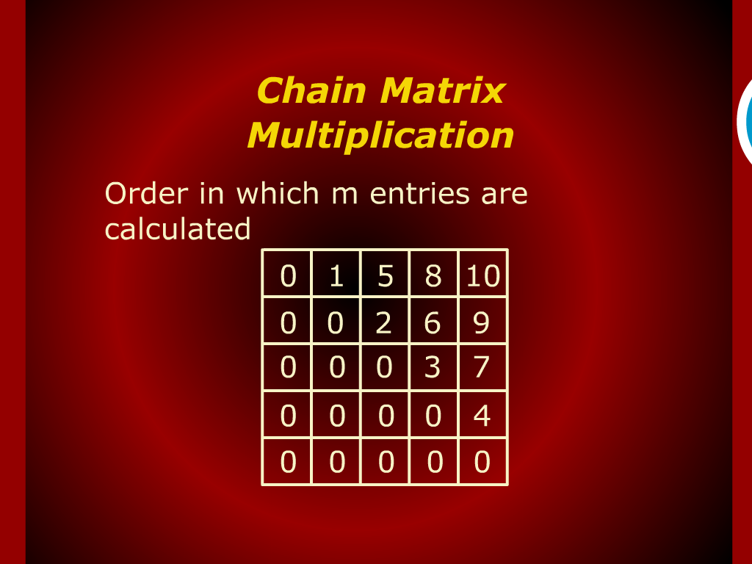
Chain Matrix Multiplication

Slide 26
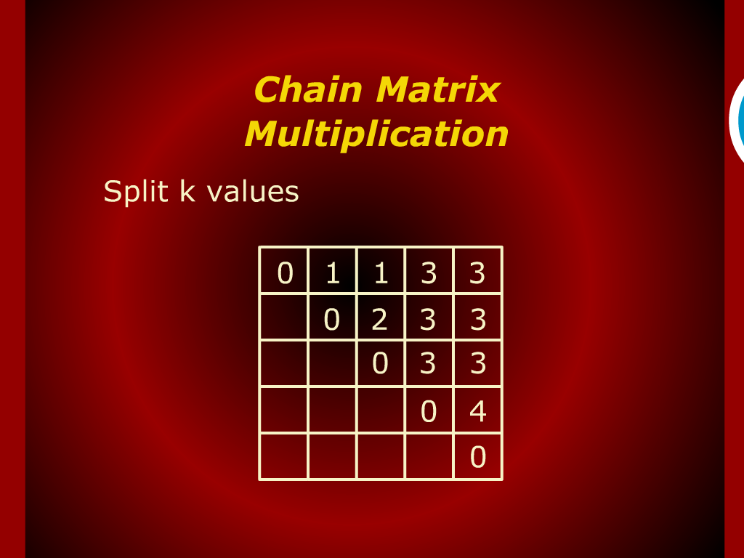
Chain Matrix Multiplication

Slide 27
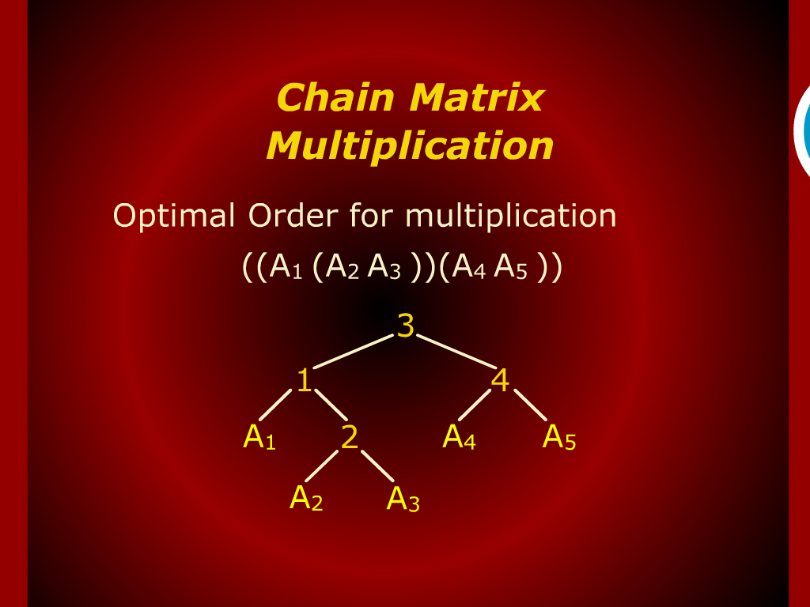
Chain Matrix Multiplication

Slide 28
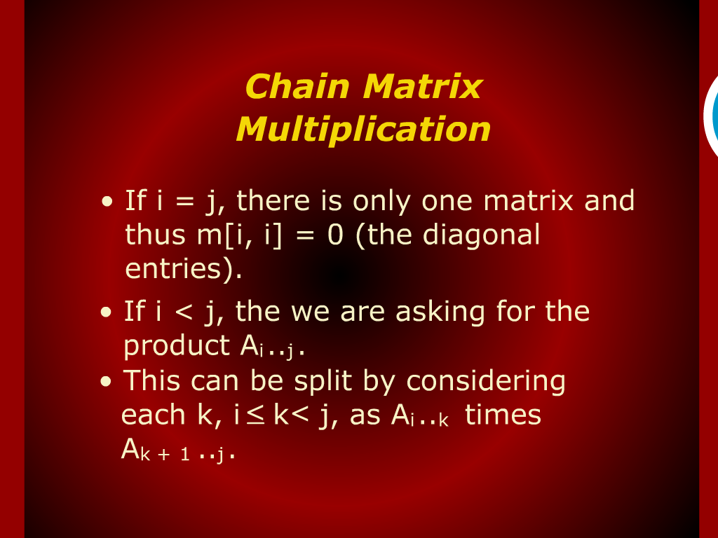
Chain Matrix Multiplication

