Slide 1
Algorithms
Lecture #21
Dr.Sohail Aslam

Slide 2
Design & Analysis
of
Algorithms

Slide 3
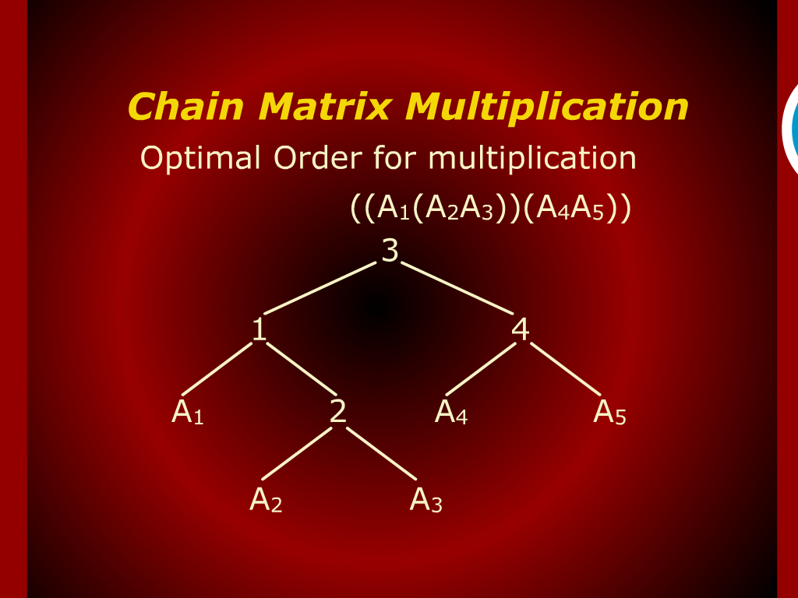
Chain Matrix Multiplication

Slide 4
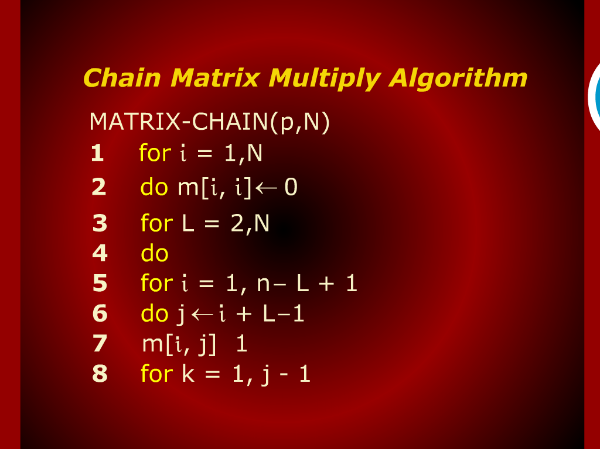
Chain Matrix Multiply Algorithm

Slide 5
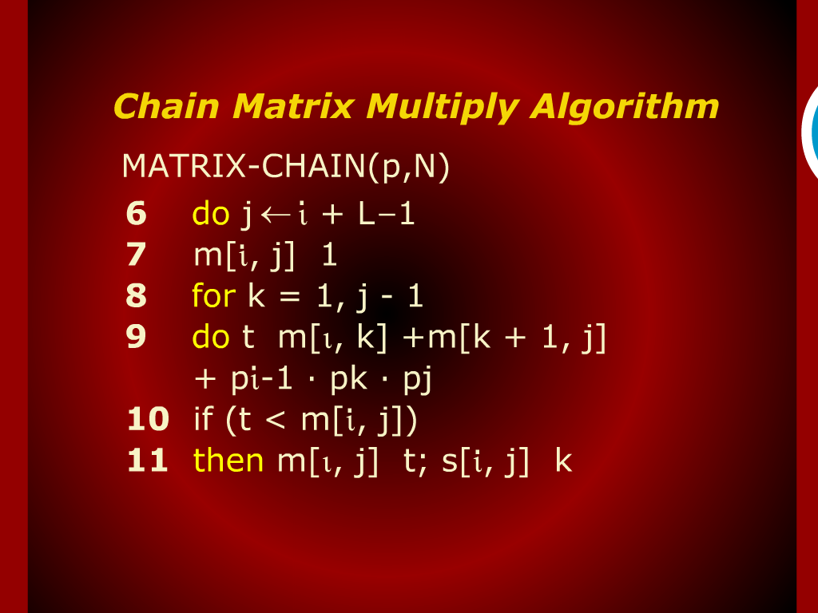
Chain Matrix Multiply Algorithm

Slide 6
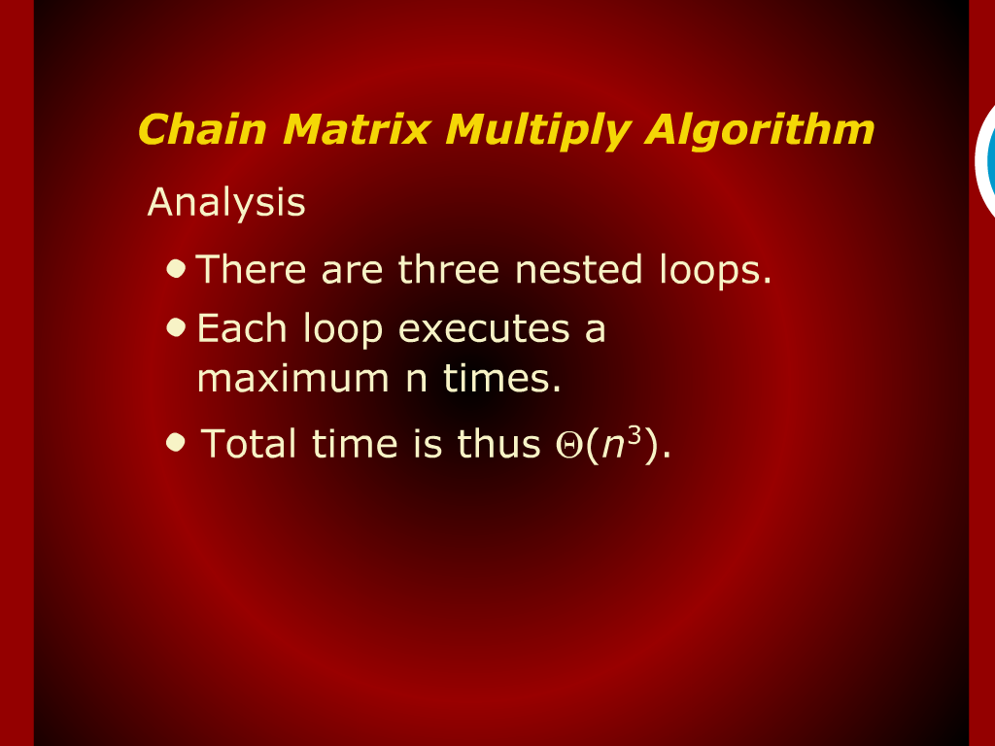
Chain Matrix Multiply Algorithm

Slide 7
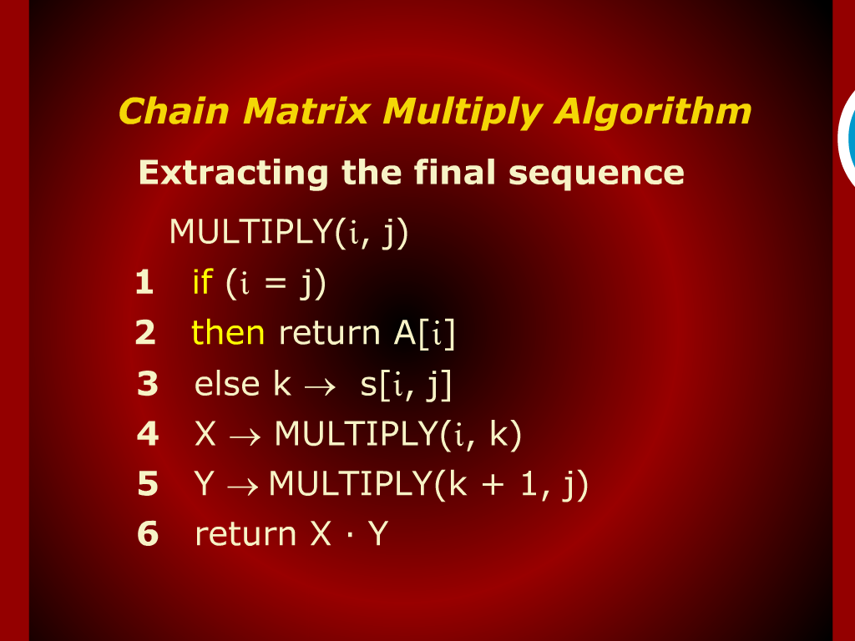
Chain Matrix Multiply Algorithm

Slide 8
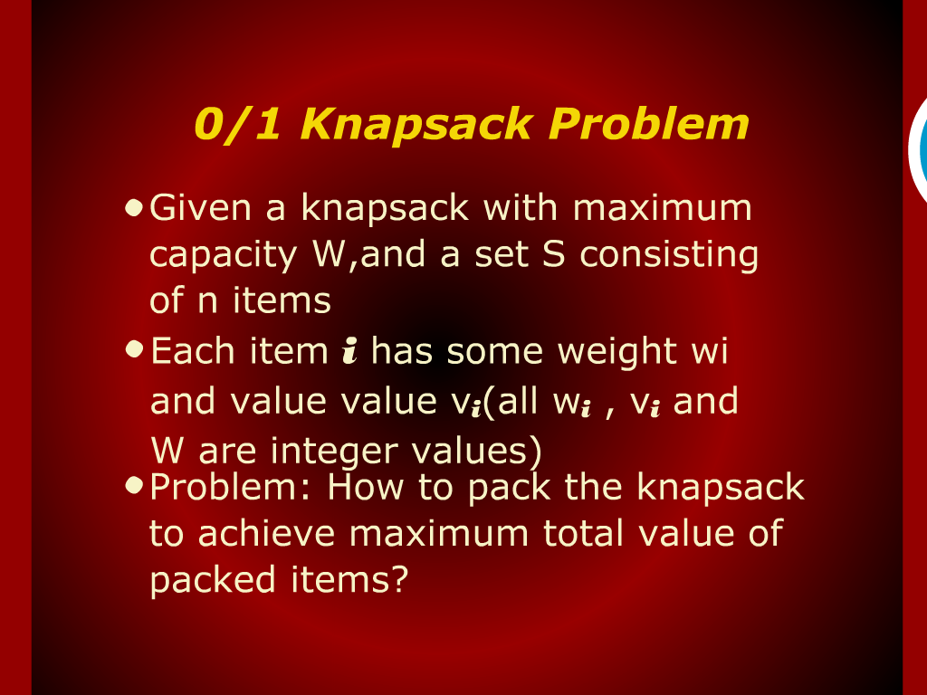
0/1 Knapsack Problem

Slide 9
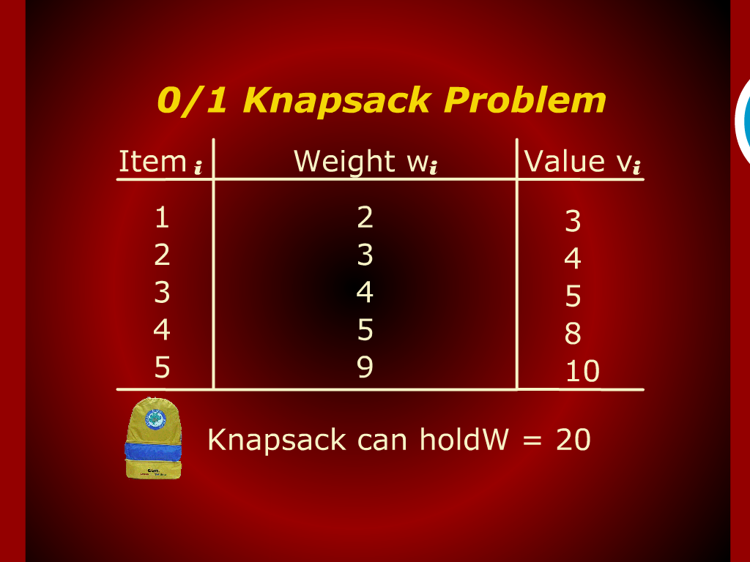
0/1 Knapsack Problem

Slide 10
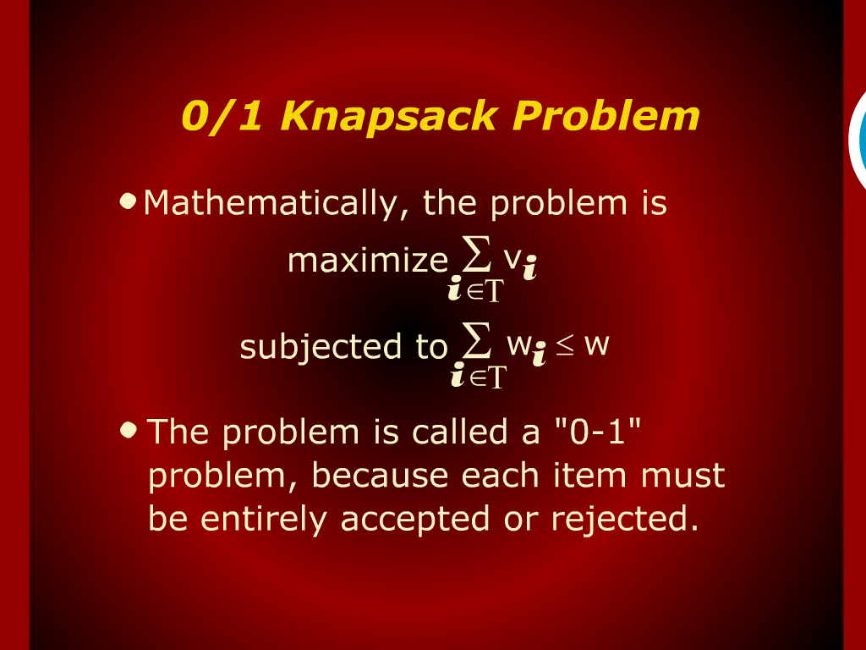
0/1 Knapsack Problem

Slide 11
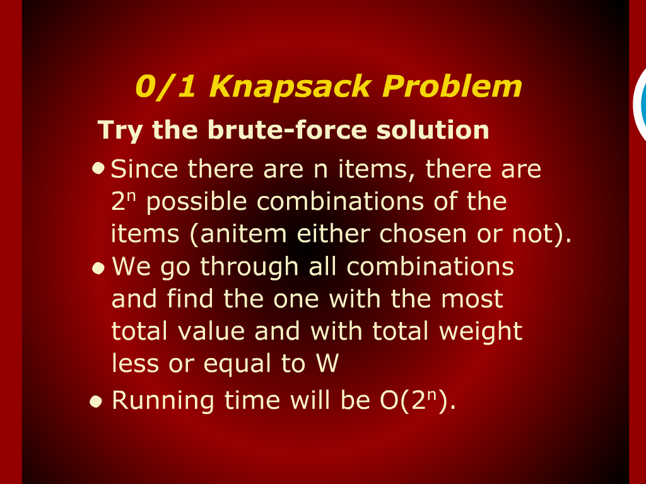
0/1 Knapsack Problem

Slide 12
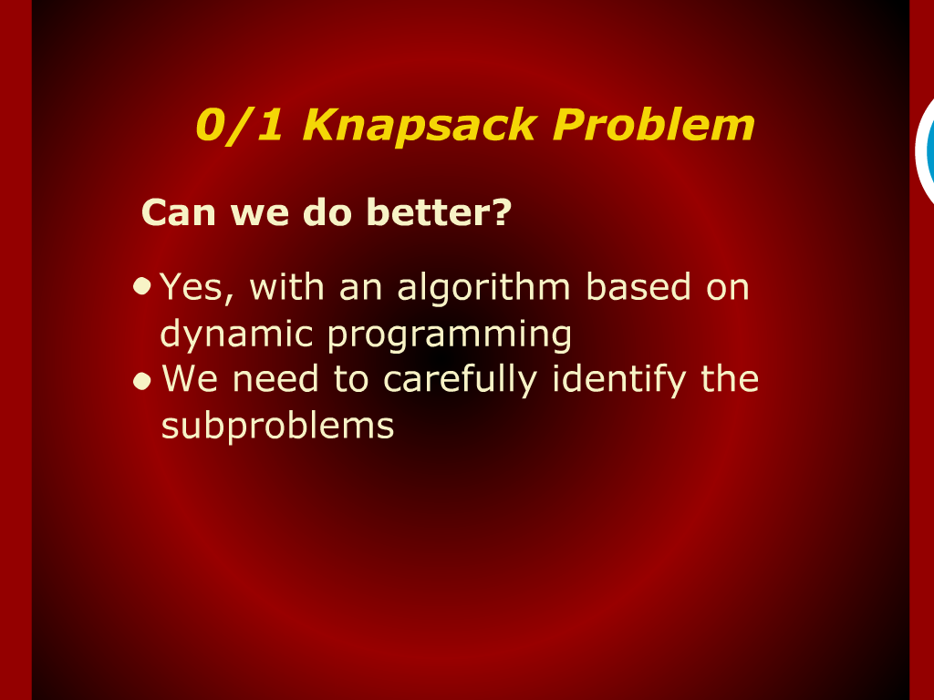
0/1 Knapsack Problem

Slide 13
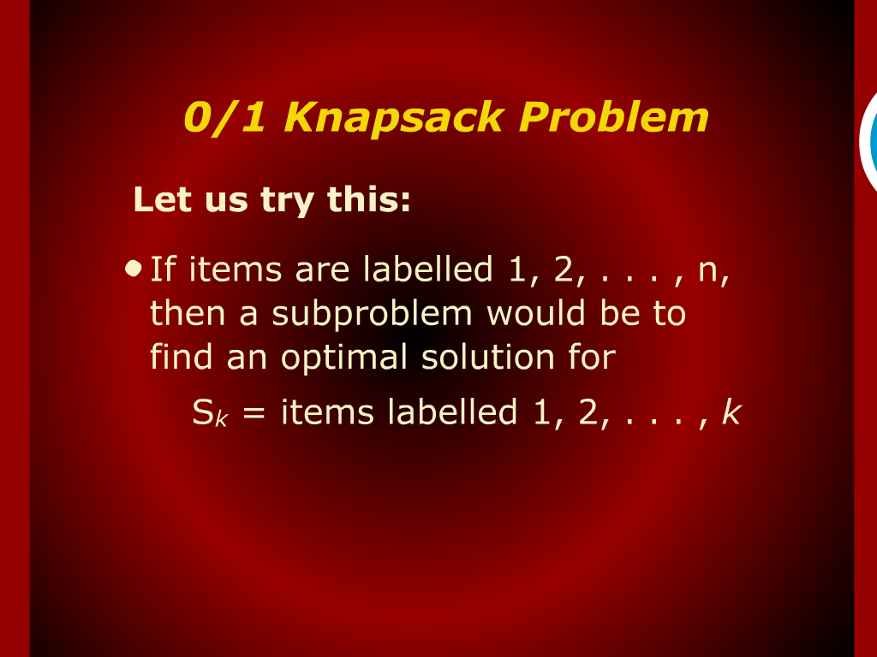
0/1 Knapsack Problem

Slide 14
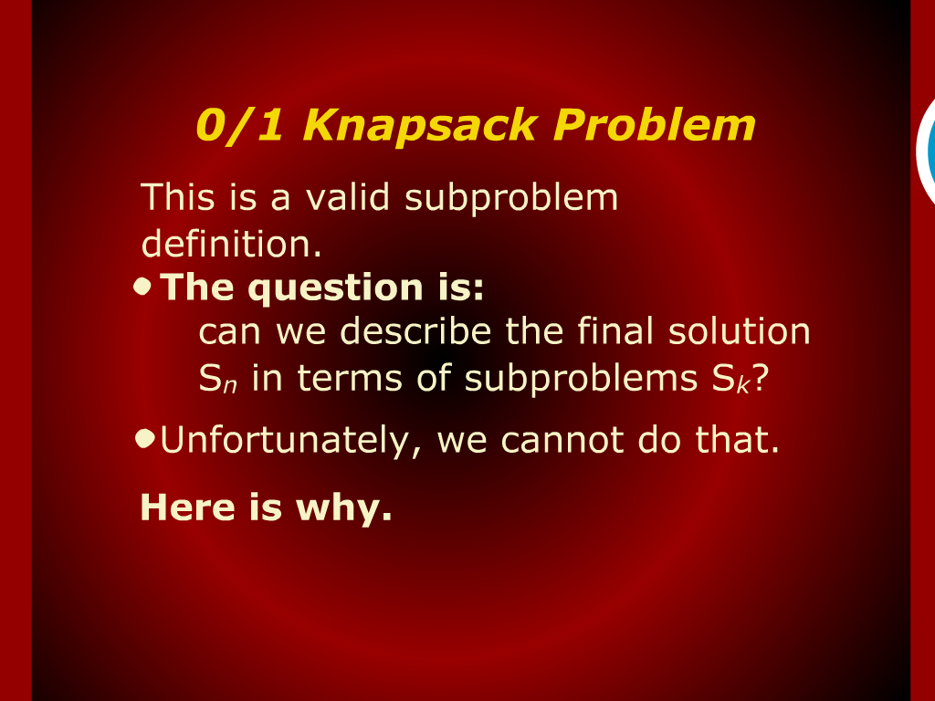
0/1 Knapsack Problem

Slide 15
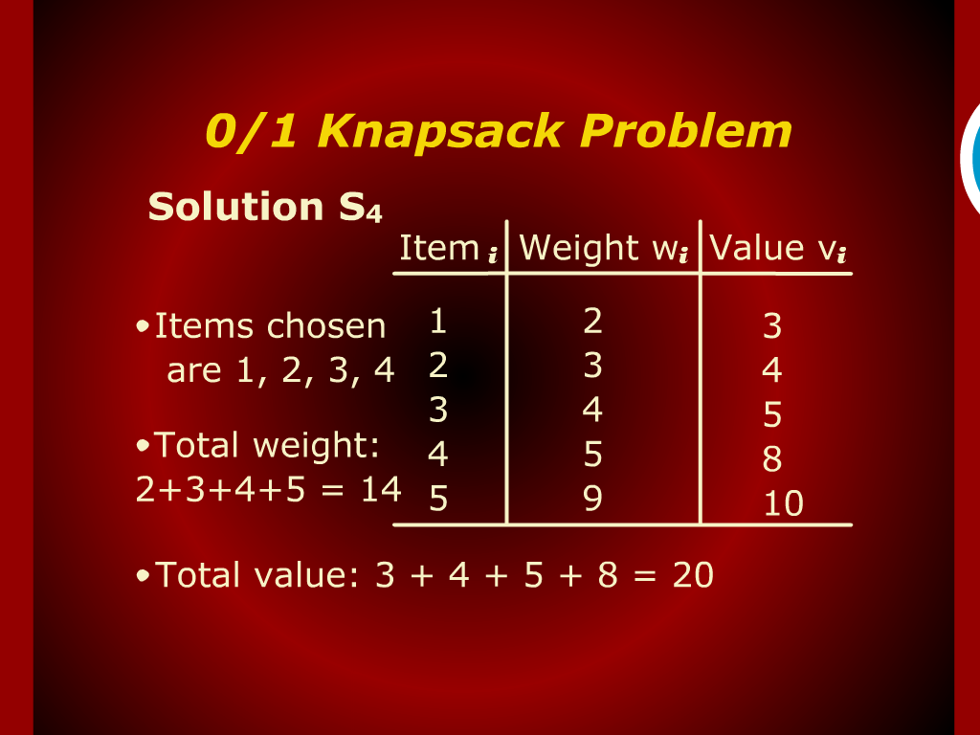
0/1 Knapsack Problem

Slide 16
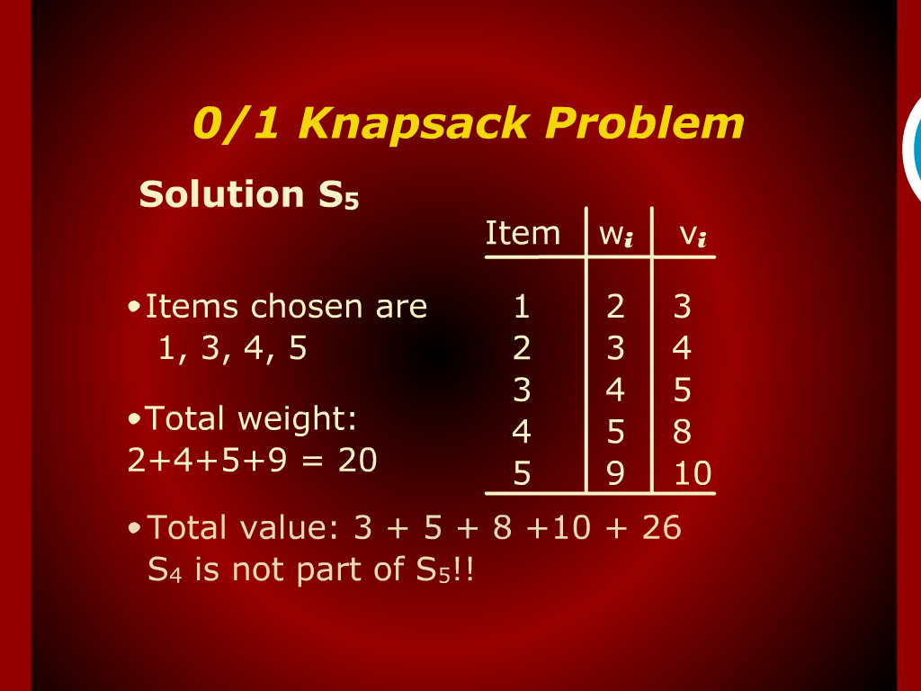
0/1 Knapsack Problem

Slide 17
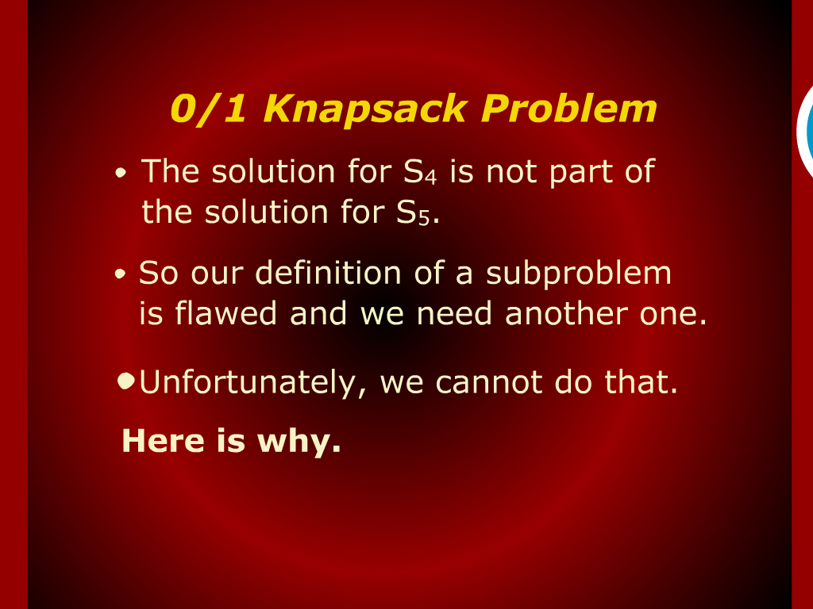
0/1 Knapsack Problem

Slide 18
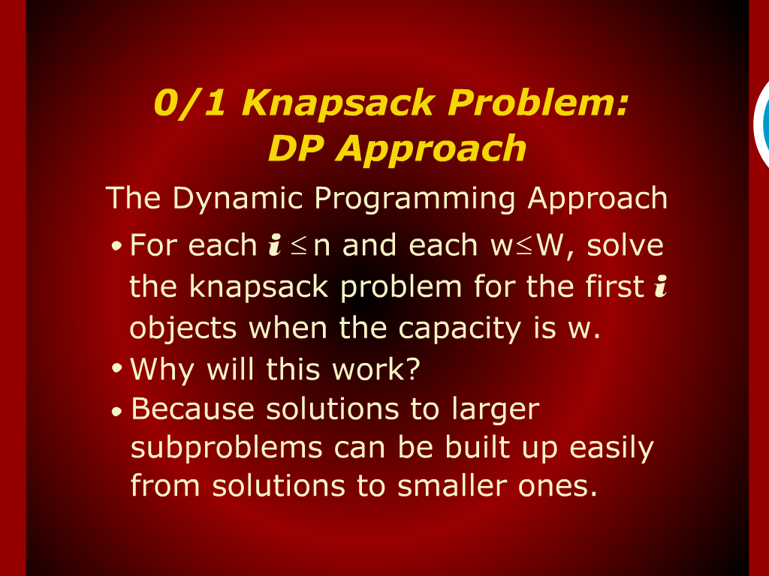
0/1 Knapsack Problem: DP Approach

Slide 19
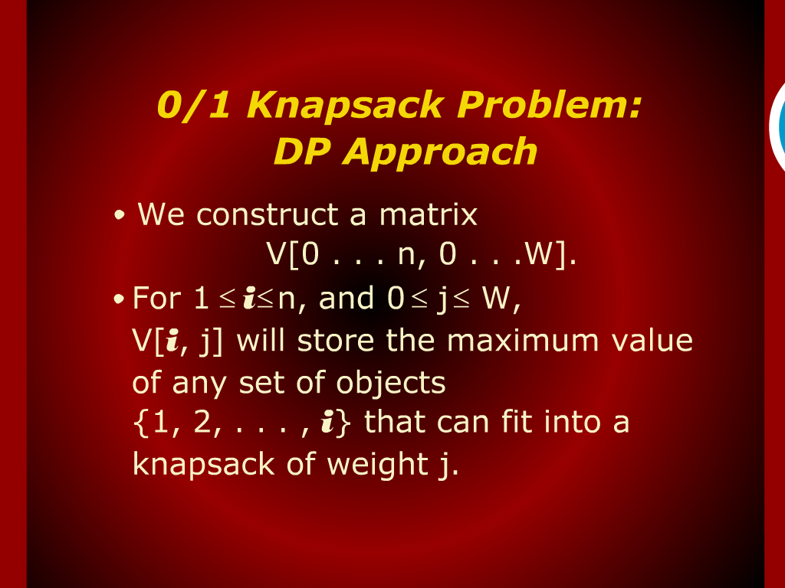
0/1 Knapsack Problem: DP Approach

Slide 20
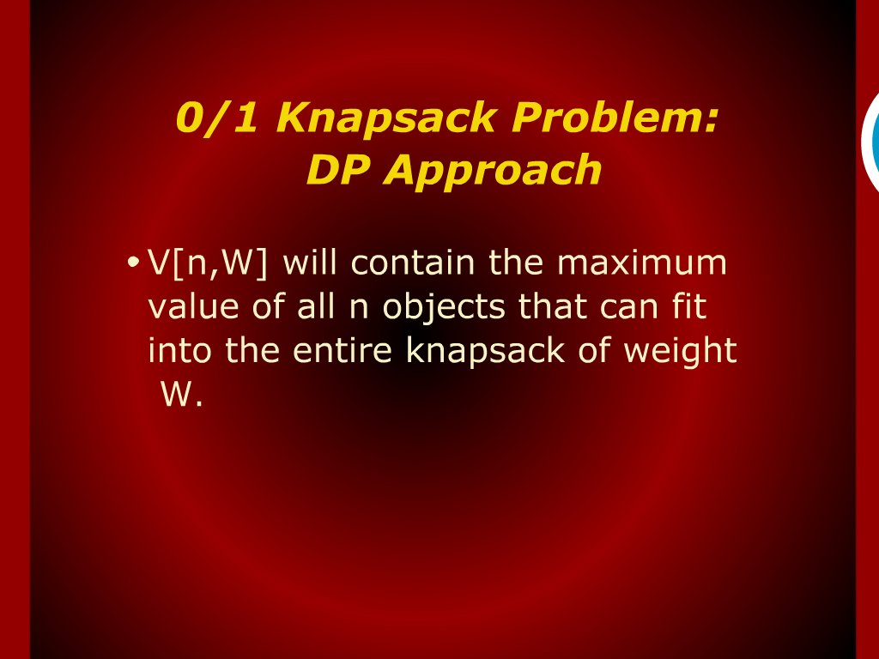
0/1 Knapsack Problem: DP Approach

Slide 21
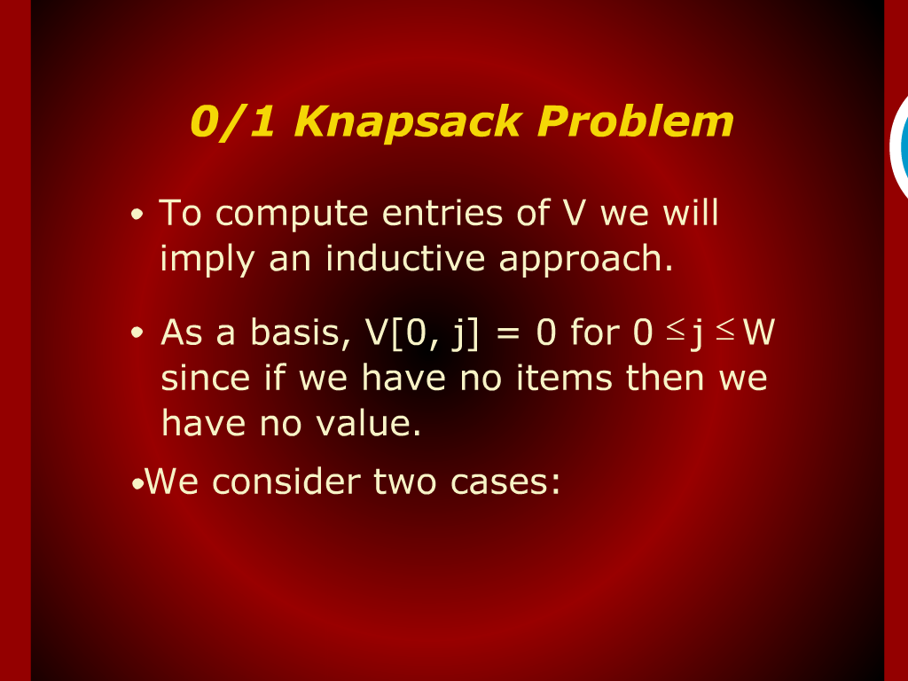
0/1 Knapsack Problem

Slide 22
O/1
Knapsack

Slide 23
Design and Analysis
of
Algorithms

